Slide 1
Factor Analysis
- with an end to end case study on water treatment dataset

Slide 2
Agenda
Factor analysis application
Reason for performing factor analysis
Mathematics behind factor analysis
Where to use factor analysis?
How to evaluate factor analysis results?
Summary
No text- only graphics – For Prezi
2

Slide 3
Application:
Market segmentation for identifying the underlying variables to group the customers
Identifying the characteristics of a certain types of customers (for example, dividing population based on the price sensitiveness)
Identifying the brand attributes that influence consumer choice.
Heavily used in advertising studies and product research
Minimal text- only graphics require to explain business situations – For Prezi
3

Slide 4
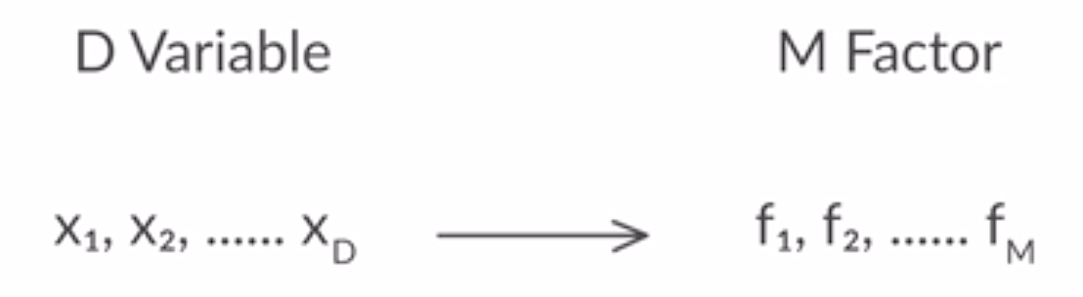
Factor Analysis
It is a dimensionality reduction technique
It combines the correlated variables by condensing the information contained in a number of original variables into a smaller set of new factors with a minimum loss of information.
It’s primary purpose is to define the underlying structure among the variables in the analysis.
Each bullet should have a graphics – For Prezi
4

Slide 5
Process for Factor Analysis
Formulate the problem
Construct the correlation matrix
Determine the method of factor analysis
Determine the number of factors
Estimate the factor matrix
Rotate the factors
Relevance/Significance of factor analysis
What is Machine Learning??
Flow chart with the graphics helps in structuring the content flow– For Prezi
5

Slide 6
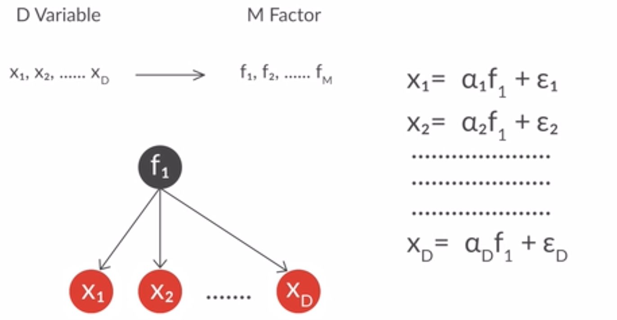
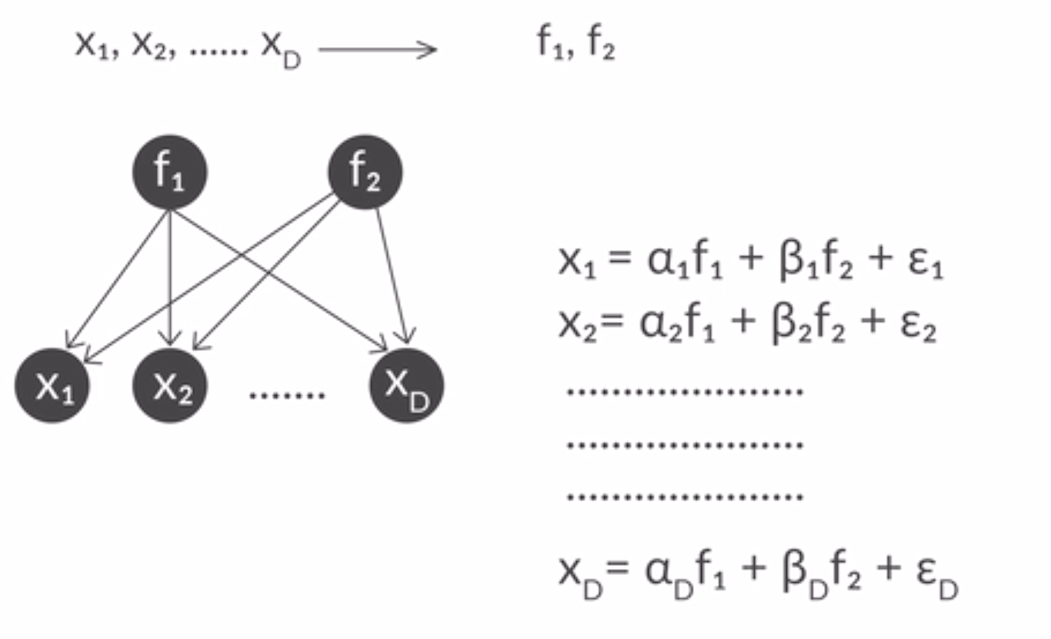
Mathematics involves in factor analysis?
- D attributes and 1 factor
Requires graphics and animation of each element – For prazi
What is Machine Learning??
- D attributes and 2 factors
6

Slide 7
Factor Analysis
Each bullet should have a graphics – For Prezi
It is a dimensionality reduction technique
It combines the correlated variables
7

Slide 8
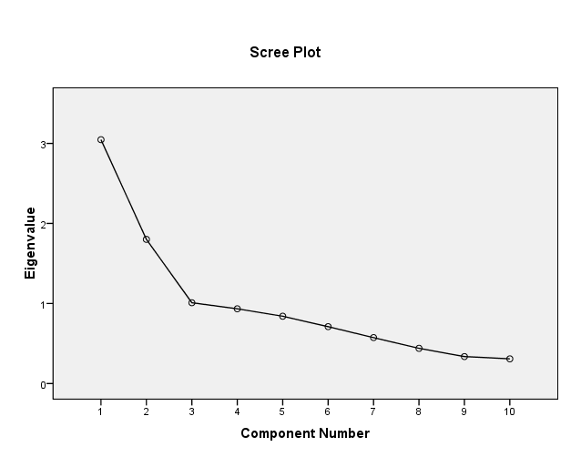
Determine the number of factors
Apriori determination : Based on prior knowledge and the correlation matrix
Determination based on eigen values: It represents the amount of variance accounted for by the factor. It is column sum of squared loading for a factor.
Only factors with eigen value greater than 1.0 are retained.
All factors having eigen value less than 1 are considered insignificant
Scree Plot
A scree plot shows the eigenvalues on the y-axis and the number of factors on the x-axis. It always displays a downward curve. The point where the slope of the curve is clearly levelling off (the “elbow) indicates the number of factors that should be generated by the analysis.
Each bullet should have a graphics(plots and correlation matrix require) – For Prezi
8

Slide 9
Factor Rotation
*Need to learn in depth
Two types:
Orthogonal (factors are uncorrelated)
Oblique (factors inter correlate)
Each bullet should have a graphics – For Prezi
9

Slide 10
Interpreting the factors
Factor loadings are the correlation of each variable and the factor
Higher loadings making the variable representative of the factor
Values greater than +0.50 are generally considered necessary for practical significance.
Interpretation of treatment dataset factors will be included with the graphics – For Prezi
10

