Slide 1
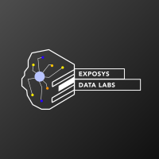
Customer Segmentation
By:Prajwal B Mani
Poisiton:Data Science Intern

Slide 2
Motivation
Let's imagine you're owning a supermarket mall and through membership cards, you have some basic data about your customers like Customer ID, age, gender, annual income and spending score, which is something you assign to the customer based on your defined parameters like customer behavior and purchasing data .based on this parameters we can provide variety of discounts & offers which in return we get more customers in the future resulting to more profit.

Slide 3
Aim
The main aim of this problem is learning the purpose of the customer segmentation concepts, also known as market basket analysis, trying to understand customers and separate them in different groups according to their preferences, and once the division is done, this information can be given to marketing team so they can plan the strategy accordingly.

Slide 4
Basic Life Cycle Of The Project
EDA
Visualization
Clustering

Slide 5


Language
IDE
Version:6.1.1
Version:3.7.7

Slide 6
Dependences
pandas(V1.1.0)
numpy(V1.19.1)
matplotlib(V3.2.2)
seaborn(V0.10.0)
plotly(V4.8.1)
sklearn(V0.23.1)
kneed(V0.6.0)
warnings(V0.3.0)

Slide 7
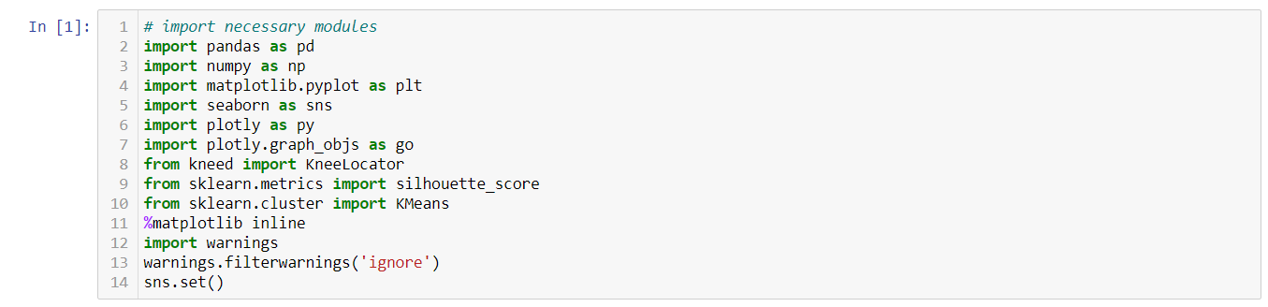
Import the modules

Slide 8
EDA

Slide 9
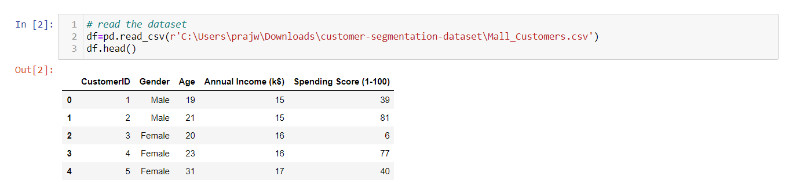
Read the given dataset

Slide 10
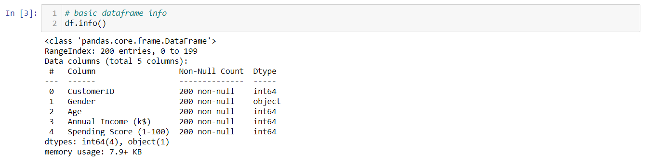
Basic info of the dataframe

Slide 11
Features details
This dataset is composed by the following five features:
CustomerID: Unique ID assigned to the customer
Gender: Gender of the customer
Age: Age of the customer
Annual Income (k$): Annual Income of the customer
Spending Score (1-100): Score assigned by the mall based on customer behavior and spending nature.
In this particular dataset we have 200 samples to study.

Slide 12
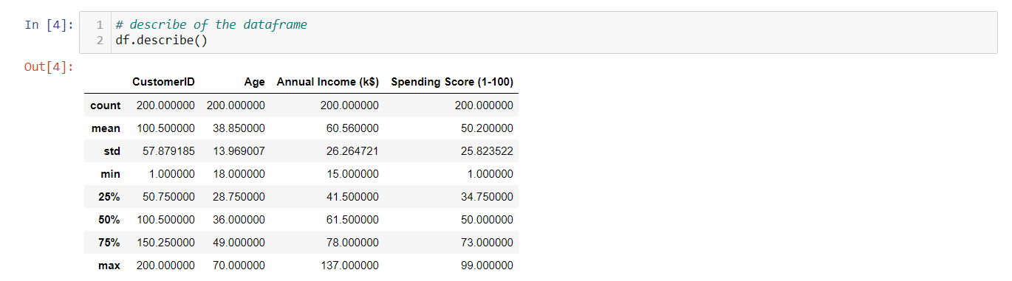
Description of the dataframe

Slide 13
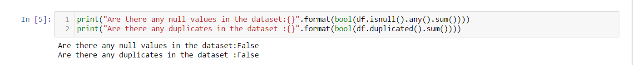
Checking for null & duplicate values

Slide 14
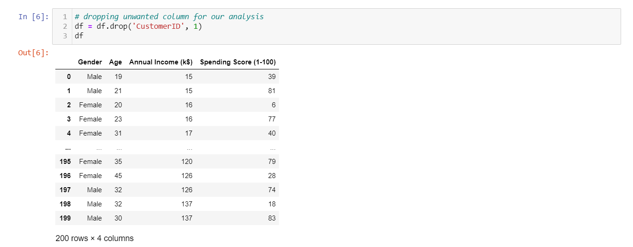
Dropping unwanted features for our analysis

Slide 15
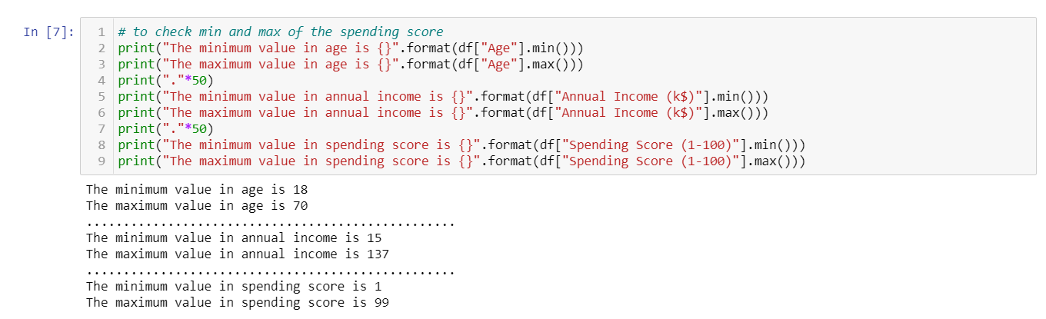
Min & Max Boundry

Slide 16
Visualization

Slide 17
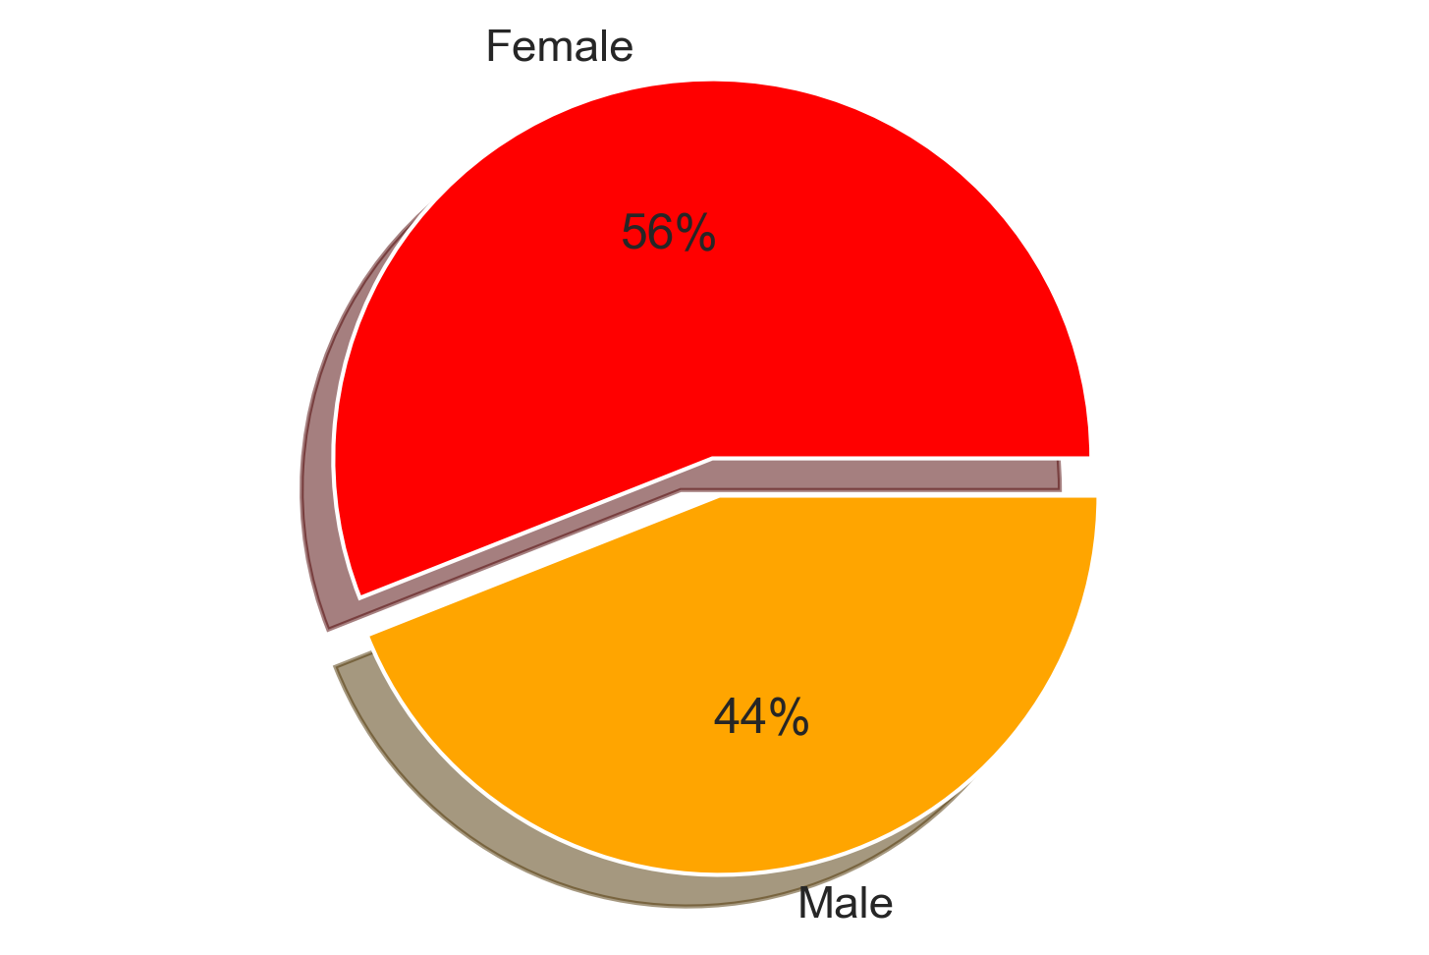
What’s the percentage of Male & Female in total customers?

Slide 18
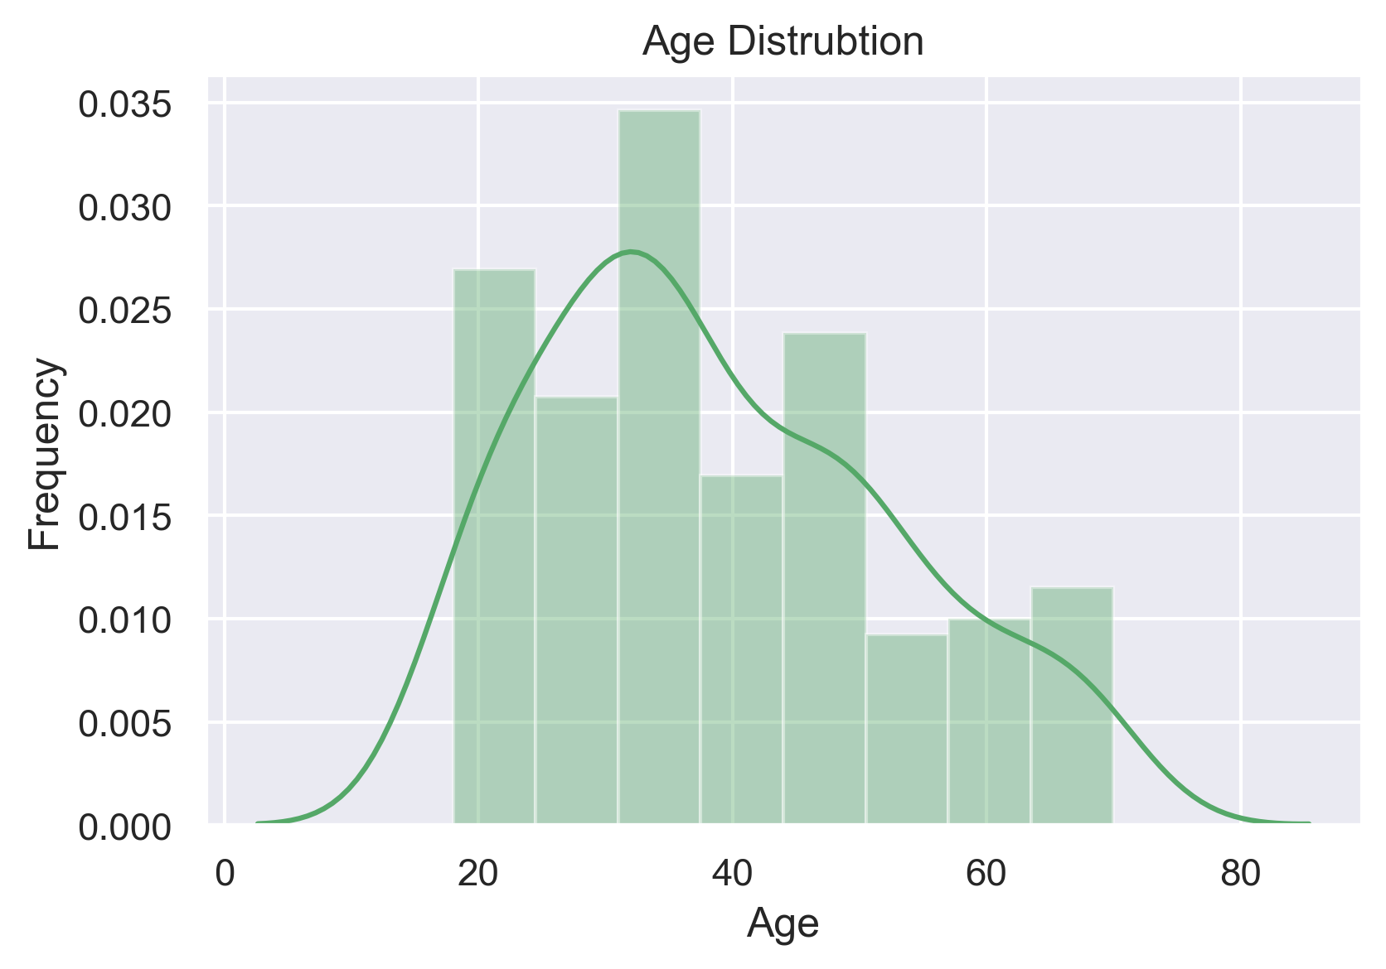
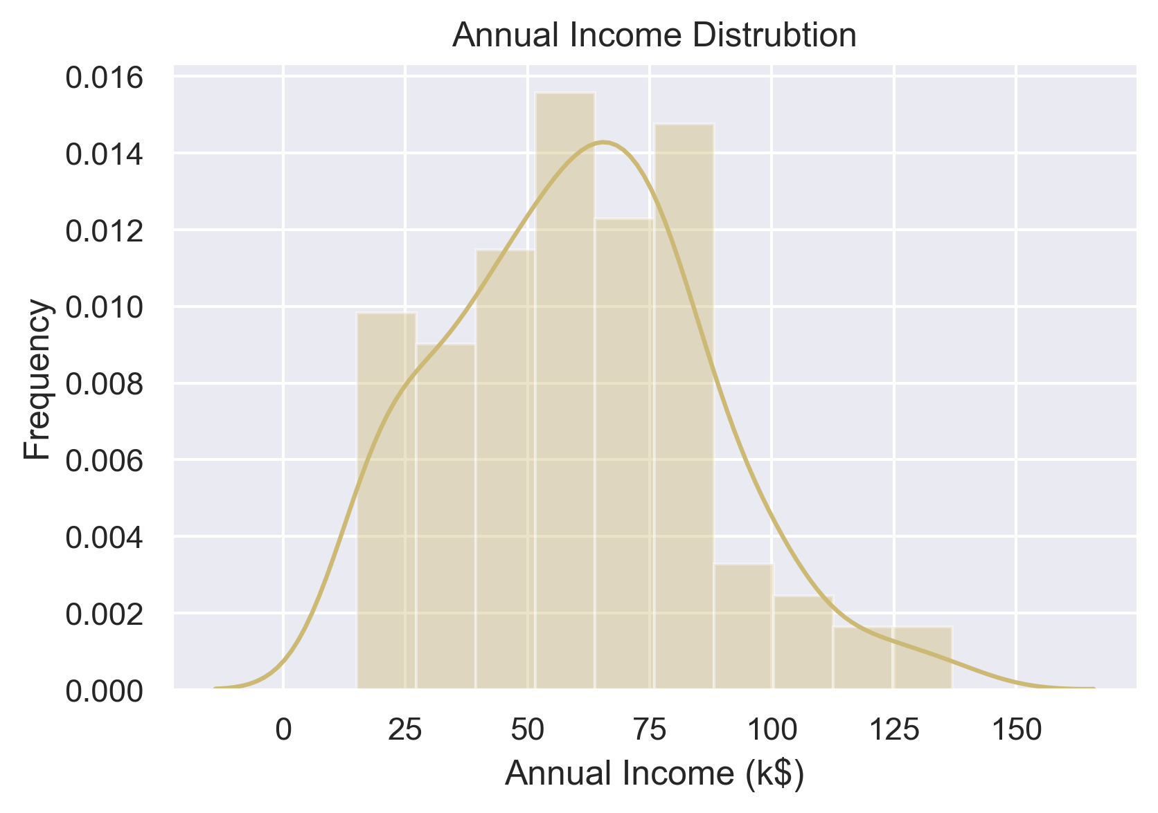
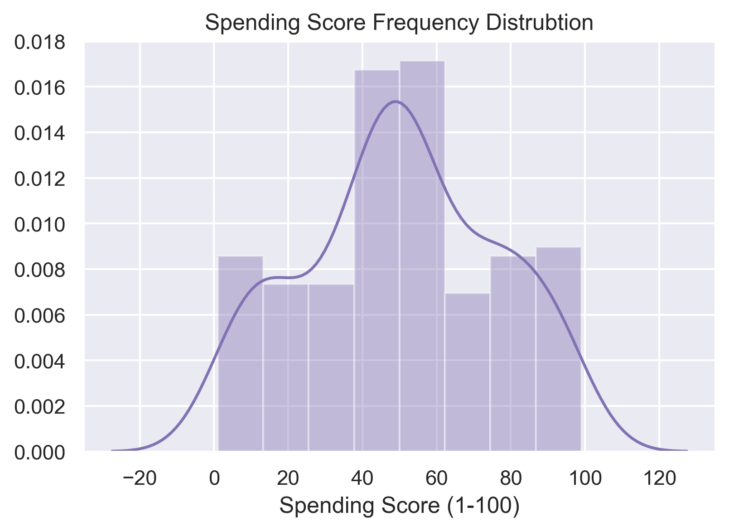
FREQUENCY DISTRIBUTION
FREQUENCY DISTRIBUTION

Slide 19
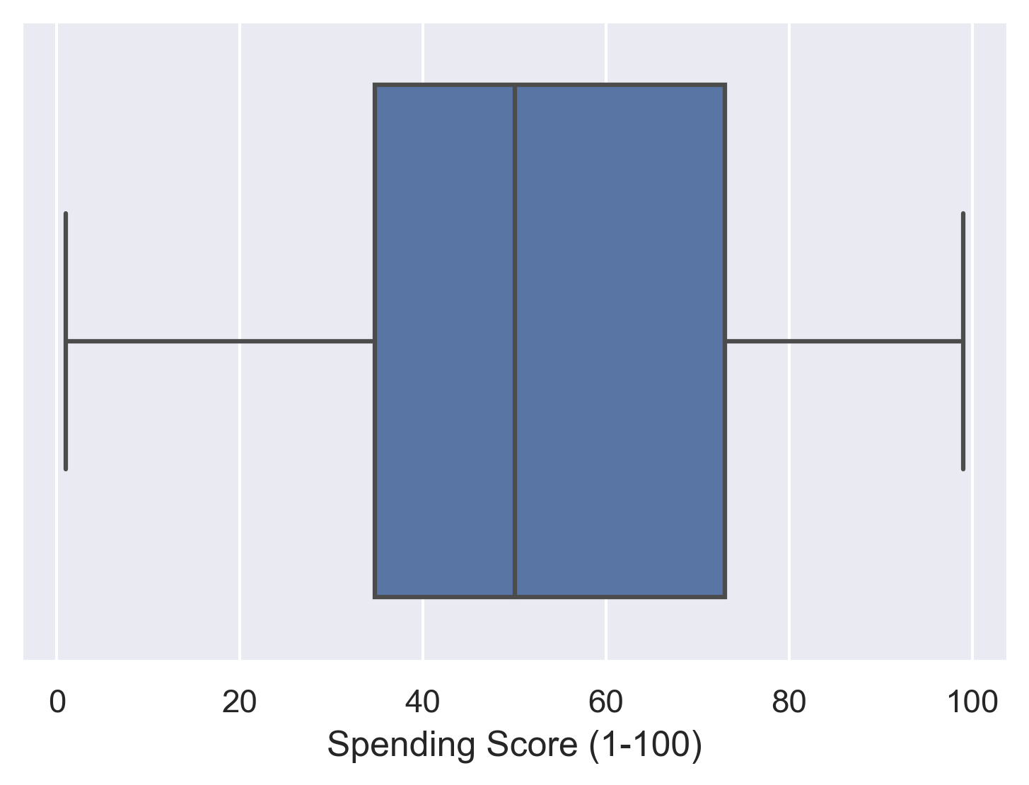
Are there any Outlier in the Spending score?

Slide 20
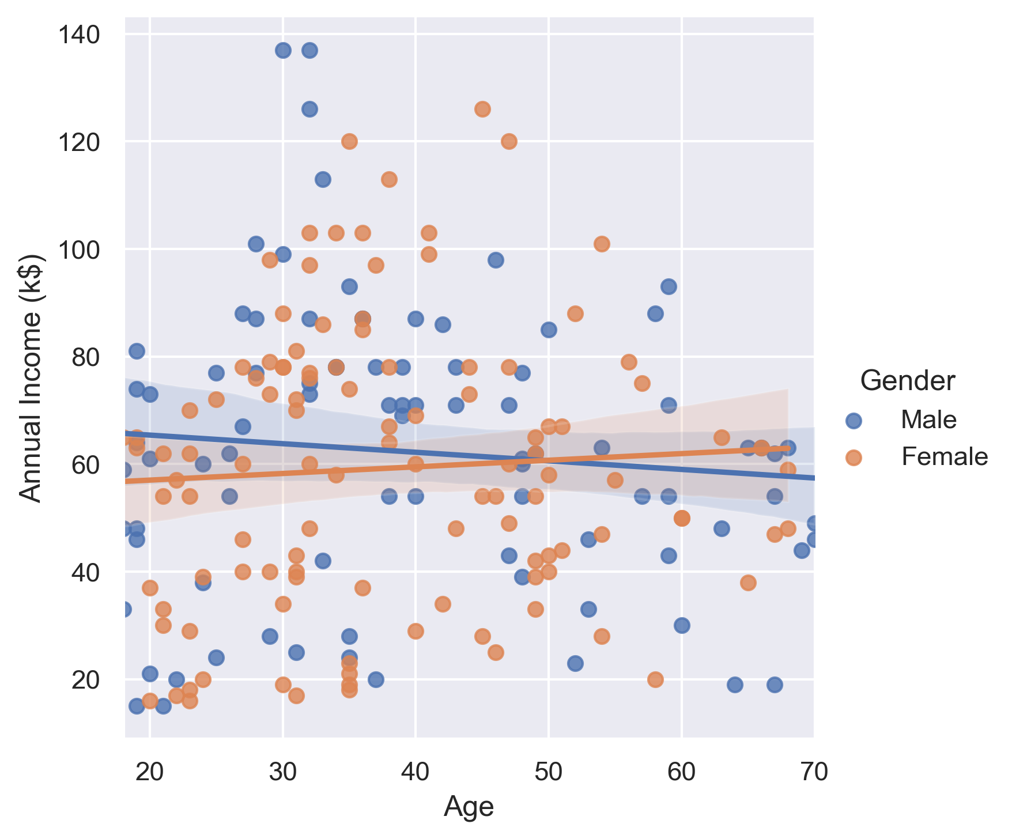
Which age group earns more income?
Age group between 30 to 50 earn more income than the other age groups

Slide 21
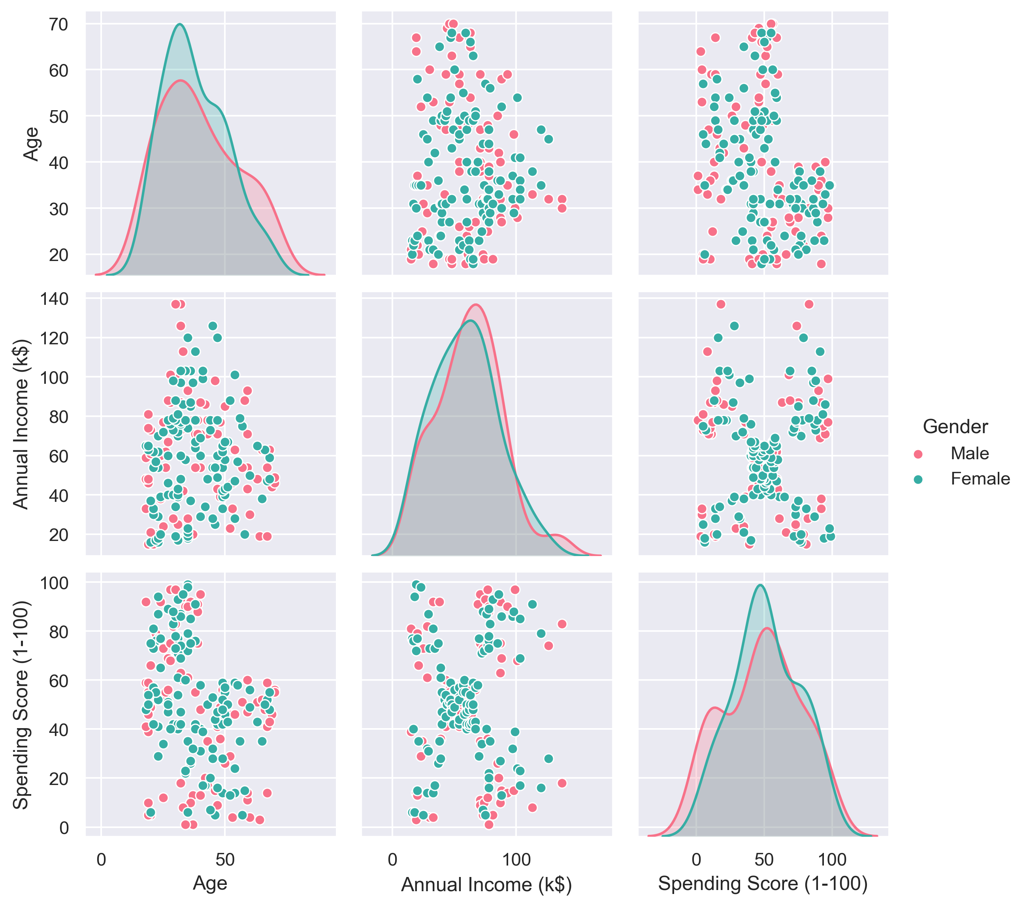
Relationship between age ,annual income and spending score pairwise

Slide 22
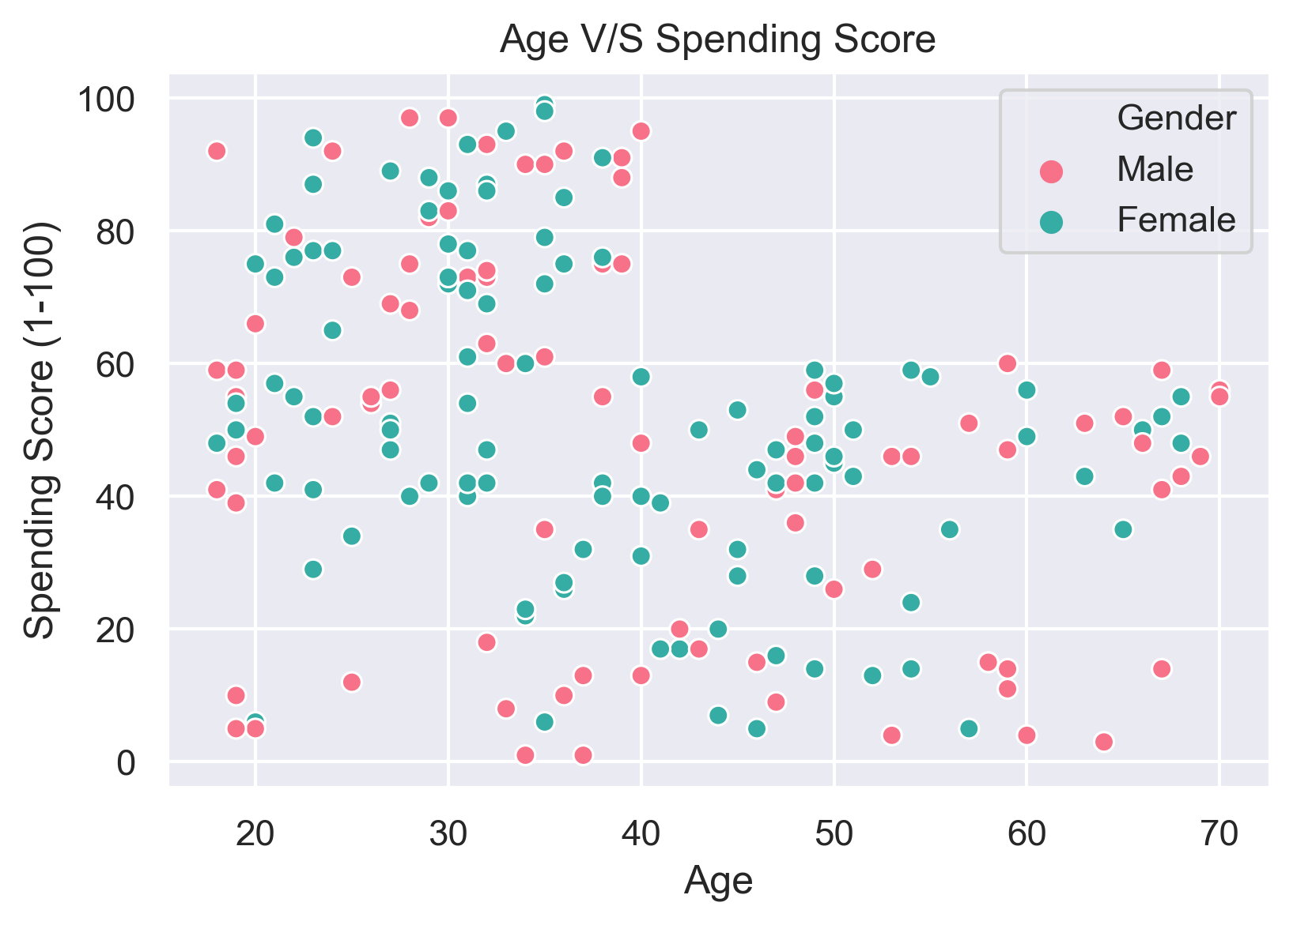
Will spending score decrease after certain age?
We can find a relation that people with age >= 40 have spending rate less than 60

Slide 23
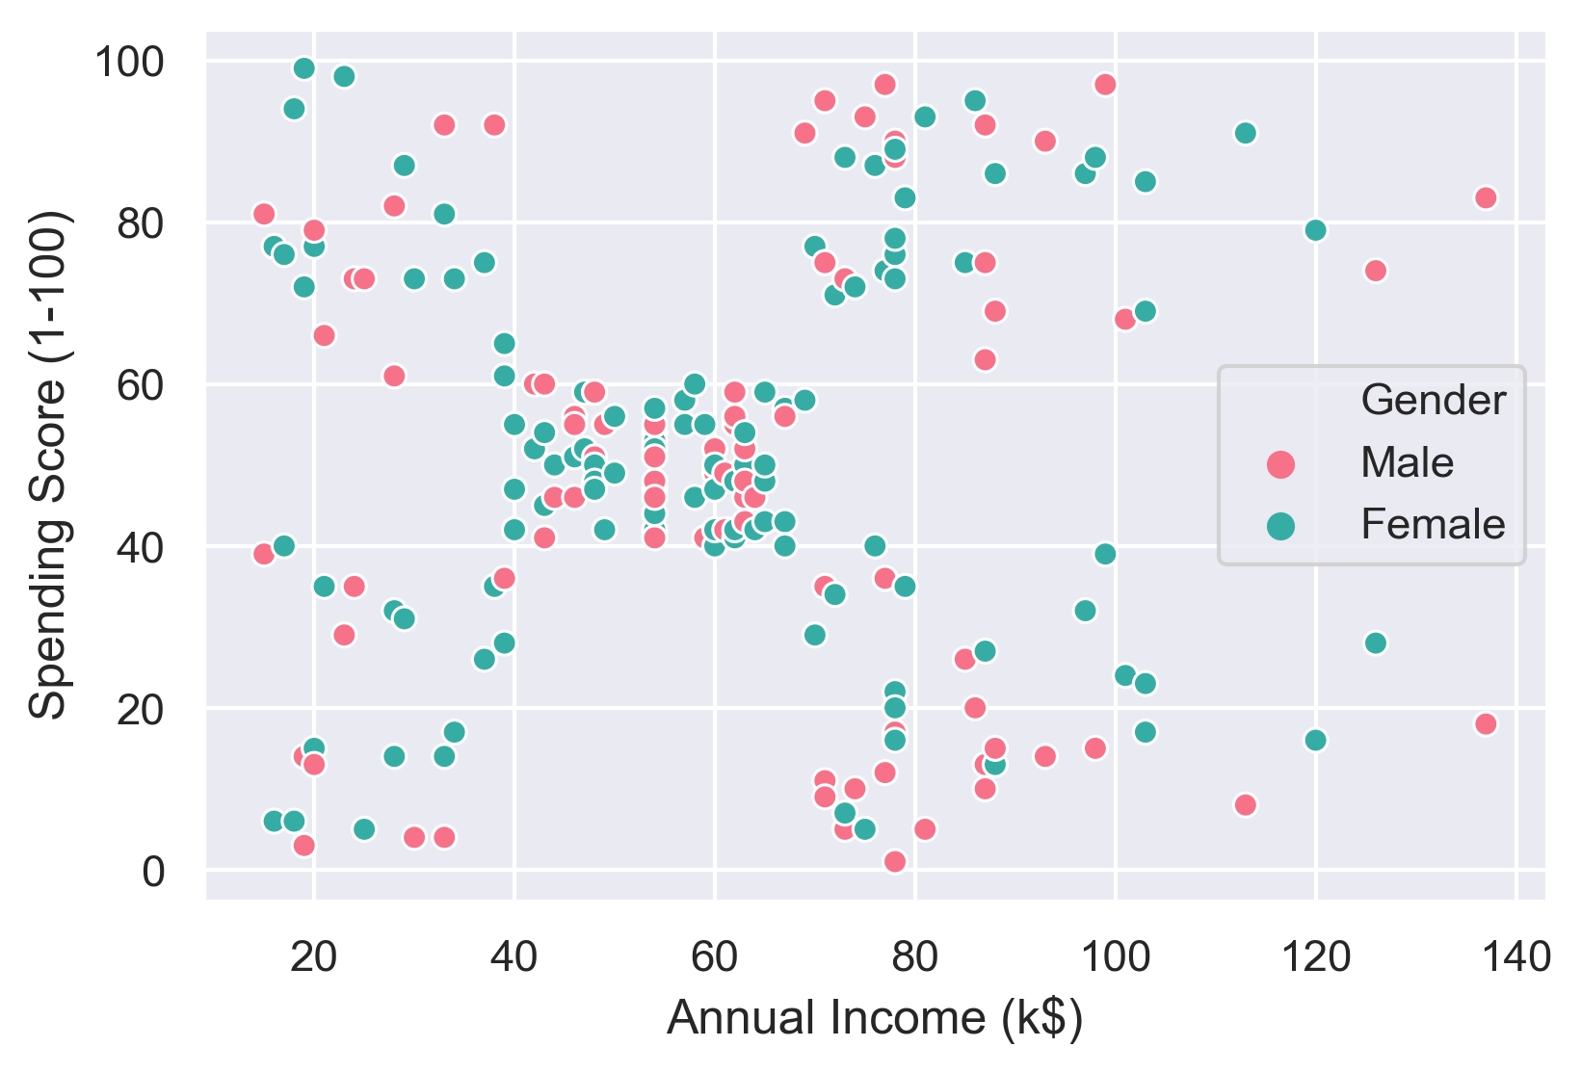
Are there any clusters in annual income and spending score

Slide 24
Clustering

Slide 25
What is clustering ?
Clustering is one of the most common exploratory data analysis technique
We can define it has the task of identifying subgroups in the data such that data points in the same subgroup (cluster) are very similar while data points in different clusters are very different
We use similarity measure such as euclidean-based distance or correlation-based distance.
Some of the most popular applications of clustering is customer segmentation ,image compression & document clustering

Slide 26
Whats K-Means Clustering?
Kmeans algorithm is an iterative algorithm
The algorithm tries to partition the dataset into k pre-defined distinct non-overlapping cluster
Each data point will belong to only one cluster
It assigns data points to a cluster such that the sum of the squared distance between the data points and the cluster’s centroid
The less variation we have within clusters, the more homogeneous the data points are within the same cluster.

Slide 27
Steps in K-Means Clustering
Step 1:Initialize k centroids=number of clusters randomly or smartly
Step 2:Assign each data point to the closest centroid based on euclidian distance, thus forming the cluster
Step 3:Move centers to the average of all points in the cluster

Slide 28
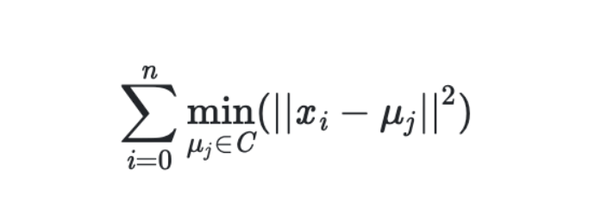
What does K-Means use to group the data points?
It tries to minimize & optimize within-cluster sum-of-squared-distances or inertia of each cluster.
When inertia value does not minimize further, algorithm converges. Thus, iteration stops.

Slide 29
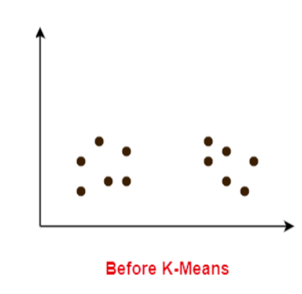
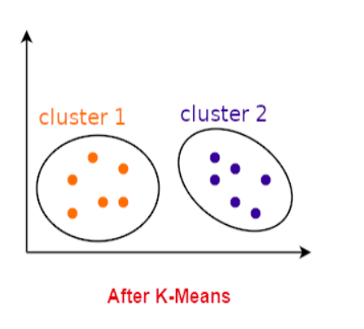
Pictorial representation of k means algorithm
K-Means

Slide 30
How to choose K(centroids) for clustering ?
Elbow Method
Silhouette Coefficient Method

Slide 31
Clustering for 2 Features

Slide 32
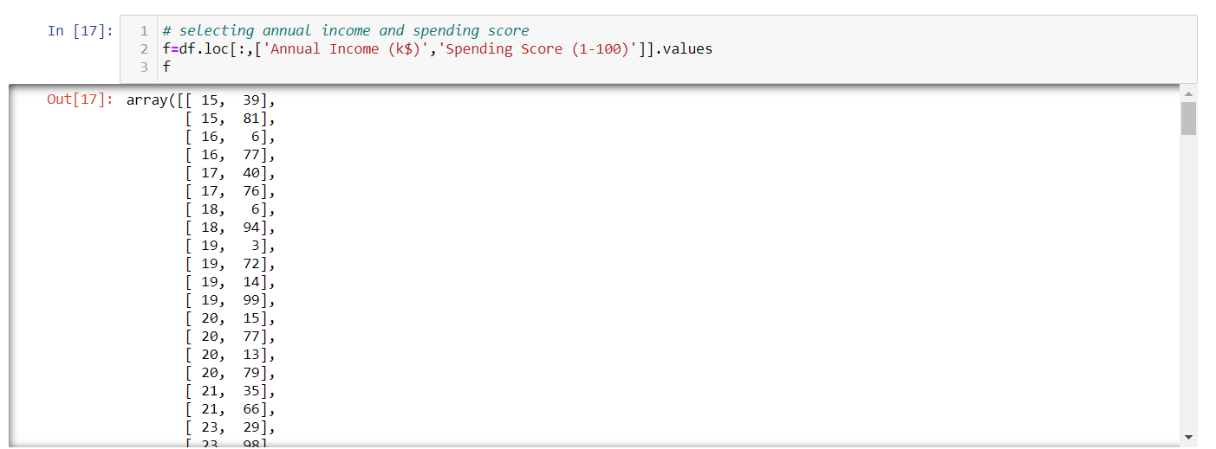
Selecting the 2 important features

Slide 33
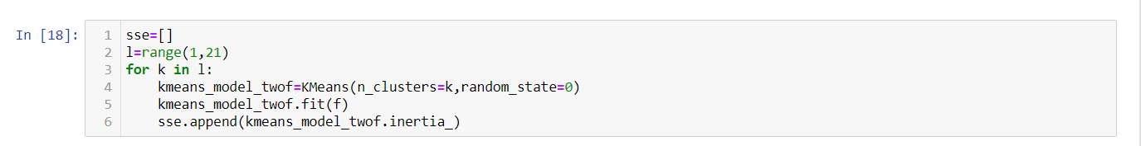
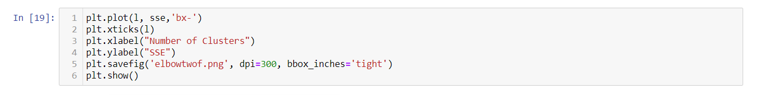
Elbow Method

Slide 34
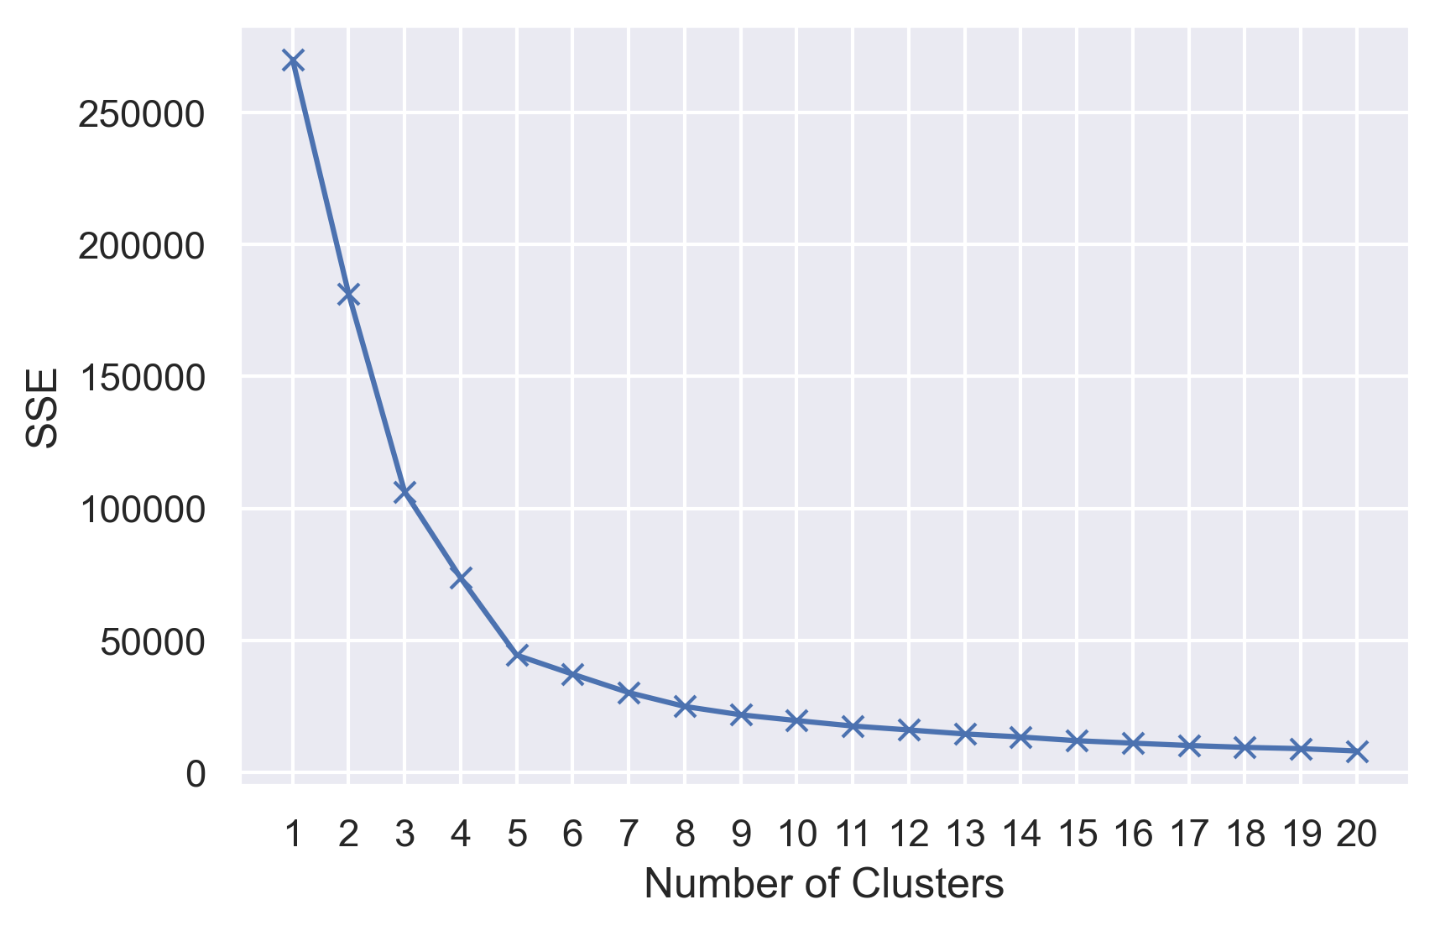
Elbow Method Plot

Slide 35
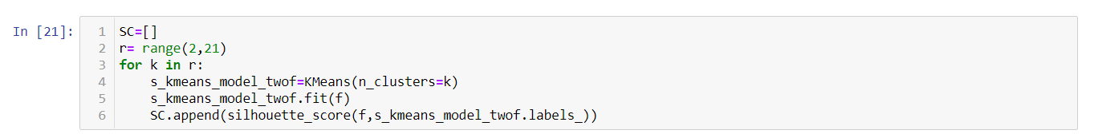
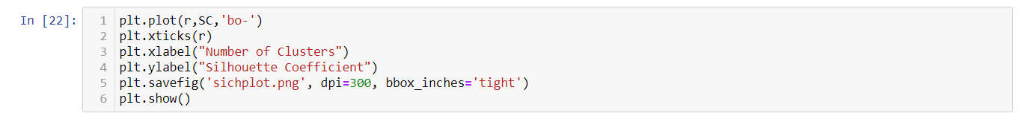
Silhouette Coefficient Method

Slide 36
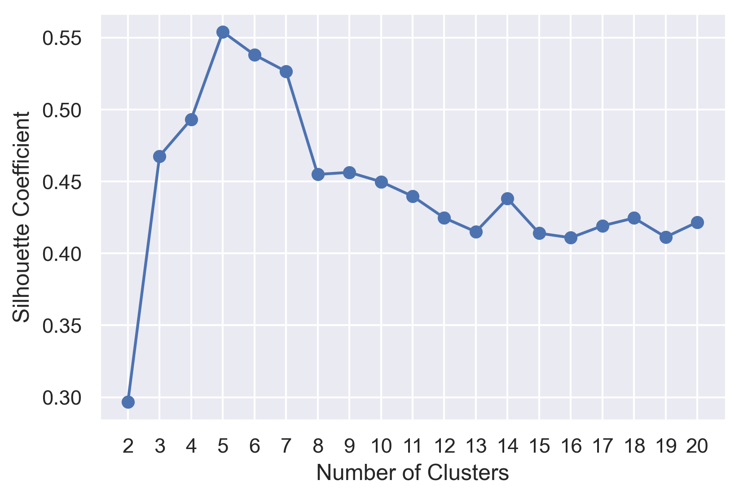
Silhouette Coefficient Method Plot

Slide 37
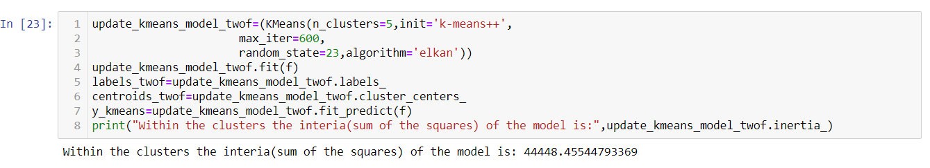
K Means Algorithm

Slide 38
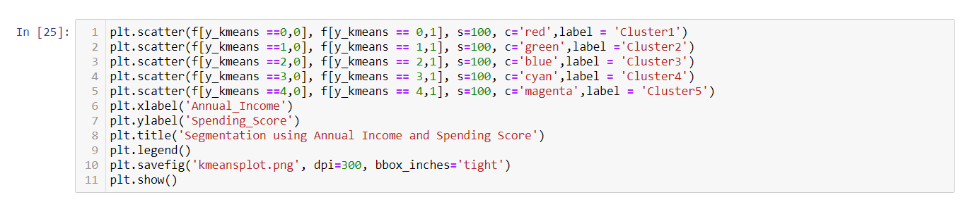
K Means Plotting

Slide 39
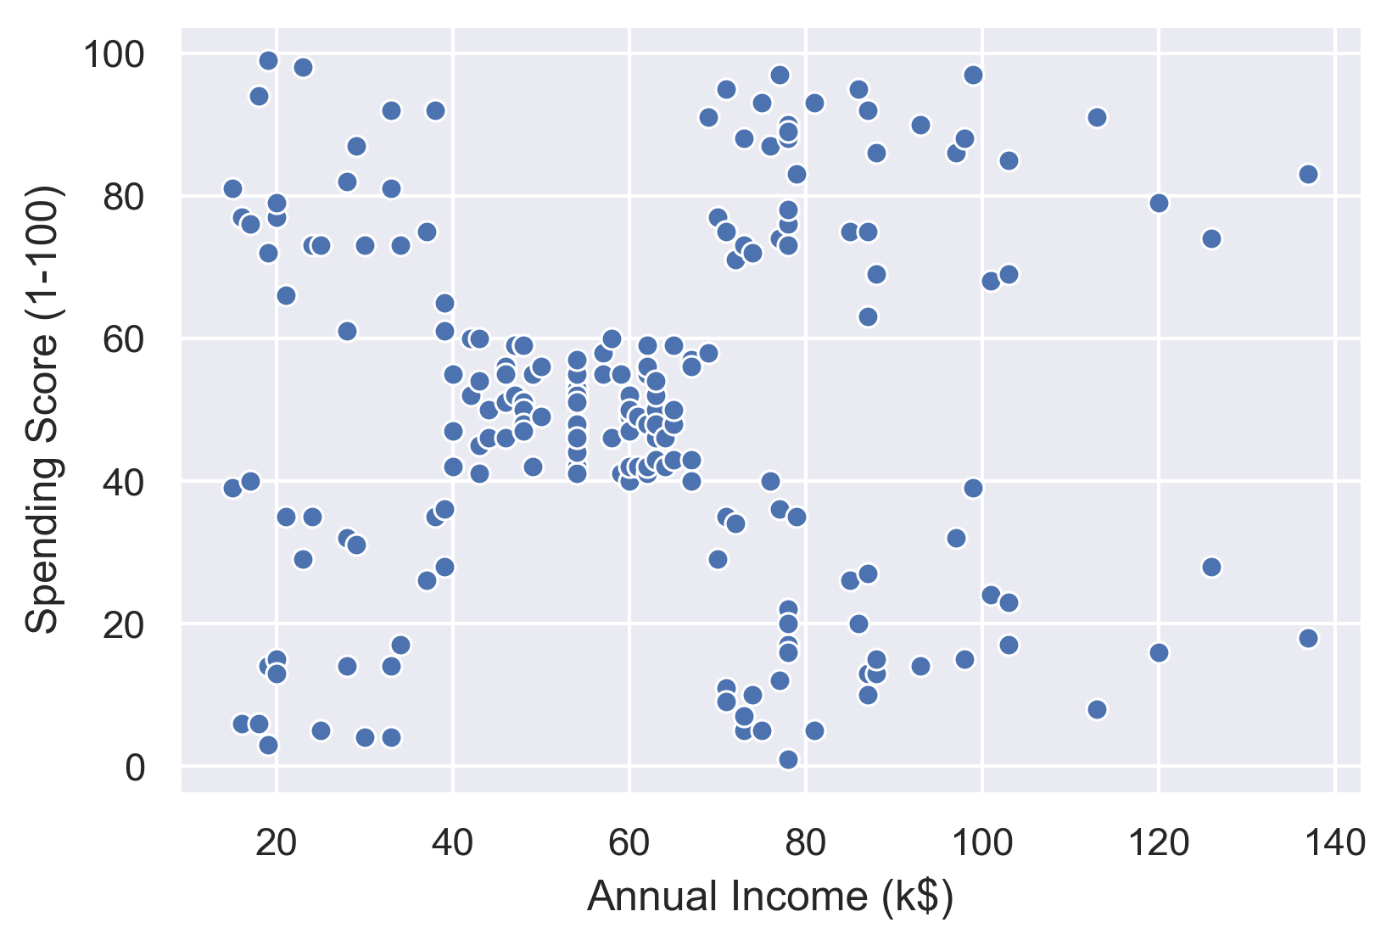
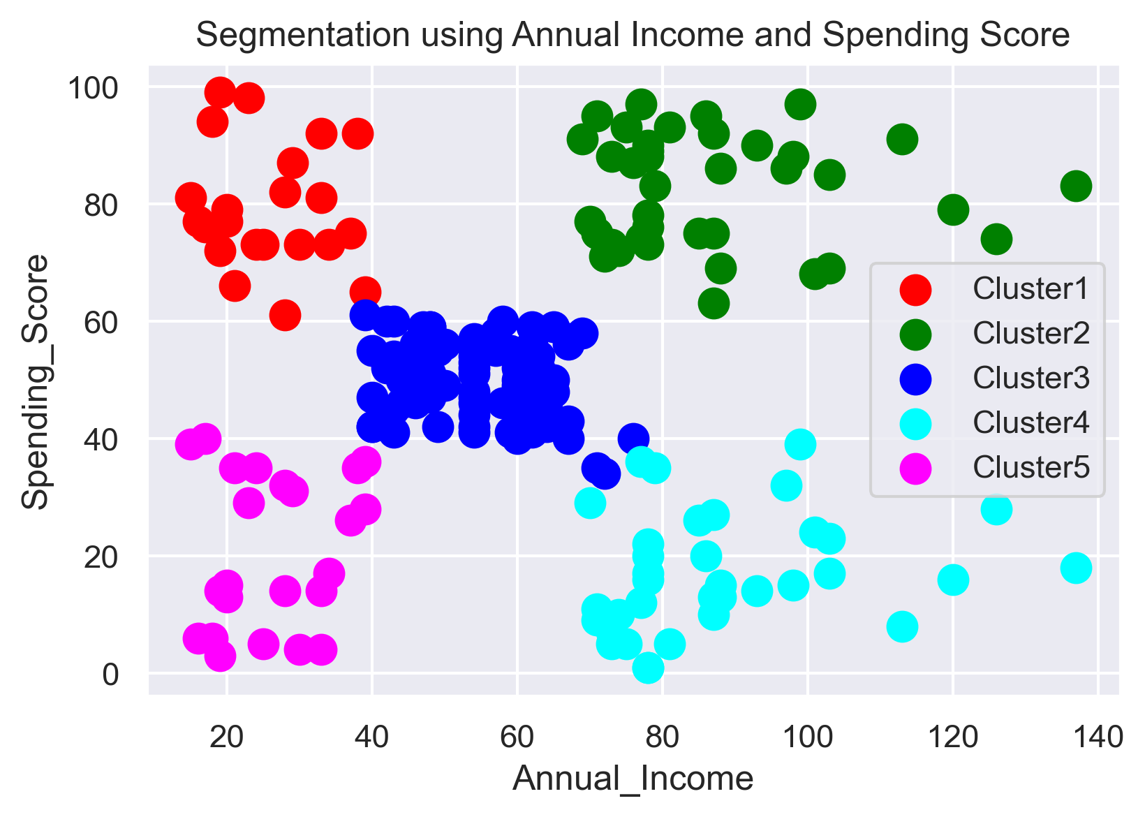
Before & After Applying K-Means
K-Means

Slide 40
Interpreting The Clusters
Cluster 1:The Red cluster groups people with low annual income & high spending score Cluster 2:The Green cluster groups people with high annual income & high spending score Cluster 3:The Blue Cluster groups people with medium annual income & spending score Cluster 4:The Cyan cluster groups people with high annual income & low spending score Cluster 5:The Magenta Cluster groups people with low annual income & spending score

Slide 41
Clustering for 3 Features

Slide 42
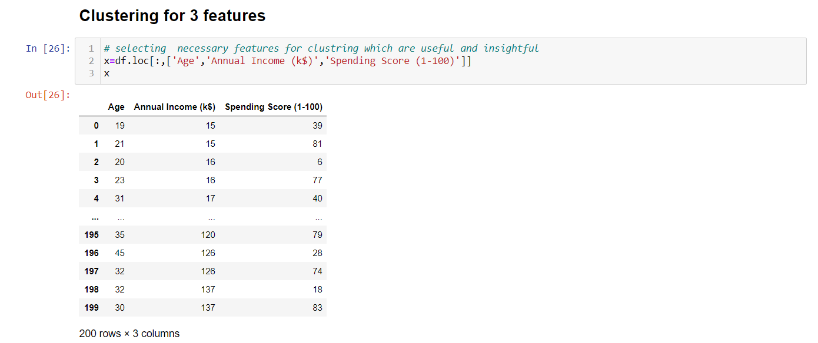
Selecting the 3 important features

Slide 43
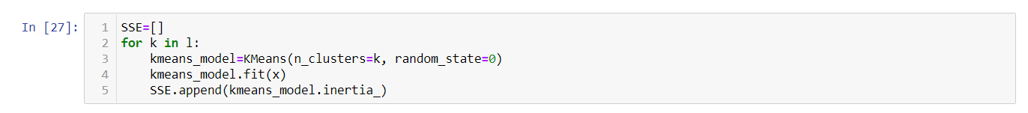
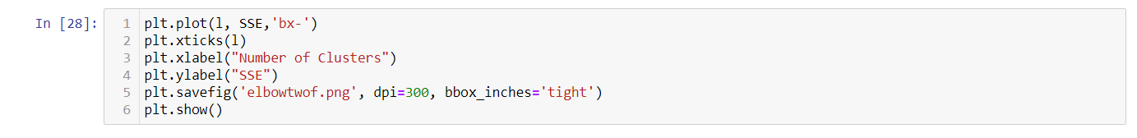
Elbow Method

Slide 44
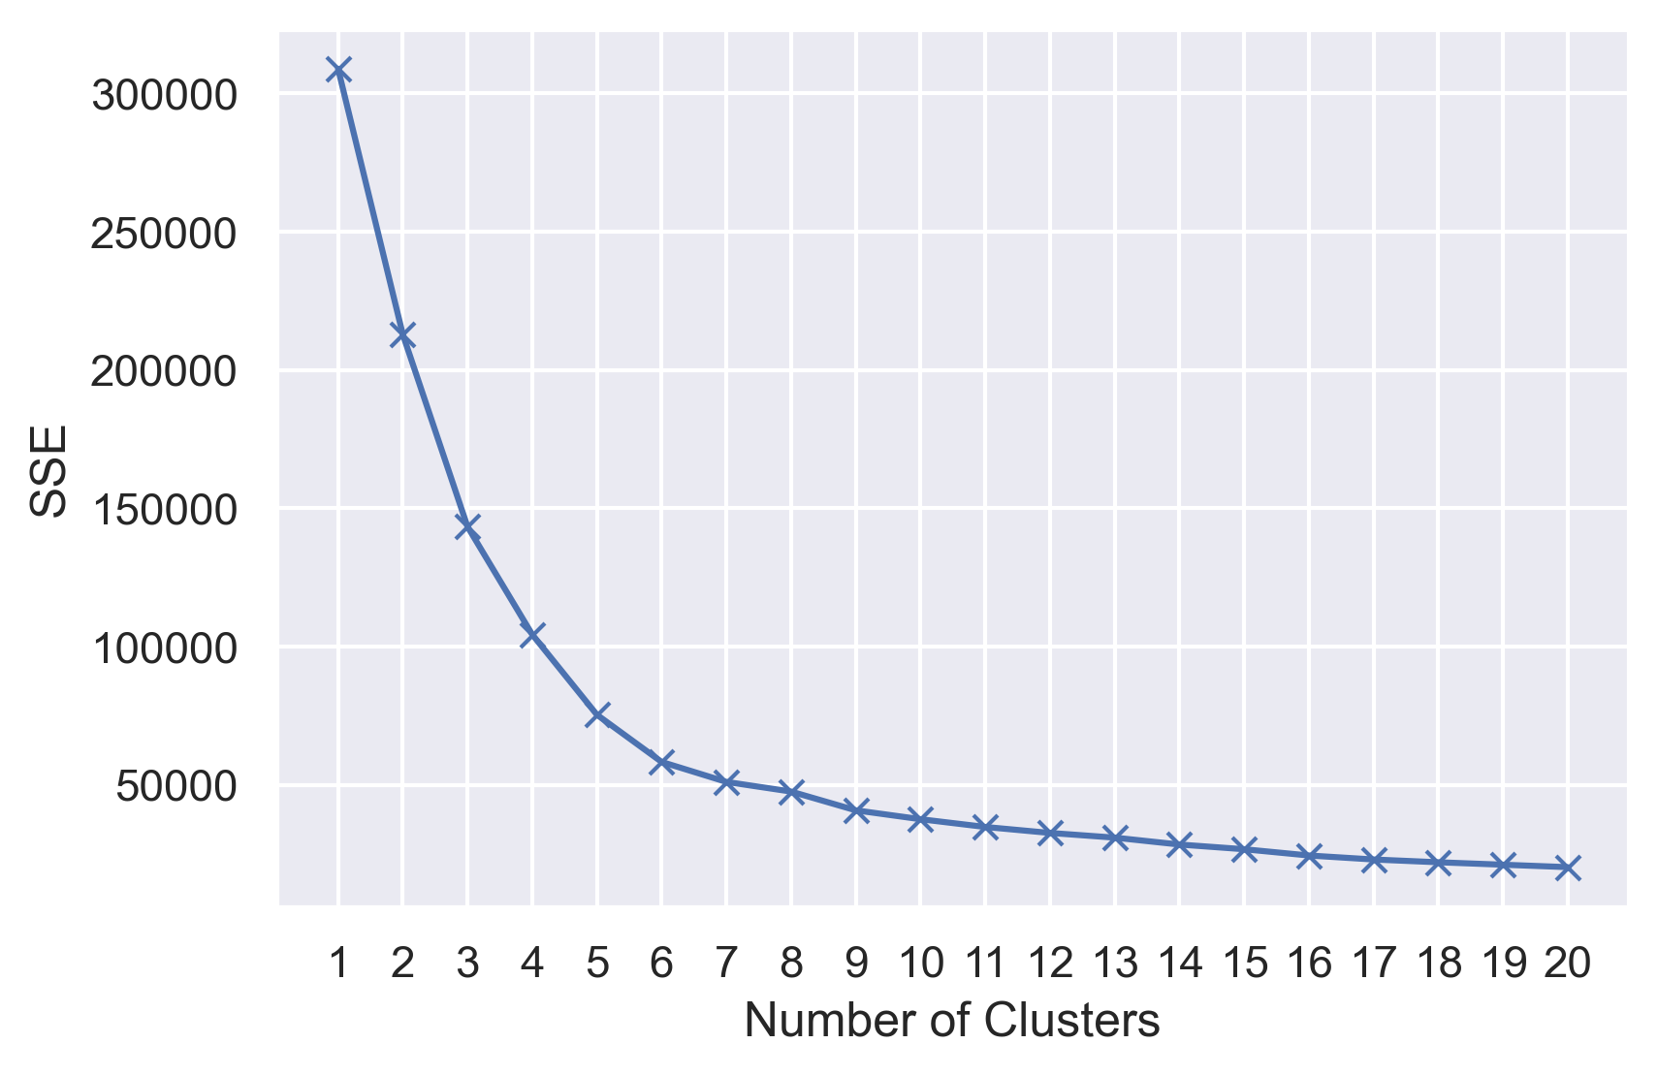
Elbow Method Plot

Slide 45
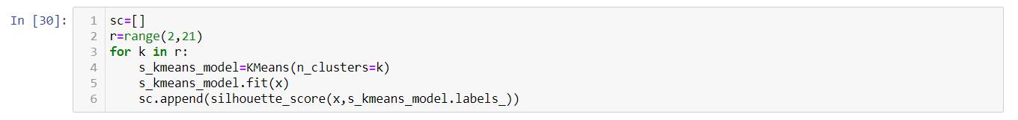
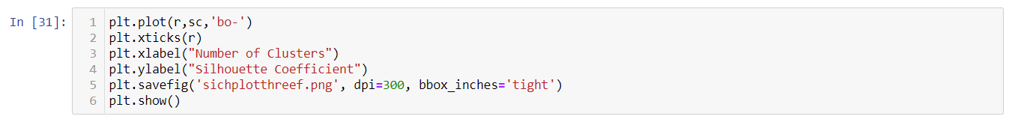
Silhouette Coefficient Method

Slide 46
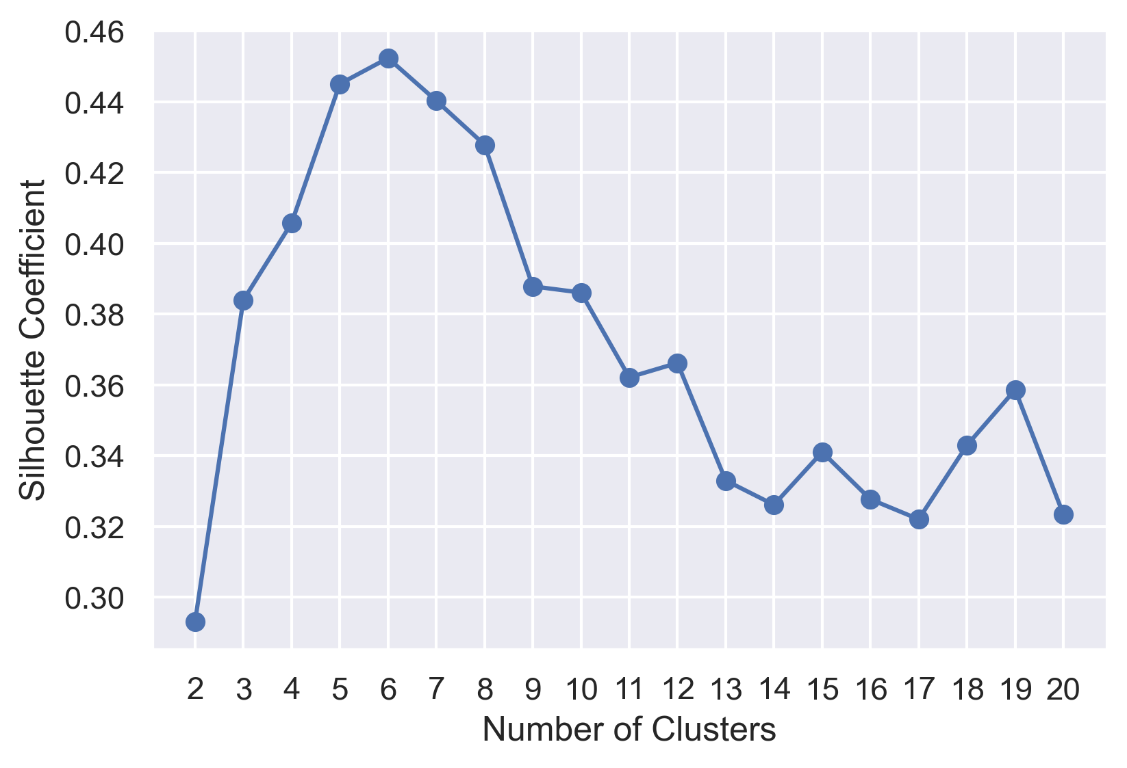
Silhouette Coefficient Method Plot

Slide 47
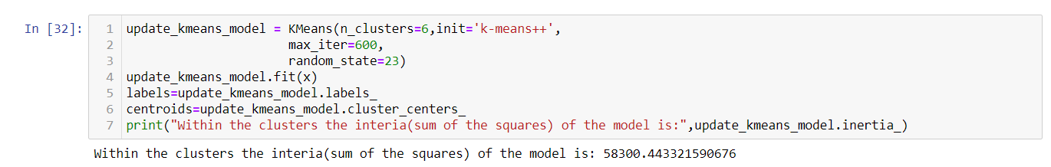
K Means Algorithm

Slide 48
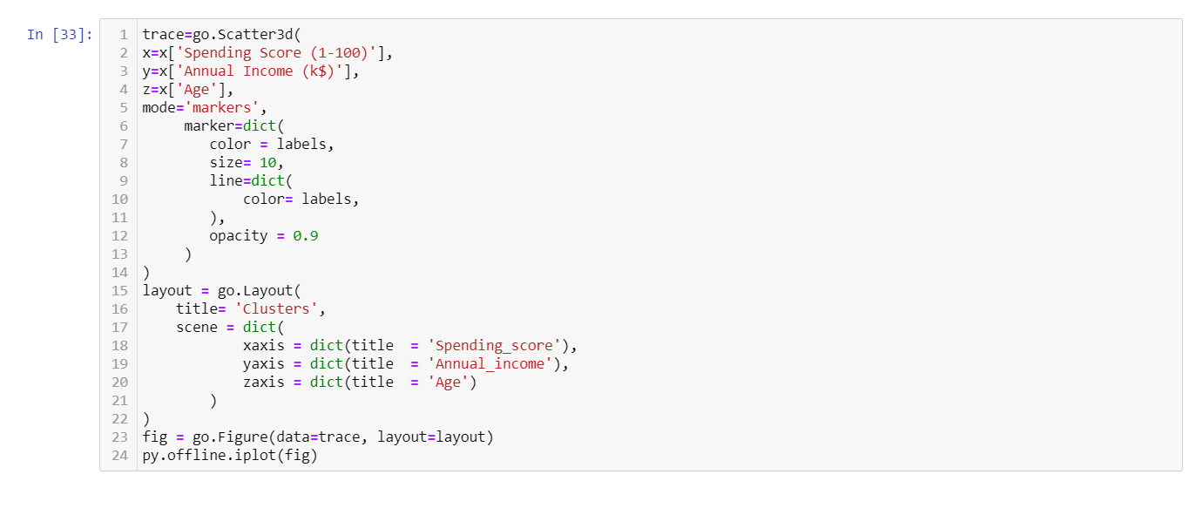
K Means Plotting

Slide 49
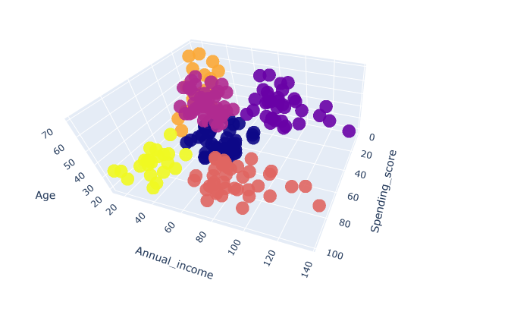
Interpreting The Clusters
Yellow Cluster:The yellow cluster groups young people with moderate to low annual income who actually spend a lot. Dark Blue Cluster:The dark blue clusters groups who are adults pretty medium annual income and spending score OrangeRed Cluster:The OrangeRed cluster groups reasonably young people with pretty decent salaries who spend a lot. Orange Cluster:The Orange cluster groups whose salary is pretty low and don't spend much money in stores, they are people of all ages. BlueViolet Cluster:The blueViolet cluster groups people who actually have pretty good salaries and barely spend money, their age usually lays between thirty and sixty years Purple Cluster:The purple cluster groups people who are old with pretty medium annual income and spending score

Slide 50
Thank You

