Slide 1
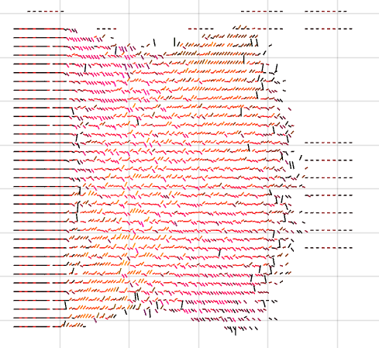


Physical Boundary
-Fluid Anti-Boundary

Slide 2



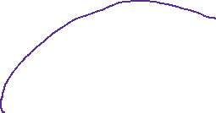
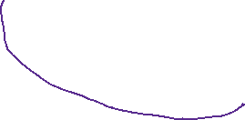

P1
P2
> P3
de Laval nozzle
Choked Flow
>P3
P2
P1

