Slide 1
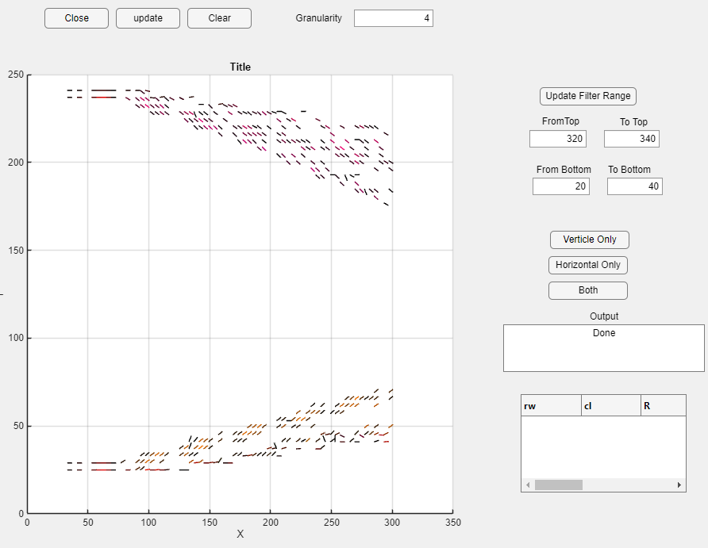
Granularity
Angle Filter Entries
Velocity Angle Gradient Field
Component Filter Entries

