Slide 1
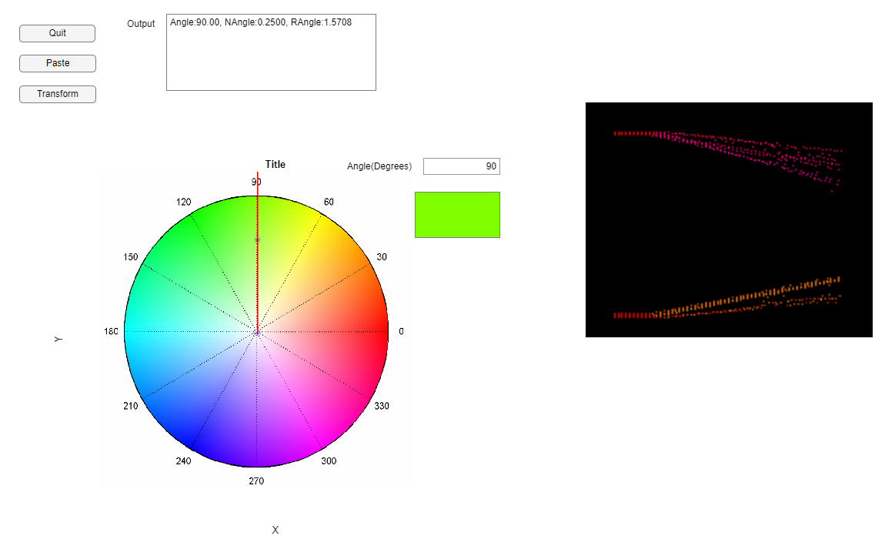
Angle Input
Angle Vector
HSV Map
HSV Color Output
Image Evaluation Field

