Slide 1
p = [0.0,0.0,radius];
This position vector lay in the Z plane but gets moved in the ZY
ang = [xomega,yomega,zomega];
veca = [1.0,0.0,0.0];
Rotating around X puts the arrow in the ZY plane
rvbq(p, xomega, veca);
Z
Y
X

Slide 2
p = [radius,0.0,0.0];
X
ang = [xomega,yomega,zomega];
veca = [0.0,1.0,0.0];
Rotating around Y puts the arrow in the ZX plane
rvbq(p, yomega, veca);
Z
Y

Slide 3
p = [0.0,radius,0.0];
X
ang = [xomega,yomega,zomega];
veca = [0.0,0.0,1.0];
rvbq(p, zomega, veca);
Y
Z
Z
Rotating around Z puts the arrow in the XY plane

Slide 4
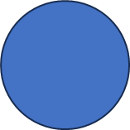


Slide 5


Slide 9
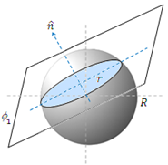

Slide 10


Slide 11



Slide 12


Slide 13
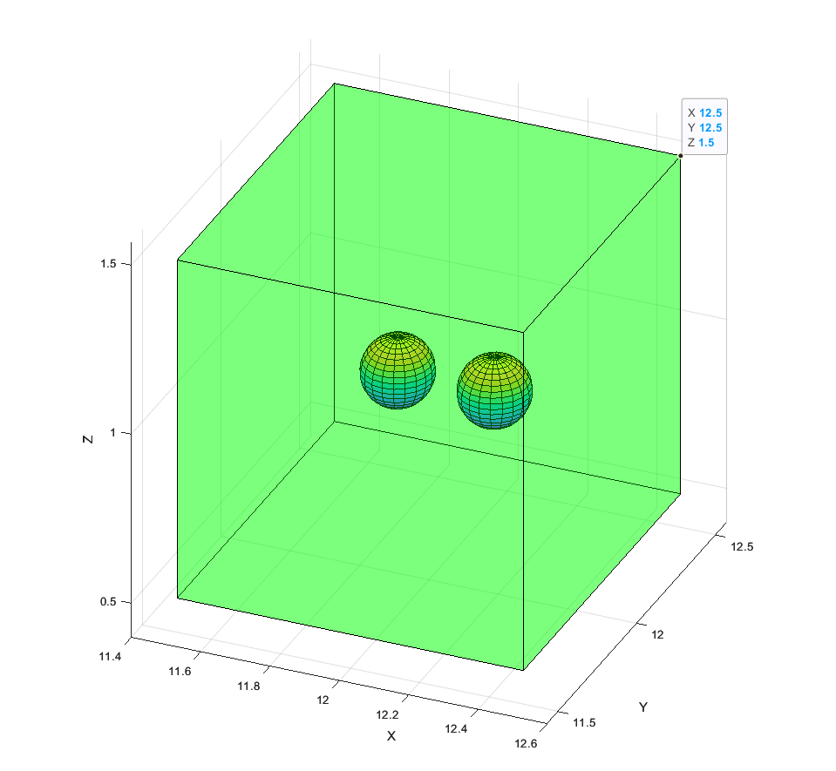




Slide 14




Slide 15
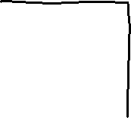





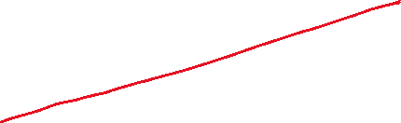



Slide 16



Slide 17


Slide 19


