Slide 1
Ambiguity and Compound Lottery Aversion
Notes:
Neuroeconomists have ignored
It has never been imaged
Separating beliefs and traits: can help to explain noted effects. More experience reduces aa etc
Can be important for trying to move the needle. Beliefs should be easier to change than traits.

Slide 2
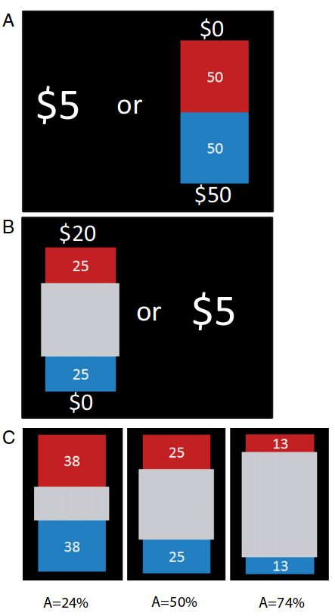
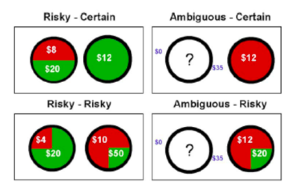
Risk vs. Uncertainty
Risk is knowns Uncertainty is Unknowns
Uncertain choices are more ‘real world’ should I eat sushi at this shady restaurant
Notes:
A quick review Risk aversion refers to how people make decisions when they know what the probabilities of the outcomes (left), Ambiguity (uncertainty) avers. Refers to decision making when probabilities are not fully known.
Amb reflects more everyday decisions. We don’t often know exactly how likely outcomes are. Probability of a trustee being trustworthy, getting an upset stomach from new food, getting published in a journal, etc.

Slide 3
Expected Value
sum(p_{i}*V_{i})
The sum of the value of all outcomes multiplied by their corresponding probability
On average a gamble on a coin-flip for $10 will win us $5

Slide 4
Aversion
Risk Aversion:
Lotteries < Expected Value
Utility
Twice the amount of money isn’t worth twice the amount of utility
Ambiguity Aversion:
Probability is a range

Slide 5
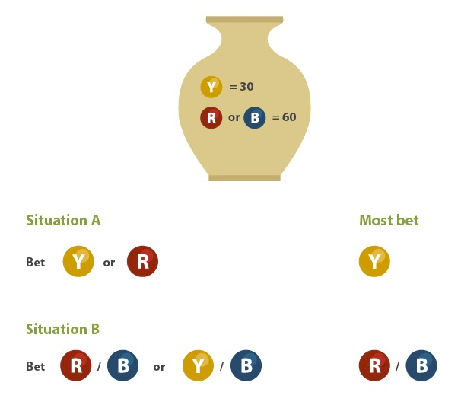
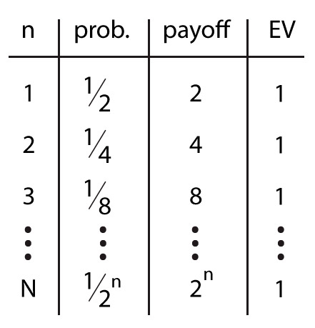
Paradoxes: People are not ‘Maximizers’
St. Petersburg
Flip a coin until it lands on tails.
Every heads the pot doubles
Ellsberg
Notes:
-If we are unfamiliar or if you don’t trust that people are ‘bad’ at making risky decisions and worse at making uncertain decisions we can look at these two paradoxes.
- In these situations people are leaving money on the table just as certain as if they refuse offers in the Ultimatum game.

Slide 6
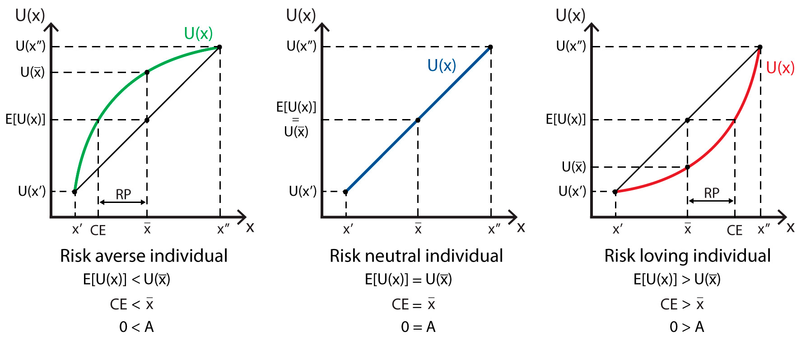
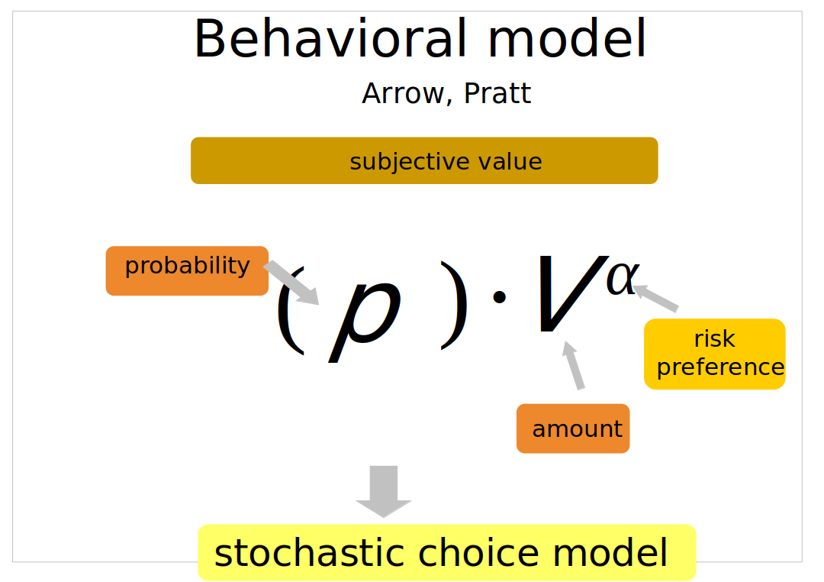
Utility and Risk Aversion
$10 million won’t buy me a life 2x better than $4 million why take the risk?
Notes:
For risk this was solved 350yrs ago. Blais Pascal suggested people are trying to maximize Utility/happiness/ etc.
The more money we get the less even more money means to (most of) us.
This model get’s output to a statistical model typically a logistic regression with Maximum Likelihood estimation error

Slide 7
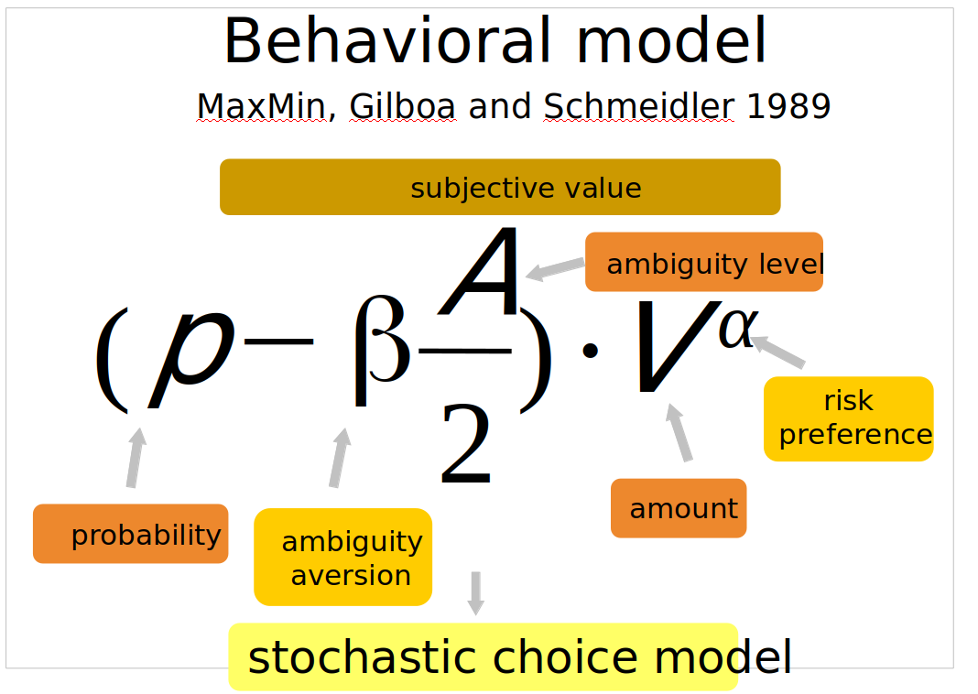
Gilboa Schmiedler
=v
~
A
~
P=0.5
Notes:
Gilboa Schmidler
The interpretation makes me uncomfortable. People just pick some lower proportion of the possible ‘real lotteries’ to hedge their bets?
It feels a bit off as the amount of Ambiguity increases. I have a feeling the my unsureness compounds as that gray space gets bigger.
Do people just not think about what might be in the bag?

Slide 8
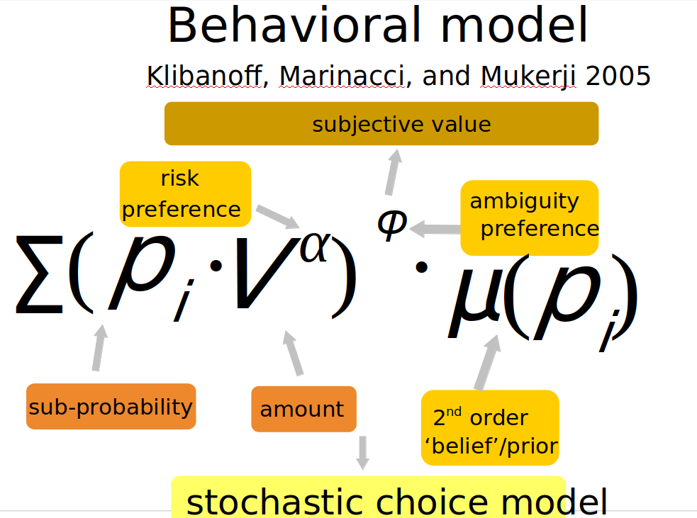
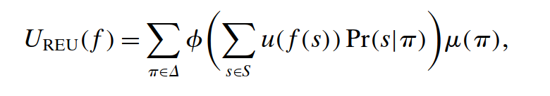
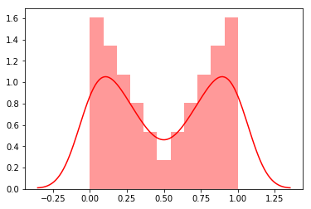
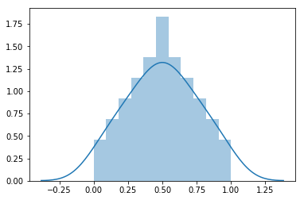
Compound Lottery Aversion
DM’s think about the possible lotteries.
These become multi-stage lotteries.
Violates Reduction of Compound lotteries
Notes:
The top equation looks scary but it’s just long winded.
We’re going to break it down to the second equation.

Slide 9
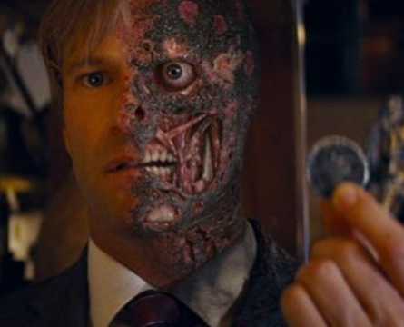
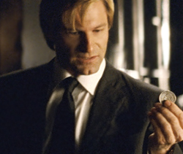
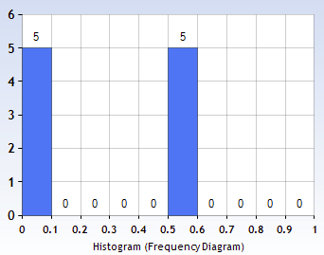
KMM Example
Are you dealing with Two-Face or Harvey Dent
(V^{α}*0.0)^{φ}*.50+(V^{α}*0.5)^{φ}*.50=
Note: paper publishing
Notes:
A quick application will explain the idea better than going through what each individual piece stands for.
If you remember the dark night the movie begins with Harvey Dent and his two headed coin but after caught in an explosion half of his face and coin becomes marred.

Slide 10


Why do I care? How to test?
Separating ‘belief’ and ‘attitudes’.
Probing & predicting beliefs.
Model realistic ambiguity
Halevy 2007
Danese 2017
Do people naturally build and act on these beliefs?
} Explicitly ask for 2nd order beliefs
Notes:
Previous studies have explicitly asked for participant preferences over 2nd order distributions.
This still feels pretty un-natural in implementation
Are the Personality inventories and demographics typically associated with ambiguity aversion driven by their uncertainty ‘preference’ or by their 2nd order beliefs?

