Slide 1
Ambiguity Aversion and Compound Lotteries
Or:
How I learned to Stop worrying and hate Jeff for making a project about something incredibly nit-picky

Slide 2
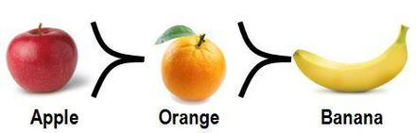
The Economist basics
Assumption that choices reveal preferences

Slide 3
The Economist basics
Assumption that choices reveal preferences
Preferences reflect subjective value (SV) or some decision variable
SV($10) > SV($9)

Slide 4
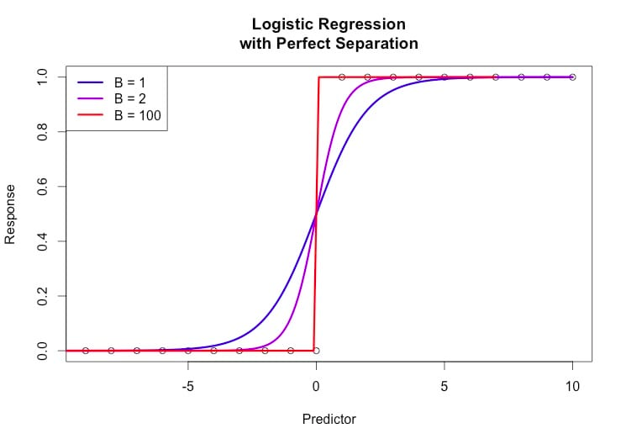
The Economist basics
Assumption that choices reveal preferences
Preferences reflect subjective value or some decision variable
A decision variable is the input to a choice operator which selects options with the highest value and takes action toward that item
Accept or Reject $X

Slide 5
RISKY Decision Making IS WEIRD
“Risk”: asset outcomes under well defined probabilities
How to Value (lotteries):
  50% at $10
  25% at $5 Million
  50% of $2 + 25% of $4 +12.5% of $8…….+ 1/N of $2^{N}

Slide 6
RISKY Decision Making IS WEIRD
How “should” we value risky assets
Expected Value!

Slide 7
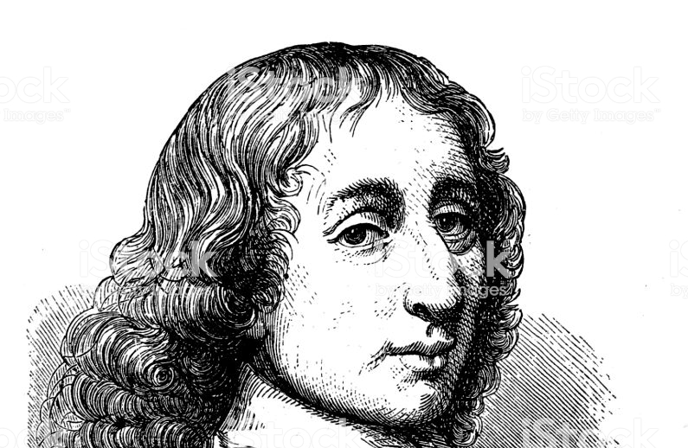
RISKY Decision Making IS WEIRD
How “should” we value risky assets
Expected Value!

Slide 8
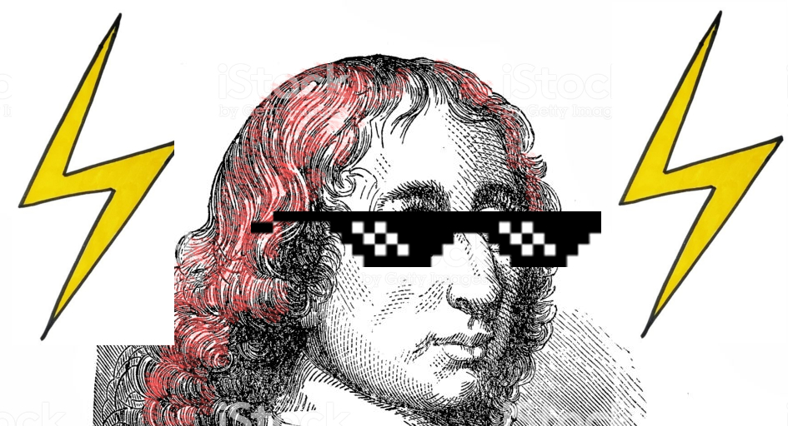
RISKY Decision Making IS WEIRD
How “should” we value risky assets
Expected Value!

Slide 9
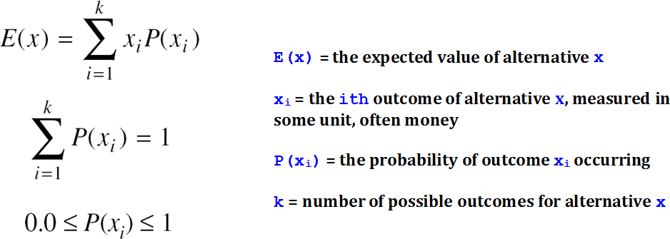
RISKY Decision Making IS WEIRD
How “should” we value risky assets
Expected Value:

Slide 10
RISKY Decision Making IS WEIRD
How “should” we value risky
assets
Expected Value:
Sum the value of all outcomes
times the probability of those outcomes
EV= the mean. Scales linearly with the Magnitude of the Value(s) and probability.
  EV($10,50%)= 2*EV($5,50%)
  EV($5,50%)= 2*EV($5,25%)

Slide 11
RISKY Decision Making IS WEIRD
Is EV the human decision making variable?

Slide 12
RISKY Decision Making IS WEIRD
Is EV the human decision making variable?
Expected Value:
  50% of $10 =
  25% of $5 Million =
  50% of $2 + 25% of $4 …….+ 1/N of $2^{N} =

Slide 13
RISKY Decision Making IS WEIRD
Is EV the human decision making variable?
Expected Value:
  50% of $10 = $5
  25% of $5 Million =
  50% of $2 + 25% of $4 …….+ 1/N of $2^{N} =

Slide 14
RISKY Decision Making IS WEIRD
Is EV the human decision making variable?
Expected Value:
  50% of $10 = $5
  25% of $5 Million = $1.25 Million
  50% of $2 + 25% of $4 …….+ 1/N of $2^{N} =

Slide 15
RISKY Decision Making IS WEIRD
Is EV the human decision making variable?
Expected Value:
  50% of $10 = $5
  25% of $5 Million = $1.25 Million
  50% of $2 + 25% of $4 …….+ 1/N of $2^{N} = $∞

Slide 16
RISKY Decision Making IS WEIRD
Is EV the human decision making variable?
Expected Value:
  50% at $10 = $5
  25% at $5 Million = $1.25 Million
  50% of $2 + 25% of $4 …….+ 1/N of $2^{N} = $∞
Preference Value:
  50% at $10 (=,<,>) $5
  25% at $5 Million (=,<,>) $1.25 Million
  50% of $2 + 25% of $4 …….+ 1/N of $2^{N} (=,<,>) $∞

Slide 17
RISKY Decision Making IS WEIRD
Is EV the human decision making variable?
Expected Value:
  50% of $10 = $5
  25% of $5 Million = $1.25 Million
  50% of $2 + 25% of $4 …….+ 1/N of $2^{N} = $∞
Preference Value:
  50% of $10 < $5
  25% of $5 Million < $1.25 Million
  50% of $2 + 25% of $4 …….+ 1/N of $2^{N} < $∞

Slide 18
What do we do?
Risky decisions aren’t random.
As the value of an asset increases or as the probability increases
  We’re more likely to accept the lottery, but they are consistently “under valued”

Slide 19
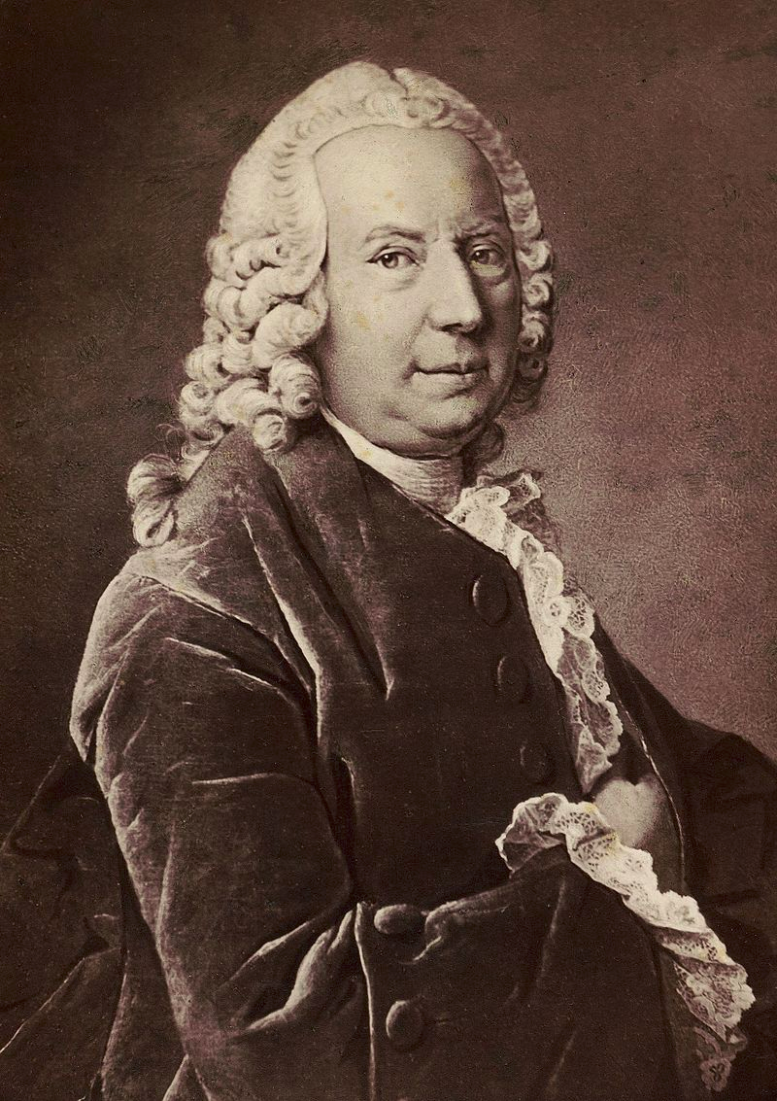
Expected Utility Theory
Risky decisions aren’t random.
As the value of an asset increases or as the probability increases
  We’re more likely to accept the lottery, but they are consistently “under valued”

Slide 20
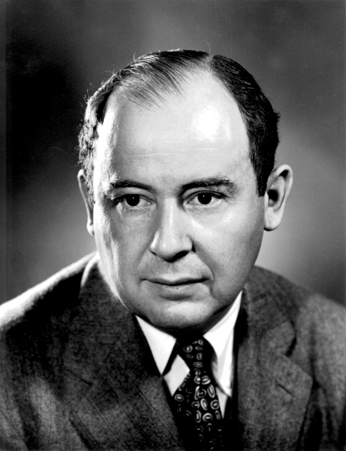
Expected Utility Theory
Risky decisions aren’t random.
As the value of an asset increases or as the probability increases
  We’re more likely to accept the lottery, but they are consistently “under valued”

Slide 21
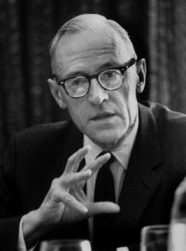
Expected Utility Theory
Risky decisions aren’t random.
As the value of an asset increases or as the probability increases
  We’re more likely to accept the lottery, but they are consistently “under valued”

Slide 22
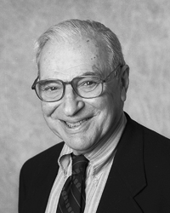
Expected Utility Theory
Risky decisions aren’t random.
As the value of an asset increases or as the probability increases
  We’re more likely to accept the lottery, but they are consistently “under valued”

Slide 23
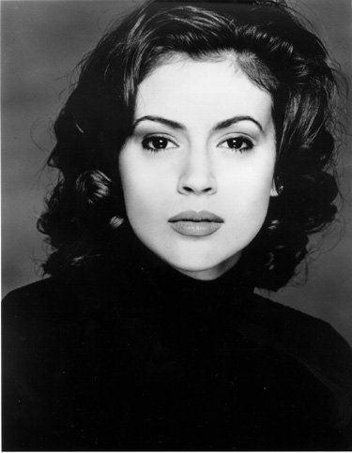
Expected Utility Theory
Risky decisions aren’t random.
As the value of an asset increases or as the probability increases
  We’re more likely to accept the lottery, but they are consistently “under valued”

Slide 24
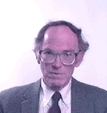
Expected Utility Theory
Risky decisions aren’t random.
As the value of an asset increases or as the probability increases
  We’re more likely to accept the lottery, but they are consistently “under valued”

Slide 25
Expected Utility Theory
Risky decisions aren’t random.
Axiom | Name
1 | Completeness | Among options lotteries are either { preferred, not preferred, or indifferent}
2 | Transitivity
3 | Continuity
4 | Reduction of Compound Lotteries

Slide 26
Expected Utility Theory
Risky decisions aren’t random.
Axiom | Name
1 | Completeness | Among options lotteries are either { preferred, not preferred, or indifferent}
2 | Transitivity | If L<M and M<N than L<N: No rock paper scissors
3 | Continuity
4 | Reduction of Compound Lotteries

Slide 27



Expected Utility Theory
Risky decisions aren’t random.
Axiom | Name
1 | Completeness | Among options lotteries are either { preferred, not preferred, or indifferent}
2 | Transitivity | If L<M and M<N then L<N: No rock paper scissors < & < then <
3 | Continuity
4 | Reduction of Compound Lotteries

Slide 28
Expected Utility Theory
Risky decisions aren’t random.
Axiom | Name
1 | Completeness | Among options lotteries are either { preferred, not preferred, or indifferent}
2 | Transitivity | If L<M and M<N then L<N: No rock paper scissors < & < then <
3 | Continuity | If L<M<N then there is a probability such that p*L+(1-p)*N~M
4 | Reduction of Compound Lotteries

Slide 29
Expected Utility Theory
Risky decisions aren’t random.
Axiom | Name
1 | Completeness | Among options lotteries are either { preferred, not preferred, or indifferent}
2 | Transitivity | If L<M and M<N then L<N: No rock paper scissors < & < then <
3 | Continuity | If L<M<N then there is a probability such that p*L+(1-p)*N~M
4 | Reduction of Compound Lotteries | If you have a 50% chance at a 50% chance of winning $10 it’s the same as a 25% of $10

Slide 30
Expected Utility Theory
Risky decisions aren’t random.
Axiom | Name
1 | Completeness | Among options lotteries are either { preferred, not preferred, or indifferent}
2 | Transitivity | If L<M and M<N than L<N
3 | Continuity | If L<M<N then there is a probability such that p*L+(1-p)*N~M
4 | Reduction of Compound Lotteries | If you have a 50% chance at a 50% chance of winning $10 it’s the same as a 25% of $10

Slide 31
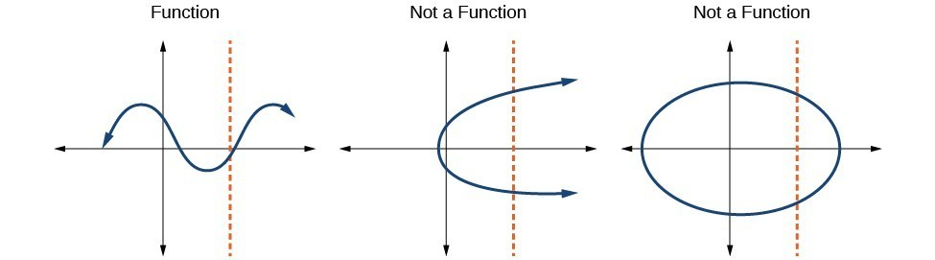
Expected Utility Theory
Risky decisions aren’t random.
There is a function f that takes an objective asset ($x) and turns it into a single SV, DV, or “Utility” value.

Slide 32
Expected Utility Theory
Risky decisions aren’t random.
There is a function f that takes an objective asset ($x) and turns it into a single SV, DV, or “Utility” value.

Slide 33
Expected Utility Theory
Risky decisions aren’t random.
There is a function f that takes an objective asset ($x) and turns it into a single SV, DV, or “Utility” value.

Slide 34
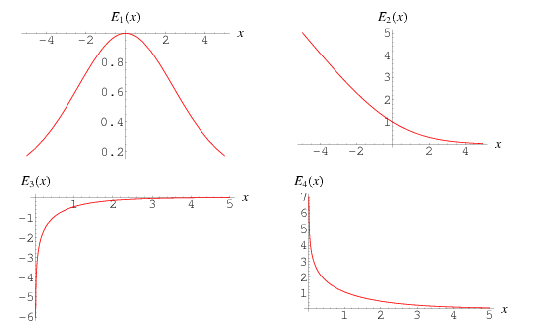
Expected Utility Theory
Risky decisions aren’t random.
There is a function f that takes an objective asset ($x) and turns it into a single SV, DV, or “Utility” value.

Slide 35
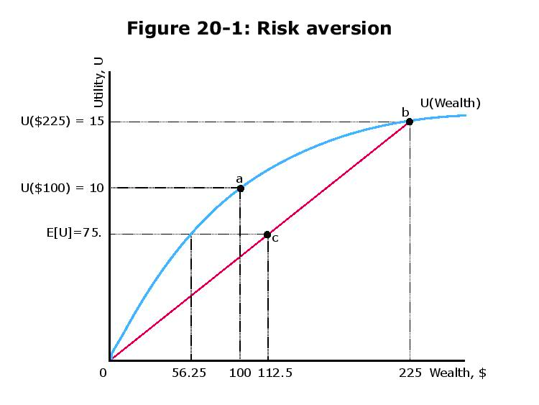
Expected Utility Theory
Risky decisions aren’t random.

Slide 36
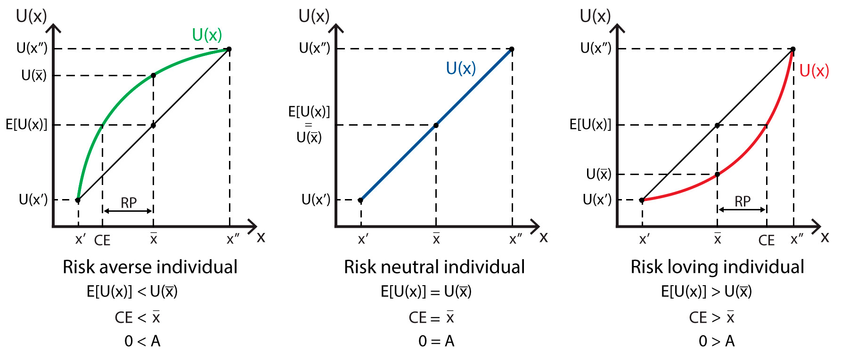
Expected Utility Theory
Risky decisions aren’t random.

Slide 37
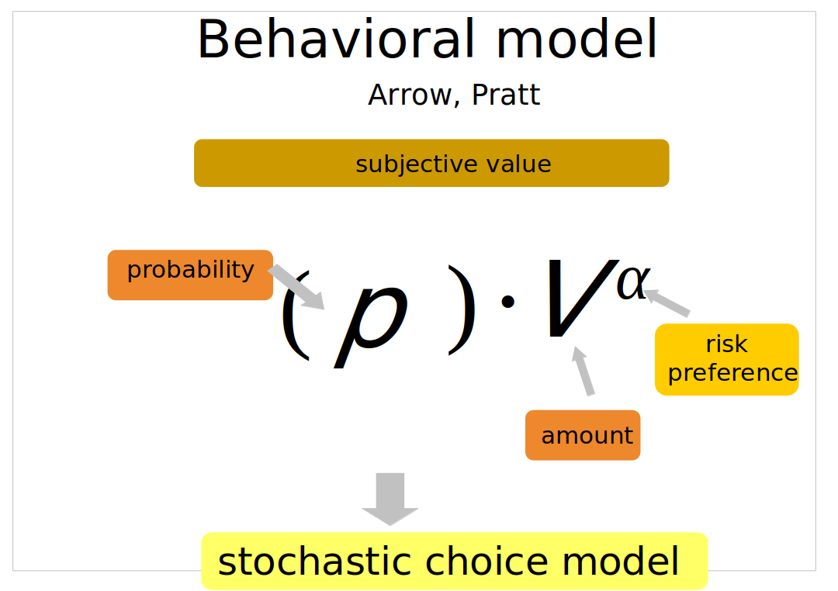
Risky decisions aren’t random.

Slide 38


Ambiguous Decision Making
IS WEIRDER
Ambiguous: assets under poorly defined or undefined probabilities
Who’s going to win?
Do we think about Ambiguous lotteries in terms of Expected Utility Theory?
VS

Slide 39
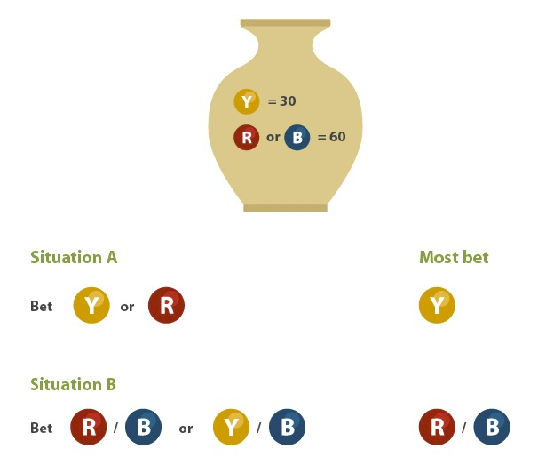

Ellsberg paradox as football betting

Slide 40

Ellsberg paradox as football betting
 | We Think They are going to lose

Slide 41
Ellsberg paradox as football betting
 | We Think They are going to loose
 |  | We think They are going to lose

Slide 42
In The Urn | R:0 B:10 | R:1 B:9 | R:2 B:8 | R:3 B:7 | R:4 B:6 | R:5 B:5 | R:6 B:4 | R:7 B:3 | R:8 B:2 | R:9 B:1 | R:10 B:0
EV | $0 | $1 | $2 | $3 | $4 | $5 | $6 | $7 | $8 | $9 | $10
Belief | 1/11 | 1/11 | 1/11 | 1/11 | 1/11 | 1/11 | 1/11 | 1/11 | 1/11 | 1/11 | 1/11

