Slide 1
Welcome to the risky decision making game!
In Part One, you will be presented with a choice between a sure amount of money or a gamble, for a chance to win a larger amount of money,
The pie chart represents the gamble and displays the prize on the top and chance of winning on the bottom.
Press the space bar to see an example

Slide 2
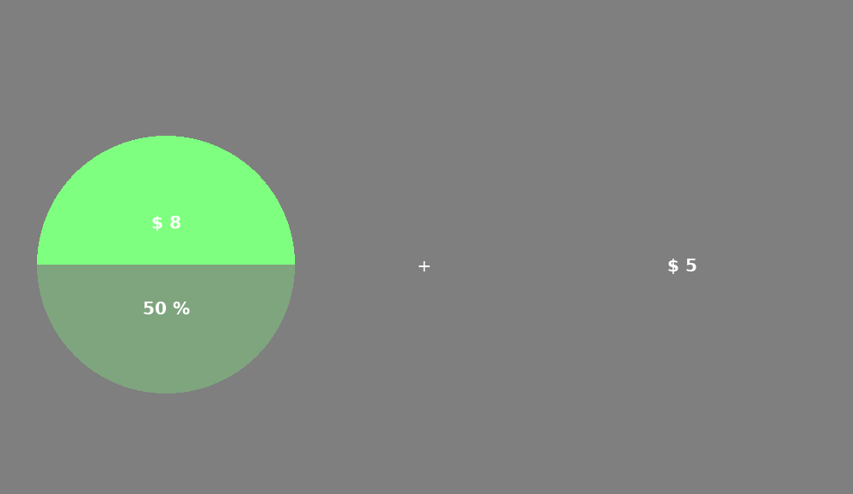
50%

Slide 3
In this case you are being asked whether you rather a sure $5 or a 50% chance to win $8. To select the option presented on the left press ‘f’. To select the option presented on the right press ‘g’.
You will have 6 seconds to make your choice.
Press the space bar

Slide 4
Each gamble will be red, green, or blue.
!Pay Attention!
For Part 2: You will need to remember how good each kind of gamble was.
You will be asked to choose between a random gamble of a given color from part one or a gamble with a known chance.
Press the space bar to see an example

Slide 5
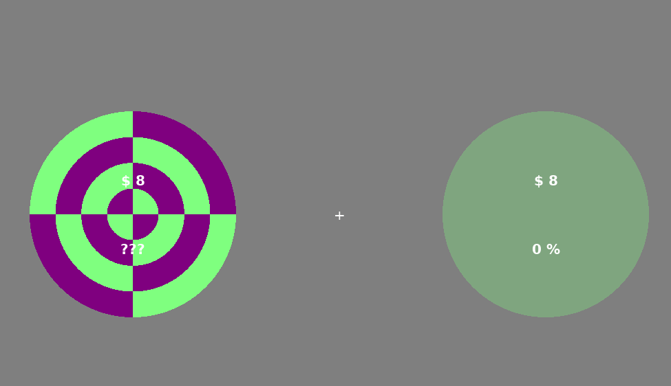
25%
??%

Slide 6
Just like before you will press ‘f’ to choose the option on the left and ‘j’ to choose the option on the right.
At the end we will play out your decisions and your bonus will depend on the decisions you made.
Do you have any questions before you start?

