Slide 1

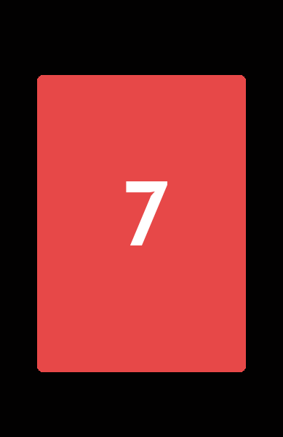

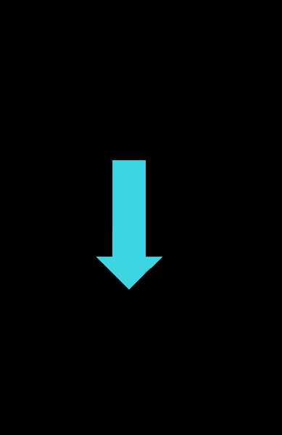

In this game you need to guess the value of a card by indicating either less than 5 with your index finger or greater than 5 with your middle finger.
You’ll have 1 ½ seconds to guess. If you’re too slow you’ll need to make a guess on the next rial

Slide 2
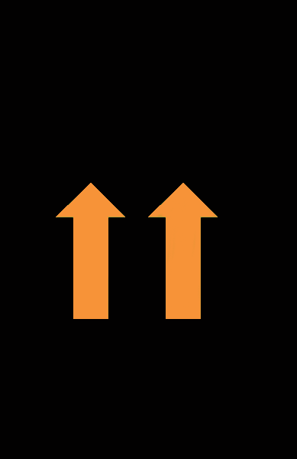
If you guess correctly, you will see orange up arrows and we add tokens to your bank. The single arrow adds a token for the small reward ($1) while the two arrows together add tokens towards the large reward ($10)

Slide 3
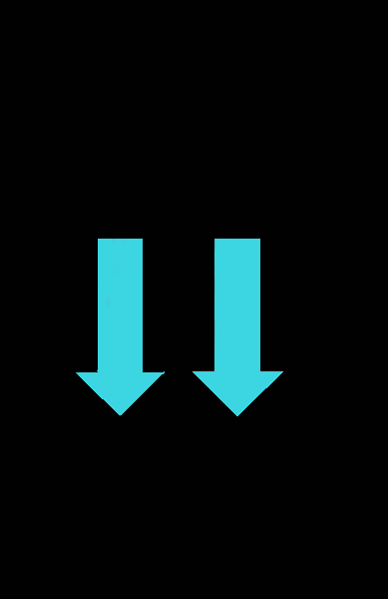
If you guess wrong, you see blue down arrows and we remove tokens from your bank. The single arrow takes a token for the small reward while the two arrows together takes a token for the large reward

Slide 4
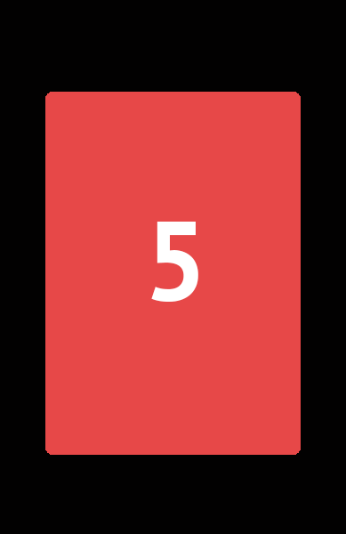

If the card’s value is 5, no tokens will be added or taken from your bank and you will just see a gray bar for feedback

Slide 5
If you have enough tokens at the end, the matching reward will be added to your bonus. You won’t be told how much you need to win or how much you’ve gained or lost so try hard on every trial.
If you have any questions please ask now.

