Slide 1

Air Quality during the Covid-19 Pandemic
Including an Analysis of how Traffic Patterns Impacted Air Quality
By: Gonzalo Reusch, Bill Troolin, Jasper Beachy, Matthew Rud, and Myles Miller

Slide 2

Scope
In this study we looked specifically at data for the Minneapolis-St. Paul Metro area
This study incorporates over 5,000 lines of data across all data frames
Data was obtained from the US Environmental Protection Agency, MN Department of Transportation, and the Covid Tracker Project sponsored by The Atlantic with data provided by state governments
Historical data was obtained as far back as 2015

Slide 3

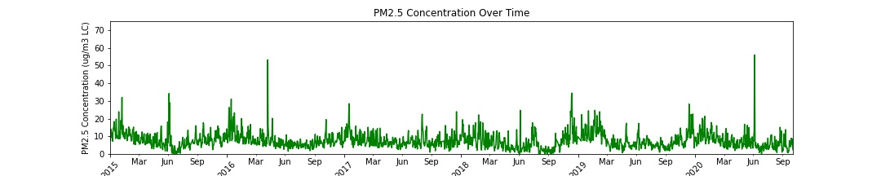
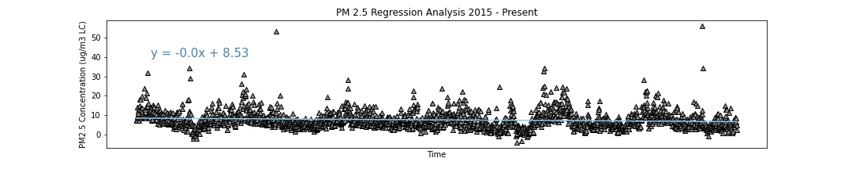
AQI Trends from 2015 to 2020
AQI has been shown to be in steady decline during the timeframe that we examined.
It is noteworthy to highlight that AQI seems to be season-dependent, with winter months having a spike in AQI and summer months being generally lower.
This likely stems from the increased burning of gas and coal in order to heat homes and businesses.

Slide 4
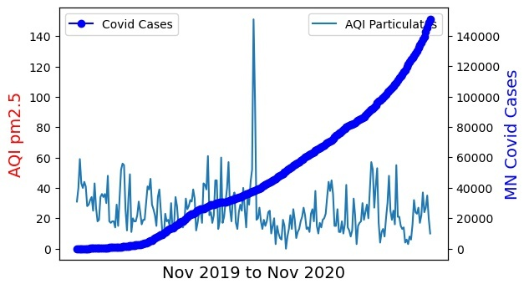
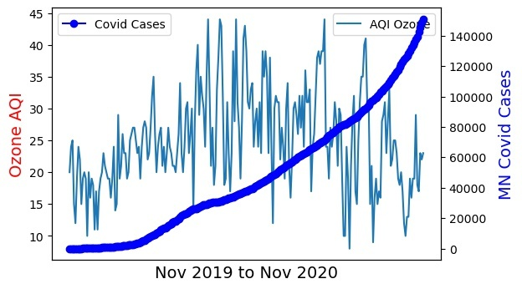
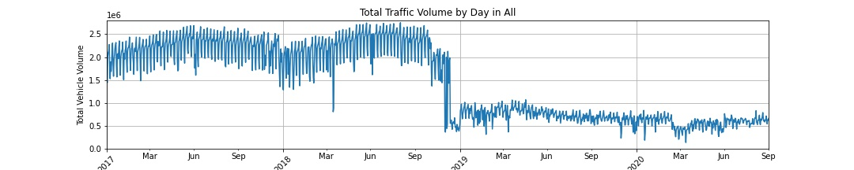
Covid-19’s Effect on Traffic Patterns and AQI
When analyzing the impact of the pandemic on traffic patterns in the MPLS metro area we saw a small decrease in traffic volume as Covid-19 cases rose.
When further analyzing the relation between Covid-19 and traffic patterns we also showed a very minor relationship.

Slide 5
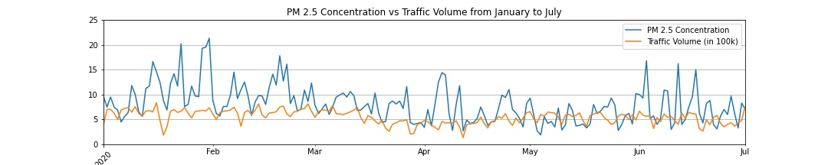
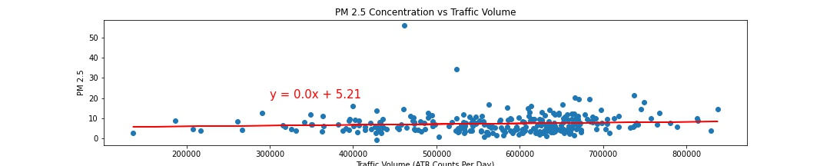
Traffic Patterns in relation to AQI
When analyzing traffic data in relation to AQI we saw a very minor impact.
While traffic trends seemed to decrease during the most significant part of the state-wide lockdown, AQI was only minimally effected; showing only minor smoothing of the variance observed prior to the virus impacting Minnesota.

Slide 6


Prediction of AQI for 2020 Based on Historical Trends
This is a work in progress, we have thus far succeeded in compiling a linear regression for AQI for the data set used. However, we’ve run into problems limiting the data used in the regression and then expanding this regression outside the given data set.
Of the data we have succeeded in compiling a linear regression for, we show a negative correlation between the advancement of time and AQI.
The formula we compiled is:
y=-0.0x*8.53
This correlation is quite weak.

Slide 7

Relationship Analysis between Data Sets
Our analysis shows that Covid-19’s infection rate in Minnesota only had a minimal impact on general traffic patterns, despite the stay-at-home order issues by the governor.
While traffic did see a slight decrease in the late-spring/early-summer it did not impact AQI in a significant manner and was shown to only have a minor correlation.
Generally AQI has slowly but steadily decreased(improved) over time. However this does not seem to be the result of individual habits.
Likely this improvement is the result of wider macro-industrial trends towards cleaner and more efficient operation, however more analysis is necessary.

Slide 8

Future Analysis
In what ways do seasons impact overall AQI, and is this a predictive measure for cities sharing a similar climate?
What wider macro-level trends have contributed to the low but consistent improvement in AQI?
What consumer and industrial habits have the most impact on AQI, and how can these be improved upon to improve the air we breath?

Slide 9
Tools Used in Analysis
We employed various analytic tools throughout this project.
These include: Python, Pandas, Matplotlib, Excel, Jupyter Notebook, VS Code, and several APIs

Slide 10
Questions?

