Slide 1

World Happiness Index
Vs.
Various Socioeconomic Data
(Health, GDP, Suicide Rate, Refugee Numbers, Pop. Growth)

Slide 2


Getting the Data
Kaggle: World Happiness Index
Gapminder.org
Suicide Rates
Refugee Numbers
Military Expenditures
Children out of school
Population growth

Slide 3
Cleaning the Data
Removing empty or N/A cells
Removing columns of years with no happiness index to compare to in long datasets
Trimmed down 200 years of GDP data

Slide 4
Cleaning the Data Continued
Combining CSV’s with yearly values from gapminder
1 csv file per year with combined happiness and socioeconomic data
Easier to analyze data this way
Experimenting with different formats to more easily read data into PostgreSQL (yearly tables vs one master table with yearly columns)

Slide 5
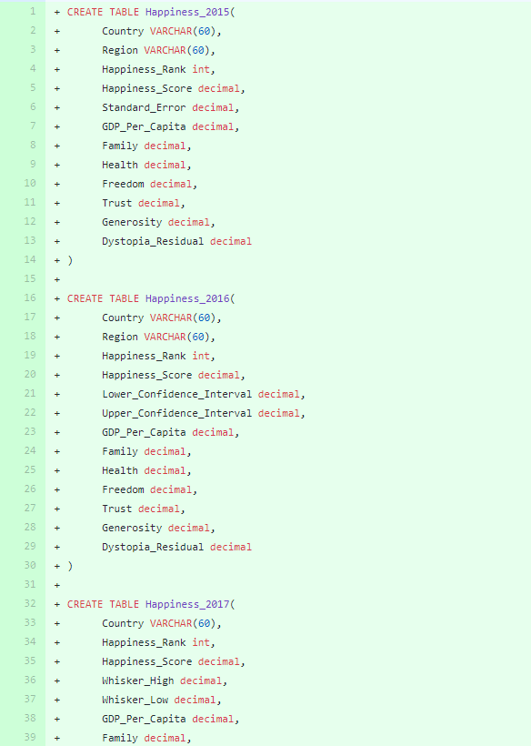
Putting the data into PGSQL
Import into PostgreSQL database
Create tables for each year of happiness
Tables include other values such as:
Suicide
Refugee rates
Military budget
Population growth
Children out of school

Slide 6
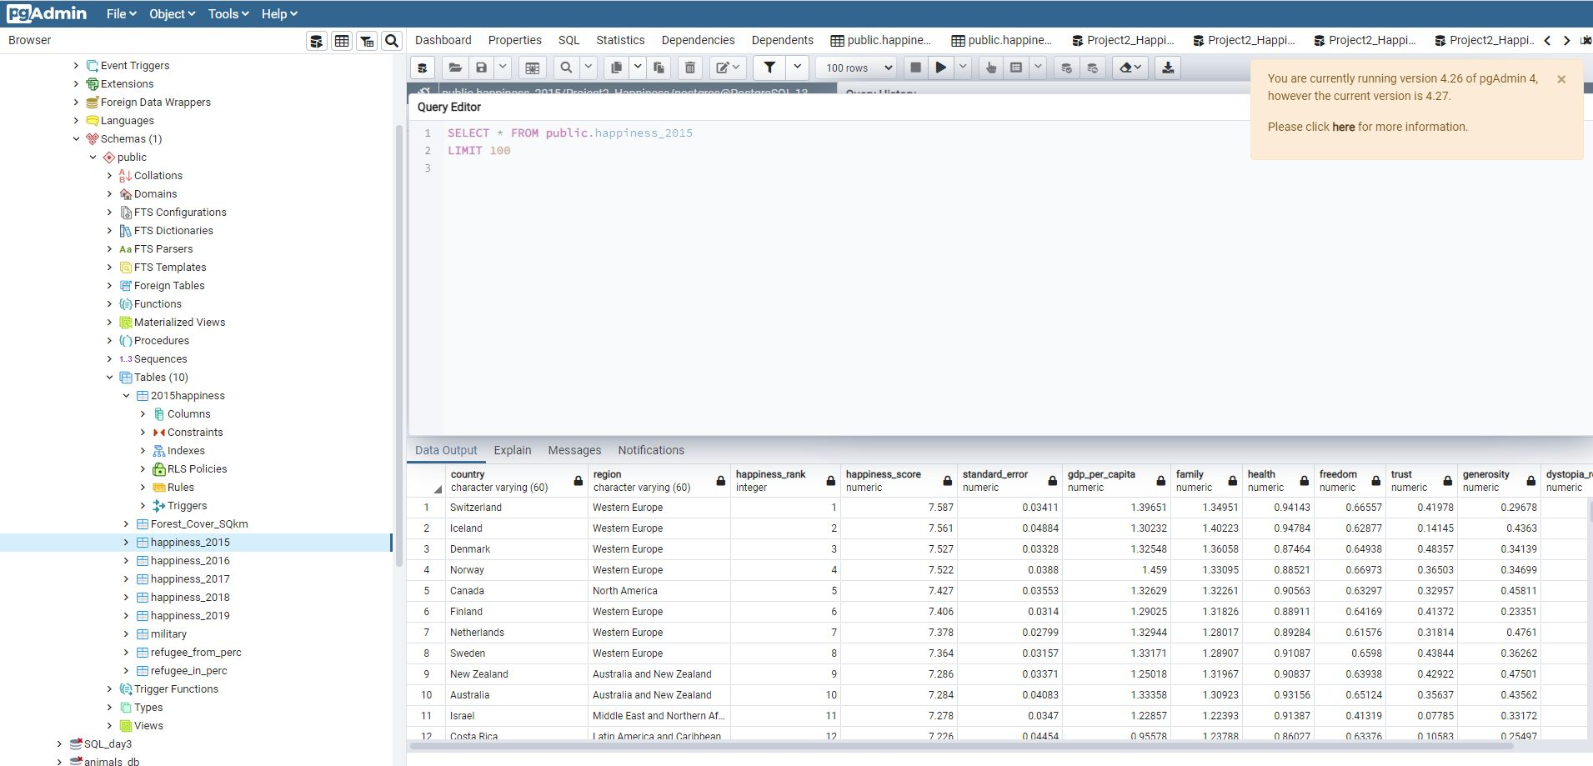
Creating Tables for happiness and related data

Slide 7
Questions & Shortcomings
Other questions to ask:
What factors are the largest impactors of happiness?
Are the factors the same over space and time?
Why does the corruption index impact happiness the way it does?
Potential shortcomings:
Happiness index is based on a list of variables; may not be all inclusive

Slide 8

Questions?

