Slide 1

TEXT CLASSIFICATION WITH MACHINE LEARNING
Predicting News Article Topics Using Linear Models, RNNs, and Transformers
By: Jonathan Beck

Slide 2
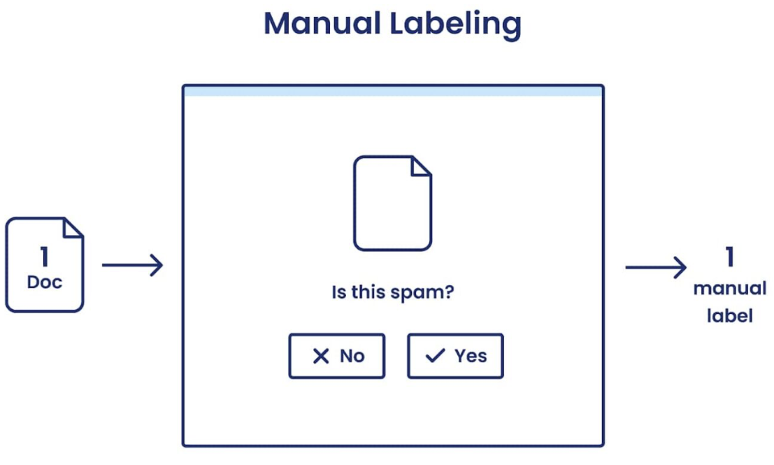
Business Problem & Objectives
Why This Problem Matters
Organizations ingest massive volumes of text every day
Manual labeling is slow, inconsistent, and expensive
Automated topic classification improves:
Content recommendation
News aggregation
Trend monitoring
User experience
Core Question: "What modeling approach provides the optimal balance of accuracy, cost, and complexity for accurately classifying news articles?"
Notes:
quick read through report

Slide 3
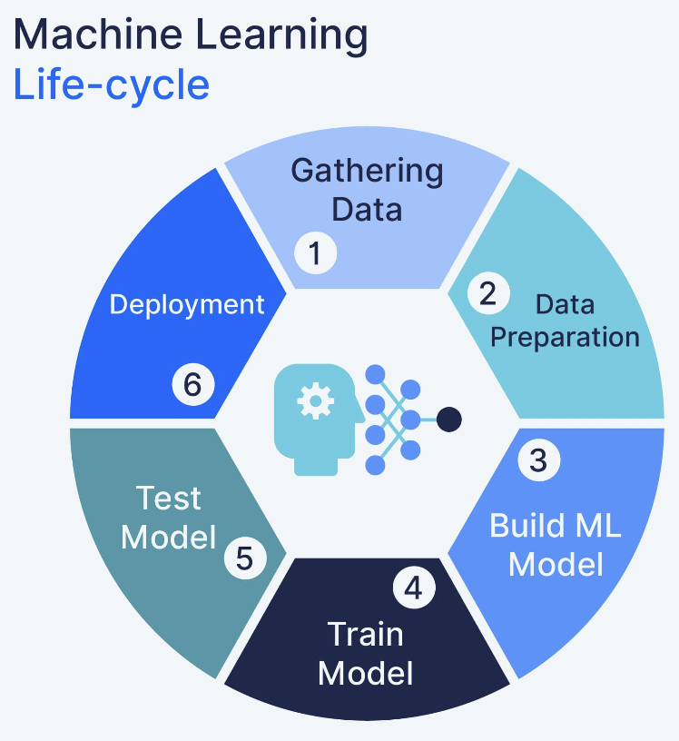
Project Goals
Build a clean and auditable preprocessing pipeline
Standardized text fields
Controlled feature variations (title-only vs description-only vs both)
Establish defensible baseline performance
Naive Bayes
Regularized Logistic Regression
Evaluate advanced architectures
LSTM-based RNN
RoBERTa Transformer (transfer learning)
Compare accuracy, runtime, and practicality
Identify the "best" model for real-world deployment, not just accuracy.
Notes:
quick read through report

Slide 4
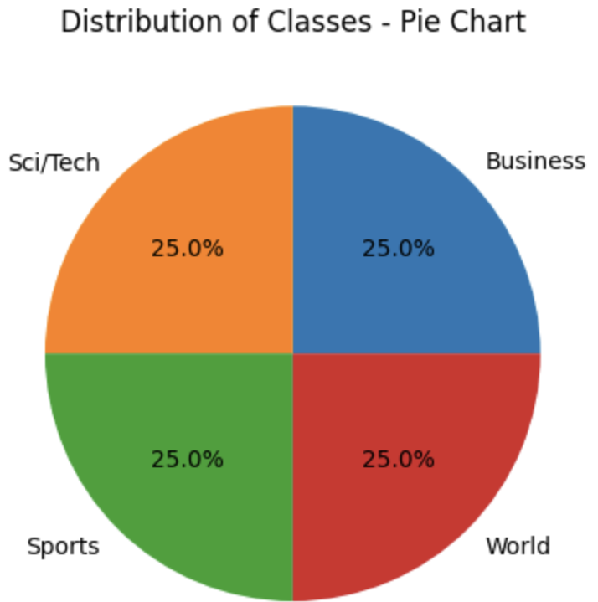
Data Overview
AG News Dataset (Kaggle)
120,000 training articles
7,600 test articles
Perfectly balances across four classes:
World, Sports, Business, Sci/Tech
Key Properties
No missing values
Structured text fields
Titles = short, sparse signals
Descriptions = richer, more informative

Slide 5
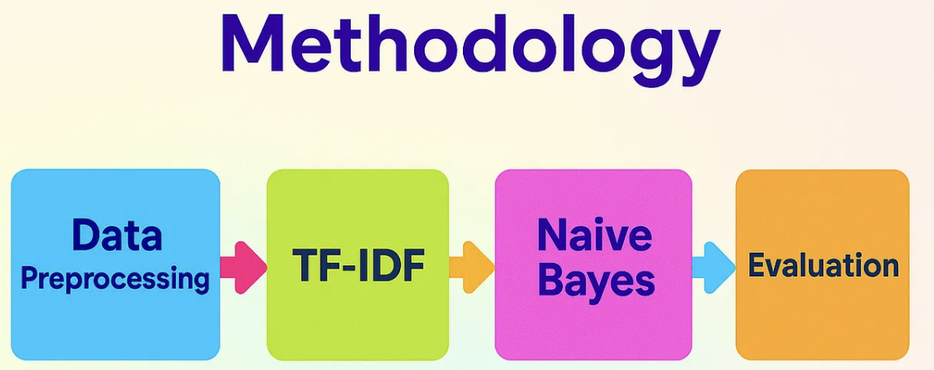
Preprocessing & Design: Baseline Models
Naive Bayes (TF-IDF)
Text normalization
Unigram + bigram tokenization
Stop-word removal
Vocabulary capped at 30K, ranked by term frequency across corpus
determines number of columns in feature matrix (regularization control)
TF-IDF Weighting
Higher score implies token is important to document
Downweights tokens found frequently across corpus
L2 normalization
ensures model not biased by document length
Sparse matrix
Shape (n_documents, 30K)

Slide 6
Preprocessing & Design: Baseline Models
Logistic Regression (TF-IDF)
Similar text preprocessing as Naive Bayes
Two stage 5-Fold Stratified Cross Validation Grid Search to speed up training and fine-tuning
First Stage: Fine-tune logistic regression parameters
Unigrams + top 20K features
Solver set to lbfgs (well-suited for high dimensional spaces), L2 (ridge) penalty term and a search through four regularization, C, terms to control how heavily the model penalizes large weights on the features
Second Stage: Apply logistic parameters to determine optimal TFIDF column length and n-gram range

Slide 7
Preprocessing & Design: Deep Learning
RNN (LSTM)
All terms across corpus tokenized and normalized, token frequencies counted and ranked to assign IDs to each token
Top 30000 kept (number of embeddings learned across entire corpus - regularization)
Sequence tokenization at embedding layer
200 tokens per input sequence (time steps per article)
Shorter articles padded with zeros, longer articles truncated
LSTM (128 units)
Compresses all text embeddings into single vector of length 128 to be fed into classification head
Transformer (RoBERTa)
Subword tokenization
Smaller segments of words mapped to pretrained RoBERTa vocabulary, which effectively enables model to handle any word
Max-length: 128 tokens (article token input length, provided tokes IDs)
Start and end tokens applied (boundary signals).
Enables use of first token embedding as summary vector (contextualized embedding for every token in article sequence)
Frozen pretrained backbone
768 neurons in dense feedforward network
Weights updated with a light learning rate (3e-5)
Multinomial classification head (softmax)
Early stopping (validation loss monitored, restore best weights if loss doesn't improve after two epochs

Slide 8
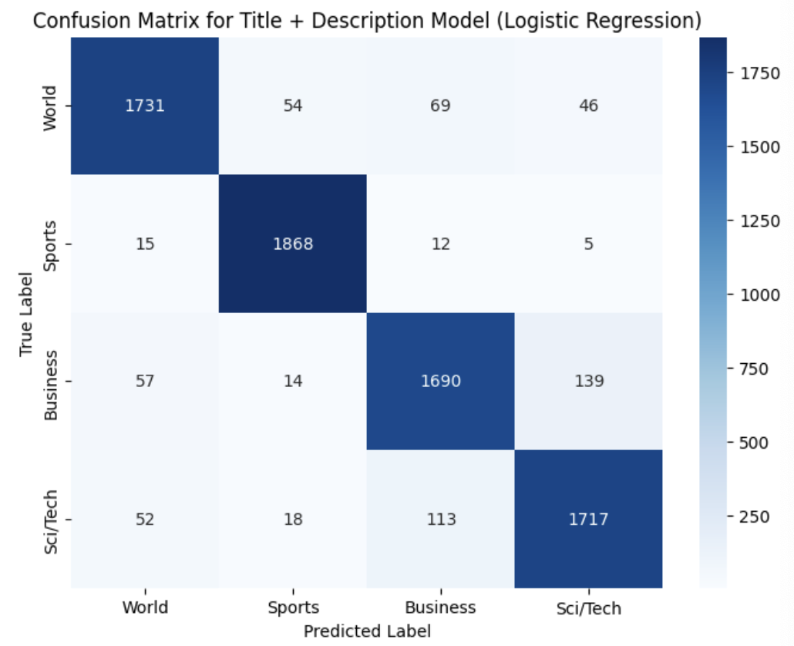
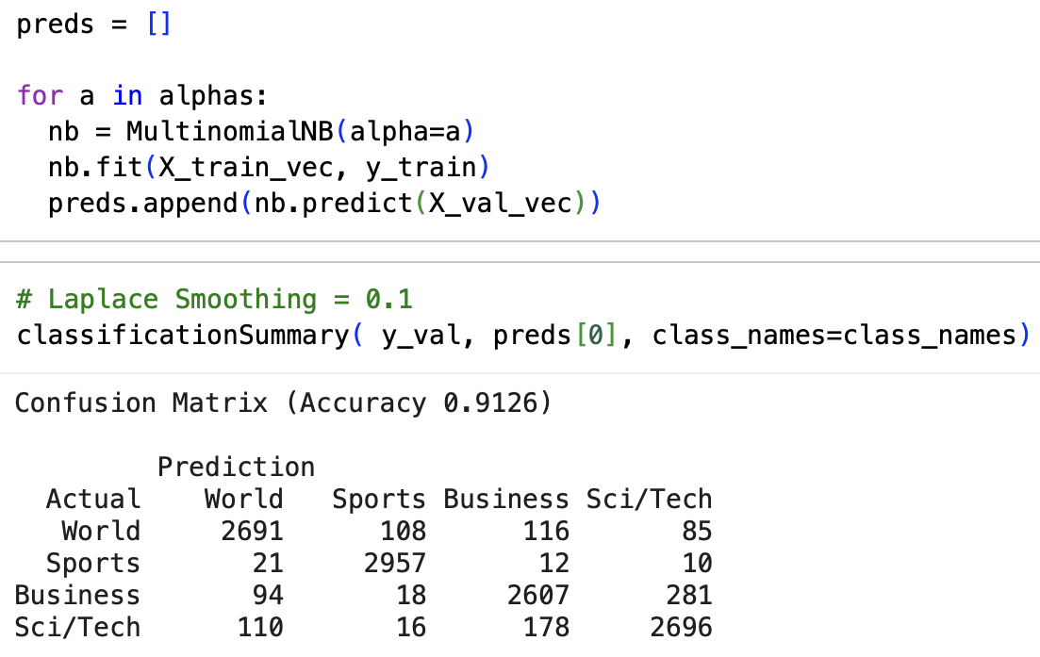
Baseline Model Results
Naive Bayes
Fast, interpretable, strong baseline
Best accuracy with title + description
Alpha = 0.1 performed best (light smoothing)
Logistic Regression
Outperformed Naive Bayes
Accuracy of ~ 92% on holdout test set
Best configuration: {C=1, L2 penalty, 40K vocabulary, Unigrams + bigrams}
Moderate shinkage of weights, prevents any weights being driven to zero entirely
Critical Insight: Combining text + description fields as predictors outperformed single-field models across the board.
Notes:
Light smoothing keeps probabilities close to raw terms

Slide 9
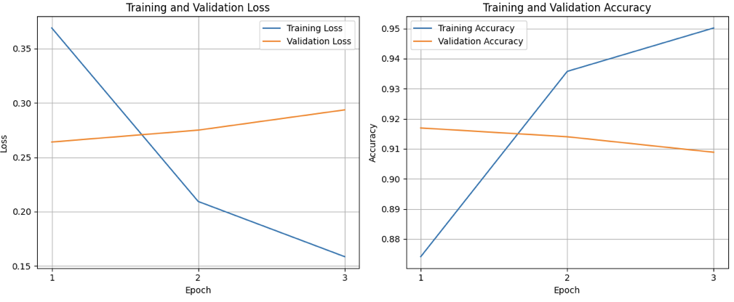
RNN (LSTM) Results
Why Use an RNN?
Captures sequential structure
reads sequence of article token inputs step-by-step
Learns contextual relationships
Single learned embedding representation of whole sequence fed into classification head
Disadvantages
Struggle with long range dependencies
Performance
Validation accuracy plateaued after 3 epochs
Similar to Logistic Regression in terms of accuracy
Significantly higher training cost
Takeaway: RNNs add complexity without meaningful performance uplift for this classification task.
Notes:
Downside: difficult looking "far back" in sequence: hard for model to use information from many time steps earlier

Slide 10
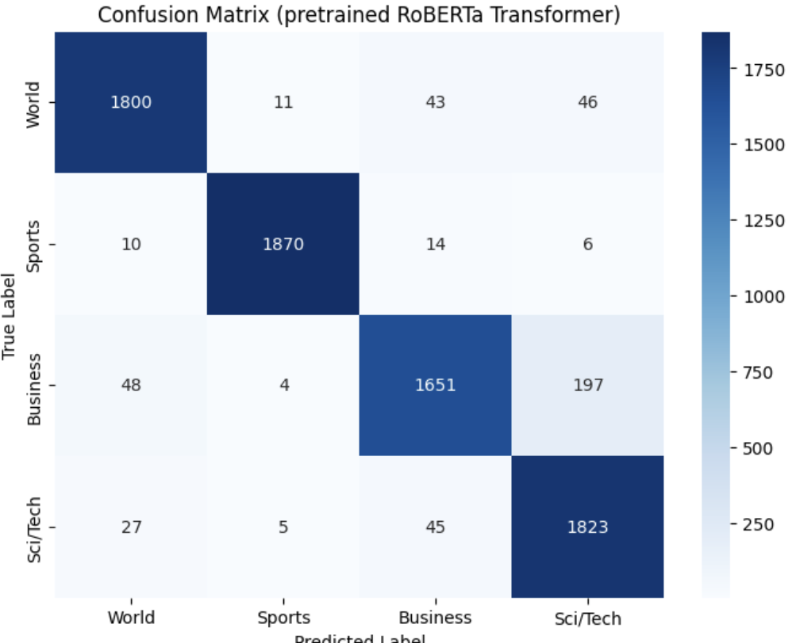
Transformer (RoBERTa) Results
Why RoBERTa?
Contextual embeddings
Learns long-range dependencies
Transfer learning: strong performance with limited training
Training Strategy
Frozen backbone + fine-tuned classification head
Early stopping after 3 epochs
Avoided full fine-tuning due to training cost: 45-minutes per epoch
Results
94% accuracy on unseen, test data
Balanced across all classes
Best overall performance.

Slide 11
Cross-Model Insights
Text Field Choice Matters
Title alone: limited signal
Descriptions: richer vocabulary, stronger boundaries
less overlap between class clusters
Combined fields: best performance across all models
Complexity vs Value
Logistic Regression
Fast, interpretable, high accuracy
RNNs
More complex, higher computational cost for no real gain
Transformers
Best accuracy, but highest computational cost
Practicality Depends on Use Case
High-stakes classification = Transformer; Fast and efficient deployment = Logistic Regression

Slide 12

Business-Oriented Recommendations
Recommended Baseline: TF-IDF + Logistic Regression architecture
High accuracy
Transparent decision rules
Minimal infrastructure requirements
Trains in seconds
When to Consider Transformers
Premium content recommendations
High-precision classification tasks
Scenarios where marginal accuracy gains justify cost
Strategic Guidance
Start simple & scale complexity only when business value demands it

Slide 13

Conclusion
Clean preprocessing pipelines matter
Linear models remain competitive
Deep learning is powerful but computationally expensive
Modeling selection is a strategic decision, not just a technical one
FINAL TAKEAWAY:A well-tuned Logistic Regression model offers the best balance of accuracy, interpretability, and efficiency, while Transformers provide the premium selection when cost is no barrier

