Slide 1


LIGHT-BASED ARTISTIC CONCEPTS SUBMISSION
Beetz, Jason
::Image
2019
Notes:
Important message from BLINK Creative Team:
Please email your final presentation as a PowerPoint document (NOT a PDF) to BLINKsubmissions@gmail.com with the subject line: “BLINK 2017 Submission – [Last Name], [First Name]”.

Slide 2

Artist Contact Information
Beetz, Jason
Contact Information
Artist or artistic group’s full name:
Jason Beetz
Email address*:
jbeetz@hotmail.com
Phone number: 859-443-4667
::Image
Concept Proposal Checklist**
€ Artist’s Biography
€ Previous Work Samples
(Up to 5 images with corresponding information)
€ BLINK Concept Proposal Description
€ BLINK Concept Proposal Supporting Images
€ BLINK Concept Proposal Location Request
(optional; location not guaranteed)
€ BLINK Concept Proposal Budget
€ $35 application fee
Visit BLINKcincinnati.com to submit payment
**All proposals must be received by January 28, 2019. Incomplete or late proposals will not be accepted.
To Apply, please download and submit the Light-Based Artistic Concepts Submission document via BLINKCincinnati.com/artistapplication.
*Our primary mode of communication will be email.
Please use the templates provided.
Any submissions that do not use the provided templates will not be reviewed.
Questions: Contact Liz Miller, ArtWorks
Liz@artworkscincinnati.org / 513.333.3608

Slide 3
Artist Biography
Jason Beetz
born 1974
BFA Painting Massachusetts College of Art 98
Post-Baccalaureate Study Brandeis University 99
Worked primarily in oils / gouache until 2010.
All images are representative from 1998 - 2010.
Currently working in Information Technology, passionately developing web-based approaches to modern life.
Early influences
Cubism
Bonnard
Matisse
Diebenkorn
Current Projects
www.mshrwb.com (as part of this application)
Transforming words into images using Advanced Text analysis, Image recognition, human interaction.
www.varproto.com (coming soon)
An open lab for projects that interact with humans and computers using conventional and
non-conventional approaches

Slide 4
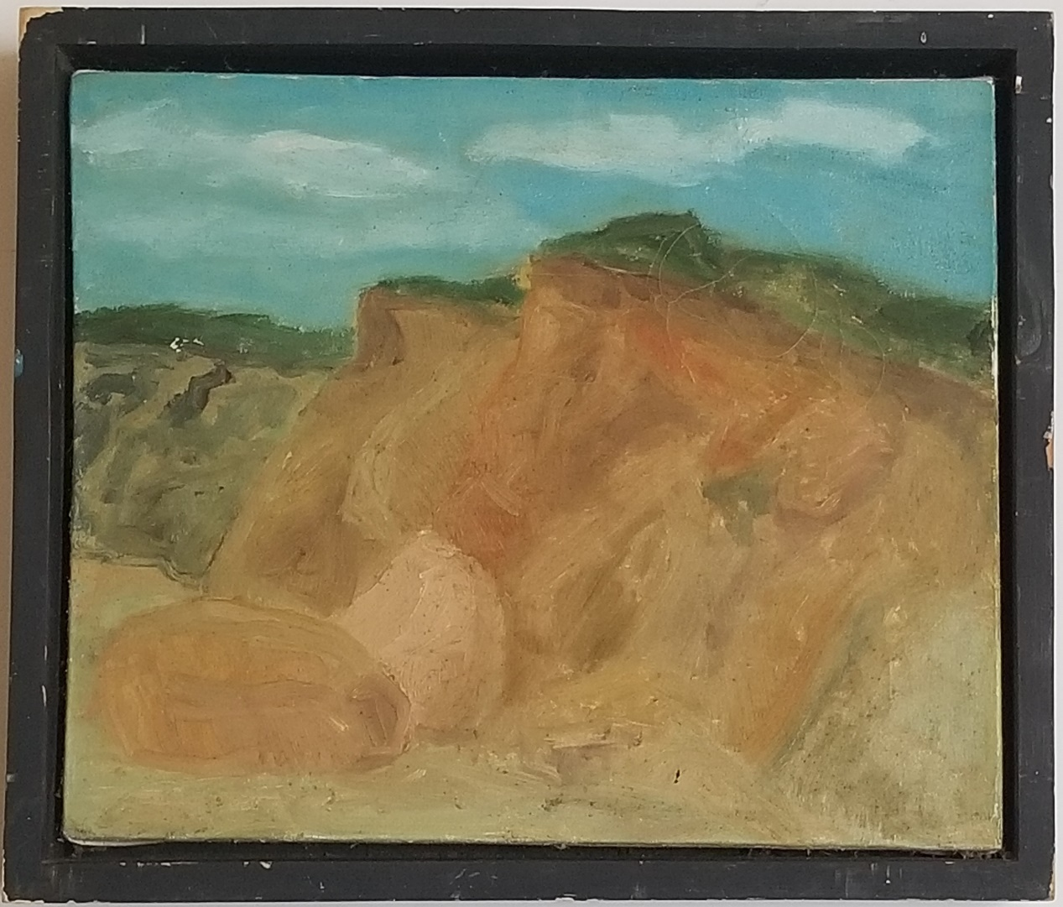
Previous Work (Please duplicate this slide to include up to 5 slides with submission)
Beetz, Jason
Lucy Vincent Beach
2000
Oil on canvas
18 X 15
Landscape painting representative of that period of my life.

Slide 5
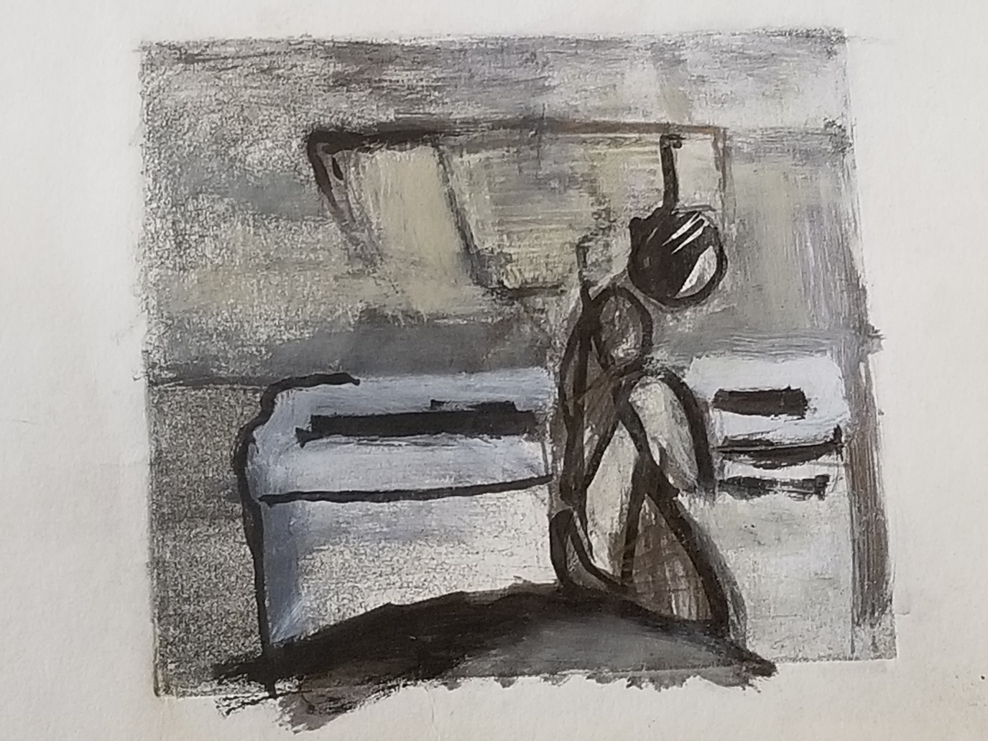
Previous Work (Please duplicate this slide to include up to 5 slides with submission)
Beetz, Jason
Kitchen 1
1998
Etching, reworked, mixed media
5.5 X 5 inches
Variations on a theme

Slide 6
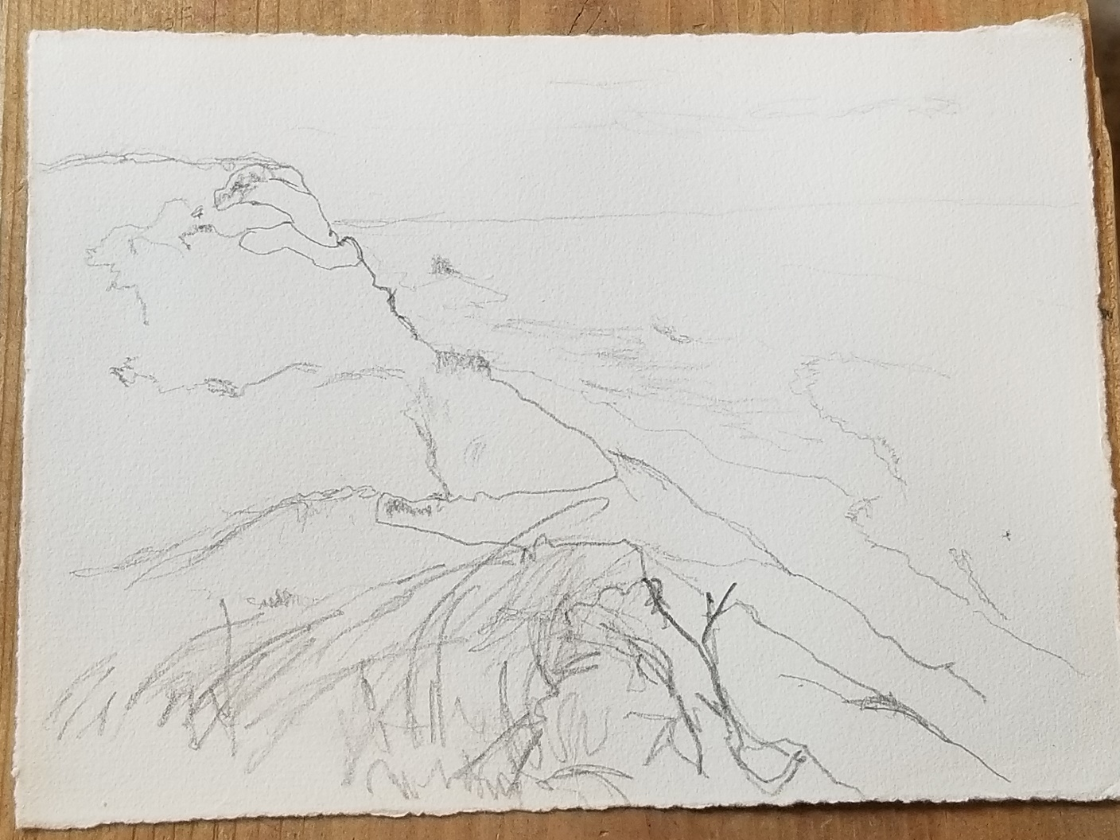
Previous Work (Please duplicate this slide to include up to 5 slides with submission)
Beetz, Jason
Ballston Beach, Truro MA
2005
Graphite on paper
10 X 7 inches
Landscape study, variations on a theme

Slide 7
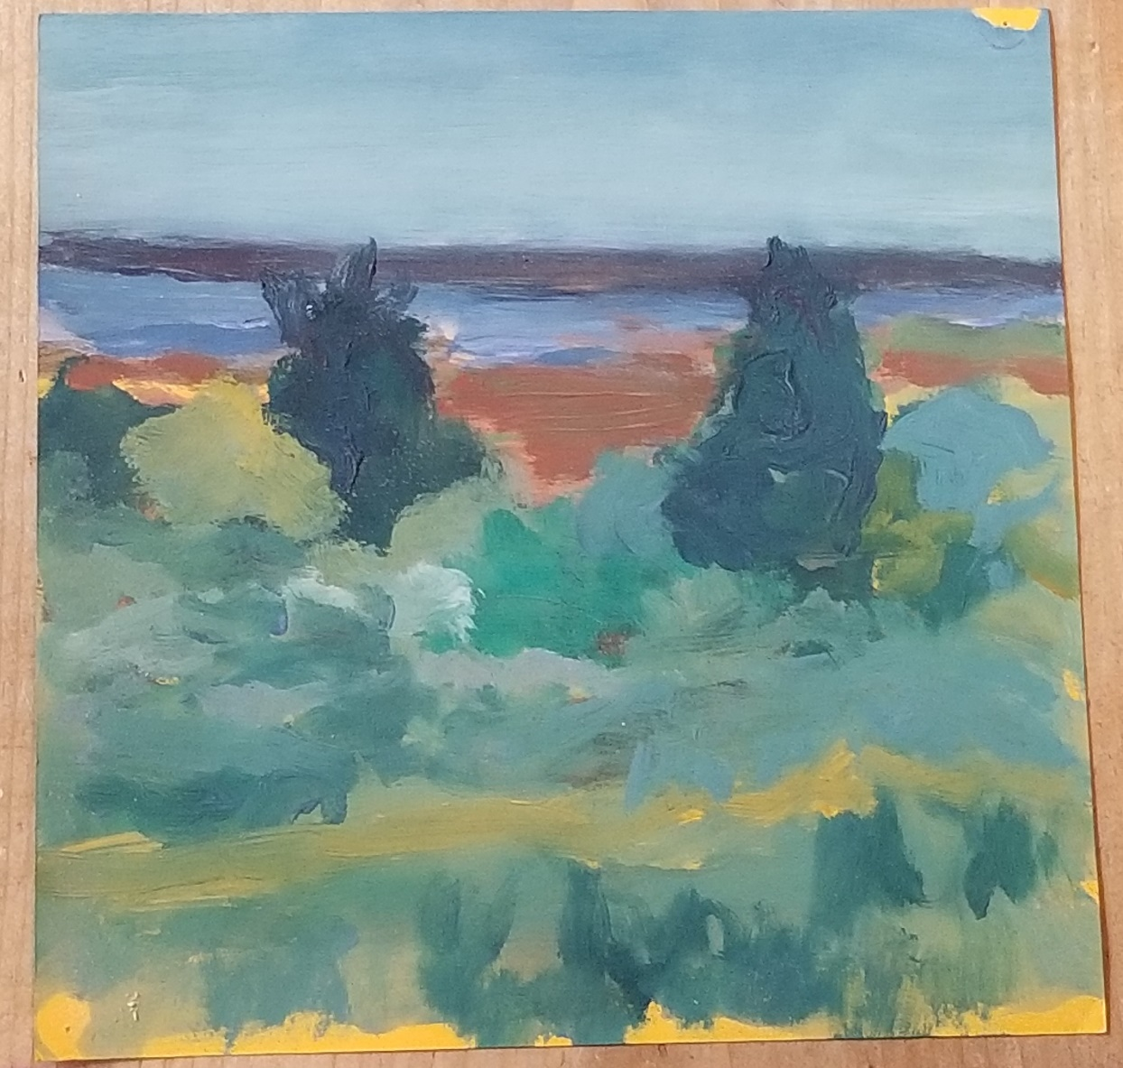
Previous Work (Please duplicate this slide to include up to 5 slides with submission)
Beetz, Jason
Indian Trace, Crowes Pasture
2005
Gouache on paper
8 X 8 inches
Landscape study, variations on a theme

Slide 8
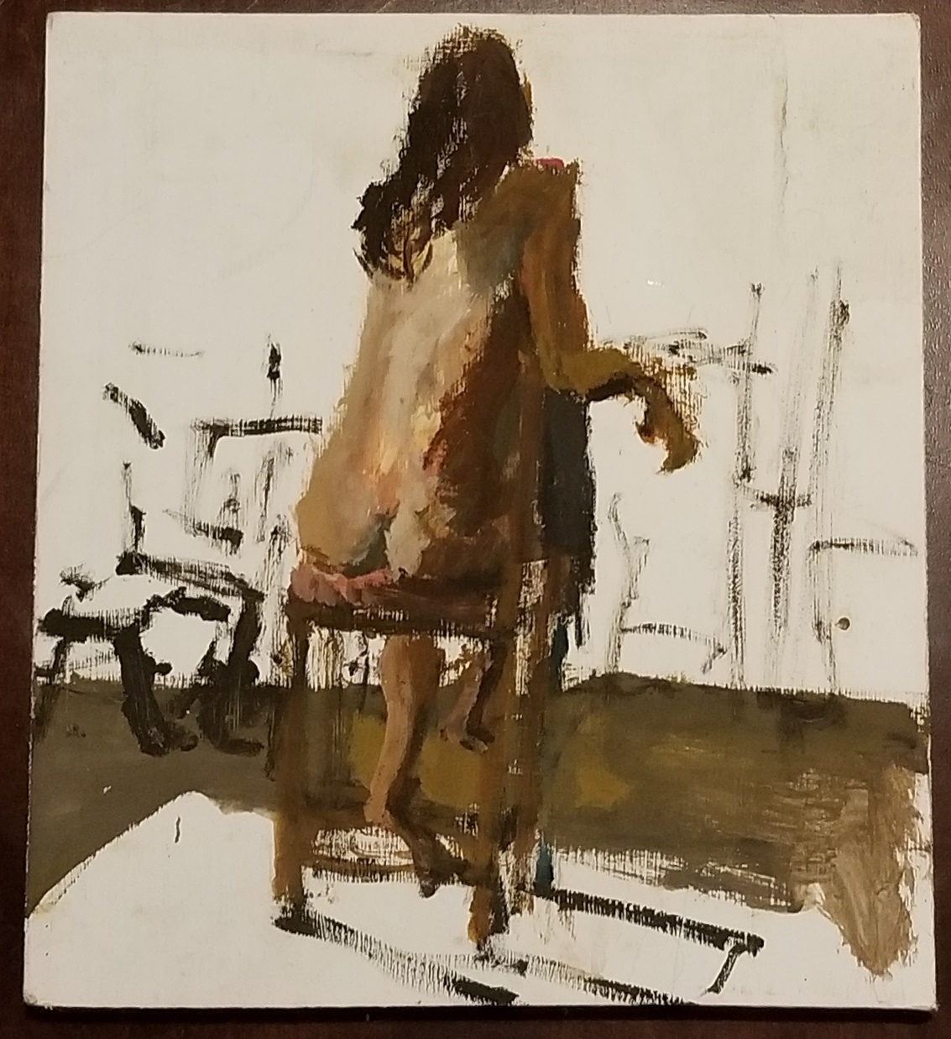
Previous Work (Please duplicate this slide to include up to 5 slides with submission)
Beetz, Jason
Model Sketch
2005
Gouache on wood
10.5 X 12 inches
Model study, variations on a theme

Slide 9
BLINK Concept Proposal Description
Example website: https://mshrwb.com
Concept
::Image is a web based application that provides interactive image curation / projection.
::Image connects Blink Festival Attendees to images shared by artists from around the world.
::Image aggregates the Blink Festival Attendees into simple metrics, providing insight into Blink 2019.
Experience
::Image provides Blink Festival Attendees a means to contribute through an interpretive experience. Using modern web technologies, ::Image analyzes text based inputs and returns a subset of relevant images provided by the image service Unsplash. ::Image users then curate an image from the subset for projection. ::Image provides a means of commemorating the projection using an internet connected camera to save each projection. In this way, ::Image provides a Collaborative, Engaging, and Transformative experience.
Safety
::Image will insure only Blink Festival Attendees will be able to access and project images
::Image will provide content moderation / malicious user redirection
Physical Requirements
::Image requires 2 120 VAC outlets, Internet Service, one projector and one camera.
Additional Requirements
::Image will run on a Local Area Network sharing internet access, as such all ::Image services will be running on Amazon Web Services or equivalent.
Fair Use
As part of the conditions of the Unsplash API, a credit to the photographer and Unsplash must be displayed. An example of this can be found at https://www.mshrwb.com

Slide 10
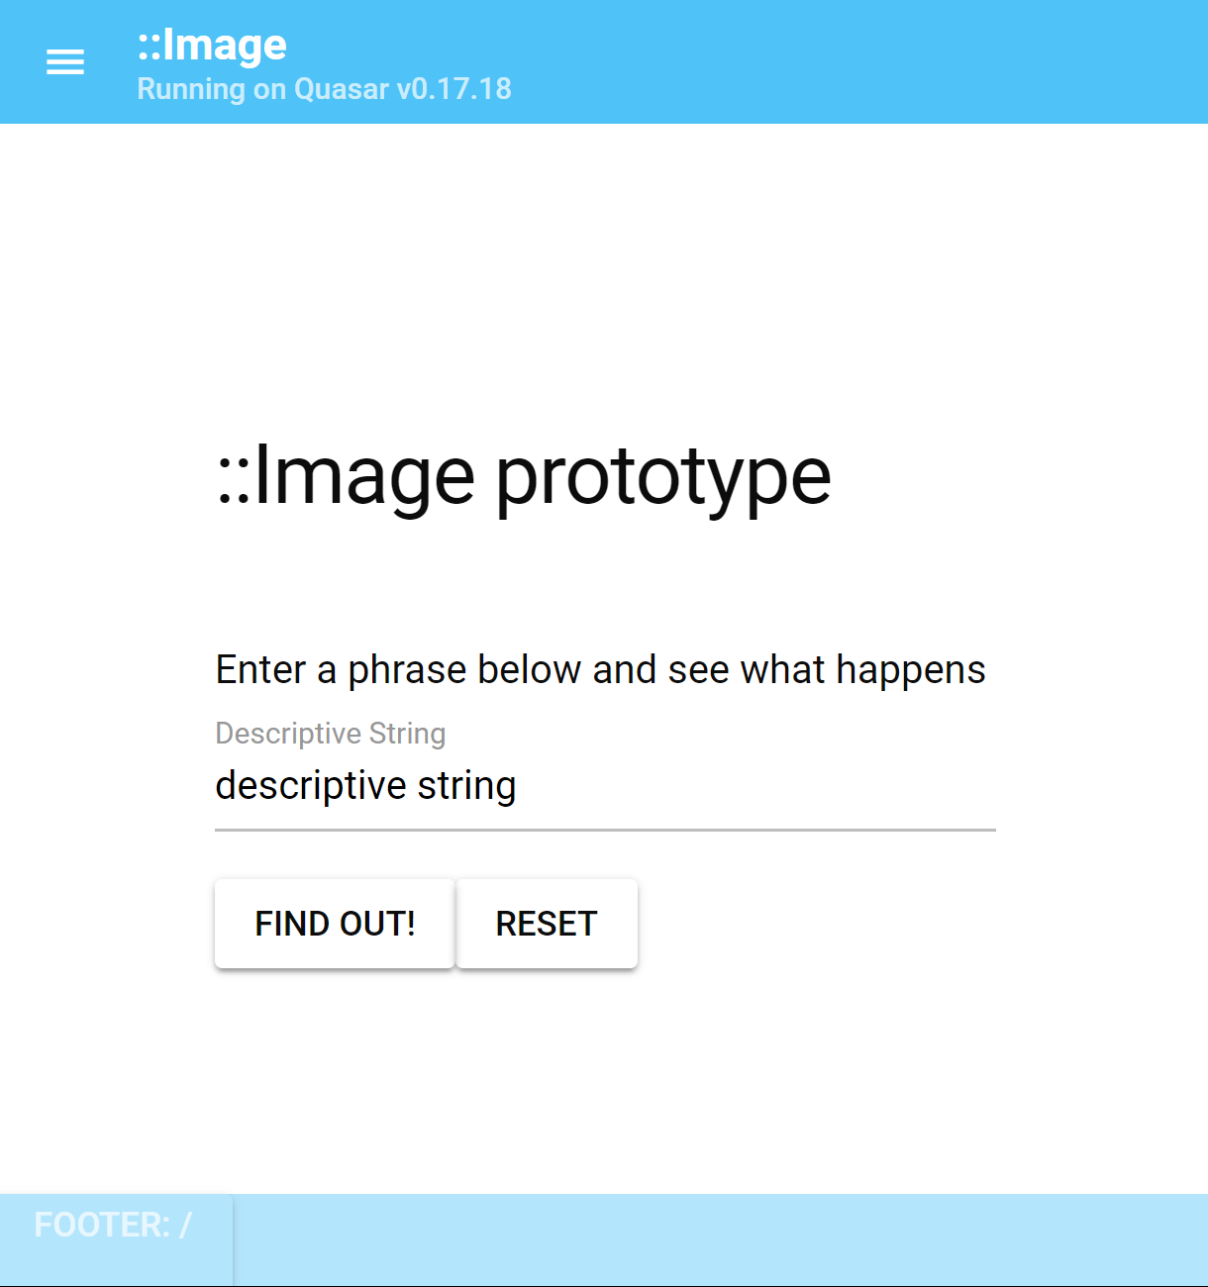
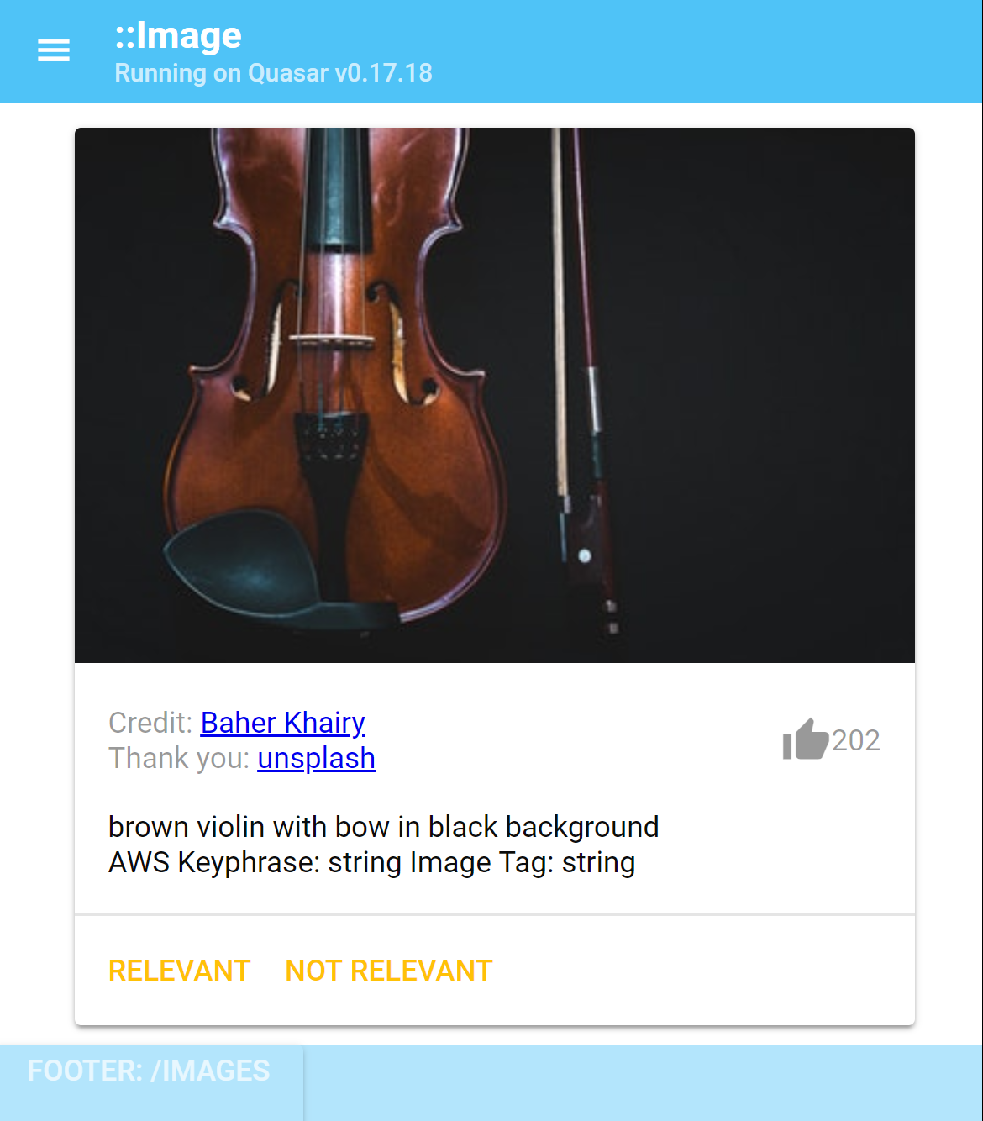
BLINK Concept Proposal Supporting Images (Please duplicate this slide to include multiple images, minimum 1 and limit 3)
https://mshrwb.com
Please keep in mind the Algorithm is under development
Screen elements, colors , number of images are all subject to change

Slide 11
BLINK Concept Proposal Location (Locations not guaranteed)
Projection / Blink Location
As this is an experimental application of technology, location of the projection can be at Blink's discretion. Projection surfaces should be relatively smooth. Projection scale can be any size, I was thinking slightly larger than human scale, at ground level. If possible, preference would be for the Newport or OTR locations.

Slide 12
BLINK Concept Proposal Budget (Double-click the Excel spreadsheet to edit or indicated if )
_X_Check here if you are seeking funds for your proposal from BLINK (If so, fill out the budget form below)
__Check here if your project is self-funded or has underwriting outside of BLINK.

Slide 13

Thank You for Your Submission!
For additional questions about this Call for Artistic Concepts,
please contact Liz Miller, ArtWorks BLINK Installations Program Manager
at liz@artworkscincinnati.org / 513.333.3608

