Slide 1
RISC Based Processor
Conner Bell, josh behlen, peyton owens

Slide 2
RISC
“one cycle execution time: RISC processors have a CPI (clock per instruction) of one cycle. This is due to the optimization of each instruction on the CPU and a technique called pipelining;
pipelining: a technique that allows for simultaneous execution of parts, or stages, of instructions to more efficiently process instructions;
large number of registers: the RISC design philosophy generally incorporates a larger number of registers to prevent in large amounts of interactions with memory.”
- Eric Roberts
https://cs.stanford.edu/people/eroberts/courses/soco/projects/risc/whatis/index.html

Slide 3
Relative Additions/Debugging

Slide 4
Phase Objectives
Phase I
Implement ALU and gate level logic capable of handling R-Type instructions
Phase V
Phase II
Phase III
Implement D-Type and B-Type instructions with the use of memory
Phase IV
Implement IO components and a separate memory block exclusive to memory
Implement R-Type instructions based on hardcoded input data
Implement any additional IO, create a program for your processor

Slide 5
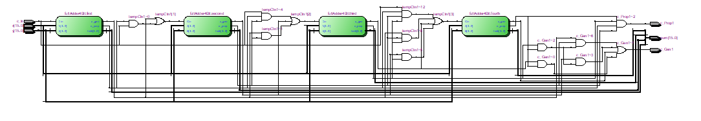
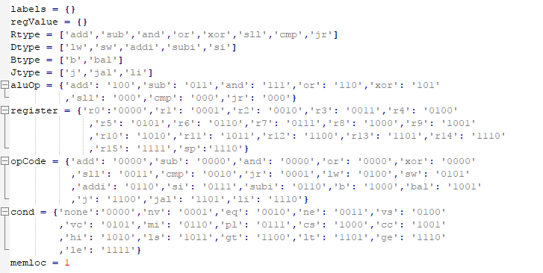
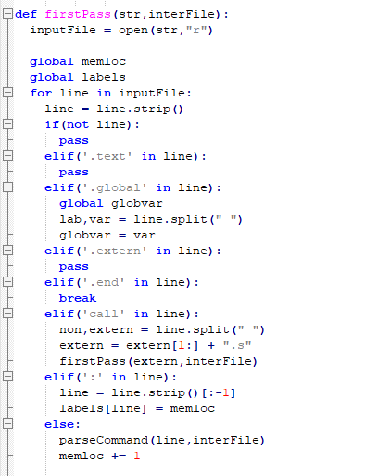
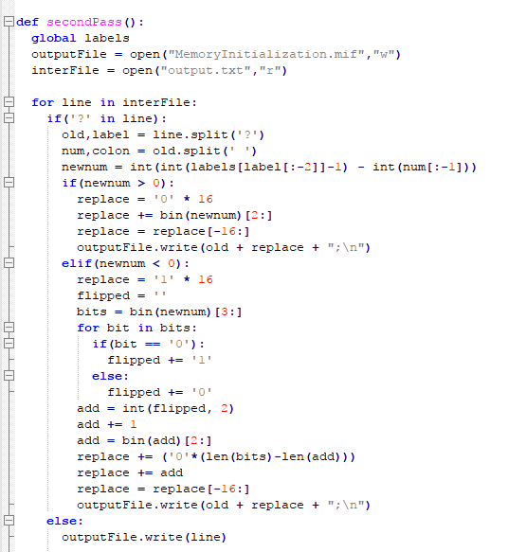
Assembler/ Carry Look Ahead Adder
Assembler: Written in python; DOUBLE PASS
Adder Ingredients: 1 Full adder, 4 four bit adders

Slide 6
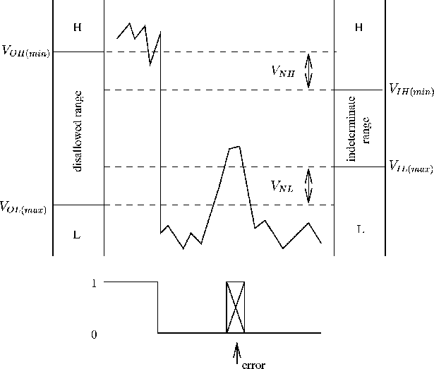
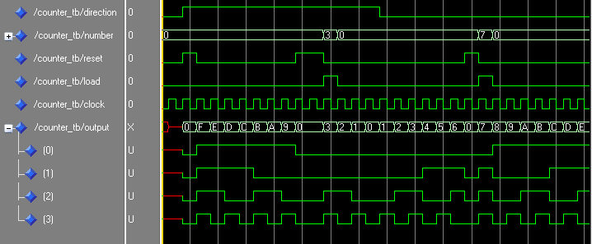
Difficulties
Noise/indeterminate voltage
Unused/junk data
https://commons.wikimedia.org/wiki/File:Counter_Final.png
http://users.cecs.anu.edu.au/~Matthew.James/engn2211-2002/notes/digdevnode4.html

Slide 7
Extra Credit:
Assembler
Carry Look-Ahead Adder
3 Additional Hex displays
Red LEDs
J (jump) instruction
Timer (loading bar)

Slide 8
Final Product
demonstration

