Slide 1
MLB Trade Deadline
Impact Model
Estimating excess returns from 2025 deadline activity
using a CatBoost counterfactual framework
April 2026

Slide 2
162 games
30 teams | 2 leagues | July 31 trade deadline
The Deadline
Teams either buy (add players) or sell (trade away players)
before July 31, reshaping rosters for the second half
The Question
How much did those moves actually matter in 2025?

Slide 3
Addressing Critiques
What we cannot claim and why that is okay

Slide 4
Key Limitations We Acknowledge Up Front
1. This is not pure causal identification
  Every historical second half we trained on was itself affected by that year’s deadline moves
  The model learns ‘average deadline effects’ as part of the baseline
  Our delta measures deviation from historical peer expectation, not a clean causal estimate
2. Deadline activity is endogenous
  Good teams buy, struggling teams sell, first-half performance is correlated with the treatment itself
  Violates the exogeneity assumption of a formal ITS design, which is why we say ITS-inspired
3. We cannot observe the counterfactual
  We never see what a team would have done without their deadline moves
  Our projection is a model-based estimate — not a controlled experiment
The right interpretation: given a team’s first-half profile, how did they perform relative to historically similar teams?

Slide 5
Our Baseline & Model Choice
The Pythagorean Baseline
Why CatBoost?
Bill James formula from the 1980s, fundamental to baseball analytics
Win% ≈ RS¹·⁸³ / (RS¹·⁸³ + RA¹·⁸³)
Our baseline: use each team’s first-half cumulative R/G and RA/G as a flat projection for the second half
No model, no machine learning, just ‘you will continue at your current pace’
Used in every MLB front office as a sanity check. Our model must beat this.
Gradient boosting family: ensemble of decision trees, each correcting errors of the last
3 reasons we chose CatBoost over XGBoost or sklearn GBM:
  Native categorical feature handling — Team and Opp IDs handled without one-hot encoding
  Ordered boosting — prevents target leakage in gradient computation (Prokhorenkova et al. 2018)
  Built-in SHAP — principled feature selection without extra packages
Why not a regression tree? No ensemble = high variance, poor generalization
Why not linear regression? Cannot capture nonlinear interactions between features

Slide 6
Feature Engineering
What the model sees before the deadline

Slide 7
How We Use First Half vs Second Half Data
FIRST HALF
SECOND HALF
TRADE
DEADLINE
July 31
Aug 1 — Season End
April 1 — July 30
All 135 features computed here
Own team: batting, pitching, rolling avgs, trends, variance
Opponent: mirrored feature set for every opponent faced
Frozen at July 31 — zero leakage
Model generates predictions only
Actual results compared to projection
Gap = estimated deadline impact
(excess return)
⚠ Key point about opponent features: For every second-half game, the model uses that opponent’s first-half profile as the opponent features, not their actual second-half stats. This ensures the model only uses information that was available before the game was played.

Slide 8
135 Features — All From Pre-Deadline First Half
Own team batting (cumulative)
  R/G, OBP, SLG, OPS, HR/G, RBI/G, BB/G, SO/G, LOB/G, XBH/G, WPA, RE24
Own team pitching (cumulative)
  ERA, ER/G, H_allowed/G, HR_allowed/G, BB_allowed/G, SO_pit/G, HBP/G, WP/G
Pitcher splits (own + opponent)
  starter_ERA, bullpen_ERA, starter_IP%, bullpen_IP/G — captures who actually pitched
Rolling averages (15-game window)
  Same stats but over last 15 games only — captures recent form vs season average
WLS trend slopes
  Weighted least squares slope of key stats — is the team improving or declining?
Variance / consistency features
  q25, q75, IQR, coefficient of variation of R/G and run differential
Game context
  is_home, is_shortened_season, second_half_game_num, n_pre_games
Opponent mirrors
  Every own-team feature is mirrored for the opponent — doubles the feature space to capture matchup quality
Feature separation: RS model sees own batting + opp pitching. RA model sees own pitching + opp batting. W/L sees all.

Slide 9
Model Training
& Optimization
How we built and tuned three independent models

Slide 10
Hyperparameter Optimization — 175 Combinations
Three parameters tuned in the grid search:
  Depth (3–7): how many yes/no questions each tree can ask. Deeper = more complex but risks memorizing training data
  Learning rate (0.01–0.08): how much each new tree corrects previous errors. Lower = more careful, higher = faster but can overshoot
  L2 regularization (1–15): penalizes overconfident predictions. Higher = more conservative. Important for noisy game data
175 combinations evaluated on 4-fold rolling cross-validation. Early stopping: patience of 75 trees on validation set.
Model | Depth | Learning Rate | L2 Reg | Features | Optimal Trees
Runs Scored | 5 | 0.08 | 2 | 50 (SHAP) | 183
Runs Allowed | 4 | 0.08 | 3 | 77 (SHAP) | 134
Win/Loss | 6 | 0.05 | 3 | 114 | 358
Two-phase final retrain: Phase 1 finds optimal tree count (train 2005–2023, val 2024). Phase 2 retrains on full 2005–2024 with that exact count — maximizing recency before predicting 2025.

Slide 11
Performance Evaluation
RMSE, accuracy, confidence intervals, and statistical tests

Slide 12
What is RMSE and Why Does It Matter Here?
RMSE = √( (1/n) × Σ(actualᵢ − predictedᵢ)² )
expressed in runs per game
In plain language:
  On average, how many runs off is our prediction for a given game?
  Our RMSE of 3.05 means the model’s typical error is about 3 runs per game on the 2024 test set
Why this is near the theoretical ceiling — not a model failure:
  Li, Huang & Li (2022) review all published methods: MLB win/loss accuracy falls between 55–62%
  Baseball game outcomes are inherently noisy, a bad inning or hot streak cannot be predicted from pre-game stats
  The right comparison is not against zero, but against the Pythagorean naive baseline
Why RMSE over alternatives:
  vs MAE: RMSE penalizes large errors more, this is important because a big miss distorts team-level impact estimates
  vs R-squared: R² is misleadingly low for noisy game outcomes. RMSE is in interpretable units (runs)

Slide 13
2024 Held-Out Test Set: Model vs Pythagorean Baseline
3.0493
3.0730
57.96%
54.70%
Model RS RMSE
(2024 test)
Baseline RS RMSE
(2024 test)
Model W/L Accuracy
(2024 test)
Baseline W/L Accuracy
(2024 test)
Statistical tests: is the improvement real or sampling noise?
RS paired t-test: t = −2.10, p = 0.018 Model squared errors significantly lower than baseline (one-sided H₁: model MSE < baseline)
RA paired t-test: t = −2.93, p = 0.0017 Highly significant improvement in runs allowed prediction
W/L McNemar test: χ² = 7.31, p = 0.0069 Model correctly called 52 more games that the baseline missed
Paired t-test: squared errors compared per game (paired because both methods predict the same games). McNemar’s test: compares per-game W/L correctness between classifiers.

Slide 14
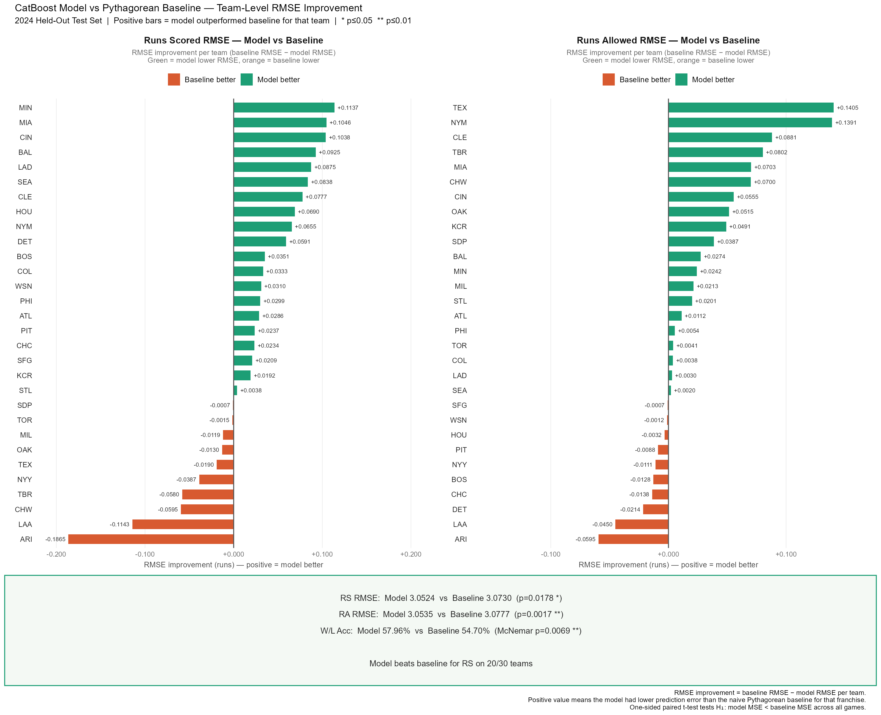
2024

Slide 15
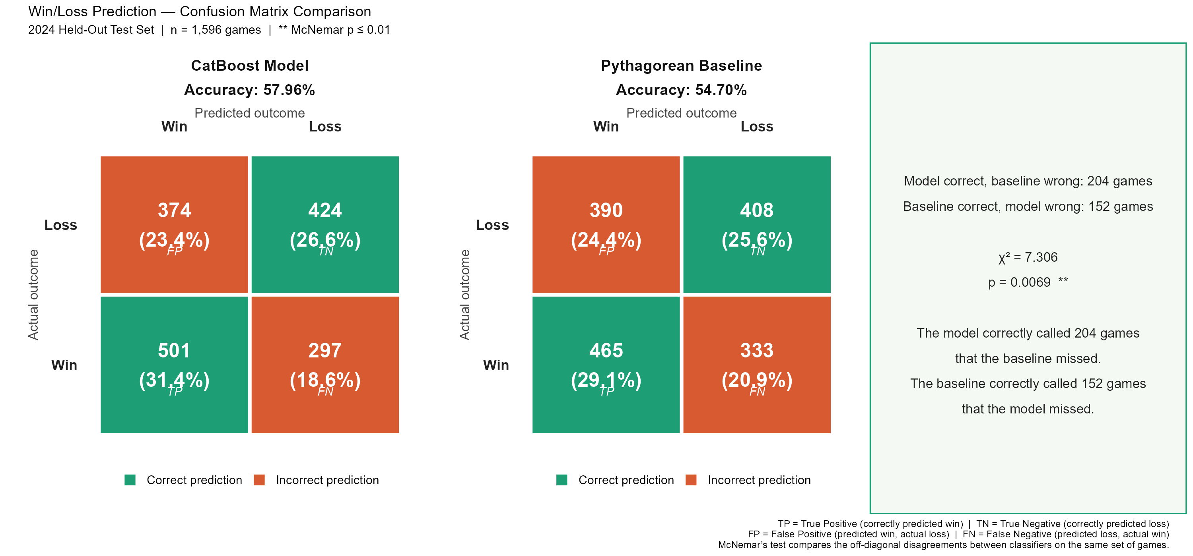
2024 Performance Visuals: Model vs Baseline

Slide 16
Confidence Intervals & Forecast Coverage Stars
RS/G CI = projection ± Z × (RMSE / √n)
Wins CI = proj_wins ± Z × √(Σ pᵢ(1−pᵢ))
For ~53 games per team: 90% CI ≈ ±0.70 R/G | 95% CI ≈ ±0.83 R/G | 99% CI ≈ ±1.09 R/G
For wins: SD ≈ √(53 × 0.25) ≈ 3.6 wins → 90% CI ≈ ±5.9 wins
***
**
*
(blank)
Within 90% CI
Within 95% CI
Within 99% CI
Outside 99% CI
Tightest band = best prediction
Outside 90%, inside 95%
Outside 95%, inside 99%
Model significantly missed
More stars = actual result was closer to the projection. NYM’s RS/G earned no stars — +1.12 R/G above projection was outside even the 99% CI.

Slide 17
2025 Impact Estimates
Excess returns for all 30 teams

Slide 18
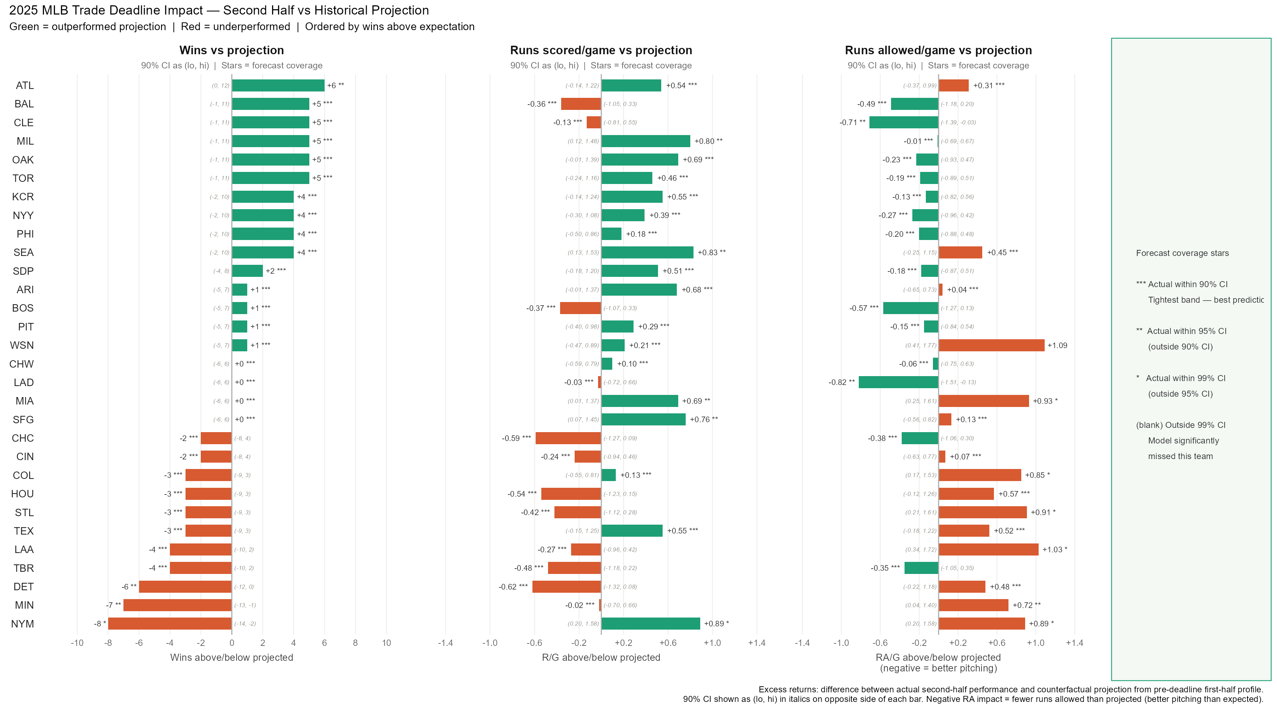
2025 Trade Deadline Impact: All 30 Teams
[INSERT: 2025_deadline_impact_summary.png]

Slide 19
Key 2025 Findings
Outperformed Projection
Underperformed Projection
ATL +6 wins
  Offense-driven: +0.54 R/G above projection
CLE +5 wins
  Pitching-driven: −0.71 RA/G below projection ***
MIL +5 wins
  Strong offense: +0.80 R/G above projection **
OAK +5 wins
  Both sides improved vs projection
NYM −7 wins
  +0.89 R/G— historic offense
  +0.89 RA/G = pitching collapse offset all offensive gains
MIN −6 wins
  Pitching collapse: +0.72 RA/G above projection
  Traded several players including pitchers
DET −5 wins
  Both RS and RA underperformed despite adding Morton & Finnegan

Slide 20
Individual Team
Deep Dives
ITS-style panels with trade annotations

Slide 21
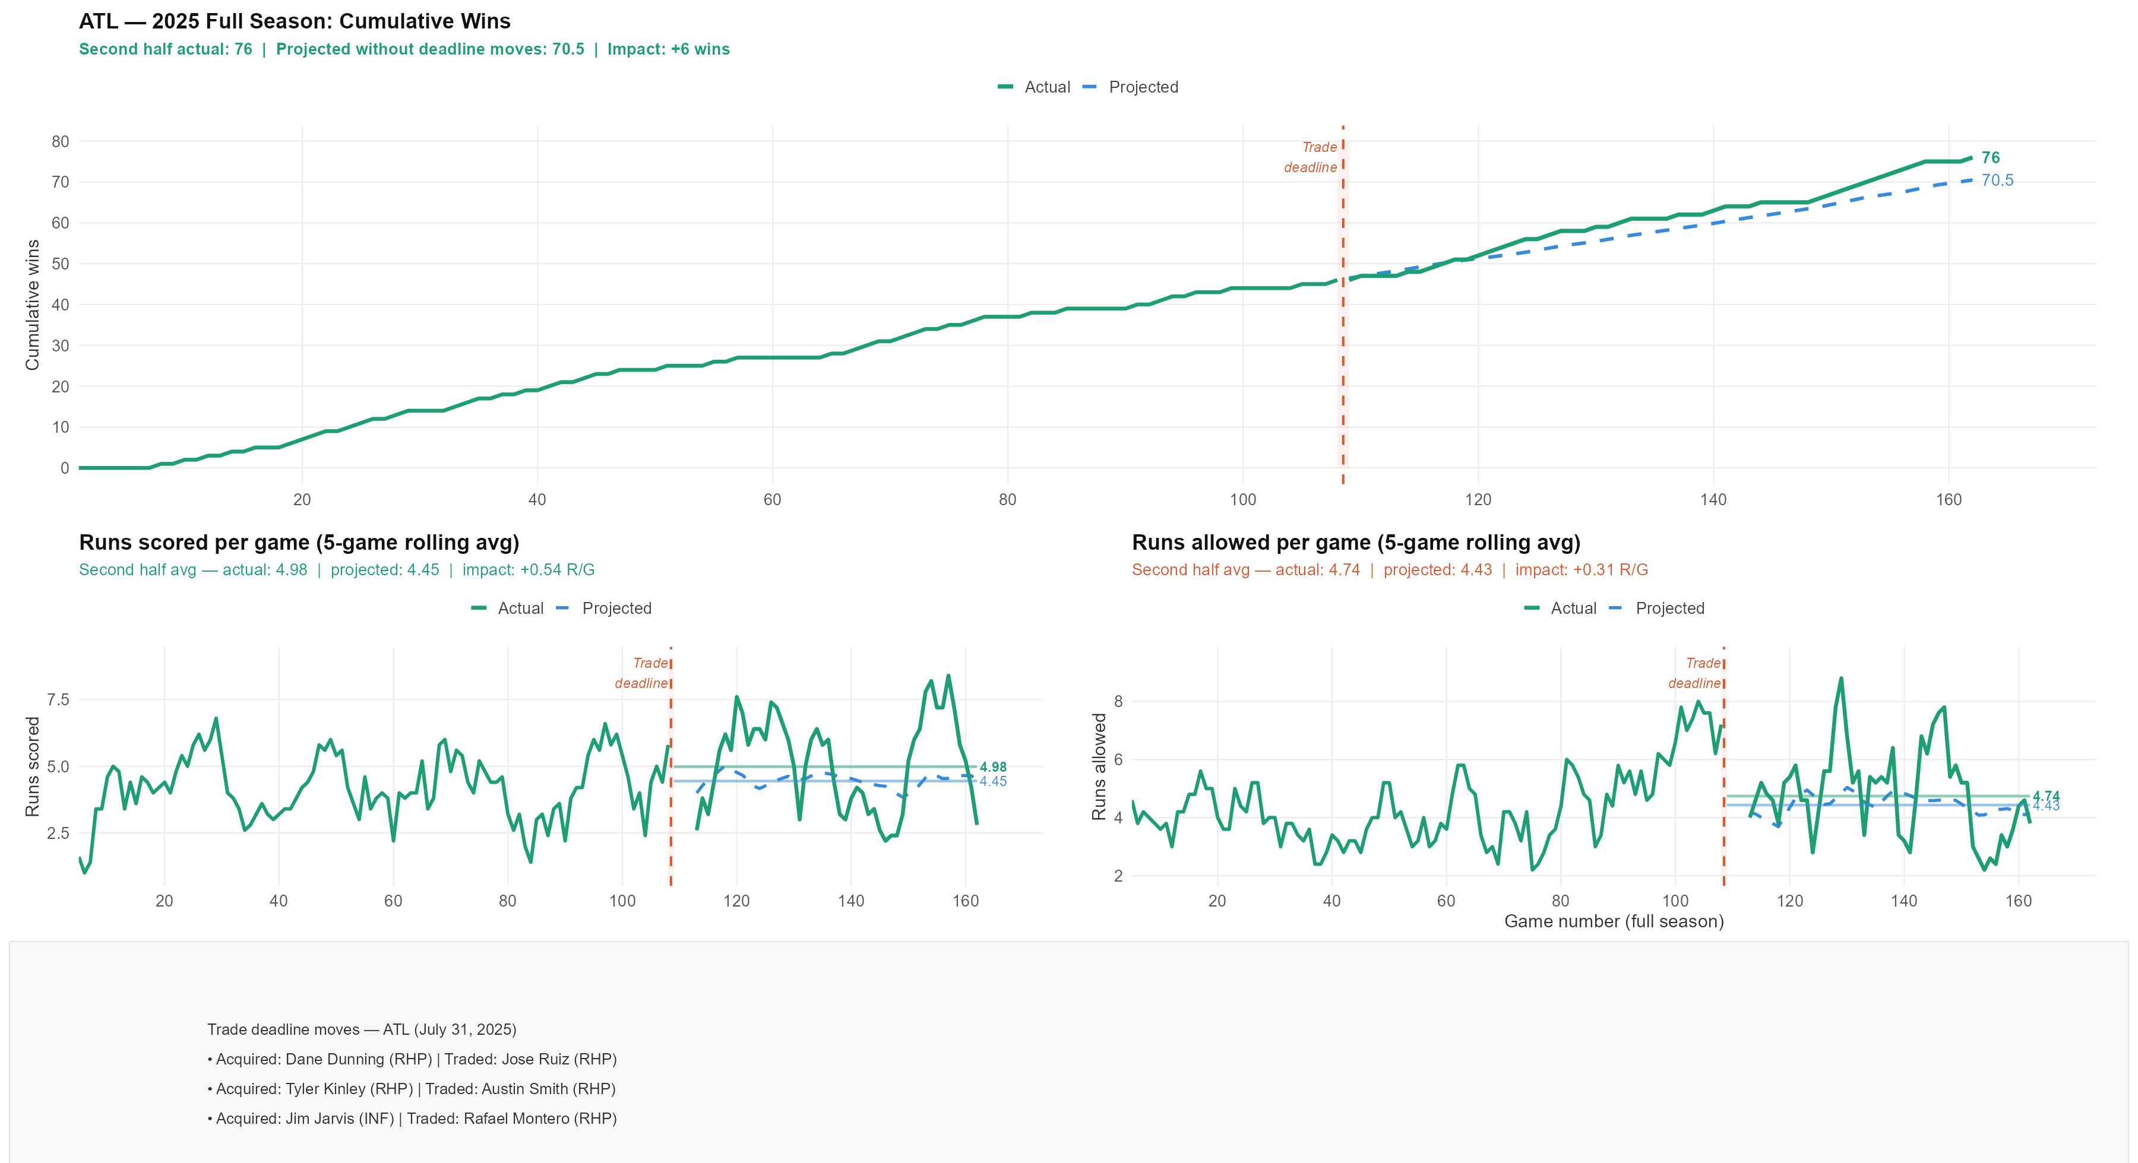
Team Deep Dive: ATL
[INSERT: NYM_2025_its_panel.png]

Slide 22
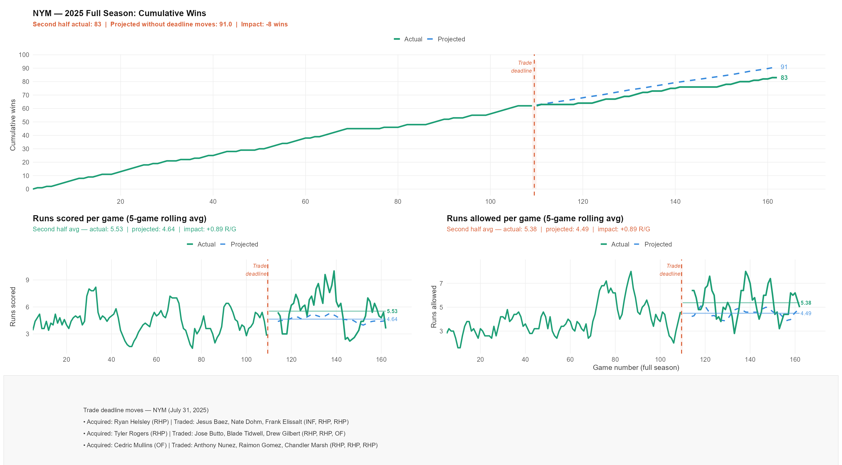
Team Deep Dive: NYM
[INSERT: CLE_2025_its_panel.png]

Slide 23
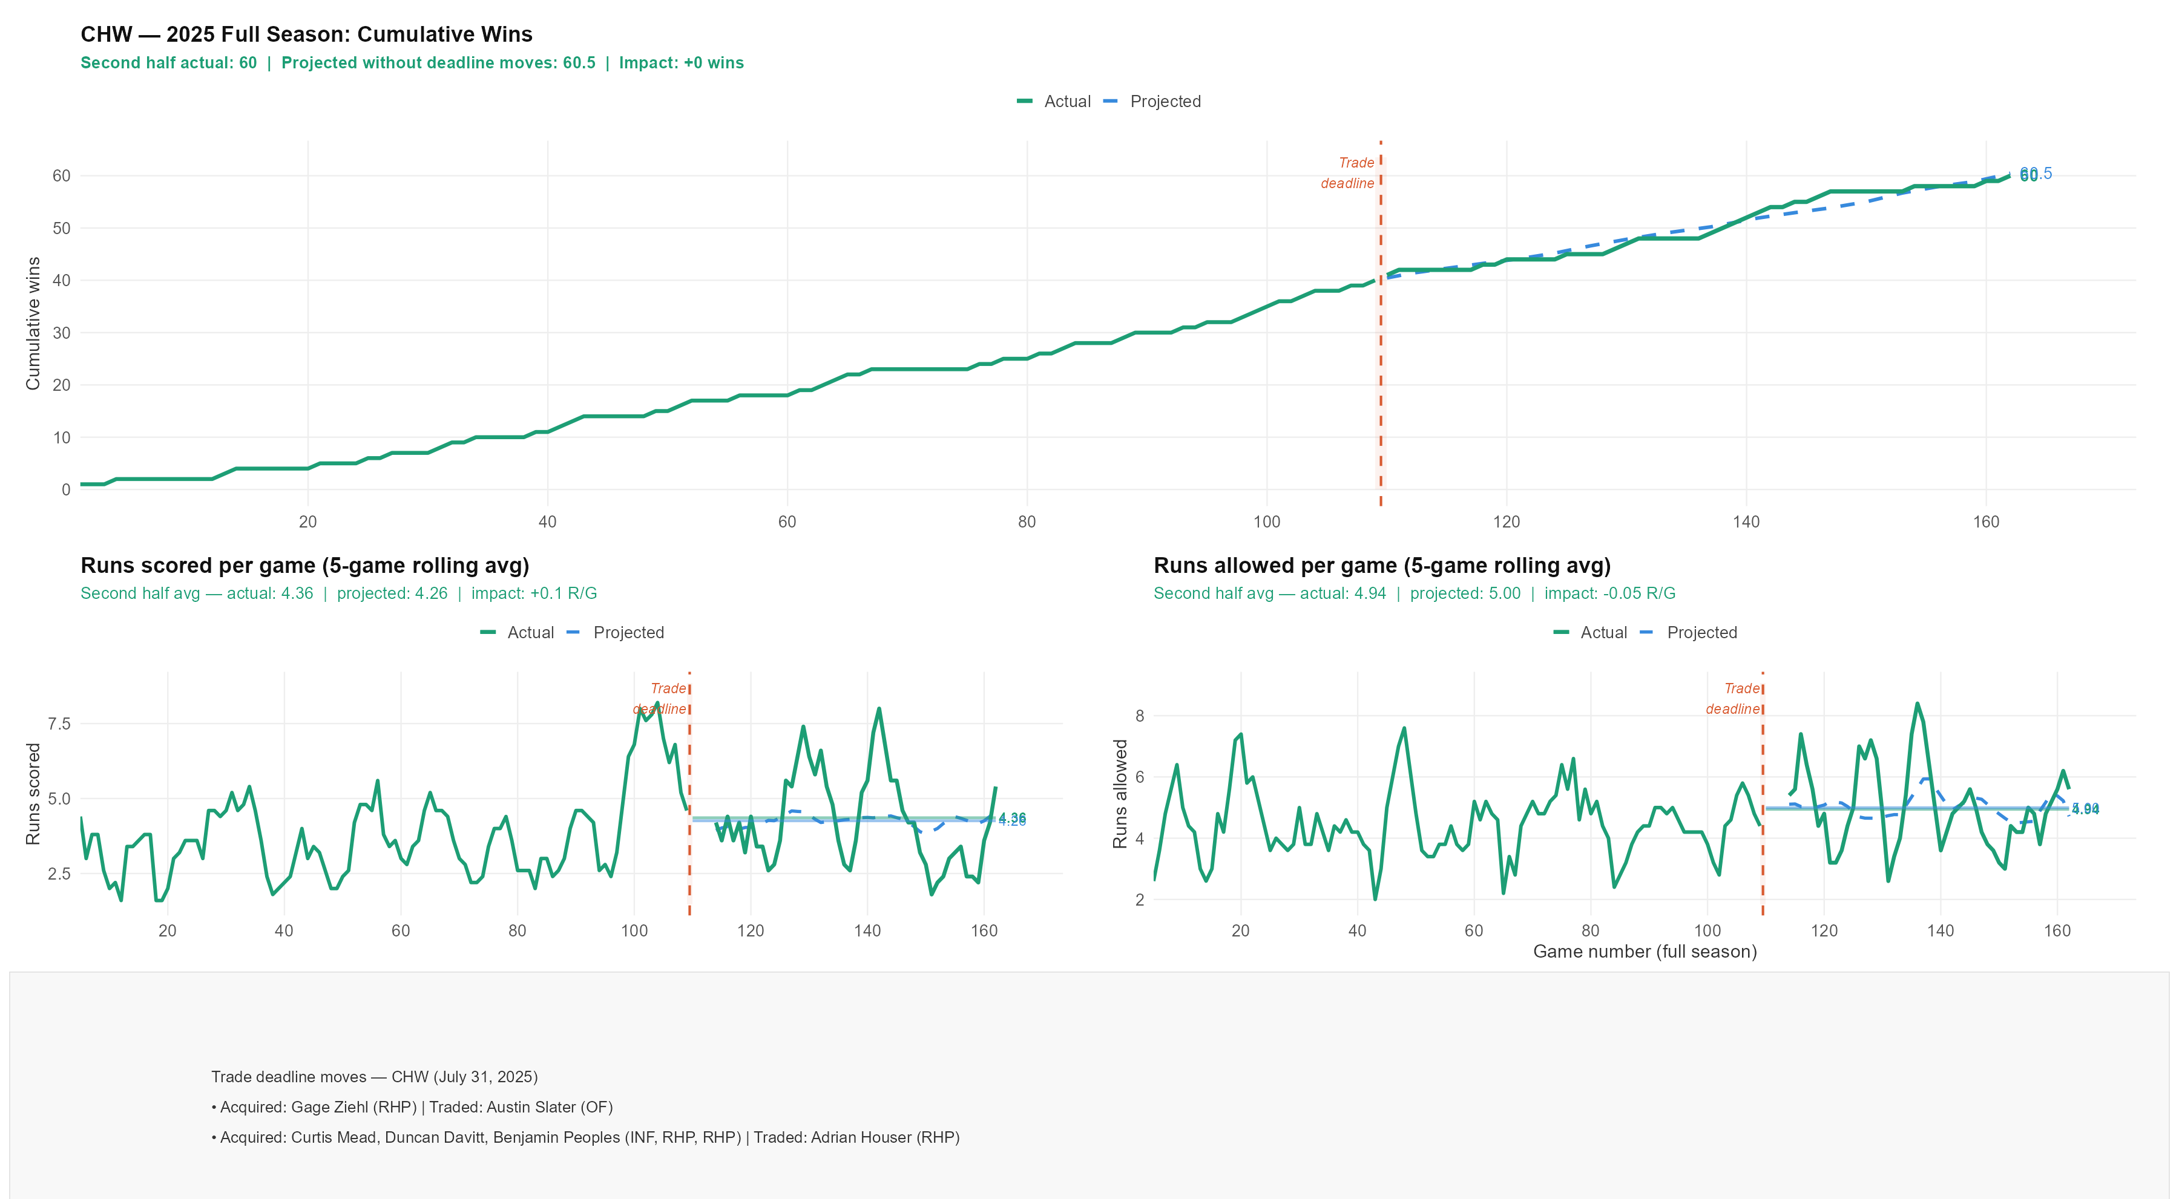
Team Deep Dive: CHW
[INSERT: CLE_2025_its_panel.png]

Slide 24
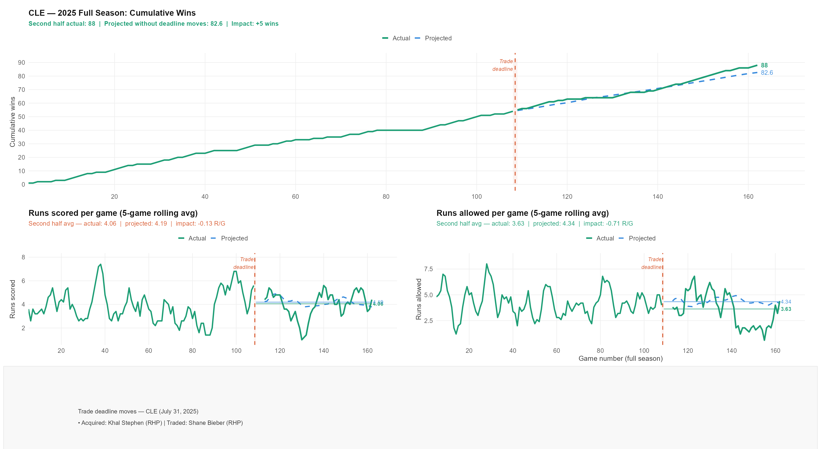
Team Deep Dive: CLE
[INSERT: CLE_2025_its_panel.png]

Slide 25
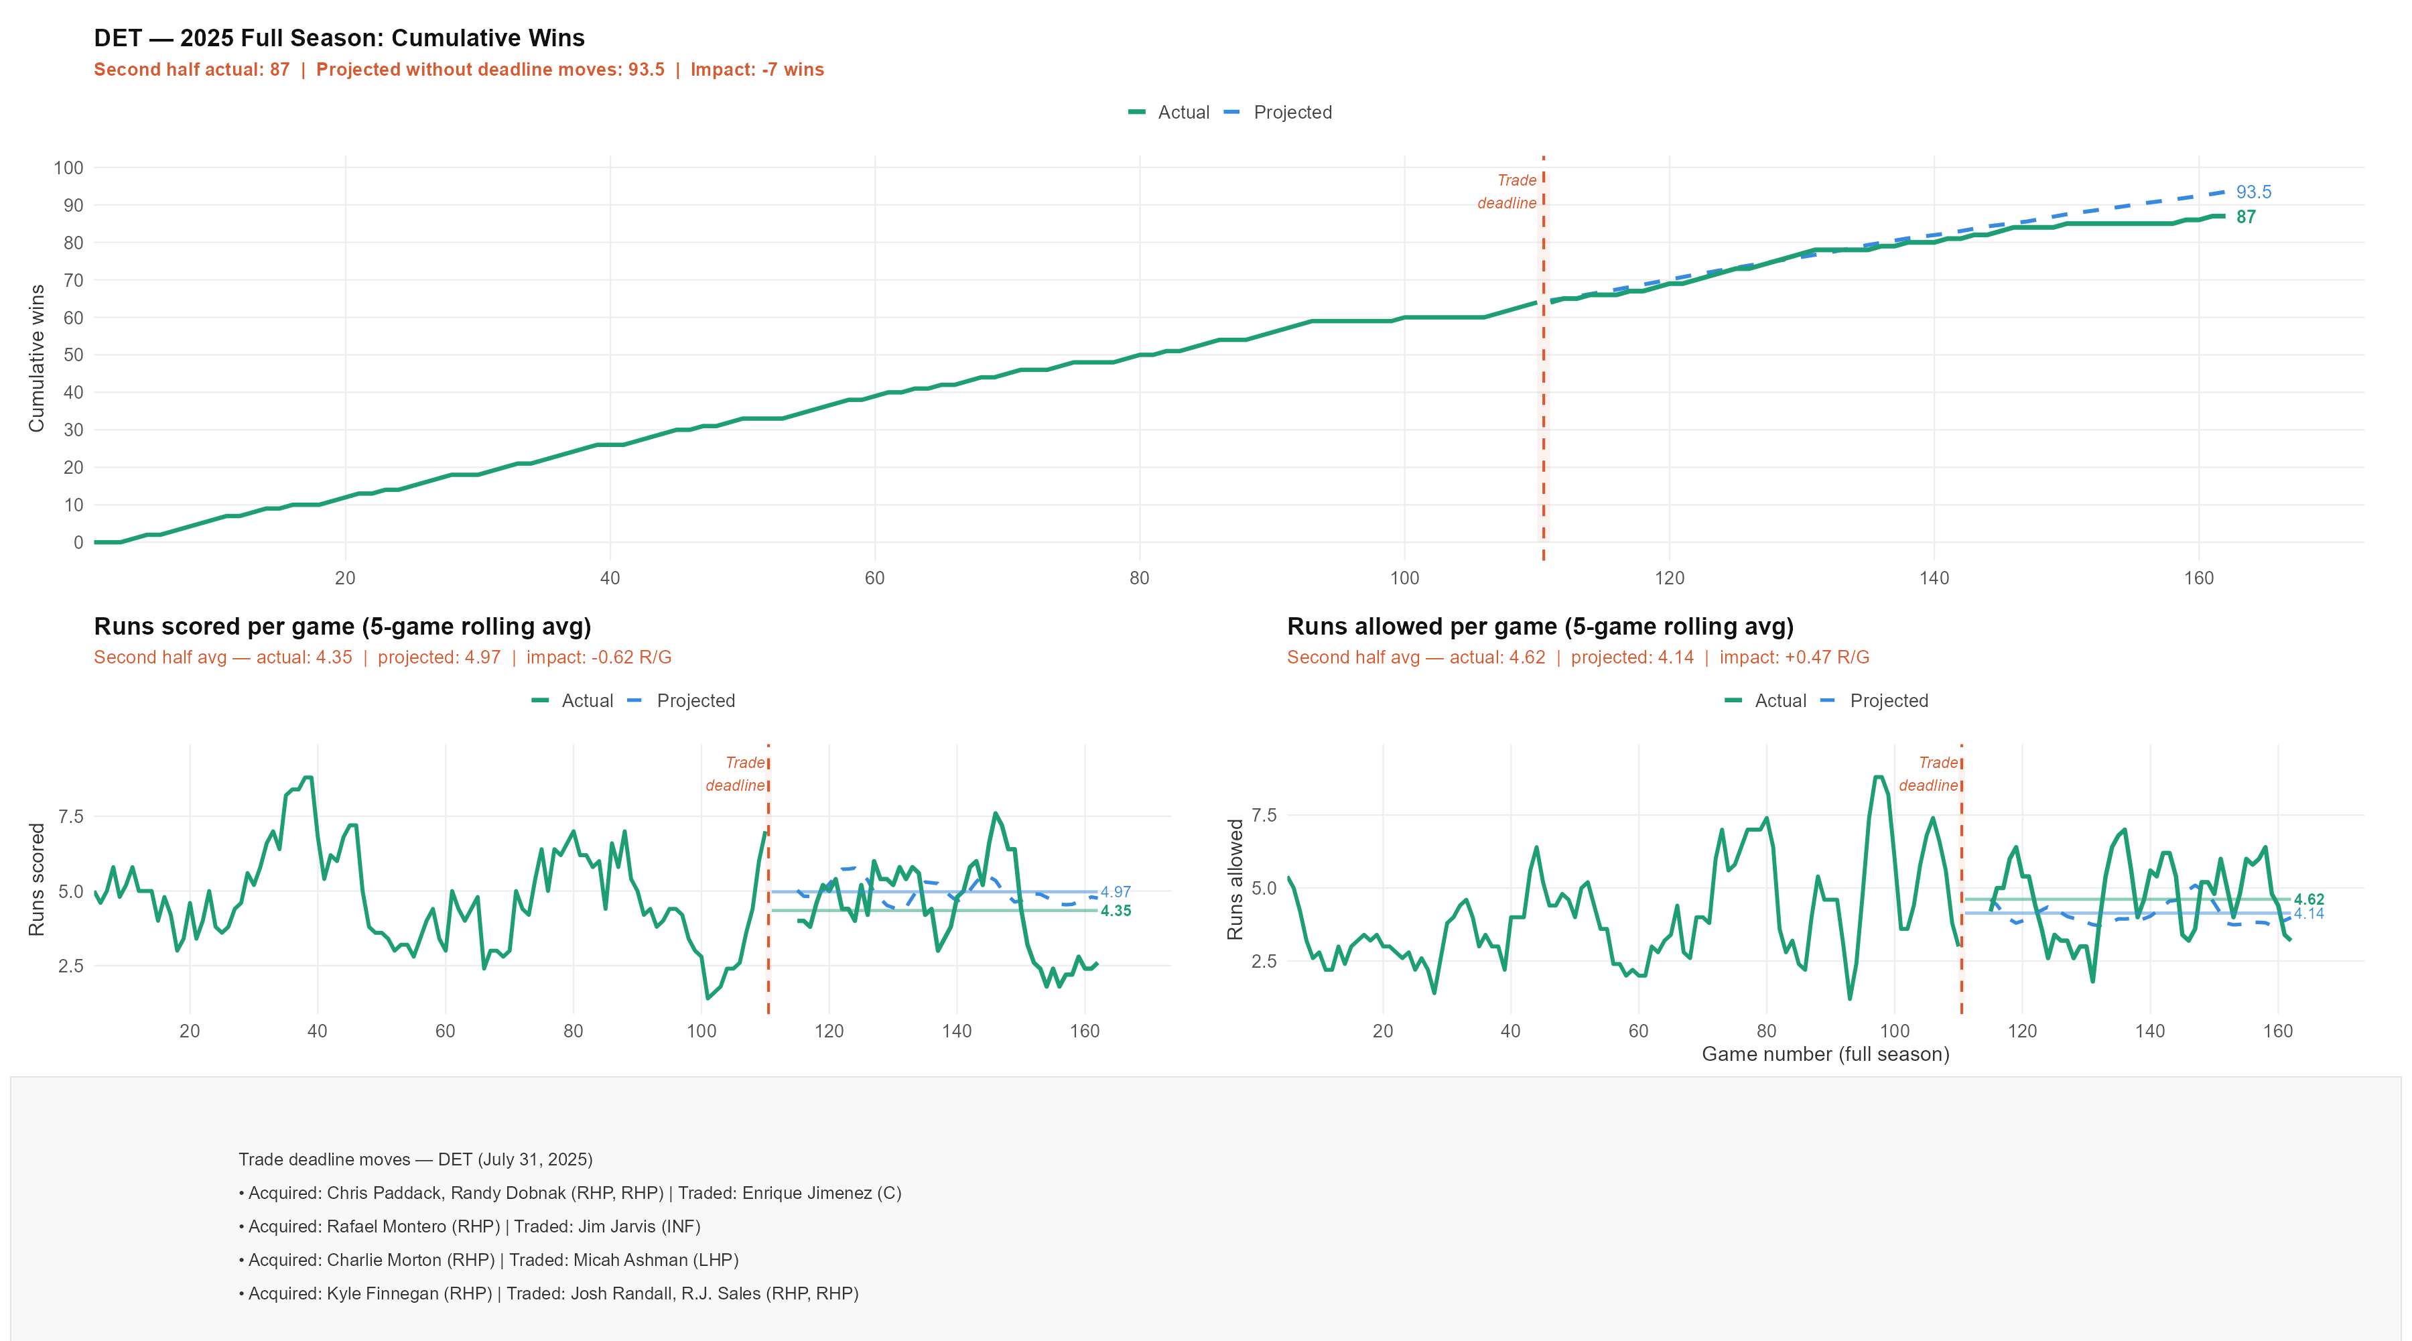
Team Deep Dive: DET
[INSERT: CLE_2025_its_panel.png]

Slide 26
Future Work
Where this framework goes next

Slide 27
Extensions & Improvements
Data improvements
  Statcast integration: xwOBA, xERA, barrel rate, sprint speed = better pre-deadline profiles
  Park factor adjustments: explicit run environment correction beyond is_home
  Injury data: days on IL per player, severity weighting
Methodological improvements
  Player-level modeling: project individual player contributions and aggregate to team level
Scope expansion
  Playoff impact: do deadline acquisitions predict postseason performance?
  Market efficiency: are certain types of trades (rental pitchers, contact hitters) systematically over/undervalued?

Slide 28
Conclusions

Slide 29
What We Built and What We Found
3.0524
57.96%
p=0.0017
p=0.007
RS RMSE
2024 test set
W/L Accuracy
2024 test set
RA t-test
Model < Baseline
McNemar
W/L Improvement
What we built
  Three independent CatBoost models trained on 2005–2024 pre-deadline profiles, projecting 2025 second-half performance for all 30 teams with confidence intervals and forecast coverage stars
What we found
  Model significantly outperforms the Pythagorean baseline on RS (p=0.018), RA (p=0.0017), and W/L (McNemar p=0.007) on the 2024 held-out test set
  Most 2025 deadline impacts fall within the model’s expected range, consistent with the inherent uncertainty of 53-game samples
  NYM’s RS/G improvement (+1.12 R/G) was outside the 99% CI, an unprecedented offensive outcome still resulting in EIGHT more losses than expected due to an inflated ERA
The bottom line
  Deadline moves matter, but quantifying how much requires a rigorous counterfactual framework. Excess returns tell a more honest story than wins above .500.

Slide 30
Thank You
Questions?
Li, Huang & Li (2022) — Entropy 24(2):288 | Prokhorenkova et al. (2018) — CatBoost NeurIPS | Shadish, Cook & Campbell (2002)
MLB Trade Deadline Impact Model | April 2026

