Slide 1
USCO BEINSOF52 · Artificial Intelligence · Project C1
Hydroponic Lettuce Growth-Stage Classifier
Five deep-learning backbones · ensemble · FastAPI · React
Jesús Beleño · Juan Forero
May 2026
c1 · hydroponic lettuce growth-stage classifier · USCO BEINSOF52
01 / 13

Slide 2
01 · THE DECISION
Is this pod ready to harvest?
Hydroponic operators face a recurrent perception task: every pod in a tray is at a different point of the growth timeline, and the right moment to harvest, re-sow or fertilize is decided pod-by-pod. Doing this visually for 1,500+ pods a day is feasible but fatiguing. The cost of error compounds in both directions — harvest early and yield drops; harvest late and the plant bolts. We trained an image classifier that returns the growth stage of one pod in under a second and persists every decision so the same farm can audit and retrain.
19,721
labeled pod crops
5
growth stages classified
93.86%
test accuracy (Swin-T)
c1 · hydroponic lettuce growth-stage classifier · USCO BEINSOF52
02 / 13

Slide 3
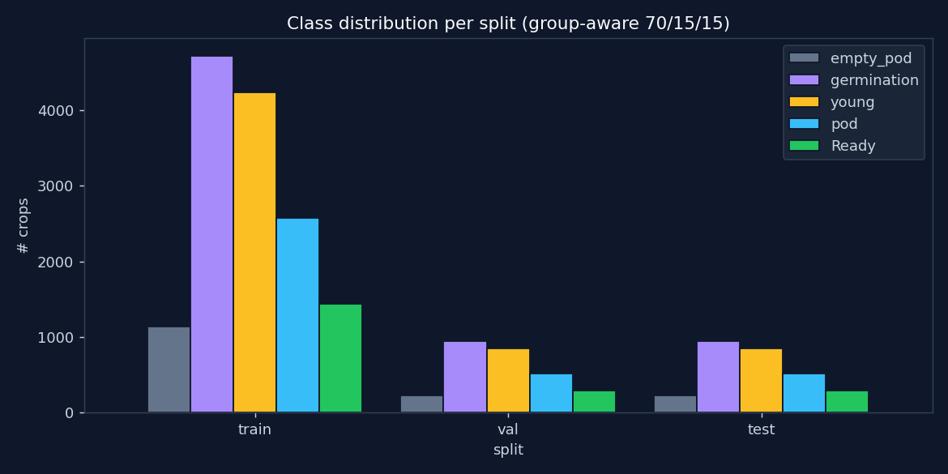
02 · DATASET
Roboflow lettuce-pallets · 19,721 crops
SOURCE FRAMES
1,501
CROPS TOTAL
19,721
TRAIN · VAL · TEST
71.4 % · 14.3 % · 14.3 %
SPLIT STRATEGY
Stratified group-aware (no source-frame leak)
CLASS BALANCE
germ 33.5 % → empty 8.1 % (4.1×)
BALANCING IN LOSS
class_weight = "balanced"
c1 · hydroponic lettuce growth-stage classifier · USCO BEINSOF52
03 / 13

Slide 4
03 · BACKBONES
Five ImageNet-pretrained networks compared
MODEL
FRAMEWORK
PARAMETERS
ROLE
MobileNetV3-Small
TensorFlow
~2.5 M
edge baseline
EfficientNet-B0
TensorFlow
~5.3 M
midsize CNN
ResNet50
TensorFlow
~25.6 M
canonical CNN
ViT-B/16
PyTorch
~86 M
global self-attention
Swin-Tiny
PyTorch
~28 M
hierarchical attention
Same head topology across the five: backbone → pooling → dropout (TF) → Dense(5, softmax) with dtype=float32 on the head so mixed precision stays numerically stable.
c1 · hydroponic lettuce growth-stage classifier · USCO BEINSOF52
04 / 13

Slide 5
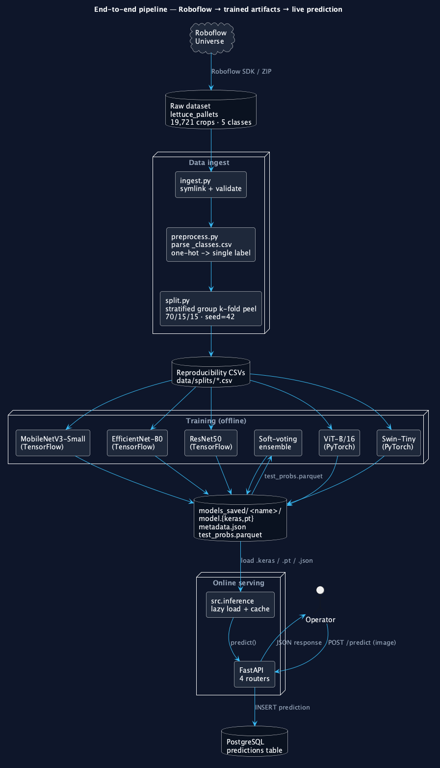
04 · PIPELINE
End-to-end pipeline
c1 · hydroponic lettuce growth-stage classifier · USCO BEINSOF52
05 / 13

Slide 6
05 · TRAINING
Two-phase fit for CNNs · end-to-end for transformers
TF CNNs
phase 1 — head only
12 ep · Adam(1e-3)
TF CNNs
phase 2 — top 30 % of backbone
4 ep · Adam(1e-5)
TF CNNs
BatchNorm always frozen
preserves running stats
Torch
ViT-B/16 + Swin-T end-to-end
8 ep · AdamW(3e-5)
All
two-layer class balancing
sample-level oversampling (balance.py) + loss-level class_weight
All
augmentation pipeline
flip · rotation · brightness · contrast · zoom
All
mixed precision on CUDA
fp16 forward · fp32 softmax/loss
All
checkpoints on best val_acc
ModelCheckpoint + EarlyStopping (patience 3)
c1 · hydroponic lettuce growth-stage classifier · USCO BEINSOF52
06 / 13

Slide 7
06 · RESULTS
Held-out test set comparison
MODEL
ACC.
MACRO F1
MACRO RECALL
BEST VAL
swin_t
93.86%
93.19%
93.39%
94.03%
vit_b_16
93.65%
92.81%
92.57%
94.28%
ensemble_avg
93.65%
93.22%
94.06%
—
resnet50
90.98%
90.56%
91.72%
90.41%
efficientnet_b0
89.39%
89.32%
91.78%
88.88%
mobilenet_v3_small
88.32%
88.55%
90.19%
88.28%
Swin-Tiny wins overall accuracy. The ensemble wins macro-recall — the metric aligned with operational cost (every missed Ready costs harvest timing; every missed empty_pod costs re-sowing).
c1 · hydroponic lettuce growth-stage classifier · USCO BEINSOF52
07 / 13

Slide 8
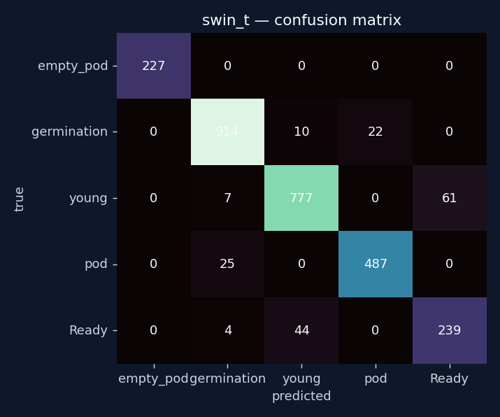
07 · PER-CLASS
Where does Swin-Tiny still confuse?
young → pod
the most expensive confusion. Visually similar mid-stage canopies.
empty_pod
highest per-class precision. Visually distinct (no plant).
Ready
high recall. The operationally critical class is well caught.
germination
isolated. Smallest class but most distinct early-stage cue.
c1 · hydroponic lettuce growth-stage classifier · USCO BEINSOF52
08 / 13

Slide 9
08 · SYSTEM
FastAPI · PostgreSQL · React · Vite
ENDPOINTS
ENGINEERING
POST /predict
upload → predict → persist
Lazy model loading
TF + Torch share one process · RLock so the ensemble loader doesn't self-deadlock
GET /history
paginated, label/model filters
TF pinned to CPU
GET /metrics
model-comparison table
PyTorch keeps the GPU; no Metal/CUDA contention
GET /models
what is loadable right now
StaticPool SQLite
in-memory database in tests · production runs on PostgreSQL
Vite proxy
/api/* → 127.0.0.1:8000 — no CORS in dev
c1 · hydroponic lettuce growth-stage classifier · USCO BEINSOF52
09 / 13

Slide 10
09 · FRONTEND
React dashboard · webcam · viewfinder crop
● c1/lettuce
predict · history · metrics · models
Vanilla getUserMedia for the laptop webcam — no camera library
germination
Drag-and-drop, clipboard paste or click on the viewfinder
98.21%
drag, paste or click
via ensemble_avg · 42 ms
Crop step between picking and predicting — one pod per request
empty_pod
0.000
germination
0.982
The GrowthSpine signature runs across all four routes
young
0.018
pod
0.000
Ready
0.000
Single accent per card = the predicted class color, never two
c1 · hydroponic lettuce growth-stage classifier · USCO BEINSOF52
10 / 13

Slide 11
10 · WHAT ALMOST SHIPPED WRONG
A loss of 1,191 on the very first MobileNet run
The smell test
BEFORE
MobileNetV3 was passed include_preprocessing=False with no manual normalisation, while modern Keras preprocess_input for MobileNetV3 is a no-op. The network was fed pixels in [0, 255] when its ImageNet weights expected [-1, 1]. Loss exploded into the thousands; test accuracy capped at 0.35 — barely above the 0.20 random baseline. The fix was one flag.
test_acc 0.3465 loss epoch 1: 1190.88
AFTER
test_acc 0.8832 loss epoch 1: 0.59
One line of code · 4 min training +0.53 accuracy
c1 · hydroponic lettuce growth-stage classifier · USCO BEINSOF52
11 / 13

Slide 12
11 · WHAT'S NEXT
Engineering and product directions
Detection layer
Add YOLOv8 in front of the classifier. The Roboflow source is annotated with boxes already — fine-tune on the same data, then run our 5-model classifier on each detected box. Closes the multi-pod gap end-to-end.
Weighted ensemble + stacking
Uniform soft-voting underweights the transformers. Weighted soft voting (val-accuracy proportional) or a logistic-regression meta-learner trained on out-of-fold softmax vectors.
K-fold CV in the report
make cv-swin already exists and writes reports/cv_swin_t/. Attach a mean ± std to the headline 0.9386 to silence the "lucky split" question.
Cloud deployment
Dockerize the FastAPI service + Postgres, push to Render free tier, get a public https URL the operator opens on a tablet.
c1 · hydroponic lettuce growth-stage classifier · USCO BEINSOF52
12 / 13

Slide 13
QUESTIONS · DISCUSSION
Thanks.
github.com/jbeleno/c1-lettuce-classifier
Jesús Beleño · Juan Forero
c1 · hydroponic lettuce growth-stage classifier · USCO BEINSOF52
13 / 13

