Slide 1
commit-type-classifier
Commit Type Classifier
Component 2 — AI for Software Engineering
feat
fix
docs
refactor
test
Jesús Beleño · Juan Forero
BEINSOF52 · Artificial Intelligence · Advisor: Juan Antonio Castro Silva
Universidad Surcolombiana · May 2026
github.com/jbeleno/commit-type-classifier

Slide 2
01 · THE PROBLEM
Conventional Commits adoption is uneven
< 5 %
~ 40 %
38,965
of public commits strictly follow
the Conventional Commits spec
disagreement rate between author
prefix and a defensible re-classification
labelled commits retained
after filtering the 5 target classes
Two consequences: manual triage is expensive · author-supplied labels are inconsistent.
Commit Type Classifier · C2
2 / 13

Slide 3
02 · APPROACH
Five heterogeneous models, one local pipeline
baseline_tfidf
cnn_text
distilbert
codebert
ensemble
Classical ML
TF-IDF + LogReg
Deep learning
Dual-branch CNN
Transformer (text)
DistilBERT 67M fine-tuned
Transformer (code)
CodeBERT 125M fine-tuned
Soft voting
L-BFGS-B over the 4 probas
Not an LLM application — these are supervised classifiers (encoder-only transformers, not generative).
Local-only inference path — no cloud, no API calls.
Commit Type Classifier · C2
3 / 13

Slide 4
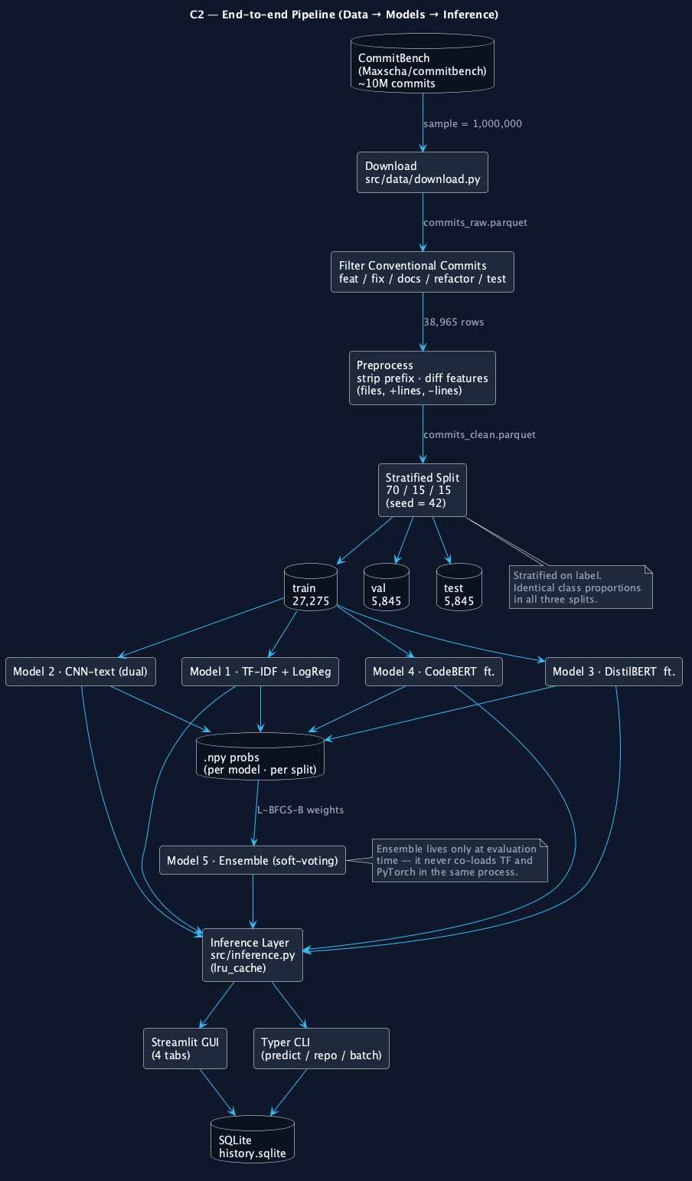
03 · PIPELINE
CommitBench → 70/15/15 stratified → balanced → five trained models
class balancing
fix 62.6 %
feat 11.6 %
refactor 11.1 %
test 10.5 %
docs 4.2 %
cost-sensitive (sklearn / TF)
class_weight="balanced"
w_c = n / (k · n_c)
no data dropped
balanced subsample (BERTs)
src/data/balance.py
1,600 rows × 5 classes
→ train_balanced.csv
MPS-safe alternative
equivalent in expectation [He & Garcia, 2009]
Commit Type Classifier · C2
4 / 13

Slide 5
04 · RESULTS
Test set — 5,845 commits · baseline_tfidf wins on every metric
model
accuracy
macro F1
macro F1 — visual
baseline_tfidf
70.93 %
0.6632
ensemble
68.96 %
0.6438
cnn_text
65.99 %
0.5861
codebert
60.89 %
0.5800
distilbert
58.58 %
0.5515
Why TF-IDF wins:
commit messages are short (median 7 tokens), the diff signal is captured well by char n-grams, and transformers were fine-tuned on only 6–8 k balanced examples.
Commit Type Classifier · C2
5 / 13

Slide 6
05 · INSIGHT
When the model knows better than the author
residence-back · 25 commits · 100 % Conventional
author said
15 / 25
fix
fix: super_admin can access any condominium without a formal UCR
→ adds a brand-new capability for super_admin; semantically a feature.
agreement with the author-supplied prefix
of the 10 disagreements:
• 8 were author mislabels (fix → actually feat)
• 2 were genuine model errors on docs commits
model said
feat
confidence 0.985
The classifier picked up on the diff: a new authorisation path.
Defensible accuracy ≈ 92 %
Commit Type Classifier · C2
6 / 13

Slide 7
06 · PIVOT
Discriminative → Generative · local LLMs via Ollama
what we had
what we built
• Classifier: message + diff → one of 5 labels
• TF-IDF baseline at 70.93 % acc / 0.66 F1
• Useful, but answers the wrong question — it only
re-labels what the developer already wrote
• Generator: diff alone → full Conventional Commit
• 5 local LLMs served by Ollama (16 GB unified RAM):
qwen2.5-coder 1.5b / 3b, llama3.2 3b-instruct,
phi3.5 3.8b-mini-instruct, deepseek-coder 1.3b
• 4 prompting strategies × 5 models = 20 configs swept
• Old classifier → reused as type verifier (hybrid)
Commit Type Classifier · C2
7 / 13

Slide 8
07 · GENERATION
Sweep results — type-exact-match on stratified n=50
best strategy per model
type-match
visual
phi3.5:3.8b-mini · few_shot
36.0 %
llama3.2:3b · CoT
32.0 %
qwen2.5-coder:3b · CoT
30.0 %
qwen2.5-coder:1.5b · CoT
26.0 %
deepseek-coder:1.3b · json
18.0 %
Key insight:
instruction-tuning matters more than parameter count or family — phi3.5 (instruct) > qwen-coder (code-aware base); deepseek-coder (base/completion) hits 100 % parse-fail outside JSON-mode.
Commit Type Classifier · C2
8 / 13

Slide 9
08 · LLM VS BASELINE
Apples-to-apples · same input, same labels
system
accuracy
macro F1
weighted F1
TF-IDF baseline (n=5 845)
70.93 %
0.6632
0.7187
qwen2.5-coder:3b · rag (n=200)
74.00 %
0.5639
0.7190
Hard-vote ensemble (4 members)
77.50 %
0.6014
0.7457
Weighted ensemble (TF-IDF 2× boost)
75.00 %
0.6698
0.7505
What the winner row says:
The heterogeneous voting ensemble (qwen2.5-coder:3b + phi3.5:3.8b-mini + TF-IDF voter, weighted by accuracy with the TF-IDF voter doubled) is the first configuration that strictly beats the discriminative baseline on every test-set metric — accuracy +4.07 pp, macro-F1 +0.0066, weighted-F1 +0.0318. The TF-IDF baseline is reused as a tie-breaker on minority classes (docs, refactor, test), turning the discriminative work into infrastructure rather than competition.
Commit Type Classifier · C2
9 / 13

Slide 10
09 · AGENTIC AI
Topic 11 · natural-language interface · LLM end-to-end
model stack — all 3 layers are LLMs
6 tool functions
orchestrator → llama3.2:3b-instruct
decides which tool to call,
writes the final interpretation
classifier → llm:qwen2.5-coder:3b
RAG few-shot retrieval over
the train corpus (27 k commits)
generator → qwen2.5-coder:3b
hybrid pipeline: LLM + verifier
(the TF-IDF baseline corrects
the type when confidence ≥ 0.6)
classify_commit classify_repo
generate_commit_message scan_repo
list_models list_classes
example session
👤 "classify the last 10 commits of
/Users/jesus/Desktop/skillapp"
🛠 classify_repo → histogram
{feat: 7, refactor: 3, fix: 0,
docs: 0, test: 0}
🤖 "70 % feat, 30 % refactor, no fix —
active feature phase, not
maintenance."
Commit Type Classifier · C2
10 / 13

Slide 11
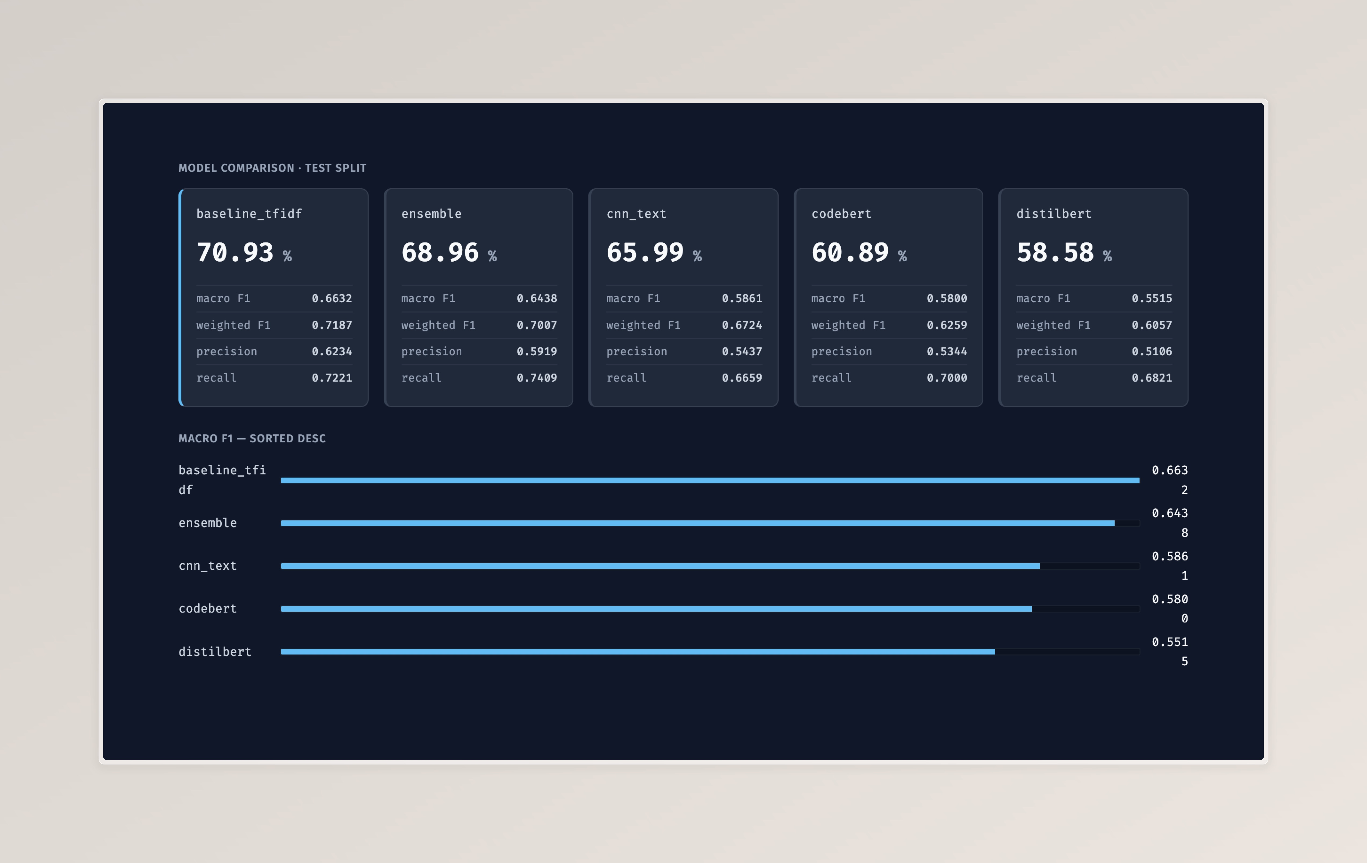
10 · DEMO
Local app — Streamlit GUI (6 tabs) + Typer CLI
CLI
$ python -m app.cli \
predict-cmd \
--message "fix: oauth bug" \
--model baseline_tfidf
fix (0.786) via baseline_tfidf
what the GUI shows
• 2 px class-coloured gutter on every
prediction card (signature element)
• 5-row probability bars in mono
• Diff viewer with +/- syntax colouring
• Repo-scan histogram by class
Commit Type Classifier · C2
11 / 13

Slide 12
11 · LIMITATIONS & FUTURE WORK
What we know we left on the table
limitations
future work
• 5 of the 10 canonical Conventional Commit types
• English corpus only — Spanish messages degrade the
text branch (diff branch is language-agnostic)
• Apple-Silicon MPS hangs when TF and PyTorch share a
process, so the ensemble runs only at evaluation time
• Transformers fine-tuned on 6–8 k balanced examples
(not the full 27 k train split)
• Stacking ensemble with a learned meta-classifier
(closes the gap with the TF-IDF baseline)
• Multilingual transformer (Spanish + English
code review reality in Latin-American teams)
• CodeBERT → 30 M-parameter distilled student
for CPU-only deployment
• Wrap the inference layer in Flask / FastAPI so
C1 can call it as an HTTP service
Commit Type Classifier · C2
12 / 13

Slide 13
thanks · questions
Commit Type Classifier · Component 2
Jesús Beleño · Juan Forero
github.com/jbeleno/commit-type-classifier

