Slide 1
Mini Project 1
Jordan Bell
COSC 445
Analyzing the writing styles of Arthur Conan Doyle and Jack London

Slide 2
What was the question?
Can the writing styles of different authors be identified and compared through patterns in their language, and how much does genre influence those patterns?

Slide 3
What was the approach?
1. Find two authors who have made multiple books in the same two genres and download their books.
2. Clean the book text so that only the book contents were left.
3. Measure various aspects of the books such as word count, average sentence length, unique words, etc.
4. Compare the various aspects of the books against each other.

Slide 4
What problems did I encounter?
Comparing books of different lengths: The books vary considerably in length, so some measurements had to be normalized, such as questions and exclamations per 1,000 words.
Separating author from genre: Since both authors wrote in both genres, it was necessary to distinguish patterns caused by the author from patterns that might simply come from the genre.
Avoiding misleading similarities: Two books can have similar vocabulary without necessarily having similar writing styles, so similarity scores had to be interpreted carefully.
Finding meaningful distinctive words: Common words can dominate text analysis, so methods such as TF-IDF were used to focus on words that were more characteristic of one author.

Slide 5
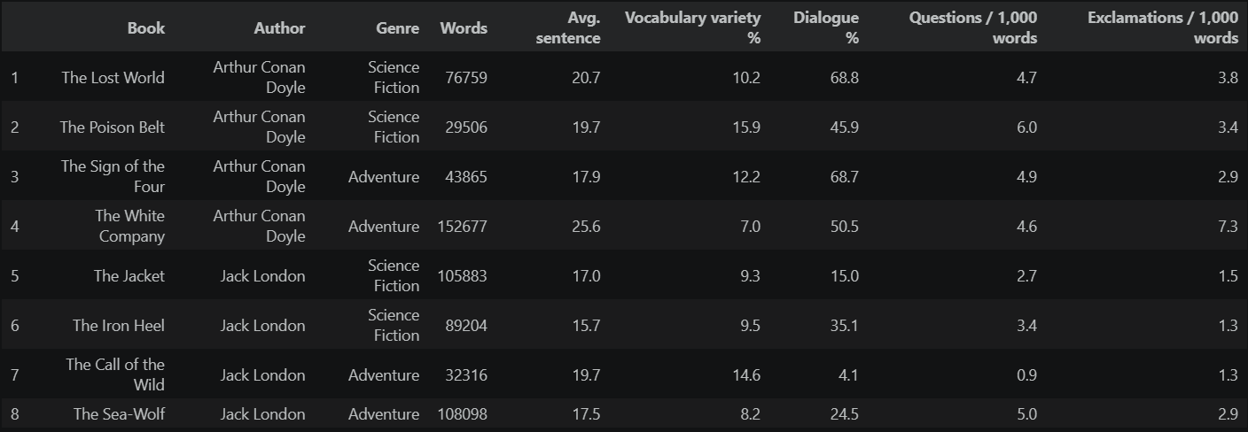
What results did I get? Writing Characteristics

Slide 6
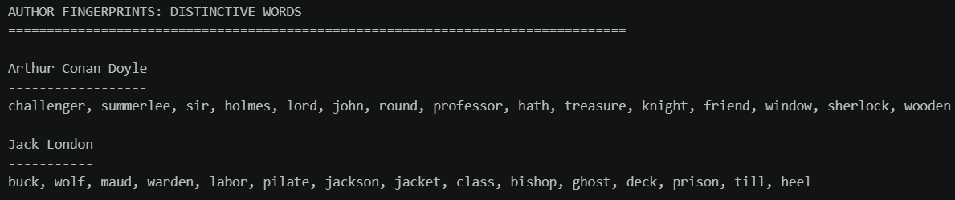
What results did I get? Distinctive Words

Slide 7
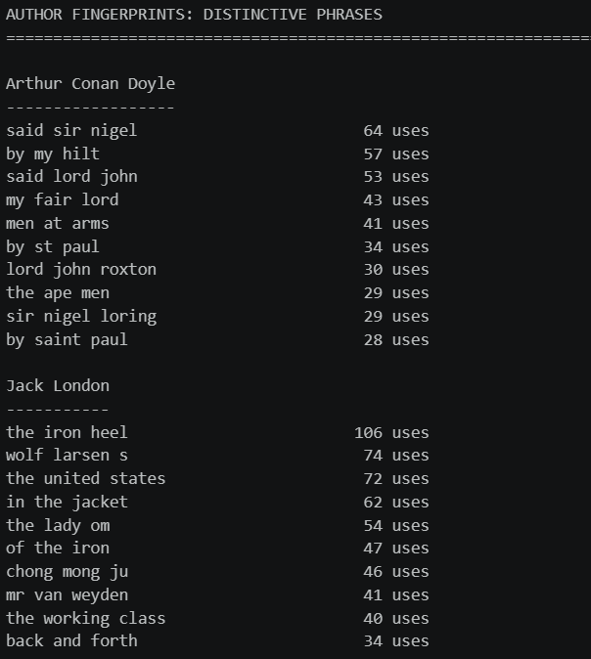
What results did I get? Distinctive Phrases

Slide 8
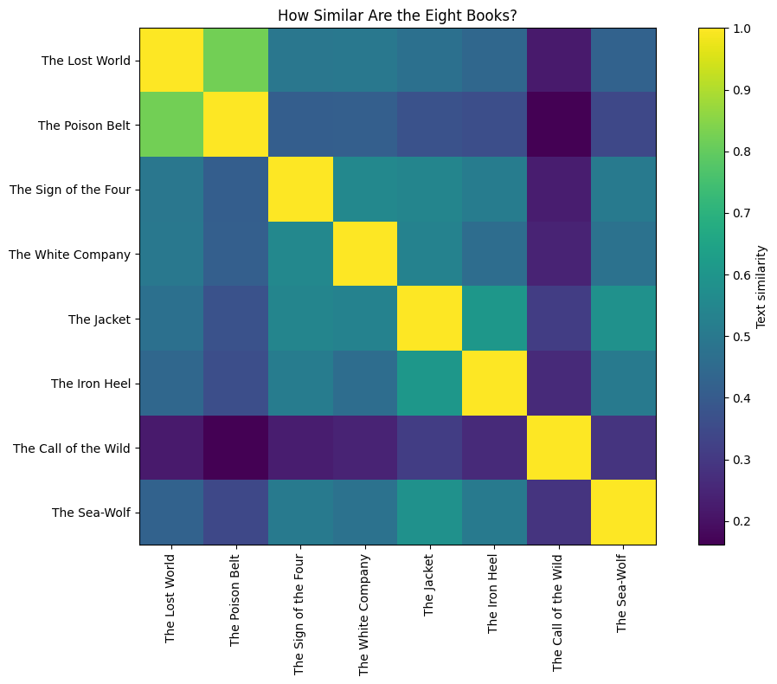
What results did I get?
Book Similarity

Slide 9
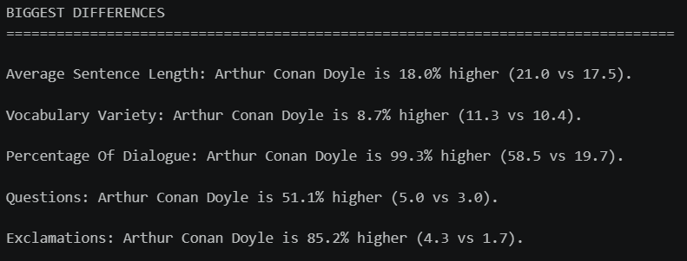
What results did I get? Biggest Differences

Slide 10
What new ideas did this generate?
Would the same author differences appear in more books?
Would the results hold across other genres, rather than just Science Fiction and Adventure?
Which specific features are most useful for identifying an author?
Would the results change if we included more features?
Could the same approach distinguish more than two authors?

