Slide 1

Building Single Page Apps with
Jarrod Bellmore
Developer/Architect
Guardian, BTS Disability (BRO)

Slide 2
Single Page Apps?
An application that only performs one full page load and dynamically loads data & markup as needed asynchronously.
One giant page, are you crazy?!
No, I promise I am not…
Not really new, just evolution of things we already do!

Slide 3
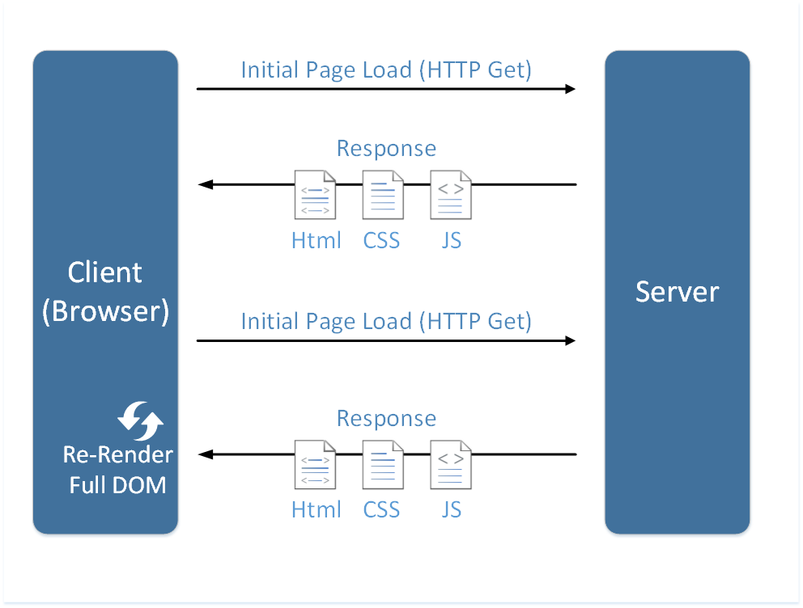
Traditional Page Lifecycle

Slide 4
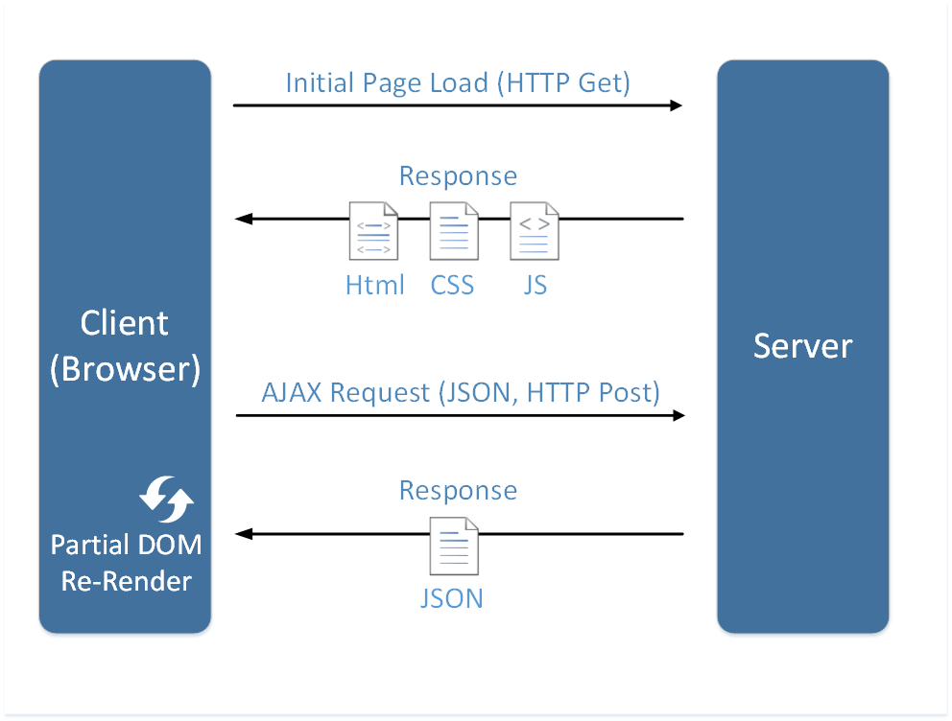
SPA Page Lifecycle

Slide 5
Advantages
Fast and responsive user experiences
Lighter payloads – great for mobile
Clear separation between client and server –responsibilities
Application/session state managed in client
Where it belongs!
Offload processing to the client, less stress on servers
“It’s the new hotness!”

Slide 6
Disadvantages & Challenges
Heavier initial page load
Requires more client side resources
Potential problems with legacy browsers
Requires deeper understanding of Javascript
jQuery != Javascript!
Need to open the “sharp tools drawer”
Bookmarkability / Deep Linking

Slide 7
SPA Framework Requirements
Application structure/consistency
Dependency management
State management
Routing
Deep linking
Data binding
Internal application communication
DRY code
Extensibility

Slide 8
Why AngularJS?
Mature & robust MVC framework
Active development
Built to power large apps like Gmail
Is a true “framework” not just a library
Provides majority of features needed in one framework rather than patchwork of several libraries
Testable
Most importantly, enjoyable!

Slide 9
Getting Started
https://angularjs.org/
Start with open mind
More similar to thick client or mobile app
Learn to love Javascript!
Start simple, don’t boil the SPA ocean all at once
Learn one framework at a time, then add others as needed
Notes:
Discuss documentation that can be found there
Talk about difficulties caused by documentation using SPA “buzzwords”
Throw away preconceptions of how web apps work, once you understand the concepts Angular becomes WAY easier

Slide 10
Key Concepts
Application structure/Initialization
Modules
Dependency Injection
Routing/State Management
Controllers
Views
Scope
Data-Binding
Services

Slide 11
Demo
Enough slides, show me the codez!
https://github.com/jbellmore/GSDC-2014-AngularJS

Slide 12
Angular in Guardian
Used on the Disability AUS project
Lines of Code:
43,536 - C#/.NET
8,109 - JavaScript
7,081 - HTML
537 - CSS
~ 40 states/views defined nested several levels deep
Around 10 months development time
Roughly 6 core developers

Slide 13
Lessons Learned
Authentication/authorization via Webseal
Solved with cookie based custom ASP.NET provider
mVC framework – must implement your own “model”
Duplication of REST api calls - Use Services!
Client side caching?

Slide 14
Lessons Learned Cont.
Learn about the $digest & data binding cycle
Avoid non-Angular DOM manipulation
Avoid use of $scope inheritance
Tight coupling
Use events instead ($broadcast and $on)
Avoid “scope soup”
Keeps code DRY

Slide 15
Additional Resources
Dan Wahlin - AngularJS Fundamentals in 60-ish Minutes Video
https://egghead.io/technologies/angularjs
http://www.stackdriver.com/managing-missing-model-angular
http://www.technofattie.com/2014/03/21/five-guidelines-for-avoiding-scope-soup-in-angular.html
AngularJS Yammer Group

