Slide 1
NEG+ Innovations, Inc.
Partnership Opportunity Briefing
Closing the Expression Gap in Women's Health Through Precision Device Innovation
JIMMY BELOTTE, MD, PHD, MBA; FACOG
FOUNDER & CEO, NEG+ INNOVATIONS, INC.
NEG+ Innovations, Inc. · Confidential · May 2026
BIDC/HMS Zoom Meeting with Greg Matz

Slide 2
Agenda
1 | Introduction
2 | The Expression Gap : Why Women's Health Can't Wait
3 | Problems & Opportunities
4 | Our Device Portfolio
5 | The Ask: Opportunity to Help Build the Future of Women’s Health
6 | Value to You
7 | Value to NEG+ Innovations
8 | Next Steps (OTT)
12 | Q&A
NEG+ Innovations, Inc. · Confidential · May 2026

Slide 3
01
Introduction
Every device in our portfolio was born from a clinical moment — a patient who deserved better.
JIMMY BELOTTE
NEG+ INNOVATIONS, INC.
FOUNDER CLINICIAN-SCIENTIST (MD, PHD)
B/C OB/GYN (FACOG), 19+ YRS.
ACTIVE LICENSES (NY, MI, MA)
R&D EXPERTISE (GSK)
NIH SCHOLAR (WRHR)
FORMER ASSOCIATE PROFESSOR
(WSU, EINSTEIN COLLEGE OF MEDICINE)
BUSINESS EXECUTIVE (MBA)
DELAWARE C-CORP.
WESTON, MA (HQ)
FOCUS (FEMTECH)
MISSION
VISION
VALUES
NEG+ Innovations, Inc. · Confidential · May 2026

Slide 4
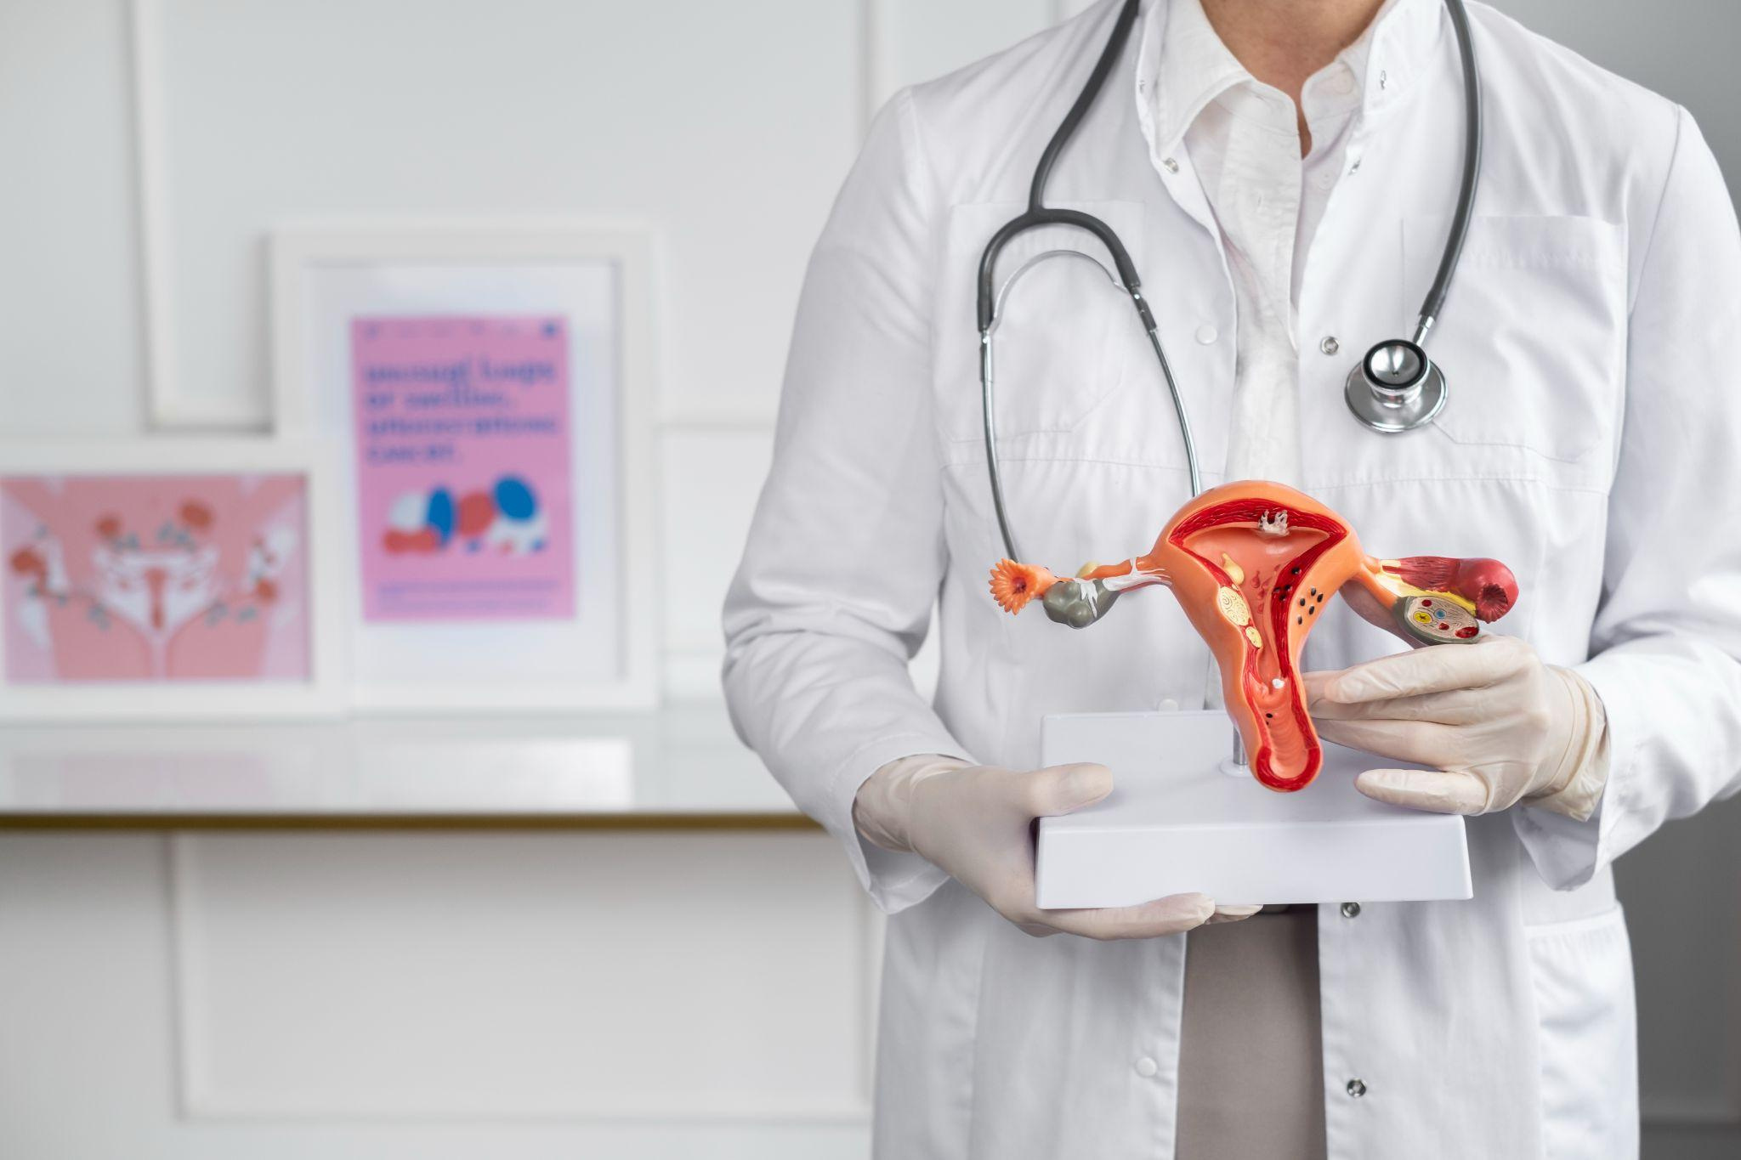
Why NEG+ Is Different
Clinician-led innovation
Evidence-driven development
Equity-centered design
Academic co-development
Diverse and experienced team
NEG+ Innovations, Inc. · Confidential · May 2026

Slide 5
Who We Are?
MISSION
To close the expression gap in women's health by designing, developing, and commercializing novel medical devices that improve clinical outcomes, enhance procedural safety, and give every woman — regardless of geography or socioeconomic status — access to the standard of care she deserves. We exist for the patient first.
VISION
To become the defining physician-led women's health medical device company of the next decade — one where every innovation in our portfolio is grounded in evidence, protected by strong IP, built in partnership with academic medicine, and scaled through a commercial infrastructure designed for lasting patient impact.
VALUES
Patient First, Always · Physician-Driven Design · Evidence Before Everything · Equity in Women's Health Access · Rigorous Regulatory Stewardship · Transparent Partnership · Commercial Purpose in Service of Clinical Mission
NEG+ Innovations, Inc. · Confidential · May 2026

Slide 6
02
The Expression Gap
Why Women's Health Can't Wait
5%
$1T
40X
160%
OF GLOBAL R&D FUNDS WOMEN'S HEALTH
ANNUAL GDP GAIN BY CLOSING THE WOMEN'S HEALTH GAP
MOIC $350M→$14B
ECONOMIC RETURN (WHAM)
FASTER FEMTECH GROWTH VS. BROADER HEALTHCARE MARKET
NEG+ Innovations, Inc. · Confidential · May 2026

Slide 7
THE R&D GAP
PAYER & VALUE
~5% of global R&D targets women’s health
~10.8% of NIH funding goes to women
3.5× more likely to face drug safety recalls
700+ diseases are diagnosed later
Cancer diagnosis delayed ~2.5 years
$12.22B saved/year from 5% nurse turnover reduction
£5 return per £1 invested in women’s health hubs
Endometriosis coding expanded (9 → 100+), improving reimbursement
FemTech partnerships = 23% of 2024 deals, surpassing pharma
INVESTOR ROI
EMPLOYER & IMPACT
$2.6B invested in FemTech (2024), +55% YoY
Market projected to reach $206.8B by 2033 (+260%)
Endometriosis: $44M vs. $1.24B for erectile dysfunction
$1 in family planning → $120 economic return
20% of work hours lost to presenteeism (~49.7 days/year)
50% of women’s health burden affects working-age women
+1.7% GDP from closing the women’s health gap
~$400B gain from reducing disease burden
60% of top-20 pharma revenue tied to women-related conditions
NEG+ Innovations, Inc. · Confidential · May2026

Slide 8
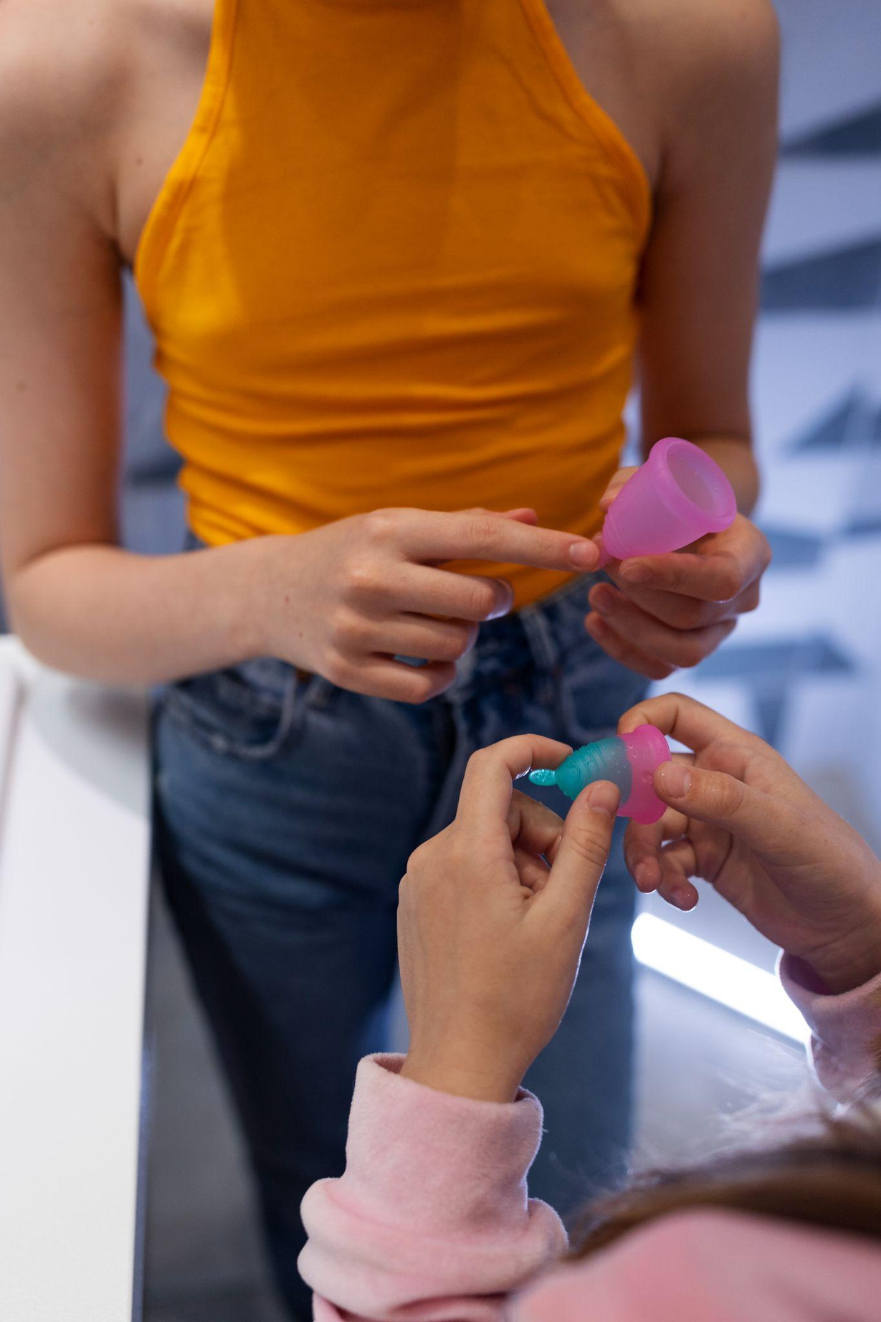
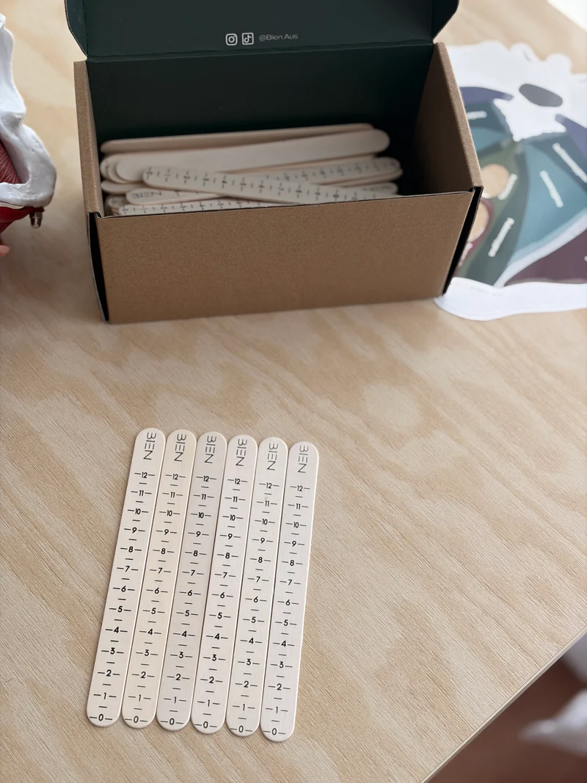
03
Problems & Opportunities
Analog Diagnostics
POP-Q staging: ICC 0.45–0.75 — two physicians examining the same patient often reach different diagnoses. No digital record, no standardization.
NEG+ Innovations, Inc. · Confidential · May 2026

Slide 9
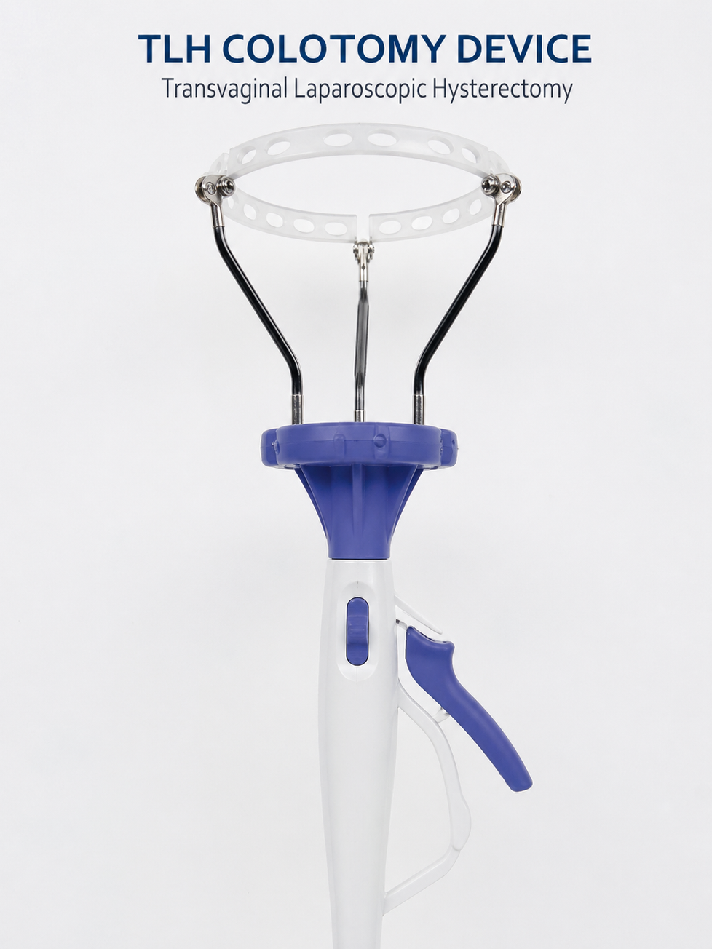
Problems & Opportunities
Outdated Instrumentation
TLH colpotomy: 8–14 min free-hand average, 3–6mm thermal spread, 1–4% vaginal cuff dehiscence — leading cause of post-hysterectomy reoperation.
NEG+ Innovations, Inc. · Confidential · May 2026

Slide 10
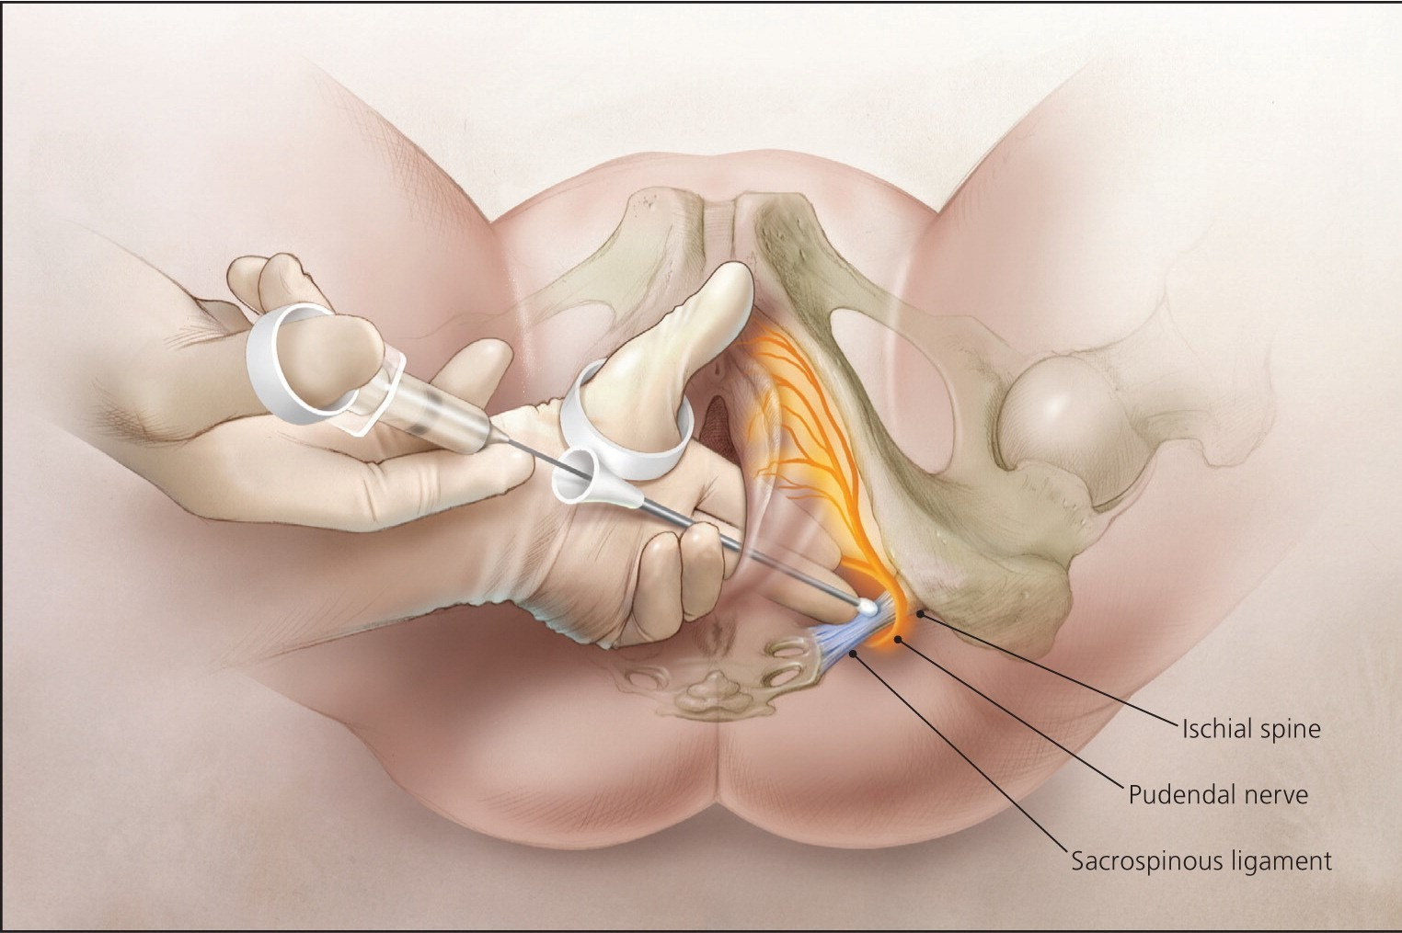
03
Problems & Opportunities
Blind Nerve Block
Pudendal blocks: 15–30% first-attempt failure, 3–8% hematoma risk from inadvertent vascular puncture. No depth confirmation, no standardization.
NEG+ Innovations, Inc. · Confidential · May 2026

Slide 11
04
Device Portfolio
Three Active Clinical Programs — Provisional Patents Filed
Pudendal Nerve Block Device
Belotte Colpotomizer™
POP-Q Digital Platform-Autosense™
MUMS™ (IP hold)
NEG+ Innovations, Inc. · Confidential · May 2026

Slide 12
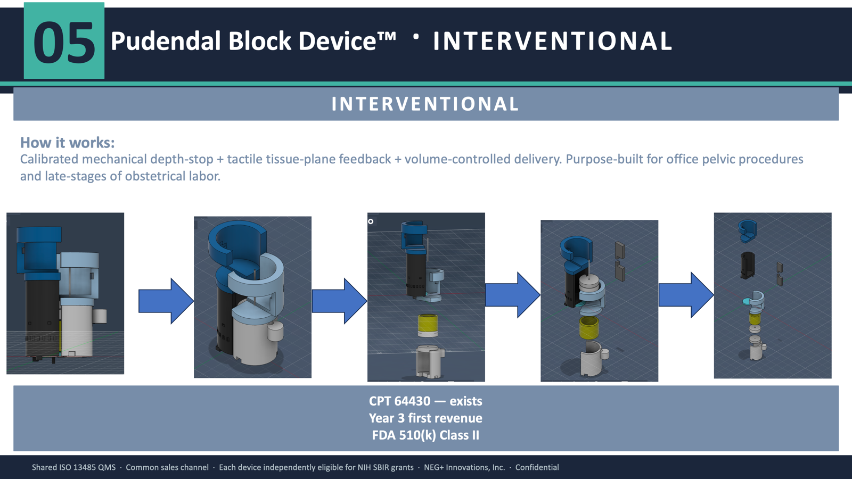
Pudendal Nerve Block Device
Precision Regional Anesthesia Platform
Provisional Patent Filed · STTR-Ready
Novel device for precision-guided pudendal nerve block delivery in OB/Gyn and other pelvic procedures — closing the gap in reproducible, safe regional anesthesia that disproportionately affects women in labor and pelvic surgery. Addresses a critical unmet need in pain management equity.
NEG+ Innovations, Inc. · Confidential · May 2026

Slide 13
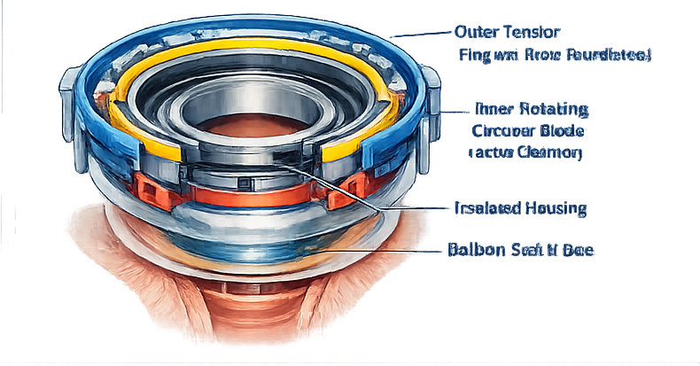
Belotte Colpotomizer™
Motorized Electrosurgical Platform· FDA Pre-Sub Filed · STTR-Ready
Motorized double-walled rotating blade electrosurgical colpotomy device — transforming laparoscopic hysterectomy precision and reducing surgical morbidity at the vaginal cuff. Directly addresses the leading source of post-hysterectomy complications in women.
NEG+ Innovations, Inc. · Confidential · May 2026
NEG+ Innovations, Inc. · Confidential · February 2026

Slide 14
07
Benefits to NEG+ Innovations
01
REGULATORY ACCELERATION
Partnered academic sites enable IDE study execution and IRB approval — the critical path to FDA 510(k) clearance for each of our three STTR-eligible devices
02
NON-DILUTIVE CAPITAL VIA STTR
STTR Phase I ($300K) and Phase II ($1.5–2M) awards provide non-dilutive funding that preserves founder equity and extends pre-Series A runway — your institution's participation is structurally required and directly funded
03
CLINICAL EVIDENCE & IP STRENGTHENING FOR PATIENTS
Real-world data from a credentialed academic partner strengthens patent claims, supports regulatory submissions, and anchors clinical evidence dossiers — ultimately getting better devices to the women who need them faster
NEG+ Innovations, Inc. · Confidential · May 2026

Slide 15
08
NEXT STEPS
Week 1–2 | Expression of Interest
Week 2-3
Ongoing
Ongoing
Ongoing
Formalize the relationship
Audit/Finance Committee
NEG+ Innovations, Inc. · Confidential · May 2026

Slide 16
Conclusion
MISSION
To close the expression gap in women's health by designing, developing, and commercializing novel medical devices that improve clinical outcomes, enhance procedural safety, and give every woman — regardless of geography or socioeconomic status — access to the standard of care she deserves. We exist for the patient first.
We are closing the expression gap in women's health
and we want to build this with you.
NEG+ Innovations, Inc. · Confidential · May 2026

Slide 17
12
Thank You!
Questions?
Contact: Jimmy Belotte, MD, PhD, MBA; FACOG · Founder & CEO,
NEG+ Innovations, Inc. · Confidential · May 2026

Slide 18


COMPETITIVE LANDSCAPE · THE MOAT
The market has left the same quadrant open.
In both procedures.
Plotted on the two axes investors care about — cost per case and skill required — every existing alternative for both procedures clusters in the high-skill or high-cost half-plane. The low-skill / low-cost quadrant is empty.
Pudendal Nerve Block — Alternatives
Colpotomy — Alternatives
↑ COST PER CASE
↑ COST PER CASE
Neuraxial /
epidural
high
Robotic platform
(Da Vinci)
high
Local
infiltration
Open colpotomy
(TAH default)
Ultrasound-
guided PNB
WHITE SPACE
WHITE SPACE
Electrosurgical
colpotomy (TLH)
Iowa trumpet
(landmark)
Belotte Colpotomizer™
Pudendal Nerve Block Device™
Manual cup
(RUMI / V-Care)
low
low
SKILL REQUIRED →
SKILL REQUIRED →
The moat: two purpose-built devices in two empty quadrants — protected by IP, regulatory pathway, and workflow simplicity.
NEG-PITCH-CMP-2026-002 · Slide 09 / Competitive Landscape
© 2026 NEG+ Innovations, Inc. · Reg D Rule 506(b) · Confidential

Slide 19
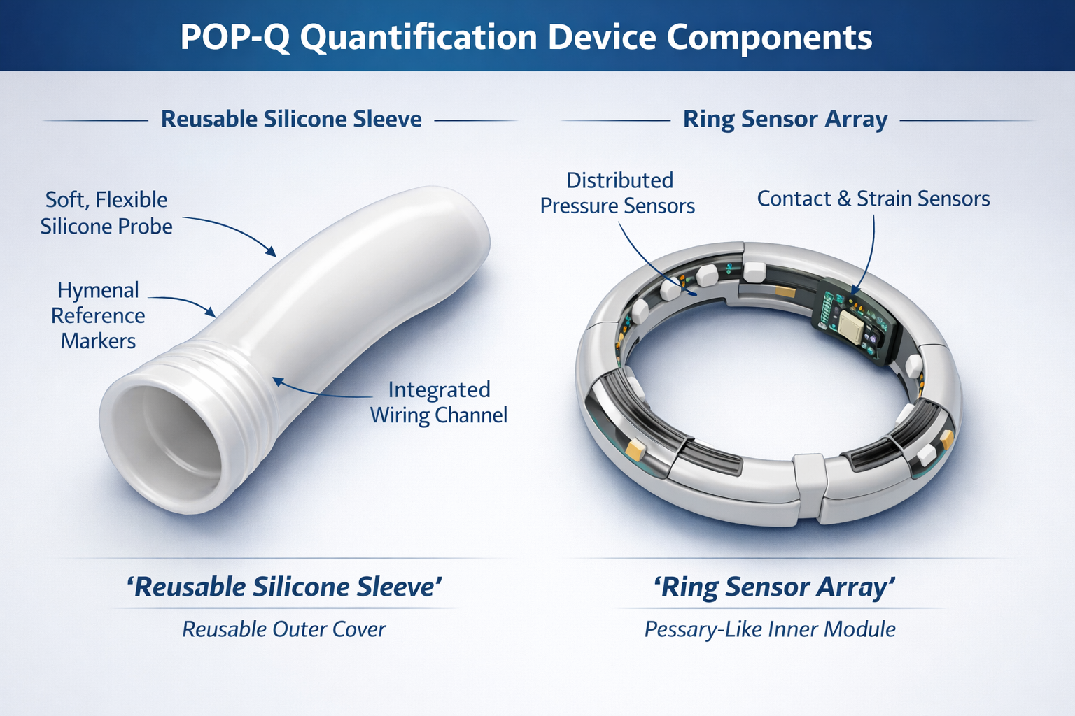
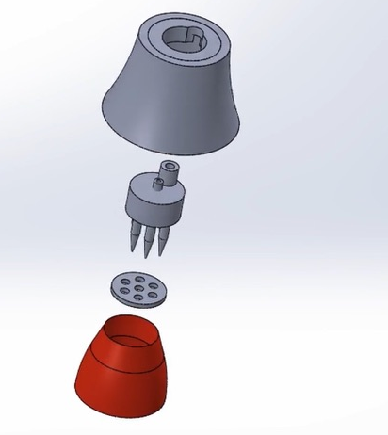
04
Three Devices. One Platform. Shared Infrastructure.
DIAGNOSTICS
SURGICAL
INTERVENTIONAL
POP-Q Sensorized
Device™
Belotte
Colpotomizer™
Pudendal Block
Device™
How it works:
How it works:
How it works:
Multi-axis MEMS sensor array simultaneously measures all 9 POP-Q points. Real-time digital twin. HL7 FHIR EMR integration. SaaS AI/ML analytics platform.
Motor-driven 360° circumferential incision + pneumatic balloon stent + microprocessor-regulated electrosurgery. One integrated system — no direct competitor anywhere.
Calibrated mechanical depth-stop + tactile tissue-plane feedback + volume-controlled delivery. Purpose-built for office pelvic procedures and late-stages of obstetrical labor.
ICC 0.45 → >0.90
First-in-category
FDA 510(k) / De Novo
60-sec vs 8–14 min
<2mm thermal spread
FDA 510(k) Class II
CPT 64430 — exists
Year 3 first revenue
FDA 510(k) Class II
Shared ISO 13485 QMS · Common sales channel · Each device independently eligible for NIH SBIR grants · NEG+ Innovations, Inc. · Confidential

Slide 20
