Slide 1
DISTRIBUTED SYSTEMS
Principles and Paradigms
Third Edition
MAARTEN VAN STEEN
ANDREW S. TANENBAUM
Chapter 2
ARCHITECTURES
Elliott mods in Cambria Font
Tanenbaum & Van Steen, Distributed Systems: Principles and Paradigms, 2e, (c) 2007 Prentice-Hall, Inc. All rights reserved. 0-13-239227-5

Slide 2
Architectural Styles (1)
Important styles of architecture for distributed systems
Layered architectures
Object-based architectures
Data-centered architectures
Event-based architectures
Tanenbaum & Van Steen, Distributed Systems: Principles and Paradigms, 2e, (c) 2007 Prentice-Hall, Inc. All rights reserved. 0-13-239227-5

Slide 3
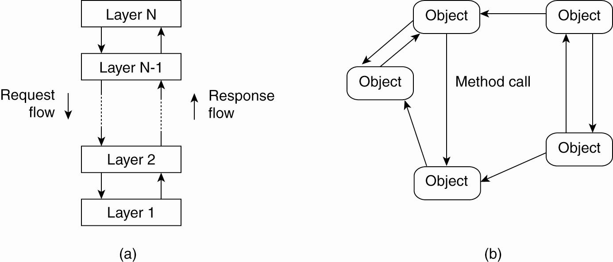
Architectural Styles (2)
Figure 2-1. The (a) layered architectural style and …
Tanenbaum & Van Steen, Distributed Systems: Principles and Paradigms, 2e, (c) 2007 Prentice-Hall, Inc. All rights reserved. 0-13-239227-5

Slide 4
Architectural Styles (3)
Figure 2-1. (b) The object-based architectural style.
Tanenbaum & Van Steen, Distributed Systems: Principles and Paradigms, 2e, (c) 2007 Prentice-Hall, Inc. All rights reserved. 0-13-239227-5

Slide 5
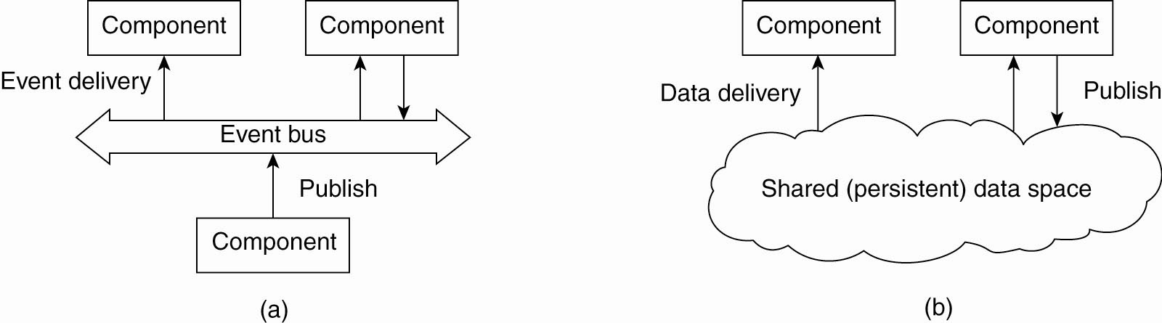
Architectural Styles (4)
Figure 2-2. (a) The event-based architectural style and …
Tanenbaum & Van Steen, Distributed Systems: Principles and Paradigms, 2e, (c) 2007 Prentice-Hall, Inc. All rights reserved. 0-13-239227-5

Slide 6
Publish / subscribe
Publish to, and subscribe from, the event bus
Processes publish events, and the middleware arranges that only those processes that subscribed to that type of event receive them
Processes are referentially decoupled which means that they do not need to know about each other.
Tanenbaum & Van Steen, Distributed Systems: Principles and Paradigms, 2e, (c) 2007 Prentice-Hall, Inc. All rights reserved. 0-13-239227-5

Slide 7
Architectural Styles (5)
Figure 2-2. (b) The shared data-space architectural style.
Tanenbaum & Van Steen, Distributed Systems: Principles and Paradigms, 2e, (c) 2007 Prentice-Hall, Inc. All rights reserved. 0-13-239227-5

Slide 8
Publish / subscribe across time
Publish to, and subscribe from, the persistent data space
Processes publish events, and the middleware arranges that only those processes that subscribed to that type of event receive them – but the processes can be running, or not, at any time
Processes are time decoupled which means that the events (and data) must be stored in some persistent form.
Tanenbaum & Van Steen, Distributed Systems: Principles and Paradigms, 2e, (c) 2007 Prentice-Hall, Inc. All rights reserved. 0-13-239227-5

Slide 9
Data-centric intelligent DB
Can create intelligent databases using logic:
  Modus ponens: A -> B AND A, THEN B
  Resolution: X v Y AND not(Y) v Z THEN X or Z
Forward chaining database:
  Publish A // a fact
  Publish A -> B [not(A) v B] // an implication
Tanenbaum & Van Steen, Distributed Systems: Principles and Paradigms, 2e, (c) 2007 Prentice-Hall, Inc. All rights reserved. 0-13-239227-5

Slide 10
Retrieve B from intelligent DB
Use simple external code on top of the database:
Select *B* (pattern match) from Implications yields
  “not(A) v B”
  […] (all other implications with B in them)
Using: “not(A) v B”
  Search for A;
  If A is true, then report that B is true.
Tanenbaum & Van Steen, Distributed Systems: Principles and Paradigms, 2e, (c) 2007 Prentice-Hall, Inc. All rights reserved. 0-13-239227-5

Slide 11
Using resolution logic…
Forward chaining database:
  Publish X v Y
  Publish not(Y) v Z
Search for proof of X v Z:
  Retrieve terms with X or with Z in them.
  Using resolution, combine:
    X v Y
    Not(Y) v Z
  Yields X v Z
Tanenbaum & Van Steen, Distributed Systems: Principles and Paradigms, 2e, (c) 2007 Prentice-Hall, Inc. All rights reserved. 0-13-239227-5

Slide 12

Event Bus architectures.
  Referential decoupling
  Temporal decoupling if persistence is implemented.
  Add to your toolbox!
Tanenbaum & Van Steen, Distributed Systems: Principles and Paradigms, 2e, (c) 2007 Prentice-Hall, Inc. All rights reserved. 0-13-239227-5

Slide 13
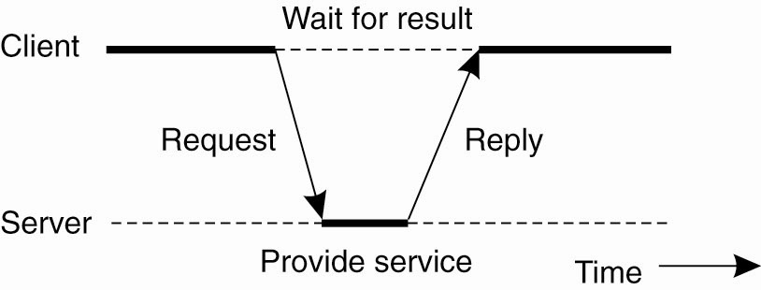
Centralized Architectures
Figure 2-3. General interaction between a client and a server.
Tanenbaum & Van Steen, Distributed Systems: Principles and Paradigms, 2e, (c) 2007 Prentice-Hall, Inc. All rights reserved. 0-13-239227-5

Slide 14
Application Layering (1)
Recall previously mentioned layers of architectural style
    The user-interface level
    The processing level
    The data level
Tanenbaum & Van Steen, Distributed Systems: Principles and Paradigms, 2e, (c) 2007 Prentice-Hall, Inc. All rights reserved. 0-13-239227-5

Slide 15
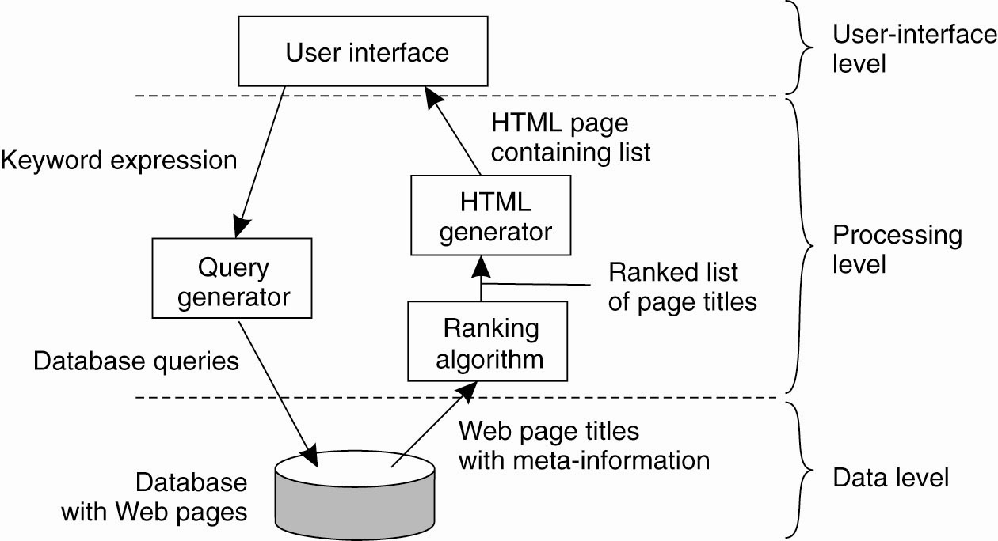
Application Layering (2)
Figure 2-4. The simplified organization of an Internet search engine into three different layers.
Tanenbaum & Van Steen, Distributed Systems: Principles and Paradigms, 2e, (c) 2007 Prentice-Hall, Inc. All rights reserved. 0-13-239227-5

Slide 16
Multitiered Architectures (1)
The simplest organization is to have only two types of machines:
    A client machine containing only the programs implementing (part of) the user-interface level
    A server machine containing the rest,
    the programs implementing the processing and data level
Tanenbaum & Van Steen, Distributed Systems: Principles and Paradigms, 2e, (c) 2007 Prentice-Hall, Inc. All rights reserved. 0-13-239227-5

Slide 17
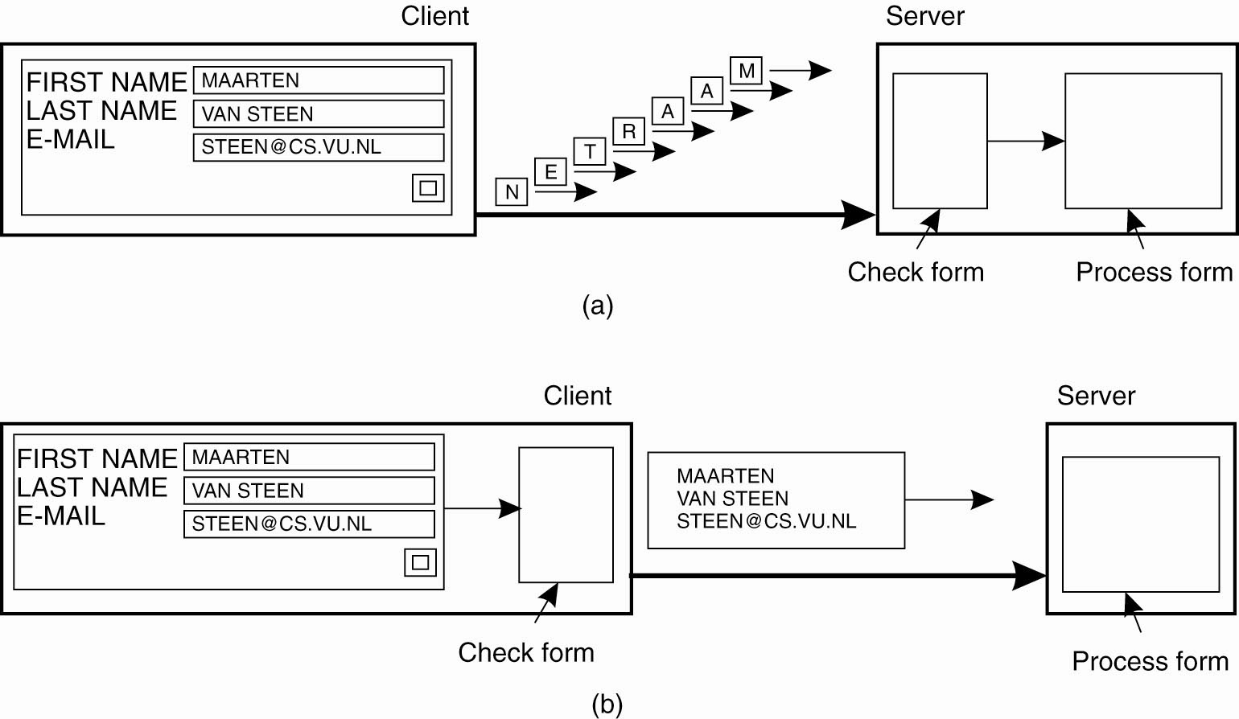

Scaling Techniques
Figure 1-4. The difference between letting (a) a server or (b) a client check forms as they are being filled.
Tanenbaum & Van Steen, Distributed Systems: Principles and Paradigms, 2e, (c) 2007 Prentice-Hall, Inc. All rights reserved. 0-13-239227-5

Slide 18
Example: Security tradeoffs thick/thin client
Thin: More packets, more exposure and more chance for profiling sender/receiver patterns.
Thick: more code exposed on the client, more chance for out-of-date, insecure client code.
Tanenbaum & Van Steen, Distributed Systems: Principles and Paradigms, 2e, (c) 2007 Prentice-Hall, Inc. All rights reserved. 0-13-239227-5

Slide 19
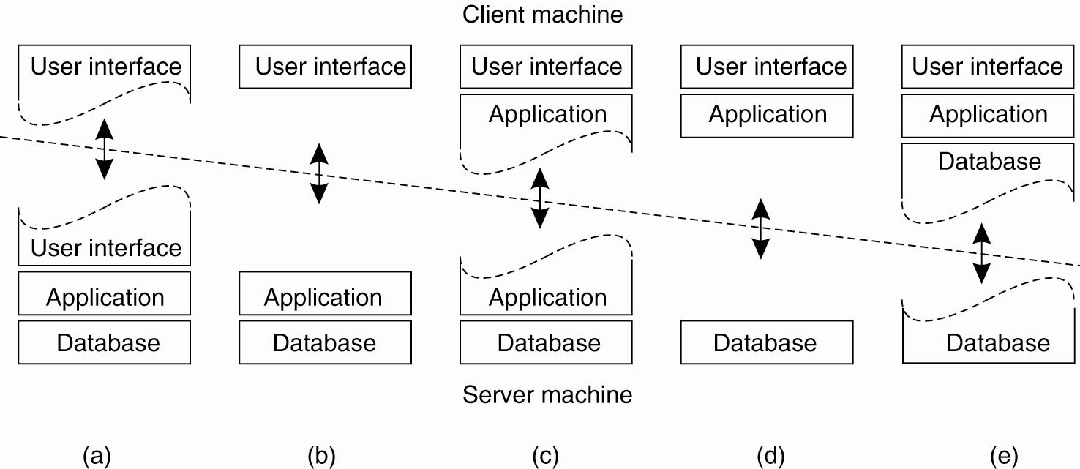
Multitiered Architectures (2)
Figure 2-5. Alternative client-server organizations (a)–(e).
Tanenbaum & Van Steen, Distributed Systems: Principles and Paradigms, 2e, (c) 2007 Prentice-Hall, Inc. All rights reserved. 0-13-239227-5

Slide 20
Heavy Client
Pro:
  Less network traffic
  Quick interactive response
  Handle many exceptions locally and gracefully
  Possibly fewer security issues to address
  Offload computational and data burden to client
  Offload data security problem to client
Con:
  Offline/push update nightmare! ← !!!!!!!!!!!!!!!!
  Code lives in many places at once, versions out of sync.
  More difficult to administer
  Possibly harder to code because of split application.
  System errors must be handled by the client
Tanenbaum & Van Steen, Distributed Systems: Principles and Paradigms, 2e, (c) 2007 Prentice-Hall, Inc. All rights reserved. 0-13-239227-5

Slide 21
Heavy Server
Pro:
  Do not have to distribute updates(!!!!)
  Simple to code because everything is in one place.
  Simple to maintain and monitor
  May have increased security from code managed on server
  Handle exceptions in one place
Con:
  Lots of (inefficient) traffic over the network
  Slow interactive client response.
  Increased computational and data burden on server
  May have to ship large amounts of data from client
  Security challenges for sensitive client data(!)
Tanenbaum & Van Steen, Distributed Systems: Principles and Paradigms, 2e, (c) 2007 Prentice-Hall, Inc. All rights reserved. 0-13-239227-5

Slide 22
Thick Client / Thin Client
  Add your expert knowledge of the pros and cons of thick and thin clients to your toolbox:
Tanenbaum & Van Steen, Distributed Systems: Principles and Paradigms, 2e, (c) 2007 Prentice-Hall, Inc. All rights reserved. 0-13-239227-5

Slide 23
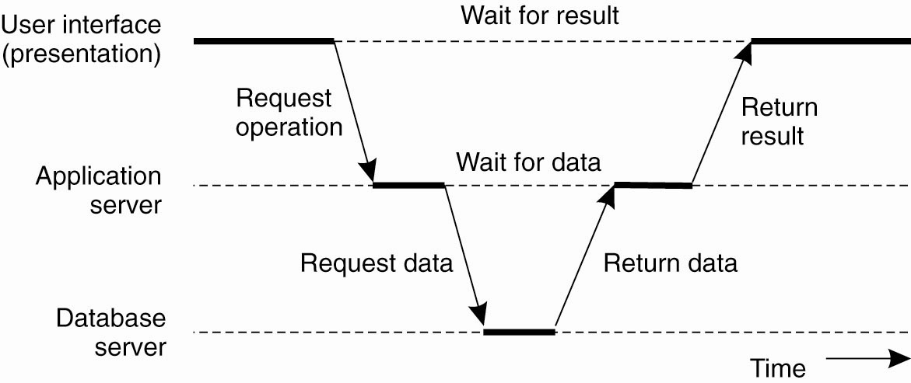
Multitiered Architectures (3)
Figure 2-6. An example of a server acting as client.
Tanenbaum & Van Steen, Distributed Systems: Principles and Paradigms, 2e, (c) 2007 Prentice-Hall, Inc. All rights reserved. 0-13-239227-5

Slide 24
Different types of operations
When messages can be lost, there is a big difference between idempotent operations, and those that can only be executed one time.
“Add $50,000 to Smith’s account” (only once)
“Return the current balance in Smith’s account” (idempotent, can repeat many times if thought lost)
Tanenbaum & Van Steen, Distributed Systems: Principles and Paradigms, 2e, (c) 2007 Prentice-Hall, Inc. All rights reserved. 0-13-239227-5

Slide 25
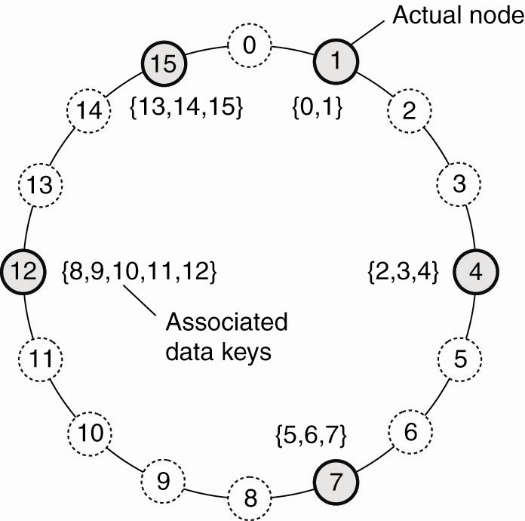
Structured Peer-to-Peer Architectures (1)
Figure 2-7. The mapping of data items onto nodes in Chord.
Tanenbaum & Van Steen, Distributed Systems: Principles and Paradigms, 2e, (c) 2007 Prentice-Hall, Inc. All rights reserved. 0-13-239227-5

Slide 26
Adding/removing a node from DHT
To add a node to a DHT (Distributed Hash Table)
Use a RNG (random number generator) to produce some number in the correct key range—Chance of conflict is low
Look up the next highest numbered node, make successor
Insert new node in between predecessor and successor. Move data/processing code from successor as needed.
Removal of node is the reverse, including moving data/processing code
Tanenbaum & Van Steen, Distributed Systems: Principles and Paradigms, 2e, (c) 2007 Prentice-Hall, Inc. All rights reserved. 0-13-239227-5

Slide 27
DHT dynamics
What makes DHT work:
Deterministic scheme to map key of data item to identifier of some node to store it.
Look up data by same key – get to node that has stored it
Nodes can join and quit at will
Logical organization independent of physical network
General purpose: can support many kinds of applications.
Tanenbaum & Van Steen, Distributed Systems: Principles and Paradigms, 2e, (c) 2007 Prentice-Hall, Inc. All rights reserved. 0-13-239227-5

Slide 28
Rapid communication between nodes
Communication in DHT is not around the ring…
  Nodes maintain overlay network
  Actual location time is O(log(N)) where N is the number nodes.
For our examples we will use the simpler “around the ring” description because it is easier to visualize
Tanenbaum & Van Steen, Distributed Systems: Principles and Paradigms, 2e, (c) 2007 Prentice-Hall, Inc. All rights reserved. 0-13-239227-5

Slide 29
Distributed Hash Tables (DHT)
  Dynamic distributed collaboration
  Extremely powerful and flexible
  Add these devices to your toolbox:
Tanenbaum & Van Steen, Distributed Systems: Principles and Paradigms, 2e, (c) 2007 Prentice-Hall, Inc. All rights reserved. 0-13-239227-5

Slide 30
Bit Torrent
Primarily peer-to-peer with some centralized components.
Both structured and unstructured.
  Structured: .torrent files/trackers → centralized
  Unstructured: regular nodes → de-centralized
Nodes (computers) exist in swarms. For any particular file, at least one set of nodes in the swarm must have a complete copy of the file, and typically this is on a single node to start.
Tanenbaum & Van Steen, Distributed Systems: Principles and Paradigms, 2e, (c) 2007 Prentice-Hall, Inc. All rights reserved. 0-13-239227-5

Slide 31
Torrent Trackers
.torrent files (fixed location) point to trackers
Trackers (servers) for F keep lists of active nodes with file F
Download chunks of F from various nodes.
Nodes upload and download the file simultaneously
Two nodes can even trade pieces of F
Tanenbaum & Van Steen, Distributed Systems: Principles and Paradigms, 2e, (c) 2007 Prentice-Hall, Inc. All rights reserved. 0-13-239227-5

Slide 32
Leechers and Seeders
Seeders remain connected to the swarm even when they are not downloading from it
Leechers don’t allow upload, then just want to download. In general this is locally optimal.
So, for these systems, reward for good behavior must be built into the design.
Tanenbaum & Van Steen, Distributed Systems: Principles and Paradigms, 2e, (c) 2007 Prentice-Hall, Inc. All rights reserved. 0-13-239227-5

Slide 33
Trackerless Torrents
Often implemented as a DHT. Sometimes can also work alongside a traditional tracker system as a backup.
Nodes discover one another and share information about the torrent.
No central server.
Tanenbaum & Van Steen, Distributed Systems: Principles and Paradigms, 2e, (c) 2007 Prentice-Hall, Inc. All rights reserved. 0-13-239227-5

Slide 34
Bit Torrent
Both structured and unstructured.
  Structured: .torrent files/trackers → centralized
  Unstructured: regular nodes → de-centralized
.torrent files (fixed location) point to trackers
Trackers (servers) for F keep lists of active nodes with file F
Download chunks of F from various nodes.
Good behavior enforced: upload and download rates are considered
Two nodes can even trade pieces of F
Tanenbaum & Van Steen, Distributed Systems: Principles and Paradigms, 2e, (c) 2007 Prentice-Hall, Inc. All rights reserved. 0-13-239227-5

Slide 35
Bit torrent
  Add this powerful and efficient file distribution design to your toolbox:
Tanenbaum & Van Steen, Distributed Systems: Principles and Paradigms, 2e, (c) 2007 Prentice-Hall, Inc. All rights reserved. 0-13-239227-5

