Slide 1
Measuring “proof” of an effect.
Clark Elliott
DePaul University

Slide 2
Basic science

Slide 3
Repeatability
Can these results be repeated by a [completely] independent lab?
Provide a careful written record of all procedures with the prior intention that the experiments will be replicated by others—preferably without consultation prior to the replication design.

Slide 4
Verification
Provide all your data [online]. This is now required for acceptance at many journals.
Others can verify your statistical results, without having to re-run the study (a huge savings in time).
They can use other statistical methods as well.

Slide 5
Design for repeatability
What you did.
How you selected subjects
Motivation behind your design (e.g., when looking at gambling outcomes, accounting for the fact that most gamblers have consumed alcohol.)
Etc.

Slide 6
Make your computer code, questionnaires, device manufacturers, etc. available and explicit.
Have a protocol for answering design questions for replication studies.

Slide 7
Pre-registration of replications!
Establish a protocol for pre-registration of studies that will be included in any later meta-analysis of results.
This helps to reduce the publication-bias / file-drawer problem.
There is no Journal of Non-results so studies that don’t reject the null hypothesis tend to get stuffed in file drawers.

Slide 8
Replication crisis
A very large percentage of the published experiments from the twentieth century on have either never been replicated, or have failed replication attempts.
Most of those failed replication attempts have gone unreported.
This has brought historical statistical methods and standards (e.g., p < 0.5) into question.

Slide 9
Why the web helps
Prior to the web, publishing results may take several years from the start of a major experiment.
It could take many months to gather data, analyze it, and write up the results.

Slide 10
It could take years to complete a scholarly review:
Finding reviewers willing to put in the time
Getting them to complete their review
Rounds of back-and-forth for accept-with-questions discussion
Rounds of back-and-forth with a scholarly editor.
Many months for the print version to arrive.

Slide 11
With the Internet we still have the turnaround time with reviewers and editors, but communication is much more rapid.
Online journals are much cheaper to produce, and articles are available much sooner.

Slide 12
Good and bad when no results…
When good work shows no results, this can be important for others to know—especially with replication studies. It is now trivial to place these results on the Web.
However, “non-results” generally do not receive the same level of scholarly review. When this is true, we should not have the same level of confidence in these otherwise important results.

Slide 13
Peer discussion
Engage in peer discussion of your work at conferences, on campus and online.
This cross-pollination of ideas, and criticisms is invaluable.
Students: go to conferences. Submit your work. Attend. Take part in discussions. There is no substitute for this activity.

Slide 14
Some basics of science
Hypothesis & Null hypothesis
Odds against chance / t-test / Bayes factors
Reputation of the researcher
Independent replications
Effect size

Slide 15
(Null) Hypothesis
A tentative explanation of observations
Ex: Men’s hands are larger than women’s.
Null hypothesis: There is no significant hand size difference between males and females.
A claim is considered valid if its counter-claim is improbable.
How confidently can we reject the null hypothesis?

Slide 16
Odds against chance—example
Hypothesis—if a person stands on one leg and flips a coin it will usually be heads.
I flip a coin once, and it is heads. What are the odds it is a coincidence only? 1 in 2. How confident are you of the effect?
2 flips, both heads…? 1 in 4. Confidence?

Slide 17
3 flips, all heads. 1 in 8 (2³). Confidence?
4 flips, 1 in 16; 5: 1 in 32; 6: 1 in 64 […]
32 flips: 1 in 4,294,967,296. Confidence?
The higher the odds against chance of it being merely a coincidence, the more confident we are the hypothesis is proven.

Slide 18
Common sense suggests that at some point we have to take the hypothesis seriously.
We can compare this to the odds against chance when not standing on one leg in our control group. (Assume 1 to 1.)
This suggests a correlation with standing on one leg.

Slide 19
P-value
Probability of an observed result, assuming the null hypothesis is true: likelihood of a coincidence. Think of shading the edge of your bell curve.
Tradition has p < 0.05 (1 in 20) yielding statistical significance. Modern push for p < 0.01 (1 in 100) and use of Bayes factors.
The smaller the p-value, the stronger the results.

Slide 20
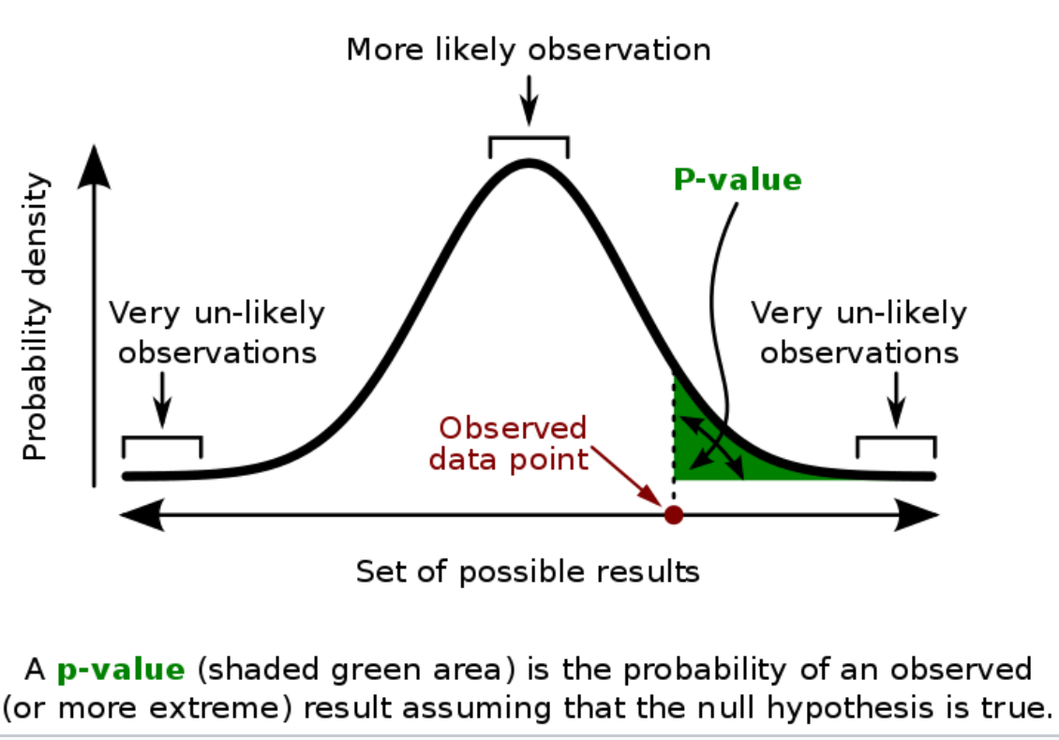
(Wikipedia)

Slide 21
Status and reputation.
Who was flipping the coin?
Could Elliott be a fraud? Is it a magic trick? What does he have to gain?
Did he consider all the factors like some weird magnetism or bias in the coin? Confident of a good study design?
How good is DePaul’s reputation?

Slide 22
Replications
With staggering OAC now our curiosity is piqued, but we don’t believe it.
Repeat at another university, with another coin, and another flipper. Completely independent, but the same experiment.
Same results. 32 flips: 1 in 4,294,967,296.

Slide 23
Each time we gather another replication, our confidence goes up.
Meta-analysis gathers all the results of similar studies together.

Slide 24
Bayes factors
An alternate method of calculating how unlikely the null hypothesis is.
Compare two models, often null hypothesis and the experimental hypothesis
Include a prior and post prior values, so some weight is given to how things have been believed to be before.

Slide 25
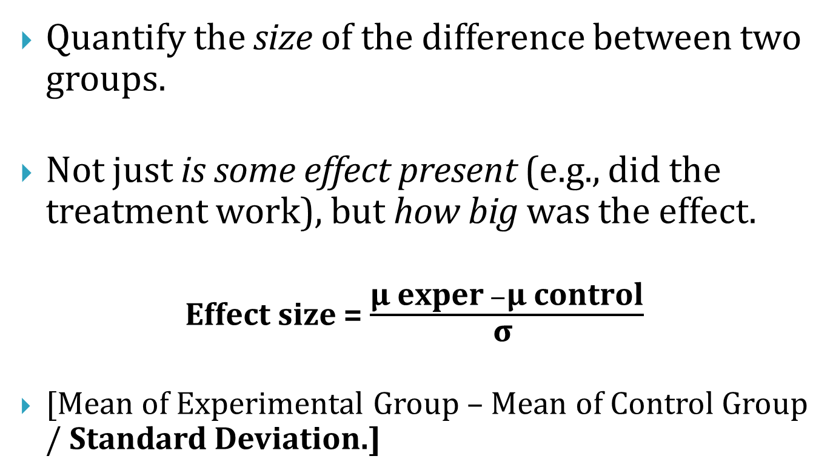
Effect Size
Quantify the size of the difference between two groups.
Not just is some effect present (e.g., did the treatment work), but how big was the effect.
Effect size = $\frac{\text{μ} \text{exper} −\text{μ} \text{control}}{\text{σ} }$
[Mean of Experimental Group – Mean of Control Group / Standard Deviation.]

Slide 26
The larger the standard deviation, the wider the curve, and the more overlap there is between groups.
The more overlap there is, the less of an effect we see, even if the average of the two groups is significant.

Slide 27
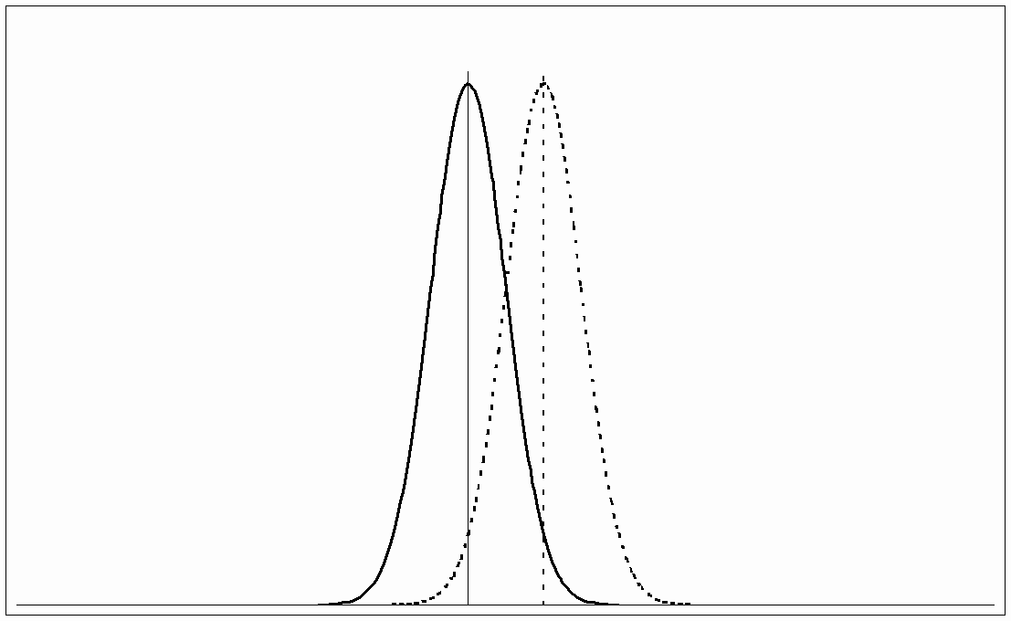
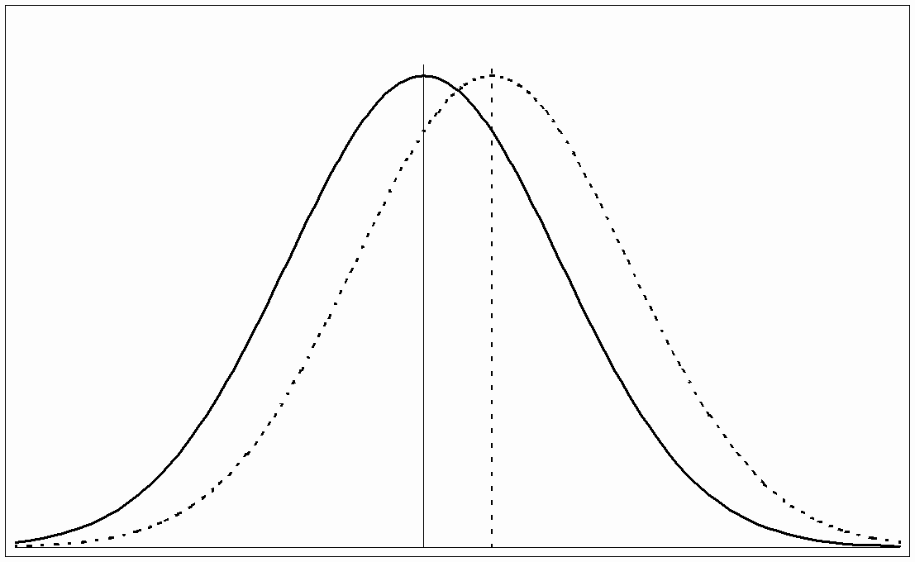
Each of these conditions has the same difference in average scores between the two conditions. But the overlap on the left is much smaller, so the effect is larger.

Slide 28
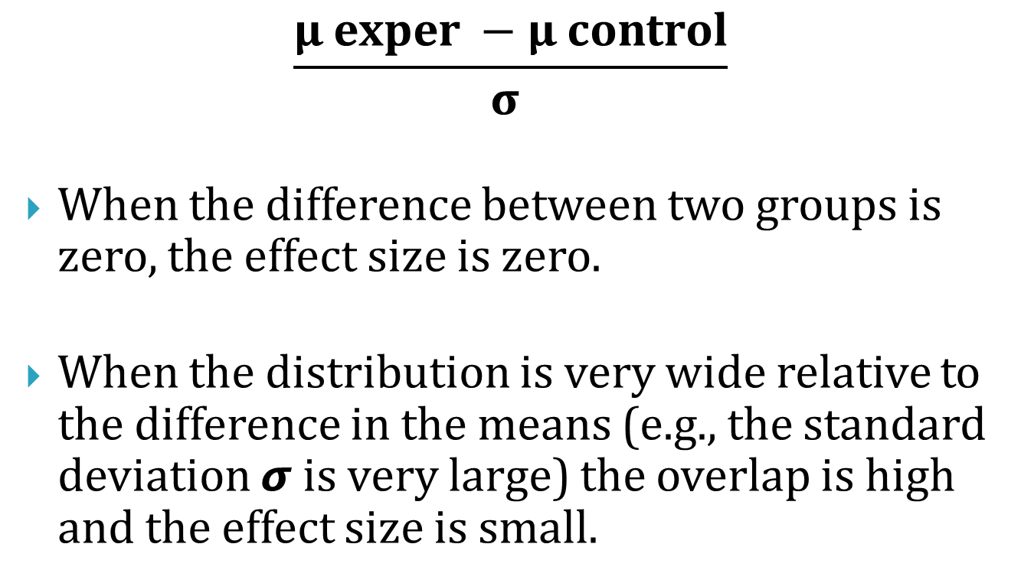
$$\frac{\text{μ} \text{exper} −\text{μ} \text{control}}{\text{σ} }$$
When the difference between two groups is zero, the effect size is zero.
When the distribution is very wide relative to the difference in the means (e.g., the standard deviation 𝞼 is very large) the overlap is high and the effect size is small.

Slide 29
Effect size is equivalent to a Z-score of a standard Normal Distribution.
An effect size of 0.2 means that the average score in exp. group is 0.2 SDs above the average score in control group and exceeds the scores of 58% of the control group.

Slide 30
Case studies
In the modern world, these are not given the same way as evidence-based science.
This is a shame, because scrupulously detailed case reports have a much higher level of what might later turn out to be critically important detail than does controlled experiments.

Slide 31
With controlled experiments we tend to do our best to limit the number of variables. We often do this artificially.
The rich details in the natural world are lost.
Some of this came with the Flexner report in 1911, which set the tone for modern American Allopathic medicine.

Slide 32
File drawer / publication bias
Another challenge we might make to work is that it suffers from a file drawer problem.
There is no Journal of non-results
Suppose we stood on one leg and flipped a coin 16 times and it came up heads 8 times. No one would publish those results.

Slide 33
But if we stand on one leg and flip a coin 16 times and it comes up heads 16 times, we have very strong odds against chance (1 in 65,536). So we submit our paper.
An argument against accepting our paper for publication is that there might be that there are 65,000 people who flipped coins with pretty normal results. And they never published a paper. Instead they stuffed their “non-results” in a file drawer and left them there.

Slide 34
How to address it— common sense
First, use common sense. How difficult is it to run this kind of study? How likely is it than anyone ever did?
Is this kind of study dependent on newer results or technology, so no history?

Slide 35
Encourage replication
Make your entire design public. Provide access to computer code, databases, and equipment sources.
Provide commentary on difficulties to be avoided.
Solicit replications in the academic community.

Slide 36
Pre-register replications
Provide a pre-registration site.
Make it known that ONLY pre-registered studies will be included in any follow-up meta-analysis of replication studies.
During later meta-analysis, use ONLY pre-registered studies, and include all that have been completed. Note all failures—in effect publishing “non-results” along with results.

Slide 37
Replication crisis
In 2016 Nature reported that of 1,500 scientists responding to a poll, 70% of them had failed to reproduce at least one other scientist's experiment.
50% had failed to reproduce one of their own experiments.
Most published work is not replicated.

Slide 38
Some prestigious journals have a policy of never publishing replications, only original research—even if the replication failure is of much interest.
Academics don’t receive nearly as much credit for replications.

Slide 39
Certainty?
In science, we are rarely certain.
We simply align ourselves with the best odds against chance to separate scientific effects and knowledge from coincidence.

Slide 40
95+% of climate scientists agree that not only is the environment changing in potentially catastrophic ways, but also that humans are the primary cause.
But there is a (small) possibility that it just happens to be a coincidence that CO² is rising and humans are producing CO².

Slide 41
Politicians use this to convince large numbers of voters that no one knows the cause because “it is not certain.”

Slide 42
Weak science should be vetted
When we don’t have good OAC, statistics, design, reputations, repeatability, effect size, then we should consider that the results might be suspect. We would not want to rely on them.

Slide 43
Good science should be accepted
When we see repeatable results, strong OAC, reasonable effect size, good reputations and good study design… we should agree the results are good science.
If we don’t like the results, we are allowed our opinion, but it should not change the science.

