Slide 1
Ethical concerns as we approach the singularity
Clark Elliott
DePaul University
Copyright 2013

Slide 2
Overview of Artificial Sentience
The complexity of the human mind.
Odd capabilities of humans, supported by science
God helmet, internet brain communication, etc.
The nature of true science, and real scientific curiosity
Looking at assumptions we are often taught as gospel
Surprising results about the nature of reality and human consciousness

Slide 3
How computers work
The correspondence of humans and computers
Causing pain to an artificial human
The updated China Brain exercise
Ethical questions raised
The generation of humans that must consider policy regarding the approach of the singularity

Slide 4
The size of the problem – why we can’t know where this will lead.
Humans are very complex
Our current understanding of who we are is very limited.

Slide 5
The human “CPU”
Estimates of raw human processing power run to exaflop computing speeds (1,000,000,000,000,000,000 [10-18] flops). That's roughly 50 million desktop computers.
Stretch to China with 3,000 miles to spare.

Slide 6
Memory
Biological storage capability: write everything down on 8.5x11 pages, 12-point font, both sides, one-byte per char. How high is the stack?
Harvard researchers stored information in DNA molecules. If our brain were made of pure DNA our stack of paper might stretch out into space for 2,485,795,454 miles -- or circle the earth 100 million times.
Most estimates take us at least 5 miles high. Some 280,000 miles. How do we index this? (The door)

Slide 7
Size of the human mind
When we look at everything that might contribute to the human mind the numbers are staggering.
University of Leicester physics department ran numbers on shipping the human mind via high-speed internet rates over a star-trek like tele-porter. Students produced a paper published in Journal of Physics Special Topics
It would take...

Slide 8
…350,000 times the current age of the universe to teleport a human mind from this room to the next at current Internet speeds.
https://www2.le.ac.uk/news/blog/2013/july/the-final-frontier-just-how-easy-is-it-to-teleport-humans-into-space-ask-leicester-physics-students

Slide 9
The technology is coming…
Advances in technology continue not only through increments in the speed and size of computers, but also in surprising discoveries that lead to new fields of human endeavor:

Slide 10
The God Helmet
http://en.wikipedia.org/wiki/God_helmet
We can artificially stimulate people's brains to, roughly, have a sense of spiritual communion. Let's imagine that we perfect our understanding of this part of the brain.
Common sense (careful!) suggests that, like taking a hallucinogenic drug we are just creating a local condition in the brain.
But theoretically, the question remains unanswered (and maybe unanswerable?) whether such stimulation generates the local illusion of communion with God, or stimulates that part of humans that actually allows some form of communion with God.

Slide 11
Branch of study in neurotheology
Consider:
We hear waves on the beach at night.
We go deaf. Then return to the beach.
Just because we don’t hear the waves doesn’t mean they aren’t there.
It is conceivable that the brain has hardware for communion with God, but we just aren’t using our “ears.”
It is conceivable that we also just make God up, locally, in our brains.

Slide 12
Internet brains
Rat brains, and now human brains, are connected over the internet.
http://bits.blogs.nytimes.com/2013/08/27/researcher-controls-another-persons-brain-over-the-internet/?_r=0
Bilton writes:“Two researchers connected their brains by slipping on a hat that included a “magnetic stimulation coil,” which can read and stimulate the brain. A sent a signal to B’s brain, forcing him to move his right index finger to hit the “fire” button in a computer game…

Slide 13
Thought-controlled robot arms
Researchers at University of Pittsburgh and Carnegie Mellon University have inserted sensors into the brains of monkeys which allow them to control robot arms strictly with their thoughts.
The monkeys could reach for and grab food, and adjust for size and stickiness of morsels.
Warning: images and Ted video might be disturbing!
http://www.nytimes.com/2008/05/29/science/29brain.html?_r=0
http://www.ted.com/talks/miguel_nicolelis_a_monkey_that_controls_a_robot_with_its_thoughts_no_really.html
http://www.nature.com/news/2008/080528/full/news.2008.861.html

Slide 14
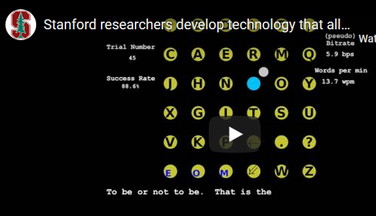
Typing with neural implants
A monkey was taught to type twelve words a minute using neural implants and a displayed keyboard.
https://spectrum.ieee.org/the-human-os/biomedical/bionics/monkeys-type-12-words-per-minute-with-braintokeyboard-communication

Slide 15
Graphene helmet
Graphene helmet 14 nanometers thick conducts electricity. Dr. Mark Hersam at NU, MIT, 1.3 billion dollars research award in Europe, Cal Berkeley.
Foldable electronics
“Printing” of skull communication helmets
http://www.northwestern.edu/newscenter/stories/2013/11/researchers-grow-graphene-on-silver.html http://www.mccormick.northwestern.edu/news/articles/2013/05/opening-doors-to-foldable-electronics-with-inkjet-printed-graphene.html
http://www.hersam-group.northwestern.edu/

Slide 16
qEEG and LoRETA 19-channel passive electrode input allows for mapping brainwaves in up to 6,000 locations in the brain for many amplitudes of 8 brain wave frequencies simultaneously.
We now have up to 5,000 graphene electrodes inserted into primate brains. How much information does THAT allow as output?

Slide 17
Infra-low waves (<.5HZ)
Delta waves (.5 to 3 Hz)
Theta waves (3 to 8 Hz)
Alpha waves (8 to 12 Hz)
Beta waves (12 to 38 Hz)
Low, medium, high
Gamma waves (38 to 42 Hz)
https://brainworksneurotherapy.com/what-are-different-types-neurofeedback

Slide 18
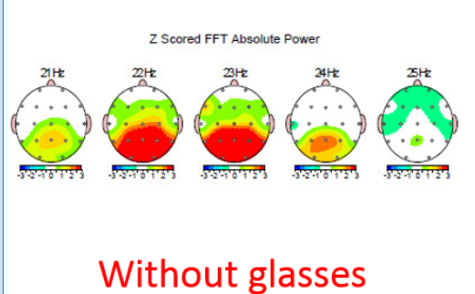

Slide 19
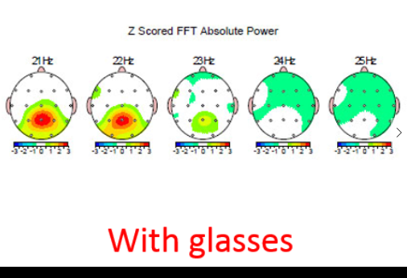

Slide 20
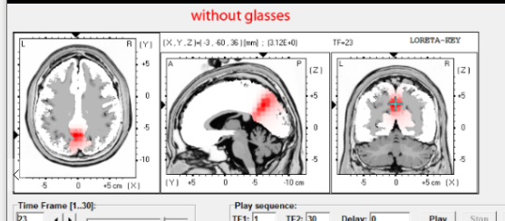

Slide 21
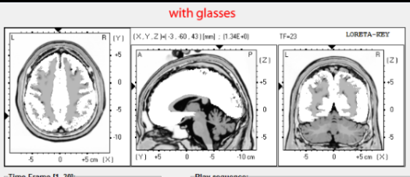

Slide 22
Real science remains curious…
Scientists are often not very scientific. When the world does not match their narrow area where "new" facts about the world are being discovered, they are often very defensive about their beliefs.
True science is not a "perfect" system. Progress is usually incremental. Theories come into vogue, with supporting evidence, then often are replaced with updated theories that better match the (new) data.

Slide 23
Results are typically measured as "odds against chance." The greater the odds against chance, the more confidence we have in a theory that predicts the results.
We like to see results repeated by different researchers. The more we have different researchers showing the same results, the more confident we are in the measurements.

Slide 24
It is a mistake to ever say, "Well it can't be, so it isn't" and in this way discount the data. Data is data. Science is science. Forming an attachment to a theory, and to assumptions, is not science.
Borrowing from Dean Radin, "Supernormal," page 298-300:
Let's look at some assumptions that we typically make:

Slide 25
1. *Realism: The physical world consists of objects that are completely independent of observation. The world is still there when you are not looking at it.
2. *Localism: Objects are completely separate. There is no such thing as "action at a distance.”
3. *Causality: time points exclusively from the past to the future, with no exceptions.
4. Mechanism: Everything can be understood in the form of causal networks, like the gears of a clock.

Slide 26
5. Physicalism: Everything can be described with real properties that exist in space and time, and all meaningul statements are either analytically provable, as in logic and mathematics, or can be reduced to experimentally verifiable facts.
6. Materialism: Everything, including the mind, is made of matter or energy: anything else thought to be "immaterial" doesn't exist. Ideas, for example, are encoded in the real world, either as physical documents, or neural encodings.

Slide 27
7. Determinism: There is no free will, and all events are fully caused by preceding states.
8. Reductionism: Objects are made up of a hierarchy of ever-smaller objects, with sumatomic particles at the bottom. All causation is strictly "upward," from the microscopic to the macroscopic world.

Slide 28
Most college students in the Western world are taught these doctrines, but they are seldom presented as assumptions. Yet none of these assumptions has ever been proven.
Unexamined assumptions can be problematic when we are trying to determine the nature of an area of study -- in this case the nature of reality, or "life.“
Consider what modern physics has to say…

Slide 29
1. *Realism may be falsified by quantum mechanics which can be seen, from theory and experimentation, that quantum objects do not have fully determined properties before they are observed.
2. *Locality may be falsified by quantum mechanics in which quantum-entangled objects display "spooky action" at a distance, and simultaneous interaction not lying within the bounds of traditional space-time.

Slide 30
3. *Causality may be falsified by the general theory of relativity which can be seen to tell us that the arrow of time is an illusion, and that causality can also run backwards.
4. Mechanism also fails if causality is not absolute.
5. Physicalism is falsified if we consider that observation may require consciousness.

Slide 31
Materialism may be falsified if the recent slew of "psi" experimental results cannot be seen to be effected by any known form of matter or energy. Alternatively some theories of physics explain the universe in terms of information from which the material world arises. Might consciousness create brain activity instead of the other way around?

Slide 32
7. Determinism fails because of the collapse of causality.
8. Reductionism may fail because of studies showing the effects of psycho-kinesis –effects from the "top down."

Slide 33
Physicists are used to paradigm shift…
“It would be a shock to come across a university where it was the practice of the students to recite adherence to Newton’s laws of motion, to Maxwell’s equations, and to the electromagnetic theory of light.” -- Sir Arthur Stanley Eddington
“…it is equally a shock, today, to find reputable scientists categorically asserting, in the manner of dogma, the impossibility of phenomena such as ESP”
-- Nobel Laureate Brian Josephson

Slide 34
Odd capabilities of the human mind
So now, applying an open mind with respect to assumptions we can consider some modern areas of study in the scientific light they should be taken, that is with an appropriately open mind, looking at odds against chance, repeatability, and effect size.

Slide 35
Reverse stroop test.
Standard Stroop
https://www.google.com/url?sa=t&rct=j&q=&esrc=s&source=web&cd=2&cad=rja&ved=0CDQQFjAB&url=http%3A%2F%2Ffaculty.txwes.edu%2Fjbrown06%2Fcourse7%2Fdocuments%2F9-2-08StroopEffectIntroduction.ppt&ei=KolkUrraJZTYyAGA2IBQ&usg=AFQjCNGfOtgfRfYui0935YTM9L5pYmJ27g
Same representation in the brain for viewing color, thinking of color, and the concept of color?
Measures cognitive interference

Slide 36
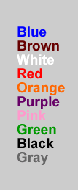
Stroop test #1 (NCW)
Read the color of the word
Piece of cake right??

Slide 37
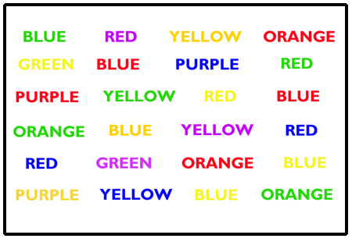
Stroop test #2 (RCN)
Read the word and time yourself – NOT the color
Still easy right?

Slide 38
Stroop test #3
Now….. Read the color of the word and time yourself – NOT the word
Not so easy, eh??

Slide 39
Klintman – retrograde stroop
Klintman, Holgar. 1983. "Is there a paranormal (precognitive) influence in certain types of perceptual sequences," Part I, Eur. J of Parapsychology, 5, pp. 19-49.
Klintman, Holgar. 1984. "Is there a paranormal (precognitive) influence in certain types of perceptual sequences," Part II, Eur. J of Parapsychology, 5, pp. 125-40.
Lund University, Sweden.
Summarized in Dean Radin, 1997, The Conscious Universe, pp. 117-118.
Radin and May, 2001, Proceedings of presented papers, Parapsychological Associatiation 44th. http://www.boundaryinstitute.org/articles/tri2.pdf

Slide 40
As discussed, Stroop Test shows cognitive interference
Show patch of color, e.g., GREEN, followed by a word, e.g., green or red
Measure how long it takes for a subject to name the patch of color, say the word
.
Do this sequentially, show / say, then show /say.
When the color and word match, then it takes less time to say the word. Stroop effect.

Slide 41
Then, for the heck of it, measure how long it takes to name the original color patch. RT1
Noticed some odd results – RT1 was too variable. Control for these. Explanation is difficult.
Here is what happened:
When the color and the word matched, then it took less time to name the color patch even though the word had not yet been displayed.
Simple explanation is (TRI) time-reversed interference. But, this goes against “science.”

Slide 42
Radin and May
A personal anecdote
Ortony and the hospital bed
The parking lot
Quality of the researcher is important
Company they keep?

Slide 43
Further investigation. In the Dean Radin, and Edwin May studies performed later some alternate explanations were sought:

Slide 44
1. Sensory cues: e.g., sound of the disk drive
a. Double blind
b. no feedback given
c. future match/mismatch not generated until after first response was given
2. Alertness linked RT1 and RT2 – not an explanation, but dampened interest (1987 Camfferman) – Radin and May showed evidence against this.

Slide 45
2. Statistical hints
Traditional investigation of randomness performed
3. Timing problems
Highest processing priority for this process
Must show bias which could not be found
Redundancy built into the timings, and different systems agreed
Results were gathered before match/mismatch was generated

Slide 46
4. Selective data reporting
All data was reported for all studies. No pilots were run
5. Selective stopping.
No performance feedback either per-session or per-trial
Double blind
So, no way to know when it was best to stop.

Slide 47
Over the web, e.g., study 3:
111 Sessions of 20 trials
1 session of 30 trials
2,270 total trials: 1,160 match, 1,110 mismatch
47 > 5 second max for RT1 or RT2, eliminated

Slide 48
Is the web too messy…? No!
Even though study 3 was a repeat of study 2 but where participants could download the program and run the trials on their own, how is it possible to “cheat” – either consciously or not?
Hint: it is not possible because the generation of match/mismatch takes place after RT1 is recorded.

Slide 49
An overview of the research
Radin, D. I. (2011). Predicting the unpredictable: 75 years of experimental evidence. In D. Sheehan (Ed)., Frontiers of Time: Quantum retrocausation. American Institutes of Physics. (Forthcoming.)

Slide 50
Main point is that good science…
A) follows the rules, always
B) pays attention to the data
C) is inquisitive by nature
D) is impartial, and unbiased, always
Extraordinary results require extraordinary data, yes. But, beyond that…
…we are not allowed to break the rules of science!

Slide 51
Meta analysis
In statistics, meta-analysis comprises statistical methods for contrasting and combining results from different studies in the hope of identifying patterns among study results, sources of disagreement among those results, or other interesting relationships that may come to light in the context of multiple studies. (Wikipedia)
When correctly done, can tease out small effects and increase odds against chance.

Slide 52
Meta analysis of psychology effect size.
F.D. Richard and colleagues in Review of General Psychology. (2003;7:331-363)
One hundred years. 25,000 experiments, 8 million subjects.
Average effect size was 0.21
Explains 4.4 percent of relationships(from the square) and leaves 95.6 percent unexplained.
96 percent of DNA has no known biological purpose

Slide 53
SAIC / Princeton / Standford
Science Applications International Corporation
“a $4-billion technology and engineering company that uses its deep domain knowledge to solve problems of vital importance in the world”
Many government contracts.

Slide 54
Free-response pre-cognition experiments
Small effect size – usually wrong about guessing the future. Skeptics thus discount the results.
Meta analysis of 770 free-response precognition experiments by the Stanford Research Institute. Odds against chance of 300 million to 1.
SAIC: 445 tests. OAC of 1.6 million to 1.
Princeton: 653 sessions. OAC 33 million to 1.
Effect size: about 0.20 – consistent with 100 years of psychology testing.

Slide 55
J. Utts. An assessment of the evidence for psychic functioning. Journal of Scientific Exploration. 1996;10(1):3-30.
BJ Dunne and RG Jahn. Information and uncertainty in remote perception research. Ibid. 2003;17(2):207-241

Slide 56
Telepathy – Ganzfield experiments
Four unlike photos at remote location randomly selected for sender at a remote, isolated location.
Stimulate special brain state in receiver with Ping-Pong balls over the eyes, headphones with pink noise, relaxation.
Receiver reports impressions. Audio is recorded.
Same results when using skeptics.
Meta analysis of studies published through 2010 yield OAC of 13 billion trillion to 1. (Radin p. 190)

Slide 57
File drawer problem
To reduce the OAC to 1:1 for previous (Ganzfield) studies, you would have to run sessions 24 hours a day for 36 years – and report nothing.

Slide 58
Effects are ubiquitous
Similar results for psychokinesis, feeling of being stared at, clairvoyance (knowledge at a distance – not being sent), clairaudience, affecting body states at a distance (e.g., skin response, pupils), etc.

Slide 59
Daryl J. Bem, Cornell University, 2011
Feeling the Future: Experimental Evidence for Anomalous Retroactive Influences on Cognition and Affect
Same results as Radin and May, Klintman, et al.
9 experiments, 1,000+ participants
All but one of the experiments yielded statistically significant results; and, across all 9 experiments, Stouffer’s z = 6.66, p = 1.34 × 10-11 with a mean effect size (d) of 0.22. (P value of 0.05 or 0.01 is typically significant in rejecting Null Hypothesis.)

Slide 60
Traditional memory studies…
People are shown particular words, and then are given a list of words that include the ones they have previously experienced. The participants are next asked to recall as many words as possible from the list, allowing the experimenters to quantify the effect of the prior priming on the recall of those words.

Slide 61
Reversed…
In Bem's back-to-front version, participants were shown a list of words and then asked to recall words from it. Later Bem showed them words randomly selected from the same list, and it turned out that they had been better at recalling these words in the prior test. The subsequent display seemed to have influenced their earlier memory.

Slide 62
Find the erotic pictures
Subjects see two computerized “curtains” hiding a picture. The computer randomly picks one and links a picture to it AFTER the subject has picked.
Subjects found the erotic picture 53.1 percent of the time.

Slide 63
Original “priming” design
Computer randomly selects 24 words from a list of 48 nouns, “Please type in these words from the list.” (so they are “learning” the 24 words)
Study the whole list of common nouns by seeing them for three seconds each, and visualizing the object
Told to recall the words they could remember and type them in.
They recall the 24 they practiced at a better rate because they have been primed to remember them.

Slide 64
Time—reversed design
Study a list of common nouns by seeing them for three seconds each, and visualizing the object
Told to recall the words they could remember and type them in.
Computer randomly selects 24 words from the list, “Ah, before you leave, please type in these words from the list” (so they are “learning” the 24 words)
The students were better at recalling the 24 words, prior to studying them.

Slide 65
Replications of Bem
Bem knew that he would be under unprecedented attack for these results, and acceptance would only come with independent replications.
All of the original studies were based on well-vetted existing studies, but used time reversal as the only change
Anyone that wanted to be included in a later replications report had to register their intent to study the phenomena ahead of time—thus defeating the file drawer argument ahead of time.

Slide 66
2011 Summary of replications
90 registered replication experiments from 33 different labs in 14 different countries
Overall effect z = 6.40, p = 1.2 x 10⁻¹⁰, effect size 0.09
Bayes factor 1.4 x 10⁹ (where 100 is “decisive evidence”)
When Bem studies excluded, still p = 1.1 x 10⁻⁵, BF 3,853
File drawer: The number of potentially un-retrieved experiments required to reduce the overall effect size of the complete database to a trivial value of 0.01 is 544

Slide 67
Bounding limit
This appears to be one “upper” limit on our ability to represent the cognitive processes of sentient beings using computers.
A scientist would want to know what this bounding limit is, how it might be circumvented.

Slide 68
Quantum physics—Fred Alan Wolf
Can fully know either the position of a particle, or its momentum, but not both.
The NH₂ molecule is like an isosceles triangle
Participates in quantum reality to stay stable
H atoms cannot exist separately when part of the molecule. We see their “quantum ghosts” to know they are there.

Slide 69
That is, the H atoms don’t quite exist until they are noticed, and the molecule is in two states at once.
Once it is seen or noticed, the molecule becomes unstable and morphs into a gate being open / high-frequence, or a gate being closed / low frequency.
If this molecule is part of a neuron, then neighboring neurons will either get a stimulating signal, or they won’t depending on the position of the gate.

Slide 70
But whether the gate is open, or is closed, depends on the agency of whatever it is that noticed the H atoms. Did you notice a high frequency or low-frequency signal?
So, in this theory, we are not deterministic, but rather dependent on the consciousness that noticed the H atoms.
Do we have a quantum component to the sentient computers of the future?
Can this quantum component be affected by the future?

Slide 71
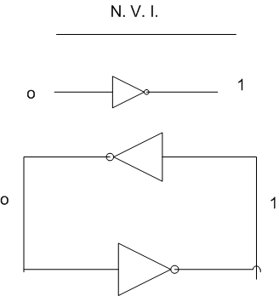
Elliott’s simple memory
.

Slide 72
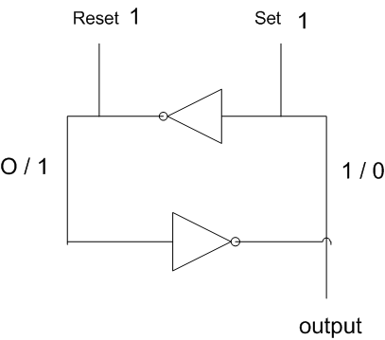
Elliott’s simple memory
.

Slide 73
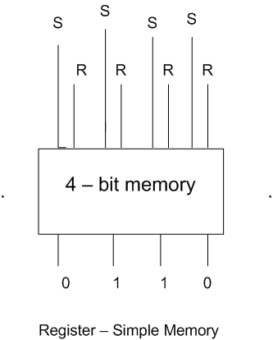
A 4-bit memory register
.

Slide 74
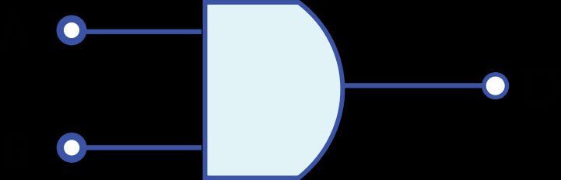
AND gate – The top intput is true AND the bottom input is true.
Top input: Trigger from the clock (5 volts) 2 billion times a second for 2.0 Ghz machine
Bottom input: When this instruction is activated
Output: Then write a green pixel on the screen.

Slide 75
Building very complex computers
Computers have billions of hardware locations, which can be set to zero volts or five volts (or magnetic charges), and software programs which are all stored as binary patterns, with 0s, and 1s, stored on the hardware as those charges.
CPUs are getting faster. Memory is getting larger.
At some point we might support the complexity of the human brain.

Slide 76
The artificial human and “pain”
Thus, if we build an artificial human, we can imagine that increasing "pain" would simply be like changing the number 5 in the "pain register" to the number 9. It is hard to imaging caring about this, from the perspective of the computer.
However while it might "yell" about it, and upset us, to the computer it is just a number in memory.

Slide 77
Just a register in memory.
0 1 0 1 is the number five in binary [8s,4s,2s,1s].
1 0 0 1 is the number nine.
Does it really matter what the bit configuration is in a computer register? 5 volts, 0 volts?

Slide 78
But not so fast...

Slide 79
Correspondence of the human brain and a computer
[For the moment] let's make the assumption that a human is like a computer.
Neurons (and glia, etc.) are the hardware.
Electrical and chemical activations of the [neurons] are the software.
Many have made this case. Otherwise, from a “science” standpoint, what else is there?

Slide 80
The China Brain exercise
With the China Brain exercise, in its original form we have every person in China act like a neuron and send messages to other Chinese people.
In the updated version, we build a computer that can fully implement the 7,000+- network connections of a neuron (glial cell, etc.), along with its various states of activation, growth, death.

Slide 81
We then begin replacing each of the neurons of The Human Brain with our computers.
If we have replaced one of the 180 billion cells with a computer, we probably still have a human, and probably still cannot cause her pain.
If we replace all the cells with computers, we have a computer.

Slide 82
At what point does the computer actually feel pain?
At what point is it no longer O.K. to cause it pain?
At what point does it become a sentient being?
Plants, single-cell animals, insects, worms, nervous systems?

Slide 83
Turning a human into a computer process.
In theory, we can now take a living human, and replace one of her 180 billion brain cells with a computer that FULLY implements her brain.
Is she still a human? Probably, yes. Everything she feels should be identical to what she felt before.
Now, one by one, replace ALL of her neurons (glia, etc.). She will still FEEL everything she felt before.
She is FULLY IMPLMENTED. Is she still a human?

Slide 84
Turning a computer process into a human.
Now let's work the other direction.
One by one we replace the silicon of a [complex, neuron-based] computer and running process (such as from the previous slide) with a biological implementation of a neuron, along with all the activations that are identical to that of our human.
Is the computer now human?

Slide 85
Counter argument, against argument against…
Might it be true that sentience (life) and the special talents that humans exhibit beyond the purely physical might simply come as a “critical mass” of complexity? That is, if we build a computerized artificial human that is as complex as a human, might we get the rest of this for free, rising purely out of the complexity of the system in some way we don’t now understand?

Slide 86
Argument against…
Humans are NOT just computational devices, because we have scientific evidence that supports capabilities (however small and however seldom they show up) that are not explained as purely physical, computational, talents. (E.g., seeing slightly into the future, occasionally, but reliably / Affecting matter at a distance.)
How do we write a computer program to implement these talents? Answer: no clue! Perhaps it can’t be done. If so, then humans are more than computers ever will be, or can be.

Slide 87
Ethical scenarios to consider. Is it ethical to…
...cause pain to a computer that fully implements a human being?
...treat fully a implemented computer version of a human different from the identical biological version of the human? Do the two different actions always result in the same ethical outcome?
...make a copy of a human being?

Slide 88
...pursue the creation of artificial, but fully implemented, humans?
...create artificial humans for the purpose of enslaving them for work?
...modify artificial humans so they are "happy slaves" and cheerfully do our work for us?

Slide 89
...modify humans so that they can become part computer, and are computationally enhanced?
...allow humans to choose to be modified so they are enhanced?
...modify children so they are enhanced, and become more competitive?
...create fully new humans from the ground up?

Slide 90
...do nothing, when we could create fully implemented human beings that spend their days in [the feeling of?] communion with God?
...kill (turn off) fully implemented copies of humans.
...preserve human consciousness indefinitely as a non-deteriorating, non-aging, software program?
...make perfect replications of existing humans?

Slide 91
...invest resources in creating "super-humans" (non-aging, continually learning human-like programs) that can lead us in the technology of the future?
...prohibit the creation of artificial humans that can harm us?
...prohibit the creation of artificial humans that can fight our (human?) enemies?

Slide 92
...prohibit the creation of artificial humans that can lead to the singularity (when artificial humans become smarter, and more capable, than we are, such that they understand us better than we understand them).

Slide 93
Your policy?
The current generation has a choice:
(a) fail to agree on a policy in these matters and wait to see what happens to us, or
(b) form our best policy now, and adapt it as needed.

Slide 94
Unknown future
Barring disaster, at least some of this technology is on its way here. Because of the complexity of humans, and the scientific (!) fact that there are human capabilities that are not explained as merely hardware and software, we don't know either how soon, or whether, we will ever build artificial humans.
We also don't know if, when we build them, whether they will be sentient, or have true consciousness (e.g., possibly testable with quantum mechanical observations).

Slide 95
Smmary
True scientists are not allowed to be selectively scientific.
There is (highly scientific) research, consistent with modern physics, that shows humans to have capabilities beyond the merely physical
The human brain is almost unimaginably complex and powerful
Many see the human brain as hardware and software, just like a computer.

Slide 96
One neuron at a time we can turn a human into computer, and vice versa
Have we then built an artificial human?
An argument against would be that humans have capabilities beyond the merely computational and physical, which may be necessary for sentience.
These special talents might, however, arise purely from complexity. We wouldn’t know because we’ve never built anything even remotely as complex as the human brain.

Slide 97
There are serious ethical questions that arise.
It is conceivable that ethical policy may be required in this, or the next, generation.

Slide 98
Caveats:
There are huge, currently unsolvable technological barriers to overcome before we can build artificial humans.

Slide 99
Caveats:
Even if we have the un-imaginably complex and powerful hardware to support a human mind, we still have no clue about how to write the software to run on it.
We don’t have any way to connect to an individual neuron in the brain such that we could replace all of its connections. Nor do we know which neurons to look for even if we could.
The psi effects reported are small, and thus limited in their immediate usefulness beyond theory.

