Slide 1
DISTRIBUTED SYSTEMS Principles and Paradigms Second Edition ANDREW S. TANENBAUM MAARTEN VAN STEEN Chapter 6 Synchronization (Many Elliott additions)

Slide 2
PowerPoint slides copyright
Tanenbaum & Van Steen, Distributed Systems: Principles and Paradigms, 2e, (c) 2007 Prentice-Hall, Inc. All rights reserved. 0-13-239227-5

Slide 3
Synchronization
Synchronizing the steps of a set of processes implementing the steps of a cooperative algorithm requires that we have a deterministic set of numbered steps, possibly determined by input into the program.
For a given input, the program always executes the same steps.
All steps have a timestamp T and T_{n} occurs before T_{n+1}.

Slide 4
The timestamp T_{n} on system A has no reliable relationship to the timestamp T_{n} on system B.
The two clocks generating the timestamp Tn on each system cannot be reliably synchronized.

Slide 5
System time
Getting the system time in any process is like reading a value from memory. It is a system library call.
It’s just a count, which is translated into a valid time string.
The starting point sets the epoch.
The Unix Epoch started 1970-01-01:00:00:00

Slide 6
If we had a globally shared memory location for all computers on earth, we could put the current time there, and many of our distributed systems algorithm difficulties would be solved.
To get the time, you would just read it from that shared memory register.
But, we don’t have globally shared memory…
So we don’t have an agreement about what time it is.

Slide 7
Speed
Modern computers run so fast that we need a new model of time for coordinating them in distributed systems.

Slide 8
No global clock: classic coordination problem
An example rule is: whenever P1 updates then P2 notices the timestamp and updates also.
That is: if the timestamp for P1 is later than the timestamp for P2, then P2 updates.
P2 update is an expensive process and would like avoid it, but it is also critical to meet the coordination invariants.

Slide 9
P2 always updates after P1 does P1 & P2 on the same hardware
P1 Timestamp | P2 Timestamp | Rerun P2?
20:20:18 | 20:20:16 | Yes
20:20:18 | 20:20:22 | No

Slide 10
P2 always updates after P1 does P1 & P2 on different hardware nodes
P1 Timestamp | P2 Timestamp | Rerun P2?
20:20:18 Real 20:20:30 Time | 20:20:16 Real 20:20:32 Time | Yes Error!!
20:20:18 Real 20:20:40 Time | 20:20:22 Real 20:20:38 Time | No Error!!

Slide 11
No global clock
Our i7 CPU clocks can run at ~5 billion ticks per second.
One CPU clock is always going to be skewed with respect another CPU clock.
Example: we are running a distributed “algorithm” on two hardware nodes that cooperate.
If we are off by only a millionth of a second between the two CPU clocks…

Slide 12
Core i7 8086K runs at 5 GHz, 44.34 instructions per cycle
221,720,000,000 instructions per second.
So our distributed “algorithm” is now off by 221,720 steps between the two processes.
Because of a sync error of 1/1,000,000th of a second!

Slide 13
AMD Ryzen Threadripper 3990X ($4K) CPU runs at 2,356,230 MIPS, so a sync error of 1/1,000,000th of a second would leave our two processes out of sync by…
2,356,230 instruction steps.
Algorithm means precision coordination down to the single step.
https://en.wikipedia.org/wiki/Instructions_per_second

Slide 14
Cesium clocks
Has been the standard for modern time since the 1958, based on the cesium-133 atom’s oscillations. ~9 billion cycles per second.
No longer fast enough.
GPS satellites each have several such clocks.
We are now developing clocks with far higher accuracy. Stronium clocks may be ~47,722 times as accurate as cesium.

Slide 15
Commerce…
The seasons, planting cycles, travel cycles, shipping cycles, lease terms and etc. used to be based on the day, month and year.
Which was fine… then.

Slide 16
But figuring a standard measure nowadays is harder.
(3600x24) Solar second is 1/86,400th of a solar day.
But earth slowing down, and also wobbles.
300 million years ago we had 400 days.
Temporary fluctuations, probably due to molten iron core.

Slide 17
Spinning in reverse
Seen from “the top / north pole” the earth spins counterclockwise and also orbits counterclockwise around the sun. The orbit is elliptical.
If the earth did not spin on its access, we would still have one solar day a year, with the sun rising in the west (backwards).
So we have one fewer solar days than we do “star” days each year because we are in a fixed position relative to distant stars.

Slide 18
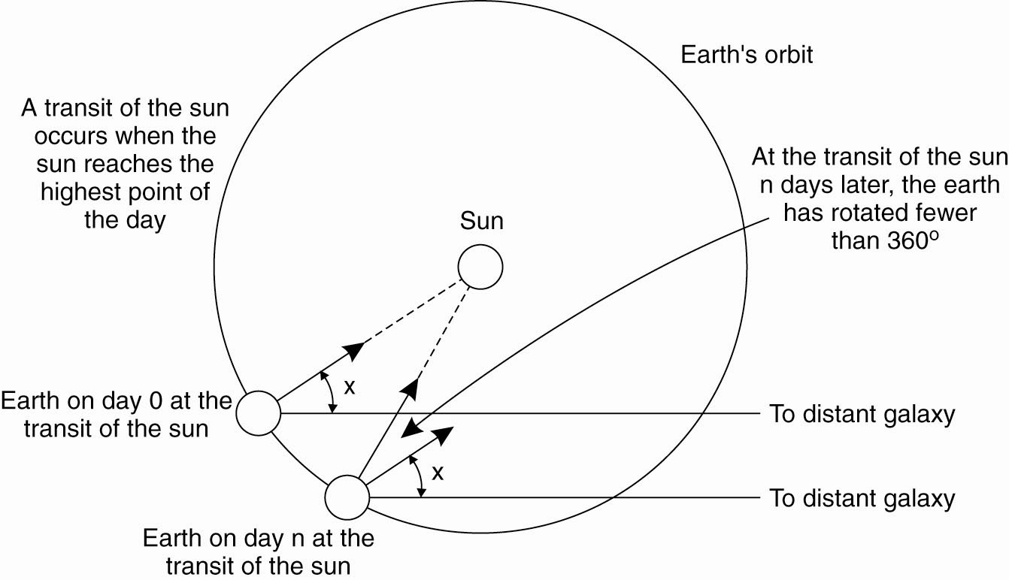
Physical Clocks (1)
Figure 6-2. Computation of the mean solar day.

Slide 19
High noon (independent of the seasons) depends on where the earth is in its transit of the sun. Because the orbit is elliptical, it is not a simple “24 hour” calculation.
Given the wobble of the earth, the slowing of its spin and the elliptical orbit, a solar day is not a very good modern measurement of time.

Slide 20
Mean solar day takes an average.
Cesium-133 atom, 9,192,631,770 transitions in a second.
TAI International atomic time, just a cesium-33 counter since midnight 1958-01-01.
But 86,400 cesium-133 seconds is now ~3msec less than a solar day, because slowing of Earth’s spin!
Recall, that is 7,068,690,000 instructions on a consumer-grade CPU.

Slide 21
How much money could Goldman Sachs make with 7,068,690,000 “free” instructions?
Consider, in 2019 they spent $100 million to shave, in some cases, a microsecond (millionth of a second) off a 30-second trade.
https://www.cnbc.com/2019/08/01/goldman-spending-100-million-to-shave-milliseconds-off-stock-trades.html

Slide 22
Distributed time
Modern distributed systems, which require instruction-level coordination of the algorithms at each node, but operate on multiple nodes, must consider a new model of time.

Slide 23
Longitude by Dava Sobel—what time is it?
A recommended technology book. Navigation on the face of the earth is not possible without knowing what time it is.

Slide 24
Julian calendar used in the west
Used from -45 CE, but miscalculated the solar year by 11 minutes.
Politics! 1582 Pope Gregory removed 10 days from the Julian calendar. Rent/interest vs. month’s pay. Finally September 2 became September 14 in 1752 in England leading to unrest.
Gregorian Calendar is still off by 26 seconds.

Slide 25
BIH (Bureau international de l’Heure) collects reports of cesium clocks and makes an average.
Cesium time is just a count since 1958
Leap seconds introduced to adjust to the skew with the solar day.
Universal Coordinated Time UTC

Slide 26
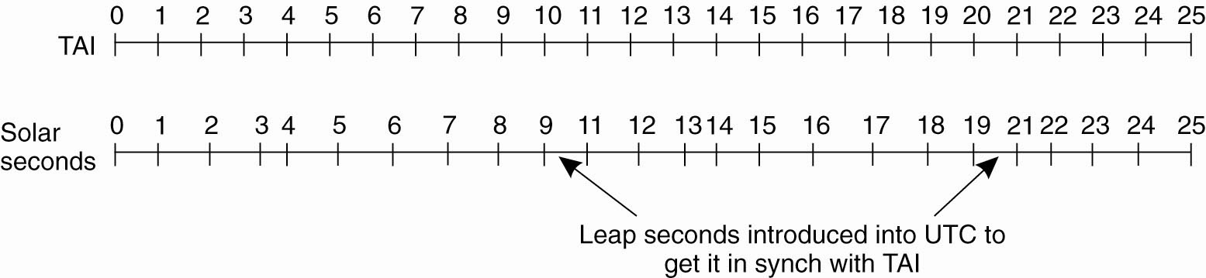
Physical Clocks
Figure 6-3. TAI (Int. Atomic Time) seconds are of constant length, unlike solar seconds. Leap seconds are introduced when necessary to keep in phase with the sun.

Slide 27
Cesium-133 under microwave bombardment yields accuracy of about 1 second drift in 200 million years—not good enough. (Off by 10M instructions per year…)
Optical clocks (under development) are 100 times more accurate.
Stronium clocks may be ~47,722 times as accurate as cesium-133 clocks.

Slide 29
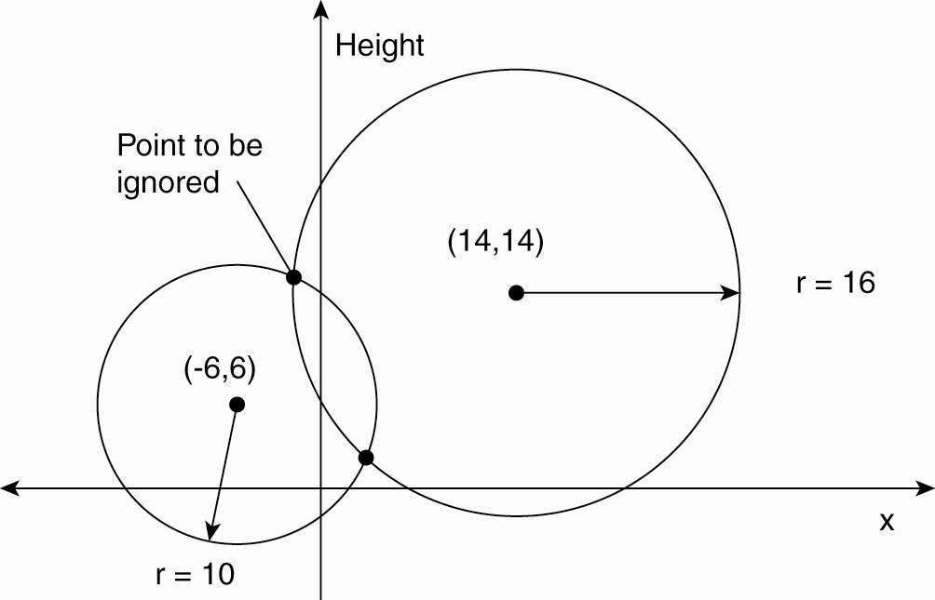
Global Positioning System (2 D)
Figure 6-4. Computing a position in a two-dimensional space.

Slide 30
If you know the location of the satellite and you know what time you’ve received its signal, then you know how far away you are from it (the radius of the circle you are on).
Using two radii you know where you are on the plane (ignoring the upper intersection).
GPS signals also give us the time

Slide 31
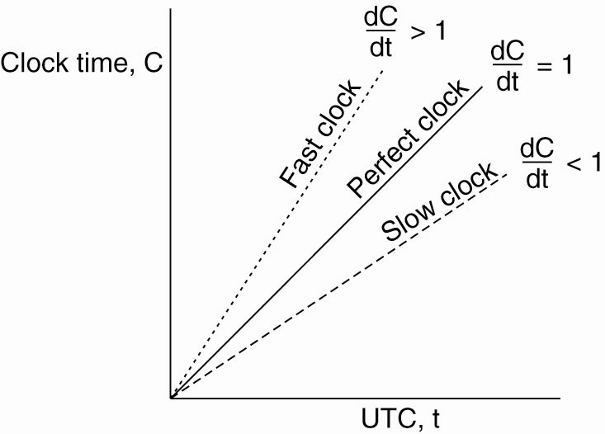
Clock Synchronization Algorithms
Figure 6-5. The relation between clock time and UTC when clocks tick at different rates.

Slide 32
Synchronization
You would like to have all clocks perfectly synchronized, meaning that C = t (Clock seconds counted = UTC seconds counted since the start of the CPU)
Because this is never true, we have to periodically adjust the CPU clocks, either to one another (relative) or to an external source (absolute).

Slide 33
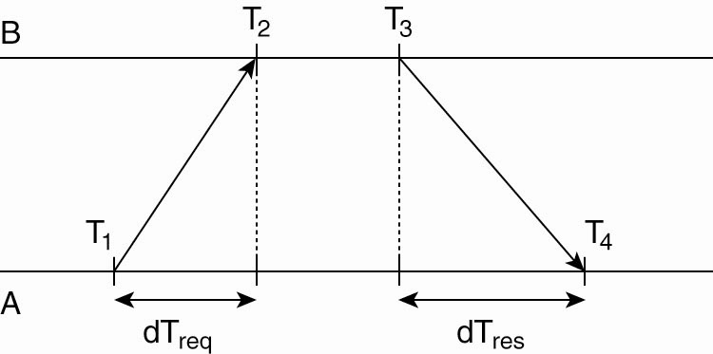
Network Time Protocol
Figure 6-6. Getting the current time from a time server.

Slide 34
Know time of request at A, and of receipt of response at A.
Know processing time on the TimeServer B.
Know that the difference of the two = sum of delays
To adjust: The average of the two network delays should be added to time at send from the TimeServer.

Slide 35
Berkeley Algorithm
When no machine has a reliably accurate clock, we can use agreement to get an average, or a weighted average.
Set the clock manually, from time to time based on an external source.

Slide 36
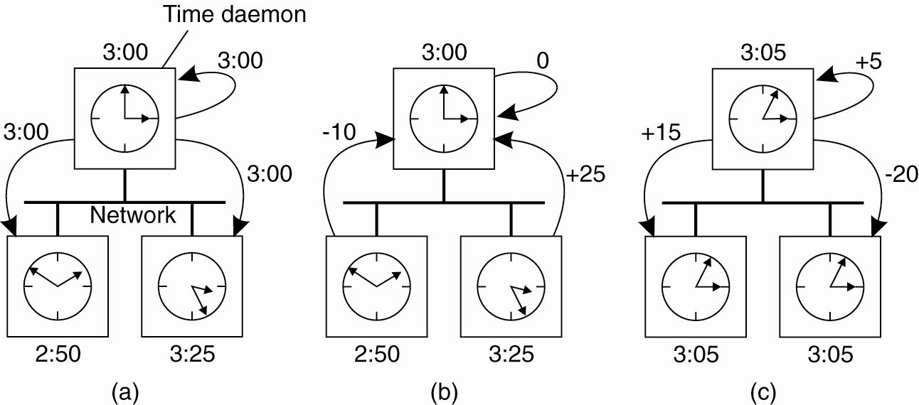
The Berkeley Algorithm (1)
Figure 6-7. (a) The time
daemon asks all the other
machines for their clock
values.

Slide 37
The Berkeley Algorithm (2)
Figure 6-7.
(b) The machines answer.

Slide 38
The Berkeley Algorithm (3)
Figure 6-7. (c) The time
daemon tells everyone how
to adjust their clock.

Slide 39
Adjusting clocks can be problematic
Time cannot run backwards.
Changes in time have to take place gradually on a system, because in practice systems use time-outs to simulate a synchronous system. [Assumption is made that message will arrive within a certain time window.]

Slide 40
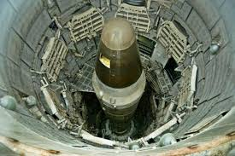
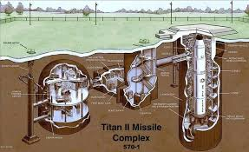
ICBM mutual assured destruction

Slide 41
Example
Failsafe timer at the missile silo: if you don’t get a reset from headquarters every hour then send the missiles. (Presumably because headquarters no longer exists…)
At headquarters: Every hour on the hour send a reset to the missile silo.
Clock coordination message to headquarters at 2:59: Set the clock ahead to 3:05.
[…]!

Slide 42
Speed up or slow down the “clock ticks” at a lower level.
Imagine that if you put ice on the CPU clock, it ran a little slower for a while.
If you are too far ahead and need to “set your time back” you could ice the clock until you were in sync, then remove the ice.
The operating system would never know the difference.
Similarly, if you could physically stop the ticking of the clock for a while it would achieve the same thing.

Slide 43
The former doesn’t work, and the latter might not be possible, but there are mechanisms that achieve the same result.
The key is to work at a lower level that where the clock ticks drive the system.

Slide 44
Weighted Berkeley Algorithm
Some clocks are known to be more accurate than others.
So, alter the following step to reflect a weight multiplier for clocks according to their known accuracy: add a phantom second clock to weight 2x, two phantoms to weight 3x, etc.

Slide 45
The Berkeley Algorithm (2)
Figure 6-7.
(b) The machines answer.

Slide 46

Time coordination algorithms
Toolbox!

Slide 47
Lamport time stamps and logical clocks
General heuristic: get by with the minimum that you actually need—less code, less to maintain, more efficient.
Time moves forward by discrete steps kept as local counters which are translated into timestamps.
Piggyback information about the timestamps in data messages traded between the processes.
Follow the rule: receive a message at least one count after it has been sent.

Slide 48
Lamport Logical Clocks
The "happens-before" relation → can be observed directly in two situations:
If a and b are events in the same process, and a occurs before b, then a → b is true.
If a is the event of a message being sent by one process, and b is the event of the message being received by another process, then a → b is true.
Transitive: a → b, b →c :== a → c

Slide 49
If events x, y, happen in different processes that do not exchange messages (incl. 3rd party transmission) then neither x→y, or y→x, are true. Instead are said to be concurrent.
C is clock value, C(x) is the clock value when x occurred, as agreed by all processes.
Time only moves forward by incrementing the clock.

Slide 50
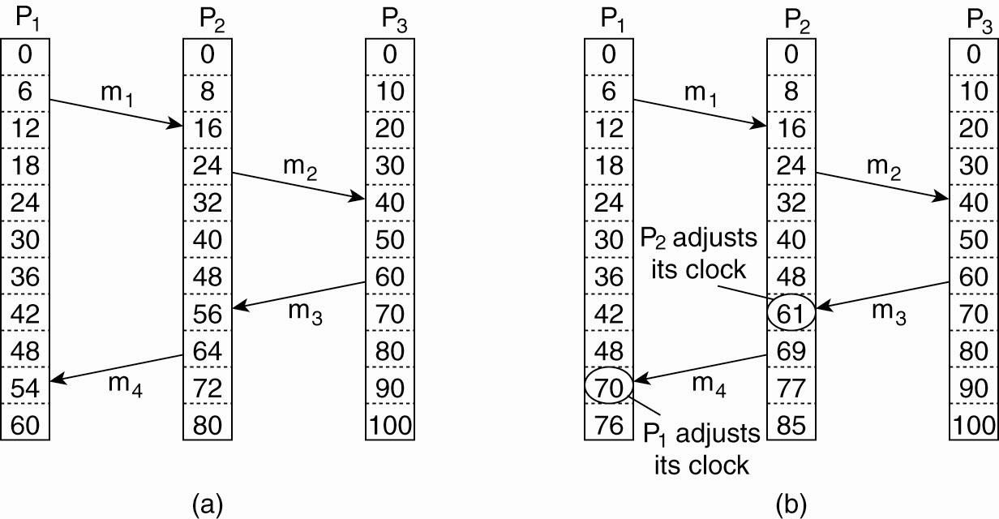
Example send/receive three processes
Figure 6-9. (a) Three processes, each with its own clock. The clocks run at different rates.

Slide 51
Figure 6-9. (b) Lamport’s algorithm corrects the clocks.

Slide 52
Updating counter C_{i} for process P_{i}
Before executing an event P_{i} executes C_{i} ← C_{i} + 1.
When process P_{i} sends a message m to P_{j}, it sets m’s timestamp ts (m) equal to C_{i} after having executed the previous step.
Upon the receipt of a message m, process P_{j} adjusts its own local counter as C_{j} ← max{C_{j} , ts (m)}, after which it then executes the first step and delivers the message to the application.

Slide 53
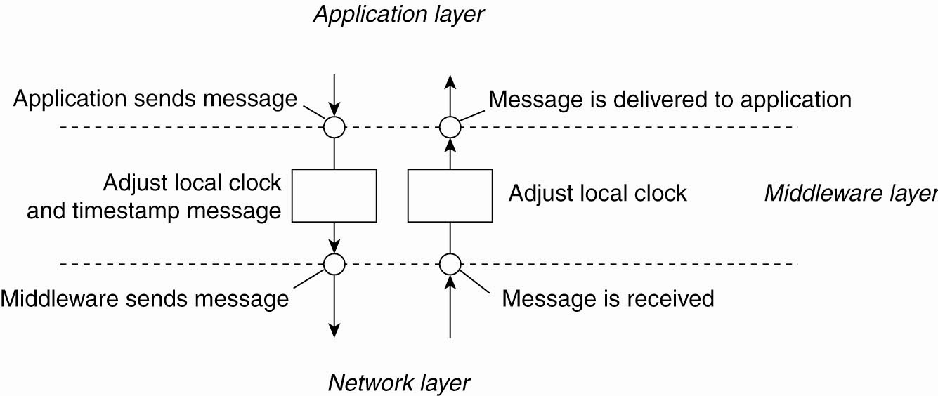
Figure 6-10. The positioning of Lamport’s logical clocks in distributed systems.

Slide 54
Every event is unique—use process #
Can add the process number on any particular machine after a decimal point, to guarantee unique events and time ordering.
For P₀ event 12 becomes 12.0, for P₁ it would be 12.1
12.0 comes before 12.1 in an ordering of events.

Slide 55
Applying updates in the right order
For a replication server replicating a database, it may not matter which order the updates are applied as long as every instance of the server uses the same order.
Example: E₁ is add ten percent. E₂ is add $100.
For $1,000 balance:
E1, E2 = $1,000 + 100 = 1100. Plus $100 is $1,200
E2, E1 = $1,000 + 100 = 1100. Plus ten percent is $1,210

Slide 56
Solution is to have totally ordered multicasting.
Don’t need a shared clock, just Lamport time stamps.

Slide 57
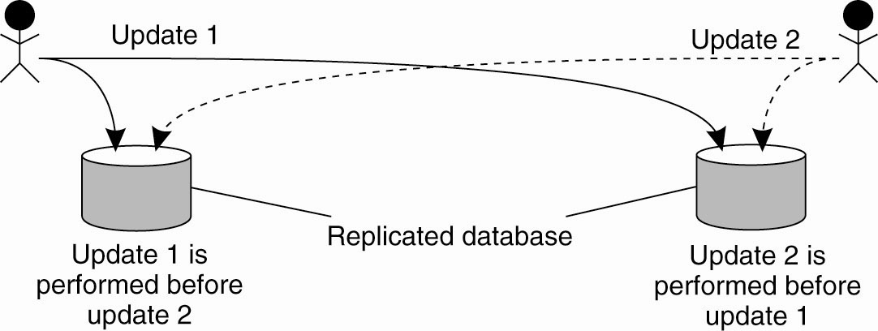
Example: Totally Ordered Multicasting
Figure 6-11. Updating a replicated database and leaving it in an inconsistent state.

Slide 58
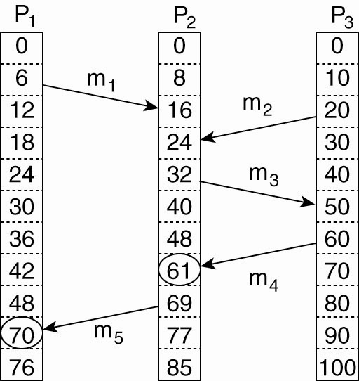
Vector Clocks
Figure 6-12. Concurrent message transmission using logical clocks.

Slide 59
Vector clocks
Like the Lamport Time Stamps, but now send a complete (integer) vector which contains the sending process’s knowledge of the latest counter value for each process, including itself.
That is, for process P₀ Vector[0] will have the actual clock (counter) value for P₀ in it. Vector[1] will have P₀’s knowledge of the latest clock value for P₁.
[12, 33, 19]₀ ← an example for three processes.

Slide 60
Every time a message is sent from one process P_{N} to another P_{p} a complete Vector is sent to gossip about the values on all the processes, including an accurate value for the sending process itself.
Compare what you already know about P_{q} and what you get in the gossip. Update your knowledge to the latest of the two.
In this way, reasonably current values for all of the clocks of active processes propagate throughout the system.

Slide 61
More formally…
Vector clocks are constructed by letting each process P_{i} maintain a vector VC_{i} with the following two properties:
VC_{i} [ i ] is the number of events that have occurred so far at P_{i}. In other words, VC_{i} [ i ] is the local logical clock at process P_{i} .
If VC_{i} [ j ] = k then P_{i} knows that k events have occurred at P_{j}. It is thus P_{i}’s knowledge of the local time at P_{j} .

Slide 62
Steps carried out to accomplish property 2 of previous slide:
Before executing an event, P_{i} executes VC_{i} [ i ] ← VC_{i} [i ] + 1.
When process P_{i} sends a message m to P_{j}, it sets m’s (vector) timestamp ts (m) equal to VC_{i} after having executed the previous step. It then sends the entire vector, VC_{i} along with m to the receiving process. (The book is not very clear on this point.)

Slide 63
Upon the receipt of a message m (and the entire vector) from a sender, process P_{j} adjusts its own vector by setting VC_{j} [k ] ← max{VC_{j} [k ], ts (m)[k ]} for each k, after which it updates its own clock and delivers the message to the application.
In this way, the maximum amount of time information about all processes in the system are transferred with each message.

Slide 64
Example application
Causally-ordered communication is weaker than totally ordered communication, but might be enough for your application.
There may be lots of actions that take place outside of causal chains for which we have no order information, & do not need it.
Following the heuristic that we want the simplest, cheapest algorithm, we can implement causally-ordered communication with vector clocks as middleware for applications that can use it.

Slide 65
Causally-ordered communication
System A and System B have user logins for UserA and UserB.
UserA logs in to A and sends UserB a message M.
If M is received before UserB logs in to B, then we know that A_{login} happened before B_{login}, written as A_{login}→B_{login}.
In networked distributed systems, the sending of a message always causally precedes the receiving of a message.
This is causal ordering.

Slide 66
Further reading on ordering
Understanding the Limitations of Causally and Totally Ordered Communication Cheriton and Skeen, 1993. Good overview of the issues.
https://www.cs.rice.edu/~alc/comp520/papers/Cheriton_Skeen.pdf

Slide 67
Using a process to manage exclusive resources
We have no globally shared memory.
Therefore we have no global test-and-set instruction for distributed systems.
We must us a process to coordinate mutual exclusion.

Slide 68
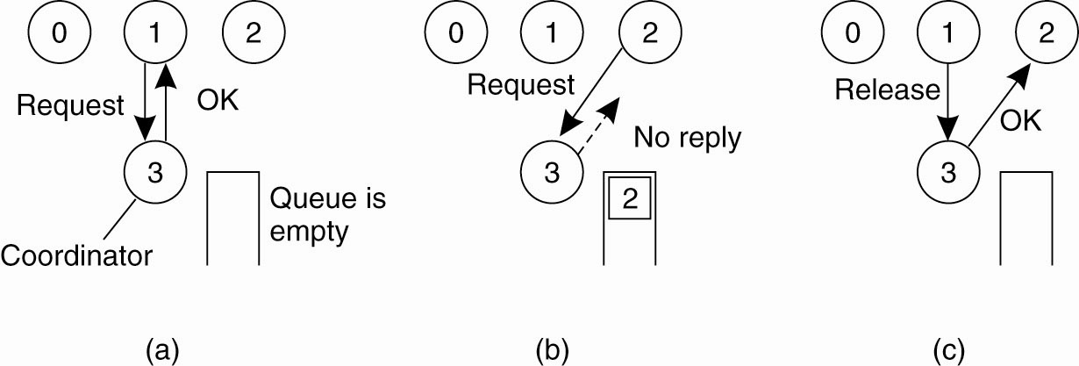
Mutual Exclusion (ME) A Centralized Algorithm
Figure 6-14. (a) Process 1 asks the coordinator for permission to access a shared resource. Permission is granted.

Slide 69
Figure 6-14. (b) Process 2 then asks permission to access the same resource. The coordinator does not reply.

Slide 70
Figure 6-14. (c) When process 1 releases the resource, it tells the coordinator, which then replies to 2.

Slide 71
A distributed algorithm (for ME)
Three different cases:
If the receiver is not accessing the resource and does not want to access it, it sends back an OK message to the sender.
If the receiver already has access to the resource, it simply does not reply. Instead, it queues the request.
If the receiver wants to access the resource as well but has not yet done so, it compares the timestamp of the incoming message with the one contained in the message that it has sent everyone. The lowest one wins

Slide 72
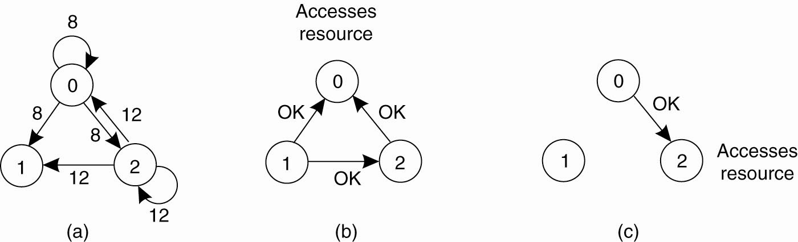
A Distributed Algorithm
Figure 6-15. (a) Two processes want to access a shared resource at the same moment.

Slide 73
Figure 6-15. (b) Process 0 has the lowest timestamp, so it wins.

Slide 74
Figure 6-15. (c) When process 0 is done, it sends an OK also, so 2 can now go ahead.

Slide 75
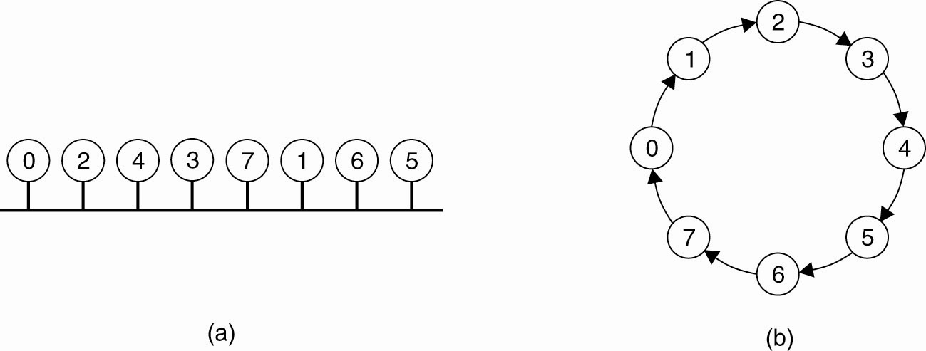
A Token Ring Algorithm (ME)
Figure 6-16. (a) An unordered group of processes on a network. (b) A logical ring constructed in software.

Slide 76
The “token” is passed around the ring. That is: the previous process in the ring tells you to set your “I have the token” bit to TRUE.
It is your “turn” to enter the critical section / use the exclusive resource if you want to.
When you are done, set the “token” bit to FALSE and inform the next process in the ring it is their turn.
It’s like sitting in a discussion circle wherein you only get
to talk when the talking stick is passed to you.

Slide 77
Election algorithms
When the coordinator process fails, a new coordinator has to get elected.
Some process notices that the old coordinator has failed.
It calls an election.
The new coordinator takes over managing the resource.

Slide 78
Bully algorithm
P, having noticed a coordinator failure, sends an ELECTION message to all processes with higher numbers.
If no one responds, P wins the election and becomes coordinator.
If one of the higher-ups answers, it takes over. P’s job is done.

Slide 79
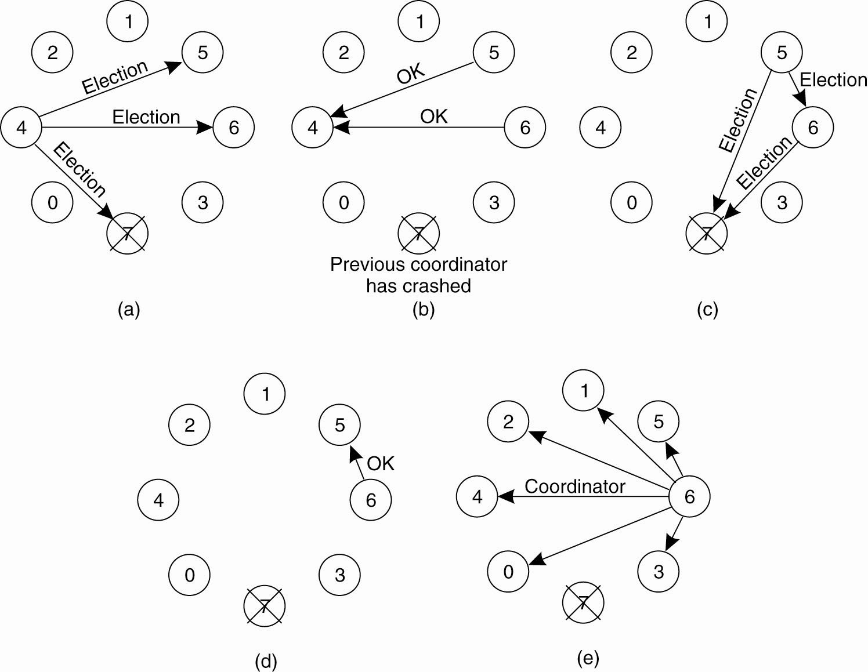
Figure 6-20. The bully election algorithm. (a) Process 4 holds an
election. (b) Processes 5 and 6 respond, telling 4 to stop.
(c) Now 5 and 6 each hold an election.

Slide 80
Figure 6-20. The bully election algorithm. (d) Process 6 tells 5 to stop. (e) Process 6 wins and tells everyone.

Slide 81
Replacing a lost token
Processes know of their successor(s) in the ring
P_{N} notes failure—sends election msg with own proc # to current live successor
Each proc adds its proc # to the list in the election msg.
Message finally gets around ring to the start node P_{N}.
Select new coordinator (highest proc #?), send around the ring with new list of members. New coordinator starts with the token.
When coordinator msg returns, all are informed.
If two sets of messages are sent, highest coordinator wins. Presumably, lower coordinator is removed by any node.

Slide 82
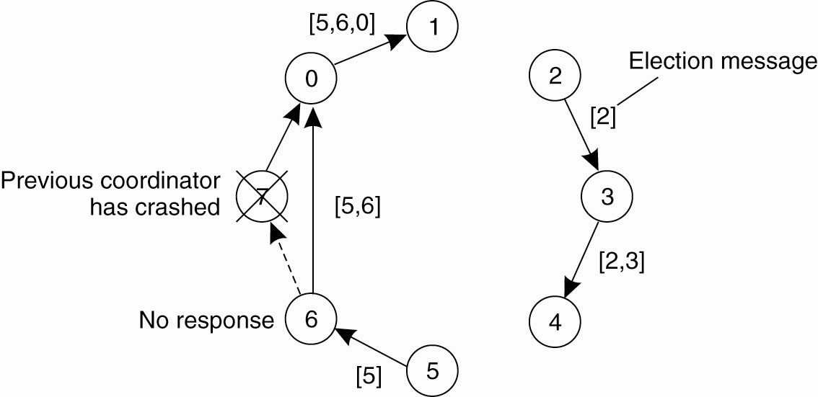
Figure 6-21. Election algorithm using a ring to replace the token

Slide 83
Non-token ring election
Same as previous, except rather than initiating a moving token, the winning process manages an exclusive resource.

Slide 84
Wireless election
Cannot assume full network connectivity, stable connections, stable topology (mobile?)
Node and network failure, partitioning?
Need to select BEST (best connected / geography / battery) node for coordinator
Vasudevan et al. (2004): source node sends election msg to all nodes it can reach
Receiving node notes parent (sender) and sends to all nodes IT can reach, minus parent node
If node received msg from node other than its parent, simply send ack, then ignore.

Slide 85
Each node waits for ack from all its neighbors, then sends back ack to parent. Nodes that have a parent, send back immediate ack. If all acks then node is a leaf node in the network. Leaf nodes respond quickly and send information about qualities as a coordinator (e.g., battery life)
When a node finally sends message to its parent it also sends info about the best available coordinator candidate. This percolates back up to the original source, which then broadcasts a msg about who is the new coordinator.

Slide 86
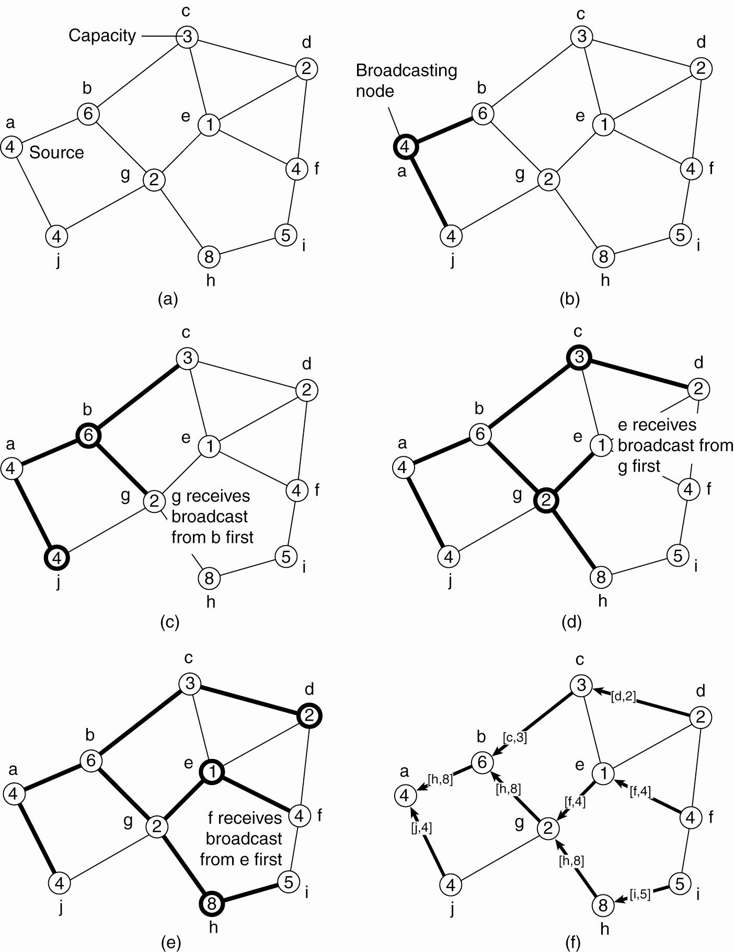
Elections in Wireless Environments
Figure 6-22. Election algorithm in a wireless network, with node a as the source. (a) Initial network. (b)–(e) The build-tree phase

Slide 87
Figure 6-22. Election algorithm in a wireless network, with node a as the source. (a) Initial network. (b)–(e) The build-tree phase

Slide 88
Figure 6-22. (e) The build-tree phase. c (f) Reporting of best node to source.

Slide 89
Elections in Large-Scale Systems
Requirements for SuperPeer selection:
Normal nodes should have low-latency access to SuperPeers.
SuperPeers should be evenly distributed across the overlay network.
There should be a predefined portion of superpeers relative to the total number of nodes in the overlay network.
Each SuperPeer should not need to serve more than a fixed number of normal nodes.

Slide 90
SuperPeer selection with DHT
Can select any SuperPeer/RegularNode ratio we like based on random node ID.
DHT addressing is via m-bit space. Using the rightmost [3] bits (AND with 0…0111) then:
= 7 means select one in eight as a SuperPeer
< 4 means select one in four as a SuperPeer
Etc.

Slide 91
Spreading SuperPeers in an unstructured network
Each node with a token sends repulsion messages.
Each node with a token that receives too much repulsive force, sends the token to a neighbor in the opposite direction.
Can have local maxima problem

Slide 92
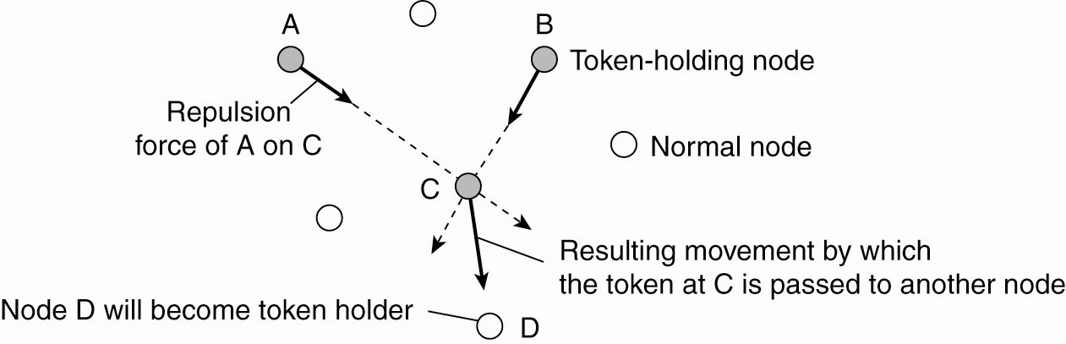
Figure 6-23. Moving tokens in a two-dimensional space using repulsion forces.

Slide 93
Coordinator election algorithms

Slide 95
RBS – wireless sensor networks
Reference Broadcast Synchronization
Internally synchronize the clocks – no attempt at UTC
Only the receiver synchronizes
In sensor networks constructing the time message and accessing the network are constant, so not part of the critical path that determines variations in propagation.
No timestamp. Just mark when the reference message is received. Can then trade with other nodes to determine offset. Keeping a record allows for linear regression to account for drift.

Slide 96
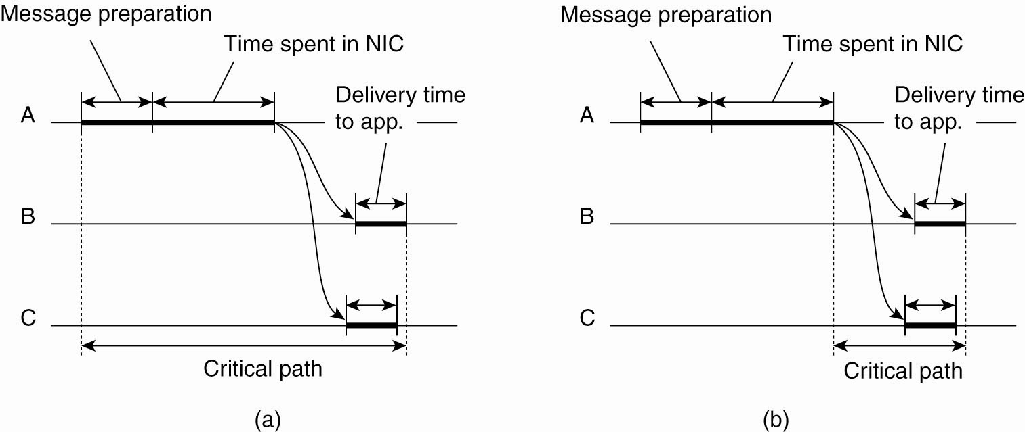
Clock Synchronization in Wireless Networks (1)
Figure 6-8. (a) The usual
critical path in determining
network delays.

Slide 97
Clock Synchronization in Wireless Networks (2)
Figure 6-8. (b) The
critical path in the
case of RBS.

Slide 98
Vector clock example, enforcing causal communication
Causally-ordered communication is weaker than totally ordered communication, but might be enough.
In the next example, vector-entry time stamps are only incremented when a message is sent.
Vector adjustment is as usual.

Slide 99
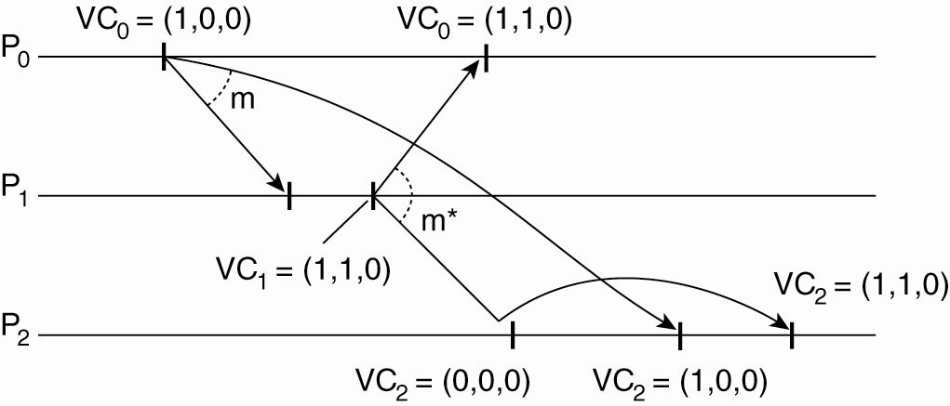
Enforcing Causal Communication
Figure 6-13. Enforcing causal communication.

Slide 100
Problems with moving ordering of messages to middleware
Middleware does not know what a message contains. E.g., two msgs from the same proc may not be related but are treated as causal. Less efficient.
Not all actual causality may be captured. E.g., external causation (say by a phone call) will not be captured.
Refer again to Saltzer (1984) end-to-end argument in system’s design.
But, places non-content burden on the developer, which we like to avoid.

Slide 101
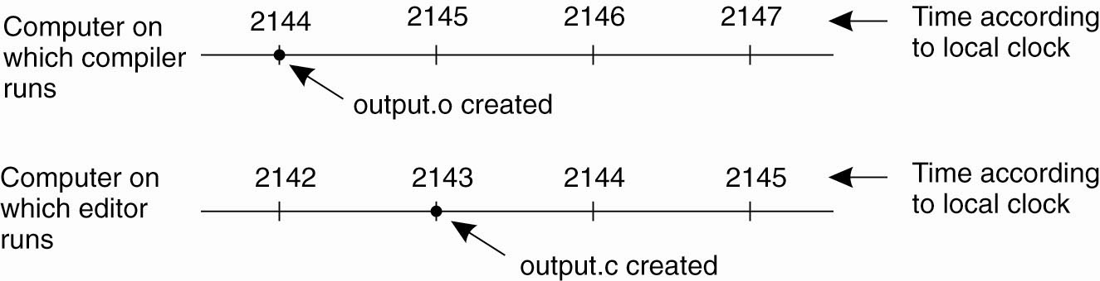
Clock Synchronization
Figure 6-1. When each machine has its own clock, an event that occurred after another event may nevertheless be assigned an earlier time.

