Slide 1

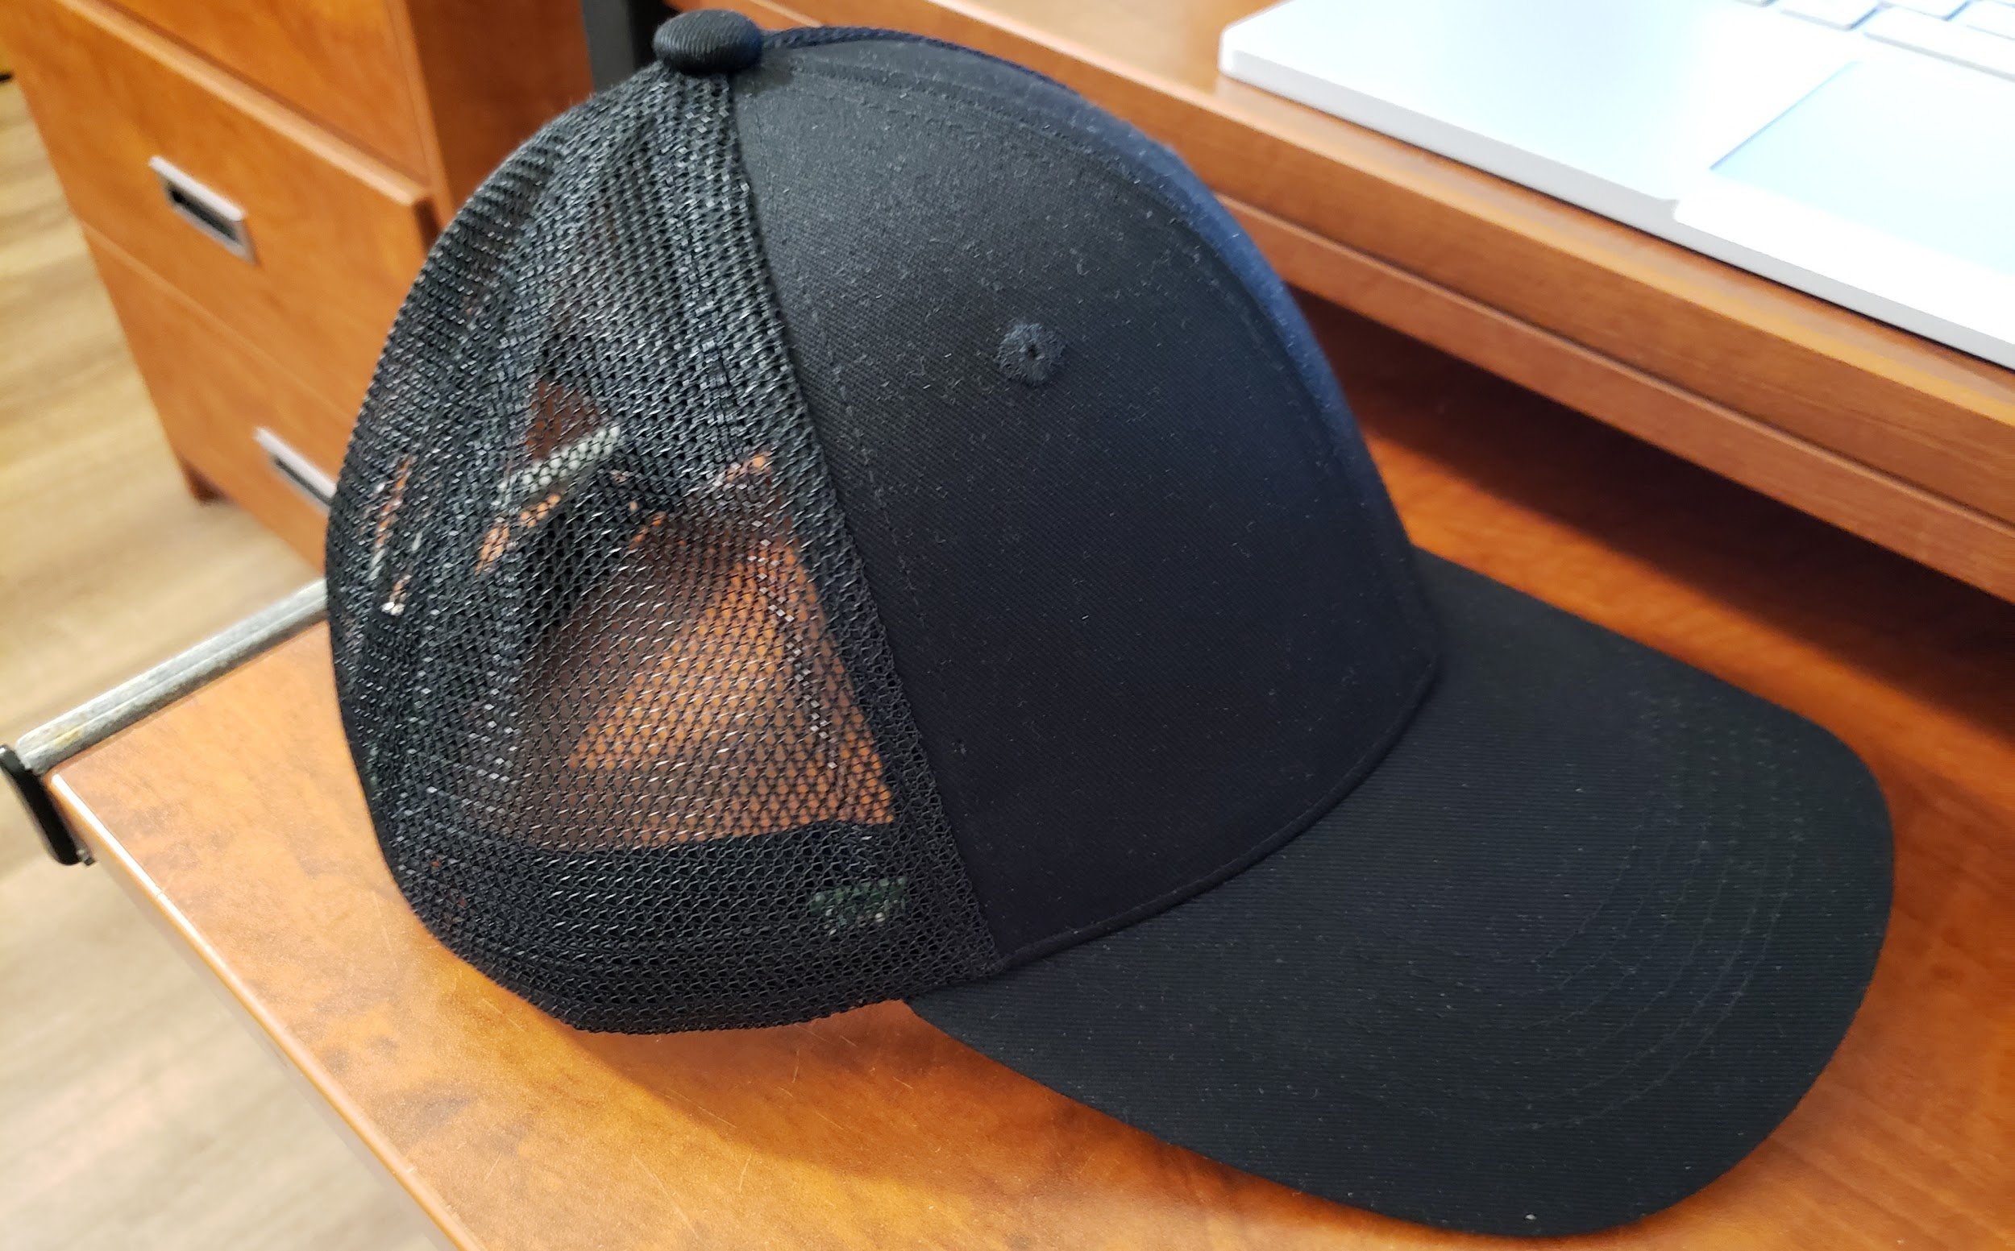
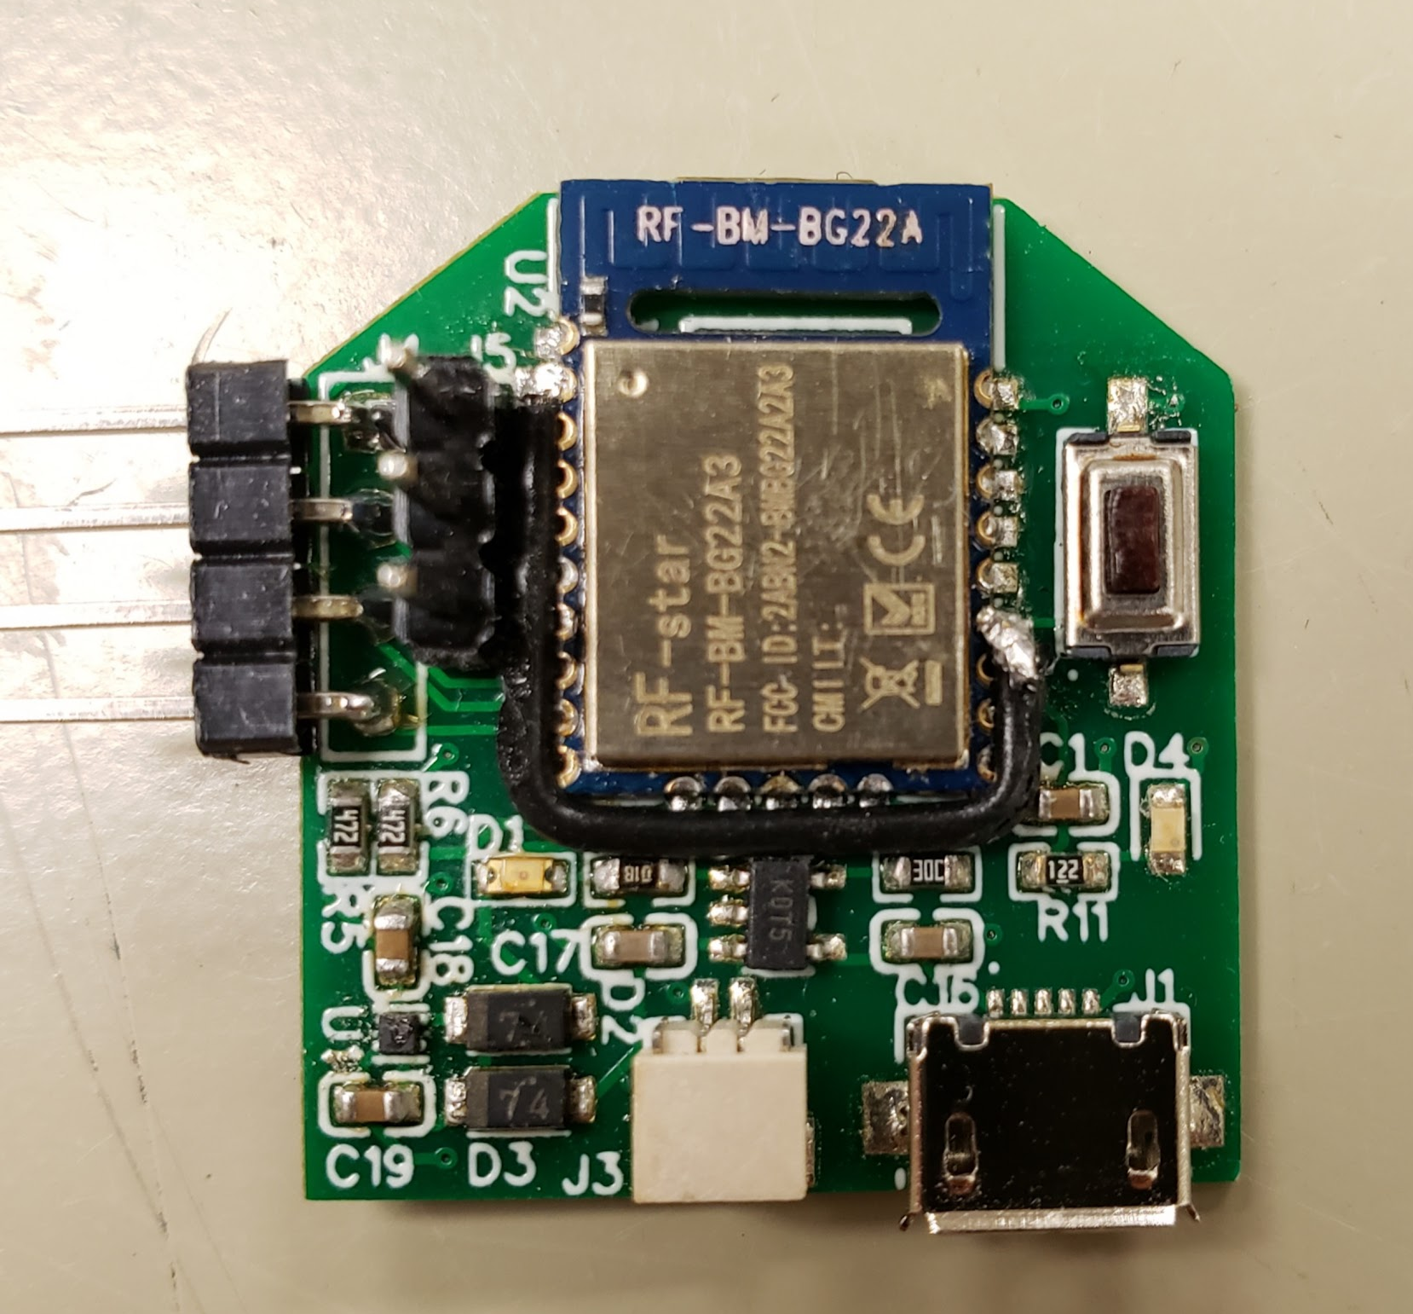
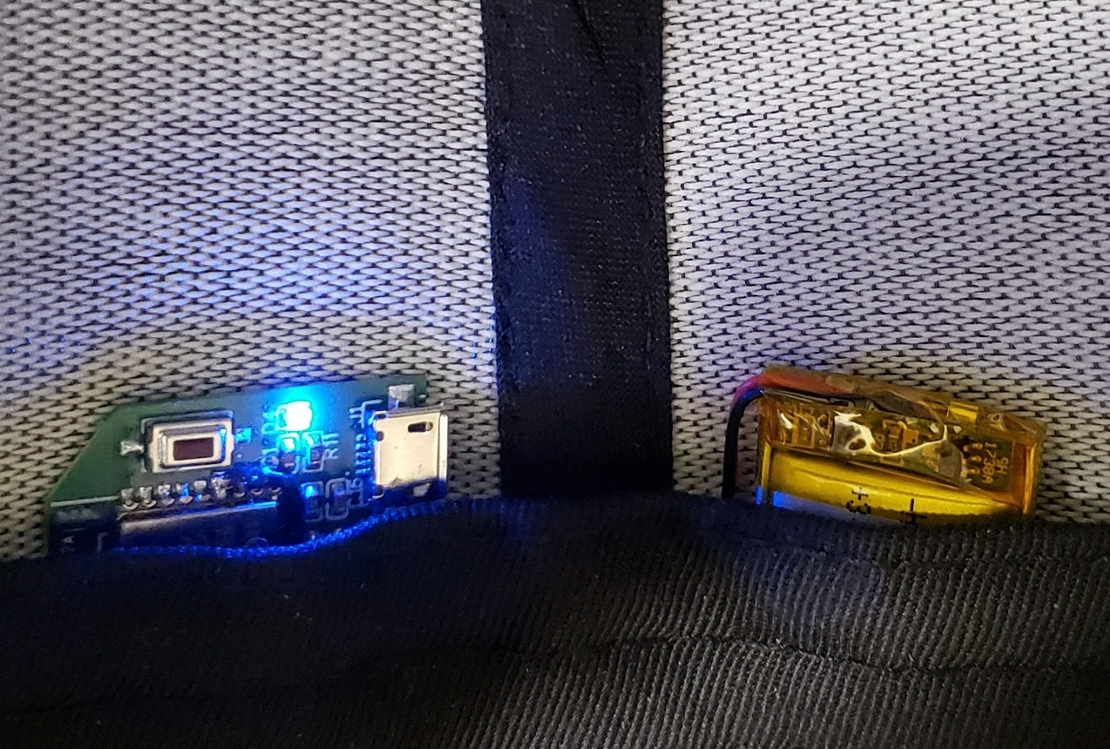
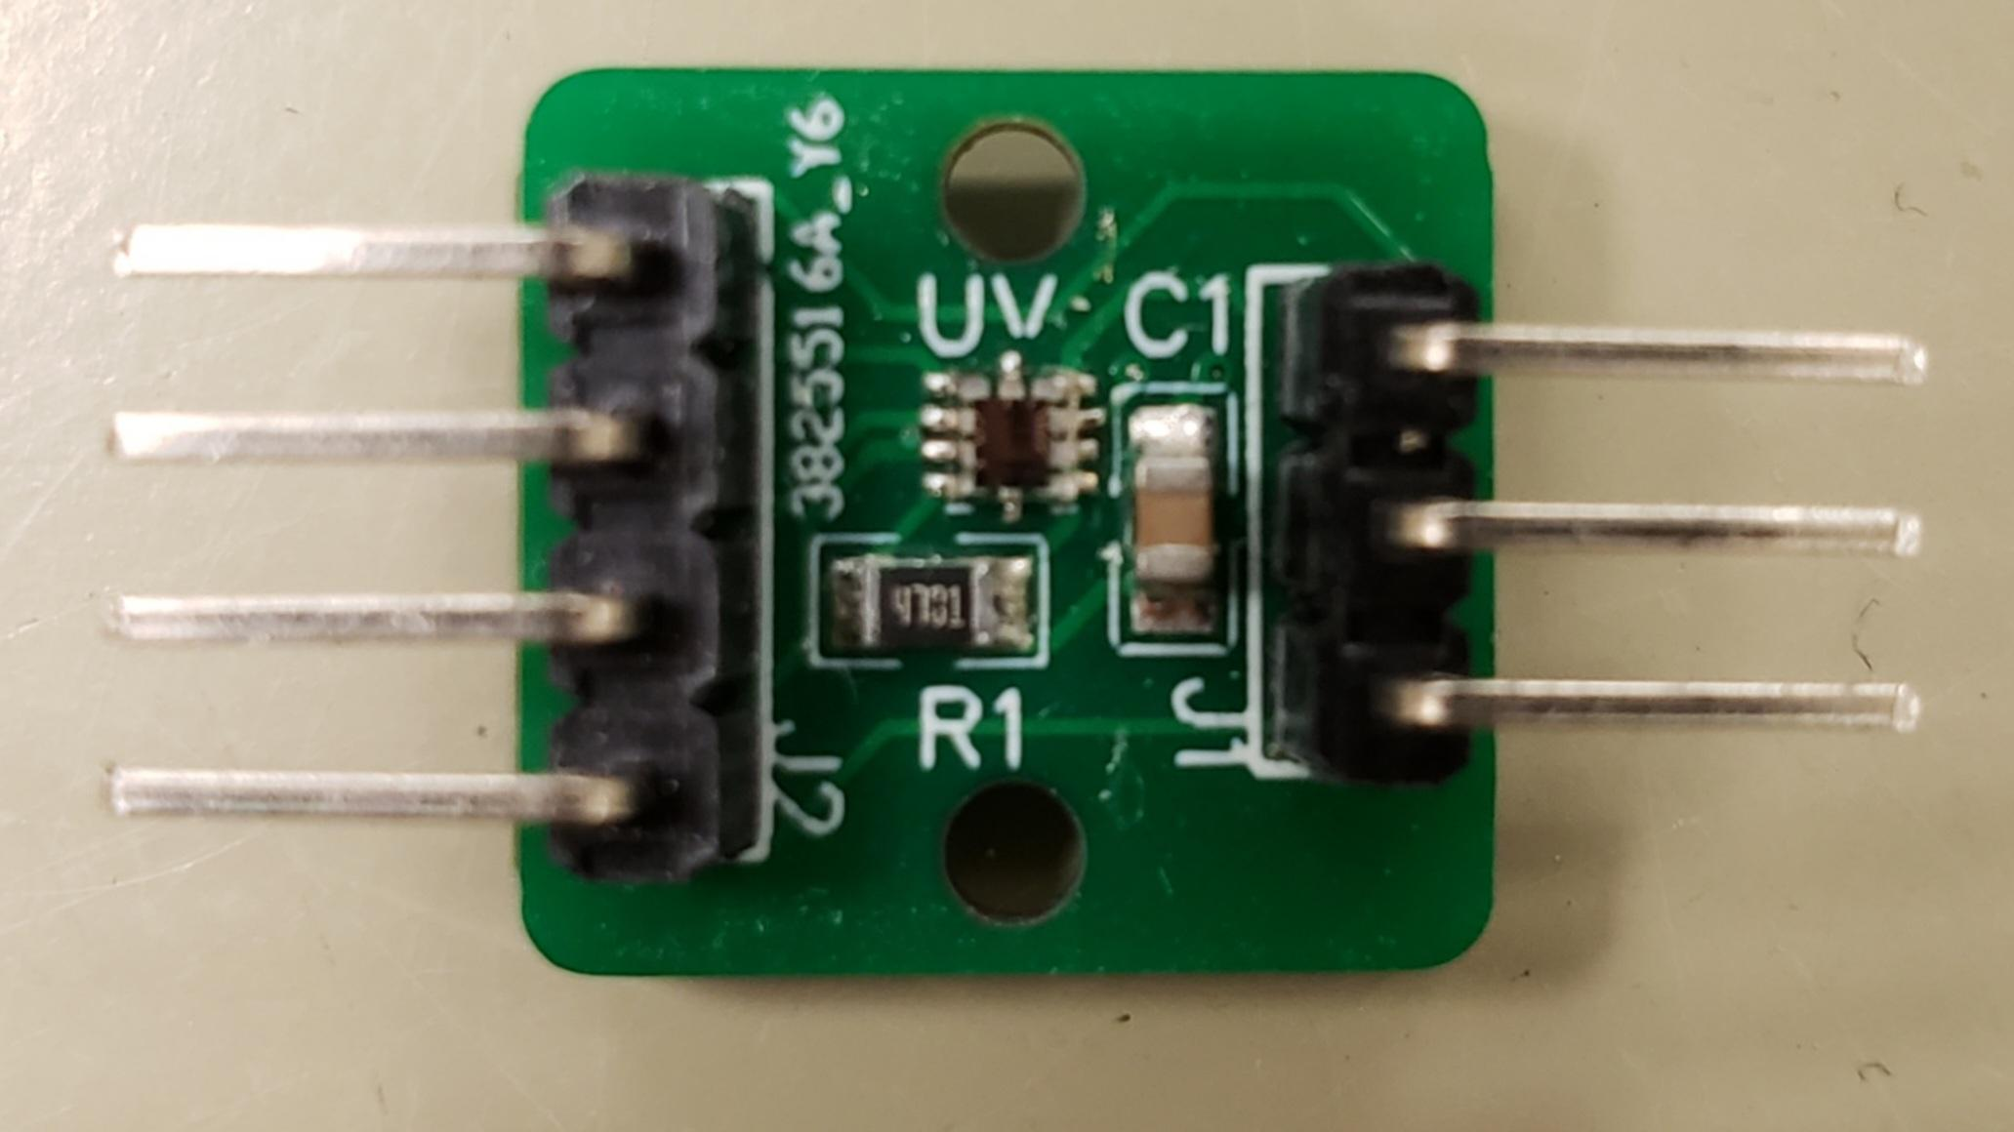
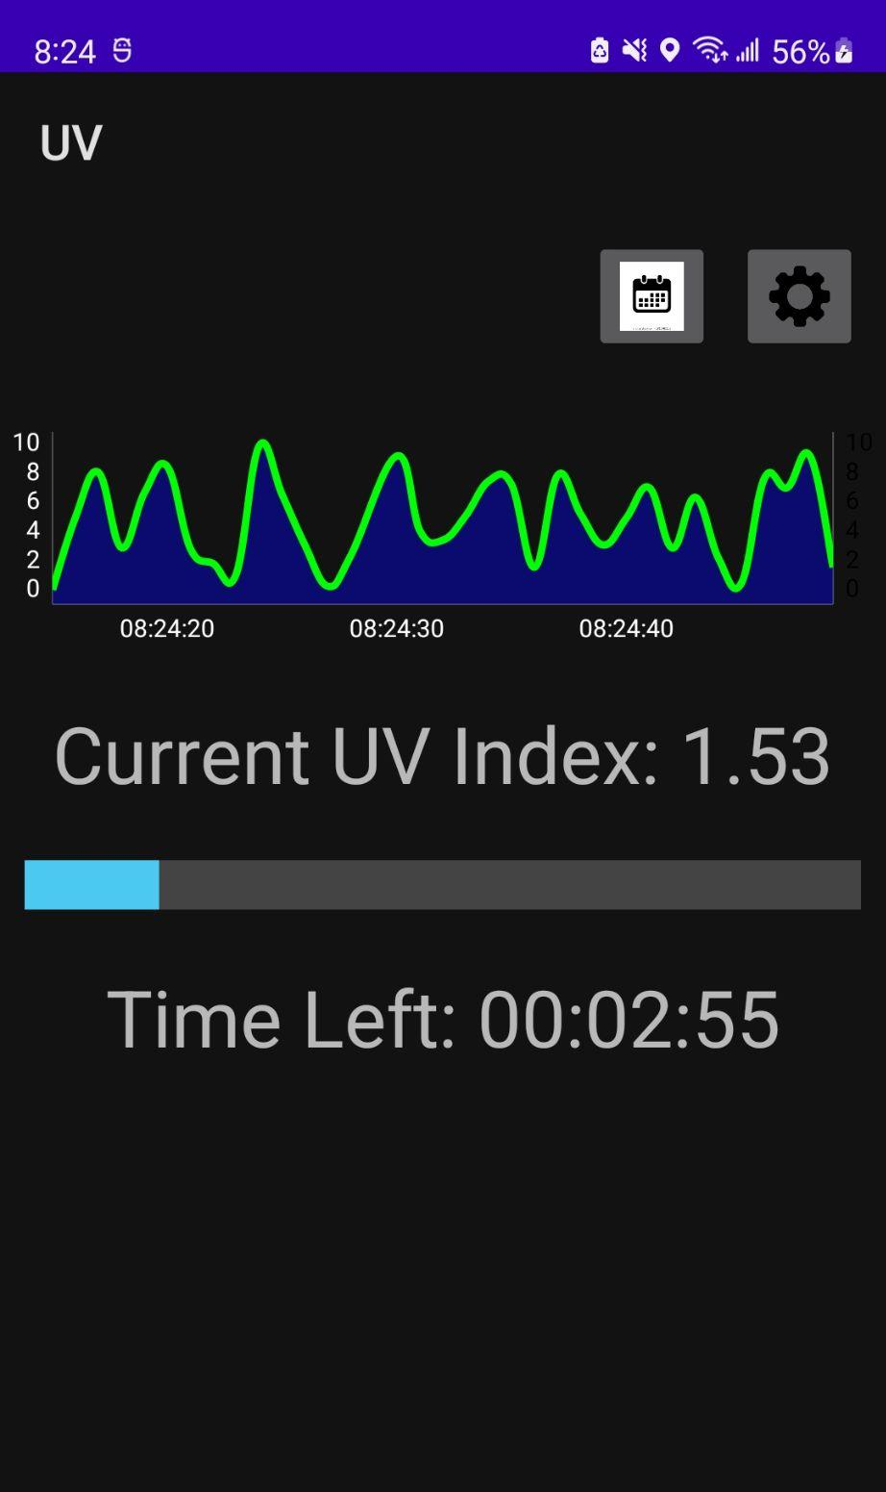
Wearable UV Sensor Advisor: Dmitri Donetski
Members: Tennyson Cheng, Judah Ben-Eliezer
Abstract
Physical Product
BLE Functionality
UV rays due to emission from the sun are everywhere. Excessive exposure to the sun’s UV rays can cause sunburns, premature aging of skin and worst of all, skin cancer. Our product will measure the amount of UV exposure and notify the user of when to reapply sunscreen, while being completely non-intrusive to everyday life.
The UVtech Hat has 4 integrated UV sensors. The main board holds the MCU, physical user interface and power supply components.
Main Board Dimensions: 27.3mm x 25.4mm
The individual sensors are modular and communicate to the main board via I2C.
Sensor Dimensions: 15.2mm x 13.9mm
With 80% battery utilization, the system can operate for 23.1 days. The main board reads the UV index from the sensors every second via I2C. On every 3rd second, the main board will also transmit the data to the phone via BLE. The MCU firmware can be upgraded via BLE as well.
Main Board Unit Cost: $6.03 (1), $4.37 (1000)
Sensor Unit Cost: $4.04 (1), $1.72 (1000)
The GATT profile is configured to send UV data via notifications. This allows the device to control when data is sent, rather than wait for the mobile phone to request data. Notifications also do not need to be acknowledged by the mobile phone.
Mobile App
The app receives a buffer of the sensor data every 3 seconds. This data does not represent the UV index yet, so conversion is done on the mobile phone. This alleviates processing time to the phone rather than the wearable. The data from the sensors are averaged to accurately represent the UV radiation experienced by the user.
Objective
Wearable Device:
Capable of supporting up to 4 UV sensors.
Sensors can be swapped/added/removed.
Battery life to last at least week.
Rechargeable via micro USB.
Seamless power source switching between battery and USB
Small enough to be integrated anywhere.
Mobile App:
Communication through BLE between the phone and wearable device.
Logs data received from wearable and displays the UV index in user-friendly form.
Allows for user to input sunscreen SPF.
App tracks duration of sunscreen potency.
Glossary
t
UV Index: measure of the level of Ultraviolet radiation from 0 to 11+.
SPF: measure of how much UV radiation a sunscreen blocks.
BLE: Bluetooth Low Energy
Primary Components
EFR32BG22 Microcontroller
Si1132 UV Sensor
ASR00003 3.7V, 150mAh Li-Po Battery
MCP73831 Charging IC
NCP707CMX300TCG 3.0V Voltage Regulator
Power Consumption
Acknowledgement
The system only consumes 3mA @ 3.7V when active. It is only active for 7.2% of the time. This yields an effective power consumption of 0.8mWh
Harbans Dhadwal, Dimitri Donetski
UVtech

