Slide 1
BIII – Lattice design
LIMITS OF
MBA–LATTICES WITH REVERSE BENDS
USING SEPERATED FUNCTION MAGNETS
PART II
Bettina Kuske, 11-2020

Slide 2
Content
Structure of this talk:
Short recapitulation of last talks results
Matching cell
Further boundary conditions
Restrictions on α
Restrictions of normalized chromaticity
Options to relax previous boundary conditions in order to meet new ones
Lattice options for BIII

Slide 3
Summary last talk I
„Prototype“ lattices:
Typical lattice solutions that emerge from certain boundary conditions
Standard MBA lattices:
(using separated function magnets and reverse bends)
Achromatic arc: identical MBA-cells and 2 matching cells at each end
Optimization criteria:
TME: theoretical minimal emittance
minimal circumference
(TME conditions are an important ‘anchor’ in the multi-parameter space)
Development of MBA-cell can follow “deterministic procedure”
Half MBA-cell: Transfer line with “TME” initial conditions (β_{x}, η_{x})
QF, QD and reverse bend angle to fit α_{x} = α_{y} = η'_{x} = 0 @end
Reverse bend: negligible impact on ε, needed for compactness
Hardware: Maximal fields and gradients (B~1.5T, G<100T/m), equal drifts of 0.1m

Slide 4
Summary last talk II
 |  | # achromats / straights 16 18 20
MBA-cell/arc |  | 5 | 4 | 3
Angle main-dipole | [°] | 2.0 | 2.15 | 2.4
Circumference | [m] | 332 | 333 | 327
Emittance | [pm rad] | 66 | 80 | 112
Efficiency (free space / circ) | [%] | 24 | 27 | 30
Efficiency: SLS2: 17%, Soleil2: 45%, Elettra: 30%, Diamond: 25%
Smallest emittance is not of highest priority ⬄
5 bend achromat (3MBA-cells) and 20 periods:
But: results hold for 16 and 18 periods as well
(different combination of very similar structures)
LER workshop 2020, link to talks: https://agenda.infn.it/event/20813/timetable/#20201026.detailed

Slide 5
Requirements for matching cell
Tasks of matching cell:
Suppress dispersion
Fit beta functions in straight section: injection, optimal conditions for experiment
Need high degree of flexibility
As short as possible (1/2 MBA-cell)
Last MBA-cell
Matching-cell
η = η’ = 0
η_{x}
Dispersion suppressor
½ MBA-cell
Matching to straight section

Slide 6
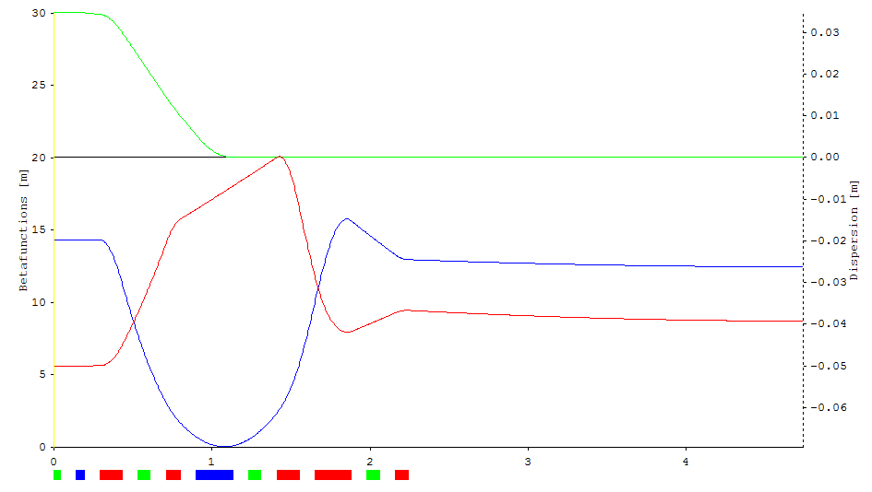
matching cell with reverse bend, 5-bend, 20 periods (last talk)
Initial conditions fixed by MBA-cell for β_{x}, β_{y}, η_{x} (α_{x} = α_{y}= η'_{x} = 0)
L = 4.74m
(1.13 + 1.11+2.5m)
𝜀 = 108pmrad
𝜉_{x} = -3.4
𝜉_{y} = -1.2
𝜑_{x} = 174.4°
𝜑_{y} = 12.9°
β_{x} = 12.5m
β_{y} = 8.7m
η_{x}
β_{x}
β_{y}
Problem: MQD, MQF, UQ1, UQ2, UQ3 – 5 knobs
need to fit η, η‘, β _{x}, β_{y}, α_{x}, α_{y} - 6 parameters

Slide 7
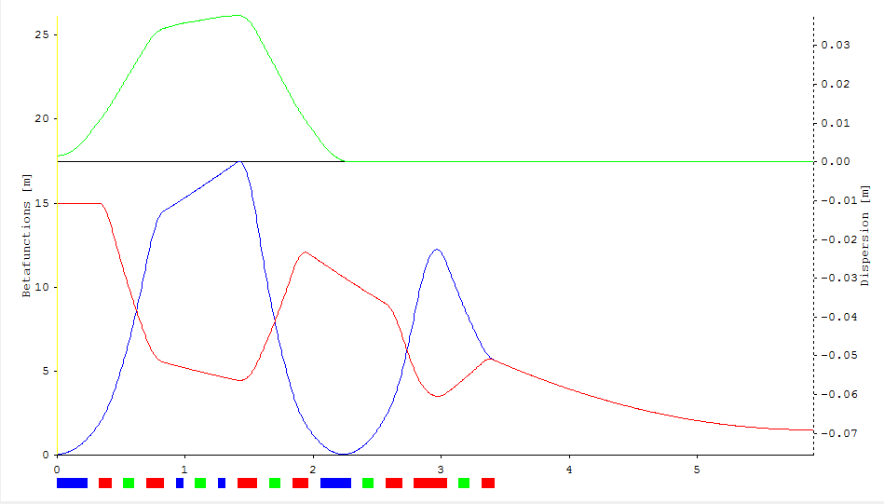
“Extended” matching cell
L = 5.93m
𝜀 = 104pmrad
𝜉_{x} = -5.2
𝜉_{y} = -1.3
𝜑_{x} = 320.8°
𝜑_{y} = 89.3°
β_{x} = 1.5m
β_{y} = 1.5m
η_{x}
β_{x}
β_{y}
½ last MBA-cell
Matching-cell
Solution: use ‚QFA‘ (focusing) quadrupoles of last MBA-cell:
No (significant) change of emittance
Long leaver – small changes in field
ΔK(QFA) ~ 1% for 1.5m < β_{x} < 17m
‘QDA’ defocussing – not effective

Slide 8
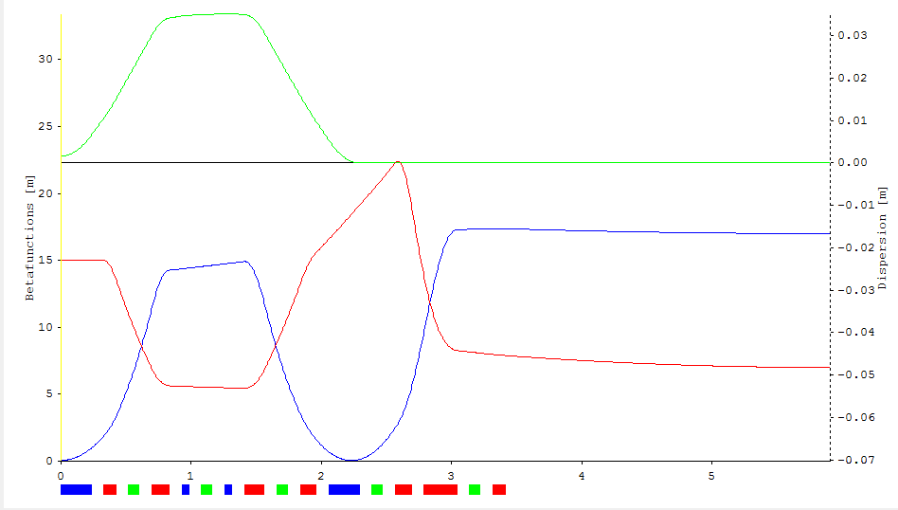
Flexibility of the Matching section
Fitting different beta functions in straight section:
βx [m] | βy [m] | Qx | Qy | ξx | ξy | [pm] | K > 12 [1/m²]
1.5 | 1.5 | 54.8 | 11.5 | -322 | -88 | 111
3.0 | 3.0 | 52.7 | 9.9 | -312 | -81 | 113 | MQ2 1.6%
5.0 | 5.0 | 51.2 | 8.1 | -310 | -81 | 112
11.0 | 3.0 | 49.6 | 9.1 | -312 | -89 | 110 | UQ1 3%
17.0 | 7.0 | 49.1 | 6.2 | -313 | -104 | 109 | UQ1 20%
 |  | Δ 5.7 | Δ 5.3 | +/-2% | +/-13% | +/- 2%
JB: 1.5-2m for 3-4m undulator
Soleil injection
values
no optimization of dynamic aperture at this stage, only crude verification of few initial mm.
SLS2 injection
values
βx, = βy = 1.5m
SLS2 injection betas

Slide 9
Reverse bend in matching cell
Reverse bend not needed in matching cell
η’ = 0, but no conditions on α_{x}, α_{y} at end of bend
Use MQF, MQD to fit η = η’ = 0
Saves 0.15m*40=6m circumference
Emittance decreases (reduced angle in bend)
α increases
Matching-cell
η = η’ = 0
η_{x}
Keep all other elements (at this stage):
Quadrupoles to provide knobs for fitting
Sextupoles to make chromaticity compensation more flexible
9

Slide 10
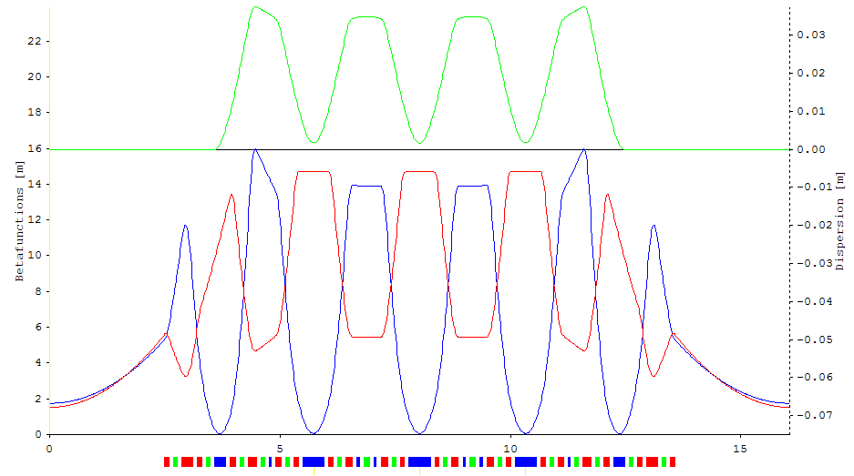
Prototype lattice 5 bend 20 periods
“Best” lattice: 5-bend MBA with 20 straight sections, separated function magnets:
“Reference lattice” for the rest of the talk
Shortest, separated function magnet lattice-type
with ~100pm and 20 straight sections.
(non-hybrid MBA)
L = 16.06m 𝜉_{x} = -307 Qx = 54.25 ε = 105pmrad
C = 321.2m 𝜉_{y} = -89 Qy = 11.35 α = 0.14e-4
“Norm. chromaticity”: 𝜉_{x} /Qx = ~5.7, 𝜉_{y} /Qy = ~7.8

Slide 11
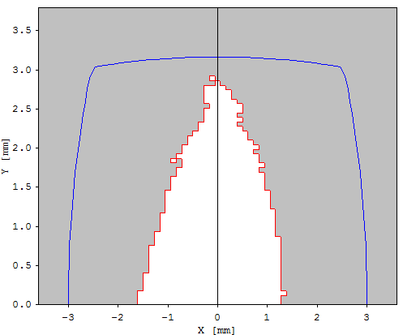
Prototype lattice 5 bend 20 periods
Dynamic Aperture – stage 0 – 1000 turns
Qx=54.25, Qy=11.35
Chromaticity tuned to +2
6 SX families: SD/SF in MBA cell
SDA/SFA in matching cell
S3,S4 in straight section
OPA – optimization tune shift terms
=> Promising start for optimization
@ center of
straight section
β_{x} = 1.5m
β_{y} = 1.5m

Slide 12


Further boundary conditions
Other labs / lattices obey two further constraints:
Limitation on α (SLS2, Soleil: α > 1e-4)
=> Touschek lifetime, instabilities, orbit stability
Increase η, θ in main bend
Decrease η, |θ| in reverse bend
X
$$αc=\frac{ΔL/L}{Δp/p} ∆L=\frac{∆p}{p}\int{\frac{\text{h}(z)}{ρ(z)}dz}$$
$αc≈$ $\frac{θ}{L }\overline{\text{h}(z)}$
X
Limitation of normalized chromaticity
=> off momentum properties
(A. Streun: „gut-feeling“– should be rather 3 than 10,
J. Bengtson: „Chromaticity wall“)
$$\frac{ξ}{Q}={∆Q/Q }/{∆p/p}$$
=> decrease β_{x}, β_{y}
Reference lattice 5 bend MBA, 20 periods:
α = 0.14e-4 ⬄ 1e-4 factor ~7
Norm. chromaticity:
𝜉_{x} /Qx = ~5.7, 𝜉_{y} /Qy = ~7.8 ⬄ 𝜉/Q = ~3 factor 2-3

Slide 13


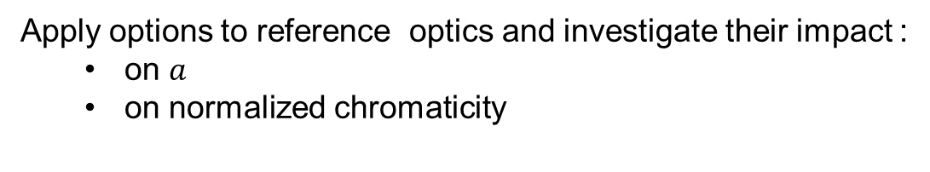

Relaxation of boundary conditions
Relaxation of boundary conditions – what do we gain?
Relax TME-condition on η
Relax TME-condition on β_{x}
costs emittance,
reversible
$$β0\text{TME}=\frac{L}{\sqrt{15}}$$
$$0\text{TME}=\frac{Lθ}{6}$$
3. Increase L - main dipole length
Keep TME-emittance (?)
$$\frac{I5}{I2}\text{TME}=θ³\frac{2}{3\sqrt{15}}$$
Use combined function magnets:
4. Gradient in main dipole (TG, LG)
fixed gradients, not tunable!
Gradient in reverse bend
Option concern MBA-cell, matching cell needs to be adjusted
Constraints on drifts, fields, gradients not studied in this context (technical)
Combined function magnets: loss of incorporated steering/multipole options
Apply options to reference optics and investigate their impact :
on $a$
on normalized chromaticity

Slide 14
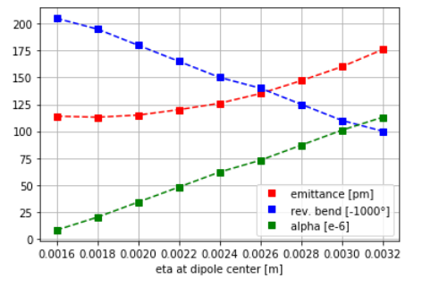
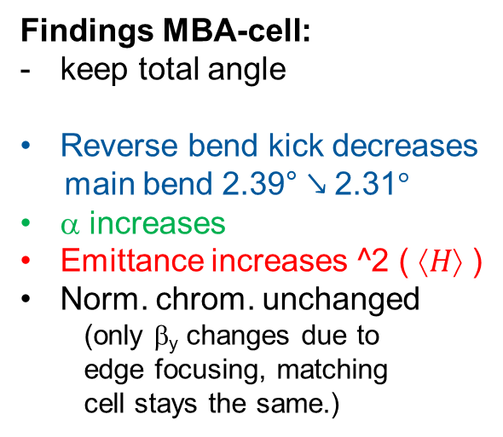
1 - Relax TME-condition on η
reference input (MBA-cell):
Half length dipole: 23cm
Half angle m-bend: 2.39°
Rev. bend angle: -0.205°
TME-β: 0.0594m
TME-η: 0.0016m
reference output
(MBA-cell):
ε: 114pm
α: 0.08e-4
ξ_{x}/ Q_{x} : -6.1
ξ_{y}/ Q_{y} : -19.4
reference output
(matching-cell):
ε: 97pm
α: 0.13e-4
ξ_{x}/ Q_{x} : -5.8
ξ_{y}/ Q_{y} : -5.9
reference output
(full lattice):
ε: 105pm
α: 0.14e-4
ξ_{x}/ Q_{x} : -5.7
ξ_{y}/ Q_{y} : -7.8
Findings MBA-cell:
keep total angle
Reverse bend kick decreases
main bend 2.39° ↘ 2.31°
α increases
Emittance increases ^2 ( $↑H$ )
Norm. chrom. unchanged
(only β_{y} changes due to
edge focusing, matching
cell stays the same.)
Main bend: 2.39°…. 2.31°

Slide 15
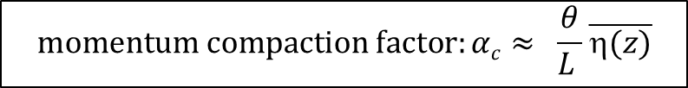
1 - Full lattice with relaxed dispersion
But: need to consider matching cell, too:
MBA-cell:
η₀ = 0.003m
θ = 2.32°
θ_{R} = -0.11°
ε = 160pm
α =1.01e-4
eMatching-cell:*
= 2.37°
θ_{R} = 0°
ε = 118pm
α = 0.32e-4
Full lattice:
ε = 140pm (105pm)
= 0.52e-4 (0.14e-4)
ξ_{x}/ Q_{x} = -5.7 (-5.7)
ξ_{y}/ Q_{y} = -7.8 (-7.8)
☹
$$momentum compaction factor:αc≈ \frac{θ}{L }\overline{\text{h}(z)}$$
=,η′ = 0 in straight section => η is small in matching dipole => $αc$ is small
θ is fixed by MBA-cell, length is minimal
1 – Increase η0 from TME-value:
good way to increase α, but not sufficient
limited by emittance growth
no impact on normalized chromaticity (MBA-cell)
*: e-matching cell includes half bend and reverse bend from last MBA-cell

Slide 16
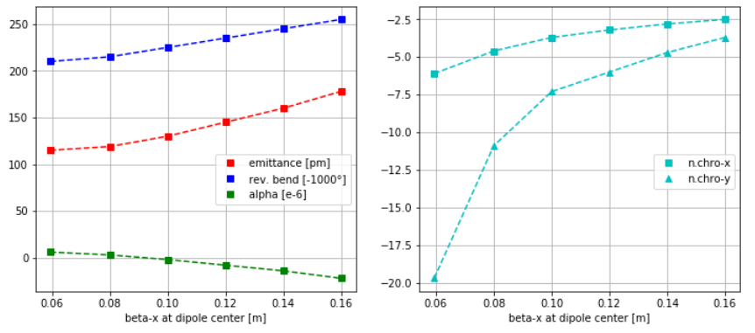
2 - Relax TME-condition on β_{x}
reference input (MBA-cell):
Half length dipole: 23cm
Half angle m-bend: 2.39°
Rev. bend angle: -0.205°
TME-β: 0.0594m
TME-η: 0.0016m
reference output
(MBA-cell):
ε: 114pm
α: 0.08e-4
ξ_{x}/ Q_{x} : -6.1
ξ_{y}/ Q_{y} : -19.4
reference output
(matching-cell):
ε: 97pm
α: 0.13e-4
ξ_{x}/ Q_{x} : -5.8
ξ_{y}/ Q_{y} : -5.9
reference output
(full lattice):
ε: 105pm
α: 0.14e-4
ξ_{x}/ Q_{x} : -5.7
ξ_{y}/ Q_{y} : -7.8
~ opposite to increase of η:
Reverse bend kick increases
α decreases < 0
Emittance increases

Slide 17
2 - Relax TME-condition on β_{x}
Normalized chromaticity
Abs (norm. chromaticity) shrinks
Half MBA-cell:
η0 = 0.0016m
β_{x}0 = 0.12m
β_{y}0 = 8m
= 2.39°
θ_{R} = -0.235°
ε = 145pm
α =-0.08e-4
ξ_{x} / Q_{x} = -3.2
ξ_{y} / Q_{y}= -6.1
Full lattice:
ε = 139pm (105pm)
= 0.06e-4 (0.14e-4)
ξ_{x} = -188 (-307)
ξ_{y} = -60 (-89)
ξ_{x} / Q_{x} = -3.5 (-5.7)
ξ_{y} / Q_{y}= -3.9 (-7.8)
☺
2 – Increase β_{x} from TME-value:
reduction of (normalized) chromaticity
increase in sextupole strength up to 50% - due to smaller beta functions
No ‘break through’ in dynamic aperture

Slide 18
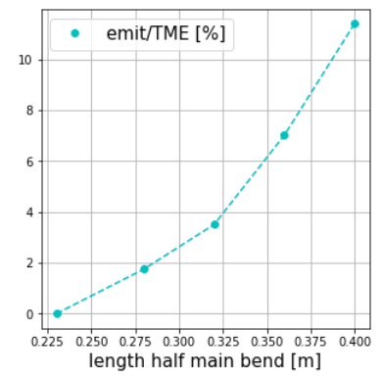


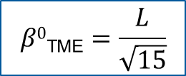
3 - Increase dipole length - keep TME-condition
Findings MBA-cell for increased dipole length:
$$β0\text{TME}=\frac{L}{\sqrt{15}}$$
$$0\text{TME}=\frac{Lθ}{6}$$
ε $\text{TME} \sim θ³\frac{2}{3\sqrt{15}}$
Half dipole: 2.39°, 0.23m → 0.40m
Field: 0.87T
ΤΜΕ: β_{x}0 = 0.103m (0.0594m)
η0 = 0.0028m (0.0016m)
Emittance contribution of RB
Impact of reverse bend on emittance
not negligible anymore
TME conditions not optimal ?

Slide 19
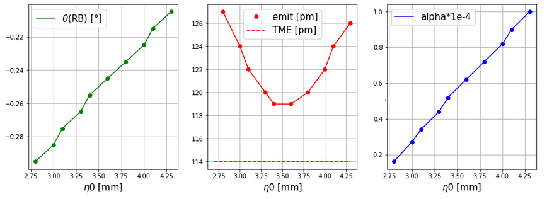
3 - Increase dipole length – restore minimal Emittance
Change η0 to recover TME-emittance:
Keep β_{x}0 = 0.103m (TME)
- Keep cell deflection angle const.
Starting point
Minimize emittance (-8pm) ⬄ keep emittance but increase α *7

Slide 20
3 - Increase dipole length – Full lattice
Minimize emittance:
Half main bend:
L_{ΜΒ} = 0.40m
= 2.345°
θ_{R} = -0.25°
η0= 0.0035m
MBA-cell: (Ref.)
ε = 119pm (114pm)
= 0.60e-4 (0.08e-4)
Full lattice: Ref.
ε = 121pm (105pm)
α = 0.38e−4 (0.14e−4)
ξ_{x} / Q_{x} = -4.6 (−5.7)
ξ_{y} / Q_{y}= -6.2 (−7.8)
Circ. = 339.6 (321.2)
Maximize α:
Half main bend:
L_{ΜΒ} = 0.40m
= 2.3°
θ_{R} = -0.205°
η0= 0.0043m
MBA-cell: (Ref.)
ε = 126pm (114pm)
= 1.00e-4 (0.08e-4)
Full lattice: Ref.
ε = 125pm (105pm)
α = 0.58e−4 (0.14e−4)
ξ_{x} / Q_{x} = -4.6 (−5.7)
ξ_{y} / Q_{y}= -6.2 (−7.8)
Circ. = 339.6 (321.2)
3 – Increase dipole length
emittance contribution of RB not negligible
full lattice: α = 1.0e-4 ⬄ ε = 158pm
+ 18m circumference
option for combined function magnets
factor 4 in α with moderate increase in ε (16%)
reduction in norm. chrom.

Slide 21
4a - Increase dipole length + include transverse gradient
Effect of transverse gradient (TG) in main dipole:
Practical: gradient cast in dipole profile – fixed
QD: η, βx (emittance) increases
Damping partition number > 1
α increases
Save circumference
emittance reduction?
Include QD in main bend:
Half main bend:
L_{ΜΒ} = 0.40m
= 2.3°, 0.84T
K = -2.28m⁻², -19T/m
η0 = 0.0059m
β_{y}0 = 9m
θ_{R} = -0.215°
MBA-cell: (long dipole)
ε = 137pm (126pm)
= 2.15e-4 (1.03e-4)
Full lattice: (Ref.)
ε = 134pm (105pm)
= 1.01e-4 (0.14e-4)
ξ_{x}/Q_{x} = -3.8 (-5.7)
ξ_{y}/Q_{y} = -3.4 (-7.8)
J_{x} = 1.22 (1.0)
Circ: = 318.8m (321.2m)
☺

Slide 22
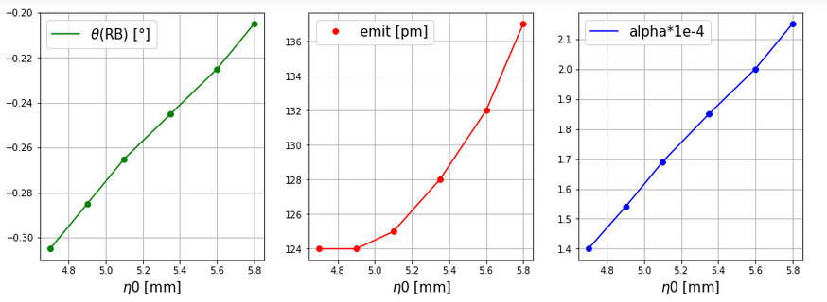
4a - Increase dipole length + include transverse gradient
Check the impact of η0 in main bend:
: best choice
4A – TG in long main dipole
Sufficient increase in α
Strong reduction in chromaticity (small β, η increase sextupole strength)
Moderate increase in emittance
Circumference ok

Slide 23
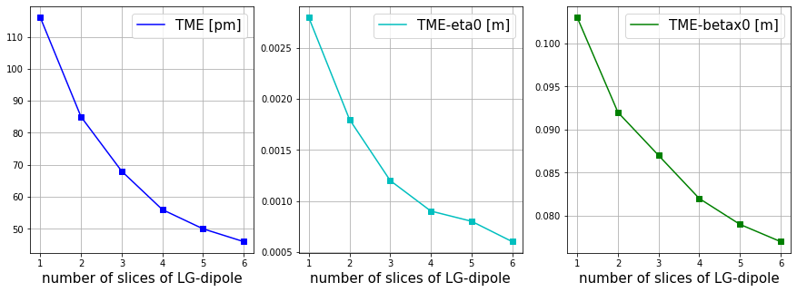
4b – LONG Main bend with longitudinal gradient
LGB:
basic idea:
B [ T ]
L [m]
Optimization module in OPA for longitudinal bends
Even 2 field levels with equal length lead to emittance reduction of 26%!
B [ T ]
B [ T ]
Further option to reduce length of central part
and increase field not yet invested
L [m]
L [m]

Slide 24
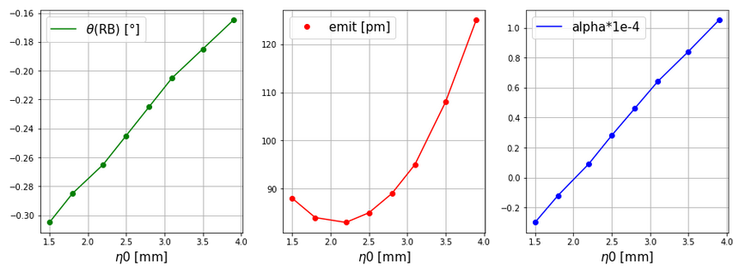
4b – LONG Main bend with longitudinal gradient
Dipole with LG, two field levels:
: best choice
Small minimal emittance => higher increase for large α

Slide 25
4b – LONG Main bend with longitudinal gradient
Half MBA-cell
(single long dipole):
= 2.3°
θ_{R} = -0.205°
η0 = 0.0043m
β_{x}0 = 0.103m
β_{y}0 = 12m
Half MBA-cell: (single long
LG dipole):
ε = 95pm (126pm)
= 0.64e-4 (1.03e-4)
ξ_{x}/Q_{x} = -4.5 (-4.5)
ξ_{y}/Q_{y} = -11.3 (-11.2)
Two parts 0.2m:
θ = 2.3° (1.5°/0.8°)
θ_{R} = -0.205°
η0 = 0.0031m
β_{x}0 = 0.103m
β_{y}0 = 12m
Full lattice (single long dipole):
ε = 125pm
= 0.58e-4
ξ_{x}/Q_{x} = -4.6
ξ_{y}/Q_{y} = -6.2
Circ. = 339.6
Full lattice: (Ref.)
LG
ε = 108pm (105pm)
= 0.40e-4 (0.14e-4)
ξ_{x}/Q_{x} = -4.6 (-5.7)
ξ_{y}/Q_{y} = -5.5 (-7.8)
Circ: = 340.4m (321.2m)
4B – LG in long main dipole
Can seek very small emittance at negative α
Full lattice: α = 1.0e-4 ⬄ ε = 179pm

Slide 26
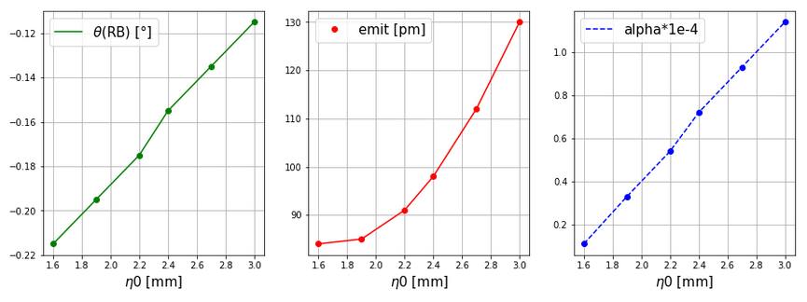
5 - include transverse gradient in reverse bend
Transverse gradient (TG) in reverse bend:
Realization as displaced quadrupole (QF)
No change in main bend 2.39°, L=0.23m
(TME: β_{x}0 = 0.0594m, β_{y}0 = 15m, η0 = 0.0016m)
J_{x} > 1 => emittance reduction
Reduction of circumference 18m (0.15*6*20)
: best choice

Slide 27
5 - include transverse gradient in reverse bend
Include QF in reverse bend :
QF/reverse bend:
θ_{R} = -0.215°, 0.22T
L_{R} = 0.14m
K = 11.1m⁻², 92T/m
MBA-cell:
= 84pm (114pm)
= 0.11e-4 (0.08e-4)
J_{x} = 1.25 (1.0)
Full lattice: Ref.
ε = 84pm (105pm)
= 0.14e-4 (0.14e-4)
J_{x} = 1.13 (1)
ξ_{x}/Q_{x} = -6.1 (-5.7)
ξ_{y}/Q_{y} = -7.7 (-7.8)
Circ: = 304.0m (322.4m)
☺
Effect of gradient in reverse bend on emittance is ~25% reduction due to J_{x}
5 – Displaced QF
Tool to reduce emittance and circumference
Full lattice: α = 1.0e-4 ⬄ ε = 254pm ⬄ no reverse bend

Slide 28
Comparison of 5 options to relax the MBA-cell
 | Results for full lattices | ε [pm] | α [e-4] | ξ/ Q x | ξ/ Q y | θ RB | Circ. [m]
 | reference | 105 | 0.14 | -5.7 | 7.8 | -0.205 | 321.2
1 | Relax η0 | 140 | 0.52 | -5.7 | -8.7 | -0.110 | 321.2
2 | Relax β0 | 139 | 0.06 | -3.6 | -3.9 | -0.235 | 322.8
3 | Increase L | 135 | 0.74 | -4.6 | -6.2 | -0.165 | 339.6
4a | Increase L + TG | 134 | 1.01 | -3.8 | -3.4 | -0.205 | 318.8
4b | Increase L (+LG) | 142 | 0.74 | -4.6 | -5.6 | -0.165 | 338.8
 |  | 98 | 0.12 | -4.6 | -6.3 | -0.265 | 339.6
5 | Displaced QF | 135 | 0.62 | -6.0 | -8.4 | -0.095 | 304.0
 |  | 84 | 0.14 | -6.1 | -7.7 | -0.215 | 304.0
Separated
function
magnets
Separated function magnet lattices do not seek α > 1e-4 with emittance ~100pm
Long bend most promising (α = 0.99e−4, ε = 158pm)
A long main bend w/, w/o gradient seeks highest α values
Both, 4b and 5 can also be used to lower the emittance
=> Combination of measures needed

Slide 29
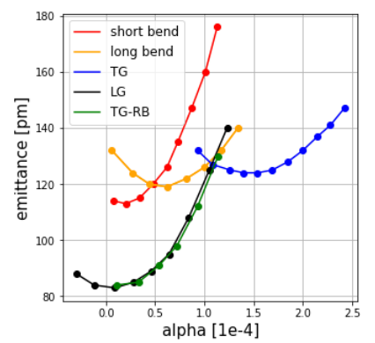
comparison of dipole options
Values for MBA-cell (not full lattice)
α ~2e-4 and ε ~100pm not possible with single measure
The original short bend is worst solution
Long bend and TG improve alpha, LG and TG-RB improve emittance
Fun fact: identical dependence of LG and TG-RB, but at different bend angles
@ ~130pm, α ~ 1e-4 achievable with all methods (but short bend)
⬄ corresponds to α ~ 0.6e-4 , ε ~125pm (full lattice)

Slide 30
lattice combining options 4a and 5
 | Results for full lattices | ε [pm] | α [e-4] | ξ/ Q x | ξ/ Q y | θ RB | Circ. [m]
 | reference | 105 | 0.14 | -5.7 | 7.8 | -0.205 | 321.2
1 | Relax η0 | 140 | 0.52 | -5.7 | -8.7 | -0.110 | 321.2
2 | Relax β0 | 139 | 0.06 | -3.6 | -3.9 | -0.235 | 322.8
3 | Increase L | 135 | 0.74 | -4.6 | -6.2 | -0.165 | 339.6
4a | Increase L + TG | 134 | 1.01 | -3.8 | -3.4 | -0.205 | 318.8
4b | Increase L (+LG) | 142 | 0.74 | -4.6 | -5.6 | -0.165 | 338.8
 |  | 98 | 0.12 | -4.6 | -6.3 | -0.265 | 339.6
5 | Displaced QF | 135 | 0.62 | -6.0 | -8.4 | -0.095 | 304.0
 |  | 84 | 0.14 | -6.1 | -7.7 | -0.215 | 304.0

Slide 31
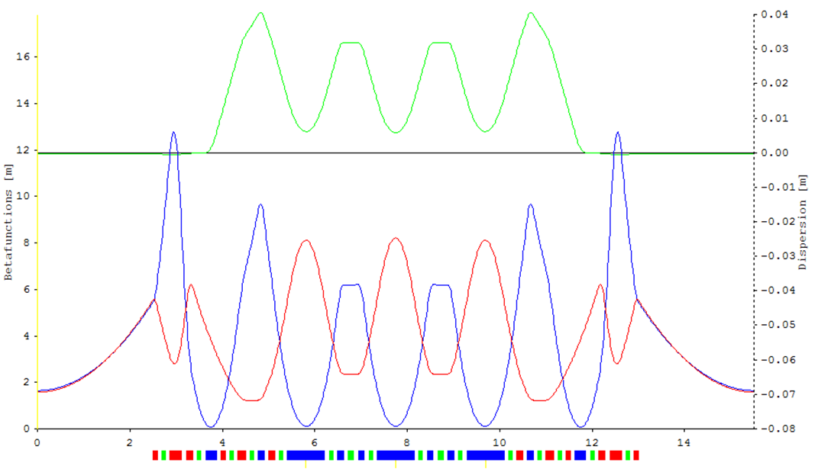
lattice combining options 4a and 5
5-bend MBA with 20 straight sections, TG in main bend and displaced QF (RB)
Input (MBA-cell):
Half length dipole: 40cm
Half angle dipole: 2.3°, 0.84T
K = -2.25, 18.8T/m
Displaced QF: 0.13m
K=11.1, 92T/m
-0.205°, Δx~2.5mm
βx = 0.103m
βy =8m
η = 0.0058m
ε = 106pm Qx = 52.27 Qy = 16.35
= 1.08e-4 𝜉_{x} = -189 𝜉_{y} = -53
C = 307.6m 𝜉_{x} /Qx = ~3.6 𝜉_{y} /Qy = ~3.2
L = 15.38m

Slide 32
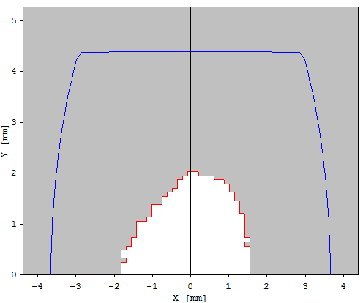
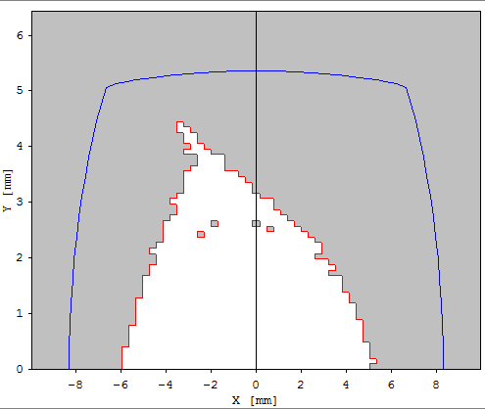
lattice combining options 4a and 5
Dynamic Aperture – stage 0 – 1000 turns
Qx=52.27, 16.35
Chromaticity tuned to +2
βx = βy = 1.5m
6 SX families: SD/SF in MBA cell
SD/SF in matching cell
S3,S4 in straight section
OPA – optimization tune shift terms
=> Promising start for optimization
Use values of Soleil upgrade
injection straight:
β_{x} = 11m
β_{y} = 3m
Soleil goal: Ax = 6mm
Ay = 2.5mm
SLS2: Ax,y < 4mm
All straights
11m / 3m
@ center of
straight section
β_{x} = 1.5m
β_{y} = 1.5m

Slide 33
lattice combining options 3 and 5
 | Results for full lattices | ε [pm] | α [e-4] | ξ/ Q x | ξ/ Q y | θ RB | Circ. [m]
 | reference | 105 | 0.14 | -5.7 | 7.8 | -0.205 | 321.2
1 | Relax η0 | 140 | 0.52 | -5.7 | -8.7 | -0.110 | 321.2
2 | Relax β0 | 139 | 0.06 | -3.6 | -3.9 | -0.235 | 322.8
3 | Increase L | 135 | 0.74 | -4.6 | -6.2 | -0.165 | 339.6
4a | Increase L + TG | 134 | 1.01 | -3.8 | -3.4 | -0.205 | 318.8
4b | Increase L (+LG) | 142 | 0.74 | -4.6 | -5.6 | -0.165 | 338.8
 |  | 98 | 0.12 | -4.6 | -6.3 | -0.265 | 339.6
5 | Displaced QF | 135 | 0.62 | -6.0 | -8.4 | -0.095 | 304.0
 |  | 84 | 0.14 | -6.1 | -7.7 | -0.215 | 304.0

Slide 34
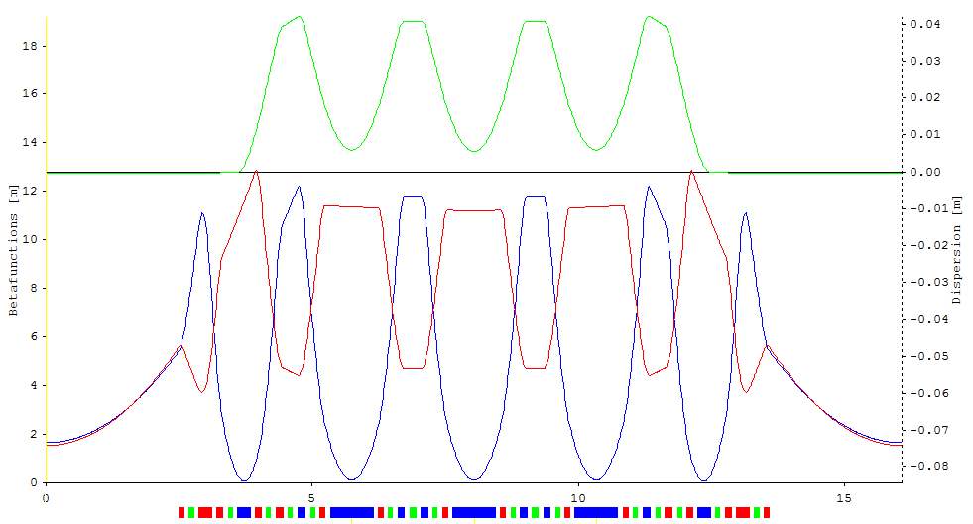
lattice combining options 3 and 5
5-bend MBA with 20 straight sections, long bend and displaced QF (RB)
Input (MBA-cell):
Half length dipole: 40cm
Half angle dipole: 2.22°, 0.81T
Displaced QF: 12cm
K=11.4, 95T/m
-0.125°, Δx~1.6mm
βx = 0.103m
βy =12m
η = 0.0058m
ε = 120pm Qx = 53.25 Qy = 11.35
= 1.00e-4 𝜉_{x} = -233 𝜉_{y} = -71
C = 321.5m 𝜉_{x} /Qx = ~-4.4 𝜉_{y} /Qy = ~-6.3
L = 16.08m
=> as close to separated function as possible

Slide 35
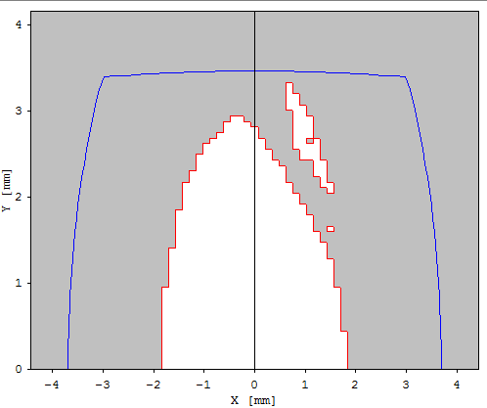
lattice combining options 3 and 5
Dynamic Aperture – stage 0 – 1000 turns
Qx=53.25, 11.35
Chromaticity tuned to +2
βx = βy = 1.5m
6 SX families: SD/SF in MBA cell
SD/SF in matching cell
S3,S4 in straight section
OPA – optimization tune shift terms
=> Promising start for optimization
@ center of
straight section
β_{x} = 1.5m
β_{y} = 1.5m

Slide 36
lattice combining options 4b and 5
 | Results for full lattices | ε [pm] | α [e-4] | ξ/ Q x | ξ/ Q y | θ RB | Circ. [m]
 | reference | 105 | 0.14 | -5.7 | 7.8 | -0.205 | 321.2
1 | Relax η0 | 140 | 0.52 | -5.7 | -8.7 | -0.110 | 321.2
2 | Relax β0 | 139 | 0.06 | -3.6 | -3.9 | -0.235 | 322.8
3 | Increase L | 135 | 0.74 | -4.6 | -6.2 | -0.165 | 339.6
4a | Increase L + TG | 134 | 1.01 | -3.8 | -3.4 | -0.205 | 318.8
4b | Increase L (+LG) | 142 | 0.74 | -4.6 | -5.6 | -0.165 | 338.8
 |  | 98 | 0.12 | -4.6 | -6.3 | -0.265 | 339.6
5 | Displaced QF | 135 | 0.62 | -6.0 | -8.4 | -0.095 | 304.0
 |  | 84 | 0.14 | -6.1 | -7.7 | -0.215 | 304.0
Not successful: ε = 144pm , α= 1.04e-4

Slide 37
lattice combining options 4A and 4b
 | Results for full lattices | ε [pm] | α [e-4] | ξ/ Q x | ξ/ Q y | θ RB | Circ. [m]
 | reference | 105 | 0.14 | -5.7 | 7.8 | -0.205 | 321.2
1 | Relax η0 | 140 | 0.52 | -5.7 | -8.7 | -0.110 | 321.2
2 | Relax β0 | 139 | 0.06 | -3.6 | -3.9 | -0.235 | 322.8
3 | Increase L | 135 | 0.74 | -4.6 | -6.2 | -0.165 | 339.6
4a | Increase L + TG | 134 | 1.01 | -3.8 | -3.4 | -0.205 | 318.8
4b | Increase L (+LG) | 142 | 0.74 | -4.6 | -5.6 | -0.165 | 338.8
 |  | 98 | 0.12 | -4.6 | -6.3 | -0.265 | 339.6
5 | Displaced QF | 135 | 0.62 | -6.0 | -8.4 | -0.095 | 304.0
 |  | 84 | 0.14 | -6.1 | -7.7 | -0.215 | 304.0
Not successful: ε = 151pm , α= 1.04e-4

Slide 38
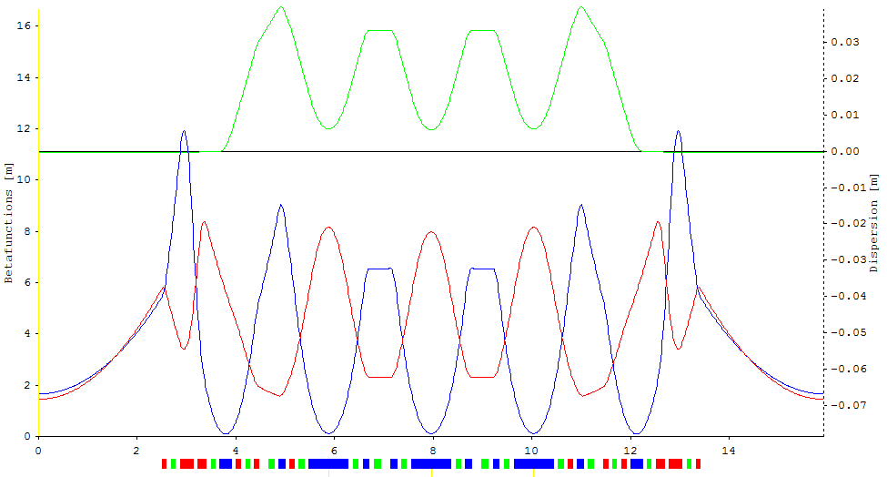
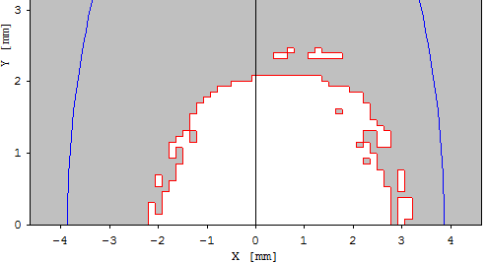
lattice combining options 4a and 5
5-bend MBA with 20 straight sections, TG in main bend and displaced QF (RB)
+ space for vacuum and adjusted sextupole length
End of identical MBA-cellls
= +10cm; 0.4m*20= 8m
ε = 104pm Qx = 52.25 Qy = 16.35
= 1.04e-4 𝜉_{x} = -176 𝜉_{y} = -57
C = 318.4m 𝜉_{x} /Qx = ~3.4 𝜉_{y} /Qy = ~3.5

Slide 39
List of magnets
E/0.3 = B*ρ = 8.333
magnet | Length [m] | Angle [°] | Field [T] | K [1/m²] | Gradient [T/m] | B’’/2Bρ [1/m³] | SX [T/m²]
main bend | 0.80 | 4.74 | 0.86 | -2.2 | 18.3
displaced QF | 0.12 | 0.215 | 0.26 | 11.7 | 97.5
Q1A | 0.09 |  |  | 4.4 | 36.7
MQ2 | 0.09 |  |  | 9.7 | 80.8
MQ1 | 0.09 |  |  | -2.8 | -23.3
UQ1 | 0.17 |  |  | -11.2 | -93.3
UQ2 | 0.26 |  |  | 11.2 | 93.3
UQ3 | 0.09 |  |  | -10.9 | 90.8
S1 | 0.10 |  |  |  |  | -793.0 | -13216
S0 | 0.14 |  |  |  |  | 789.8 | 13162
S1A | 0.08 |  |  |  |  | -157.9 | -2631
S0A | 0.10 |  |  |  |  | 871.0 | 14516
S3 | 0.08 |  |  |  |  | -568.9 | -9481
S5 | 0.08 |  |  |  |  | 302.9 | 5048

Slide 40
List of lattice options
 | lattice | # of bends | periods | Circum- ference [m] | ε [pm] | α [e-4]
 | reference | 5 | 20 | 321.2 | 105 | 0.14
1 | Long main dipole w/o gradient and displaced QF | 5 | 20 | 321.5 | 120 | 1.00
2 | Transverse gradient in main bend and displaced QF | 5 | 20 | 307.6 | 106 | 1.08
3 | Transverse gradient in main bend and displaced QF | 7 | 16 | 307.8 | 67 | 1.05
4 | Transverse gradient in main bend and displaced QF | 5 | 16 | 240.6 | 158 | 0.99
BIII in BII-tunnel ?
Length of beamlines?
Shielding (1.7->2.5GeV)?
Vibrations?
Fall back solution without magnet-technological challenges
Most efficient solution
Most inefficient solution, unless ε << 100pm is needed
816 magnets ⬄ 780 magnets for 20 periods
Tough, but feasible…(i.e. permanent magnet as matching dipole...)

Slide 41
Conclusion
Conclusion:
The bottleneck for the lattice development is the momentum compaction factor
We need to agree on what we think is the appropriate limit on α
Going to α ~ 6e-5 would open lots of possibilities for the lattice design
For α > 1e-4 we need to utilize combined function magnets
The methodology presented led to two lattice options with 20 straight sections
on ~ 300m circumference, that fulfill the considered requirements
and should be further investigated
We should specialize within the group to be more efficient
Next steps: confirm opa results with elegant/MAD
off momentum properties
rudimental hardware check (vacuum, magnets, magnet-apertures…)
injection
….
Thank you for your attention!

Slide 42
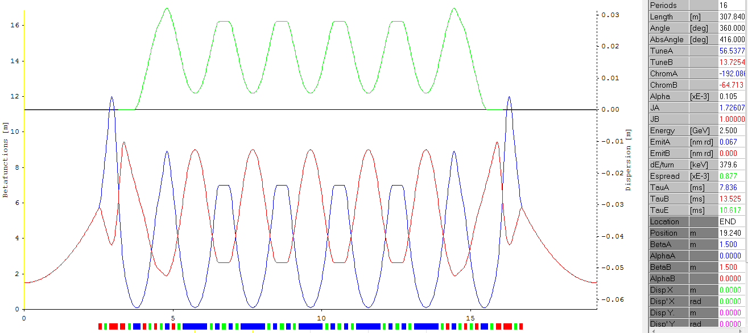
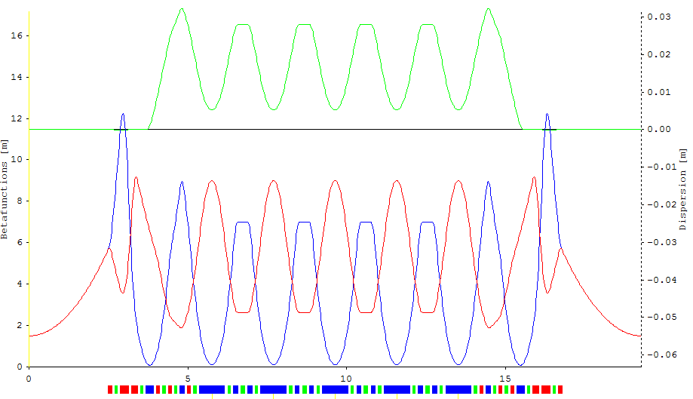
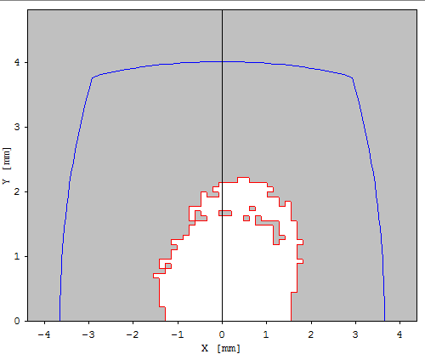
7-bend achromat, 16 periods, 300 m

Slide 43
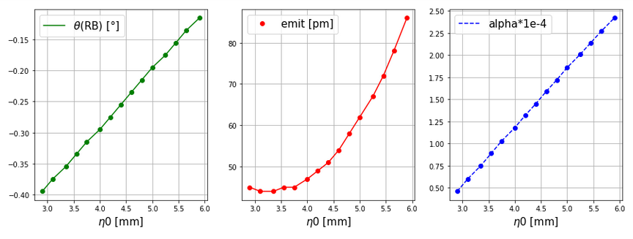
7-bend achromat, 16 periods

Slide 44
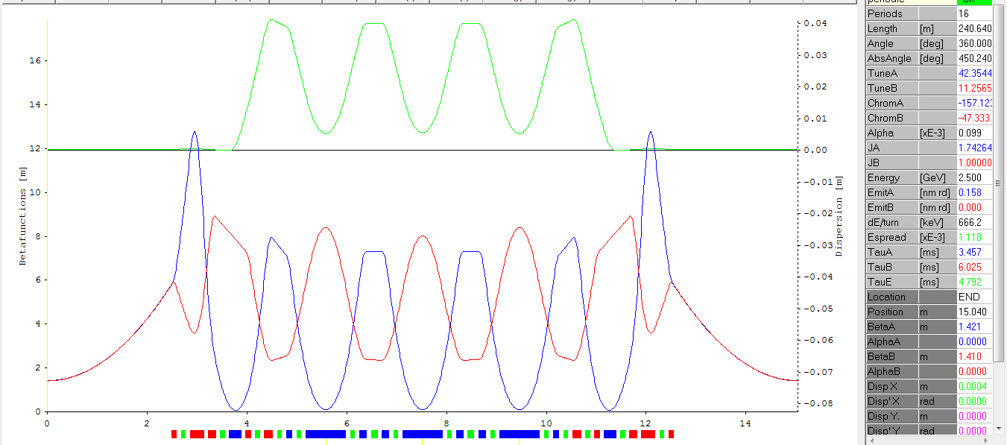
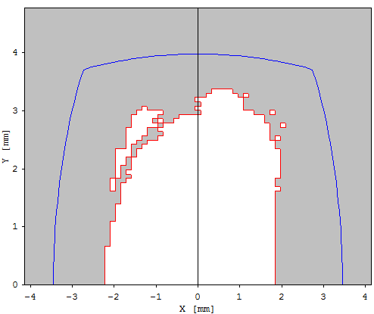
7-bend achromat, 16 periods, 240 m

Slide 45
Grundstücksgröße
=> Die benötigte Grundstückgröße ist 2x Länge der Beamlines

