Slide 1
BIII – Lattice design
LIMITS OF
MBA–LATTICES WITH REVERSE BENDS
USING SEPERATED FUNCTION MAGNETS
Bettina Kuske, 7/8-2020

Slide 2
Goal and references
Explore boundaries of MBA-lattices using separated function magnets
in terms of
minimal emittance
minimal circumference
number of straight sections
Work is inspired by paper:
B. Riemann and A. Streun:
“Low emittance lattice design from first principles:
Reverse bend and longitudinal gradient bends”
Phys. Rev. AB 22, 021601 (2019)
Some results reproduce findings by Alexander (talk in this meeting)
Development of MBA-base cell can follow a rather “deterministic procedure”
Emphasis on the MBA-base cell, matching cell and straight section
will be treated with more care later.

Slide 3
Content
Structure of the talk
How to set up shortest MBA base-cell with minimal emittance – and the lack of alternatives (under the chosen boundary conditions)
Solution for ‘a’ matching cell (not optimized)
‘Prototype’ lattice
Variations of basic lattice (emittance, straights and circumference)
If we combined function magnets after all …

Slide 4
Structure of MBA-Lattices
MBA base cell
Symmetry points
MBA half-cell
SX
η_{x}
B
B
Q
Q
B
Q
RB
Full MBA-cell
Next MBA-cell
Matching-cell
Simplest matching cell: ½ MBA
η = η’ = 0
η_{x}
Last MBA-cell
Matching cell

Slide 5
Basic MBA half-cell as transfer line
β_{y0}
α_{x}=0
η‘=0
β_{x}
α_{y}=0
QF
SF
η
β_{x0}
,η₀
0 0.2 0.4 0.6 0.8 1.0 1.2 1.4 1.6 m
RB
QD
SD
Boundary conditions :
Smallest emittance
β_{x}, η_{x} small in main bend
Adjacent Q, SX are QD, SD
As short as possible
Shortest drift spaces (10cm)
Max. field in B, Q
Reverse bend
Transfer line input:
β_{x}⁰, η_{x}⁰, β_{y}⁰
Choices ?
Order QD, SD ?
η should be large at SD
Order of QF and rev. bend, SF?
η should be large at RB, SD
β_{y0} – keep β_{y0} > β_{x0} at SD
Constraints:
α_{x}=α_{y}=η_{x}’ =0 at cell end

Slide 6
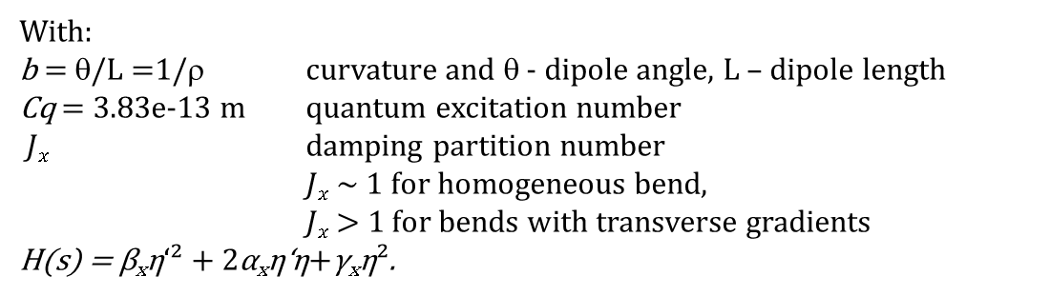
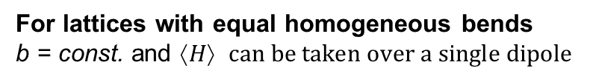
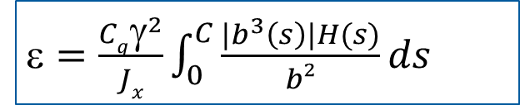
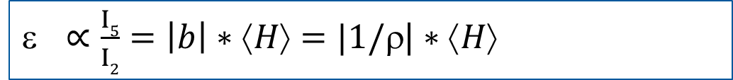


General formulas
General emittance formula:
ε $=\frac{Cqγ^{2}}{Jx}\int_{0}^{C}{\frac{|b^{3}\left(s\right)|H(s)}{b²}ds }$
With:
b = θ/L =1/ρ curvature and θ - dipole angle, L – dipole length
Cq = 3.83e-13 m quantum excitation number
$Jx$ damping partition number
$Jx$ ~ 1 for homogeneous bend,
$Jx$ > 1 for bends with transverse gradients
H(s) = β_{x}η‘² + 2α_{x}η‘η+γ_{x}η².
Radiation integrals:
$I2=\int_{0}^{C}{b²(s)ds }$
$I5=\int_{0}^{C}{|b^{3}\left(s\right)|H(s)ds }$
For lattices with equal homogeneous bends
b = const. and $↑H$ $can be taken over a single dipole$
ε $ ∝\frac{I5}{I2}=\left|b\right|∗⟨H⟩=|1/ρ$| $∗↑H$

Slide 7
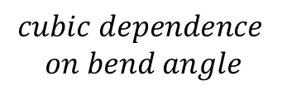
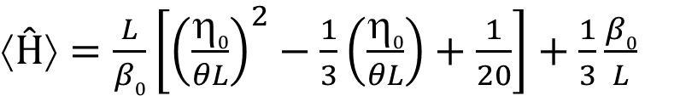
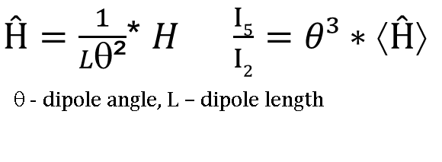

Following the paper of Riemann and Streun…
B. Riemann and A. Streun:
Phys. Rev. AB 22, 021601 (2019)
$Ĥ=\frac{1}{Lθ\text{²}}$* $H$ $\frac{I5}{I2}=θ³∗⟨Ĥ⟩$
θ - dipole angle, L – dipole length
$$cubic dependence$$
$$on bend angle$$
In a homo. bend with $θ$<<1, $β$_{x} propagates approx. like in a drift space, and
$$\left(s\right)=η0+\int_{0}^{s}{η′}\left(𝖘\right)d𝖘$$
Then $↑Ĥ$ for a bend with α_{x}= η‘= 0 at the beginning (MBA half-bend):
A.Streun, A.Wrulich: “Compact low emittance light sources based on longitudinal gradient bending magnets”
$↑Ĥ⟩=\frac{L}{β0}\left[{\left(\frac{η0}{θL}\right)}^{2}−\frac{1}{3}\left(\frac{η0}{θL}\right)+\frac{1}{20}\right]+\frac{1}{3}\frac{β0}{L}$
Eq. (14)
where $β0$, $0$ are taken at the beginning of the dipole
$$For such bends, emittance is determined expicitly by θ, L,β0\text{, }η0$$

Slide 8
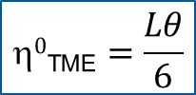
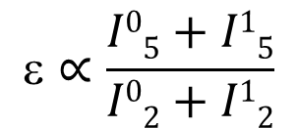
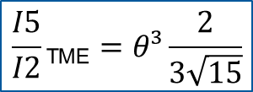
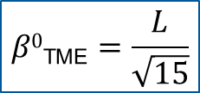
Emittance of MBA cell with single Bend and with reverse Bend
MBA-cell with a single homogeneous bend:
Minimization of $↑Ĥ$ yields theoretical minimal emittance (TME) values:
$$β0\text{TME}=\frac{L}{\sqrt{15}}$$
$$0\text{TME}=\frac{Lθ}{6}$$
$$\frac{I5}{I2}\text{TME}=θ³\frac{2}{3\sqrt{15}}$$
θ - dipole angle, L – dipole length, Streun, Riemann eq. (15)
MBA-cell with homogeneous bend and reverse bend:
$$∝\frac{I05+I15}{I02+I12}$$
Index 0 – main bend
Index 1 – reverse bend
If reverse bend has symmetry point at the end => same $↑Ĥ$ formula holds!
For small deviations – still good approximation

Slide 9
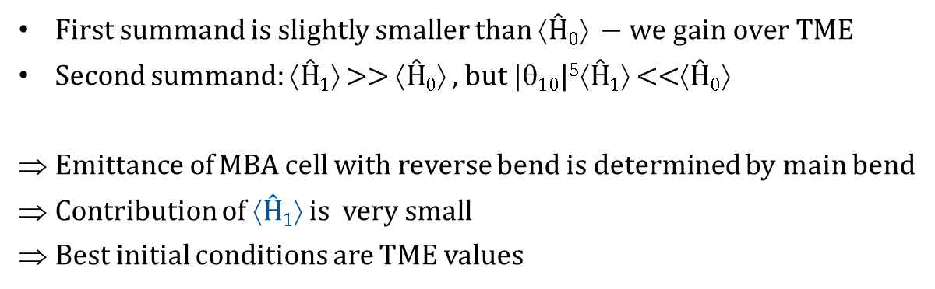
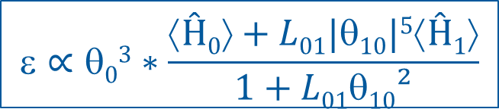
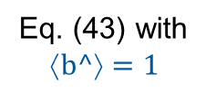

Emittance in a Cell with homo. Bend and homo. Reverse bend
MBA-cell with homogeneous bend and reverse bend:
(B. Riemann und A. Streun)
$$∝θ03∗\frac{⟨Ĥ0⟩+L01|θ10|5⟨Ĥ1⟩}{1+L01θ10²}$$
Index 0 – main bend
Index 1 – reverse bend
Eq. (43) with
$$↑b^=1$$
$10=\frac{θ1}{θ0} ≈ 0.1 L01=\frac{L0}{L1} $ 5.
First summand is slightly smaller than $↑Ĥ0 −we gain over TME$
Second summand: $↑Ĥ1$ >> $↑Ĥ0$ , but $|10|5↑Ĥ1$ <<$↑Ĥ0$
Emittance of MBA cell with reverse bend is determined by main bend
Contribution of $↑Ĥ1$ is very small
Best initial conditions are TME values

Slide 10
Twiss parameters in Basic MBA half-cell
Procedure to set up shortest MBA cell with minimal emittance
Fix dipole geometry:
L₀, θ₀ of half bend
L₁, θ₁ of rev. bend
Use QF, QD to fit
α_{x}¹ = α_{y}¹ = 0
3rd ‘knob for dispersion
η’¹ = 0: use rev. bend angle
Initial conditions:
TME β_{x}⁰, η⁰
β_{y}^{0 “}large enough”
Here we need the
reverse bend
Choices for 3rd ‚knob‘:
drift spaces set to be as short as possible
β_{x}⁰ or η⁰ set to seek TME values
β_{y}⁰ inefficient
=> Use reverse bend angle, θ₁
Adjust length of QF, QD
Procedure still works for changing boundary conditions.

Slide 11
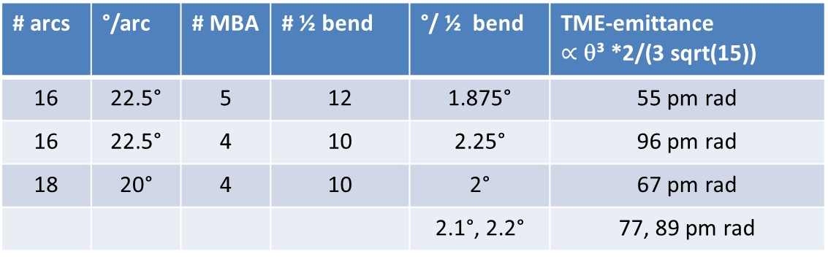
Plugging in numbers
Dipole geometry:
# arcs | °/arc | # MBA | # ½ bend | °/ ½ bend | TME-emittance $∝$ θ³ *2/(3 sqrt(15))
16 | 22.5° | 5 | 12 | 1.875° | 55 pm rad
16 | 22.5° | 4 | 10 | 2.25° | 96 pm rad
18 | 20° | 4 | 10 | 2° | 67 pm rad
 |  |  |  | 2.1°, 2.2° | 77, 89 pm rad
Angle of reverse bend has to be added to main bend
Reverse bend: angle set to fit η’¹=0 (~ 0.2°, 0.05m, ~0.5T)
For simplicity: use same reverse bend in matching cell
Length of main bend determined by max. field
Adjust angle in matching cell to seek 360°

Slide 12
Prototype MBA half-cell
E = 2.5GeV
18 arcs, 4 MBA cells
Drifts: 0.1m
Quad: 0.15m initial
Sext.: 0.08m initial
Half main bend:
2.15°, 0.21m
B=1.49T
QF
SF
0 0.2 0.4 0.6 0.8 1.0 1.2 1.4 1.6 m
QD
SD
Reverse bend:
-0.175°, 0.05m
B=0.5T
TME values:
𝛽x₀^{TME} = 0.054m
η₀^{TME} = 0.0013m
𝛽y₀ = 15m

Slide 13
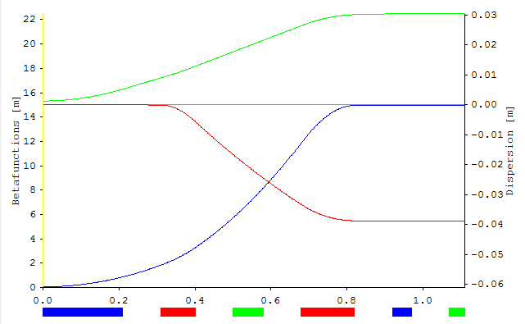
Prototyp MBA cell with reverse bend, minimal emittance
η_{x}
L = 1.11m
𝜀 = 83pmrad
TME = 83pmrad
𝜉_{x} = -1.546
𝜉_{y} = -0.436
𝜑_{x} = 86.5°
𝜑_{y} = 7.6°
β_{y}
β_{x}
Bend0 = 2.15°, L=0.21m
Bend1 = -0.175°, L=0.05m
QD = -11.3 1/m², 94T/m, L=0.09m
QF = 11.3 1/m², 94T/m, L=0.14m
Under given constraints: shortest MBA-cell using separated function magnets
with minimal emittance.

Slide 14
Matching cell
Setting up the matching cell:
Use half MBA cell (1.11m is short!)
Use same reverse bend as MBA cell
Angle of dipole set to reach 360° (2.275°)
Initial conditions for fitting set by MBA cell
Use QD, QF to suppress dispersion (reverse bend is fixed – to be optimized)
3 quadrupoles in straight section to fit α_{x}, α_{y} and one beta function
Lack of ‚knob‘ to fit both beta functions
(we can use reverse bend field, quads in last MBA cell)

Slide 15
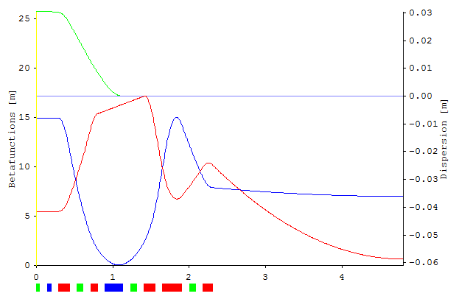
MBA cell with reverse bend, minimal emittance
L = 4.8m
(1.13 + 1.17+2.5m)
𝜀 = 68pmrad
𝜉_{x} = -3.6
𝜉_{y} = -1.5
𝜑_{x} = 197.2°
𝜑_{y} = 91.3°
η_{x}
β_{x}
β_{y}
B0 = 2.275°, L=0.23m
Q1 = -11.0 1/m², L=0.14m
Q2 = 11.6 1/m², L=0.25m
Q3 = -8.7 1/m², L=0.12m
QD = -10.4 1/m², L=0.09m
QF = 11.5 1/m², L=0.14m
Drifts: 0.1m

Slide 16
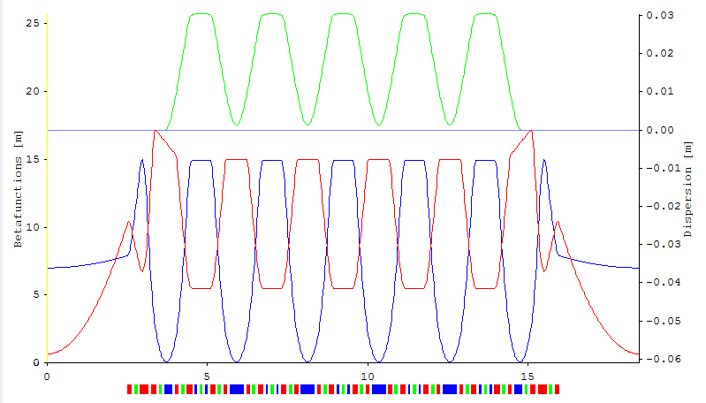
Separated function, 6-bend MBA with 18 straight sections
Separated function, 6-bend MBA with 18 straight sections:
L = 18.48m 𝜉_{x} = -352 Qx = 54.33 ε = 80pmrad
C = 332.64m 𝜉_{y} = -118 Qy = 12.17 α = 1e-6
6 SX families : SD/SF in MBA cell, SD/SF in matching cell, S3,S4 in straight section
TME:
2.15°, 83pmrad

Slide 17
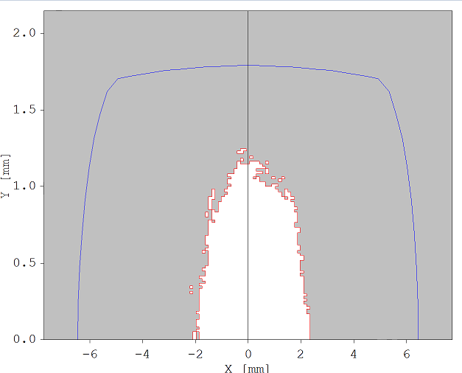
Dynamic aperture 6-bend MBA, 18 straights
Dynamic Aperture – stage 0 – 1000 turns
No tune optimization
Chromaticity tuned to +2
Manual variation of SF, SD in matching cell
OPA – optimization of amplitude dependent tune shift
=> Promising start for optimization
@ center of
straight section
β_{x} = 6.2m
β_{y} = 0.6m

Slide 18
Variations of basic MBA - Lattice
So far (separated function magnet lattice):
Procedure to develop MBA cell
Use simplest matching cell
=> Lattice with satisfactory emittance, circumference > 300m
Shorter circumference?
MBA cell: can not be shortened
Matching cell:
AM-lattice: single quad in matching cell
JGH-lattice: two quadrupoles in straight section
Loss of flexibility?
Length (some) straight section - < 5m?
(QL+0.1m)*36
~8m circ.
But: different combinations of MBA-cells and periods are feasible
Length of MBA-cell : 2.22m => 18*MBA ~ 40m
Length of MBA-achromat :18.5m => 2 achromats ~ 40m

Slide 19
Changing the number of MBA-cells / arcs
Units |  | # achromats 16 18 20
Angle/arc | [°] | 22.5 | 20 | 18
MBA-cell/arc |  | 5 | 4 | 3
Half-dipoles total |  | 192 | 180 | 160
Av. angle / half-dipole | [°] | 1.875 | 2.0 | 2.25
Angle main-dipole | [°] | 2.0 | 2.15 | 2.4
Angle reverse bend | [°] | -0.165 | -0.175 | -0.20
Angle matching bend | [°] | 2.075 | 2.275 | 2.6
circumference | [m] | 332 | 333 | 327
Emittance (TME) | [pm rad] | 66 (67) | 80 (83) | 112 (116)
“Zeroth” dyn. aperture x,y | [mm] | 4, 2 | 2, 1 | 5, 2

Slide 20
Changing the number of MBA-cells / arcs
Units |  | # achromats 16 18 20 |  |  | 16
Angle/arc | [°] | 22.5 | 20 | 18
MBA-cell/arc |  | 5 | 4 | 3 | 4
Half-dipoles total |  | 192 | 180 | 160 | 160
Av. angle /half-dipole | [°] | 1.875 | 2.0 | 2.25
Angle/MBA-dipole | [°] | 2.0 | 2.15 | 2.4 | 2.4
Angle reverse bend | [°] | -0.165 | -0.175 | -0.20 | -0.20
Angle matching bend | [°] | 2.075 | 2.275 | 2.6
circumference | [m] | 332 | 333 | 327 | 295
Emittance (TME) | [pm rad] | 66 (67) | 80 (83) | 112 (116) | 118 (116)
“Zeroth” dyn. aperture x,y | [mm] | 4, 2 | 2, 1 | 5, 2 | 2.5, 2
Lattice (sep. func. mag.) with a circumference ~300m has emittance > 100pm rad.

Slide 21
Conclusions – MBA with separated function magnets
Summary for lattices with separated function magnets
There are promising solutions of lattices without combined function magnets
Same circumference allows for different combinations of # MBA-cells
and # achromats, with different emittance
We can trade number of straight sections against emittance
A circumference of 300m seems not adequate for a goal emittance <100pm
330-340m would be sufficient (+10-15%)
~370m => ~45pmrad, 16 arcs, 6 MBA cells
Attention: +10 cm in MBA half-cell => +16-19m circumference !!
With technical realization, circumference will grow

Slide 22
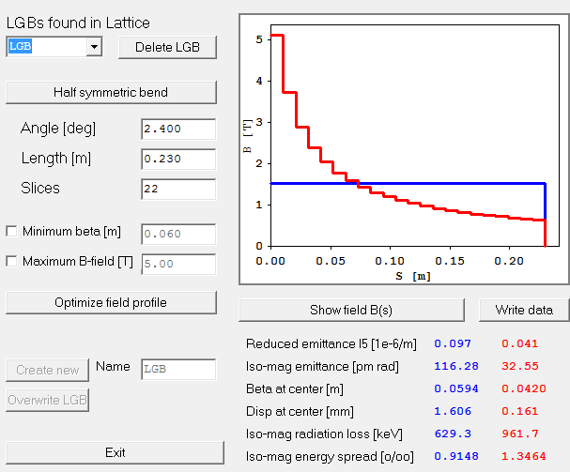
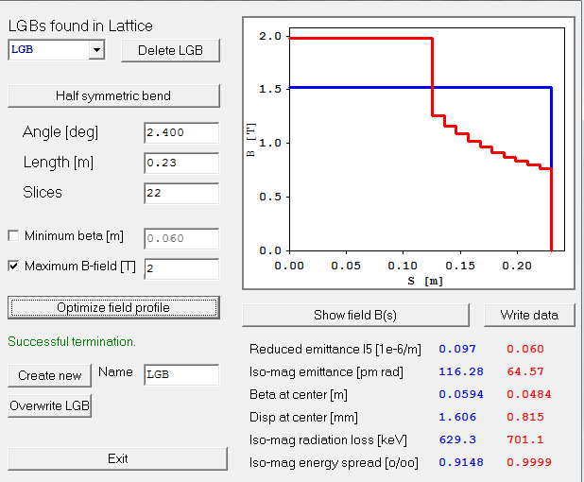
Longitudinal gradient bend
Ignoring technical challenges – what could we reach?
Longitudinal gradient bends: reduce the emittance, same circumference
Best candidate: lattice with 20 straights and 112pm
LBG-blocks:
1.05 cm
< 2T
Undulator type
dipole
65 pm (116pm-TME)
Streun
OPA
LGB-editor

Slide 23
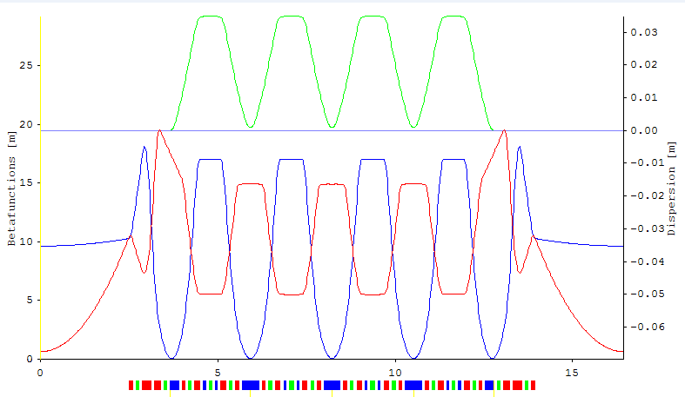
5-bend MBA with LGB main magnet, 20 straights
5-bend MBA with 20 straight sections:
L = 16.44m 𝜉_{x} = -372 Qx = 50.1 ε = 65pmrad (56% TME)
C = 328.8m 𝜉_{y} = -113 Qy = 12.5 α = -1.5e-5

Slide 24
Dynamic aperture 5 bend with LGB
Dynamic Aperture – stage 0 – 1000 turns
No tune optimization
Chromaticity tuned to +2
Manual variation of SF, SD in matching cell
OPA – optimization of amplitude dependent tune shift
=> Promising start for optimization
@ center of
straight section
β_{x} = 9.6m
β_{y} = 0.6m

Slide 25
Bends with transverse Gradient – Option 1
Ignoring technical challenges – what could we reach?
Transverse gradient bends: reduce the emittance (damping partition number Jx > 1)
Can reduce the circumference (combined magnets)
Best candidate: lattice with 16 straights and 66pm and C=332m
A: Combine QD with main bend
=> considerable increase in length of main bend
Half main bend : combined funct. :
2.0°, 22cm, 1.32T => 38cm, 0.764T
QD:
11.2 1/m², 9cm, 93 T/m => 38cm, 22T/m
ALS-U, B2: 0.848T, 47T/m
Elettra, BF2: 0.790T, 13.5 T/m
P. Schnizer, „Multibend achromat lattice magnets - An overview”
QD+drift+bend = 41cm => 38cm / MBA half cell, 4.8m circumference

Slide 26
Bends with transverse Gradient – Option 2
B: Combine QF with reverse bend by displacement
=> increase in length of (displaced) QF
Reverse bend :
-0.165°, 5cm, 0.48T => 16cm, 0.15T
QF:
11.2 /m², 14cm, 93 T/m => 16cm, 81T/m
ALS-U, QF5: 0.164T, 105T/m
SLS-2, AN: 0.4T, 30 T/m
P. Schnizer, „Multibend achromat lattice magnets - An overview”
QF+drift+RB = 29cm => 16cm / MBA half cell, 20.8m circumference (!)

Slide 27
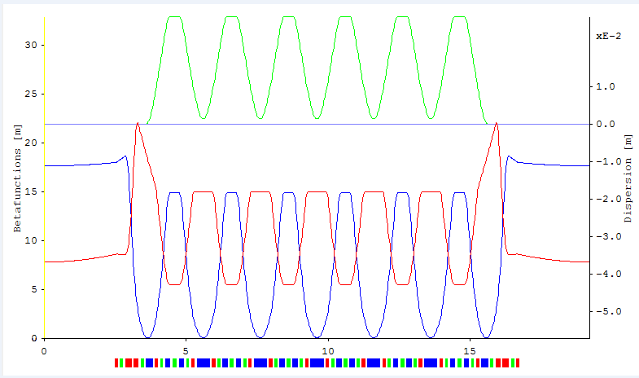
7-bend MBA with displaced QF and 16 straight sections
7-bend MBA with 16 straight sections:
L = 19.22m 𝜉_{x} = -360 Qx = 54.4 ε = 52pmrad (78% TME)
C = 307.5m 𝜉_{y} = -110 Qy = 5.4 α = 3e-6
Displaced QF => emittance ok and circumference ok, α > 0

Slide 28
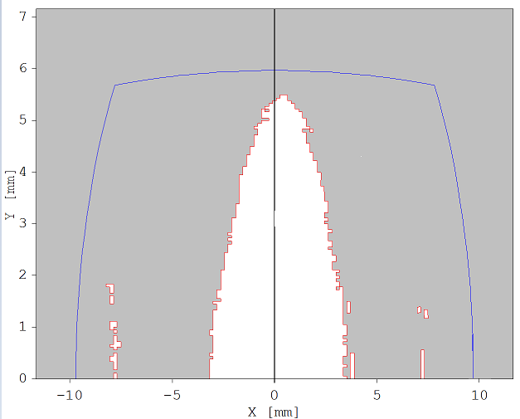
Dynamic aperture 7 bend with displaced QF
Dynamic Aperture – stage 0 – 1000 turns
No tune optimization
Chromaticity tuned to +2
Manual variation of SF, SD in matching cell
OPA – optimization of amplitude dependent tune shift
=> Promising start for optimization
@ center of
straight section
β_{x} = 17.7m
β_{y} = 7.8m

Slide 29
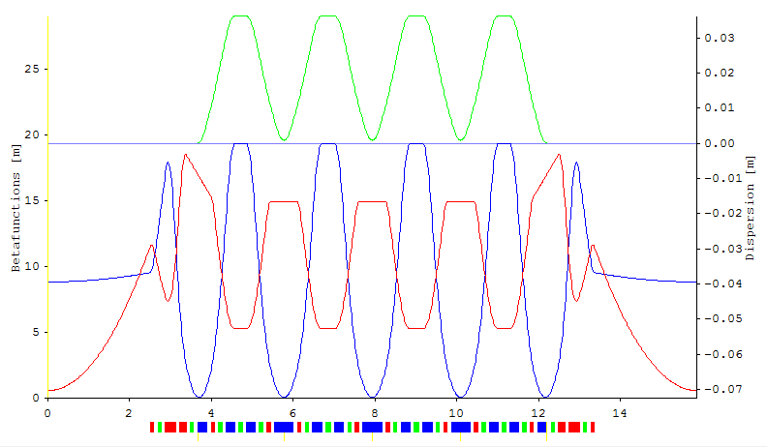
5-bend MBA with LGB, displaced QF and 20 straight sections
5-bend MBA with 20 straight sections:
L = 15.86m 𝜉_{x} = -389 Qx = 50.2 ε = 54pmrad (46% TME)
C = 317.2m 𝜉_{y} = -110 Qy = 12.3 α = -1.4e-5
LGB and displaced QF => emittance ok and circumference ok, 20 straights

Slide 30
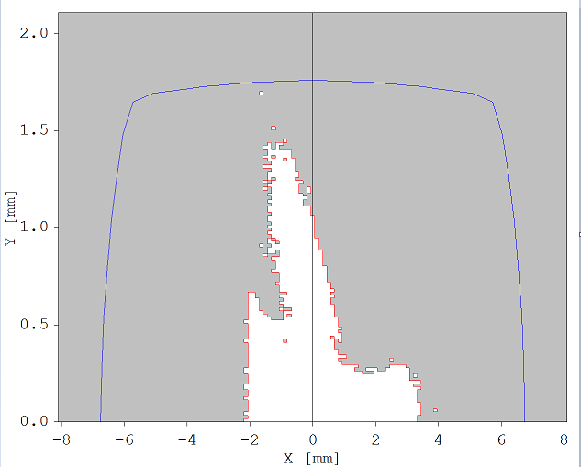
Dynamic aperture 5 bend with LGB and displ. QF 20 straights
Dynamic Aperture – stage 0 – 1000 turns
No tune optimization
Chromaticity tuned to +2
Manual variation of SF, SD in matching cell
OPA – optimization of amplitude dependent tune shift
=> Promising start for optimization
@ center of
straight section
β_{x} = 8.8m
β_{y} = 0.6m

Slide 31
Summary I
„Take- home“ messages:
Number of straight sections does not necessarily correlate with circumference
# MBA-cells ⬄ # periods
Using only separated function magnets is an option,
then, emittance correlates with number of straights (# bends)
Using a longitudinal gradient bend as main bend (LGB)
‚undulator-type‘ dipole
drastically reduce the emittance (56% of TME)
lead to negative α₀
Using transverse gradient bends (displaced QF quadrupole) (TGB)
reduce the circumference
reduce the emittance (78% of TME)
LGB and TGB
even smaller emittance (45% of TME) and negative α₀
=> Using advanced magnet technology allows to achieve ~54pm
emittance with 20 periods on 320m circumference!

Slide 32
Summary II: Prototype lattice comparison
magnet technology | # straight sections | # bends | circum- ference [m] | emittance [pm rad] | α₀
SF | 16 | 7 | 333 | 66 | 2e-6
SF | 16 | 6 | 295 | 118 | 2e-6
SF | 18 | 6 | 332 | 80 | 1e-6
SF | 20 | 5 | 327 | 112 | -3e-6 *
LGB | 20 | 5 | 329 | 65 | -1.5e-5
TGB | 16 | 7 | 307 | 52 | 3e-6
TGB | 20 | 5 | 306 | 87 | -1e-6
LGB + TGB | 20 | 5 | 317 | 54 | -1.4e-5
SF=separated function, LGB=longitudinal gradient bend, TGB= transverse gradient bend
* Negative contribution from matching cell

Slide 33
Summary III
Conclusion
Lattice design is optimization in a 20-30 (?) parameter space and there exist endless equivalent solutions
We need strategies for the development – not singular solutions
Endless adaption of lattices to changing (technical) demands/restrictions
These demands/restrictions will disqualify many solutions
Using clear strategies, we can analyze why certain lattice types work / don’t work
Strategies reveal ‚open‘ issues
In the presented case: What are our priorities?
Lowest emittance?
Efficiency in terms of number of straight section?
Boundary on α₀?
Limitation of potential candidates! Start non-linear optimization for few promising candidates.
Next steps in lattice work:
Analyze options for matching cell
skip restrictions on reverse bend angle
Understand effective α₀ manipulation

Slide 34
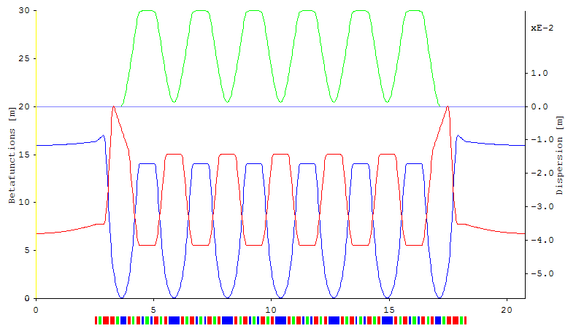
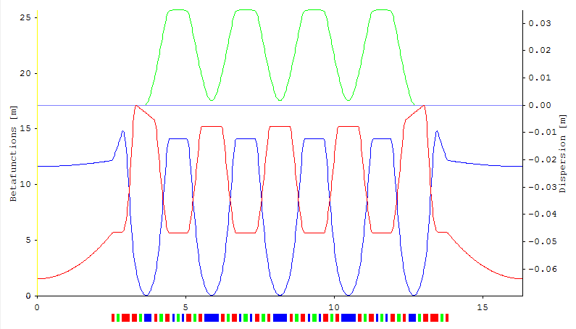
Comparison of arcs
16 arcs,
7 bend
64pm
Thank you for your attention !
18 arcs,
6 bend
80 pm
20 arcs,
5 bend
116pm

Slide 35
Elements of MBA half-cell
MBA cell
symmetry
point
Symmetry point
to next MBA cell
Half
main bend
Q
SX
Q
SX
0 0.2 0.4 0.6 0.8 1.0 1.2 1.4 1.6 m
Reverse bend
Elements (separated function magnets):
Half main bend and reverse bend
(know length and angle)
2 quadrupoles (QF, QD)
2 sextupoles (SF, SD)

