Slide 1
Off momentum investigations
Bettina Kuske

Slide 2
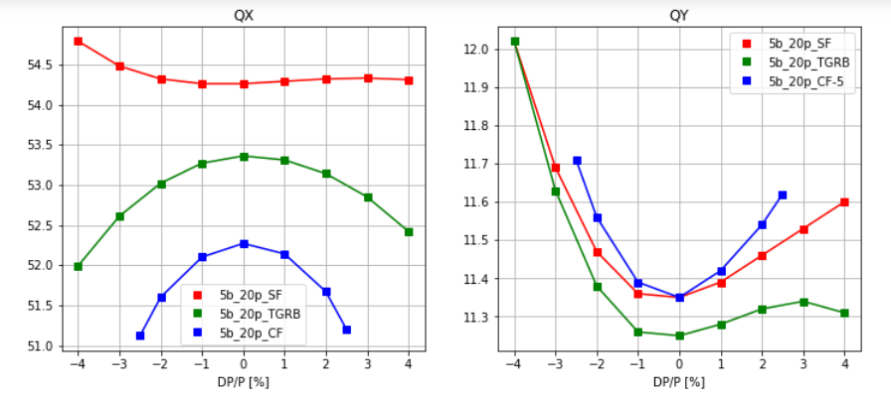
TUNESHIFT WITH ENERGY
Red: reference lattice with separated function magnets
Green: Separated functions with shifted QF as reverse bend
Blue: Combined functions (TG and TGRB) (vertical tune reduced by 5)

Slide 3
SEXTUPOLE STRENGTH AND QUADRATIC CHROMATICITY TERMS
 | SF [1/m²] | SD | SFA | SDA | CRx² | CRy²
5bend_20p_SF | 43 | -60 | 31 | -7 | 156 | 305
5bend_20p_TGRB | 49 | -62 | 23 | +14 | -620 | 266
5bend_20p_CF | 72 | -93 | 30 | +63 | 1343 | 467
 | MBA-cell phi X/2PI | MBA-cell Phi Y/2PI | Beta X @ SF | Beta Y @SD | Eta @SF | Eta QSD
5bend_20p_SF | 0.240 | 0.022 | 14.4 | 9.5 | 0.035 | 0.023
5bend_20p_TGRB | 0.233 | 0.022 | 12.6 | 8.25 | 0.041 | 0.029
5bend_20p_CF | 0.226 | 0.040 | 7.0 | 4.0 | 0.032 | 0.022

