Slide 1
CS418 Web page
Milestone 1
Basic Operations

Slide 2
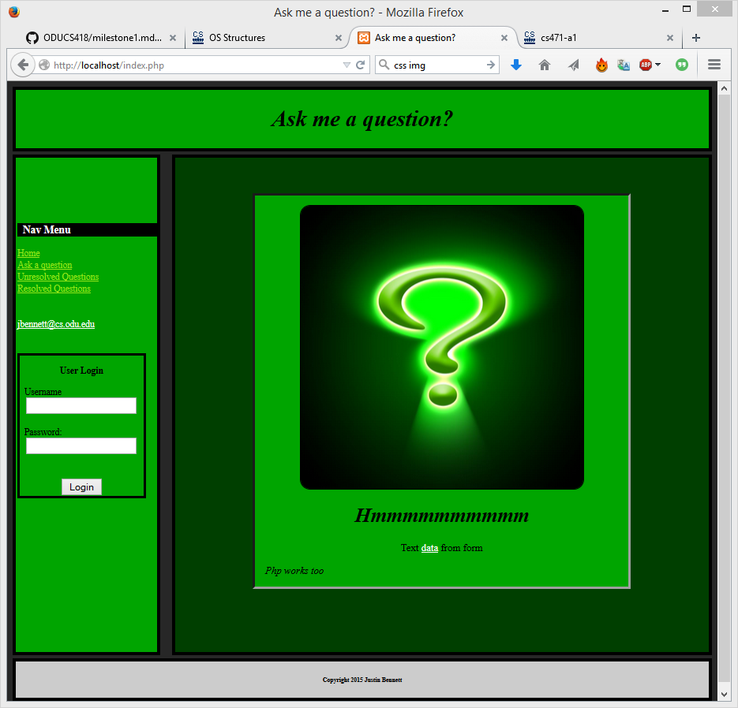
Page Layout-Home Page

Slide 3
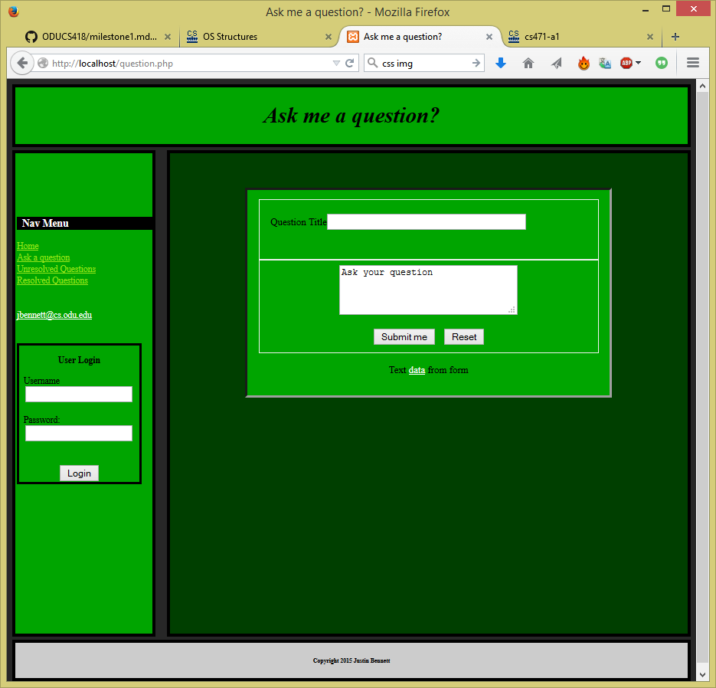
Page Layout-Ask A Question

Slide 4
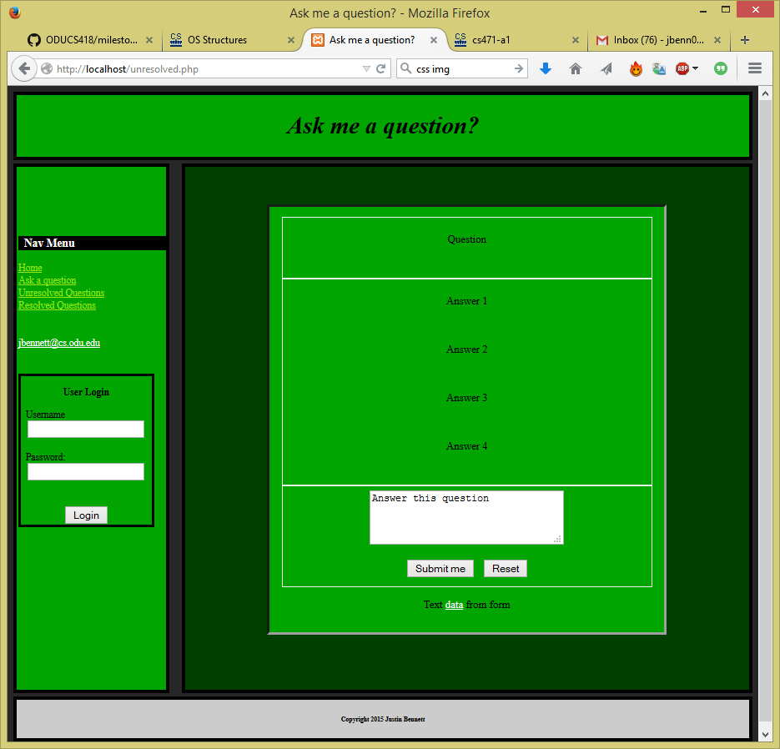
Page Layout – Question and Answers Unresolved

Slide 5
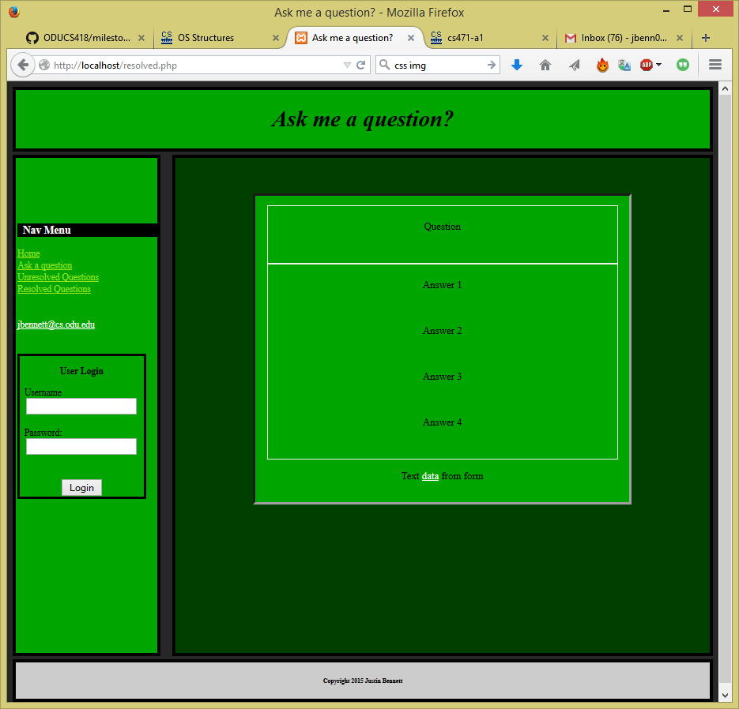
Page Layout – Question and Answers Resolved

Slide 6
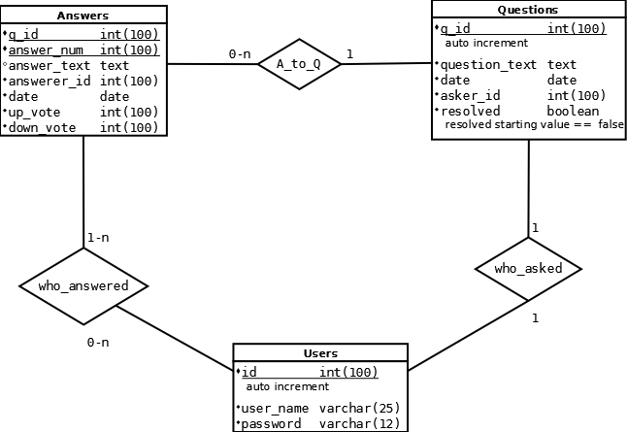
Database Design

Slide 7
Next Steps of Action
Implement user login
Write SQL queries for submitting questions
Write SQL queries for answering questions

