Slide 2
Création d’un d(r)epository
https://github.com/

Slide 3
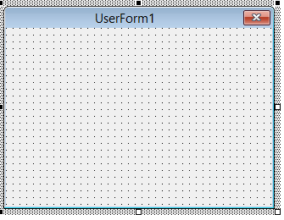
https://guides.github.com/activities/hello-world/
External Depository
https://github.com/jbenoit82/testRepository/settings
Connect
User:jbenoit_82
Pwd:jb.mauriange@byg-info.com
GitHubDesktop
https://desktop.github.com/
Administration
User:
Pwd:
Local Depository
C:\Users\jb.mauriange\Documents\testRepository

Slide 4

GitHubDesktop
Local Depository
C:\Users\jb.mauriange\Documents\testRepository

