Slide 1
Baseball_Project_Post_Feedback
File created on: 4/4/2024 5:13:37 PM

Slide 2
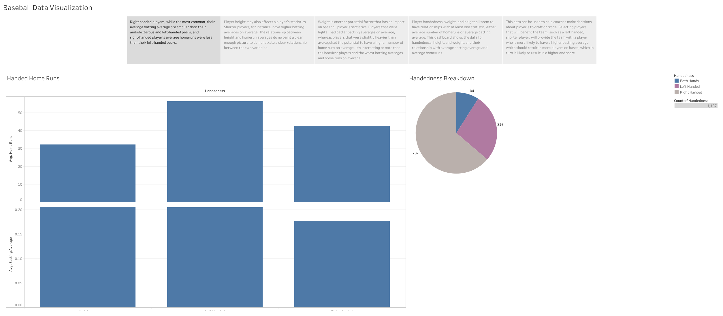

Slide 3
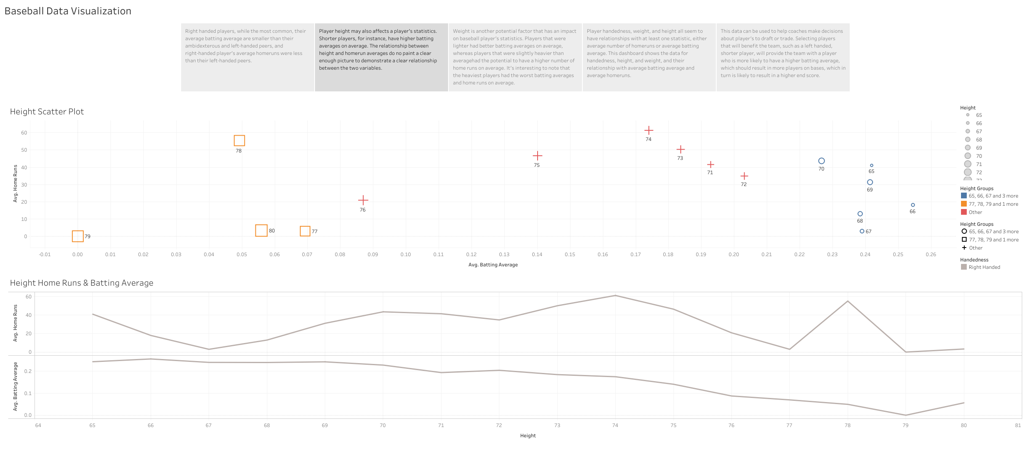

Slide 4
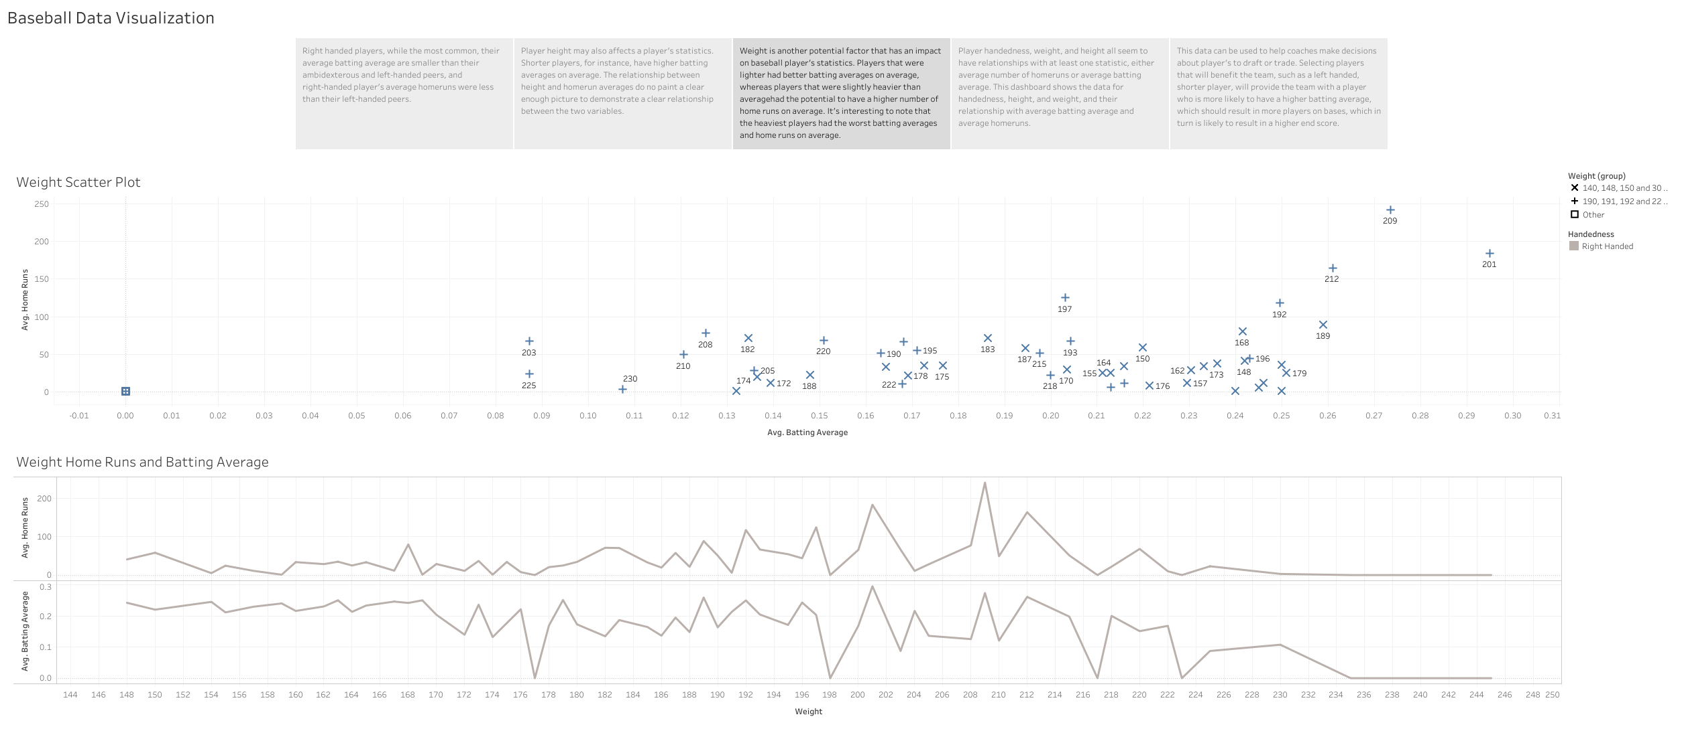

Slide 5
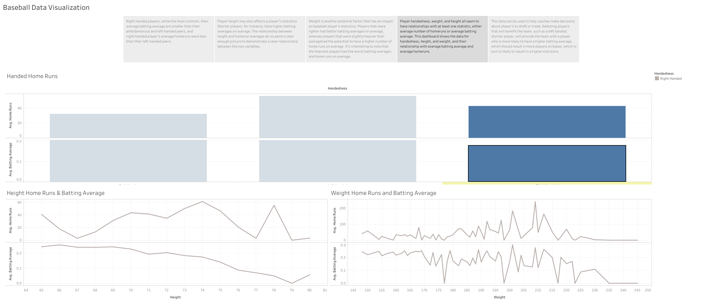

Slide 6
