Slide 1
Reversible Jump Q-Learning for a Flexible Discrete Action Space
Project Proposal

Slide 2
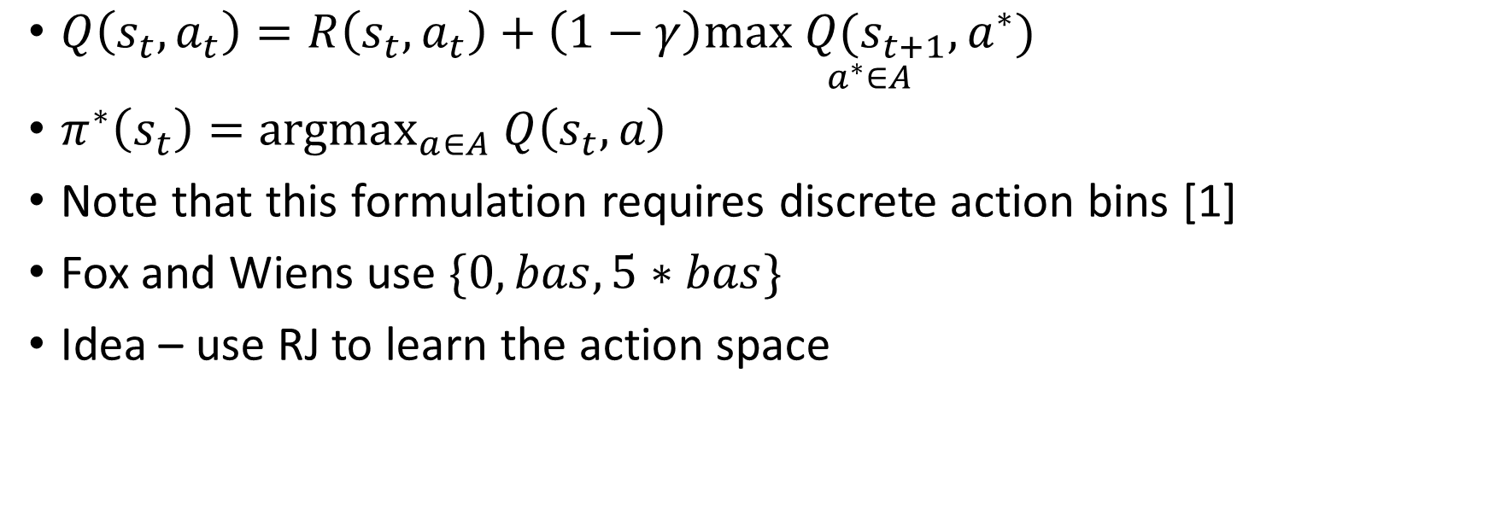
Discrete Action Spaces for Insulin Delivery
$Q\left(s_{t}, a_{t}\right)=R\left(s_{t}, a_{t}\right)+\left(1−γ\right)\underset{a^{∗}∈A}{max Q(s_{t+1}, a^{∗})}$
$π^{∗}\left(s_{t}\right)={argmax}_{a∈A} Q\left(s_{t}, a\right)$
Note that this formulation requires discrete action bins [1]
Fox and Wiens use $\{0, bas, 5∗bas\}$
Idea – use RJ to learn the action space

Slide 3
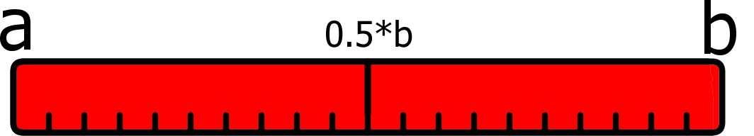
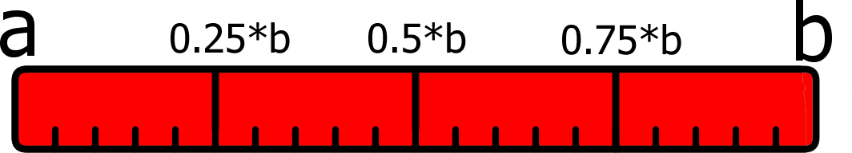
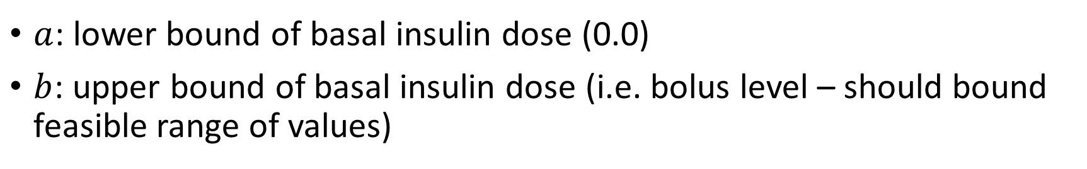
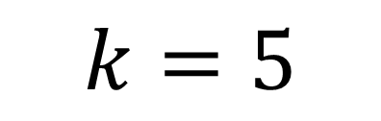
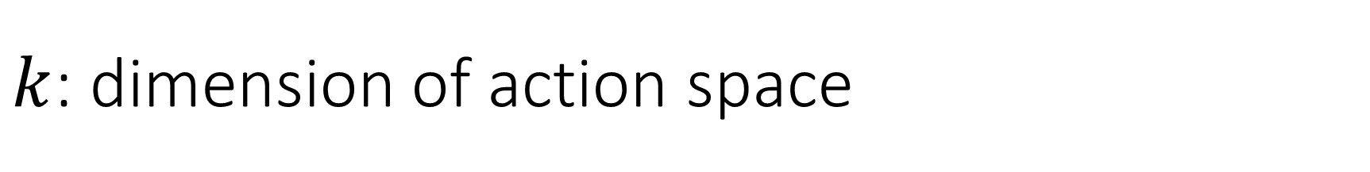
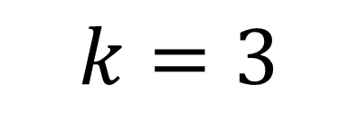
$k$: dimension of action space
$$k=3$$
$$k=5$$
$a$: lower bound of basal insulin dose (0.0)
$b$: upper bound of basal insulin dose (i.e. bolus level – should bound feasible range of values)

Slide 4
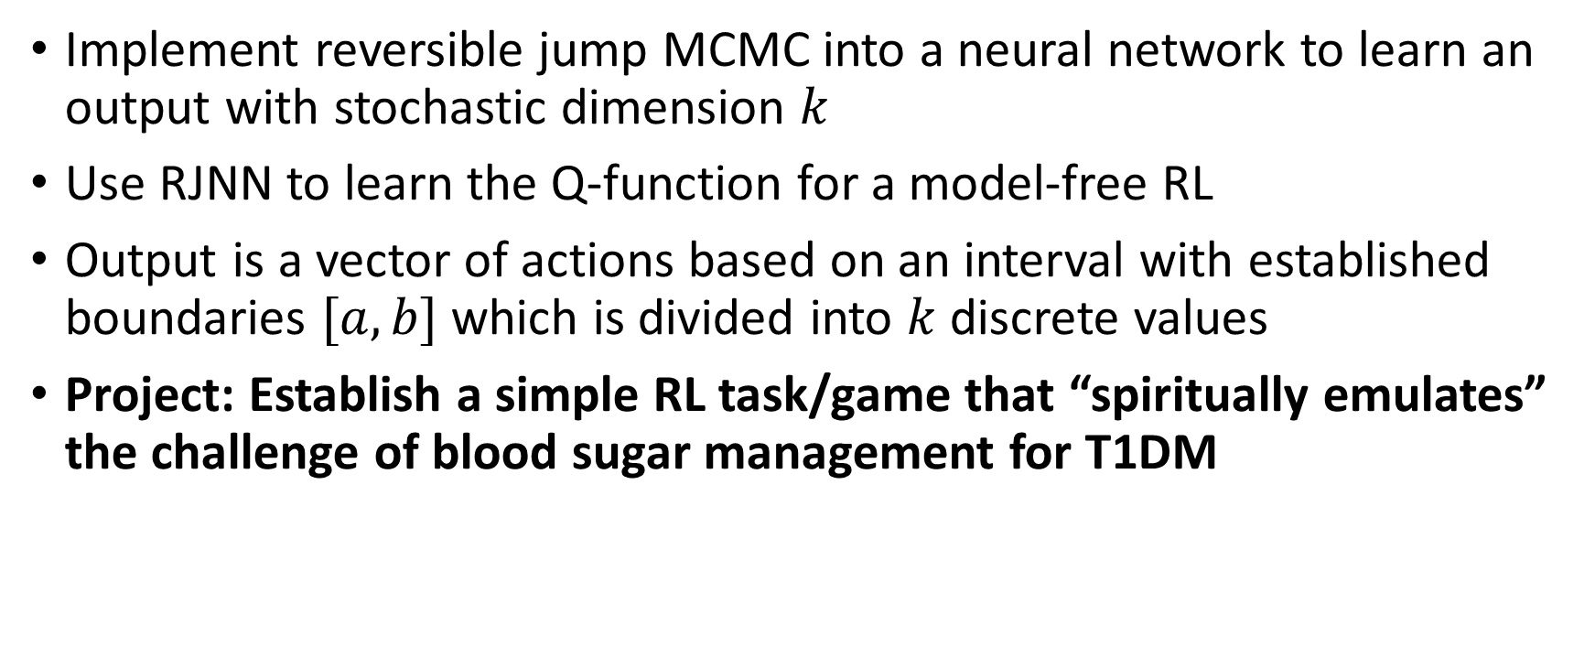
Motivation Summary
Implement reversible jump MCMC into a neural network to learn an output with stochastic dimension $k$
Use RJNN to learn the Q-function for a model-free RL
Output is a vector of actions based on an interval with established boundaries $[a,b]$ which is divided into $k$ discrete values
Project: Establish a simple RL task/game that “spiritually emulates” the challenge of blood sugar management for T1DM

Slide 5
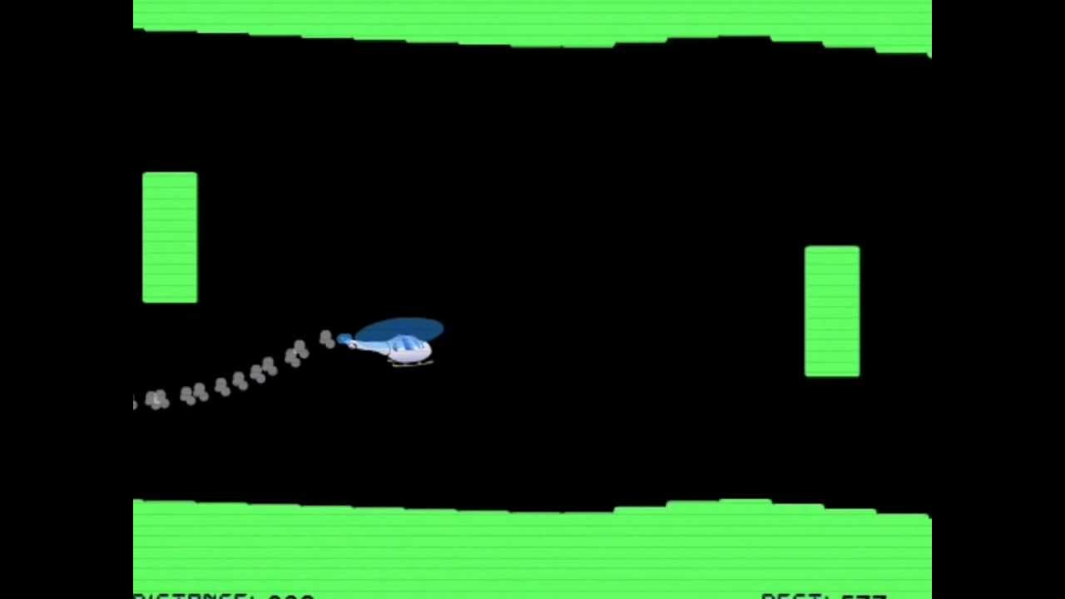
“The Helicopter Game”
A simple Flash-based browser game
The only goal is to stay flying without crashing into the ground, ceiling, or floating obstacles
Only one input – “lift”. Acceleration due to lift or gravity constantly pushes the helicopter up or down
Should be easy to implement in Python, augmented to better represent insulin management
https://www.seethru.co.uk/the-helicopter-game/

Slide 6
Bayesian Neural Net
Why use a Bayesian NN?
  Natural fit for MCMC
  Uncertainty bonus – may lead to other projects/ideas about uncertain actions
  Relatively simple learning task (at least for the game examples), shouldn’t run into computation problems
Andrieu et al[2] show how to use RJMCMC for a stochastic number of hidden nodes in a NN
My implementation would have unfixed dimension in the output layer

Slide 7
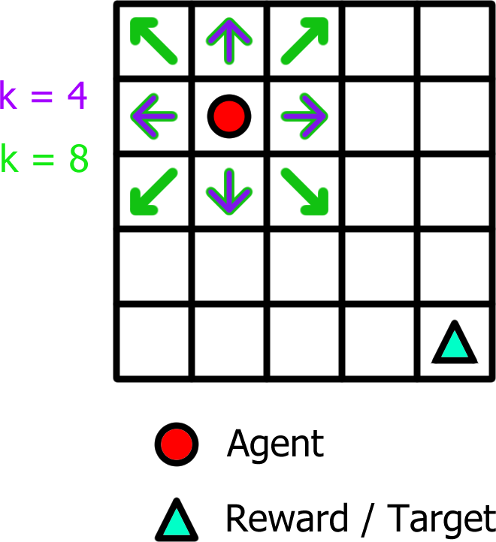
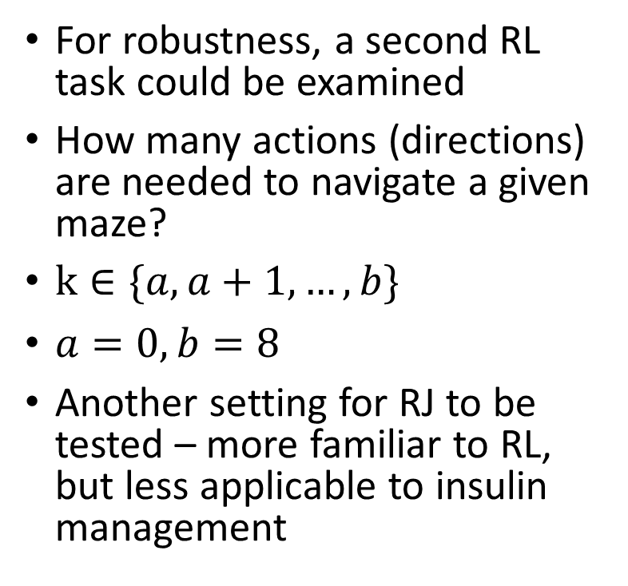
Grid World
For robustness, a second RL task could be examined
How many actions (directions) are needed to navigate a given maze?
$k∈\{a,a+1,…,b\}$
$a=0, b=8$
Another setting for RJ to be tested – more familiar to RL, but less applicable to insulin management

Slide 8
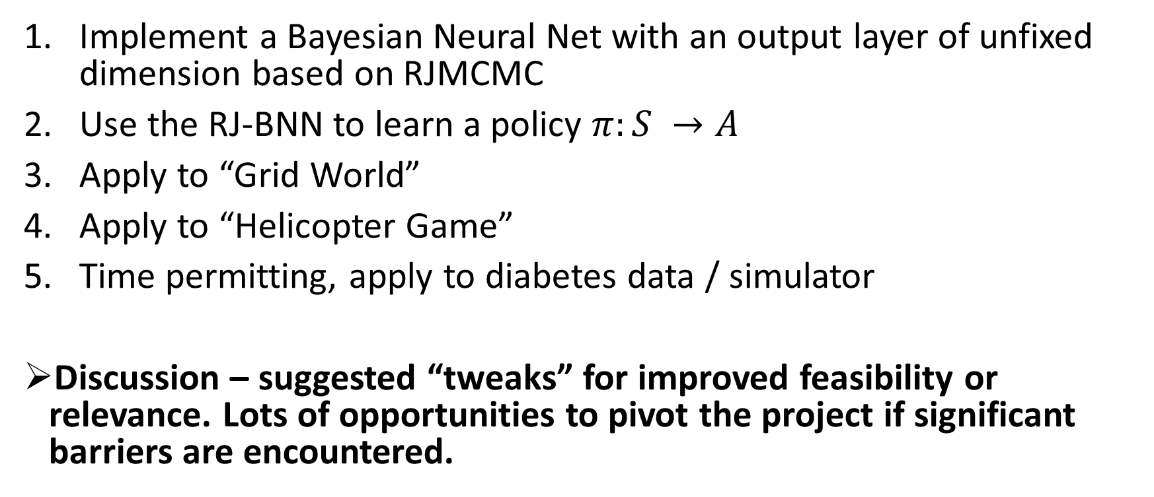
Project Proposal Summary
Implement a Bayesian Neural Net with an output layer of unfixed dimension based on RJMCMC
Use the RJ-BNN to learn a policy $π:S →A$
Apply to “Grid World”
Apply to “Helicopter Game”
Time permitting, apply to diabetes data / simulator
Discussion – suggested “tweaks” for improved feasibility or relevance. Lots of opportunities to pivot the project if significant barriers are encountered.

Slide 9
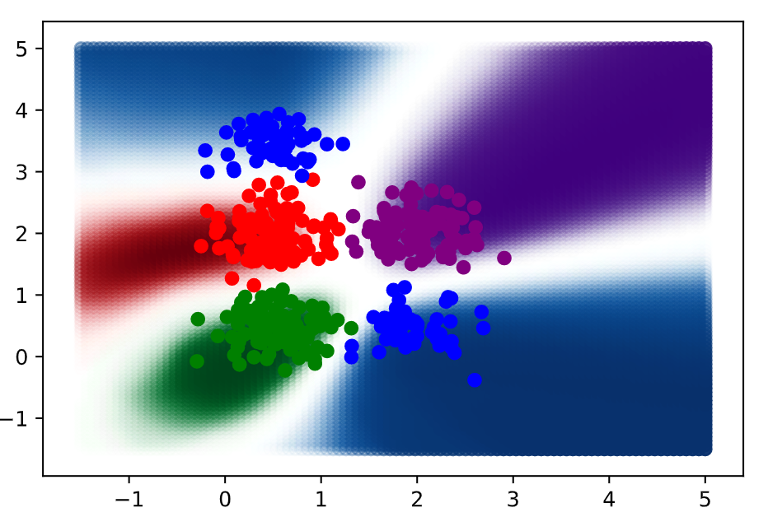
Progress Update – Bayesian Net

Slide 10
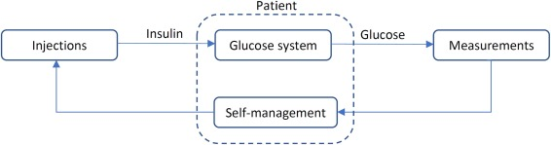

Reversible Jump MCMC Q-Learning for a Flexible Discrete Action Space
Reinforcement learning application: Automated insulin management / blood glucose control for type 1 diabetes patients
Question – can an optimal action space be learned alongside the policy on that action space?

Slide 11
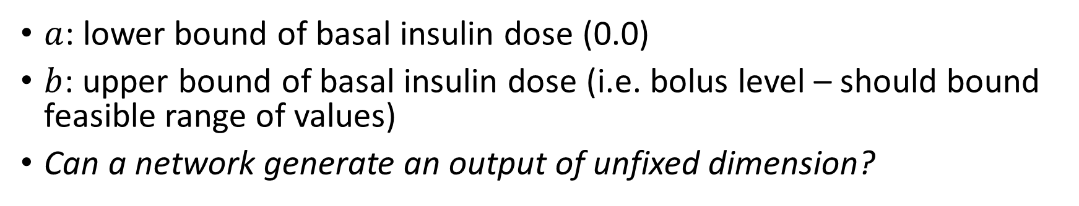
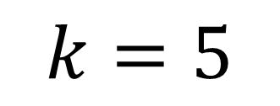
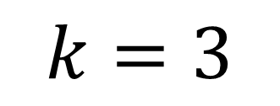
$k$: dimension of action space
$$k=3$$
$$k=5$$
$a$: lower bound of basal insulin dose (0.0)
$b$: upper bound of basal insulin dose (i.e. bolus level – should bound feasible range of values)
Can a network generate an output of unfixed dimension?

Slide 12
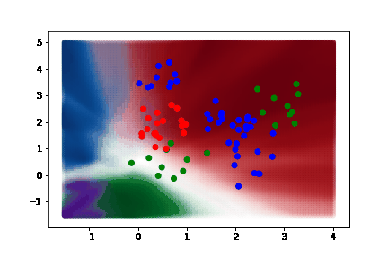

Can a network learn an output of unfixed dimension?
Approach – Using a Bayesian Neural Net to learn a joint posterior distribution over the number of actions as well as the policy corresponding to those actions
“Reversible Jump Markov Chain Monte Carlo” sampling
$$p\left(k,θ\right)∝p\left(θ_{k} | y,x,k\right)p\left(y | x,k\right)p\left(k\right)$$

Slide 13
More details on RJMCMC NN Implementation
1. Toy problem example
2. Details – proposal function, Jacobian
3. Anticipating acceptance rate issues

Slide 14

Acceptance Rate / Performance Issues
MCMC is slow – no learning, only sampling!
Python is slow – most experimental RJ work in Haskell or other PPLs
Reversible jumps are slow in high dimensions
Proposed Solution:
Improve acceptance rate with better proposals via second Markov chain [1]
Use HMC as the second Markov chain and for all within-dimension moves [2]

