Slide 1
ACE Workshop: Rare disease genetics and burden testing
Presented by: Joanne Berghout, PhD
Human Computational Genomics Specialist, Bioinformatics and Computational Biology Branch, National Institute of Allergy and Infectious Disease (NIAID), National Institutes of Health (NIH), Bethesda, MD, USA

Slide 2
Genetic variation and disease
Every human genome is approximately 6 billion nucleotides long
Human genomes are 99.6% identical to each other, however:
Each person carries approximately 5 million SNVs as well as other kinds of variation (insertions and deletions, tandem repeats, structural variation)
The vast majority of this variation is phenotypically and clinically neutral – it does nothing.
Another large fraction is common and has very small effect size on any human health traits
Certain examples of rare variation can be catastrophic and cause rare genetic diseases and syndromes

Slide 3


A fundamental component of disease-focused research is distinguishing variants that matter from variants that are unrelated to the trait of interest

Slide 4
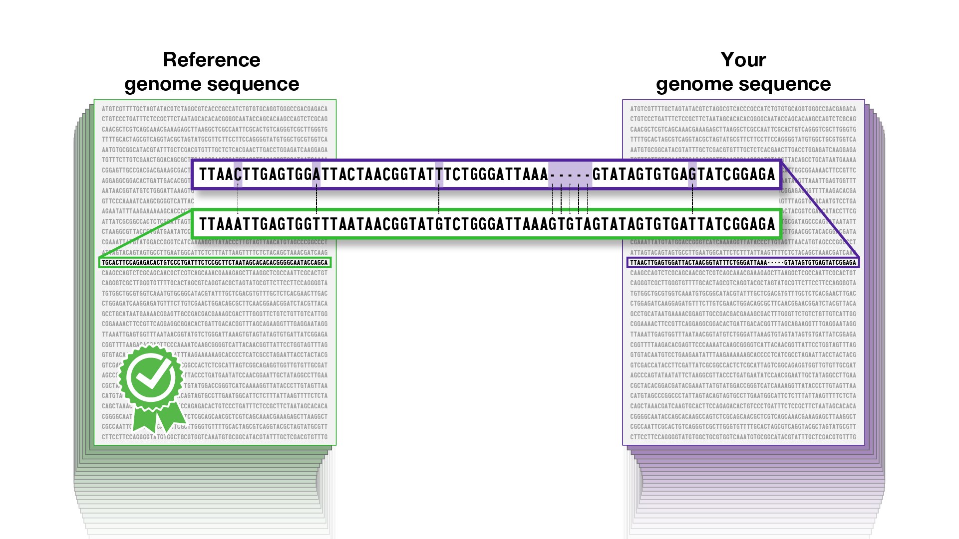
Rare Genetic Disease
Is a given gene causally associated with a disease?
Is a given variant affecting that gene associated with disease?

Slide 5
Definitions:
Gene: the basic functional unit encoded in DNA and expressed into a discrete molecular product (mRNA, protein)
Allele/variant: one of the two or more possible versions of a DNA sequence at a given genomic location (e.g. chr1:55039995-C). Can sometime describe the position itself with or without details of variation known to exist in the human population (e.g. chr1:55039995-C/T, rs334)
Diploid: the presence of two complete sets of chromosomes in an organism’s cells, one set inherited from each parental gamete. Humans are diploid.
Genotype: the diploid pair of alleles a given individual carries at a particular genomic location (e.g. AA, AG, GG, CT, …). Genotypes may be homozygous (identical to each other) or heterozygous (different from each other) in a person.
Reference genome: an accepted representation of the human genome sequence (version controlled; GRCh38 is common) that is used by researchers as a standard for comparison to DNA sequences generated in their studies. The reference genome is not a “perfect and healthy” ideal human and because it is concretely ACTG at all loci, it contains alleles that may be associated with increased and/or decreased risk for common diseases, as well as versions of genes that may predict certain traits. The reference genome is not a real person.

Slide 6
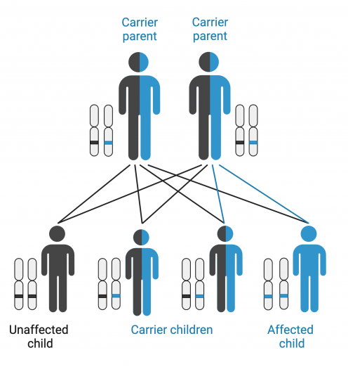
Principles of rare genetic disease association
The causal variant must be rare
The causal variant must be more common in affected cases than it is in unaffected controls
If there is family genetic data available, the causal variant should segregate with the trait in that family
The variant must have a functional effect on biology different from the reference
Bioinformatics predictions, experimental assays
A second, independent line of evidence also supports the gene-disease relationship
Other families or studies, animal models
25% 50% 25%
Strande NT, et al. Evaluating the Clinical Validity of Gene-Disease Associations: An Evidence-Based Framework Developed by the Clinical Genome Resource. Am J Hum Genet. 2017 Jun 1;100(6):895-906. doi: 10.1016/j.ajhg.2017.04.015. Epub 2017 May 25. https://pmc.ncbi.nlm.nih.gov/articles/PMC5473734/

Slide 7
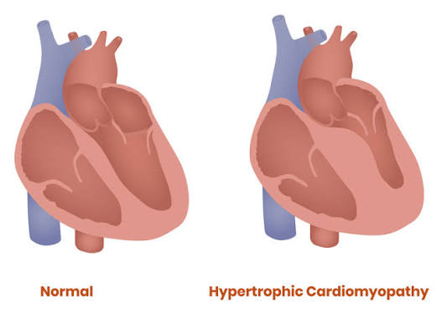
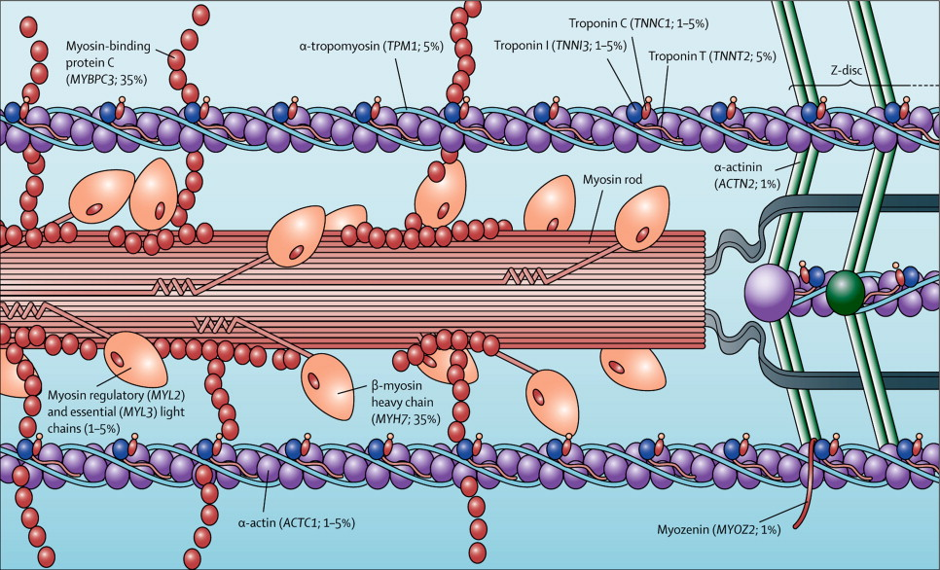
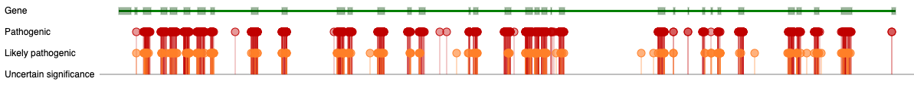
Principles of rare genetic disease association
Genetic heterogeneity: when mutations in some number of different genes can all cause the same clinical diagnosis
MYBPC3
TNNT2
MYBPC3
MYH7
ACTC1
Allelic heterogeneity: when people with the clinical diagnosis and same causal gene have different pathogenic alleles
Hypertrophic cardiomyopathy
MYBPC3:
Conceptual foundation for burden testing

Slide 8
Burden Test and Sequence Kernel Association (SKAT) Tests for Gene-Disease Association
Assumes allelic heterogeneity, and uses the gene – rather than the variant – as the unit for association
Burden test: collapses all qualifying variants to the gene level prior to association testing
SKAT: uses a variance component statistic (weighted by inverse frequency) that creates a patient-to-patient similarity score for the gene. Aka, if two patients both carry an ultra-rare variant within a gene, they are mathematically rated as two highly similar individuals.
SKAT-o (SKAT-optimal): combines burden + SKAT
Lee S, Emond MJ, Bamshad MJ, Barnes KC, Rieder MJ, Nickerson DA; NHLBI GO Exome Sequencing Project—ESP Lung Project Team; Christiani DC, Wurfel MM, Lin X. Optimal unified approach for rare-variant association testing with application to small-sample case-control whole-exome sequencing studies. Am J Hum Genet. 2012 Aug 10;91(2):224-37. doi: 10.1016/j.ajhg.2012.06.007. Epub 2012 Aug 2. https://pmc.ncbi.nlm.nih.gov/articles/PMC3415556/

Slide 9
Statistical model comparison
Feature | Burden Test (more intuitive) | SKAT tests (more sophisticated)
Core Mechanism | Collapses/aggregates variants into a single genetic score before testing association | Aggregates individual variant test statistics using pair-wise genotypic similarity
Effect Direction Assumption | Assumes all causal variants change the phenotype in the same direction | Allows variants to have different/opposite directions of effect (both disease-causing and protective)
Non-causal variants | Highly sensitive; statistical power drops if a large fraction of included variants are noncausal/benign | More robust; maintains statistical power well even with many non-causal variants
Optimal scenario | Best when most qualified variants in a genomic region are causal with all effects sharing the same direction | Continues to work when a large fraction of variants are noncausal or if effects point in opposite directions
Statistical framework | Linear or logistic regression on the collapsed burden score | Variance component test using kernel machine learning
Non-centrality parameter | Summed, then squared: NCP ∝ ( Σ w_{j} β_{j} )² | Squared, then summed: NCP ∝ Σ w_{j}² β_{j}²

Slide 10
Principles of rare genetic disease association
The causal variant must be rare
The causal variant must be more common in affected cases than it is in unaffected controls
If there is family genetic data available, the causal variant should segregate with the trait in that family
The variant must have a functional effect on biology different from the reference
Bioinformatics predictions, experimental assays
A second, independent line of evidence also supports the gene-disease relationship
Other families or studies, animal models
25% 50% 25%
Strande NT, et al. Evaluating the Clinical Validity of Gene-Disease Associations: An Evidence-Based Framework Developed by the Clinical Genome Resource. Am J Hum Genet. 2017 Jun 1;100(6):895-906. doi: 10.1016/j.ajhg.2017.04.015. Epub 2017 May 25. https://pmc.ncbi.nlm.nih.gov/articles/PMC5473734/

Slide 11
Variant annotation: how to know if a variant is rare
Start with your disease/trait, not genetics
If the disease is well studied, review known cohort studies and previously reported pathogenic variants as a guide
ClinVar: https://www.ncbi.nlm.nih.gov/clinvar/
Your own cohort
Leverage large public resources
gnomAD (see also GenIE): https://gnomad.broadinstitute.org/ (https://gnomad.broadinstitute.org/news/2024-06-genie/)
All of Us: https://databrowser.researchallofus.org/snvsindels/
Pay attention to ancestry
many variants can be rare in one population, but more frequently observed in another
Frequency is the most important criteria for ‘qualifying’ a variant

Slide 12
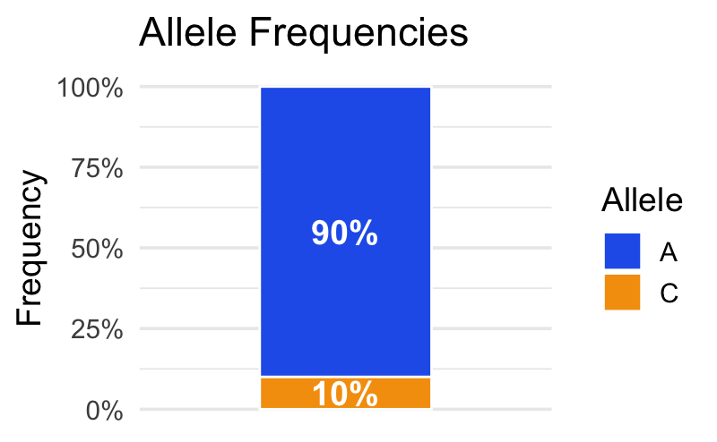
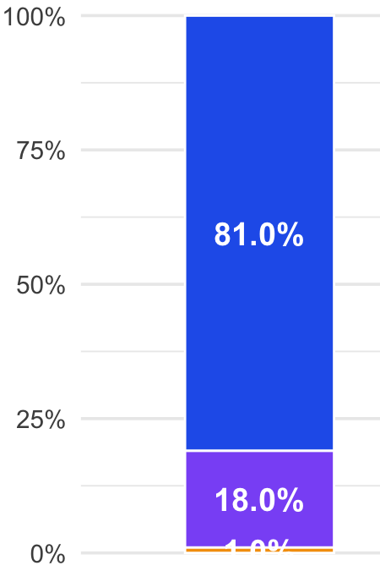

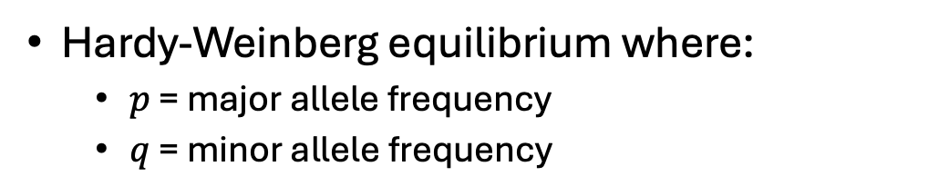
Variant annotation: how to know if a variant is rare
Allele freq. Genotype freq.
Hardy-Weinberg equilibrium where:
$p$ = major allele frequency
$q$ = minor allele frequency
A
C
AA
AC
CC
$$1=p2+2pq+q2$$
Assume minor allele frequency = 0.01, the genotype frequencies become:
$$1=\left(1−0.01\right)2+2\left(1−0.01\right)(0.01)+(0.01)2$$
98.01% 1.98% 0.01%
1 in 10,000 people will be homozygous

Slide 13
ClinVar: https://www.ncbi.nlm.nih.gov/clinvar/
A submitter-supplied database of rare variants interpreted by clinical geneticists for their potential to cause disease.
Professional, accredited clinical genetics testing companies
Researchers in the field
Intended as a way to share information about variants with the broader field
Observational, with variants observed in real people who have had clinical genetic testing or participated in clinical genetics research studies
Categorized into ACMG interpretation categories:
Pathogenic: causes a genetic disease
Likely Pathogenic: believed to cause disease, but some convincing evidence is missing
Variant of Uncertain Significnace: meets some criteria but no decision could be reached
Likely Benign: thought not to cause disease, but some convincing evidence is missing
Benign: does not cause a genetic disease

Slide 14
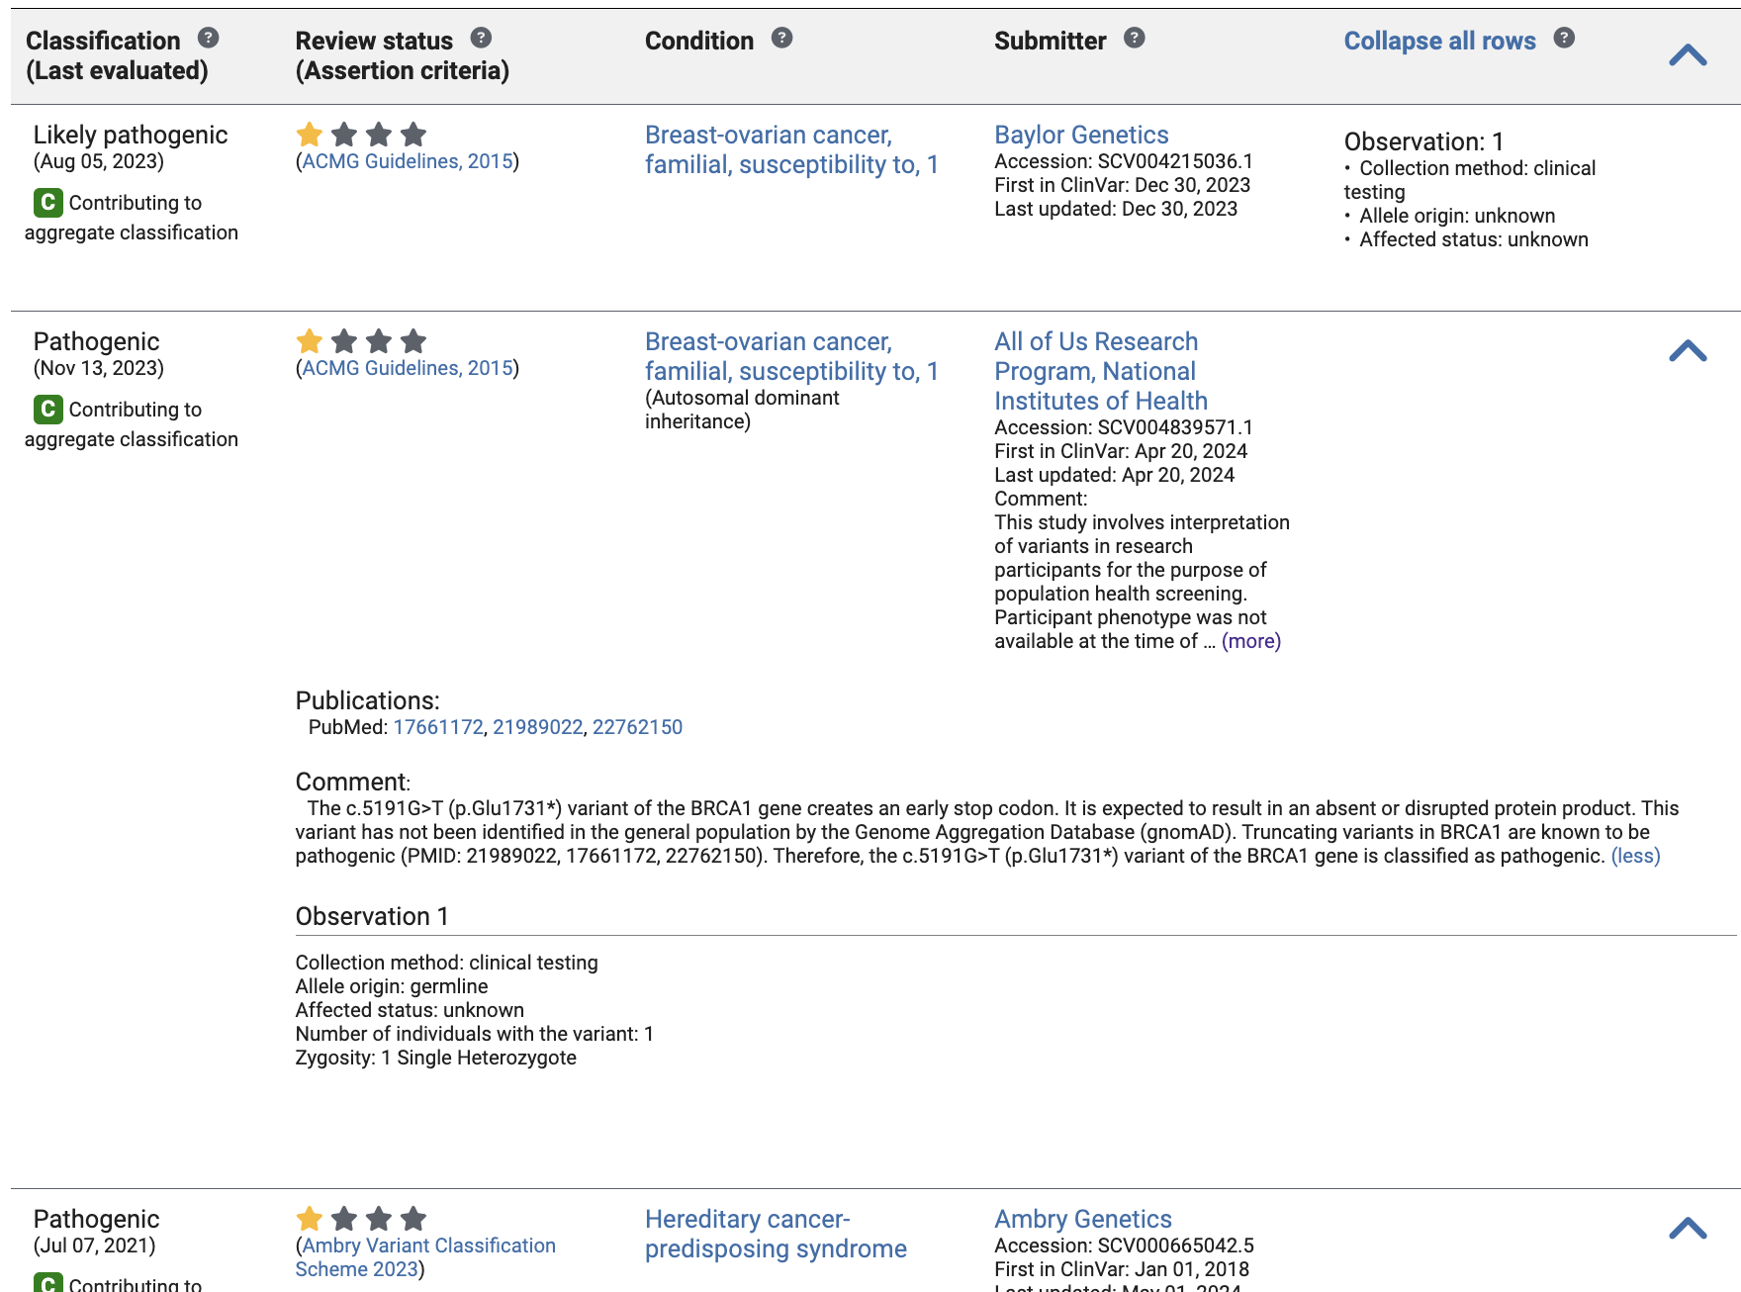
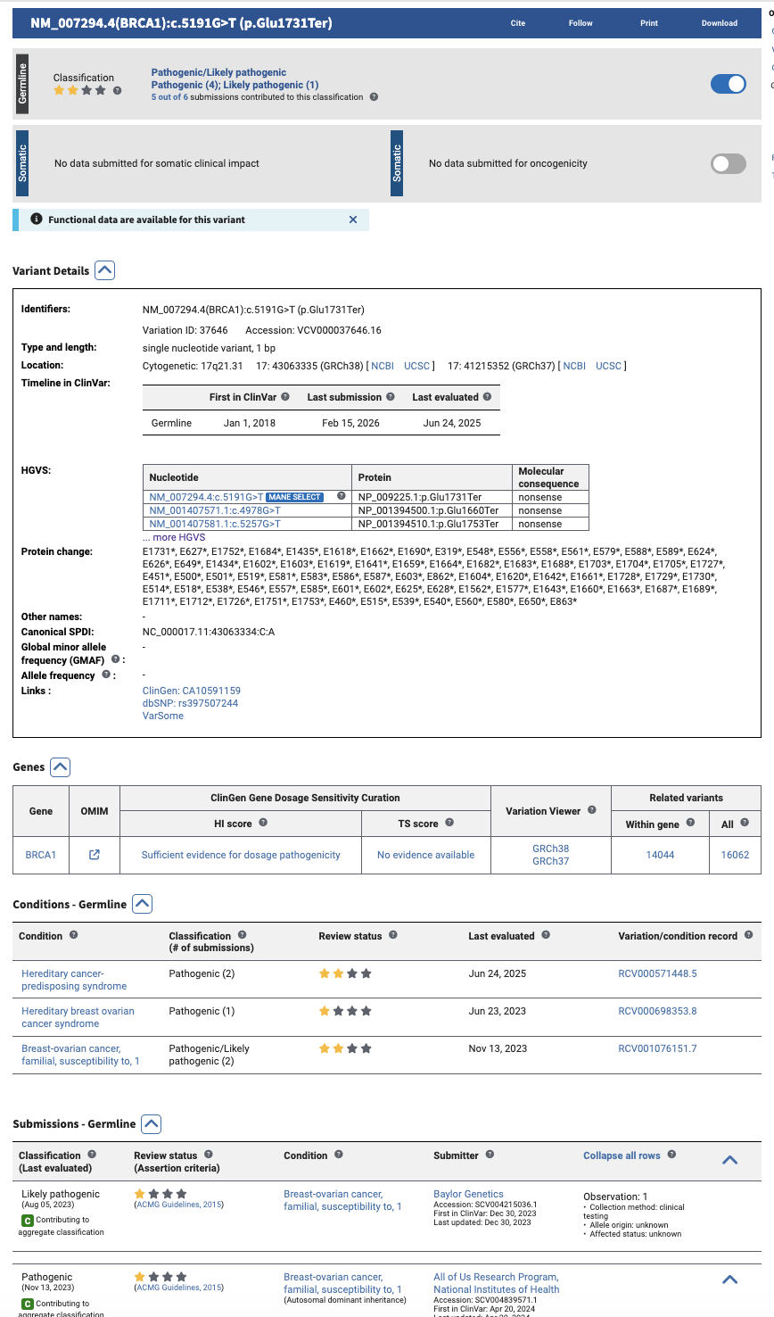
ClinVar resource: variant page
https://www.ncbi.nlm.nih.gov/clinvar/variation/37646/

Slide 15
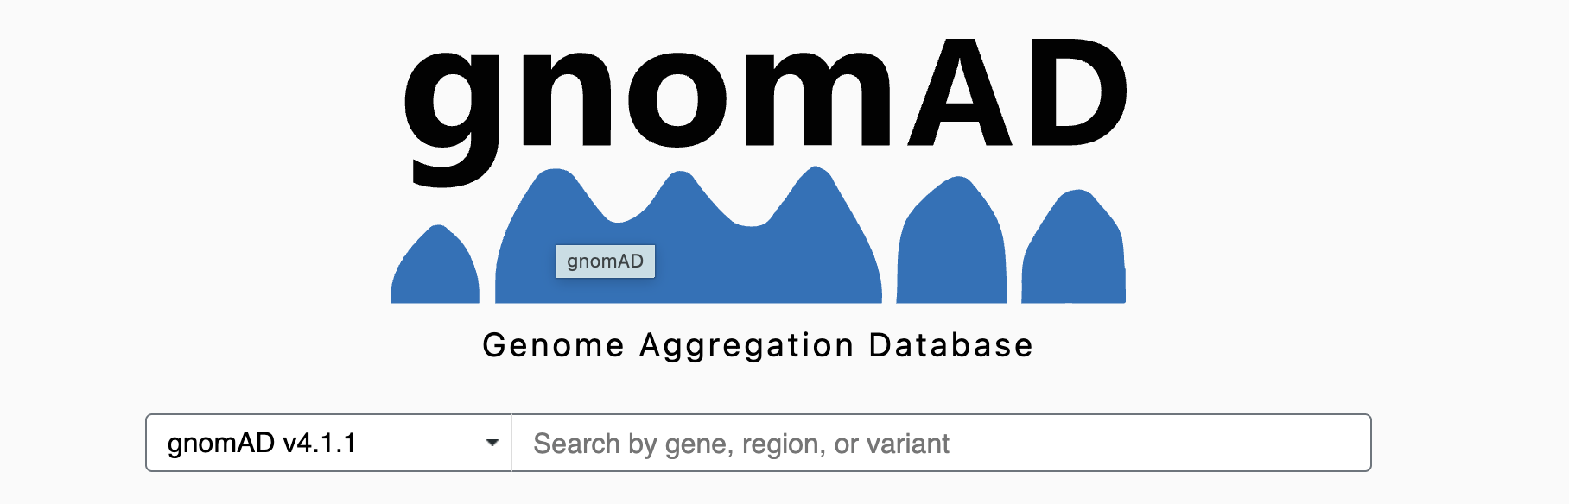
gnomAD: GeNOMe Aggregation Database
Approximately 800,000 people, largely healthy (not known to have rare, monogenic disease)
European ancestry enriched, but includes many thousands of individuals of African, Southeast Asian, East Asian, Admixed American (South American and Latino), and Middle Eastern populations
Assembled opportunistically from genomes sequenced for other genetic studies, joint processed and presented as summary statistics
https://gnomad.broadinstitute.org/

Slide 16
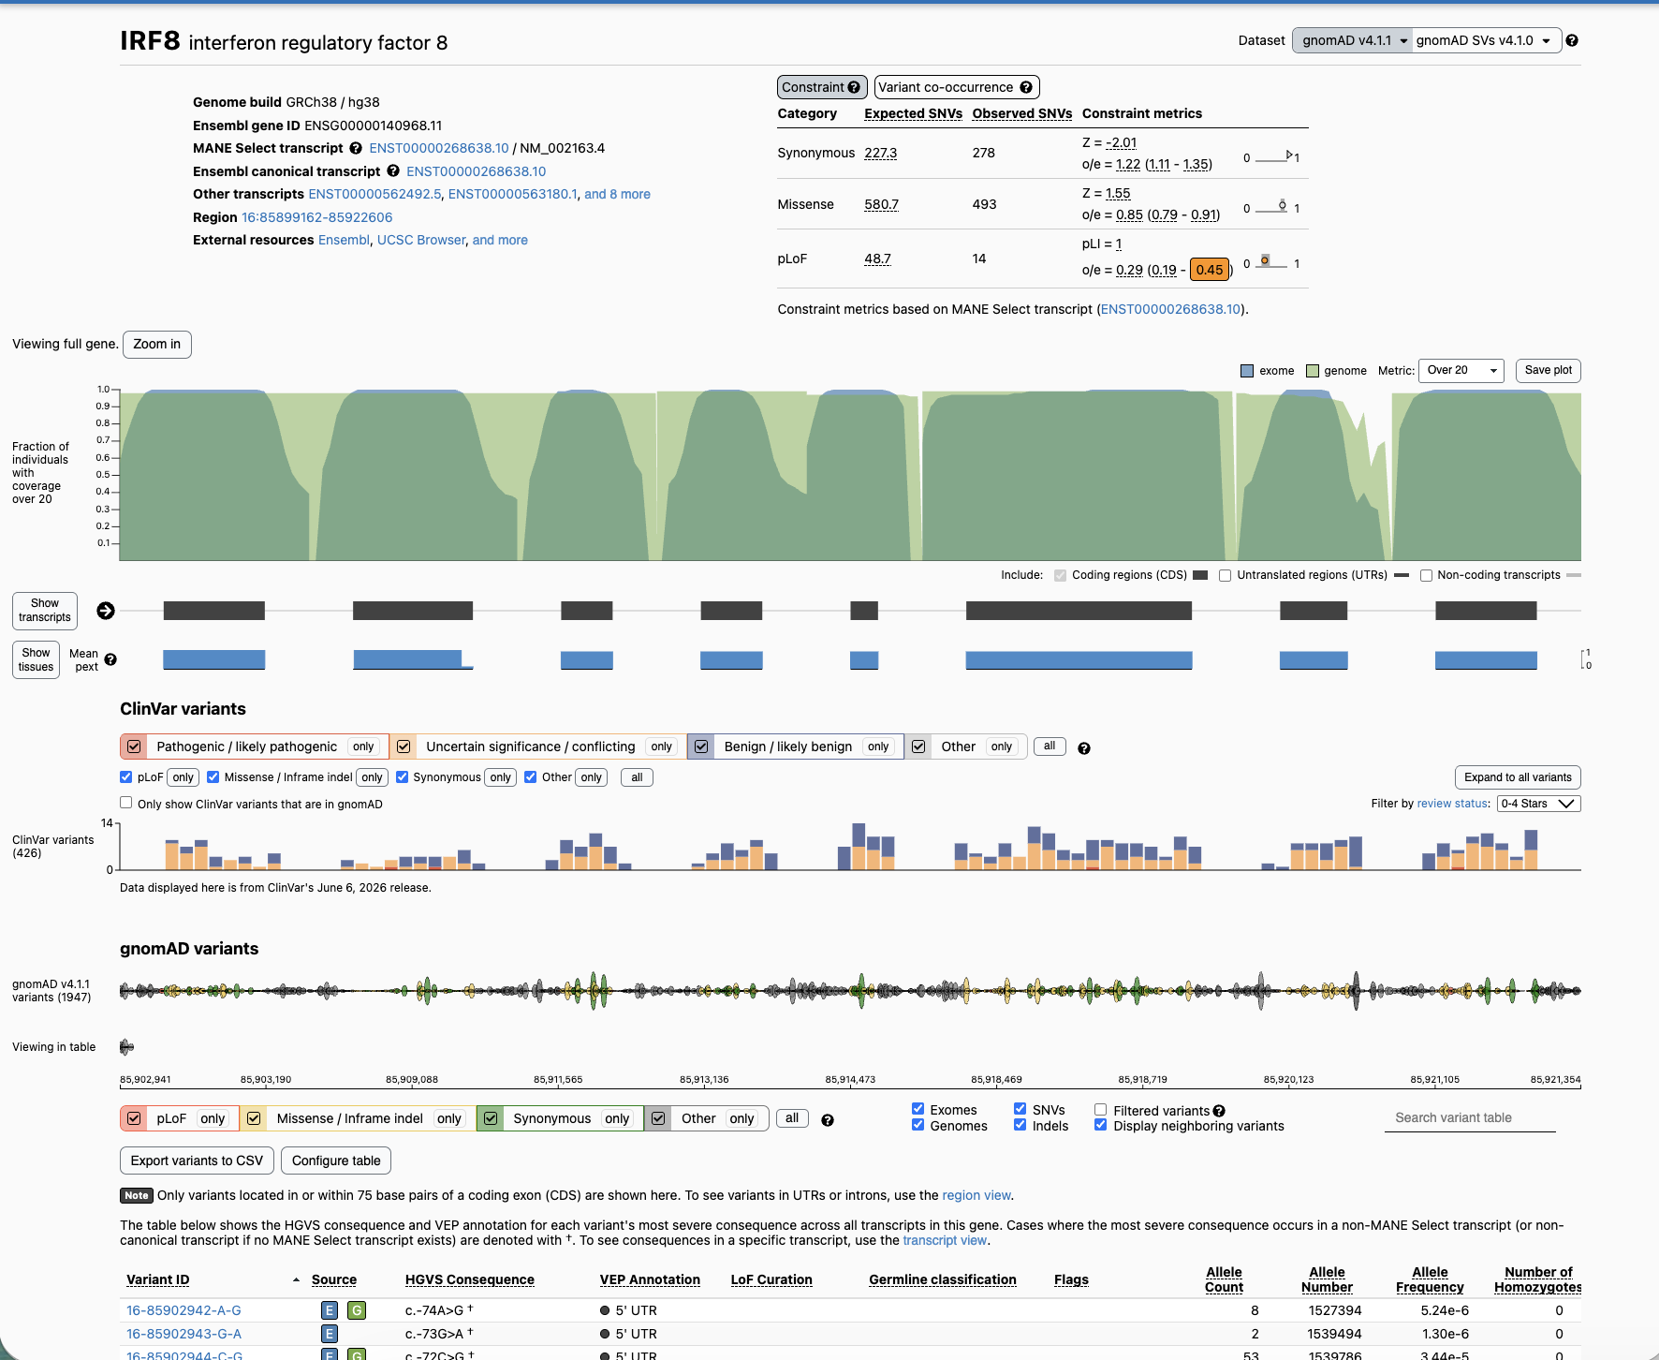
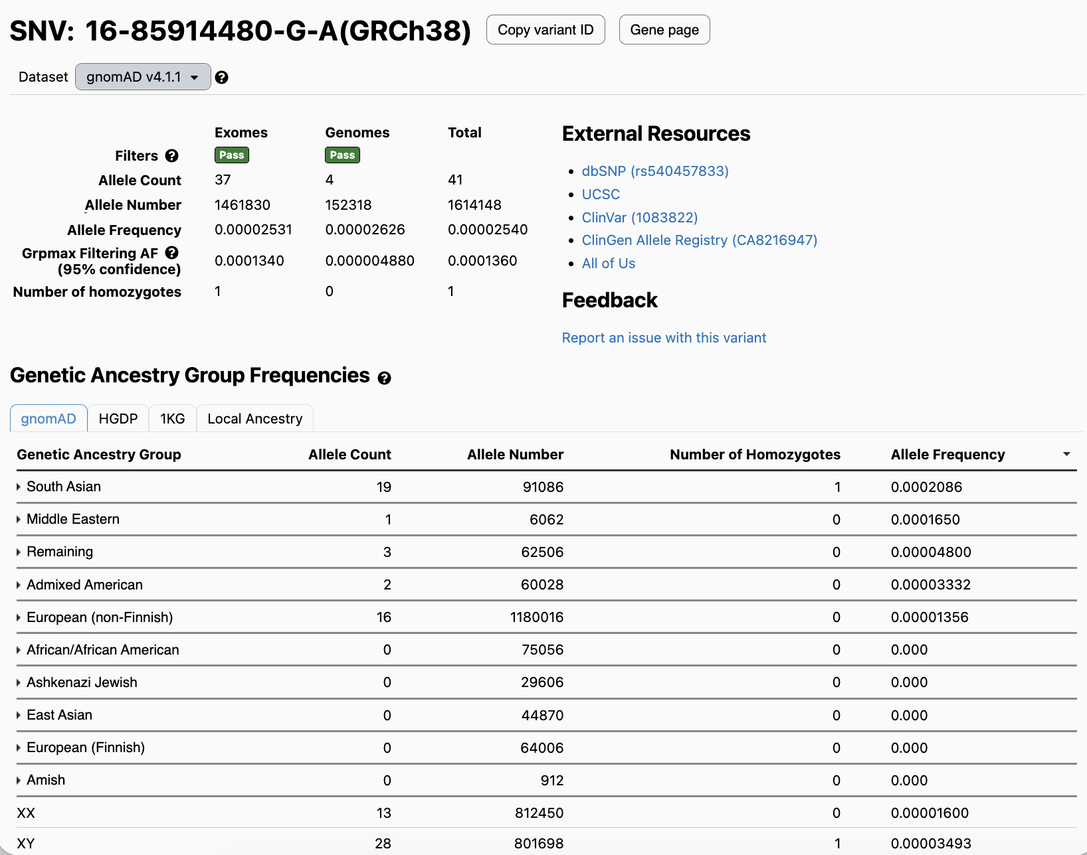
gnomAD resource

Slide 17
Variant annotation: how to know if a variant is functional
…acagaga…
…accgaga…
HIGH
MED
LOW
Intronic variant
Synonymous variant
…G TGT CAC T… (p..CysHis..)
…G TGG CAC T… (p..TrpHis..)
…G CGA CAA T… (p..ArgGln..)
…G CGG CAA T… (p..ArgGln..)
Missense variant
AUG/START
AG | GT
AG | GT
AG | GT
AG | GT
TGA/STOP
exon1
exon2
exon3
…A CTG TAC T…
…A CTG TAG T…
…A CAA GTC T…
…A CAA AGT CT…
Stop-gain or nonsense variant
…GTA CTG GTG…
…GTA CAG GTG…
Frameshift
Cryptic splicing variant
…T GTA G|gttgaat…
…T GTA C|gttgaat…
Canonical splice site

Slide 18
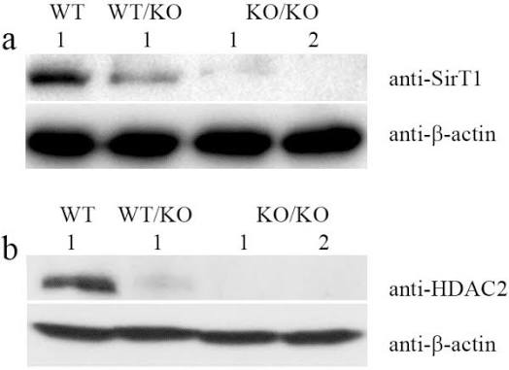
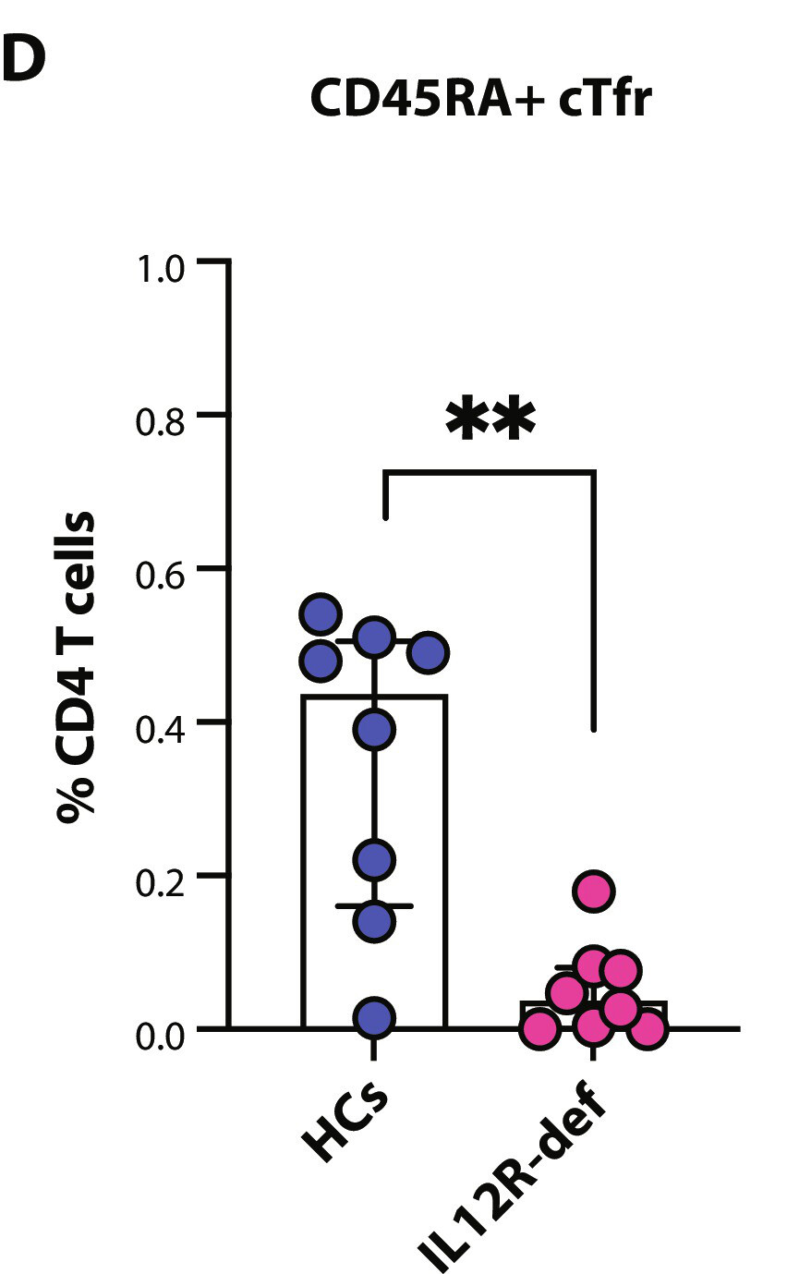
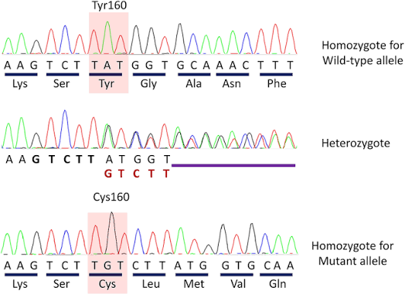
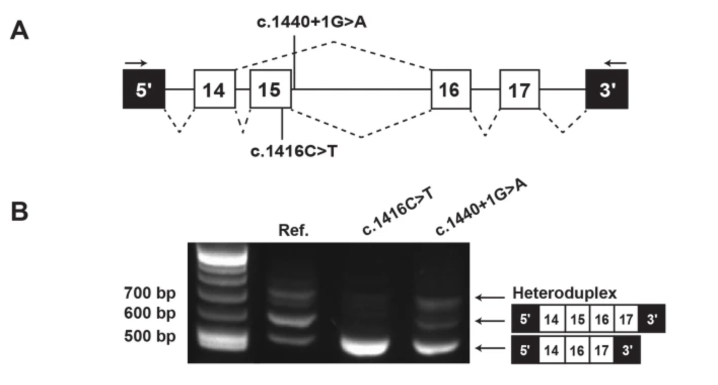
Variant annotation: how to know if a variant is functional // LOSS-OF-FUNCTION
Predicted loss of function (pLOF) variants includes deletions, stopgain, frameshift, and canonical splice site disruption
Variants with these consequences are expected to completely prevent the gene from making its functional gene product
These are considered very high impact and are almost always going to be ‘qualified variants’ when you want to evaluate whether disturbed gene function is associated with any biological or clinical outcomes

Slide 19
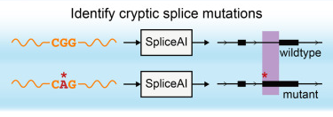
Variant annotation: how to know if a variant is functional // SPLICE SITE
SpliceAI
Calculates the difference in predicted spliceosome affinity and recognition for the the reference and variant sequences; a large difference is expected to result in the variant out-competing the reference sequence
A variant that out-competes the reference sequence can lead to exon skipping, exon truncation, intron retention, or pseudoexon inclusion
Any of these effects is considered as severe as a pLOF variant
Jaganathan K et al. Predicting Splicing from Primary Sequence with Deep Learning. Cell. 2019 Jan 24;176(3):535-548.e24. doi: 10.1016/j.cell.2018.12.015. Epub 2019 Jan 17. PMID: 30661751. https://pubmed.ncbi.nlm.nih.gov/30661751/

Slide 20
Variant annotation: how to know if a variant is functional // MISSENSE
Missense variants change one amino acid of a protein-coding gene
folding and structure
function of an active site or binding interface
stability of the protein
capacity for post-translational modifications or proper targeting
Many missense variants are compatible with normal function and some are very common, but other missense variants will create a non-functional or unstable protein
There are many bioinformatics algorithms designed to predict the deleteriousness or damaging-ness of a missense substitution
SIFT, PolyPhen, REVEL, PrimateAI, AlphaMissense, VEST4, FATHMM
As a class, this category needs to be filtered into predicted-damaging and predicted-tolerated. The predicted damaging subset are typically going to be qualified for a burden test or other genotype-phenotype study

Slide 21
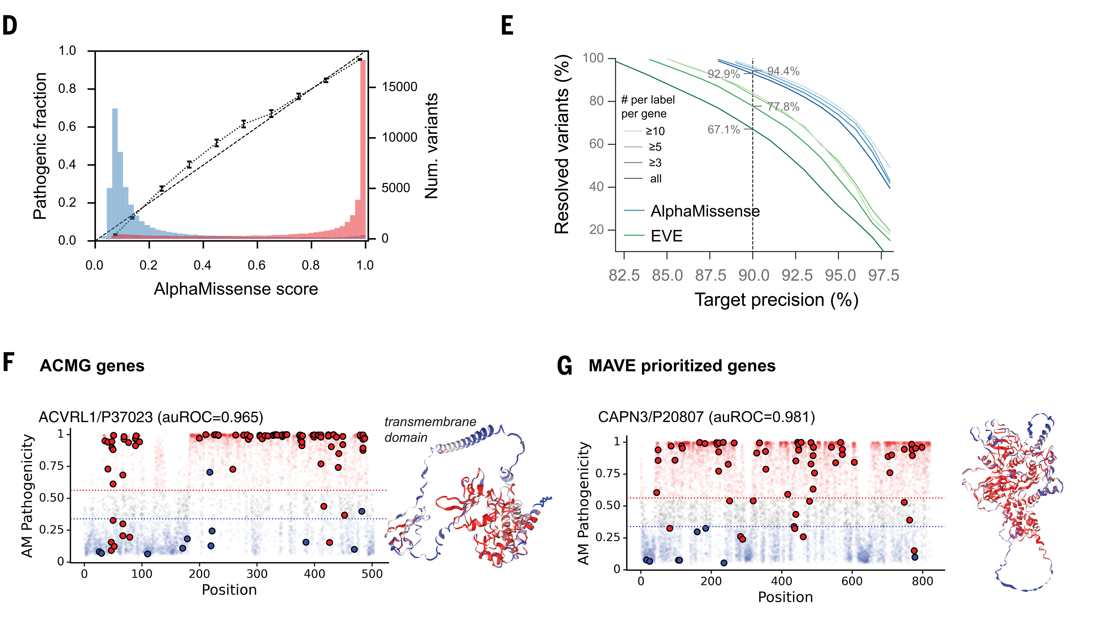
Variant annotation: how to know if a variant is functional // MISSENSE
AlphaMissense
Deep learning model that predicts the pathogenicity of missense variants by learning patterns from protein sequence, structure, and evolutionary conservation across species,
Outputs a score that classifies variants as likely benign, likely pathogenic, or uncertain based on comparison between the variant and the reference amino acid
Many other algorithms also exist
Cheng J, et al. Accurate proteome-wide missense variant effect prediction with AlphaMissense. Science. 2023 Sep 22;381(6664):eadg7492. https://www.science.org/doi/10.1126/science.adg7492

Slide 22
Principles of rare genetic disease association
The causal variant must be rare
The causal variant must be more common in affected cases than it is in unaffected controls
If there is family genetic data available, the causal variant should segregate with the trait in that family
The variant must have a functional effect on biology different from the reference
Bioinformatics predictions, experimental assays
A second, independent line of evidence also supports the gene-disease relationship
Other families or studies, animal models
25% 50% 25%
Strande NT, et al. Evaluating the Clinical Validity of Gene-Disease Associations: An Evidence-Based Framework Developed by the Clinical Genome Resource. Am J Hum Genet. 2017 Jun 1;100(6):895-906. doi: 10.1016/j.ajhg.2017.04.015. Epub 2017 May 25. https://pmc.ncbi.nlm.nih.gov/articles/PMC5473734/

Slide 23
Burden test workflow
Use domain expertise to decide on parameters and key covariates
Annotate all observed variants with consequence, frequency, and bioinformatics predictions
Apply filters to determine the qualified variant set
Conduct statistical analysis to determine if cases and controls are assymetric in their qualified variant carrier burden for any genes

Slide 24
Note: ancestry stratification
Controlling for relatedness and stratification within the analysis-ready cohort is ESSENTIAL for accurately conducting genotype-to-phenotype studies
People who are more similar in general will be more similar at every gene, not just the gene(s) that are truly associated with your trait
This can create false positives (genomic inflation)
Diseases may have different genetic architecture in different populations, especially if you have founder effects (genetic heterogeneity; slide 7)
Best approach: consider ancestry and any known relatedness while recruiting cases and controls
Next best approach: incorporate principal components as covariates
For a highly multi-ethnic cohort, you may need to go further and use meta-analysis techniques

