Slide 1

Predicting Win Shares for NBA Players
Joseph Berkowitz, Chris Jin and Rick Winfrey
8/19/2015

Slide 2
Background Information
Many different, widely accepted statistics for evaluating NBA Players
Offensively: PPG, APG, FG%
Defensively: BPG, SPG
Most important is winning
Win Shares
Developed originally for baseball, translated into basketball by Dean Oliver
An estimate of the number of team wins contributed by an individual player
When adding up the win shares of each player on a particular team, the total will be a very close approximation of the team’s wins in that season
For more information: http://www.basketball-reference.com/about/ws.html

Slide 3
Goal of our Project
What makes a “winning” player?
What specific plays does a player make that most contribute to his team winning?
Interested in finding predictors both offensively and defensively that predict Win Shares

Slide 4
Our Dataset
Per game and advanced statistics for all 492 NBA players who appeared in an NBA game
After cleaning the data due to missing information for some players, ended up with 414 players
Source: http://bkref.com/tiny/CWTxV

Slide 5
Process for Finding our Model
Began our process predicting Win Shares (WS) with 29 independent variables
Used StepAIC() function in R, which gave us the 10 best versions of our original model
Used backward selection from there to make our model more parsimonious and to eliminate multicollinearity

Slide 6
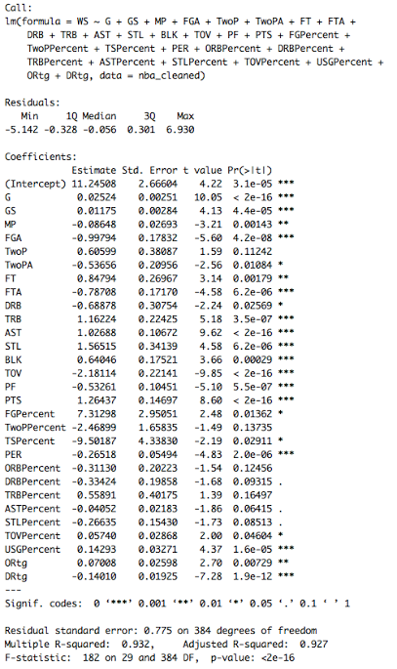
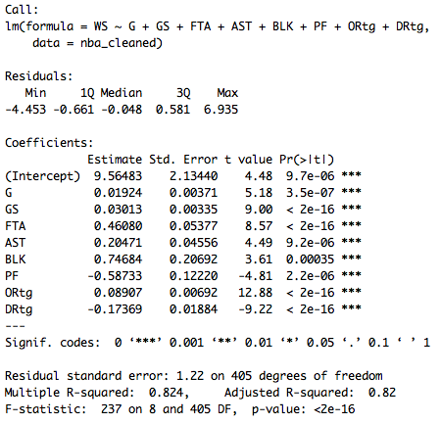
Original vs Final Model
Original Model (29 predictors)
Final Model (8 predictors)

Slide 7
Predictors for our Final Model
Games played (G)
Games started (GS)
Free throw attempts per game (FTA)
Assists per game (AST)
Blocks per game (BLK)
Personal fouls per game (PF) (negative corr.)
Offensive Rating (Ortg)
Defensive Rating (Drtg) (negative corr.)

Slide 8
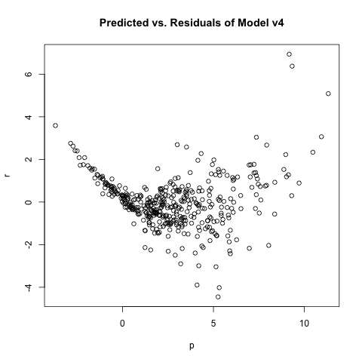
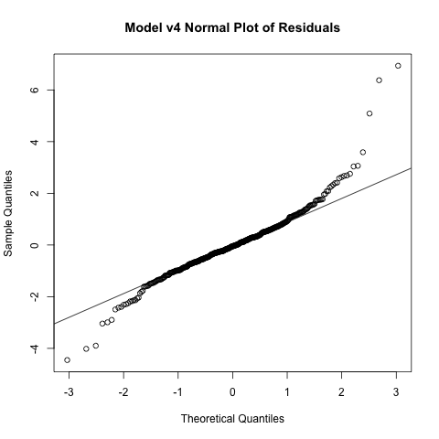
Residuals and Normal Plot
Residual Plot
Normal Plot

Slide 9
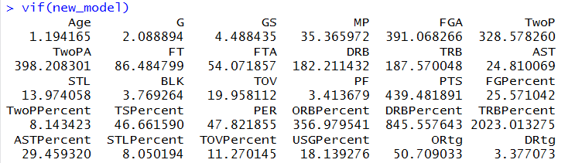
Multicollinearity
VIF for original model
VIF for Final Model

Slide 10
Influence Points
Our final model had 29 potentially influential observations within our data set
9/29 of the potentially influential observations were among the 29 players with the highest WS
Confirms the emphasis placed on superstars throughout the NBA

Slide 11
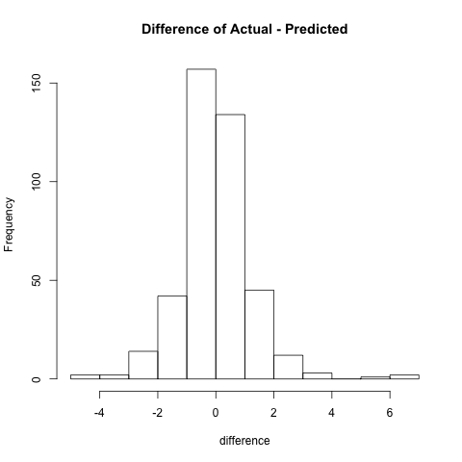
Histogram of Predicted Values vs Actual Result

Slide 12
Conclusions from our Model
Winning players have to appear in a lot of games – unfortunately injuries are a part of the NBA, and this model de-values players who get hurt
It is important to be a two-way player – both offensive and defensive parameters are emphasized within our model
Fat tails of our model and influence points confirm the emphasis on acquiring “superstar” players held throughout the NBA

