Slide 1
Follow Along!
git clone https://github.com/jberkus/annotated.conf
cd annotated.conf
createdb gucs
pg_restore -d gucs -x -O gucs.pgdump
psql gucs

Slide 2


The GUCS:
A Three-Hour Tour
Josh Berkus
Red Hat OSAS
SCALE 16x

Slide 3
agenda
what are GUCS?
understanding GUCS
simple basic configuration
new GUCS
grand tour

Slide 4
related stuff
X
pg_hba.conf
recovery.conf
pg_ident.conf
libpq settings
psql \ commands
system functions

Slide 5
What are GUCS?
“Grand Unified Configuration Settings”
  A large set of global and session database settings which live in:
  src/backend/utils/misc/guc.c
Your main way of configuring and tuning the database.
  in addition to compile options, system configuration and schema tuning!
Pronounced “gucks”

Slide 6
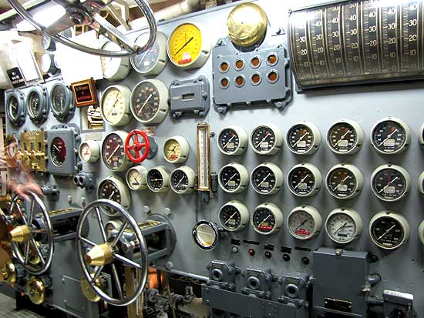
269 Switches and Levers

Slide 7

“269 Settings?!?”

Slide 8

“Don't worry, Skipper!”

Slide 9
The 19 (or so) Settings most users need to adjust
listen_addresses
max_connections
ssl (+3)
shared_buffers
work_mem
maintenance_work_mem
autovaccum_work_mem
effective_cache_size
random_page_cost
data_checksums
temp_file_limit
statement_timeout
idle_in_transaction
_timeout
archive_command
archive_mode
hot_standby_feedback
wal_level
wal_keep_segments
logging settings (3-8)

Slide 10
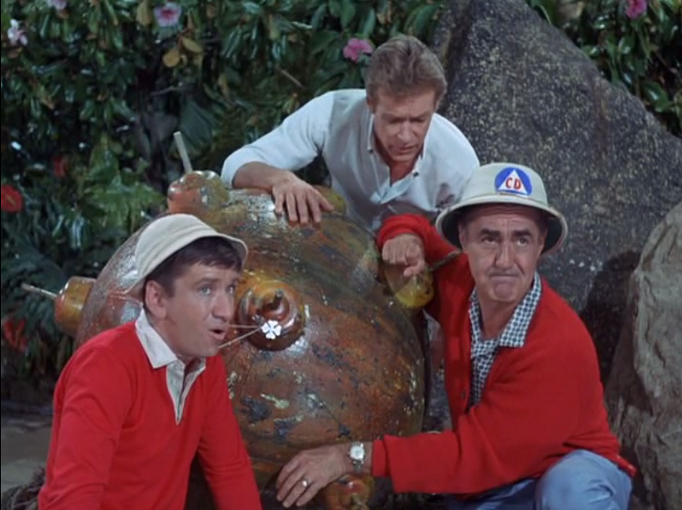
Figuring things out.

Slide 11
Setting GUCS
6
7
8

Slide 12
Six GUCS Contexts
session
superuser
reload
restart
backend
internal

Slide 13
Six GUCS Contexts
session, or “user”
  can be set on per-session basis at runtime
  can also be changed by altering the ROLE
superuser
  can be set at runtime for the whole server, but only by the superuser

Slide 14
Six GUCS Contexts
reload, or “sighup”
  requires a soft restart of the postmaster to change
  also called a “HUP”
restart, or “postmaster”
  can only be changed with a hard restart

Slide 15
More on reloading
Three methods for reloading
pg_ctl -D PGDATA reload
kill -HUP <postmaster.pid>
SELECT pg_reload_conf();

Slide 16
Six GUCS Contexts
backend
  developer settings which have to be set before session start
internal
  compile-time settings provided for reference. Unalterable.

Slide 17
7 Places to set GUCs
postgresql.conf file
config directory
SET
pg_settings
ALTER objects
command-line switches & PGOPTIONS
ALTER SYSTEM SET

Slide 18
postgresql.conf
$PGDATA/postgresql.conf
  can be relocated or symlinked
Primary way to change GUCS
  for performance
  for logging
  for defaults
Notes:
show postgresql.conf file
point out switching behavior

Slide 19
postgresql.conf
just a big list of settings
defaults are “# commented” out
if a setting appears multiple times, the last one takes effect
can use “include” files

Slide 20
config directory
include_if_exists='dir'
directories containing multiple config files
loaded in alphanum order
better for config managers/automation

Slide 21
SET & SHOW
Access GUCS in a SQL session
  SET changes
    only applies to user and superuser contexts
    best way to change things for only one session
    can be embedded in stored procedures
    SET enable_mergejoin = false;
  SHOW displays
    SHOW ALL lets you see all GUCS
    SHOW shared_buffers;

Slide 22
SET & SHOW: set_config
set_config( setting, value, is_local )
  alternative to SET
  better for scripts since it takes a string
SELECT set_config('work_mem','1GB', TRUE);
current_setting ( setting )
  alternative to SHOW
SELECT current_setting('lc_collate');

Slide 23
pg_settings
Tabular representation of GUCS
  a “system view”
  can be queried
  can be updated, which runs a SET on the relevant parameter
  SELECT * FROM pg_settings
  WHERE name = 'work_mem';
  UPDATE pg_settings SET setting = '12MB'
  WHERE name = 'work_mem';

Slide 24
ALTER objects
You can ALTER some objects to change their configuration settings
  ROLES (users)
  DATABASEs
  FUNCTIONs
  Changes configuration setting when that object is used (unless overridden by a SET)
  ALTER ROLE “data entry” SET search_path = 'entry, public';

Slide 25
ALTER ROLE + DB
ALTER ROLE IN DATABASE accts SET search_path = '$user, webview, contrib, public';
now can set ROLE-based settings just for a specific database
essential for search_path, useful for others

Slide 26
ALTER objects
Good way to discriminate between applications & users
  set search_path
    sometimes for security
  primitive resource management
    change work_mem, etc. for specific ROLES, applications or reports
  localization
    if different users have different desired displays
    ALTER DATABASE sao_paulo SET timezone = 'America/SaoPaulo';

Slide 27
ALTER objects
CREATE FUNCTION check_password(uname TEXT, pass TEXT)
RETURNS BOOLEAN AS $$
DECLARE passed BOOLEAN;
BEGIN
SELECT (pwd = $2) INTO passed
FROM pwds
WHERE username = $1;
RETURN passed;
END;
$$ LANGUAGE plpgsql
SECURITY DEFINER
-- Set a secure search_path: trusted
-- schema(s), then 'pg_temp'.
SET search_path = admin, pg_temp;

Slide 28
command-line and pgoptions
Set options when you start PostgreSQL
  as command-line switches
  using the PGOPTIONS shell variable
Good for testing
  and for restarting with recovery options
Also good with containers
postgres -c 'bgwriter_delay = 50ms'
export PGOPTIONS = '-c zero_damaged_pages = ON'

Slide 29
ALTER SYSTEM SET
set postgresql.auto.conf settings via the command-line
postgresql.auto.conf lives in PGDATA
alternative to managing postgresql.conf via template
ALTER SYSTEM SET work_mem = '128MB';

Slide 30

“That's a lot of places for settings.”

Slide 31
New: pg_file_settings
gucs=# select sourcefile, sourceline, name from pg_file_settings;
┌───────────────────────────────────────────────┬────────────┬────────────────────────────┐
│ sourcefile │ sourceline │ name │
├───────────────────────────────────────────────┼────────────┼────────────────────────────┤
│ /var/lib/postgresql/data/postgresql.conf │ 59 │ listen_addresses │
│ /var/lib/postgresql/data/postgresql.conf │ 64 │ max_connections │
│ /var/lib/postgresql/data/postgresql.conf │ 113 │ shared_buffers │
│ /var/lib/postgresql/data/postgresql.auto.conf │ 3 │ work_mem │
└───────────────────────────────────────────────┴────────────┴────────────────────────────┘

Slide 32
Eight types of GUCS
Boolean
Integer
Float
Memory / Disk
Time
Strings
ENUMs
Lists

Slide 33
Eight types of GUCS
Boolean
  take TRUE | FALSE or ON | OFF
  enable_seqscan = on
Integer
  take whole numbers only
  max_connections = 700

Slide 34
Eight types of GUCS
Float
  take decimal values
  random_page_cost = 3.75
Memory / Disk Size
  can take integers
  but can also take “computer units”: kB, MB, GB
  work_mem = 512MB
  shared_buffers = 4096

Slide 35
Eight Types of GUCS
Time
  take time values (units vary)
  units are often omitted
  authentication_timeout = 30s
Strings
  take unchecked strings
  often refers to file locations or program names
  log_directory = 'pg_log'

Slide 36
Eight Types of GUCS
ENUMs
  take a string value from a prescribed list
  wal_level = hot_standby
Lists
  take a list of values, either freeform or ENUM
  search_path = 'main, archive, “$user”'

Slide 37

What's New, GUCS?

Slide 38
23 settings eliminated
trace_locks_oidmin
wal_sender_delay
max_fsm_pages
regex_flavor
krb_server_hostname
add_missing_from
krb_realm
unix_socket_directory
max_fsm_relations
explain_pretty_print
debug_deadlocks
wal_debug
sql_inheritance
ssl_renegotiation_limit
silent_mode
trace_lwlocks
trace_locks
trace_locks_table
custom_variable_classes
log_btree_build_statsj
checkpoint_segments
trace_userlocks
krb_srvname

Slide 39
69 settings added
autovacuum_multixact_freeze_max_age
autovacuum_work_mem
backend_flush_after
bgwriter_flush_after
checkpoint_flush_after
cluster_name
data_checksums
default_transaction_deferrable
dynamic_shared_memory_type
enable_gathermerge
enable_indexonlyscan
event_source
exit_on_error
force_parallel_mode
gin_pending_list_limit
hot_standby_feedback
huge_pages
idle_in_transaction_session_timeout
ignore_checksum_failure
lock_timeout
log_file_mode
log_replication_commands
max_logical_replication_workers
max_parallel_workers
max_parallel_workers_per_gather
max_pred_locks_per_page
max_pred_locks_per_relation
max_pred_locks_per_transaction
max_replication_slots
max_sync_workers_per_subscription
max_wal_size
max_worker_processes
min_parallel_index_scan_size
min_parallel_table_scan_size
min_wal_size
old_snapshot_threshold
operator_precedence_warning
parallel_setup_cost
parallel_tuple_cost
quote_all_identifiers
replacement_sort_tuples
restart_after_crash
row_security
session_preload_libraries
ssl_ca_file
ssl_cert_file
ssl_crl_file
ssl_dh_params_file
ssl_ecdh_curve
ssl_key_file
ssl_prefer_server_ciphers
synchronous_standby_names
syslog_sequence_numbers
syslog_split_messages
temp_file_limit
track_commit_timestamp
track_io_timing
transaction_deferrable
unix_socket_directories
vacuum_multixact_freeze_min_age
vacuum_multixact_freeze_table_age
wal_compression
wal_consistency_checking
wal_log_hints
wal_receiver_status_interval
wal_receiver_timeout
wal_retrieve_retry_interval
wal_sender_timeout
wal_writer_flush_after

Slide 40
tuning disk flush
backend_flush_after
bgwriter_flush_after
checkpoint_flush_after
wal_writer_flush_after

Slide 41
identification
cluster_name
event_source

Slide 42
SSL config
ssl_ca_file
ssl_cert_file
ssl_crl_file
ssl_dh_params_file
ssl_ecdh_curve
ssl_key_file
ssl_prefer_server_ciphers

Slide 43
Timeouts & Resource Limits
old_snapshot_threshold
lock_timeout
idle_in_transaction_session_timeout
autovacuum_work_mem
max_pred_locks_per_page
max_pred_locks_per_relation
max_pred_locks_per_transaction

Slide 44
New replication stuff!
max_logical_replication_workers
max_replication_slots
max_sync_workers_per_subscription
wal_receiver_status_interval
wal_receiver_timeout
wal_retrieve_retry_interval
wal_sender_timeout
synchronous_standby_names

Slide 45
WAL compression
wal_compression
wal_log_hints

Slide 46
parallel query
max_worker_processes
max_parallel_workers
max_parallel_workers_per_gather
force_parallel_mode
enable_gathermerge
parallel_setup_cost
parallel_tuple_cost

Slide 47
Getting Simpler: WAL size
was:
  checkpoint_segments
  wal_buffers
  checkpoint_timeout
is:
  min_wal_size
  max_wal_size
… with good defaults!

Slide 48

GUCS Reference

Slide 49
The 19 (or so) Settings most users need to adjust
listen_addresses
max_connections
ssl (+3)
shared_buffers
work_mem
maintenance_work_mem
autovaccum_work_mem
effective_cache_size
random_page_cost
data_checksums
temp_file_limit
statement_timeout
idle_in_transaction
_timeout
archive_command
archive_mode
hot_standby_feedback
wal_level
wal_keep_segments
logging settings (3-8)

Slide 50

GUCS: the Grand Tour

Slide 51
Categories (mine)
file locations
connection settings
resource management
maintenance
WAL & checkpoints
replication
query tuning
logging
statistics
locks
locale & formatting
other settings & defaults
compatibility
custom GUCS
developer options
presets

Slide 52
custom variable classes
for supporting various PostgreSQL Extensions
custom_variable_classes = 'pg_stat_statements,auto_explain'
pg_stat_statements.max = 10000
pg_stat_statements.track = all
auto_explain.log_min_duration = '200ms'
auto_explain.log_nested_statements = on
auto_explain.log_format = json

Slide 53

Contact
github.com/jberkus/annotated.conf/
Josh Berkus: jberkus@redhat.com
  www.databasesoup.com
  @fuzzychef
PostgreSQL: www.postgresql.org
Red Hat: http://redhat.com/community
This talk is copyright 2018 Josh Berkus. It is licensed Creative Commons Share-Alike 4.0.
Images of Gilligan’s Island show and characters are property of CBS and are used here under terms of fair use.

