Slide 1
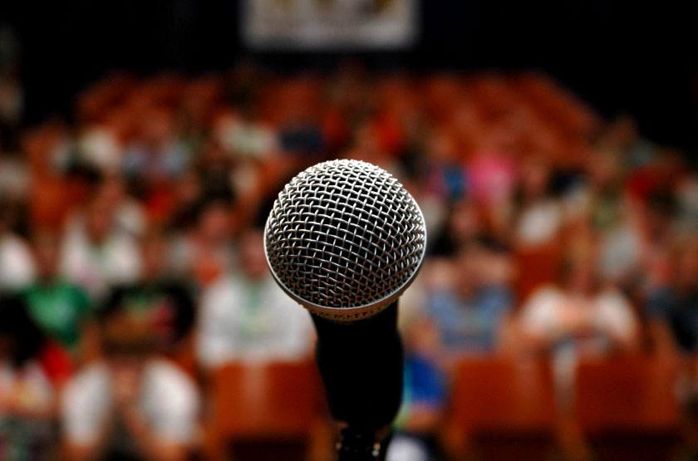

Give a Great Tech Talk
Josh Berkus
PostgreSQL Experts
LinuxCon 2013
New Orleans
with contributions from Ian Dees
Notes:
The goal of this tutorial is to improve your presentation skills. Presenting is a skill. While some people have a slightly easier time learning it, anyone can learn it, as generations of Toastmasters have proven. It's just a matter of application of good techniques, and practice.

Slide 2
for anyone who: plans to speak,
wants to speak,
has spoken,
or is thinking of speaking ...
Notes:
Public speaking is a big part of being any kind of an expert today.

Slide 3
… at an open source conference,
user group meeting,
company meeting,
or technical training ...
Notes:
There are a lot of opportunities to give technical talks. I personally give 20 to 30 a year.

Slide 4
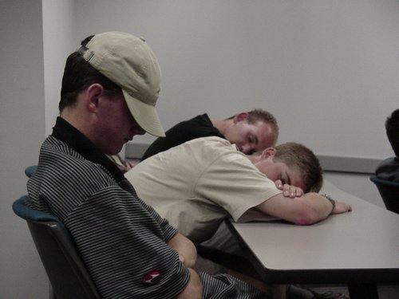
… and wants to get from
Notes:
But most of the talks I attend basically suck. At best, they're boring. And not because the speakers don't know their stuff; because they don't know how to present it.

Slide 5
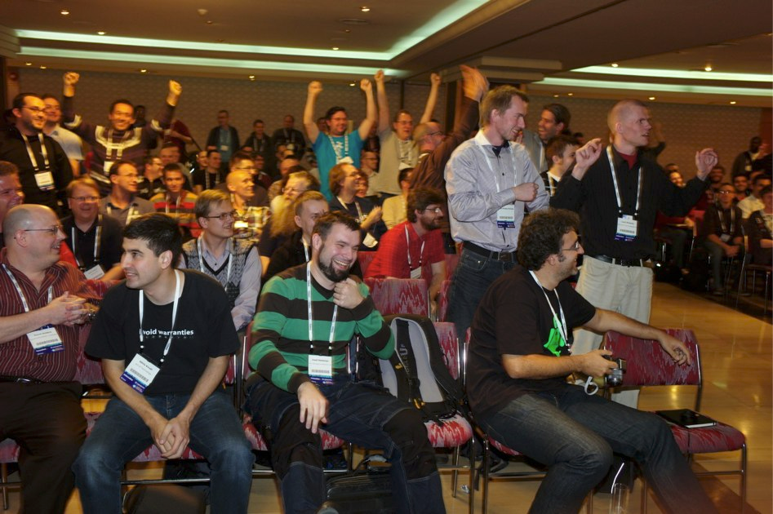
… to:
Notes:
We can fix this. Anybody can be a good speaker. Anybody who works hard can be a great speaker.

Slide 6
Schedule
Time (approx) | Part
5pm to 6:30pm | Part I: 80% Preparation
6:30pm to 7:00pm | Dinner break and discussion
7:00pm to 8:15pm | Part II: 20% Execution
8:15pm to 8:45pm | Part III: The Audience Outside The Lecture Hall Additional Q&A
Notes:
Schedule for the tutorial
You don't need, or want, a schedule and TOC for a short talk. But for a tutorial, it's a good idea.

Slide 7
Part I: 80% Preparation
Topicalilty
Know your timeslot
Know your audience
Nobody cares about your slides
… but make good ones anyway
Rehearse, rehearse, rehearse
Day Of prep
Notes:
Of course, 80% – or 90% – of giving a great talk is preparation. I personally put in 7 hours of prep for every hour of speaking. So we're going to spend the majority of the tutorial on presentation.

Slide 8
Part II: 20% Execution
The 7 Habits of Highly Ineffective Presenters
the 7 Habits, deconstructed
Presenting Exercises
Audience Interaction 101
What to do when your demo fails
Notes:
There's a bunch of tricks to actually delivering the talk too. To make this fun, I'm going to show you how NOT to do it, and then we can pick that apart.

Slide 9
III: The Audience Outside the Lecture Hall
Hallway track
Sharing slides
Video
Curating your talks
Notes:
Finally, for every person you get to present to personally, 2 to 5 people will watch video, download slides or otherwise see your stuff without you present.

Slide 10
Q&A
Question periods during tutorial
  I'll let you know when
Write down your questions
  or Tweet them: #ggtt
Notes:
Example of managing audience expectiations for questions. To control things, we're pusing them to the end of each section.

Slide 11
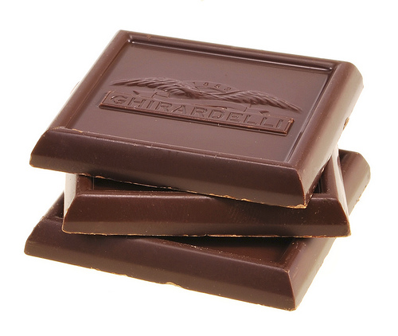
Exercises
Notes:
This tutorial also involves several participatory exercises. Since these may involve some personal risk for the participant, they'll be rewarded with chocolate.

Slide 12
Part I: 80% Preparation

Slide 13
Topicality
Always present things ...
you know a lot about
are currently topical
you're enthusiastic about
you can cover in the time allotted
Notes:
Your topic needs to be something you know well and are excited about or your talk can't be great. Excitement is often more important than content.

Slide 14
Topicality
Ask yourself ...
what do you expect the audience to learn?
what do you expect the audience to do after the talk?
Notes:
The concept of Topic goes beyond just the project or technique you're presenting. What, exactly, do you want to communicate about that?

Slide 15
$topic is {cool|easy|hard|fun}
How to $task by using $technique
{contribute to|adopt|dump}
$project
Notes:
This can be like a mad lib. Try to express, in ONE SENTENCE, what you expect to get across during the talk. If you can't do it, there's probably something wrong with your talk concept.

Slide 16
How to give a better talk by using good preparation and delivery techniques.
Notes:
For example, here's the one-sentence construction of this tutorial.

Slide 17
Speaker Exercise #1
Topicality
Notes:
In exercise #1, we give one speaker three random topic cards. They pick one to talk about, and then we pull apart why they chose that topic and what they were trying to communicate.

Slide 18
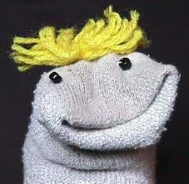
don't present things for other people
Notes:
A couple of DONTS: don't be a sock puppet. Present your own stuff. If necessary, present your own version of someone else's stuff.

Slide 19
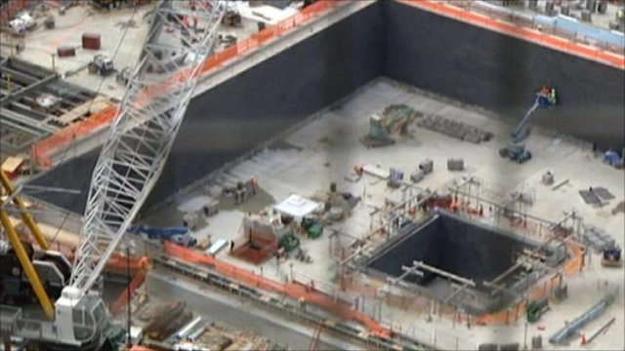
don't present incomplete projects
… unless you're at the conference to get help.
Notes:
DONT make the mistake of signing up for a talk on something in-progress which you “plan to complete before the conference”. No matter how well you think you're faking it, your audience can tell you have a big empty hole.

Slide 20
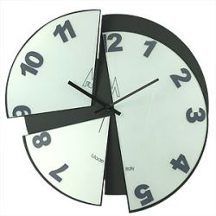
Know Your Timeslot
Notes:
When is your talk? TIme and day? What is it before/after? Is there a break? Will the audience be tired? And how long is it?

Slide 21
Basic Timeslots
5 Minutes Lightning Talk
  one small topic very briefly
30-45 Minutes Regular talk, no Q&A
1 Hour Regular talk with Q&A
  one major topic with some depth
2-3 Hours Tutorial
  entire tool or technology
Notes:
There are 4 basic timeslots. Scale your cotent to the timeslot you have; don't try to cover too much or too little for it.

Slide 22
Basic Timeslots
5 Minutes Lightning Talk
  “5 kernel settings you didn't know”
30-45 Minutes Regular talk, no Q&A
1 Hour Regular Talk with Q&A
  “Kernel settings for performance tuning”
2-3 Hours Tutorial
  “Linux 3.5 Kernel Settings: a 3-Hour Tour”
Notes:
Example fo same topic in 3 different timeslots with different scopes of coverage each.

Slide 23
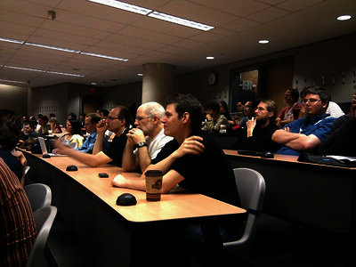
Know Your Audience
Notes:
The biggest thing is to correctly target your audience with your talk. You have to know who they are and speak to them, not some generic audience.

Slide 24
Who Are They?
Professions?
Ages?
Culture?
From where?
Groups?
Notes:
Know whom you're talking to. If you haven't been to the conference before, try asking the organizers for demographic information.
An audience of 22-year-old brazillian drupal developers is very different from an audience of 60-year-old midwestern professors.

Slide 25
What do they want?
Why are they at the conference?
What is their interest in your topic?
How much do they know already?
What style/format do they expect?
Do they have things in common you can refer to?
Notes:
Your audience is going to have expectations about what they will learn. You need to figure out those expectations and try to fullfill them. Otherwise they will be frustrated and hate you.

Slide 26

OpenSourceBridge
“Analyze query plans to find the “go faster” button”
Notes:
An example of giving the same core content to 3 different audiences. This is about a new query analysis tool for PostgreSQL.
OSB is mostly web developers and younger hackers. They don't care so much about database internals or theory. They're more interested in making their apps work better.

Slide 27

pgCon
“Find chronic performance issues in your discarded query plans”
Notes:
pgCon is a bunch of database gear-heads who are already familiar with the problem and the existing tools. They want only technical details and a demo of the new tool and how it can be used.

Slide 28

SIGCSE
“Discarded plan analysis as a method for teaching query optimization”
Notes:
SIGCSE is a bunch of computer science educators, many of them older. They expect a more academic presentation of topics. Note the passive voice in the title. And you need to relate your topic to education and theory, NOT to production environments.

Slide 29
Audience unknown?
ask questions at the beginning of the talk
  or before it
have extra slides/demos
and adjust content
Notes:
Sometimes you can't find out much about the audience beforehand. In that case, you need to be more creative. Make some extra slides and/or code examples which you can “swap in” based on who's in the audience. And then find out who is there by asking.

Slide 30
Speaker Exercise #2:
Audience
Notes:
This exercise has two parts. In part 1, we have the audience collectively analyze the audience for Linux Collab and LinuxCon. In part 2, we have speakers give the same talk twice, for different audiences each time.

Slide 31
7 Steps for Talk Preparation
Create some notes
Come up with a story
Work out a script & timings
Create slides
Rehease
Revise
Rehearse again
Notes:
Preparing for a talk is a multi-step process. It'll take you quite a bit of time; at least 5 hours for every hour presented, and ofter up to 12.
Ian and I probably spent a combined 35 hours preparing the original version of this tutorial. I then spent another 10 hours revising it for version 2.

Slide 32
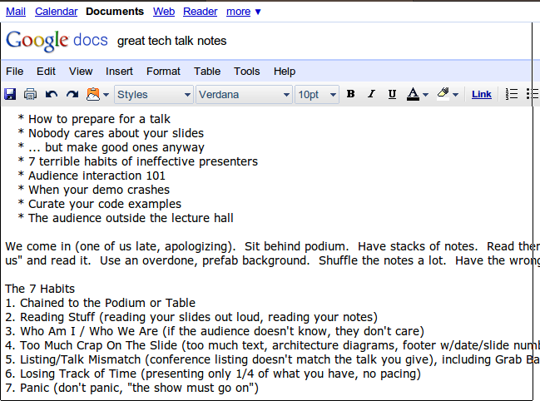
Notes:
you start with freeform notes. These are our notes from Googledocs while we were designing this presentation. It gave us an idea of the points we wanted to cover and how to consolidate them.

Slide 33
6 Basic Stories for Talks
Enlightenment
Solution Quest
A to Z
Show & Tell
Theme & Variations
The Catalog
Notes:
Once you know what you are covering your presentation needs a “story” or a plot to string it together. Otherwise it can seem random and chaotic.
There's really only 6 “stories” for technical presentations.

Slide 34
Enlightenment
a journey from ignorance to knowledge:
How I Learned
to Stop Worrying
and Love SELinux
Notes:
an explanation of each of the 6 stories, with an example.

Slide 35
Solution Quest
shows a problem and attempted solutions (maybe including success)
Building a robot anti-squirrel
sentry gun
Notes:
an explanation of each of the 6 stories, with an example.

Slide 36
A to Z
covers something from “end to end” or “bottom to top”
Tracing the performance
problem in your web stack
Notes:
an explanation of each of the 6 stories, with an example.

Slide 37
Show & Tell
Demo something. Then explain how it worked.
Postgres replication
in 10 minutes
Notes:
an explanation of each of the 6 stories, with an example.

Slide 38
Theme & Variations
Show several different ways to accomplish the same task
Generators: learn to loop
the Pythonic way
Notes:
an explanation of each of the 6 stories, with an example.

Slide 39
The Catalog
A list of items, with details of each.
This section
Notes:
an explanation of each of the 6 stories, with an example.

Slide 40
Stories & Timeslots
5 Minutes Lightning Talk
  One story
30-45 Minutes Regular talk, no Q&A
1 Hour Regular talk with Q&A
  1 or 2 stories
2-3 Hours Tutorial
  2 to 4 stories, some repeated
Notes:
Longer timeslots may call for more than one “story”.

Slide 41
Section | Story
Audience | Theme and Variations
Talk Preparation | A to Z
Timeslot | Theme and Variations
Stories | Catalog
Making Slides | A to Z
7 Habits | Catalog
Notes:
For example, here's the “stories” associated with this tutorial. Well, some of it anyway.

Slide 42
Speaker Exercise #3:
Story
Notes:
For this exercise, we have two speakers talk about the talks they are doing, and make up a story to go with them. Then they pick an alternate story and explain how it would go.

Slide 43
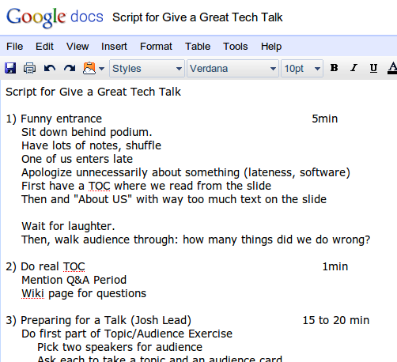
Notes:
Once you have a story, you can write a script with timings for your presentation.

Slide 44
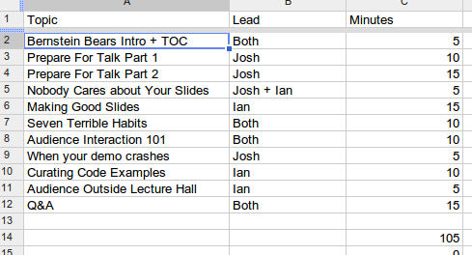
Notes:
Timings are especially important if you're covering a lot of material. You need to break down the presentation by item to know if you are getting behind.
Only then can you work on slides.

Slide 45
Nobody Cares About Your Slides
Notes:
In the next section we explore slideless presentations, starting with an audience exercise and then moving on to the options around slideless presentations, including:
demos
video
whiteboards & easels
audience exercises

Slide 46
Speaker Exercise #4
No Slides
Notes:
For this example, we ask someone to do a mental exercise about having to present with no slides.

Slide 47
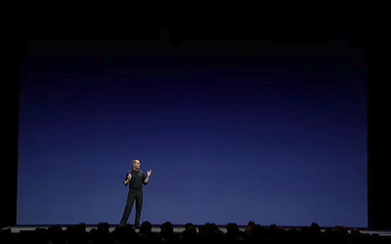
… but make good ones anyway
Notes:
It's fashionable for the presentation blogs to obsess over Steve Jobs's slides and technique. But you don't have to be Steve Jobs to use good slides.

Slide 48
Tools: the Big Three
“Create your slides in some standard slide software like Keynote, OpenOffice Impress or PowerPoint.”
- Andy Lester
Notes:
In PragPub magazine, Andy Lester advises starting with the Big Three, unless your needs are really specialized. And he's right.

Slide 49
Web-based slidemakers
Ruby apps
  Showoff
  Slidedown
HTML5 Apps
  Landslide
  html5slides
  DZSlides
Notes:
Scott Chacon has a nifty project called Showoff that's geared toward presenting code and shell sessions. It works by serving up a local web page, which you then view in a full-screen browser.

Slide 50
advantages
curate your slides in a VCS
embed actual code
  Showoff: embedded terminal
no “office app” mess
run slides on web host
Notes:
The advanced slidemakers are probably better for serious career presenters. And yet, I can't wean myself off of LibreOffice.

Slide 51
disadvantages
hard to learn
  CSS for design
can't do fancy design
  no graphics stuff either
no upload to Slideshare
run slides from a web host
Notes:
ditto.

Slide 52
Conference Themes
Josh Berkus, PostgreSQL
TS-5502
Notes:
Some conferences require you to use a specific, overly busy slide theme. Call the organizers and ask for an exception. Show them you've done your homework. You might even stealthily use your own, cleaner version for your actual talk (but don't alienate the organizers).
Worse is when your employer asks you use their theme. We'll cover that in a minute

Slide 53
Employer themes, or:
PostgreSQL Experts Inc.
April 16, 2013
Page 45
www.pgexperts.com
1-888-PG-XPERT
San Francisco, CA
“Sometimes you
just need an expert.”
Notes:
Huge obnoxious employer themes say one thing to your audience: “Sellout!”. They can't pay attention to your slides. And there's no space.

Slide 54
… you don't have to sell your soul
www.pgexperts.com
Notes:
You can rework employer branding to be inobtrusive.

Slide 55
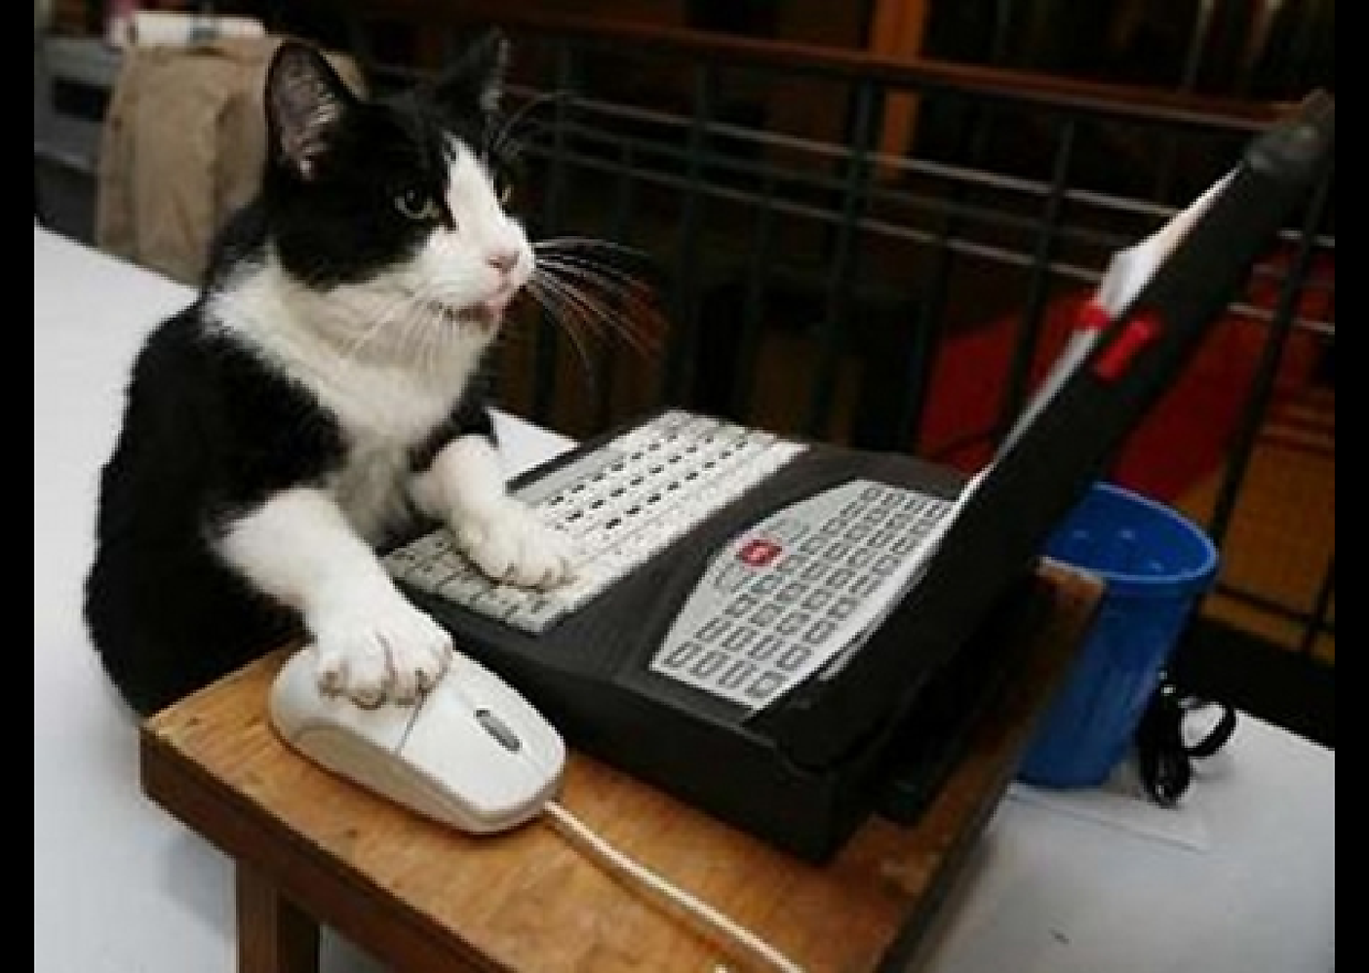
“ cute” accessory themes
Notes:
It can be fun to organize a presentation around an “accessory theme” which is an idea that is only tangentally related to the topic of the talk, like comic books or mountain climbing.

Slide 56

Josh Berkus
SCALE 2013
Notes:
We went with a “Grand Prix” theme for the 9.2 presentations. This worked because one of the major features was speed improvements.

Slide 57
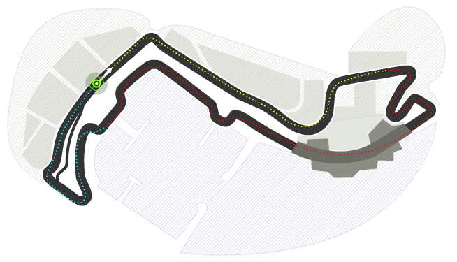
New Feature Grand Prix
Write
Performance
Cascading
Replication
Read
Scalability
Index-only
Scans
Start
Other
Features
JSON
DDL
Migrations
Range Types
SP-GiST
Admin Tools
Notes:
This theme gave us a structure for an otherwise blah catalog theme presentation.

Slide 58
Good accessory theme:
related to the main topic
provides structure
makes the talk more “fun”
Notes:
THis was an example of an accessory theme which worked.

Slide 59
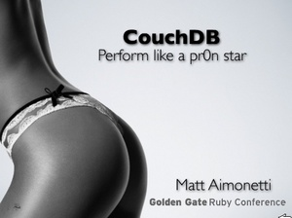
Notes:
This is a notorious example of a bad accessory theme.

Slide 60
bad accessory theme
irrelevant to the main topic
visually distracting
offensive
Notes:
It was bad not just for being highly offensive, but because it made for a bad talk.

Slide 61
a word on sensitivity
don't offend your audience
your audience includes people who are different from you
  think how you'll come across
if you offend them accidentally, apologize
Notes:
While we're at it, let's try hard not to alienate large portions of our audience. You want your talk to be famous, but not for the wrong reasons.

Slide 62
Don't be a jerk
Notes:
In four words.

Slide 63
Light on Dark
Dark on Light
Notes:
There's lots of readability research on dark vs. light backgrounds. But little of that has to do with showing code on a projector. You can make either of these work; anecdotally, light on dark is a little more legible.

Slide 64
dark rooms
video
terminal demos
bright rooms
clipart
code snippets
Notes:
There's lots of readability research on dark vs. light backgrounds. But little of that has to do with showing code on a projector. You can make either of these work; anecdotally, light on dark is a little more legible.

Slide 65

Heraldry
Notes:
When you're thinking about color visibility, you might take a page from the medieval playbook. Back then, heralds knew how to make sure contrast was visible 100 feet away. They used a set of rules based on “colors” and “metals”.

Slide 66
Metal vs. Color
Metals
  Yellow
  White
Colors
  Black
  Blue
  Red
  Green
  Purple
  Brown
Notes:
In this scheme, metals are gold (yellow) and silver (white). Everything else is a color. You can put a color on a metal or a metal on a color, but not a metal on a metal or a color on a color.

Slide 67
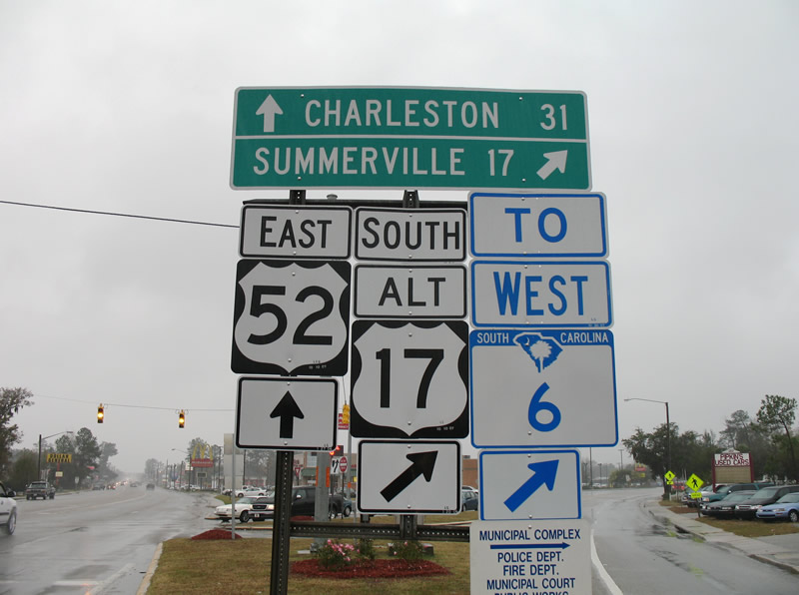
Notes:
For a modern example of this phenomenon, see your local highway department. All the signs in this intersection are either metal on color, or color on metal.

Slide 68
Point Size Is Your Barometer
Notes:
We're not going to give you an ironclad “thou shalt not” point size. Start with master slides that go down to about 36 pt or so. If you find yourself needing to make the font smaller to fit more words, consider breaking the slide up.

Slide 69
Title Font
Text Font
Code Font
3 Fonts is OK. Two is better.
Notes:
Don't be a font junkie.

Slide 70
Maybe I Should
Have Used Arial
Instead
Notes:
Cute specialty typefaces seem attractive when you're making slides. But they're darned hard to read. Stick with a simple, common font like Arial, Times, etc.

Slide 71
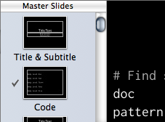
Master Slides
Notes:
The easiest way to restrict yourself to a simple palette of slide types is to use your software's master slide feature. This is also the place to add a template for slides that contain code snippets.

Slide 72
Code Examples
Notes:
You need to carefully consider which code snippets you're going to show on your slides.

Slide 73
bad code
def snippetize(self):
with ZipFile('all.key') as original:
with ZipFile('out.key', 'w') as updated:
for item in original.filelist:
if item.filename != 'index.apxl':
contents = original.read(item.filename)
updated.writestr(item, contents)
raw = original.read('index.apxl')
# Find snippets in the source tree
doc = minidom.parseString(raw)
pattern = '//sf:shape[starts-with(@sf:href,\'http://localhost/\')]'
strip = 'http://localhost/'
finder = Finder(doc, pattern, strip)
Notes:
This example is too much to absorb. It also uses a color theme that's good on screen, but hard to read on a projector. Green on white is particularly projector-unfriendly. The grey comment doesn't provide enough contrast.

Slide 74
good code
# Find snippets in the source tree
doc = minidom.parseString(raw)
pattern = "//sf:shape[starts-with(" \
"@sf:href,'http://localhost/')]"
strip = "http://localhost/"
finder = Finder(doc, pattern, strip)
Notes:
Here's a small part of that slide, reformatted to fit the screen and skinned with a higher-contrast theme.

Slide 75
create table reports.connections_by_minute as
select cast(minstart as time) as minstart,
start_count + sum( conn_count - disc_count )
OVER ( order by minstart ) as conns
from (
select minstart,
coalesce(conn_count,0) as conn_count,
coalesce(disc_count,0) as disc_count
from log_minutes
left outer join
( select date_trunc('minute', log_time) as contime,
count(*) as conn_count
from connections
group by 1 ) as conns
on minstart = conns.contime
left outer join
( select date_trunc('minute', log_time) as contime,
count(*) as disc_count
from disconnections
group by 1 ) as disconns
on minstart = disconns.contime
) as connects,
( select count(*)
as start_count
from monitor.pg_stat_activity_start )
as start_connects;
Notes:
Here's an example of a query which is way too big to fit on one slide. How to present it? Snippet expansion.

Slide 76
create table reports.connections_by_minute as
select cast(minstart as time) as minstart,
start_count +
sum( conn_count - disc_count )
OVER ( order by minstart )
as conns
from (
...
) as connects,
( ...
) as start_connects;
Notes:
“Zoom” into the first part and redact the other parts.

Slide 77
create table reports.connections_by_minute as ...
from (
select minstart,
coalesce(conn_count,0) as conn_count,
coalesce(disc_count,0) as disc_count
from log_minutes
left outer join
( ... ) as conns
on minstart = conns.contime
left outer join
( ... ) as disconns
on minstart = disconns.contime
) as connects,
( ... )
as start_connects;
Notes:
Then the 2nd part

Slide 78
create table reports.connections_by_minute as ...
from log_minutes
left outer join
( select date_trunc('minute',
log_time) as contime,
count(*) as conn_count
from connections
group by 1 ) as conns
on minstart = conns.contime
left outer join
( ... ) as disconns
on minstart = disconns.contime
) as connects,
( ... )
as start_connects;
Notes:
Then the 3rd, etc.

Slide 79
presenting code
large, fixed-width font
colorize
  not defaults!
break up long lines
snippet zoom
or switch to text editor!
Notes:
Some general tips on presenting code, recapped.

Slide 80
Does that mean I have to reformat all my examples?
Yes, it does.
Notes:
Wow, that's going to be a lot of work, isn't it?

Slide 81
Quick&Dirty colorization
Convert to HTML with http://pygments.org
Copy and paste from Chrome
Notes:
For other editors, you can get a similar effect by running the Pygments syntax highlighter as an external program. We suggest setting up a keyboard shortcut for this.

Slide 82
Text Editors
Textmate
  Slush & Poppies (light)
  Blackboard (dark)
  export to HTML & paste
Emacs, vim: customize
Kate, BBEdit: customize
Notes:
Here are a few reasonable defaults for the TextMate editor. Don't miss the Create HTML command, which hands syntax-highlighted code over to a browser window – so you don't lose your colors when you copy / paste.

Slide 83
There's Always More Code!
Provide a text file for download
Demo through a terminal session
Give a link to your github account
Notes:
You're not going to be able to show all your code in your talk. There will always be more that your audience will want to see later. So don't forget to throw in a GitHub or Bitbucket link.

Slide 84
Rehearse!
Do a run-through of the entire presentation
  out loud, standing up
Yes, really
Multiple times
Notes:
You can't possibly know if the presentation is going to work or not unless you rehearse.
Run through it, at regular speed, out loud. Really! You'll discover major things which need to be changed that way. And test your timing.

Slide 85
rehearsal in front of ...
a mirror
  body language, timing, flow
a friend/relative
  clarity, pacing, the “um” problem
video
  all of the above, exhaustively
Notes:
There's various ways to rehearse, depending on what presentation skill you really need to work on.

Slide 86
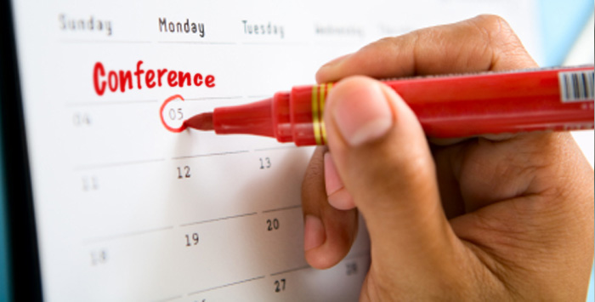
Day Of
the Conference
Notes:
Then there's a bunch of prep you need to do at, or just before, the conference.

Slide 87
- 7 days
check the schedule
  time of day
  breaks, lunch
  similar/complimentary talks
tweak content
double-check on special requests
Notes:
Just before the conference, make sure you know the environment you're presenting in. Also follow up with conference organizers.

Slide 88
- 1 day
check the room
  location
  configuration
  acoustics
  sightlines
Notes:
Take a look at the room before you have to present in it. Note any adjustments you need to make.

Slide 89
- 1 day
bring-with checklist
  laptop
  power cord
  clicker
  notes
  business cards
  handouts & exercise items
  badge
Notes:
Don't forget all your “stuff”. I find it's best to make up a “presenter bag” the night before.

Slide 90
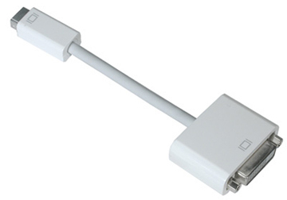
Notes:
Dongles are the bane of the presenters existance. Bring multiple dongles and adapters to the conference with you; they're easy to lose.

Slide 91
- 1 day
check the projector
  with your laptop
upload slides & materials
do last run-through
get some sleep!
Notes:
Test the projector! Don't find out your laptop doesn't work with it 5 minutes before you present.

Slide 92
- 1 hour
set up your demos
clear your laptop
  turn off email, chat, skype, etc.
  hide those personal pics
Notes:
Now's the time to turn your laptop into a presentation machine.

Slide 93
- 20 minutes
go to the restroom
get some water
head for the room
  talk right before you? attend it
Notes:
Don't forget to use the facilities. No way you can get through a presentation hopping around. You should be in your room at least 15 min before the presentation.

Slide 94
- 10 minutes
turn off your cell phone
empty your pockets
take off badge
put on mic
plug in laptop
Notes:
Remove everything which might distract your audience while you're presenting.

Slide 95
Part I: 20% Execution
Notes:
Of course, you need to actually deliver the presentation as well as preparing it.

Slide 96
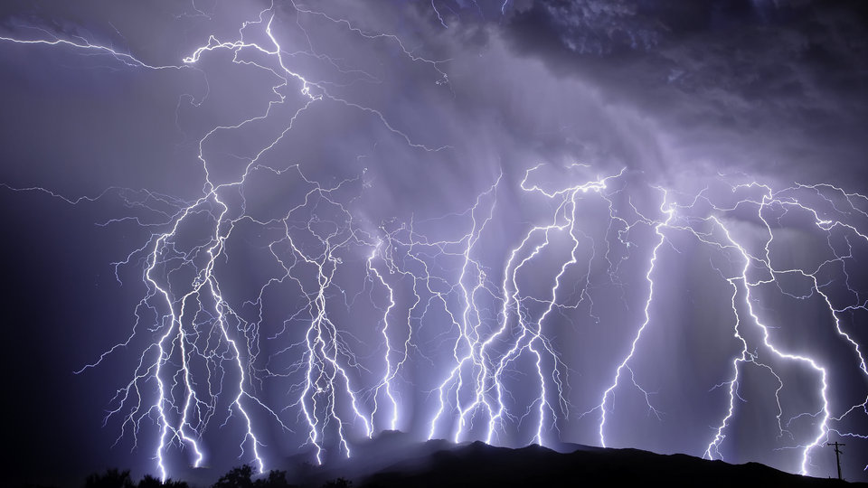
Lightning Talks
Notes:
Lightning talks can help you become a good speaker.

Slide 97
lightning talks
strictly 5 minutes
  one simple topic
great practice
  pacing, timing, topicality
Ignite Talks even better
  5min, 20 slides, auto-advance
Notes:
Lightning talks are the “sprints” of the speaking world. They help you improve all of your speaking skills, and build confidence, with a low time commitment.

Slide 98
The 7 Habits of Highly Ineffective
Speakers
Notes:
You've all seen presentations which suck. You may have given them.
While suckitude comes in a lot of flavors, I've found that there's 7 characteristics which all sucky presentations will have some or all of.

Slide 99
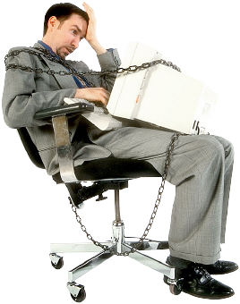
1. Chained To Your Chair
(or Podium)
Notes:
Step 1 is to hide behind the podium. Don't come out for anything! Especially don't walk out and interact with the audience.
That podium or table protects you. Just sit behind it and read your notes.

Slide 100
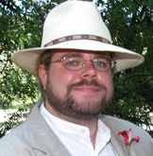
2. About Me
Education
  Brentwood Elementary School, Gainesville Florida
  Claremont Colleges – Degree in Art!
Projects
  PostgreSQL database project
  CivicDB
  Noisebridge
  pgReplay
Accomplishments
  Founded first company at age of 28
  Once shook hands with Esther Dyson
  Predicted the dot-com crash
  Nobel Prize for Peace for ending vi/emacs flamewar
Notes:
Always have an about us slide. It's useful either as a way to bore the audience or as a form of boasting.
Hint: if the audience doesn't know who you are before they walk in the room, they don't care.
Also have picture. Since they may need to ID you to the police.

Slide 101
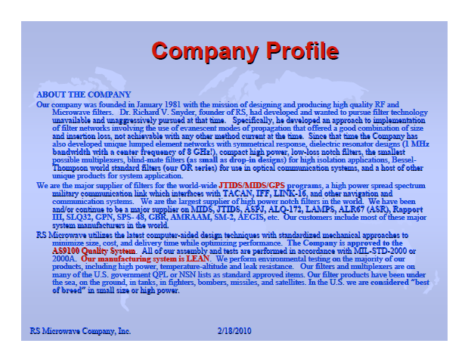
About Us
Notes:
Even better is the corporate about us slide. The ideal version recounts the entire history of the company starting at Genesis. With this, you can waste enough time that you don't have to have any presentation content.

Slide 102
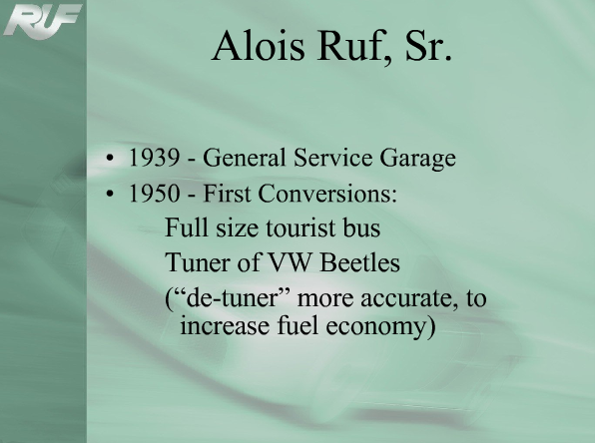

Slide 103
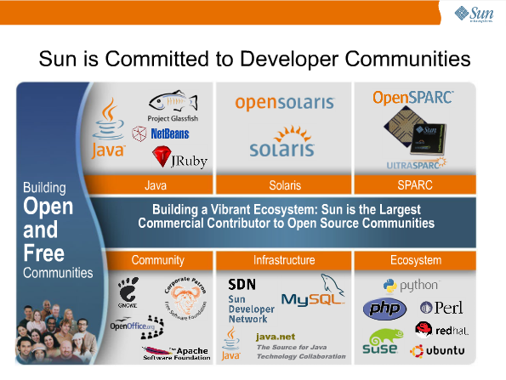

Slide 104
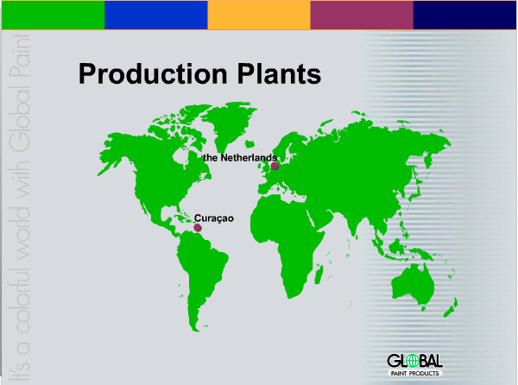

Slide 105
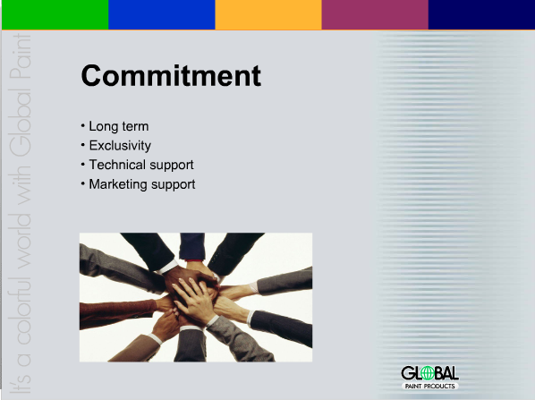

Slide 106

Notes:
The third habit caters to a select portion of the audience at the expense of everyone else.

Slide 107
3. Presenting
For The
Blind
Notes:
It's what I call “presenting for the blind”.

Slide 108
Presenting for the Blind
Presenting for the Blind is where you read every line of every slide.
It is extremely boring.
It also gives the audience the impression that you either think that they're illiterate, or that you've never seen these slides before.
  Maybe you haven't.
You can also read your notes directly off the page.
A monotone is recommended.
Notes:
Read the slide verbatim in a monotone.

Slide 109
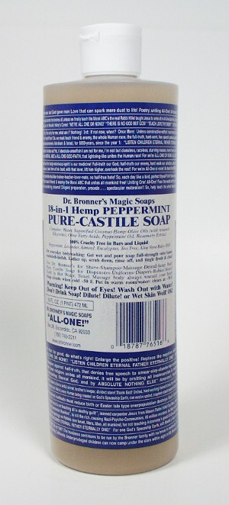
4. Dr. Bronner's
School of
Slide Design
Notes:
You can't be a really bad presenter without screwing up the slides themselves. The best way is this one.

Slide 110

Notes:
DR. Bronner jams every square millimeter of his soap labels full of bizarre propaganda. You should treat your slides the same way! Leave no square inch of whitespace!

Slide 111
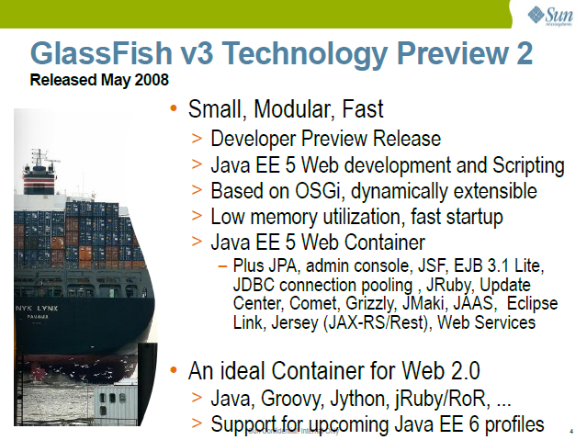
Notes:
Here's a good example of way-the-heck too much text. It's full of acronyms and runs off the page. And what the hell is that picture?

Slide 112

Notes:
Dr. Bronner would be proud.

Slide 113
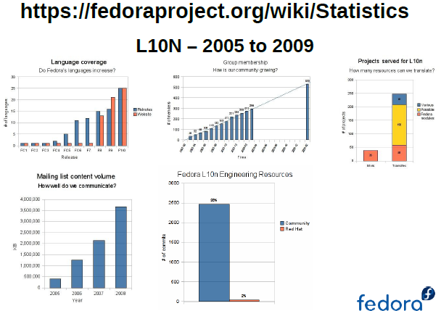
Notes:
You can also overcrowd your slides with other things. Five graphs on one page!

Slide 114
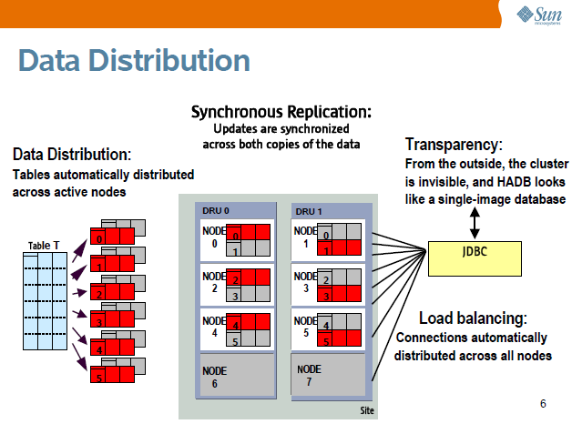
Notes:
But to really exploit the too much crap theme, you need to use some architecture diagrams. No matter what they are designed to portray, arch diagrams always look like a plate of spaghetti from the back of the room.

Slide 115
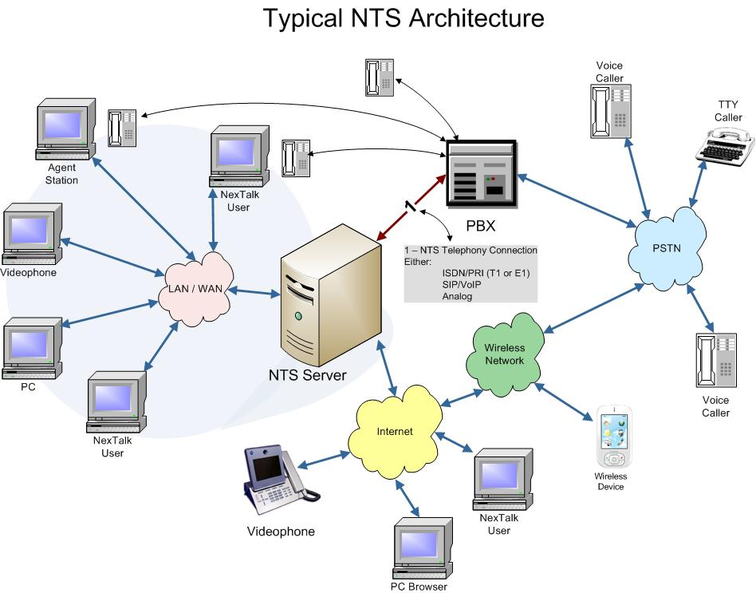
Notes:
More arch diagrams

Slide 116
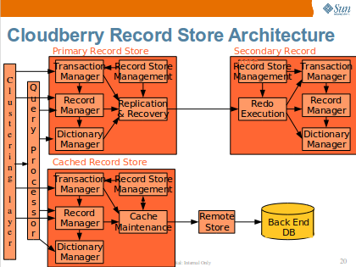
Notes:
More arch diagrams

Slide 117
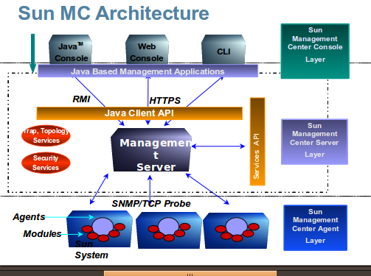
Notes:
More arch diagrams

Slide 118
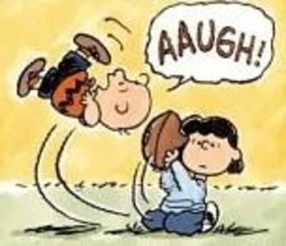
5. Bait & Switch
Notes:
You create expectations in the audience when you post your talk description in the conference catalog. If what you present is very different from the description, then you will frustrate them and they will hate it. Even if it is otherwise a good presentation.

Slide 119
7 points in description vs.
3 points covered
Notes:
Covering only half the material you promised is one way to piss people off. Some of them will have attended your talk just to hear the stuff in the other half.

Slide 120
Working Code
& Demo vs.
Just Slides
Notes:
This is the one I see the most, and the best way to make yourself look like a tool. If you promise working code, you'd better have it … or don't get invited back to that conference.

Slide 121
Expert Level vs.
Beginner Level
Notes:
See how you've pitched your talk: is it pitched to experts or beginners? If you provide the wrong level of information, people will either be disappointed or confused.

Slide 122
Beginner Level vs.
Expert Level

Slide 123
In-depth Technical vs.
Brochureware
Notes:
Like working code, if you promise in-depth hacking you'd better provide it. Otherwise you're a corporate drone. This is the trouble you'll be in if you present on something you don't know about. Marketing slides don't fool people.

Slide 124
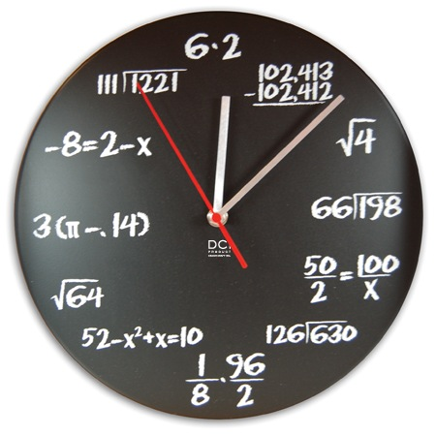
6. Time is an Illusion
Notes:
One of the most common presentations mistakes is to lose track of time.

Slide 125
6. Time is an Illusion
Notes:
Your audience has a schedule to maintain, too. And if you only cover half the material in the time allotted, they won't forgive you. Even less if you make them late for lunch!

Slide 126
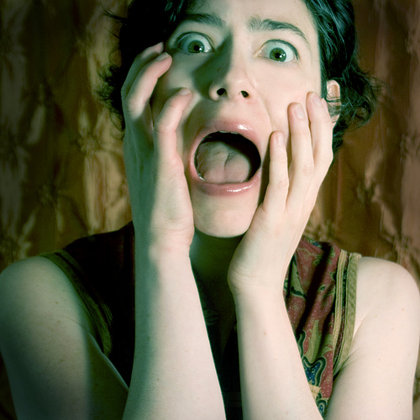
7. Panic
Notes:
Panicking in front of the audience is a guarenteed way to lose them and their opinion of you.
Stuff goes wrong while presenting. You need to keep your cool.

Slide 127
Six Stages of Panic
Apologize to the audience
Keep trying to get the demo or slides to work
Apologize to the audience again
Sit down and start hacking on your laptop to get it to work
Apologize some more
End the session early
Notes:
These 6 stages mark the descent into panic and loss of audience. If you find yourself apologizing a lot,you need to get a grip and move on.

Slide 128
7 Ineffective Habits
Chained to chair/podium
About Me/Us
Presenting for the Blind
Too Much Crap on Each Slide
Bait & Switch
Lose Track of Time
Panic
Notes:
Summary of the flavors of sucking.

Slide 129
The 7 Habits of Highly Ineffective
Speakers
Deconstructed
Notes:
Now, we're going to discuss and compare the sucky techniques and how to do better.

Slide 130
1. Chained To Your Chair
(or Podium)
Notes:
Get up! Move around! Give your audience a reason to think they couldn't have caught this on the video feed.

Slide 131
2. About Me
Education
  Brentwood Elementary School, Gainesville Florida
  Claremont Colleges – Degree in Art!
Projects
  PostgreSQL database project
  CivicDB
  Noisebridge
  pgReplay
Accomplishments
  Founded first company at age of 28
  Once shook hands with Esther Dyson
  Predicted the dot-com crash
  Nobel Prize for Peace for ending vi/emacs flamewar
Notes:
Hint: if the audience doesn't know who you are before they walk in the room, they don't care.
The only time an “about me” is appropriate is when you're known for something other than the topic you're presenting, and you have to explain your relevant experience. Then you want to explain ONLY that.

Slide 132
3. Presenting
For The
Blind
Notes:
There's only one cure for that, and that's rehearsal.

Slide 133
4. Dr. Bronner's
School of
Slide Design
Notes:
There's a number of things to remember in order not to be a Dr. Bronner.

Slide 134
One Idea
=
One Slide
Notes:
Start by making each slide about just one thing. You'll find that your slides will drift to a simple style on their own.

Slide 135
Less is More
Notes:
start by making each slide about just one thing. You'll find that your slides will drift to a simple style on their own.

Slide 136
If
Notes:
Way too many presenters behave like they're paying a fee per slide, and have to make the most efficient use of slides possible. Slides are free! Use as many as you need!

Slide 137
you

Slide 138
are

Slide 139
paying

Slide 140
per slide

Slide 141
you

Slide 142
need

Slide 143
different

Slide 144
software.

Slide 145
Think Inside the Box
Notes:
The other thing to think about is pragmatic. The most common projector or sightline issue is clipping the screen. So you don't want anything important at the edges of it.

Slide 146
5. Bait & Switch
Notes:
You create expectations in the audience when you post your talk description in the conference catalog. If what you present is very different from the description, then you will frustrate them and they will hate it. Even if it is otherwise a good presentation.

Slide 147
6. Time is an Illusion
Notes:
One of the most important things you can do is make sure to finish your presentation on time.

Slide 148
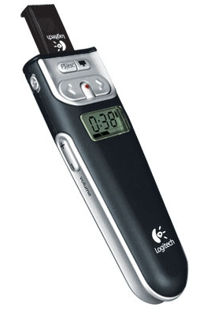
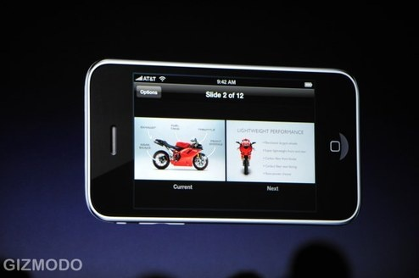
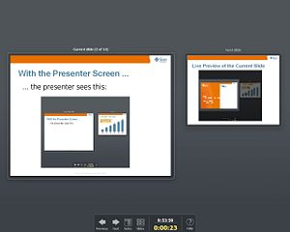
Use a timer!
Notes:
You need to pace yourself to the time. Use a timer so you know how you are doing. There are many techologies available:
Presenter screens on softtware
Clicker remotes with timers
iphone presentation control application

Slide 149
Adjusting timing
have an extra section
  in case you go too fast
  in case there's no Q&A
have sections you can cut
  in case you're running behind
Notes:
Often you get off timing, even for reasons you can't control, like the previous speaker being late. You need to be prepared to adjust your talk on the fly to fix the timing.

Slide 150
7. Panic
Notes:
Panicking in front of the audience is a guarenteed way to lose them and their opinion of you.
Stuff goes wrong while presenting. You need to keep your cool.

Slide 151

Notes:
Keeping your cool is the biggest thing.

Slide 152
Presenting
Exercises
Notes:
Good presentations require audience interaction, not just slides.

Slide 153
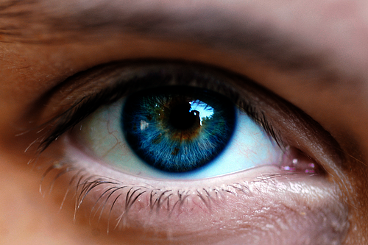
Speaker Exercise
Eye Contact
Notes:
Most basic audience interation is eye contact. Make fleeting eye contact with several members of the audience. Don't just look down.
On the other hand, don't stare at one audience member all the time. You look like a stalker.

Slide 154
Eye Contact
DO:
glance around the room
make brief eye contact
make eye contact during Q&A
DON'T:
stare at any one person

Slide 155
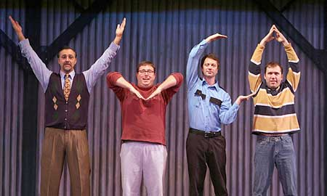
Speaker Exercise
Body Language
Notes:
Now that you've gotten out from behind the podium, be aware of your body language.
Use “open” body language, not “closed”.
Check yourself for various bad habit body language:
Covering genitals
Flapping hands
Hands in pockets
Turning away from the audience

Slide 156
Body Language Dos
have an “open” stance
stand straight to the audience
gesture
move around

Slide 157
Body Language Don'ts
hunch over
turn your back to the audience
put your hands in your pockets
“flap”
sit down
  ( unless you're giving a demo )

Slide 158
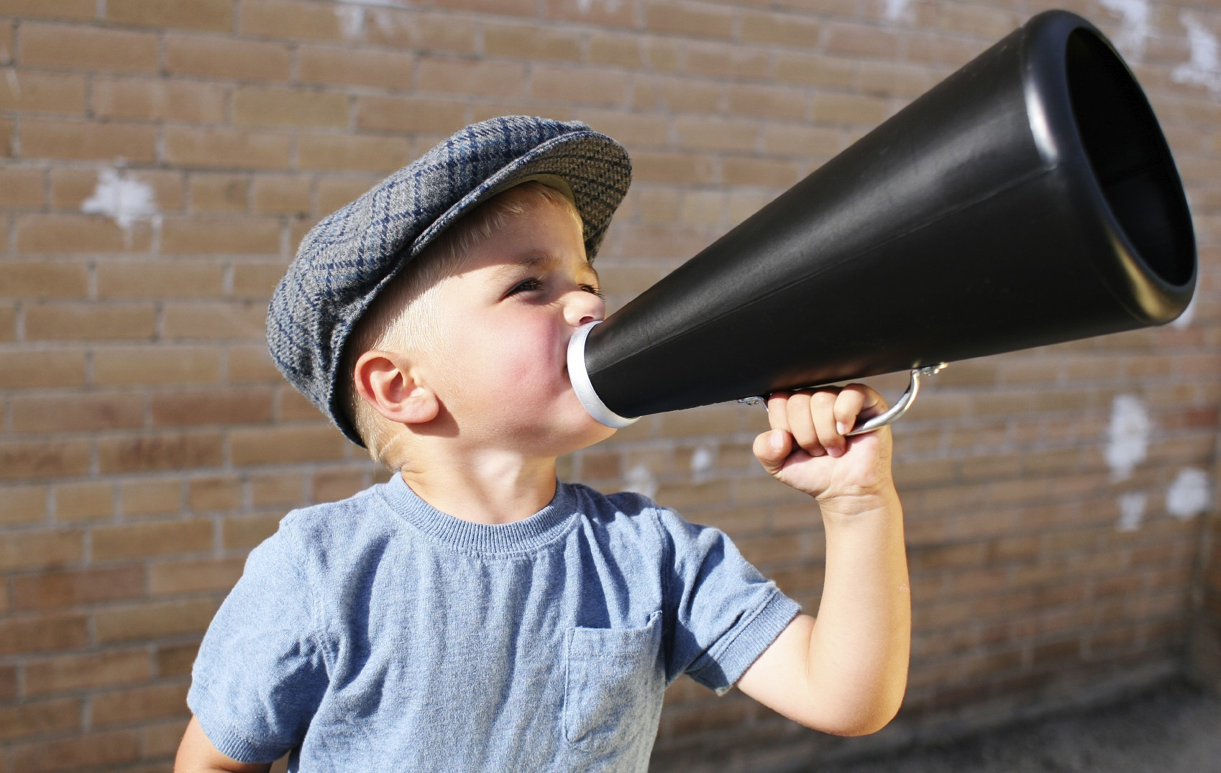
Exercise: Projection
Notes:
Now that the audience can see you, they need to hear you as well. Even if you have a mic, it's important that you be able to make your voice carry.
There's a kid in this picture because we are actually born knowing how to project – just listen to a crying baby! But we get trained out of it by our parents.

Slide 159
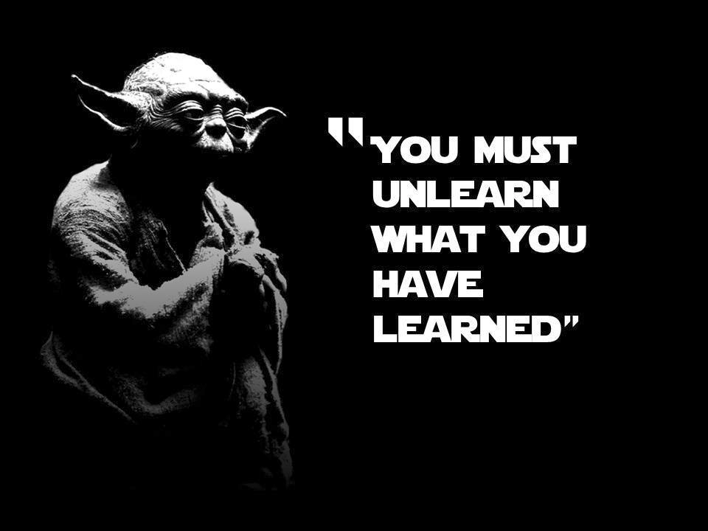
Exercise: Projection
The Yoda character is a trademark of LucasFilm. Used here as parody.
Notes:
So we need to learn to shout like a kid again.
This goes into the projection exercise.

Slide 160
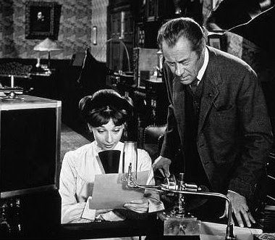
Exercise: Diction
The My Fair Lady film adaptation is copyright 1964 Warner Bros. Used here as parody.
Notes:
Once you're loud enough for the audience to hear you, they need to be able to understand you. English is a difficult language to pronounce clearly due to its hodgepodge of phonemes, so most people need to practice speaking clearly – doubly so if English is not your native language.

Slide 161
Exercise: Diction
The lips, the teeth,
the tip of the tongue,
the tip of the tongue,
the teeth, the lips.
Notes:
The fun thing is that practicing diction means tongue twisters! This one works the various parts of the mouth.

Slide 162
Exercise: Diction
She sells sea shells
by the seashore;
she's a sushi chef.
Notes:
An “S” sounds exercise.

Slide 163
Exercise: Diction
This black bug bled blue-black blood
while the other black bug bled blue.
Notes:
A “B” sounds exercise.

Slide 164
Exercise: Diction
The tough coughed
as he ploughed
the dough.
- Theodore Geisel
Notes:
You need to think about vowel sounds too. This excellent “OU” exercise comes form Dr. Seuss.

Slide 165
Exercise: Diction
Toy Boat
Toy Boat
Toy Boat
Toy Boat
Toy Boat
Notes:
Even simple tongue-twisters help! This one is surprisingly difficult.

Slide 166
Audience Interaction 101
Notes:
Good presentations require audience interaction, not just slides.

Slide 167
Asking for a Response
Wakes the audience up
Ask about them
  change your talk emphasis
Find out if you're boring them
  critical in after-lunch and end-of-day spots
Notes:
Make sure to ask the audience for responses.
At least ask them about who they are and level of experience with topic. Then you can adjust your presentation as you go.
A response near the beginning of the talk helps engage the audience.

Slide 168
Jokes
even better way to wake up the audience
  and relax them
research joke material
  current affairs for your audience
  common rivalries
Notes:
Jokes are really vital to wake up the audience, especially after lunch
But are the hardest thing … you have potential to derail the whole presentation if your joke is especially bad or offensive.
Don't use a joke without “testing” it. Especially on someone of another gender/culture.

Slide 169
Jokes
Hard to get right
  many jokes fall flat
  some can offend people
Beta-test your jokes
Notes:
Jokes are really vital to wake up the audience, especially after lunch
But are the hardest thing … you have potential to derail the whole presentation if your joke is especially bad or offensive.
Don't use a joke without “testing” it. Especially on someone of another gender/culture.

Slide 170
Taking Questions
Throughout talk
End of each section
End of the talk
… just let audience know!
Notes:
You can take questions any way you like, the audience just has to know what to expect.
For UGs and workshops questions throughout preso work better. For formal presentations, especially with short time, questions at end tend to work better.

Slide 171

Questions you can't answer
Notes:
You'll always get some questions you can't answer.
Don't BS.
Say “I don't know that right now, let me get back to you after the presentation.”

Slide 172
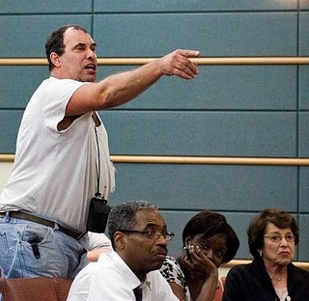
That Guy in The Third Row
Notes:
You know this guy, or you will.
He sits towards the front, asking questions, interrupting. Insisting on tangents.
Remember that your presentation is for the whole audience, not just him. Ask him to save his questions for after the talk. If he won't, rudely ignore him.

Slide 173
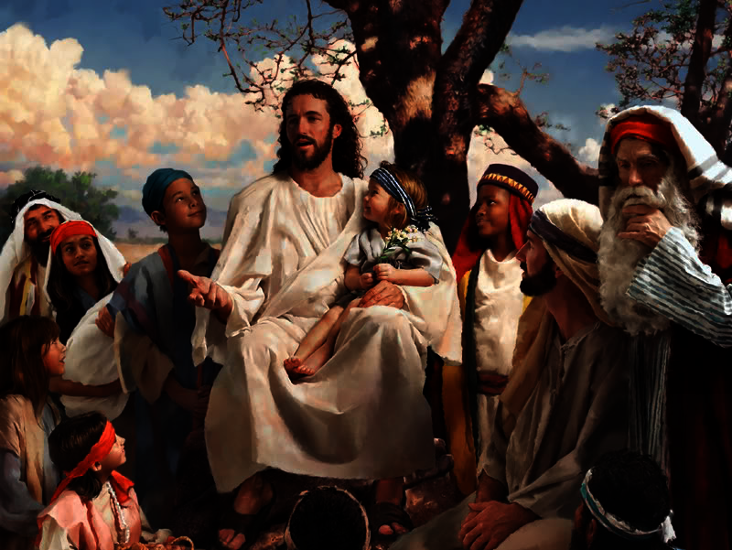
Jesus in the Audience
Notes:
This is a different kind of problem audience member.
This is the person who could give your presentation better than you, knows more than you.
Two things you can do: (1) pretend they're not there, (2) address questions to them – but not too much!

Slide 174
Audience Participation
Small-medium audiences
Choose the right person
Plan it carefully
  limited scope, timing, materials
Be ready to abort & do something else
Offer a reward for participating
Notes:
Of course, you've seen the audience participation exercises elsewhere in this talk.
The imporant thing about audience participation is to scope it correctly; you can't let it derail your talk if it doesn't work well. Be ready to drop back to something else.
Do NOT have open-ended solicitations. Always have a simple set of responses in mind, or a very carefully defined task.

Slide 175
7. When Your Demo Crashes

Slide 176
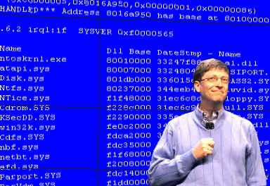
Your demo will crash
Notes:
Demos always crash. In unpredictable, unrepeatable ways. No matter how much you prepare.
You need to be mentally prepared for this.

Slide 177
3 things to count on
Conference internet will fail
… during your talk
The hardware will fail
… in unprecedented ways
The software will fail
… in unreproduceable ways
Notes:
Presentation Laptops fail in interesting ways.
Software you're demoing develops new and novel bugs at the podium which you will never see before or again.
And conference internet never ever works if you need it for your preso.

Slide 178
7 ways to avoid demo failure
Be unambitious
Test the hardware
Drill demo repeatedly
Don't expect Internet
Fake your demo
Alternative demo
Never do “cascading” demos
Notes:
Demo only stuff you know well and can repeat reliably. Do not demo the latest new features just checked in the night before.
Test your laptop, projector, etc. on the demo.
Run the demo at least 10 times.
Rewindable Virtual machines like Vagrant, VMWare, Vbox, Parallels allow you to restore your demo machine to “predemo” state.
Even better, you can fake your demo … more later.
Have an alternative demo in case one fails.
And never do demos which depend on other demos working.

Slide 179
VMs and Demos
use a VM to “rewind” demos
  Vagrant
  VMware Pro
use multiple VMs to “skip” failed demos
also great for tutorial handouts!
Notes:
Modern vm technolgy has made it much easier to rehearse and rerun demos without needing to do a lot of cleanup/setup.

Slide 180
Fake your demos
screenshots
video
shell history
recorded shell sessions (ttyrec)
interactive shell scripts (IO::prompt)
Notes:
Thanks to advancing technology there are a lot of ways to fake your demos.
First there's screenshots – mainly good if demo fails.
Video is a better way to fake a demo, especially if demo depends in internet.
For text-console demos, there are several techniques:
Bash history
Recording shell sessions using script or ttyrec and playing them back.
Interactive “fake” shell programs like Perl's IO::Prompt.

Slide 181
Part III: the Audience Outside
The Lecture Hall
Notes:
Don't forget that there are lots more people who want to see your slides, but couldn't be there in the room with you. There are several things you can do for these folks

Slide 182
the hallway track
good talk?
people will buttonhole you
take discussion into the hallway
  or to lunch, or to be pub
  give the next speaker some space
bring business cards!
Notes:
If you've given a really good talk, people will want to continue Q&A with you. Take them out into the hallway.

Slide 183

Sharing
Notes:
No, not talking about that kind of sharing.
Don't get analysis paralysis when you're deciding where to post your slides. Just stick with one of the most common options.

Slide 184
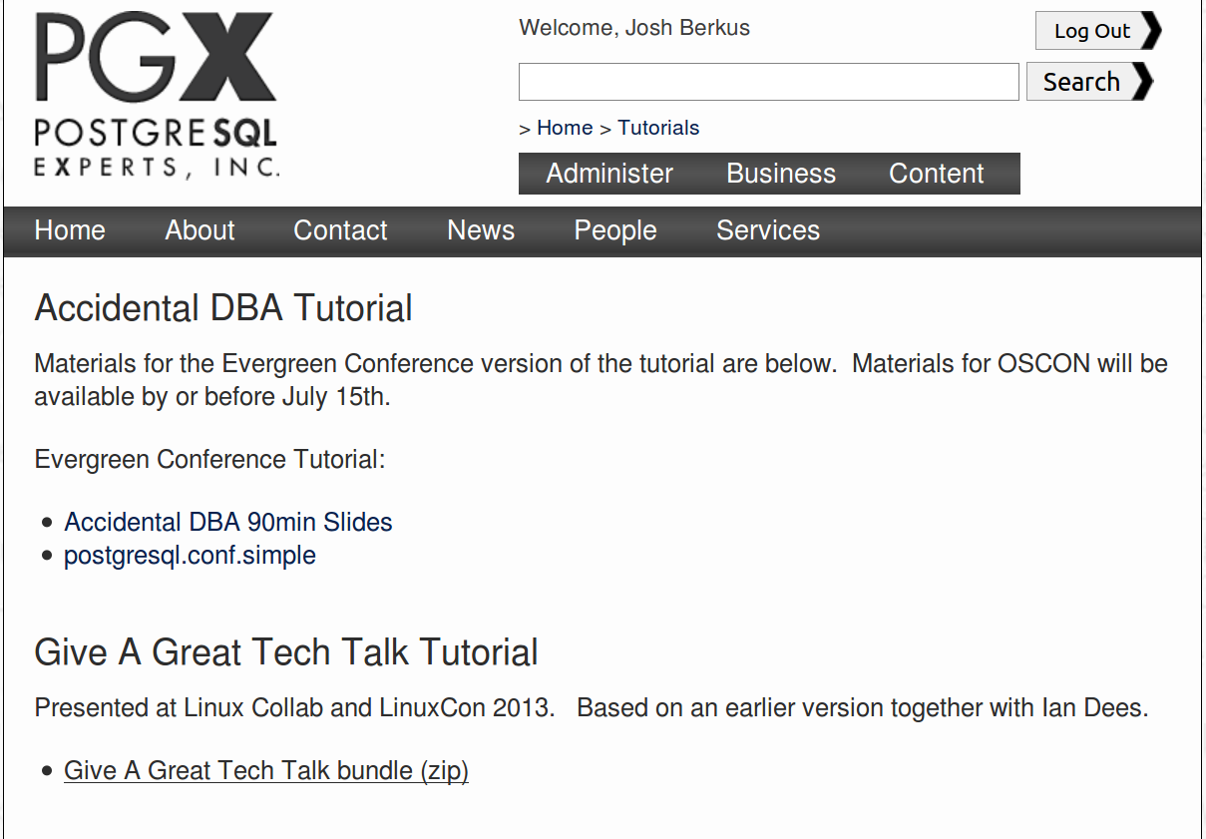
Notes:
Obviously, there's your own website.

Slide 185
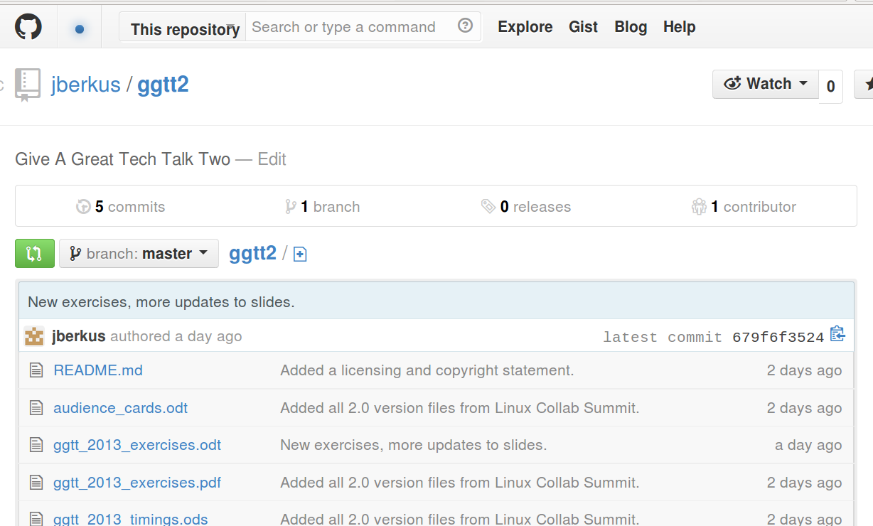
Notes:
But Github/Bitbucket and/or Slideshare are probably better. More people will find them there.

Slide 186


Slide 187
Speaker Notes
add notes for sharing
Notes:
Despite their name, speaker notes are not usually for the speaker.
If you do use notes for yourself for presenter mode, you'll want to write different notes for sharing.

Slide 188
SlideShare
http://www.slideshare.net/faqs/slidecast
Notes:
SlideShare is the granddaddy of presentation hosts. Two of its nicest features are audio sync (where you mark when the slides should advance) and embedded YouTube video (so home users can still see your demo).

Slide 189
Audio
Audio or notes; you don't need both
Notes:
When you post your presentation, you can either include the speaker notes at the bottom of the page, or you can use your software's built-in audio recording ability.

Slide 190
Video
Recorded video of talk, or
Export slides + audio to movie
Notes:
You can also just export your whole show as a movie and upload it to YouTube. Google for one of the various tutorials on getting the screen resolution just right.

Slide 191
notes on sharing
have a copyright statement on your slides
  CC is good
make sure your slides have contact info
  for attendees
  for people who download them
Notes:
some additional tips for sharing.

Slide 192
You should revise your talk every time you give it.
Yes, really.
Notes:
If you're going to give the same talk multiple times, you'll need to update it. Technology changes, audiences change, and you figure out ways to give the talk better.

Slide 193
curate your talks
github!
check talks into VCS
  advanced slide formats work better with this
update slides for each venue
update code as tech updates
Notes:
if it's a good talk, you'll give it again. Plan to track your slides, materials, notes, and keep track of the changes to them.
Otherwise it's a nightmare figuring out which version is which.

Slide 194
solicit & take feedback
audience will tell you what's needed
  in the Q&A
  after the talk
  in the conferenceware
use this to improve!
  don't be defensive
Notes:
The best source of talk improvements is audience feedback; after all they saw the talk!
This feedback is a valuable service to you, take it as a way to improve.

Slide 195
More Information
Josh Berkus
  josh@pgexperts.com
  www.pgexperts.com
  @fuzzychef
talk:
  github.com/jberkus/ggtt2
  SlideShare.net/pgexperts
This presentation copyright 2013 Josh Berkus and 2010 Josh Berkus & Ian Dees, licensed for distribution under the Creative Commons Share-Alike License, except for photos, most of which were stolen from other people's websites via images.google.com, and Sun presentations, the copyright on which is available at low, low rates.
Notes:
And here's an example of some of those sharing tips. Hope you enjoyed it!

