Slide 1
5. Audience Interaction 101
Notes:
Good presentations require audience interaction, not just slides.

Slide 2
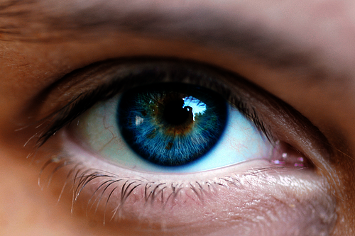
Eye Contact
Notes:
Most basic audience interation is eye contact. Make fleeting eye contact with several members of the audience. Don't just look down.
On the other hand, don't stare at one audience member all the time. You look like a stalker.

Slide 3
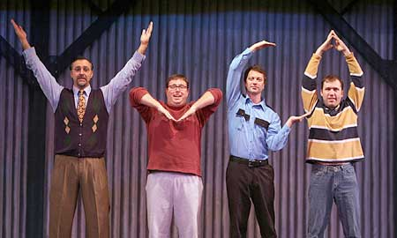
Body Language
Notes:
Now that you've gotten out from behind the podium, be aware of your body language.
Use “open” body language, not “closed”.
Check yourself for various bad habit body language:
Covering genitals
Flapping hands
Hands in pockets
Turning away from the audience

Slide 4
Asking for a Response
Wakes the audience up
Ask about them
  change your talk emphasis
Find out if you're boring them
  critical in after-lunch and end-of-day spots
Notes:
Make sure to ask the audience for responses.
At least ask them about who they are and level of experience with topic. Then you can adjust your presentation as you go.
A response near the beginning of the talk helps engage the audience.

Slide 5
Jokes
Even better way to wake up the audience
  and relax them
Hard to get right
  many jokes fall flat
  some can offend people
Investigate current affairs for your audience
Beta-test your jokes
Notes:
Jokes are really vital to wake up the audience, especially after lunch
But are the hardest thing … you have potential to derail the whole presentation if your joke is especially bad or offensive.
Don't use a joke without “testing” it. Especially on someone of another gender/culture.

Slide 6
Taking Questions
Throughout talk
End of each section
End of the talk
… just let audience know!
Notes:
You can take questions any way you like, the audience just has to know what to expect.
For UGs and workshops questions throughout preso work better. For formal presentations, especially with short time, questions at end tend to work better.

Slide 7

Questions you can't answer
Notes:
You'll always get some questions you can't answer.
Don't BS.
Say “I don't know that right now, let me get back to you after the presentation.”

Slide 8
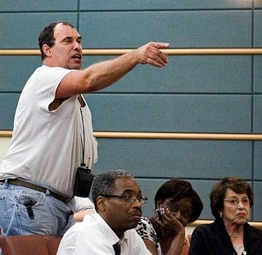
That Guy in The Third Row
Notes:
You know this guy, or you will.
He sits towards the front, asking questions, interrupting. Insisting on tangents.
Remember that your presentation is for the whole audience, not just him. Ask him to save his questions for after the talk. If he won't, rudely ignore him.

Slide 9
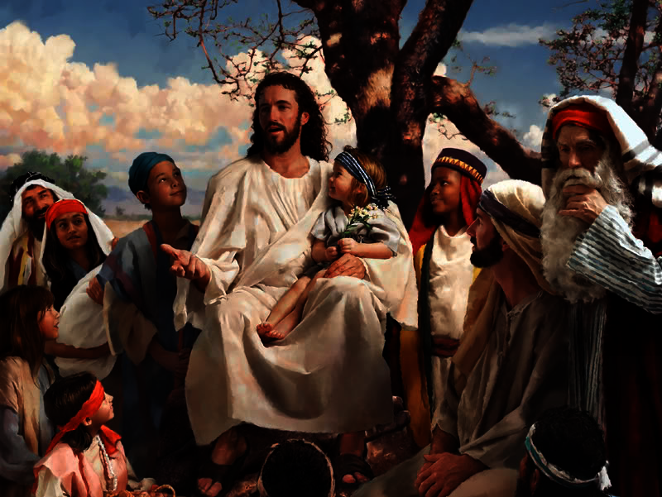
Jesus in the Audience
Notes:
This is a different kind of problem audience member.
This is the person who could give your presentation better than you, knows more than you.
Two things you can do: (1) pretend they're not there, (2) address questions to them – but not too much!

Slide 10
Audience Participation
Small-medium audiences
Choose the right person
Plan it carefully
  limited scope
  timing
  materials
Be ready to abort & do something else
Notes:
Of course, you've seen the audience participation exercises elsewhere in this talk.
The imporant thing about audience participation is to scope it correctly; you can't let it derail your talk if it doesn't work well. Be ready to drop back to something else.
Do NOT have open-ended solicitations. Always have a simple set of responses in mind, or a very carefully defined task.

