Slide 1


Documentation
Workshop
Trishna Guha
Shaun McCance
Josh Berkus
Red Hat
Flock 2017

Slide 2
program
our new docs repo
AsciiDoc/AsciiBinder crash course
building the docs
WRITE!
prizes and re-cap

Slide 3
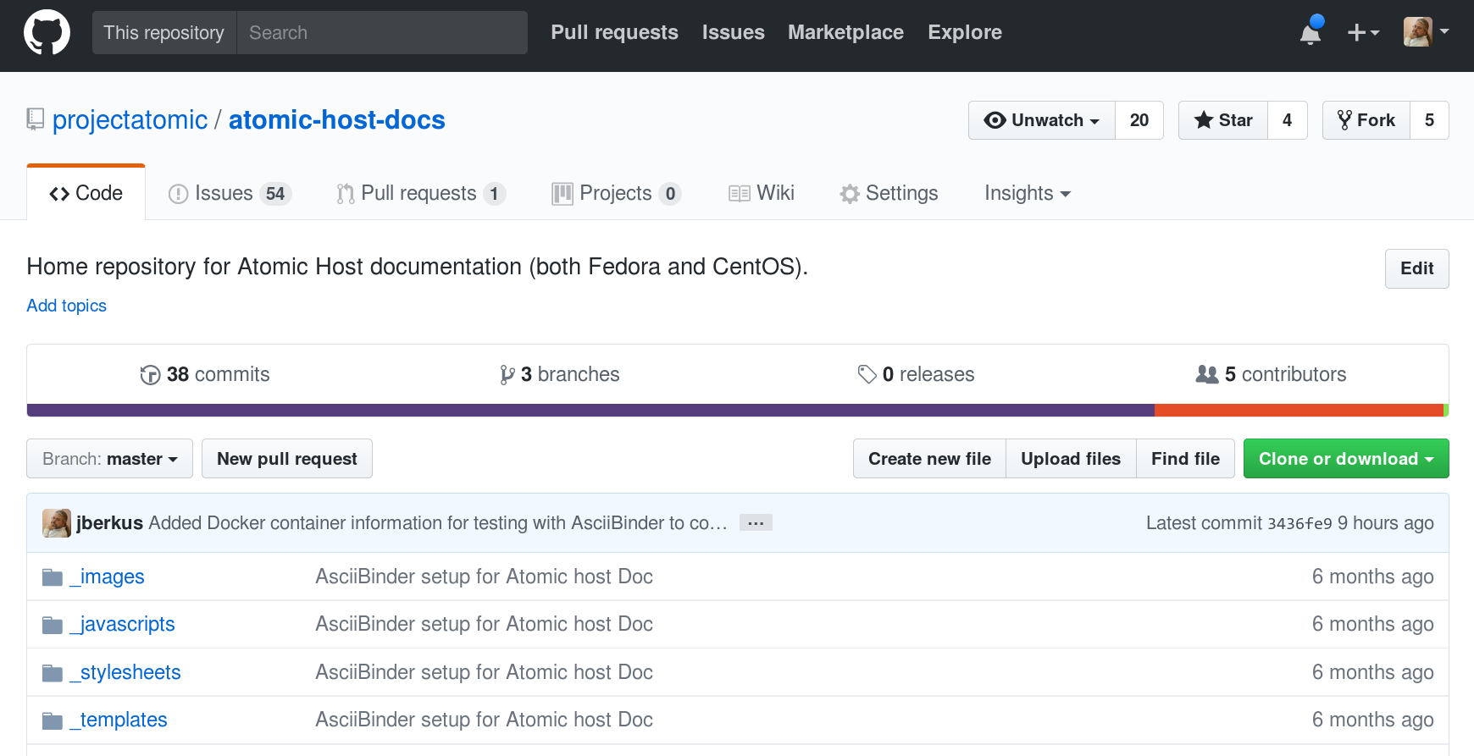
new docs repo

Slide 4
new docs repo
https://github.com/projectatomic
/atomic-host-docs
fork now, please

Slide 5
new docs repo
docs.projectatomic.io
built with AsciiBinder
hosted on OpenShift online
Administrator Guide
(developer guide later)

Slide 6




CI/CDocs
PR
source
OSBS
image
Tests
pod

Slide 8
AsciiDoc Format

Slide 9
AsciiBinder
Two ways to install:
Natively (package + gems)
As container

Slide 10
AB Container
docker load -i asciibinder.image
cd /path/to/repo
docker run -it --rm -v `pwd`:/docs:z projectatomic/ascii_binder asciibinder build
docker run -it --rm -v `pwd`:/docs:z projectatomic/ascii_binder asciibinder watch

Slide 11
workshop
go to atomic-host-docs/issues
filter on “flock”
pick an issue (which is a doc page)
start documenting that issue
swap with partner for review
submit PR

Slide 12

prizes!

Slide 13
prizes!
most/longest PRs submitted
original doc composition
outside contributor

Slide 14
doc time!

