Slide 1
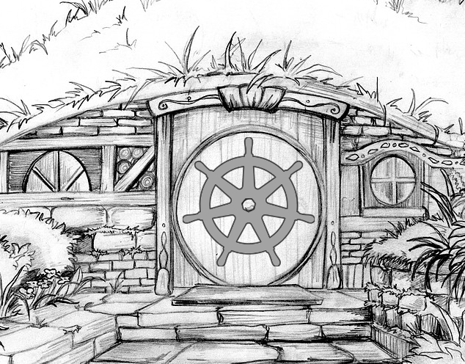
Kubernetes 1.11

Slide 2
Schedule
RC1: Today!
Final Release: June 26th (hopefully)
1.11.1
likely 2 weeks later, they way things have been going.

Slide 3
Features
KubeDNS → CoreDNS
Dynamic Kubelet Config
More CRD Features
Priority & Preemption
More Windows Features
IPVS Load-balancing

Slide 4
KubeDNS → CoreDNS
Simpler/Faster
Single go binary
Better maintained (CNCF project)
Not automatically installed in upgraded clusters

Slide 5
Dynamic Kubelet Config
Kubelet: the kubernetes daemon on each system.
Old Way: change kubelet settings by changing startup flags and restart.
New Way: change via configuration file and/or ConfigMap, make many changes without restarting.

Slide 6
More CRD Goodness
CRD: Custom Resource Definition, aka “Kubernetes-native application”.
Monitoring endpoint for CRDs (status).
CRD integration with autoscaling
CRD versions: track upgrades of CRDs

Slide 7
Priority & Premption
Ability to say “you must run this pod now, even if it means evicting running pods from nodes to do it.”
Run urgent cronjobs
Run debuggers during overload
Bump overloaded services for better, replacement services

Slide 8
More Windows Plumbing
We get closer every day to “windows-native” Kubernetes (currently in alpha).

Slide 9
IPVS load-balancing
Use in-kernel networking tools for load-balancing kubernetes services
  (requires recent kernel)
Faster, lighter
Allows self-hosting

Slide 10
Try out RC1 Soon
Install via Kubeadm
  https://kubernetes.io/docs/setup/independent/
  create-cluster-kubeadm/
Try out the new features
File bugs!

Slide 11
Upcoming
Kubernetes Anniversary July 18th, sponsored party!
  Special guests!
  Kubernetes pub quiz!
  Beer!
Late July: Nomad + Basics of Helm
Wanna speak?
  Form link from
  https://www.meetup.com/Cloud-Native-PDX/

Slide 12
OSCON
July 16-19 at the OCC
Many cloud-native topics
25% discount code: Josh25
Thank you to gift sponsor O’Reilly!

Slide 13
KubeCon Seattle
CfP now open!
Ends August 12
https://events.linuxfoundation.org/events/
kubecon-cloudnativecon-north-america-2018/program/call-for-proposals-cfp/

Slide 14
Contact & Copyright
Josh Berkus
  @fuzzychef
  jberkus@redhat.com
Licensed Creative Commons Share-Alike 4.0

