Slide 1
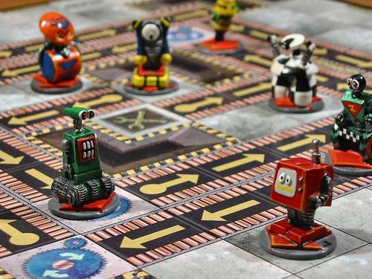

Bots Not Cattle
Josh Berkus
Red Hat
DevOpsDays PDX
August 2016

Slide 2
third wave of automation?
software packages
configuration management
container orchestration?

Slide 3
third wave of automation?
software packages
a. configuration management
b. container orchestration
???

Slide 4
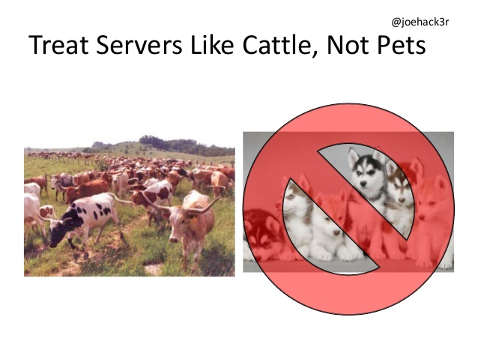

Slide 5
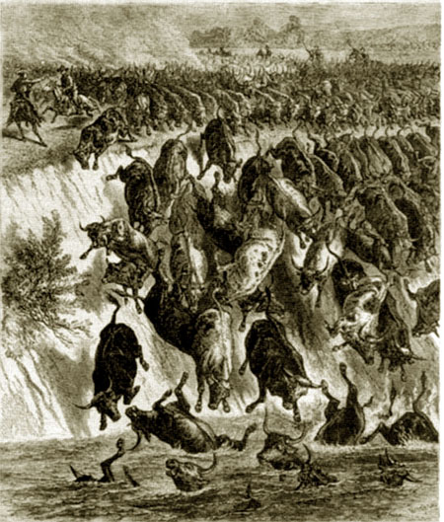
the problem with cattle
dumb
move only in one direction
require (smart) central management

Slide 6
central management limits
infrastructure scale
people scale (dev/ops split)
communications lag
application event response

Slide 7
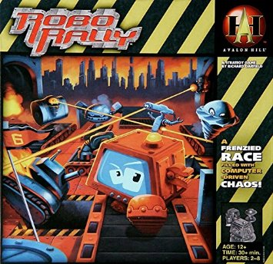
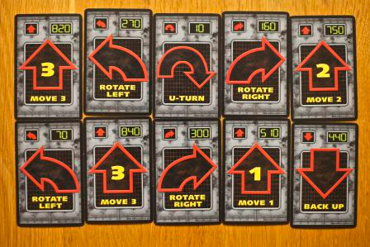

Slide 8
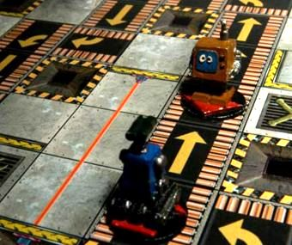
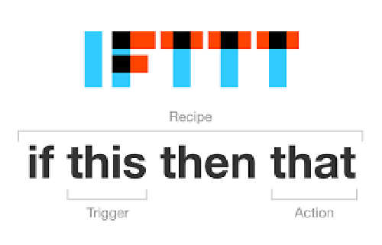

Slide 9

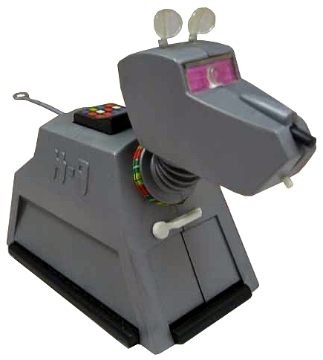
intelligent “bots”
capable of reacting to
deployment, configuration,
and availablity events
programmed to "do the right thing" in each case

Slide 10
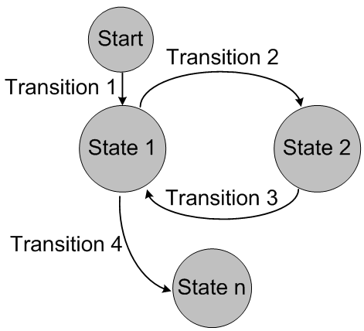
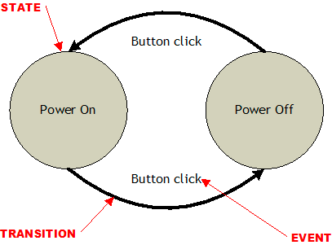
state machines

Slide 11
state machines
simpler, testable logic
avoid unhandled events
much simpler scheduling

Slide 12
new bot rules
bots initialize themselves
bots know their own state
bots share their state
bots change their state in response to events

Slide 13
new bot rules
self-configuration
local state store
distributed configuration
event-driven response loop

Slide 14
new bot rules
sophisticated init code
local daemon which maintains state
write state to etcd
watch etcd for changes

Slide 15
patroni: postgres automation
State 0
Cluster 1A
Startup
Master Found
State 1b
Transition
Cluster 1A
Replica
Start Replication

Slide 16
patroni: postgres automation
State 1a
Cluster 1A
Master
Transition
Leader Election
State 1b
Cluster 1A
Replica
Failed
Master Check

Slide 17
bot-ish platforms
Postgres: patroni, manatee, flynn.io
Chef Habitat
Nomad, Kubernetes custom schedulers
Mesos Frameworks

Slide 18
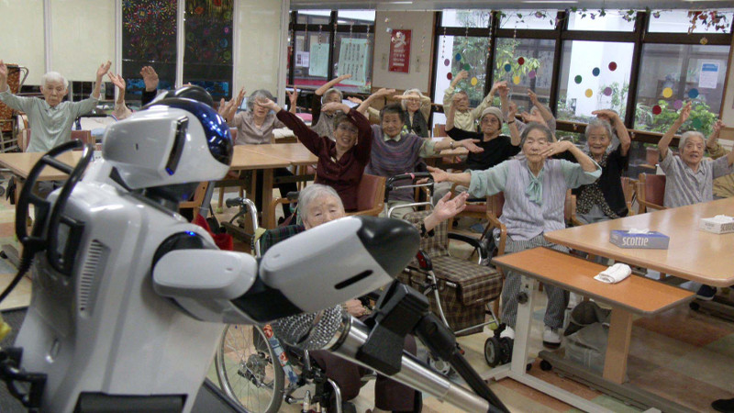
boticizing
How can it initialize and
self-configure?
How can it store state about its part of the infrastructure?
Use a DCS.
Rewrite management as a set of state transitions.

Slide 19
boticizing a web app: init
initialize with DCS connection & node name
query DCS for DB connection & CDN
pull new code from git
launch
update DCS with state

Slide 20

bot problems
lagginess:
event watch, gossip
race conditions: DCS locking
resource usage:
resource events?
frameworks for writing state machines?

Slide 21
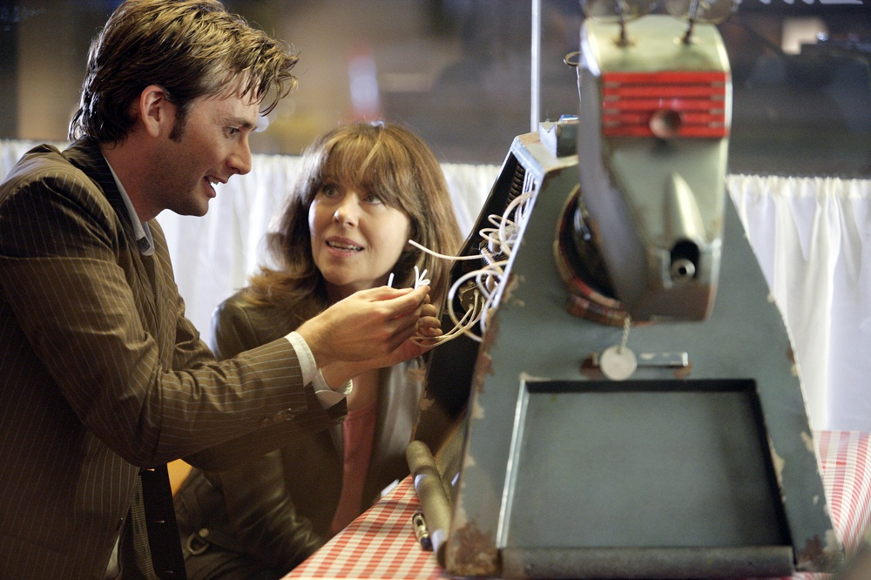
let's build some bots!
Josh Berkus
Red Hat
DevOpsDays PDX
August 2016

