Slide 1

<How>
<I_Learned>
<To_Stop>
<Worrying>
<and_Love>
<Failover>

Slide 2

discoverd

Slide 3
discoverd

Slide 4
discoverd

Slide 5
discoverd

Slide 6
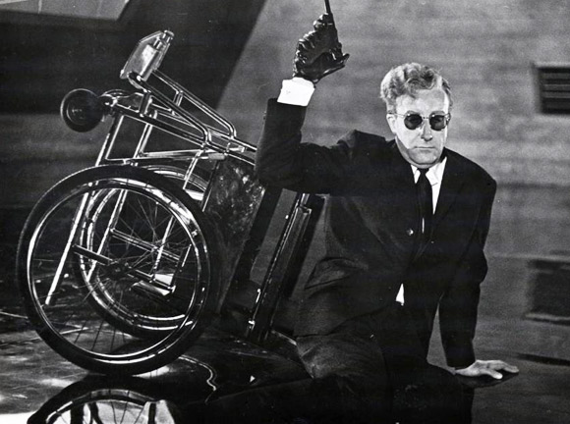
1. Noticing
Failure

Slide 7
2. Failing Over
Database
1. Noticing
Failure

Slide 8
3. Shoot the
Old Node
2. Failing Over
Database
1. Noticing
Failure

Slide 9



