Slide 1
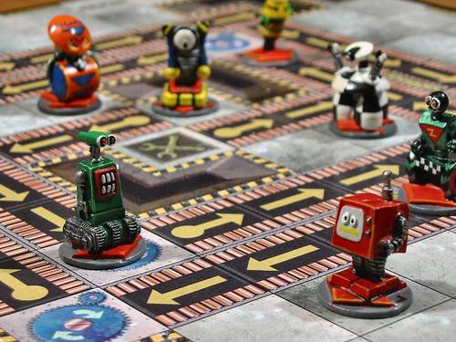

Bots Not Cattle
Josh Berkus
Red Hat
Automacon PDX
September 2016

Slide 2


Slide 3
HA Postgres

Slide 4
third wave of automation?
software packages & BASH
configuration management
???

Slide 5
third wave of automation?
software packages & BASH
configuration management
container orchestration?

Slide 6
third wave of automation?
software packages & BASH
a. configuration management
b. container orchestration

Slide 7
third wave of automation?
software packages & BASH
a. configuration management
b. container orchestration
???

Slide 8
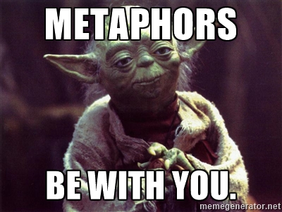

Slide 9
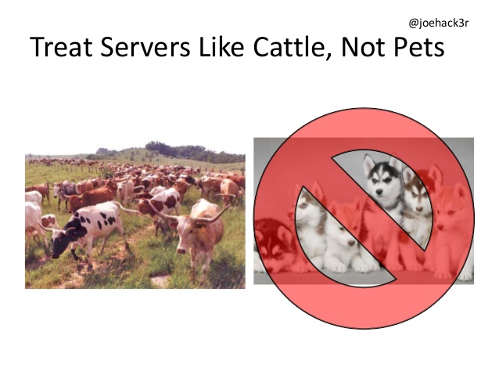

Slide 10
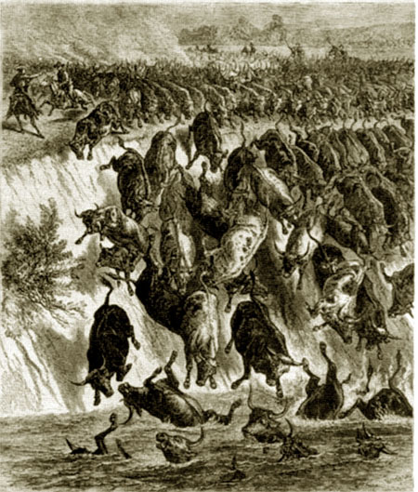
the problem with cattle
dumb
move only in one direction
require (smart) central management

Slide 11
central management limits
infrastructure scale
people scale (dev/ops split)
communications lag
application event response

Slide 12
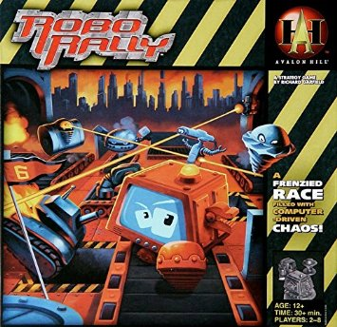

Slide 13
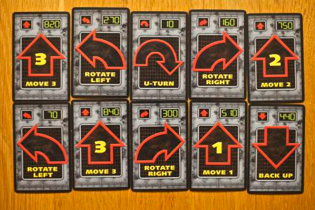

Slide 14
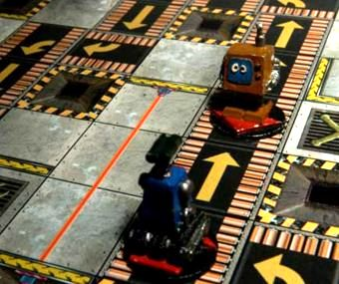

Slide 15
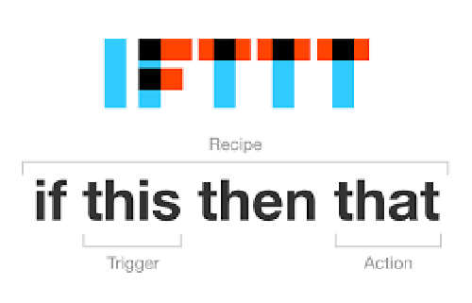

Slide 16

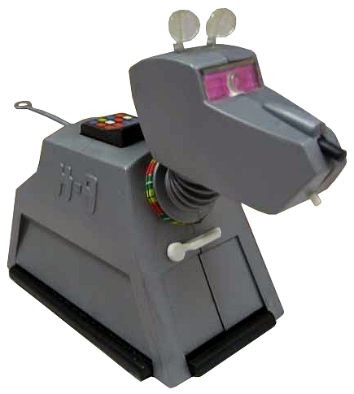
intelligent “bots”
capable of reacting to
deployment, configuration,
and availability events
programmed to "do the right thing" in each case

Slide 17
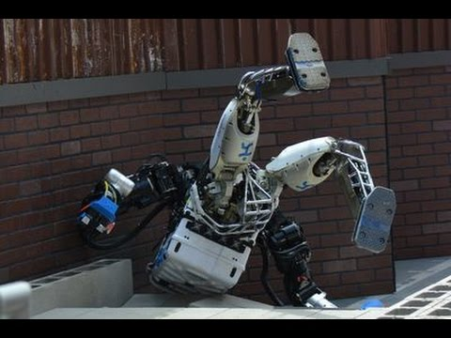

Slide 18
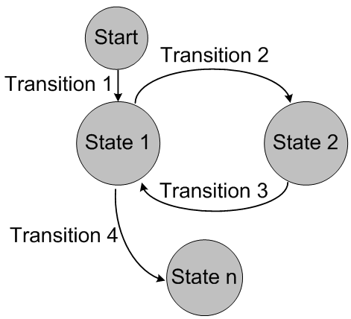
state machines

Slide 19
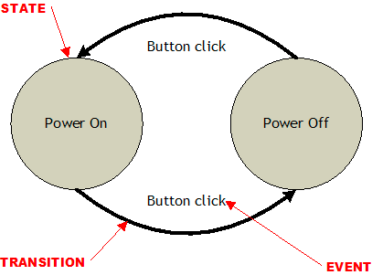
state machines

Slide 20
state machines
simpler, testable logic
avoid unhandled events
much simpler scheduling

Slide 21
patroni: postgres automation
State 0
Cluster 1A
Startup
Master Found
State 1b
Transition
Cluster 1A
Replica
Start Replication

Slide 22
State 0
Cluster 1A
Startup

Slide 23
State 0
State 1a
Cluster 1A
Startup
Transition
Cluster 1A
Master
Initialize
Failed
Master Check

Slide 24
State 0
Cluster 1A
Startup
Master Found
State 1b
Transition
Cluster 1A
Replica
Start Replication

Slide 25
Cluster 1A
Replica
Master Check
Passed

Slide 26
State 1a
Cluster 1A
Master
Transition
Leader Election
State 1b
Cluster 1A
Replica
Failed
Master Check

Slide 27
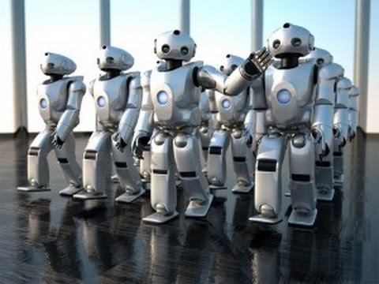
bots
automate the application, not the system

Slide 28
new bot rules
bots initialize themselves
bots know their own state
bots share their state
bots change their state in response to events

Slide 29
new bot rules
self-configuration
local state store
distributed configuration
event-driven response loop

Slide 30
new bot rules
sophisticated init code
local daemon which maintains state
write state to etcd
watch etcd for changes

Slide 31
bot-ish platforms
Postgres: patroni, manatee, flynn.io
Chef Habitat
Kubernetes custom schedulers
Mesos Frameworks

Slide 32
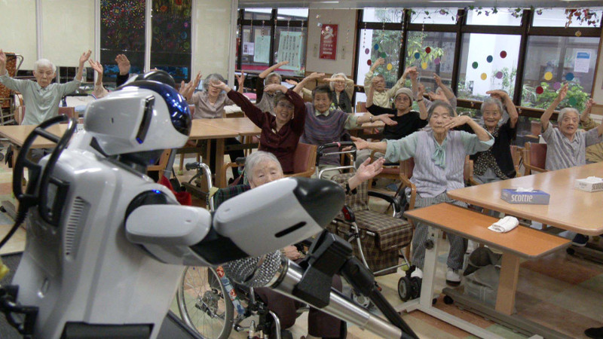
boticizing
How can it initialize and
self-configure?
How can it store state about its part of the infrastructure?
Use a DCS to share state.
Rewrite management as a set of state transitions.

Slide 33
boticizing a web app: init
initialize with DCS connection & node name
query DCS for DB connection & CDN
pull new code from git
launch
update DCS with state

Slide 34

bot problems
lagginess:
event watch, gossip
race conditions: DCS locking
resource usage:
resource events?
frameworks for writing state machines?

Slide 35
devs need to automate

Slide 36
devs need to automate
¯\_(ツ)_/¯
we're all DevOps now

Slide 37
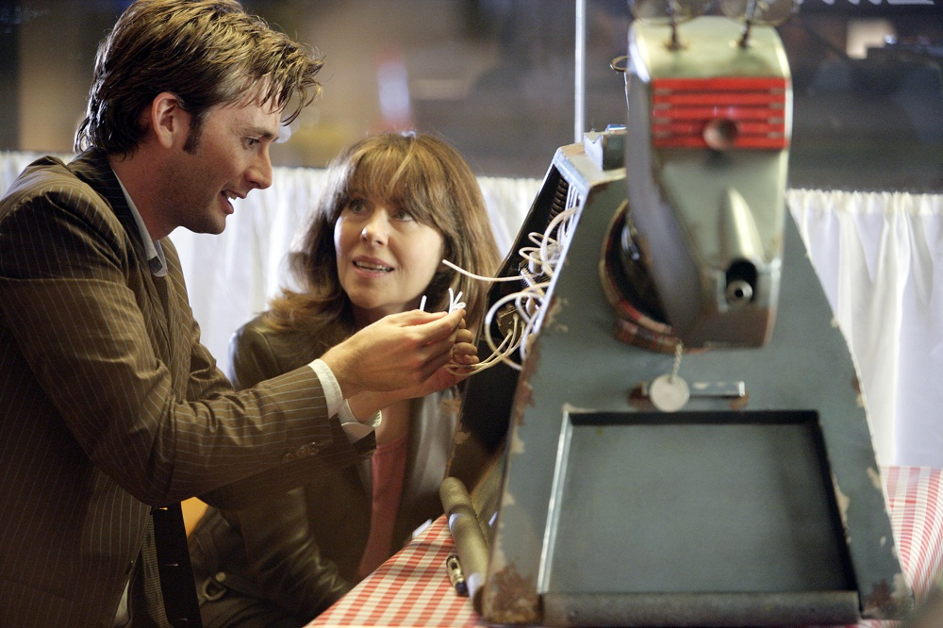
let's build some bots!
Josh Berkus
Red Hat
Automacon PDX
Sept. 2016

Slide 38

let's build some bots!
Contact
jberkus@redhat.com
@fuzzychef
www.projectatomic.io
Events
Cloud Native PDX Meetup
PyDX Oct. 1
KubeCon Nov. 7, Seattle

Slide 39
the fine print
This presentation is copyright 2016 Josh Berkus, and is released under the Creative Commons Share-Alike v3 license, excepting the following images, most used as parody, which are not covered by that license:
Images of Dr. Who and K-9 are property of the BBC
Images of RoboRally and the RoboRally game are copyright Avalon Hill
The Sorceror's Apprentice and Yoda are copyright Disney, Inc.
The Slonik logo is property of the PostgreSQL Community Associaton of Canada
The IFTTT and Red Hat logos are property of those companies
The Cattle, Not Pets slide is courtesy @joehack3r

