Slide 1


PostgreSQL replication a hands-on tutorial
Josh Berkus
PostgreSQL Experts, Inc.
Linuxconf.AU 2014

Slide 2
WiFi
Instructions here

Slide 3
covered
basic asynchronous
configuration
tools and monitoring
file-based
failover & fail-back
synchronous
cascading
query cancel/lag

Slide 4
plus 9.4 material
replication slots
logical decoding

Slide 5
not covered
DR planning
3rd-party tools
application design
non-binary replication
Point In Time Recovery

Slide 6
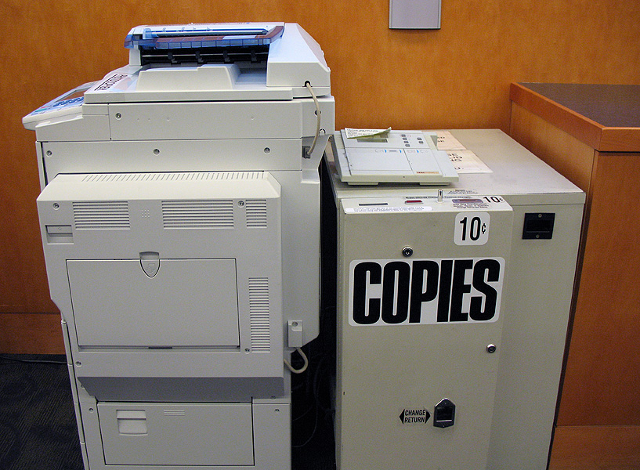
what is binary replication?

Slide 7
vagrant up or docker run now

Slide 8
replication terms
master / slave
master / standby
master / replica
primary / secondary
primary / replica

Slide 9
replication mechanisms
statement
row
binary

Slide 10
replication mechanisms
queries
rows
data pages

Slide 11

statement replication
run statements
DB
run statements
DB
Load Balancer
run statements
DB

Slide 12
statement replication
pgPool2 replication
GridSQL
C-JDBC
Continuent
DBI::Multiplex
original MySQL replication

Slide 13
row-based replication
run statements
Master
Replica
Replica

Slide 14
row-based replication
Slony-I
Londiste
Bucardo
new MySQL replication
upcoming 9.4 replication

Slide 15
binary replication
run statements
Master
Replica
Replica

Slide 16
DRBD for PostgreSQL
(only much much faster)

Slide 17
also called ...
streaming replication
  refers to the ability to stream new data pages over a network connection
hot standby
  refers to the ability of standbys to run read-only queries while in standby mode

Slide 18
advantages
low administration
low overhead on master
non-invasive
low-latency
good for large DBs

Slide 19
disadvantages
need to replicate the whole server
no writes of any kind on replicas
some things not replicated
query cancel

Slide 20

streaming asynchronous replication

Slide 21
more terms
recovery
  binary replication came from binary backup, i.e. Point In Time Recovery
snapshot, clone
  taking a moment-in-time copy of a running database server
standalone
  a lone read-write server, neither master nor replica

Slide 22

how it works

Slide 23
how it works
xlog

Slide 24
how it works
walreciever

Slide 25
how it works
walsender
walreciever

Slide 26
how it works
walsender
walreciever
walreciever

Slide 27
streaming async replication exercise

Slide 28

administering replication

Slide 29
configuration files
postgresql.conf
  same settings for master, replica
recovery.conf
  presence turns on replication
  must be in $PGDATA

Slide 30
views & functions
process list
pg_stat_replication
pg_is_in_recovery()
pg_xlog* functions

Slide 31
administration exercise

Slide 32
permissions & security
replication permission
pg_hba.conf
max_wal_senders
firewall/network

Slide 33
security exercise

Slide 34
replicating extensions
install package/libraries master
install package/libraries on each replica
install extension into database

Slide 35
replicating PostGIS
install PostGIS libraries on new replica
clone to new replica
start replication

Slide 36
upgrading PostGIS
upgrade PostGIS libraries on master
upgrade PostGIS libraries on replicas
run ALTER EXTENSION UPDATE on master

Slide 37
replication & upgrades
declare downtime
stop replication
upgrade a replica
run tests
failover
upgrade the master

Slide 38
unreplicated stuff
unlogged tables
temporary tables
LISTEN/NOTIFY
  (might get fixed)

Slide 39

cloning

Slide 40
cloning requirements
copy a point-in-time snapshot
or
copy all database files, plus all transaction logs between beginning and end of copy

Slide 41
downtime cloning
shut down PostgreSQL
copy all files
bring up master
bring up replica

Slide 42
FS snapshots
use ZFS, LVM or SAN
take point-in-time
snapshot
mount snapshot on replica
bring up replica

Slide 43
pg_basebackup
command-line tool for cloning
copies over $PGPORT
  no ssh needed
also copies required logs
requires streaming replication
no compression, incremental

Slide 44
pg_basebackup stream
pg_basebackup -X stream
prevents clone from falling behind
requires a 2nd connection

Slide 45
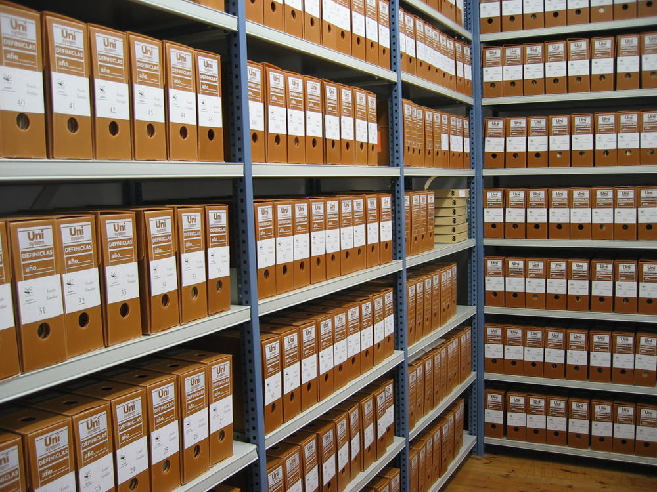
archiving replication

Slide 46
archiving replication
set up archiving
start archiving
pg_start_backup('label')
rsync all files
pg_stop_backup()
bring up replica

Slide 47
reasons to archive
replica out-of-sync
combine with PITR or DR
very erratic connection to master
need remastering before 9.3

Slide 48
falling behind
walsender
walreciever

Slide 49
falling behind
sory them
iz gone
can I haz
some old
logs plz?

Slide 50
falling behind
sory them
iz gone
:-(

Slide 51
falling behind
walsender
walreciever

Slide 52
falling behind
walsender
walreciever

Slide 53
other catchup options
wal_keep_segments
  keeps extra xlog on the master
  creates master load
replication slots
  will cover later in this tutorial

Slide 54
archiving hands-on

Slide 55
archiving tips
use a script which handles copy failure
use a shared drive
put archive on a partition
monitor for archive growth
compression

Slide 56

failover, failback
& remastering

Slide 57
more terms
failover, promotion
  making a replica into a master/standalone
failback
  returning the original master to master status
remastering
  designating a new master in a group of servers

Slide 58
replica promotion
pg_ctl promote
trigger file
rm recovery.conf & restart

Slide 59


the trouble with failback: timelines, sync
& split-brain

Slide 60
hands-on failover & failback

Slide 61
failover has 3 parts
failing over the database
failing over the connections
STONITH

Slide 62
manual failover
advantages:
  easy to set up
  fewer accidental failovers
disadvantages:
  downtime
  being woken up at 3am

Slide 63
automated failover
advantages:
  low downtime
  sleep through the night
disadvantages:
  hard to set up correctly
  need broker server
  accidentally triggered failovers

Slide 64
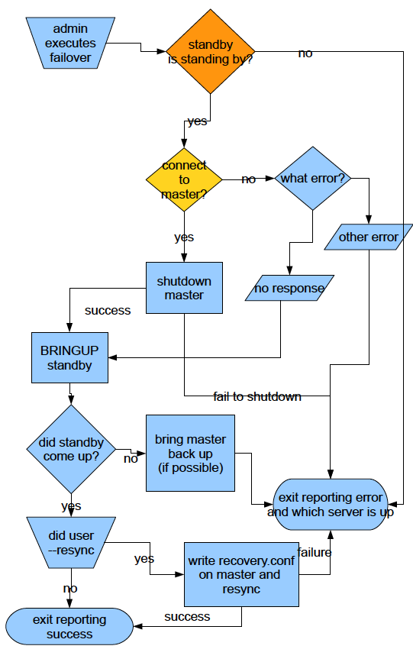
automated failover logic

Slide 65
STONITH
use corosync/VIP
use connection failover
use peer broker server

Slide 66

www.handyrep.org

Slide 67
Remastering 9.3+

Slide 68
Remastering 9.3+

Slide 69
Remastering 9.3+

Slide 70
remastering
need the replica which is “furthest ahead”
measure both receive point and replay point
need 9.3 for “streaming-only” remastering

Slide 71
replay lag
SELECT pg_xlog_location_diff(
pg_last_xlog_receive_location(),
pg_last_xlog_replay_location()
);
---------------
4294967296

Slide 72
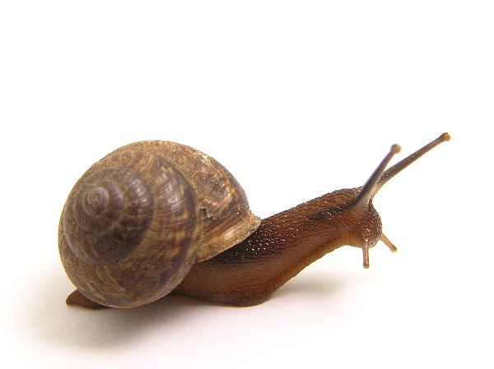
replication lag
& query cancel

Slide 73
reasons for lag
network delay
  speed of light
replica too busy
file operations block
  VACUUM
  DROP TABLE

Slide 74
replication lag issues
inconsistency (if load-balancing)
query cancel
  applications need to retry queries
catch-up speed
burden on master

Slide 75
query cancel

Slide 76

query cancel

Slide 77
query cancel
x

Slide 78
ERROR: canceling statement due to conflict with recovery
DETAIL: User query might have needed to see row versions that must be removed.

Slide 79
query cancel
max_standby_*_delay = 10min

Slide 80
max_standby_delay

Slide 81
lag vs. cancel
increase *_delay → fewer cancels, more lag
decrease *_delay → less lag, more cancles

Slide 82
lag vs. cancel
hot failover server: low *_delay
reporting server: high *_delay
load-balancing:
moderate *_delay

Slide 83
cancel-causing
DROP database;
DROP table/index;
REINDEX;
VACUUM;

Slide 84
other ways
vacuum_defer_cleanup_age
  delays all vacuuming
  set to ~~ 1000
hot_standby_feedback
  feedback from standbys to master on what's visible

Slide 85
configuring lag and cancel hands-on

Slide 86
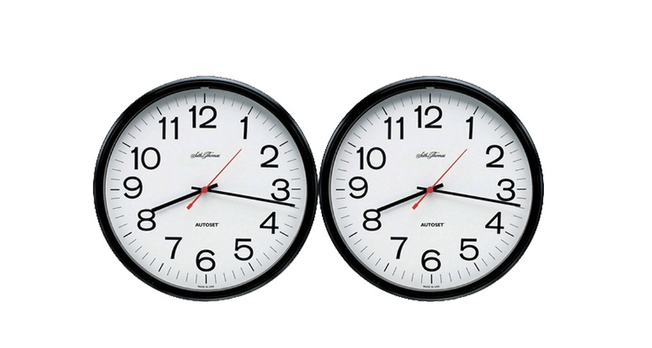
synchronous replication

Slide 87
what synch rep does
guarantee against data loss

Slide 88

how it works

Slide 89
what it doesn't
enforce global consistency
  master can be behind
  replica snapshot can be behind
help availability

Slide 90
“I would rather be down than potentially lose data.”

Slide 91
how to synch rep
pick one (or a pool) of servers to be your synch replicas
change application_name
change master's postgresql.conf
reload

Slide 92
Postgres specialities
implements only 1-redundant model
synch is per-transaction
  not per replica
  synch only important transactions

Slide 93
synchronous_commit
setting | disk | replica memory | replica disk
off | no | no | no
local | yes | no | no
remote_write | yes | yes | no
on | yes | yes | yes

Slide 94
synch rep hands-on

Slide 95
synch rep design
1 replica is synch replica
several asych replicas
load-balance to asynch only
always failover to synch replica

Slide 96
synch rep monitoring
monitor critically:
  synch rep downtime
  synch replication speed
script disabling synch rep
  if replica is down

Slide 97

cascading replication

Slide 98
how to cascade
have master & replica
clone the master or the replica
point primary_conninfo to the replica
bring up the new replica

Slide 99
why to cascade
limit connections to master
don't clone master
know which replica is ahead

Slide 100
why to cascade
Phoenix
Shanghai
walsender
walreciever
walsender
walreciever
walreciever

Slide 101
why not cascade?
complexity
cycles
increases SPOFs

Slide 102
hands-on cascading

Slide 103

load balancing

Slide 104
load-balancing?
run statements
Master
?
Replica
Replica

Slide 105
why load-balance?
get some use out of the replica
scale-out
be ready for failover
run special workloads (reporting)

Slide 106
why not load-balance?
complexity
inconsistency
limitations
additional SPOFs
not needed for performance

Slide 107
inconsistency
lag between master & replica
defeats read-then-write-then-read
django: read-then-write (fortunately)
otherwise: implement “sticky”

Slide 108
application LB
use autocommit
  django: @xact or @atomic
create “rw” and “ro” databases
route connections
  django: set up django router which directs writes & reads

Slide 109
network LB
same as application, plus:
set up virtual IPs
  using Zeus, HAproxy, Cisco, etc.
use VIPs to load-balance read traffic
use VIPs to fail over
  optional: auto-failover

Slide 110
pgPool2
connects to all servers
separates reads/writes by parsing queries
manages failover
not actually a pooler
  despite name

Slide 111
why not pgPool2?
complicated
  very hard to configure correctly
  documentation is terrible
failover logic not great
  and hard to change

Slide 112
pgBouncer
pooler & redirector
redirect read and write connections
works with manual & scripted failover

Slide 113
pgBouncer load-balancing exercise

Slide 114

replication in the cloud

Slide 115

use a shared archive
WAL-E

Slide 116
ephemeral replicas
no sync to disk
do not recover from crash
  spin up a replacement instead
turn off all logging/disk
  fsync off, bgwriter off,
  full_page_writes off

Slide 117
sharding and replication
server 1
server 2

Slide 118
sharding and replication
server 1
server 2

Slide 119
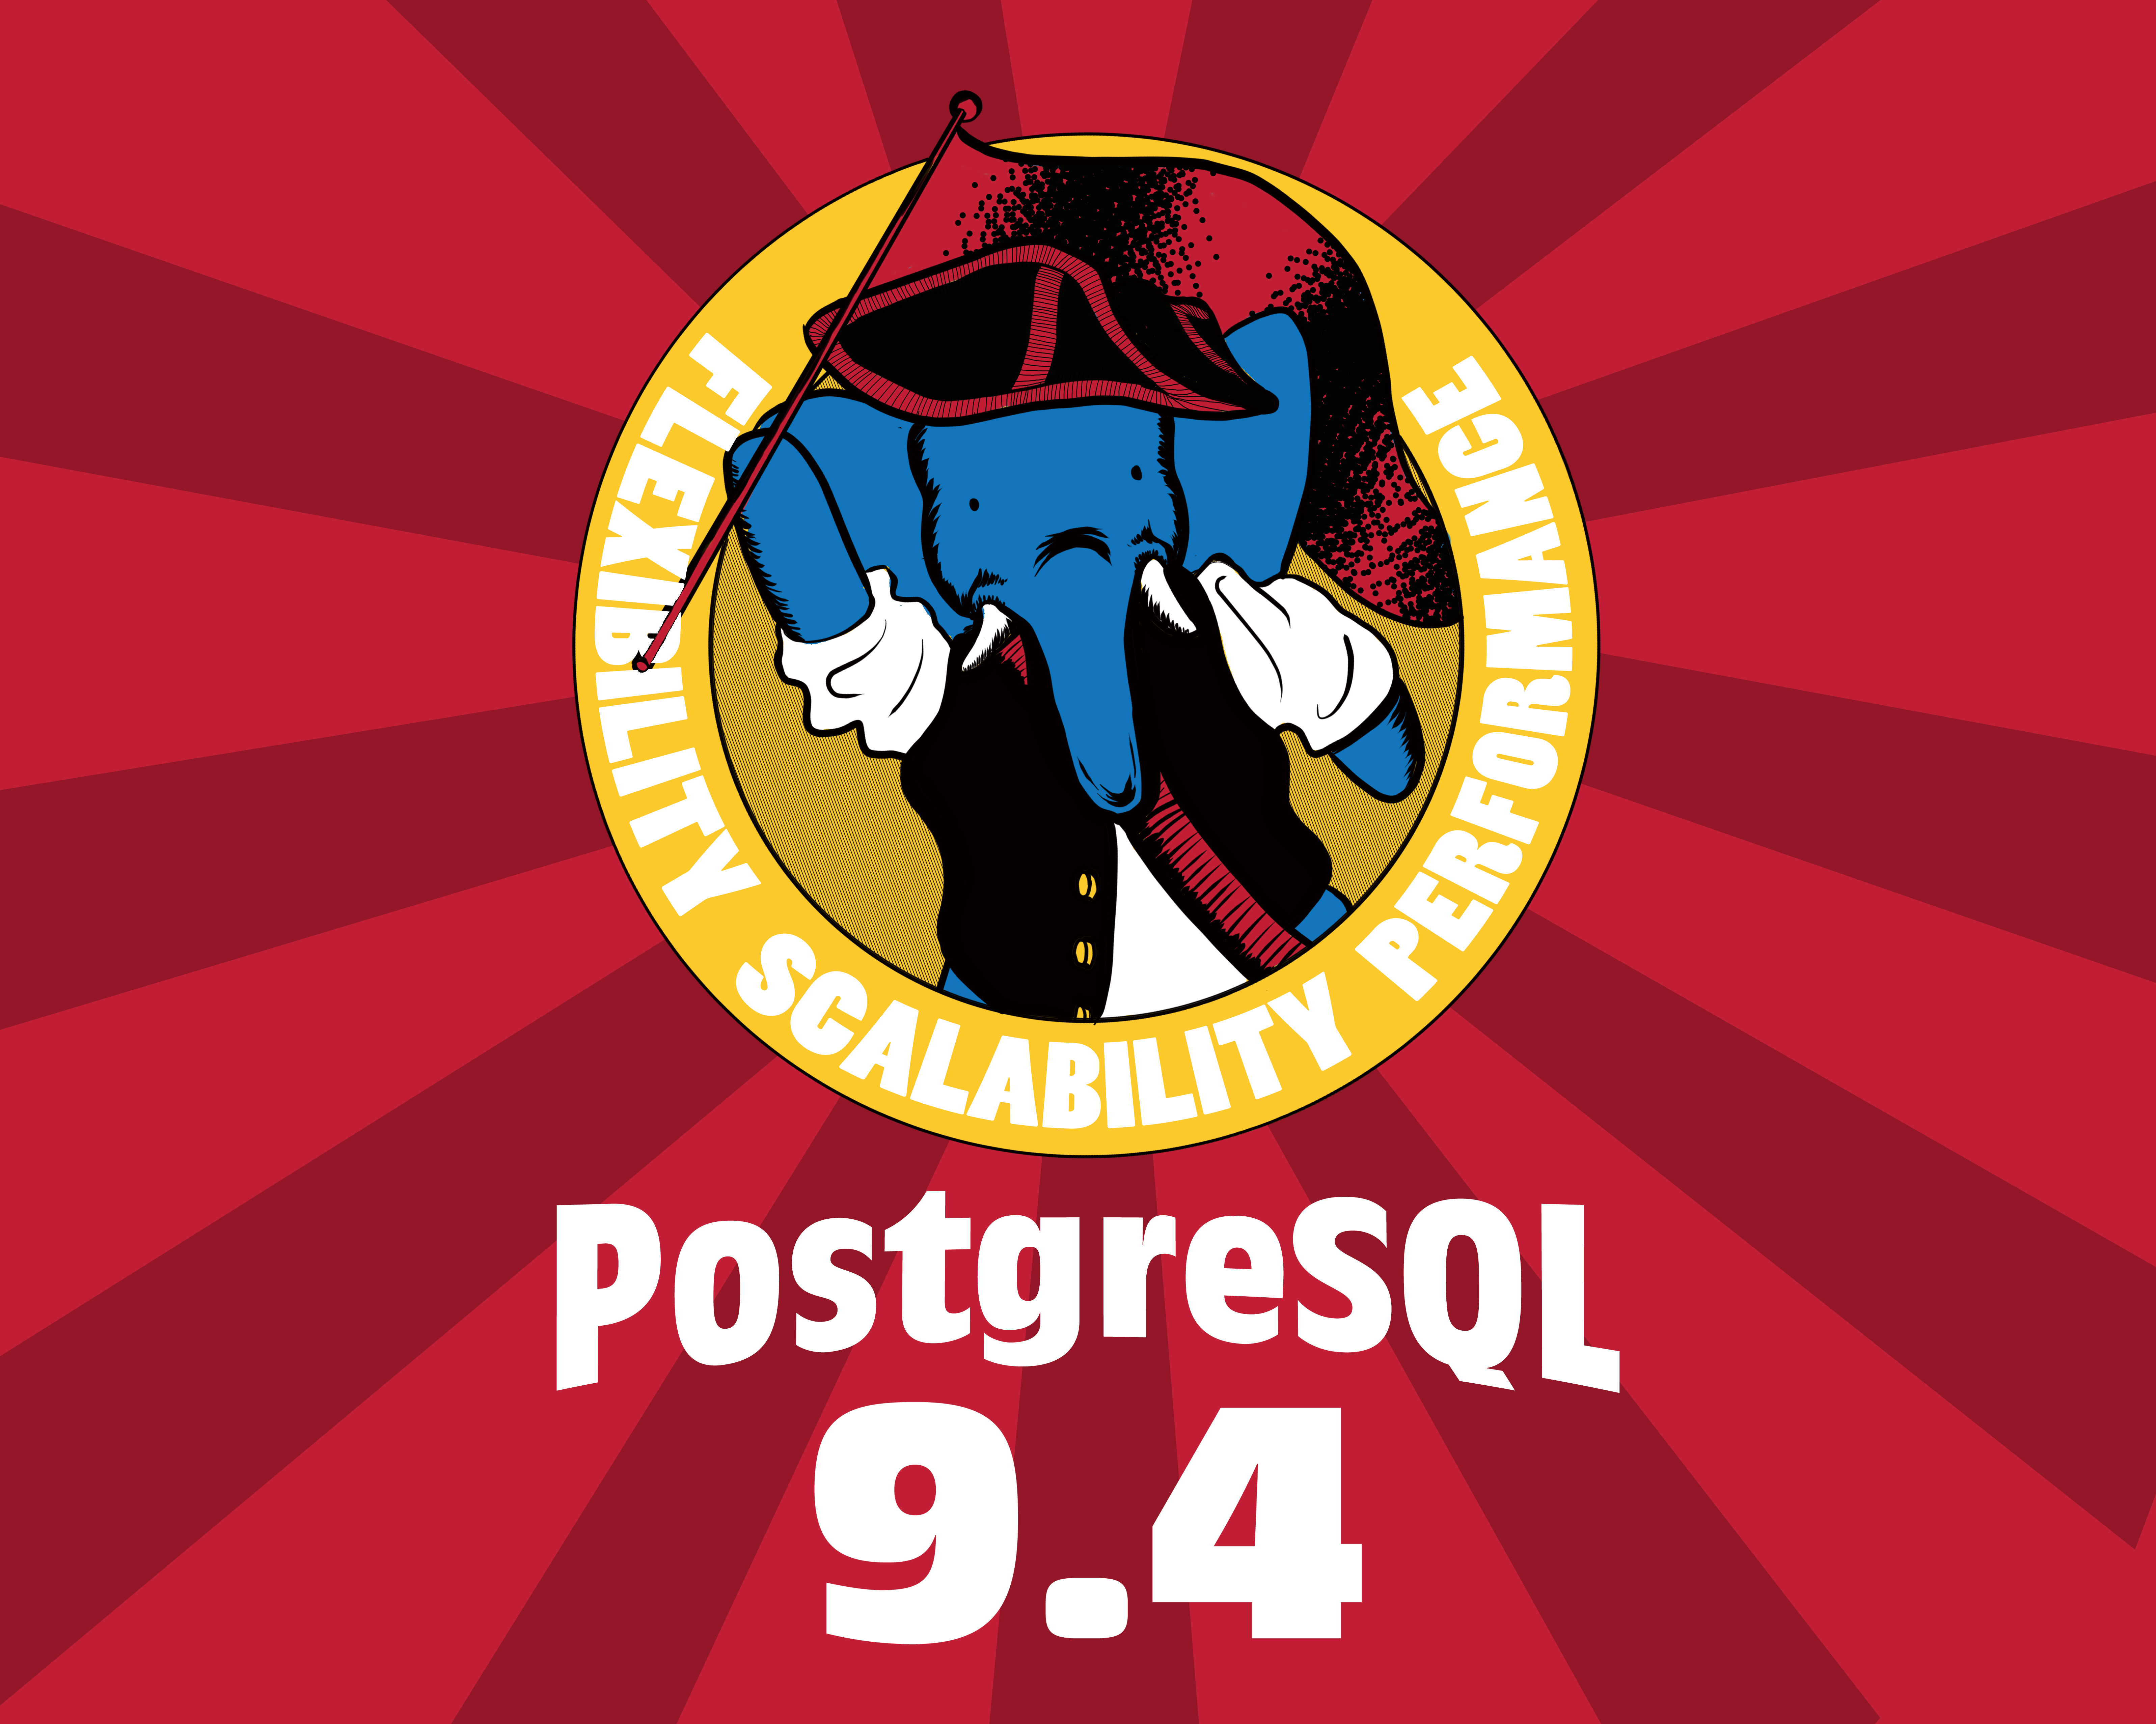
9.4 Replication

Slide 120
9.4: Replication Slots
no more wal_keep_segments
instead assign each replica a “slot”
master will keep the logs they need
  but monitor!

Slide 121
replication slots
SLOT1

Slide 122
replication slots
SLOT1

Slide 123
replication slots
SLOT1

Slide 124
9.4: Logical Decoding
convert binary stream to row-based replication
permits “bi-directional” rep.
  and other custom replication
  and cross-version replication
will require external tools

Slide 125
also 9.4: delay
recovery_min_apply_delay
  delay for applying new data, in seconds
  window for catching mistakes
  do not use with hot_standby_feedback

Slide 126
replication slots exercise

Slide 127
questions?
github.com/jberkus/pgReplicationTutorial
Josh Berkus: josh@pgexperts.com
  PGX: www.pgexperts.com
  Blog: www.databasesoup.com
Upcoming Events
  pgDaySF @ FOSS4GNA
  pgCon: Ottawa June 20th
Copyright 2014 PostgreSQL Experts Inc. Released under the Creative Commons Share-Alike 3.0 License. All images are the property of their respective owners. The WAL-E image is the property of Disney Inc. and is use here as parody.

