Slide 1


PostgreSQL replication a hands-on tutorial
Josh Berkus
PostgreSQL Experts, Inc.
Postgres Open 2015

Slide 2
covered
basic asynchronous
configuration
tools and monitoring
file-based
failover & fail-back
synchronous
cascading
query lag
load-balancing

Slide 3
not covered
performance tuning
DR planning
3rd-party tools
application design
non-binary replication
Point In Time Recovery

Slide 4
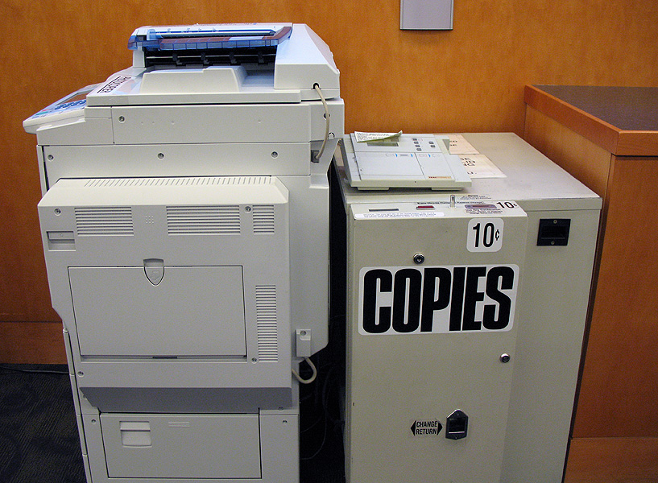
what is binary replication?

Slide 5
docker run or vagrant up now

Slide 6
replication terms
master / slave
master / standby
master / replica
primary / secondary
primary / replica

Slide 7
replication mechanisms
statement
row
binary

Slide 8
replication mechanisms
queries
rows
data pages

Slide 9

statement replication
run statements
DB
run statements
DB
Load Balancer
run statements
DB

Slide 10
statement replication
pgPool2 replication
GridSQL
C-JDBC
Continuent
DBI::Multiplex
original MySQL replication

Slide 11
row-based replication
run statements
Master
Replica
Replica

Slide 12
row-based replication
Slony-I
Londiste
Bucardo
new MySQL replication
upcoming 9.4 replication

Slide 13
binary replication
run statements
Master
Replica
Replica

Slide 14
DRBD for PostgreSQL
(only much much faster)

Slide 15
also called ...
streaming replication
  refers to the ability to stream new data pages over a network connection
hot standby
  refers to the ability of standbys to run read-only queries while in standby mode

Slide 16
advantages
low administration
low overhead on master
non-invasive
low-latency
good for large DBs

Slide 17
disadvantages
need to replicate the whole server
no writes of any kind on replicas
some things not replicated
query cancel

Slide 18

streaming asynchronous replication

Slide 19
more terms
recovery
  binary replication came from binary backup, i.e. Point In Time Recovery
snapshot, clone
  taking a moment-in-time copy of a running database server
standalone
  a lone read-write server, neither master nor replica

Slide 20

how it works

Slide 21
how it works
xlog

Slide 22
how it works
walreciever

Slide 23
how it works
walsender
walreciever

Slide 24
how it works
walsender
walreciever
walreciever

Slide 25
streaming async replication exercise

Slide 26

administering replication

Slide 27
configuration files
postgresql.conf
  same settings for master, replica
recovery.conf
  presence turns on replication
  must be in $PGDATA

Slide 28
views & functions
process list
pg_stat_replication
pg_is_in_recovery()
pg_xlog* functions

Slide 29
administration exercise

Slide 30
permissions & security
replication permission
pg_hba.conf
max_wal_senders
firewall/network

Slide 31
security exercise

Slide 32
replicating extensions
install package/libraries master
install package/libraries on each replica
install extension into database

Slide 33
example: PostGIS
install PostGIS libraries on new replica
clone to new replica
start replication

Slide 34
upgrading extensions
upgrade extension libraries on master
upgrade extension libraries on replicas
run ALTER EXTENSION UPDATE on master

Slide 35
replication & upgrades
declare downtime
stop replication
upgrade a replica
run tests
failover
upgrade the master

Slide 36
unreplicated stuff
unlogged tables
temporary tables
LISTEN/NOTIFY
  (might get fixed)

Slide 37

cloning

Slide 38
cloning requirements
copy a point-in-time snapshot
or
copy all database files, plus all transaction logs between beginning and end of copy

Slide 39
downtime cloning
shut down PostgreSQL
copy all files
bring up master
bring up replica

Slide 40
FS snapshots
use ZFS, LVM or SAN
take point-in-time
snapshot
mount snapshot on replica
bring up replica

Slide 41
pg_basebackup
command-line tool for cloning
copies over $PGPORT
  no ssh needed
also copies required logs
requires streaming replication
no compression, incremental

Slide 42
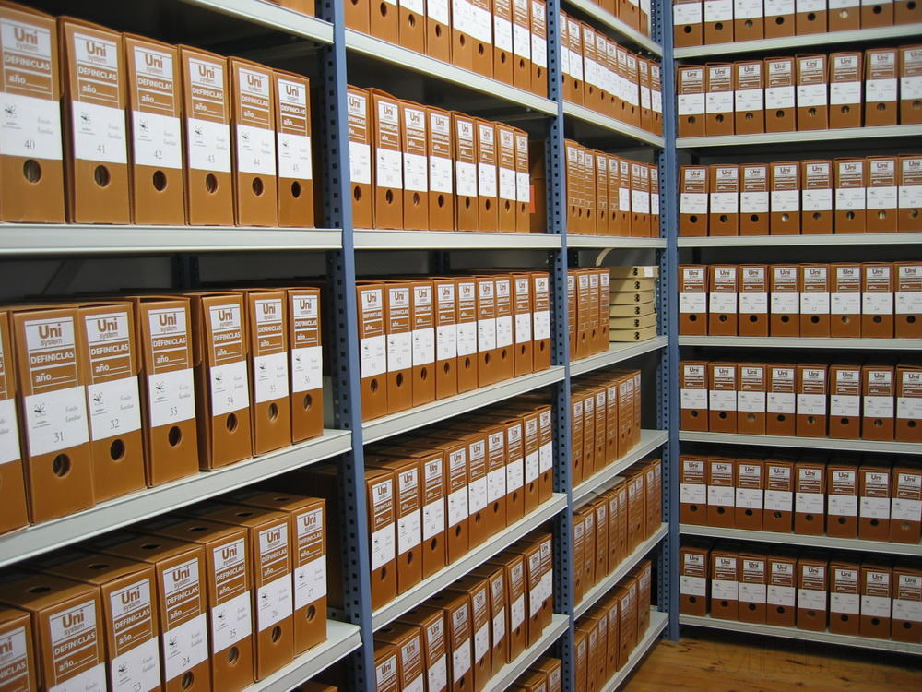
archiving replication

Slide 43
archiving replication
set up archiving
start archiving
pg_start_backup('label')
rsync all files
pg_stop_backup()
bring up replica

Slide 44
reasons to archive
replica out-of-sync
combine with PITR or DR
very erratic connection to master
need remastering before 9.3

Slide 45
archiving hands-on

Slide 46
archiving tips
use a script which handles copy failure
use a shared drive
put archive on a partition
monitor for archive growth
compression

Slide 47

failover, failback
& remastering

Slide 48
more terms
failover, promotion
  making a replica into a master/standalone
failback
  returning the original master to master status
remastering
  designating a new master in a group of servers

Slide 49
replica promotion
pg_ctl promote
trigger file
rm recovery.conf & restart

Slide 50


the trouble with failback: timelines, sync
& split-brain

Slide 51
hands-on failover & failback

Slide 52
failover has 3 parts
failing over the database
failing over the connections
STONITH

Slide 53
manual failover
advantages:
  easy to set up
  fewer accidental failovers
disadvantages:
  downtime
  being woken up at 3am

Slide 54
automated failover
advantages:
  low downtime
  sleep through the night
disadvantages:
  hard to set up correctly
  need broker server
  accidentally triggered failovers

Slide 55
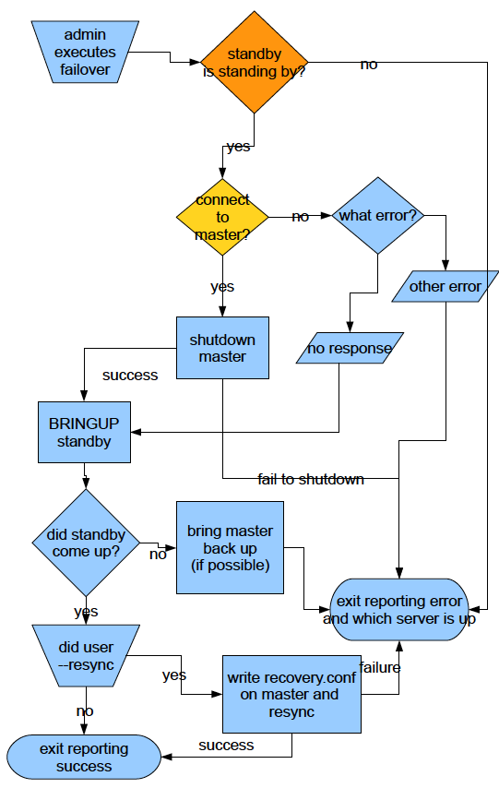
automated failover logic

Slide 56
STONITH
use corosync/VIP
use connection failover
use peer broker server

Slide 57




www.handyrep.org
https://github.com/compose/governor
https://github.com/zalando/patroni

Slide 58
Remastering 9.3+

Slide 59
Remastering 9.3+

Slide 60
Remastering 9.3+

Slide 61
remastering
need the replica which is “furthest ahead”
measure both receive point and replay point
need 9.3 for “streaming-only” remastering

Slide 62
Replay?
SELECT pg_xlog_location_diff(
pg_last_xlog_receive_location(),
pg_last_xlog_replay_location()
);
---------------
4294967296

Slide 63
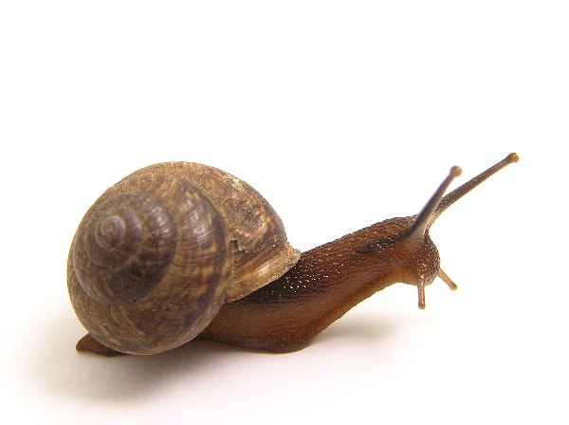
replication lag
& query cancel

Slide 64
reasons for lag
network delay
  speed of light
replica too busy
file operations block
  VACUUM
  DROP TABLE

Slide 65
replication lag issues
inconsistency (if load-balancing)
query cancel
  applications need to retry queries
catch-up speed
burden on master

Slide 66
configuring lag hands-on

Slide 67
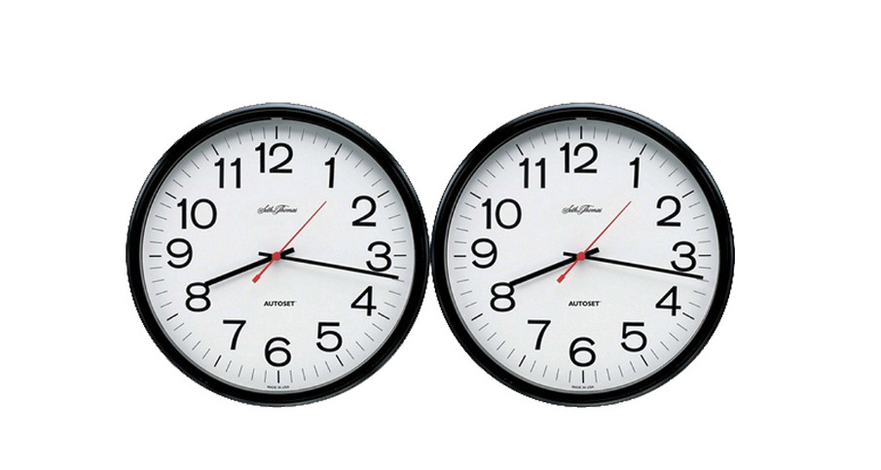
synchronous replication

Slide 68
what synch rep does
guarantee against data loss

Slide 69

how it works

Slide 70
what it doesn't
enforce global consistency
  master can be behind
  replica snapshot can be behind
help availability

Slide 71
“I would rather be down than potentially lose data.”

Slide 72
how to synch rep
pick one (or a pool) of servers to be your synch replicas
change application_name
change master's postgresql.conf
reload

Slide 73
Postgres specialities
implements only 1-redundant model
synch is per-transaction
  not per replica
  synch only important transactions

Slide 74
synchronous_commit
setting | disk | replica memory | replica disk
off | no | no | no
local | yes | no | no
remote_write | yes | yes | no
on | yes | yes | yes

Slide 75
synch rep hands-on

Slide 76
synch rep design
1 replica is synch replica
several asych replicas
load-balance to asynch only
always failover to synch replica

Slide 77
synch rep monitoring
monitor critically:
  synch rep downtime
  synch replication speed
script disabling synch rep
  if replica is down

Slide 78

cascading replication

Slide 79
how to cascade
have master & replica
clone the master or the replica
point primary_conninfo to the replica
bring up the new replica

Slide 80
why to cascade
limit connections to master
don't clone master
know which replica is ahead

Slide 81
why to cascade
Dallas
Shanghai
walsender
walreciever
walsender
walreciever
walreciever

Slide 82
why not cascade?
complexity
cycles
increases SPOFs

Slide 83
hands-on cascading

Slide 84

load balancing

Slide 85
load-balancing?
run statements
Master
?
Replica
Replica

Slide 86
why load-balance?
get some use out of the replica
scale-out
be ready for failover
run special workloads (reporting)

Slide 87
why not load-balance?
complexity
inconsistency
limitations
additional SPOFs
not needed for performance

Slide 88
inconsistency
lag between master & replica
defeats read-then-write-then-read
django: read-then-write (fortunately)
otherwise: implement “sticky”

Slide 89
application LB
use autocommit
  django: @xact or @atomic
create “rw” and “ro” databases
route connections
  django: set up django router which directs writes & reads

Slide 90
network LB
same as application, plus:
set up virtual IPs
  using Zeus, HAproxy, Cisco, etc.
use VIPs to load-balance read traffic
use VIPs to fail over
  optional: auto-failover

Slide 91
pgPool2
connects to all servers
separates reads/writes by parsing queries
manages failover
not actually a pooler
  despite name

Slide 92
why not pgPool2?
complicated
  very hard to configure correctly
  documentation is terrible
failover logic not great
  and hard to change

Slide 93
pgBouncer
pooler & redirector
redirect read and write connections
works with manual & scripted failover

Slide 94
pgBouncer load-balancing exercise

Slide 95

replication in the cloud

Slide 96

use a shared archive
WAL-E

Slide 97
ephemeral replicas
no sync to disk
do not recover from crash
  spin up a replacement instead
turn off all logging/disk
  fsync off, bgwriter off,
  full_page_writes off

Slide 98
sharding and replication
server 1
server 2

Slide 99
sharding and replication
server 1
server 2

Slide 100
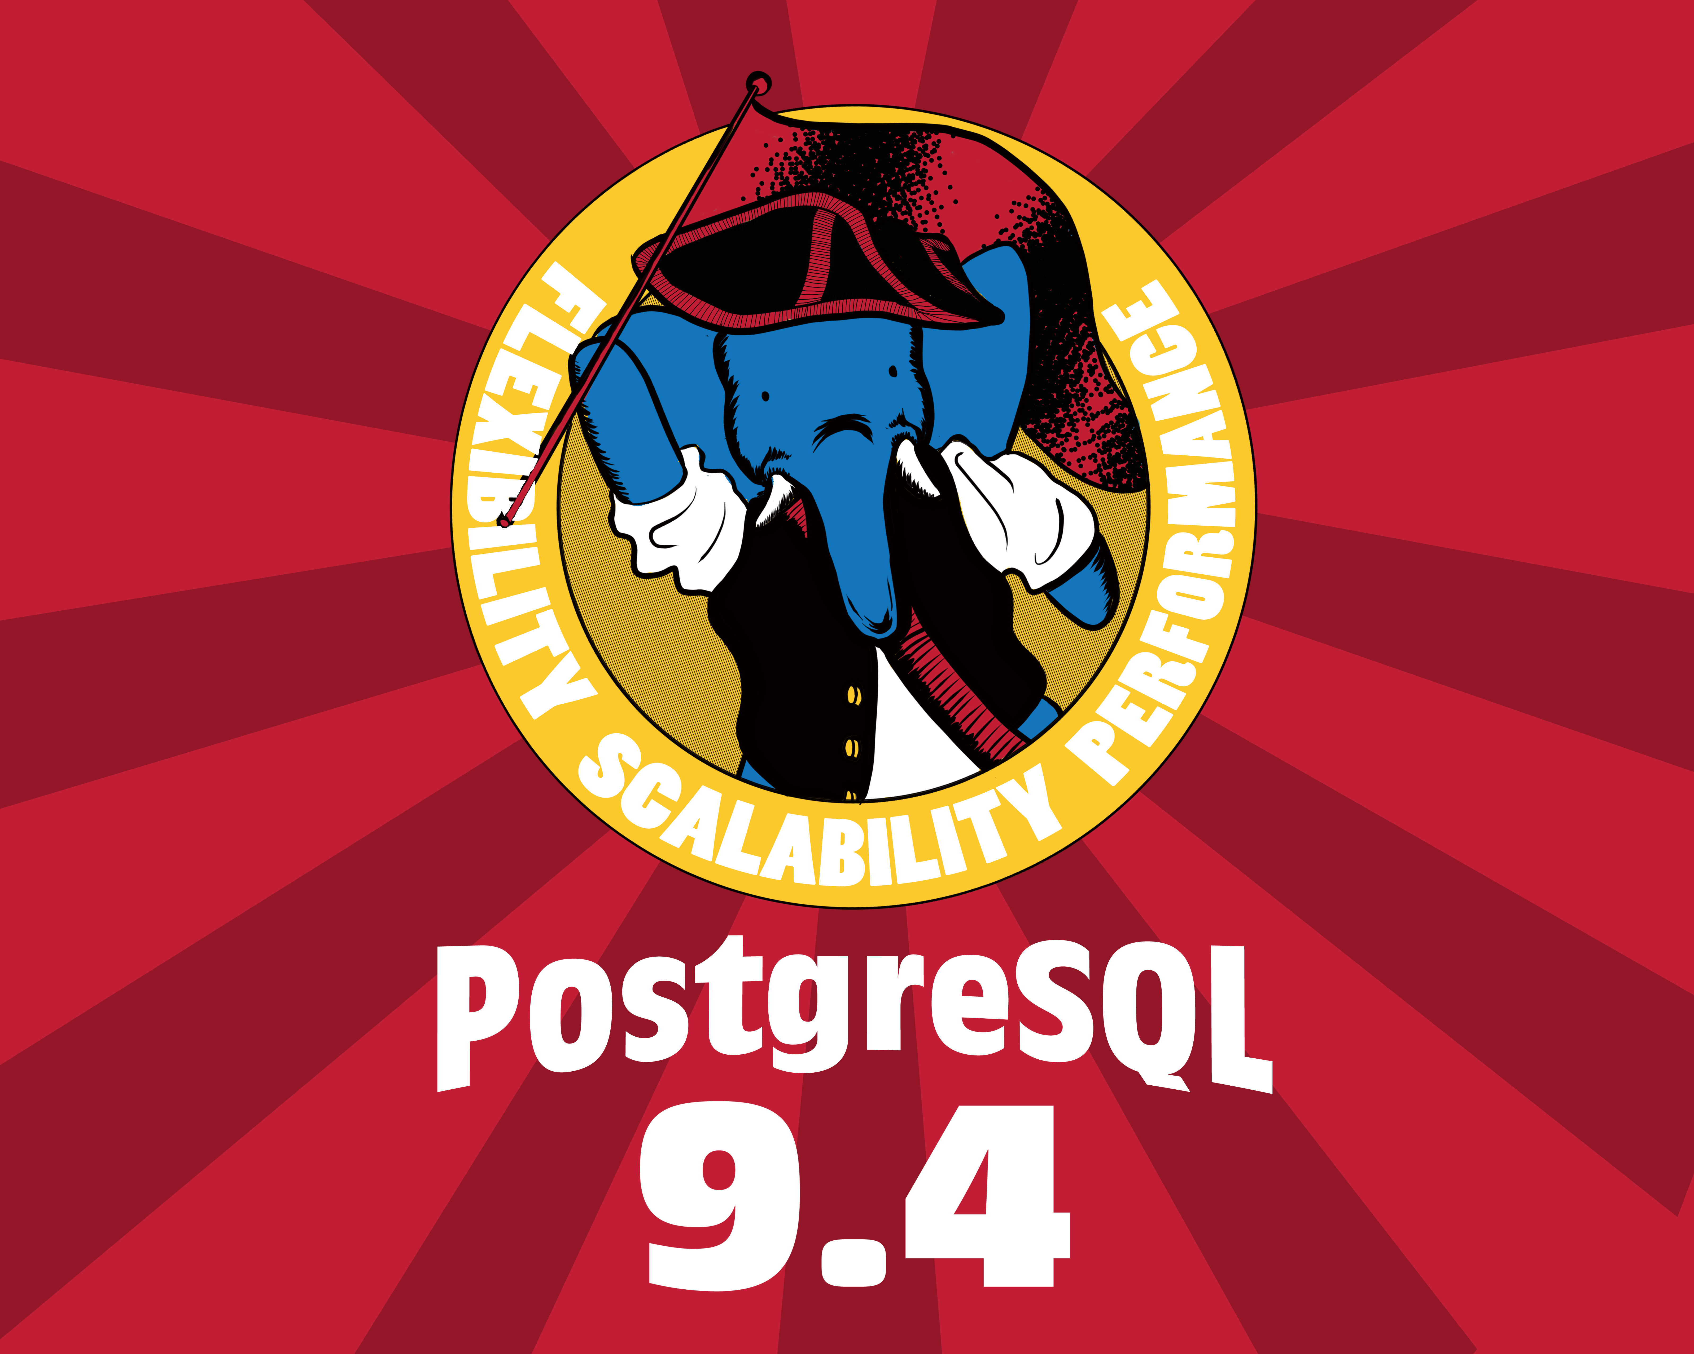
9.4 Replication

Slide 101
9.4: Replication Slots
no more wal_keep_segments
instead assign each replica a “slot”
master will keep the logs they need
  but monitor!

Slide 102
replication slots
SLOT1

Slide 103
replication slots
SLOT1

Slide 104
replication slots
SLOT1

Slide 105
9.4: Logical Decoding
convert binary stream to row-based replication
permits “bi-directional” rep.
  and other custom replication
  and cross-version replication
will require external tools

Slide 106
also 9.4: delay
recovery_min_apply_delay
  delay for applying new data, in seconds
  window for catching mistakes
  do not use with hot_standby_feedback

Slide 107
replication slots exercise

Slide 108
questions?
github.com/jberkus/pgReplicationTutorial
Josh Berkus: josh@pgexperts.com
  PGX: www.pgexperts.com
  Blog: www.databasesoup.com
Upcoming Events
  pgConfSV: San Francisco Nov. 18
Copyright 2015 PostgreSQL Experts Inc. Released under the Creative Commons Share-Alike 3.0 License. All images are the property of their respective owners. The WAL-E image is the property of Disney Inc. and is use here as parody.

