Slide 1
Jakarta Mail 2.1 / Angus Mail 1.0
1. What is Jakarta Mail
2. What is new in Jakarta Mail 2.1
3. What is Angus Mail
4. Demo
5. References

Slide 2
Jakarta Mail 2.1 / Angus Mail 1.0
1. What is Jakarta Mail
The Jakarta Mail API provides a set of abstract classes defining objects that comprise a mail system. The API defines classes like Message, Store and Transport. The API can be extended and can be subclassed to provide new protocols and to add functionality when necessary.

Slide 3
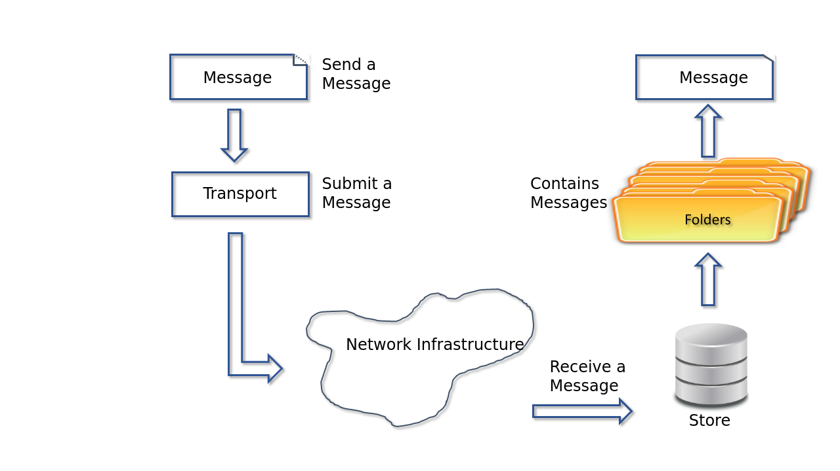
Jakarta Mail 2.1 / Angus Mail 1.0
1. What is Jakarta Mail

Slide 4
Jakarta Mail 2.1 / Angus Mail 1.0
1. What is Jakarta Mail
Message: Defines a set of attributes and a content for a mail message. For example: subject, recipients, content type, attachment, etc.
Transport: Models the transport agent that routes a message to its destination addresses.
Store: The Store class defines a database that holds a Folder hierarchy and the messages within. Folders contain messages or other folders.
Session: Factory to instance configured Transport and Store configured objects.

Slide 5
Jakarta Mail 2.1 / Angus Mail 1.0
2. What is new in Jakarta Mail 2.1
We focused to remove the implementation (com.sun.mail) from the API (jakarta.mail).
jakarta.mail.util.StreamProvider interface
It contains the methods to instance different encoders/decoders and other streams required by the API.
Encoders/Decoders: base64, b, q, binary, 7bit, 8bit, quoted-printable, uuencode, x-uuencode, x-uue.
Service lookup is used to find implementations of this interface. Which means that the implementations of this methods has to be done by third party Jakarta Mail implementations.

Slide 6
Jakarta Mail 2.1 / Angus Mail 1.0
3. What is Angus Mail
Angus is the default Jakarta Mail implementation, that comes up to implement the new interface jakarta.mail.util.StreamProvider.

Slide 7
Jakarta Mail 2.1 / Angus Mail 1.0
4. Demo
Checkout the demo:
https://github.com/jbescos/jakartaEE10MailDemo

Slide 8
Jakarta Mail 2.1 / Angus Mail 1.0
5. References
Mail API Specification: https://github.com/eclipse-ee4j/mail-spec
Mail API: https://github.com/eclipse-ee4j/mail
Angus Mail: https://github.com/eclipse-ee4j/angus-mail
Demo: https://github.com/jbescos/jakartaEE10MailDemo

