Slide 1
PCB Design & Layout Tips
Ref: Johnson, H., High-Speed Digital Design. Prentice Hall, 1993

Slide 2
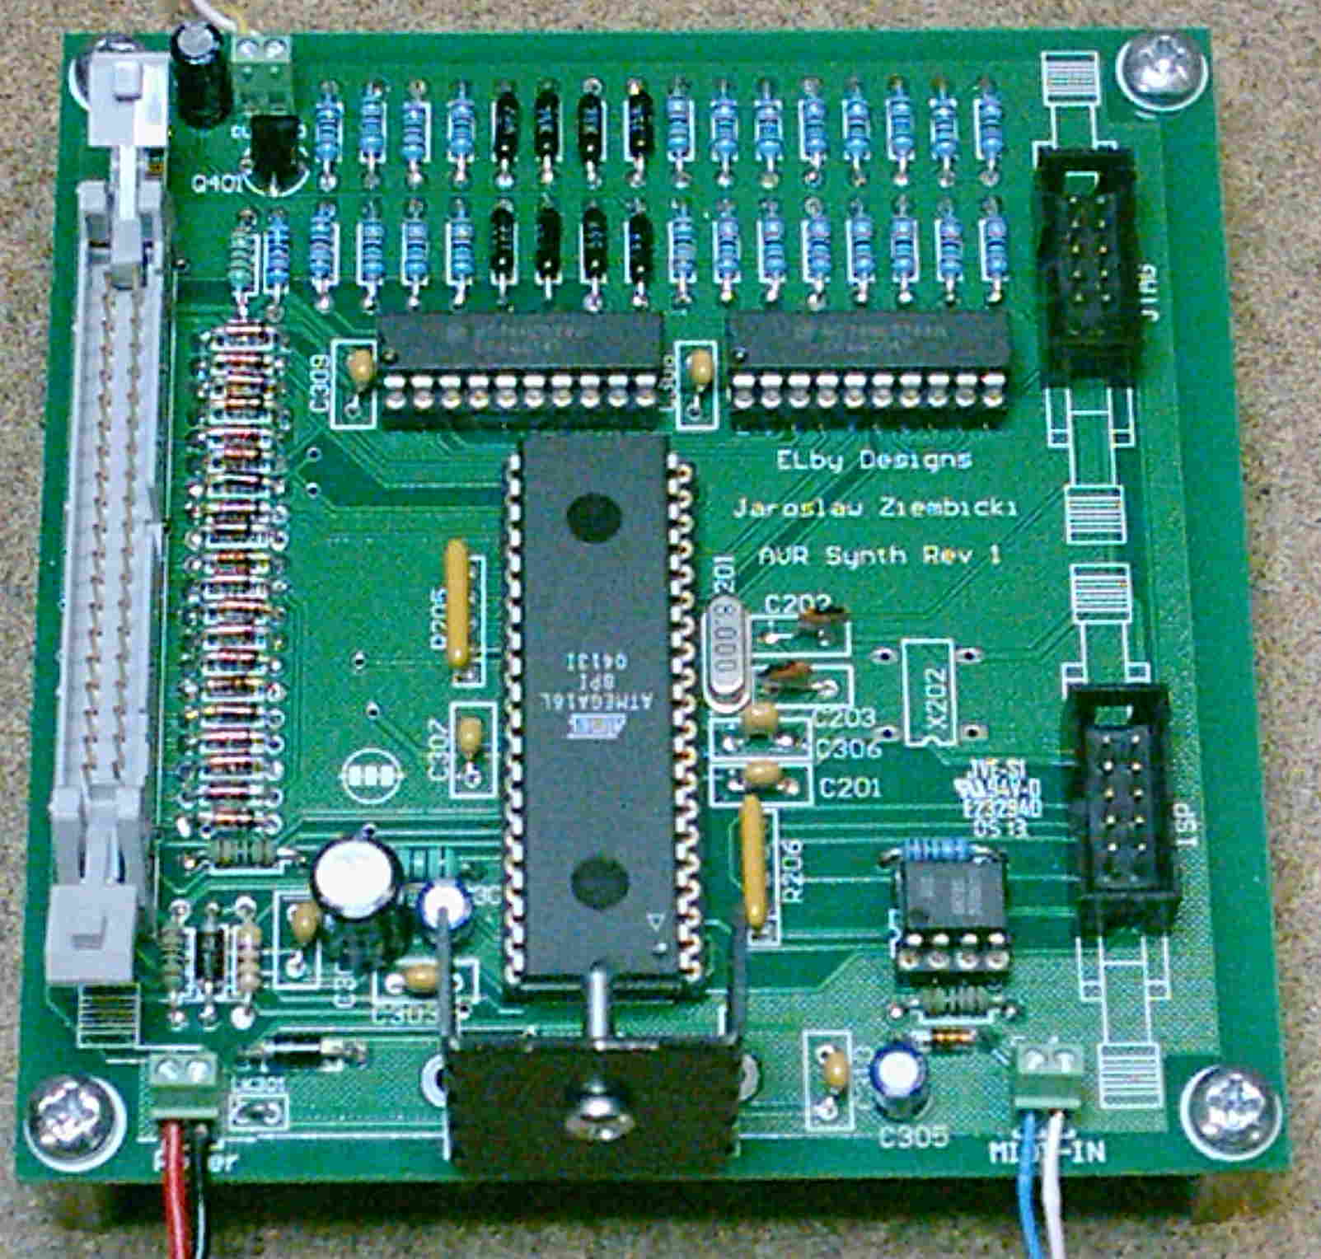
What is all the extra stuff?
Power Supply
Decoupling caps
Termination resistors
Mounting holes tied
to chassis ground
All designed to reduce parasitic effects

Slide 3
Ground Distribution
Solid ground plane is best, provides continuous, low-impedance path for return current
Absolutely necessary for designs with large amounts of high speed devices (edge rates < 5ns)
May not be feasible due to budget constraints (Usually requires at least a 4 layer board)

Slide 4
Example solid ground plane layer
Return current can follow any path and stay close to the signal trace.
Only breaks in plane are vias and thru holes

Slide 5
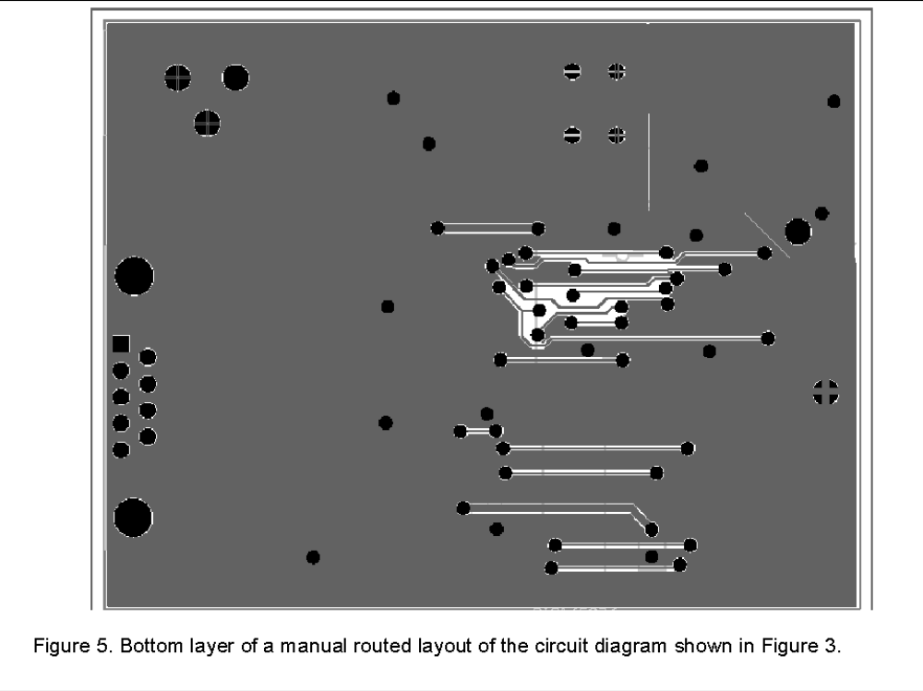
Ground distribution for 2 layer boards
Try to dedicate one layer as mostly solid ground plane, with routing slots cut out for signal traces
No traces on the other layer should perpendicularly cross a break in the ground plane (large inductive loop)
www.analogzone.com : ACQ_TechNote_052402.pdf

Slide 6
Ground distribution for 2 layer boards – right way
If most of one layer cannot be dedicated to a ground plane, use a star configuration

Slide 7
Ground distribution for 2 layer boards – wrong way
Don’t daisy chain all your ground connections together. It forces all return currents to follow the same path, possibly causing ground bounce.

Slide 8
Ground distribution for 2 layer boards, with mini ground plane
If a section of the board has ICs with lots of connections and board space allows, draw in a mini ground plane under that section.
Signals running between these ICs now have a low inductance return path

Slide 9
Example solid ground plane w/analog ground
Analog sensor
Moat in gnd plane, at least 25 mils wide (to prevent capacitive coupling)
Prevents voltage spikes caused by digital logic from degrading the analog noise margin
No traces should cross the moat, especially high speed digital ones
* Tie all gnd pins in the analog region to analog gnd

Slide 10
Mixed voltage designs
Your design could have as many as 5 or 6 different supply voltages, which will complicate the power distribution routing.
There are two choices in where to generate the secondary voltages
  Generate all voltages centrally at the power supply and distribute across the PCB (best when different sections of the board need that voltage)
  Locate the generation circuit near the components that require that voltage (best if one or two ICs need that voltage)

Slide 11
Mixed voltage designs – interfacing components
You may have to do some level translation for signals that communicate between two different voltage levels.
It’s important to realize that any level translation wastes power. The customer doesn’t care that you had to interface two parts, they only know that the battery has to be recharged too often.

Slide 12
Mixed voltage designs – interfacing components
To interface a 5V output to a 3.3V input on a slow signal, use a simple voltage divider. Note, however, that these added resistors will slow the rise time of the signal.
For a faster signal, run the signal through a buffer in the VHC logic family. These parts have 5V tolerant IO even when powered by 3.3V.
To interface a 3.3V output to a 5V input, run the signal through a buffer in the HCT product family. These parts have a TTL input stage with a Vih spec of 2V.

Slide 13
Decoupling capacitors
Main purpose is to act as temporary charge reservoirs, guarding against voltage droop.
Also serve as a path for high speed return current to jump from Vcc to Gnd (remember, to an AC signal, both Vcc and Gnd are AC gnd).
Use 10 - 100 uF for bulk decoupling.
Use 0.01 - 0.1 uF at each power pin (determined by switching frequencies used in design).
Select a voltage rating higher than Vcc.
Don’t go overboard with too many caps, it will increase cost and decrease available board area.

Slide 14
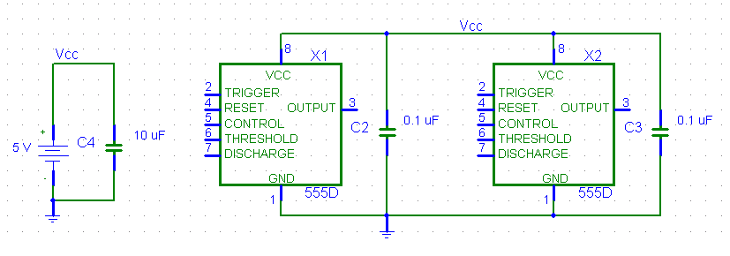
Decoupling capacitor example
Here is an example board with two 555 timers (assume that each IC is several inches away from the power supply)
The 0.1 uF cap supplies current to the IC while its outputs are switching until the power supply can “catch up”.
The large 10 uF capacitor helps recharge all the individual 0.1 uF caps

Slide 15
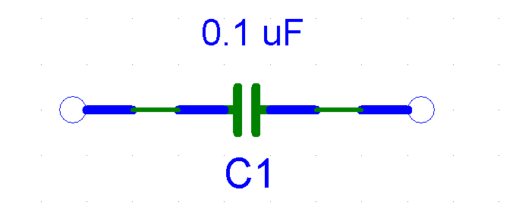
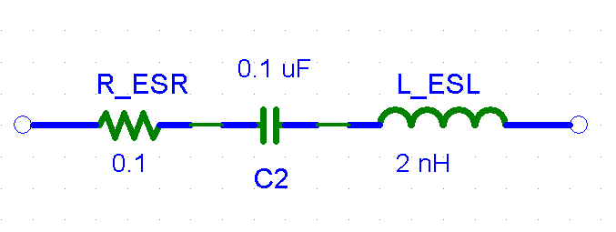
Decoupling capacitor selection
You thought the cap you just put in your design looked like this:
It actually looks like this:

Slide 16
Decoupling capacitor selection
Two parasitic effects must be considered when selecting decoupling caps. As with most parasitic effects, they are hard to measure, and no two manufacturers seem to report them the same.
  Equivalent Series Resistance (ESR) : This value will be about the same for thru-hole or SMT packages.
  Equivalent Series Inductance (ESL) : This value will be much lower for SMT parts, compared to thru-hole.
These parameters will limit the amount of instantaneous current the cap can supply. Check the cap’s datasheet and make sure that neither parameter is unacceptable for your design.

Slide 17
Decoupling capacitor types
Ceramic
  Usually have the lowest ESR/ESL
  Lowest cost
  Are only recently available in values over 100 uF
Tantalum
  Available in a higher capacitance range than ceramic, in the 220 uF – 1000 uF range
  More expensive, tantalum is rare
  Polarized, and have a tendency to explode
  Used to be the first choice for large value decoupling, but ceramics have improved

Slide 18
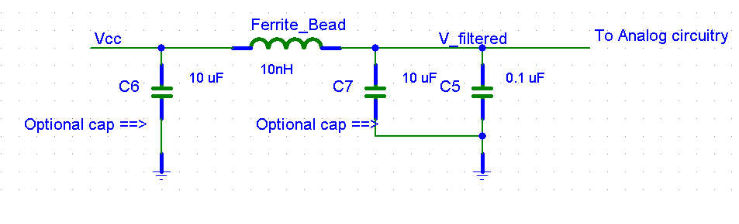
Filtered power
Some components, especially PLL’s or others with analog functions, may require very low ripple on the power rail.
One solution is to low pass filter the power rail with decoupling caps and ferrite beads (inductors).

Slide 19
Transmission Line Effects
The connection from the output of one chip, across the board to the input of another chip is not a superconductor, it’s a transmission line with parasitic parameters.
These effects must be considered for signals with fast rise times and/or long traces.
10 ns rise time : 12 in
1 ns rise time : 1.2 in

Slide 20
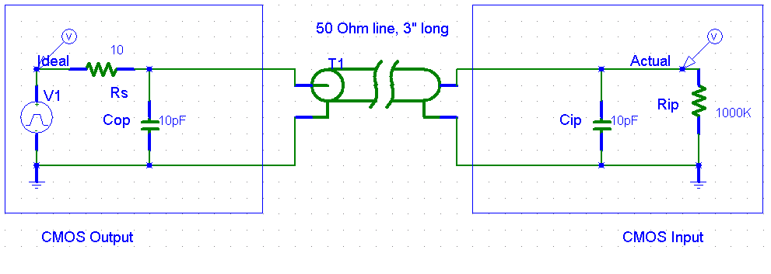
Transmission Line Model

Slide 21
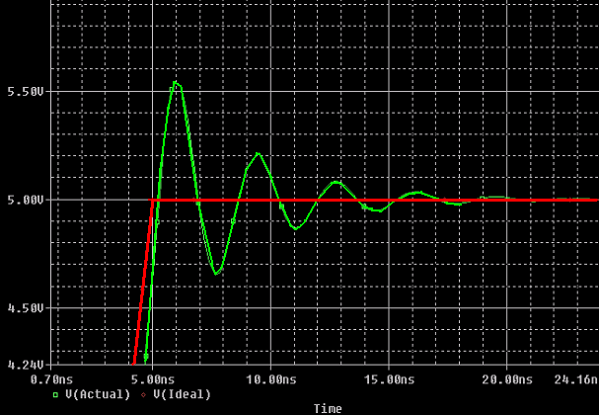
Transmission Line Effects
Here is the resulting simulation, note the overshoot and undershoot (rise time = 5 ns).

Slide 22
Transmission Line Source Termination
One resistor in series can do a lot to improve the signal integrity. The resistor should be sized so that the source resistance of the driver + the terminating resistor = characteristic impedance of the transmission line.
Rs + Rterm = Zo
There are lots of transmission line impedance calculators on the web.

Slide 23
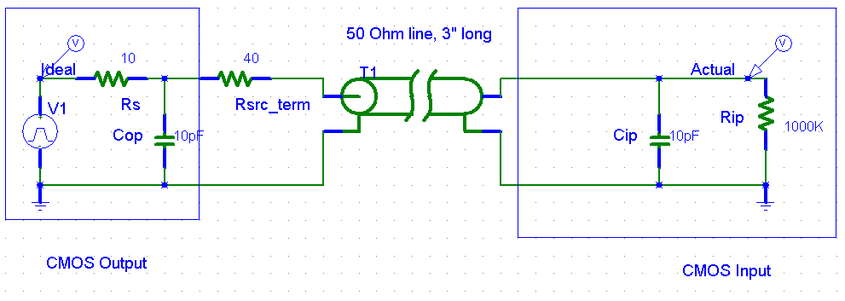
Transmission Line Source Termination Model

Slide 24
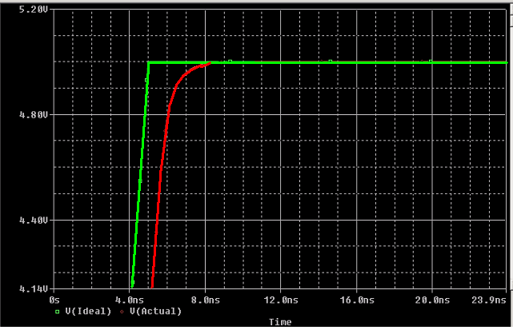
Transmission Line Source Termination
The simulation shows that the overshoot and undershoot have been eliminated, due to the low pass filter.

Slide 25
Transmission Line Parallel Termination
Source termination doesn’t work for lines that drive multiple loads, so parallel termination at the last load is used.
Ideally, Rpu || Rpd would equal the characteristic impedance of the transmission line, but most drivers can’t source that much current.

Slide 26
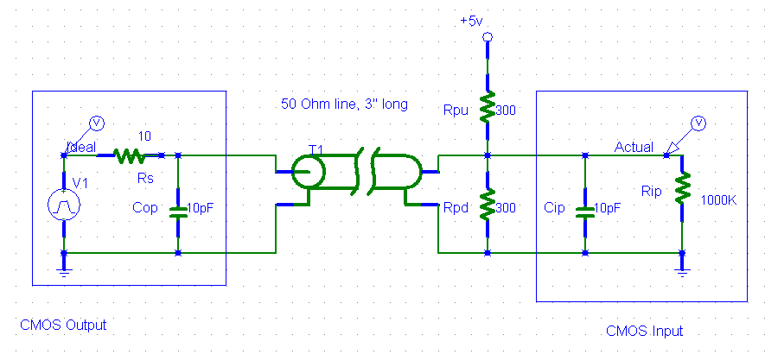
Transmission Line Parallel Termination Model

Slide 27
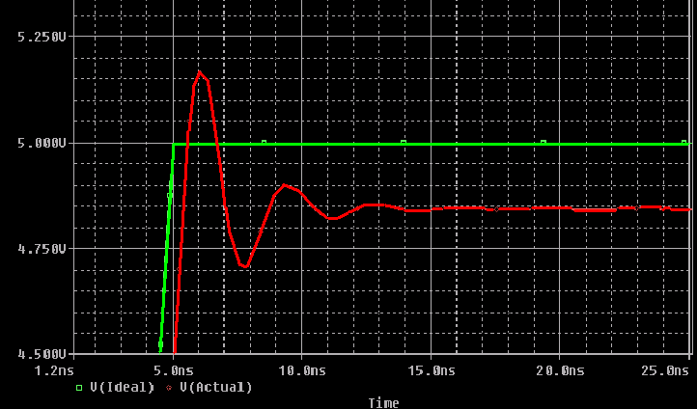
Transmission Line Parallel Termination
The overshoot and undershoot have been attenuated, whether it’s enough depends on your design.

Slide 28
Component placement
Spend some time thinking about where to place major components, it will make routing much easier.
Start with connectors, pushbuttons, etc. Their location is often fixed due to the function or form factor of the product.
Pay attention to which components have lots of connections between them, try to orient the components so that the traces can be straightforward.
Partition the board according to function, such as digital, analog and power supply. Try not to let traces from one section stray into another section.

Slide 29
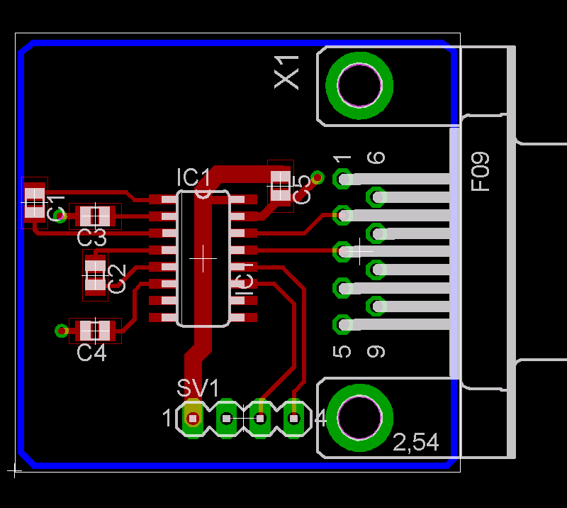
Component Placement Example

Slide 30
Critical Trace Routing
Identify the most critical traces in the design: clock signals, analog signals, RF signals, etc. Route these traces first, with the most desirable layout.
Maintain at least a 3X trace width separation around constantly switching traces like clocks (avoids crosstalk)
You are smarter than the auto router software, so don’t use it.

Slide 31
Safety considerations in routing
Some traces have safety requirements.
  AC & DC power inputs
  Traces near connectors/openings in chassis
Make high current traces large enough to safely handle the current required.
Space out high voltage traces.
Space out high voltage components with conductive housings.
  Heat sinks
  Electrolytic capacitors

Slide 32
PCB Specifications
Minimum Line/Space Minimum 6 mils
Maximum Hole Size 246 mils
Minimum Hole Size 15 mils
Only plated holes allowed
Only top silkscreen allowed
Manufacturing files in Gerber 274X format
Maximum board size for demo price: 100 sq. inches

Slide 33
DFD: Design-For-Debug
As board space allows, add features to the PCB that will help in debugging the design.
  Unconnected headers for fixing board problems
  Convenient power/gnd connections for scope probes
  Test points for important subsystems (SPI bus, ADC, etc.)
  Descriptive silkscreen
  Extra LEDs, 7 segment display, serial port connection, speaker, etc..
These extras can be no-loaded when you go to production.

Slide 34
PCB Checklist
Do I have header pins for debugging?
Do I have convenient VCC/GND test points?
Do I have unconnected header pins for fixing board problems?
Do I have mounting holes (both in schematic and board)?
Have I printed out a paper version of the top copper and ensured that my parts fit the footprints?
Do I have in-circuit programming for my CPU if it is surface mount?
Do I have test plan for my board for when it comes back?

