Slide 1


MitM: Math in the Middle
Jonas Betzendahl, 2019-11-22
Based on Kohlhase et al.’s 2017 paper:
“Knowledge-Based Interoperability for Mathematical Software Systems”
<number>

Slide 2
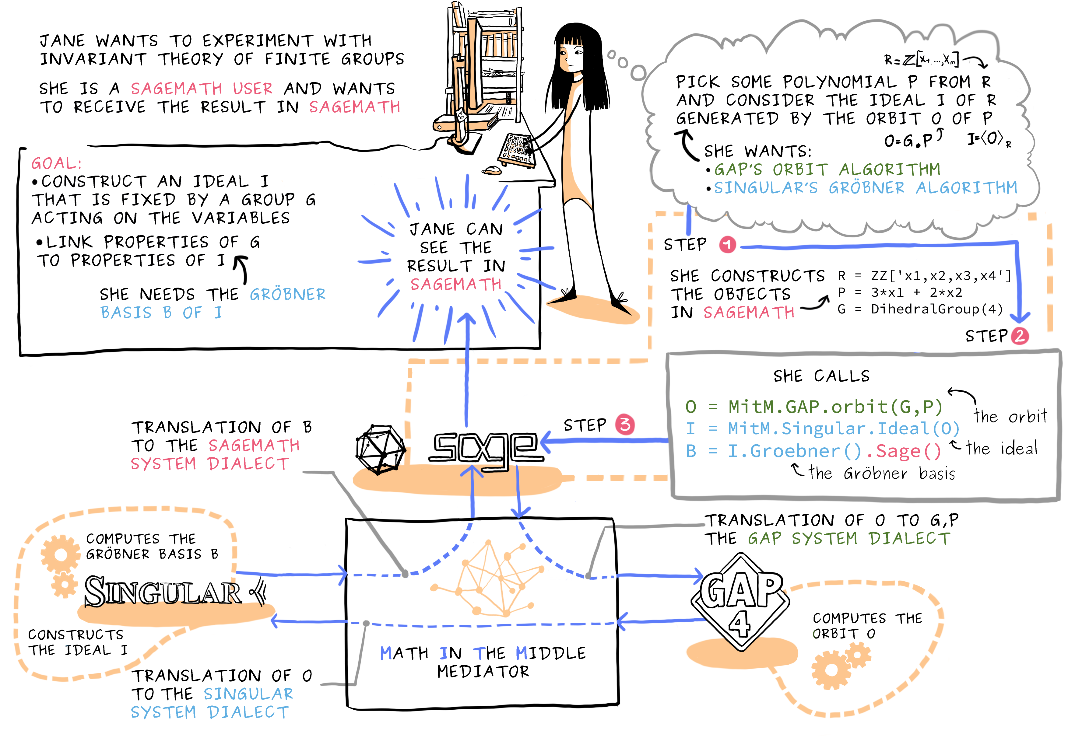
Notes:
<number>

