Slide 1
All-NBA Prediction

Slide 2
All-NBA Team
an annual National Basketball Association (NBA) honor bestowed on the best players in the league following every NBA season
the voting is conducted by a panel of sportswriters and broadcasters throughout the United States and Canada
since 1988 it is typically composed of three five-man lineups—a first, second, and third team. Before then two five-man lineups - a first, and second.

Slide 3
All-NBA Team continued
Consists of 2 Guards, 2 Forwards, 1 Center
Players receive 5 points for a first team vote, 3 points for a second team vote, and 1 point for a third team vote.
Every MVP has been a part of the 1st team (EXCEPT: 1957–58, 1960–61, 1961–62,1972–73)
5123 NBA players since 1979, 552 we’re all NBA

Slide 4
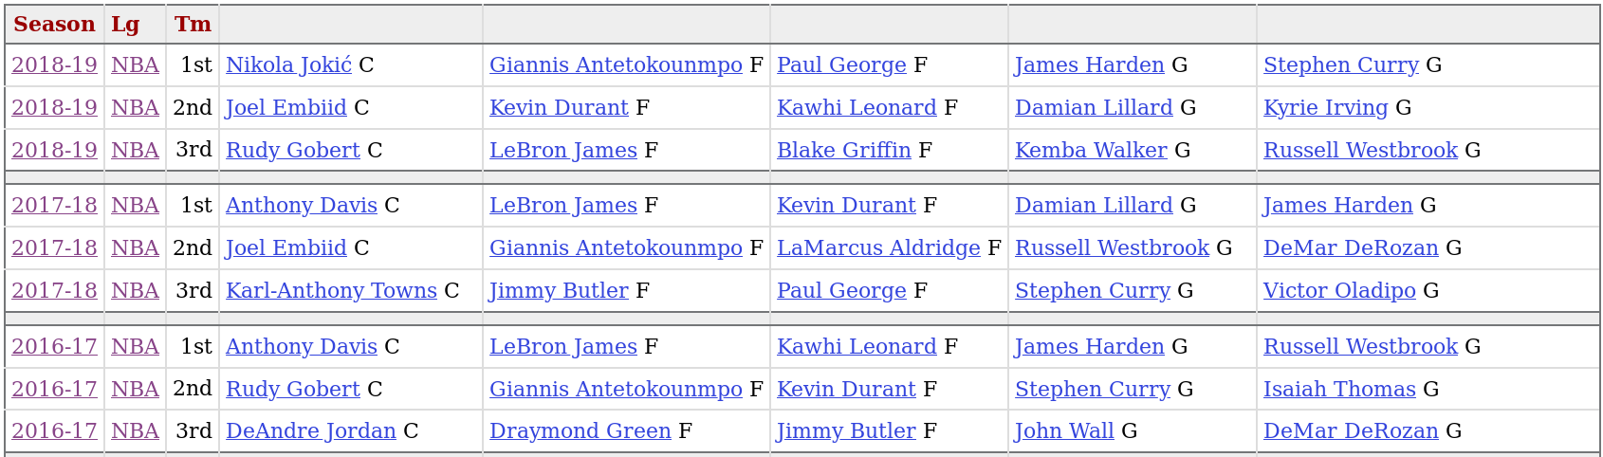
Previous Teams

Slide 5
Objectives
Be able to predict throughout the year who has the best chance at making the teams
Use machine learning to build models that predict future All-NBA players
Put a statistical value on the human element of voting for awards

Slide 6
Base Stats
What we will use:
PTS/G - Points per game
RB/G - Total rebounds per game
AST/G - Assists per game
Others:
Steals
Blocks
Turnovers
Shooting Percentages

Slide 7
Justification For Dropping Defensive Stats
A problem is there is not nearly as many stats to compare when it comes to offense versus defense ( Offensive stats, FG, FGA, 2P/2PA, 3P/3PA, FT/FTA, Shooting percentages, Offensive Efficiency stats)
More often than not a player that gets in primarily on defense, are at least passable on offense. E.g. Ben Wallace (known for primarily his defensive presence)
Only one other player has made the All-NBA team
averaging below 10 points per game, Dennis Rodman
in 1991-1992 ( 9.8 PTS/G ) and 1994-1995 ( 7.1 PTS/G )
Ben Wallace All-NBA Years
Year | Points
2001-2002 | 7.6
2002-2003 | 6.9
2003-2004 | 9.5
2004-2005 | 9.7
2005-2006 | 7.3

Slide 8
So Many Advanced Stats
Offensive Rating,
Defensive Rating,
Player Efficiency Rating (PER),
Usage Percentage (Usg%),
Offensive Win Shares, Defensive Win Shares,
Win Shares Per 48 Minutes (WS/48),
(Offensive/Defensive) Box Plus/Minus (BPM),
Value over Replacement Player(VORP),
Real Plus-Minus (RPM),
Adjusted Plus-Minus(APM),
Regularized Adjusted Plus/Minus (RAPM),
True Shooting Percentage(TS%),

Slide 9
Advanced, What We’re Using
Box Plus/Minus (BPM) - metric for evaluating basketball players' quality and contribution to the team. BPM relies on a player's box score information and the team's overall performance to estimate a player's performance relative to league average.
Value over Replacement Player (VORP) - converts the BPM rate into an estimate of each player's overall contribution to the team, measured vs. what a theoretical "replacement player" would provide, where the "replacement player" is defined as a player on minimum salary or not a normal member of a team's rotation

Slide 10
Advanced, What We’re Using
Offensive Win Shares -
  Calculate points produced for each player.
  Calculate offensive possessions for each player
  Calculate marginal offense for each player
  Calculate marginal points per win
  Credit Offensive Win Shares to the players
Defensive Win Shares -
Win Shares (WS) - final step of the process is to add Offensive Win Shares to Defensive Win Shares

Slide 11
Trimming Data
1979-1980 Three point line introduced
Lowest PTS/G - Ben Wallace in 2002-2003, 6.9 PTS/G
Lowest TRB/G - Joe Dumars in 1992-1993, 1.9 TRB/G
Lowest AST/G - DeAndre Jordan in 2014-2015, .7 AST/G
Lowest VORP - Tiny Archibald in 1980-1981, .5 VORP
Lowest WS - Bernard King in 1990-1991, 3.5 WS
In 2018-2019, 370 out of 530 players had less than 3 Win Shares
Use all players after 1979

Slide 12
Used Data
All data retrieved from basketball-reference.com
Starting at 1979-1980 season
Since 1979, there have been 555 All-NBA seasons by players
4224 Seasons by all players since 1979

Slide 13
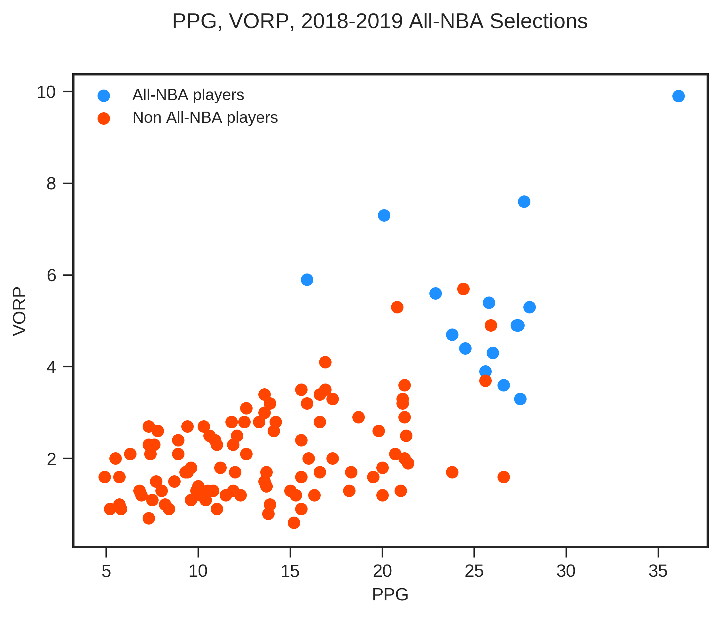

Slide 14
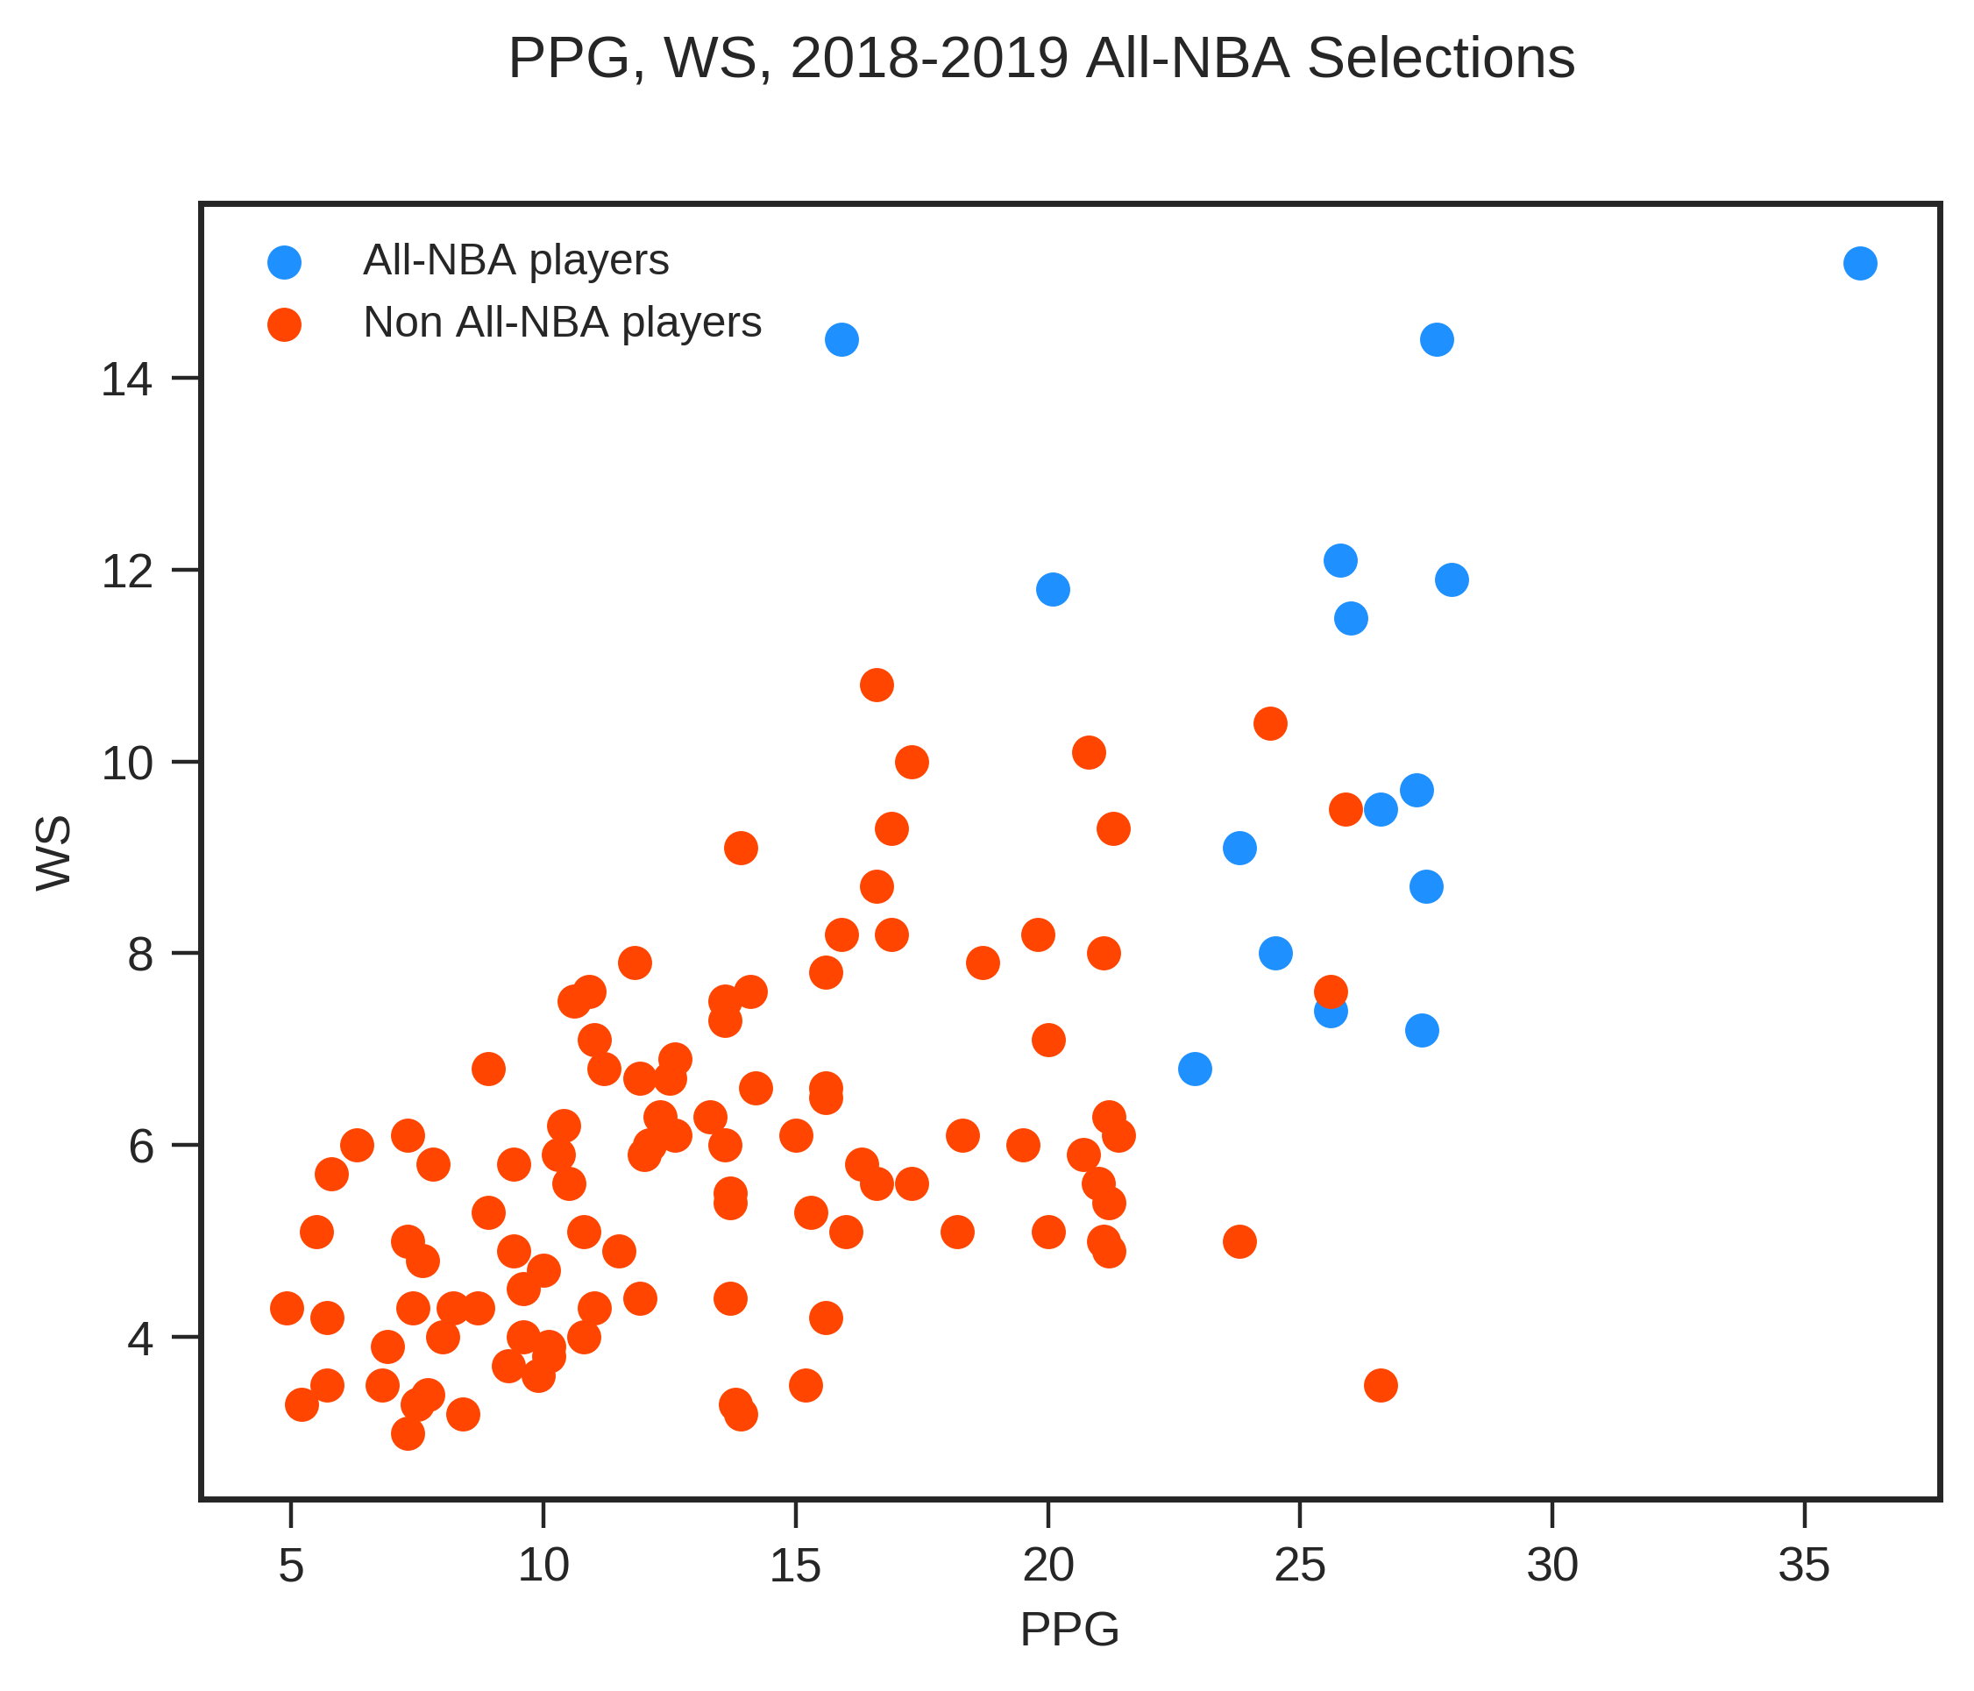

Slide 15
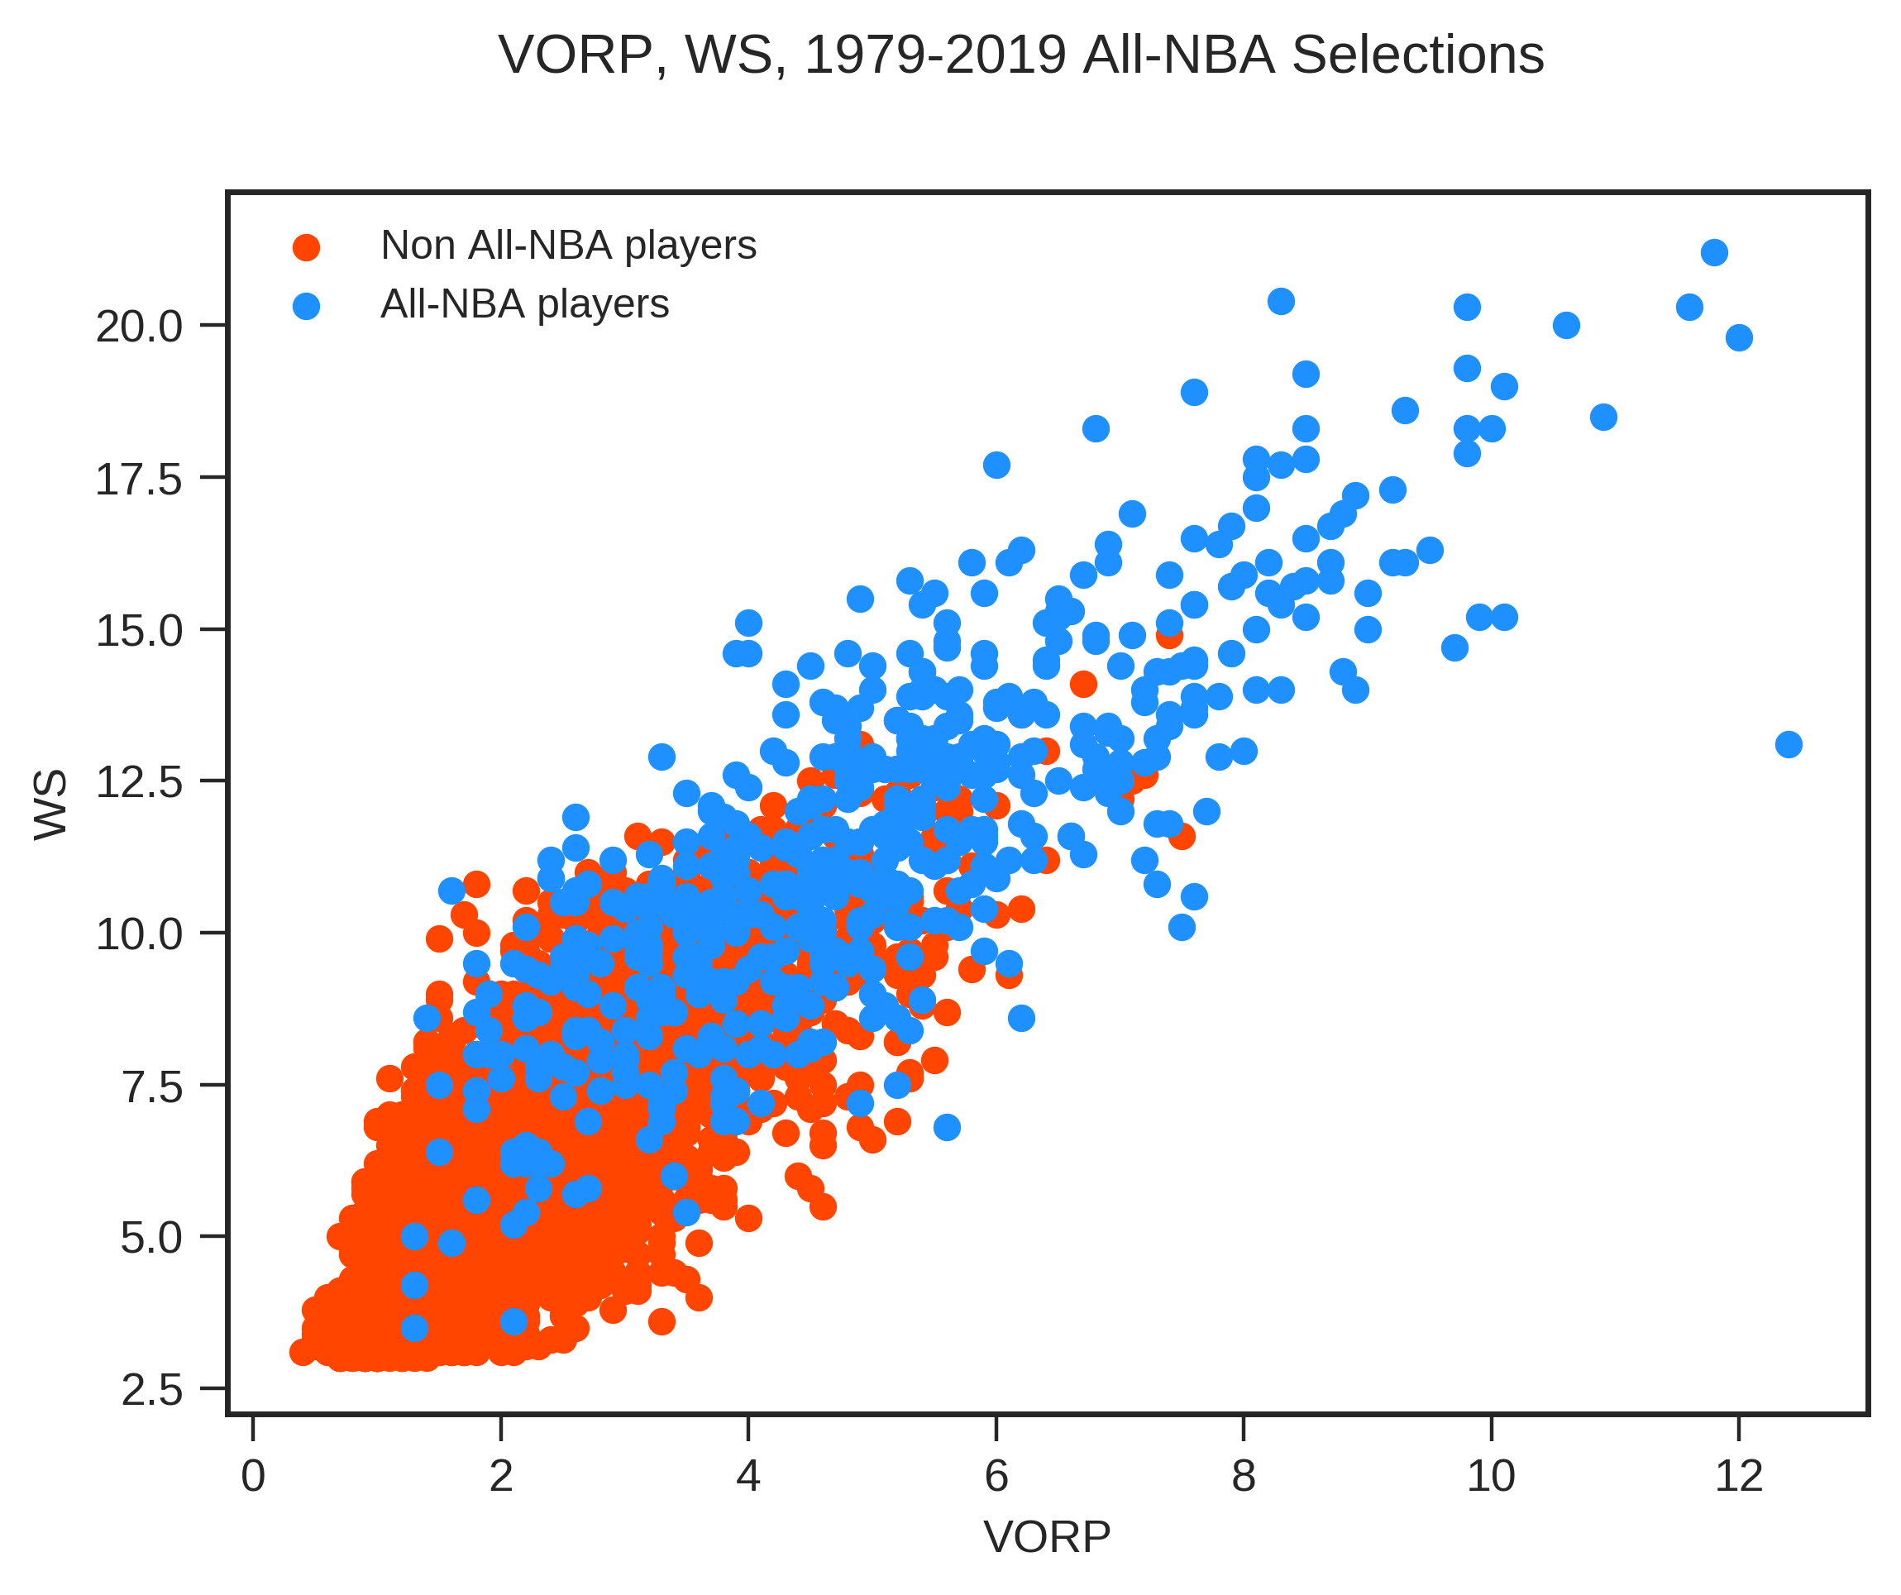

Slide 16
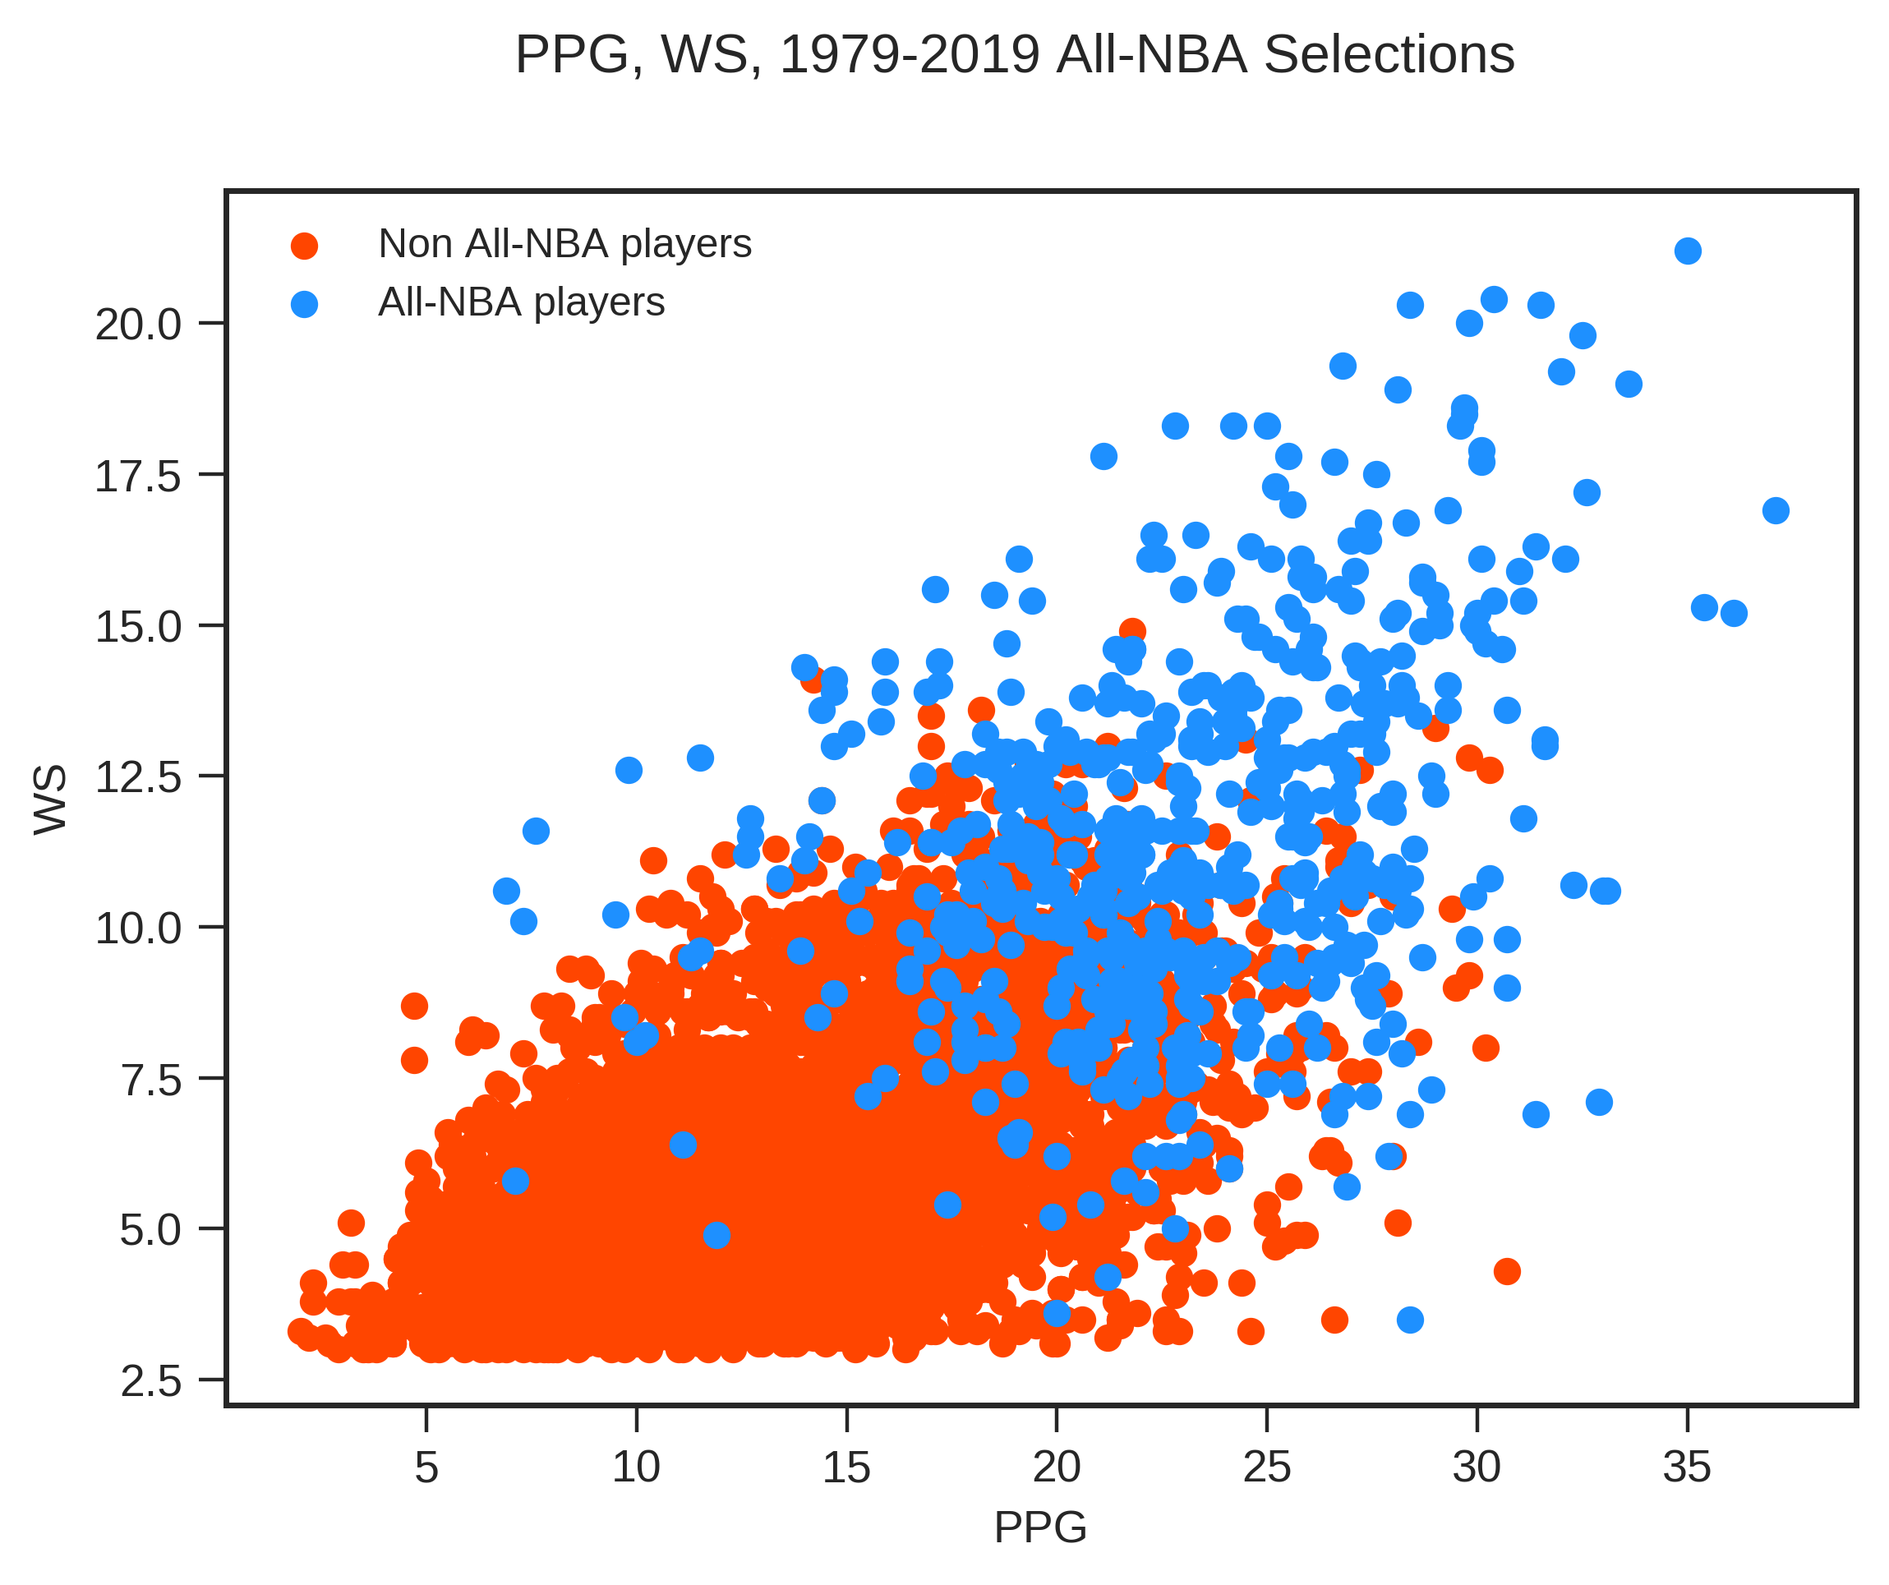

Slide 17
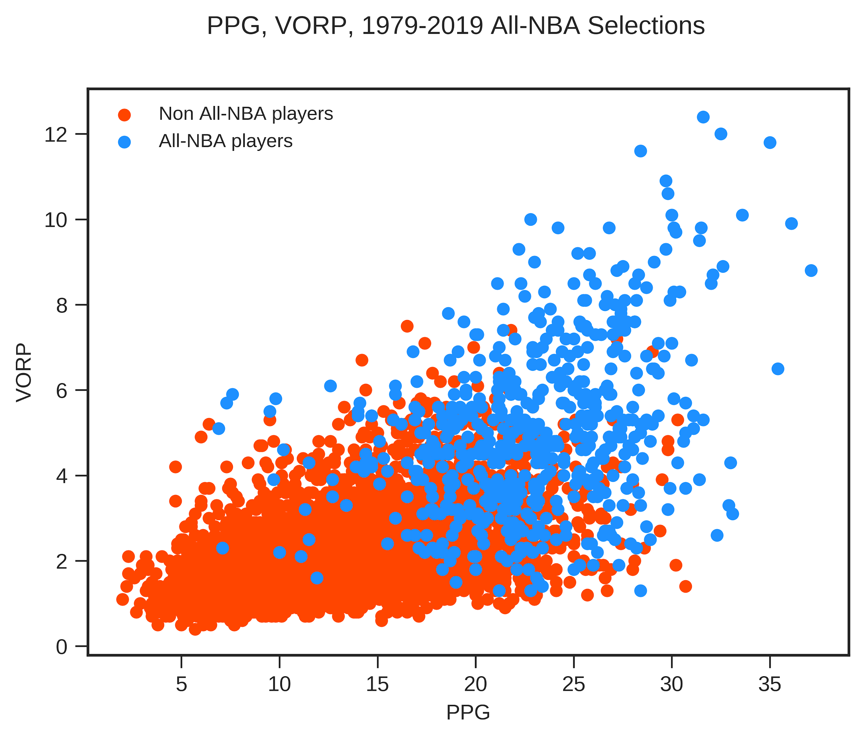

Slide 18
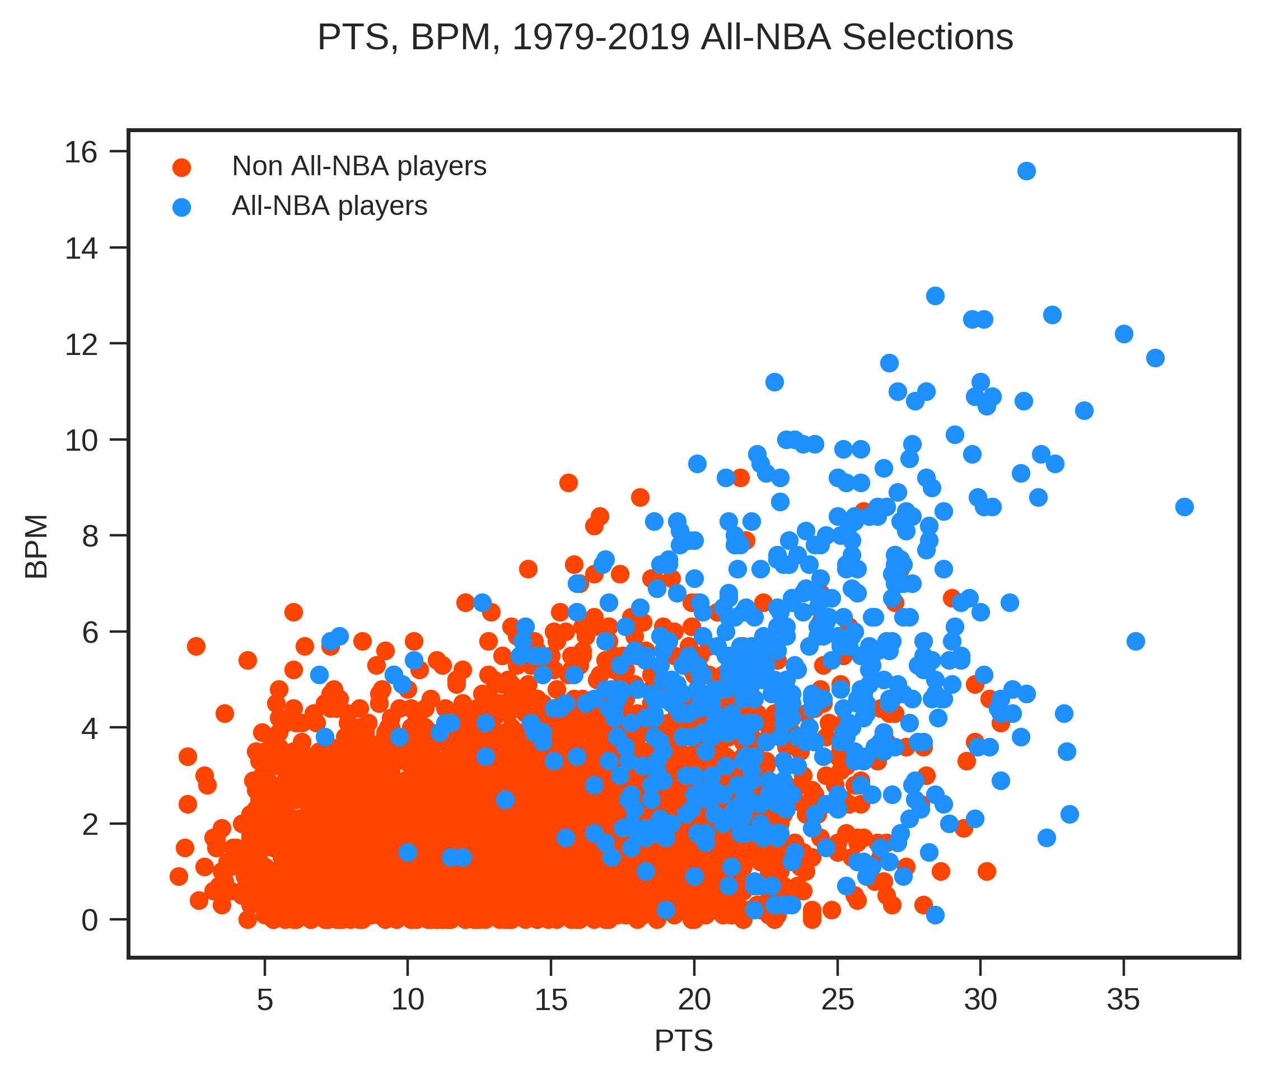

Slide 19
Data Trained
xtrain = train[['PTS', 'TRB', 'AST', 'VORP', 'WS', 'BPM']]
Ended up using
Points per game
total rebounds per game
assists per game
VORP
WS
BPM

Slide 20
Training
SVC(kernel = 'rbf', gamma = 1e-3, C = 100, probability = True)
RandomForestClassifier(random_state = 999, n_estimators = 100, criterion = 'gini')
neighbors.KNeighborsClassifier(n_neighbors = 12, weights = 'uniform')
MLPClassifier(solver = 'lbfgs', hidden_layer_sizes = 100, random_state = 999, activation = 'relu')
DecisionTreeClassifier(max_depth=5)

Slide 21
Scores
Training set size: 4012
Testing set size: 212
Classifier | Accuracy Score | Recall | Precision | F1 | Log Loss
Random Forest | 0.958 | 0.786 | 0.880 | 0.830 | 0.108
k-nearest neighbor | 0.948 | 0.643 | .947 | 0.766 | .269
Support Vector Classification | 0.958 | 0.786 | 0.88 | 0.830 | 0..018
Multi-layer Perceptron | 0.958 | 0.821 | 0.852 | 0..836 | 0.114
Decision Tree Classifier | 0.953 | 0.714 | 0.909 | 0.8 | 0.119
Had problems with very low recall scores. Shrinking the testing size was the key to get better results
F-measure = 2*r*p / (r+p)

Slide 22
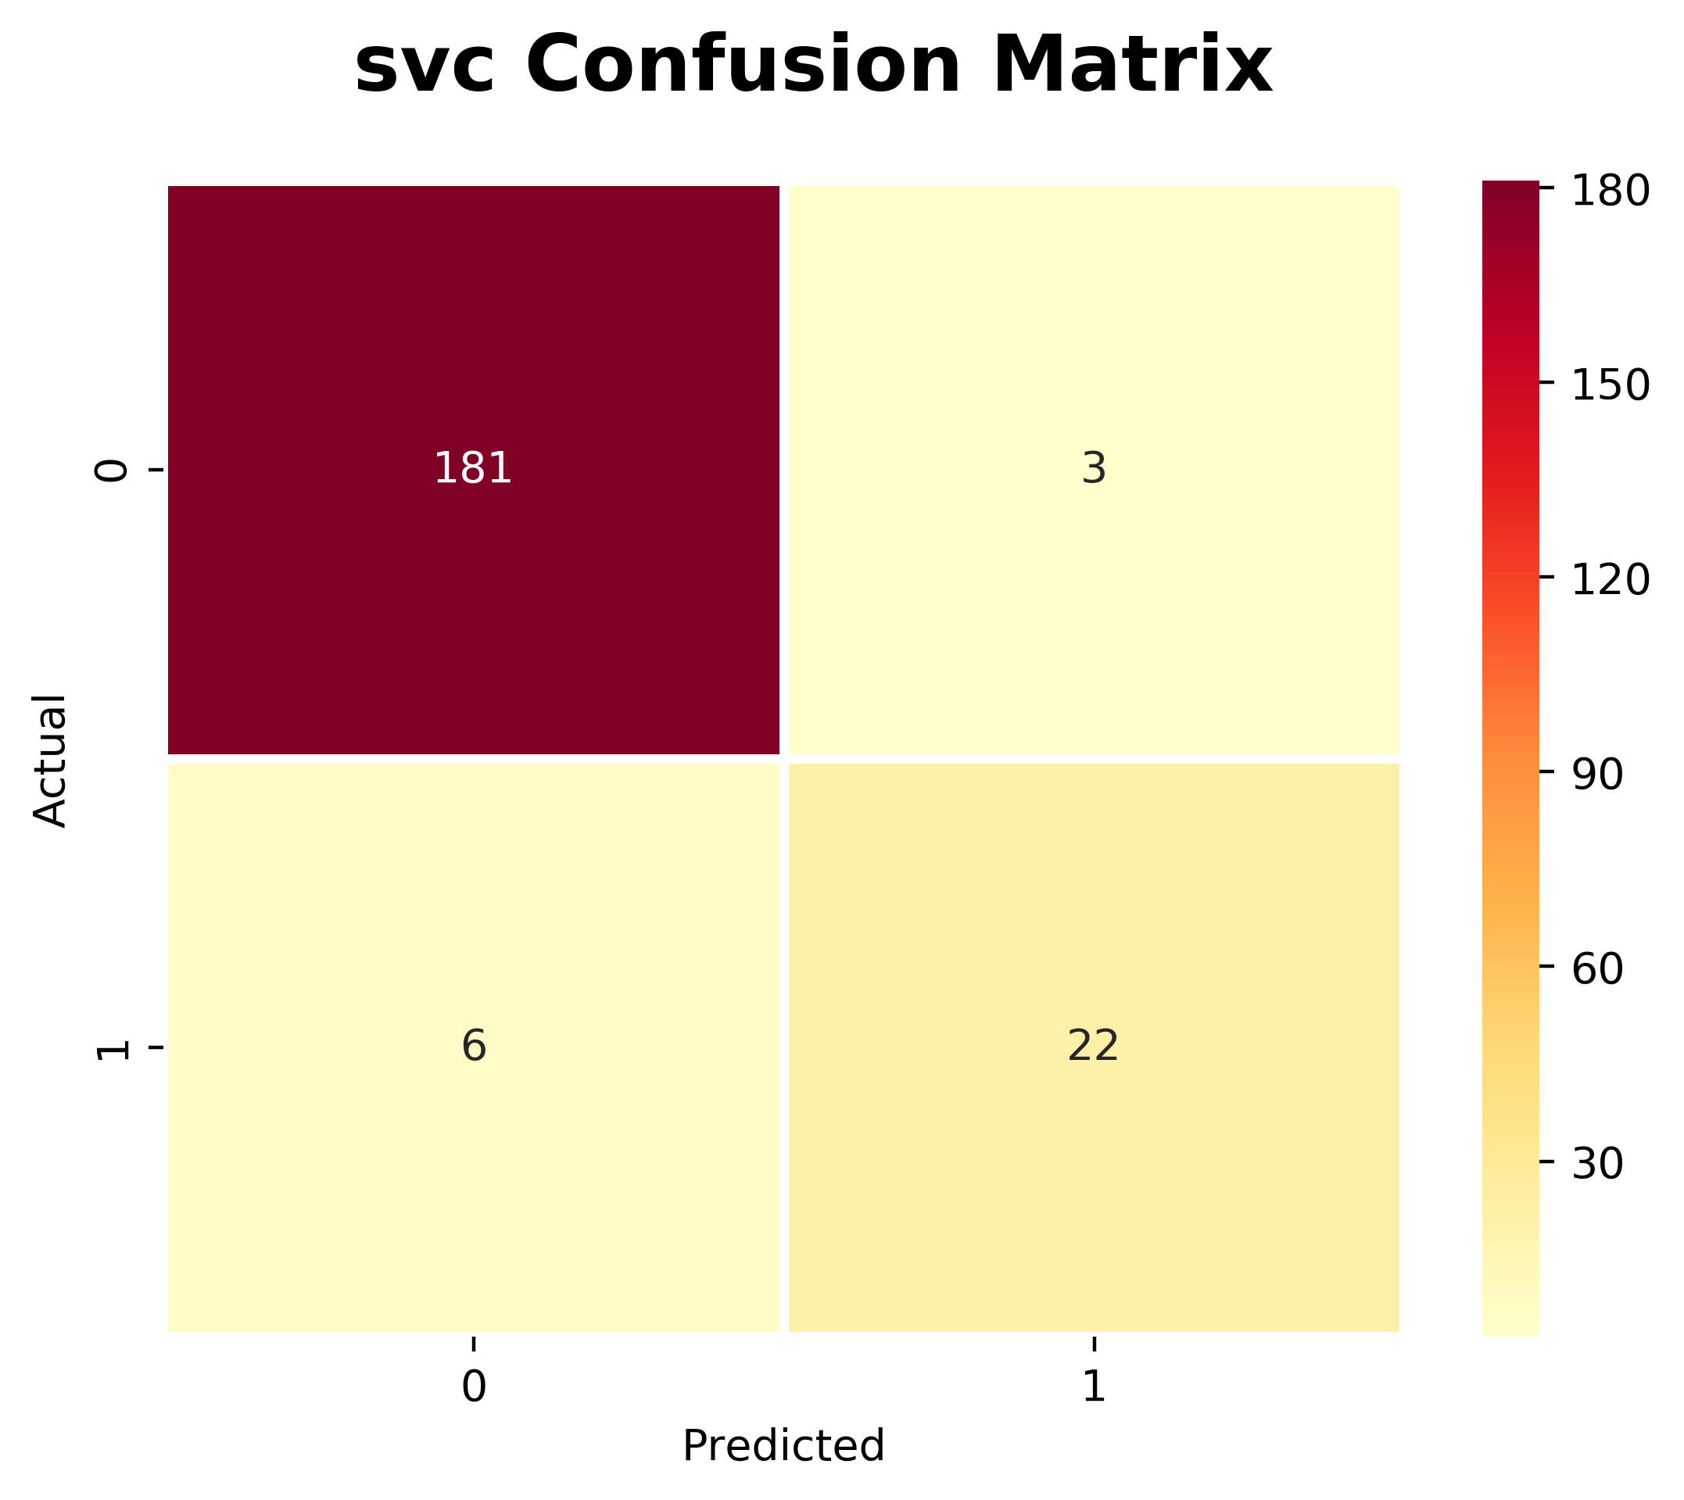

Confusion Matrix

Slide 23
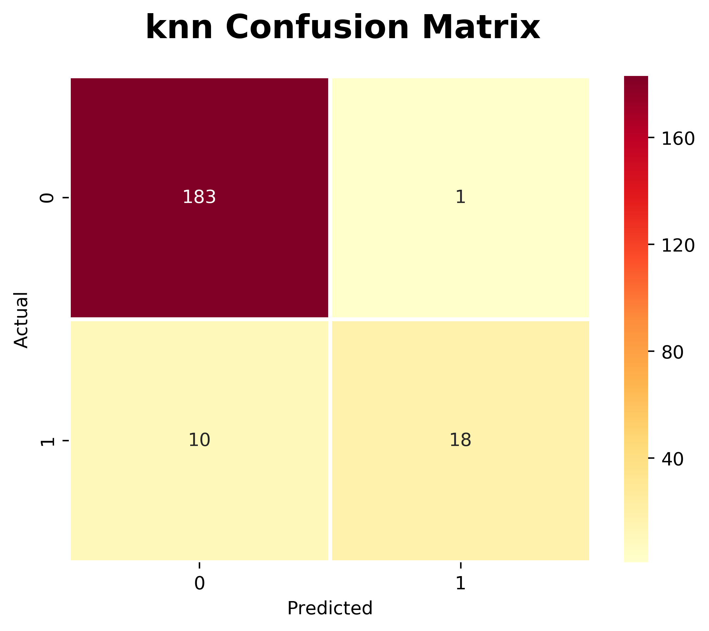
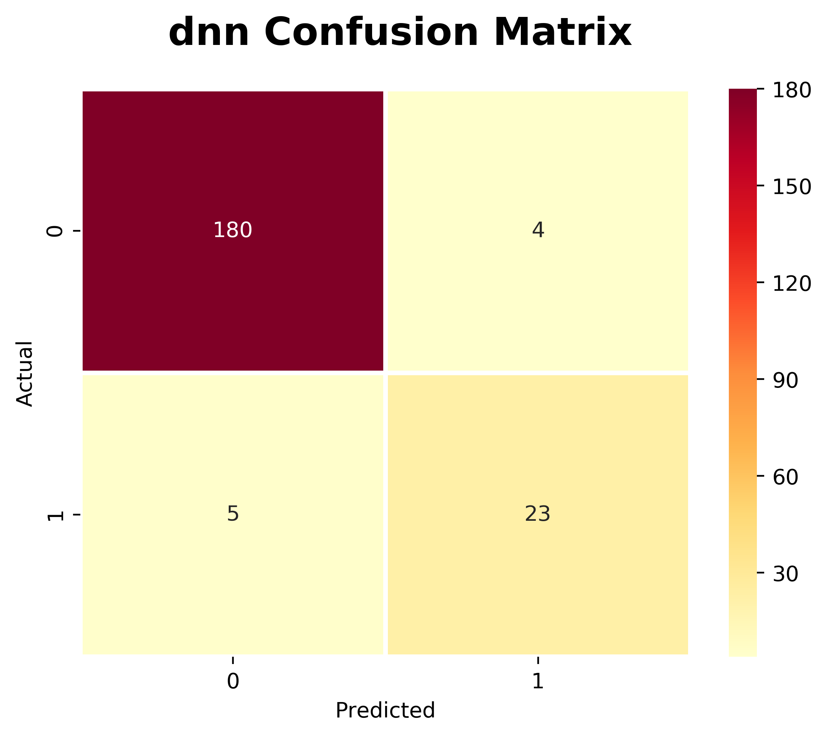

Slide 24
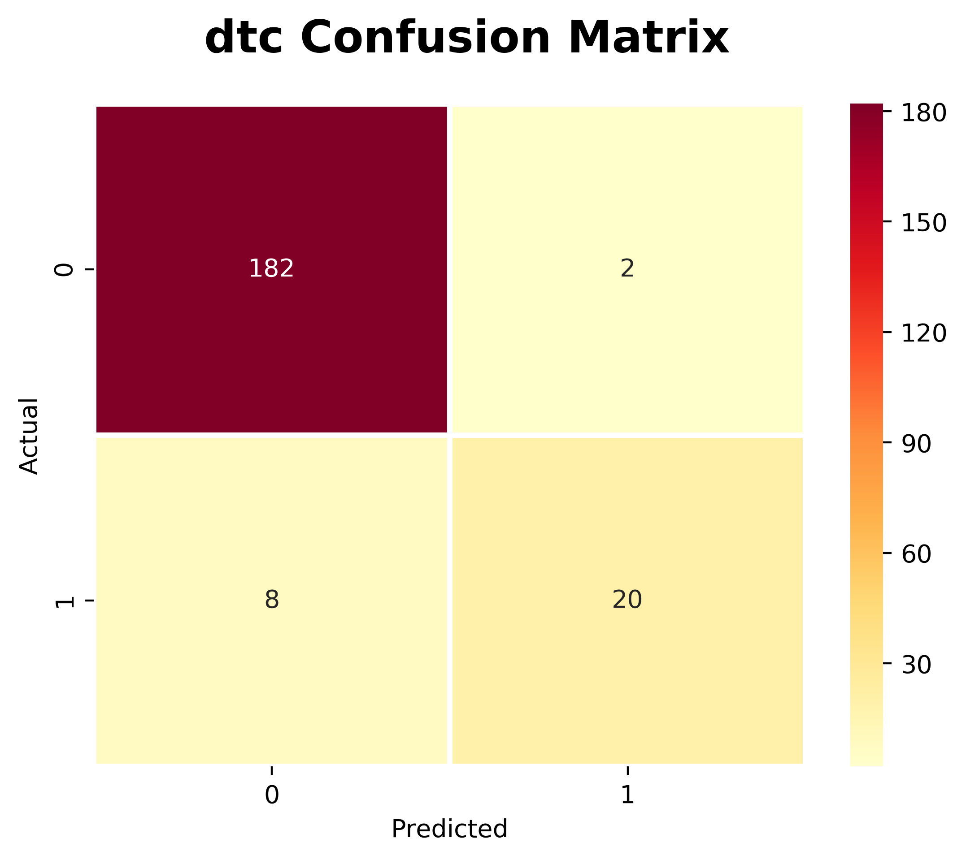

Slide 25
SVC Scores
Guards | ['James Harden, 0.999999925517939] | 1st
Forwards | ['Giannis Antetokounmpo', 0.9999994972087097] | 1st
Centers | ['Joel Embiid', 0.9863005597158346] | 1st
 | ['Paul George', 0.9709166521287745] | 1st
 | ['Nikola Jokić', 0.9680484192473774] | 2nd
 | ['Damian Lillard', 0.9527755752046231] | 1st
 | ['Rudy Gobert', 0.9375408970308351] | 3rd
 | ['Karl-Anthony Towns', 0.9322881183883422]
 | ['Kevin Durant', 0.9290420854599598] | 2nd
 | ['Stephen Curry', 0.8875705105356791] | 2nd
 | ['LeBron James', 0.8536338774226472] | 2nd
 | ['Russell Westbrook', 0.843973280205862] | 2nd
 | ['Kawhi Leonard', 0.8366251955156799] | 3rd
 | ['Nikola Vučević', 0.7078624822886264]
 | ['Kyrie Irving', 0.6420767716982124] | 3rd
 | ['Blake Griffin', 0.5320474846845713] | 3rd
 | ['Andre Drummond', 0.3760110219664676]
 | ['Clint Capela', 0.2818547200417608]
 | ['Kemba Walker', 0.21319666093306658] | 3rd

Slide 26
Voting
 | Player Name | 1st votes | 2nd votes | 3rd votes | total votes
1st team | Giannis Antetokonounmpo | 100 | 0 | 0 | 500
 | James Harden | 100 | 0 | 0 | 500
 | Stephen Curry | 91 | 9 | 0 | 482
 | Paul George | 71 | 25 | 3 | 433
 | Nikola Jokić | 59 | 38 | 2 | 411
2nd team | Joel Embiid | 40 | 56 | 4 | 372
 | Kevin Durant | 29 | 71 | 0 | 358
 | Damian Lillard | 8 | 87 | 5 | 306
 | Kawhi Leonard | 0 | 73 | 23 | 242
 | Kyrie Irving | 0 | 52 | 39 | 195
3rd team | Russell Westbrook | 1 | 43 | 44 | 178
 | Blake Griffin | 0 | 13 | 76 | 115
 | LeBron James | 0 | 13 | 72 | 111
 | Rudy Gobert | 1 | 5 | 69 | 89
 | Kemba Walker | 0 | 4 | 39 | 51
1st place votes = 5 total
2nd place votes = 3 total
3rd place votes = 1 total
100 Total voters

Slide 27
Results for 2018-2019 ALL-NBA tests
True | G | G | F | F | C
1st | James Harden | Stephen Curry | Giannis Antet.. | Paul George | Nikola Jokić
2nd | Damian Lillard | Kyrie Irving | Kevin Durant | Kawhi Leonard | Joel Embiid
3rd | Russell Westbr.. | Kemba Walker | Blake Griffin | LeBron James | Rudy Gobert
SVC | G | G | F | F | C
1st | James Harden | Damian Lillard | Giannis Antet.. | Paul George | Joel Embiid
2nd | Stephen Curry | Russell Westbr.. | Kevin Durant | Lebron James | Nikola Jokić
3rd | Kyrie Irving | Kemba Walker | Blake Griffin | Kawhi Leonard | Rudy Gobert
RF | G | G | F | F | C
1st | James Harden | Damian Lillard | Giannis Antet.. | Paul George | Nikola Jokić
2nd | Stephen Curry | Kyrie Irving | Kawhi Leonard | Lebron James | Rudy Gobert
3rd | Russell Westbr.. | Kemba Walker | Blake Griffin | Kevin Durant | Joel Embiid

Slide 28
kNN | G | G | F | F | C
1st | James Harden | Damian Lillard | Giannis Antet.. | Kevin Durant | Nikola Jokić
2nd | Stephen Curry | Kyrie Irving | Paul George | Lebron James | Joel Embiid
3rd | Russell Westbr.. | Kemba Walker | Blake Griffin | Kawhi Leonard | Karl Anthony-To..
DNN | G | G | F | F | C
1st | James Harden | Damian Lillard | Giannis Antet.. | Paul George | Rudy Gobert
2nd | Stephen Curry | Russell Westbr.. | Kevin Durant | Kawhi Leonard | Joel Embiid
3rd | Kyrie Irving | Mike Conley | Blake Griffin | Lebron James | Nikola Jokić
DTC | G | G | F | F | C
1st | James Harden | Damian Lillard | Giannis Antet.. | Paul George | Joel Embiid
2nd | Stephen Curry | Kyrie Irving | Kevin Durant | Kawhi Leonard | Nikola Jokić
3rd | Russell Westbr.. | Kemba Walker | Blake Griffin | Lebron James | Clint Capela

Slide 29
AVG | G | G | F | F | C
1st | James Harden | Damian Lillard | Giannis Antetokounmpo | Paul George | Nikola Jokić
2nd | Stephen Curry | Kyrie Irving | Kevin Durant | LeBron James | Joel Embiid
3rd | Russell Westbr.. | Kemba Walker | Blake Griffin | Kawhi Leonard | Rudy Gobert

Slide 30
2019-2020 Predictions as of November 27th
 | G | G | F | F | C
1st | James Harden | Luka Dončić | Giannis Antet.. | Anthony Davis | Karl-Anthony Towns
2nd | Damian Lillard | Kyrie Irving | Lebron James | Pascal Siakam | Joel Embiid
3rd | Trae Young | Jordan Clarkson | Kawhi Leonard | Duncan Robinson | Andre Drummond
Big stars that probably could make the team; Kevin Durant, Steph Curry, Klay Thomson, Zion Willamson?? injured.

Slide 31
Demo

Slide 32
1996-1997 | G | G | F | F | C
1st | Michael Jordan | Tim Hardaway | Grant Hill | Karl Malone | Hakeem Olajuwon
2nd | Gary Payton | Mitch Richmond | Scottie Pippen | Glen Rice | Patrick Ewing
3rd | Anfernee hardaway | John Stockton | Vin Baker | Anthony Mason | Shaquille O’neal
1st | Michael Jordan | John Stockton | Karl Malone | Grant Hill | Shaquille O’neal
2nd | Gary Payton | Tim Hardaway | Scottie Pippen | Glen Rice | Patrick Ewing
3rd | Mitch Richmond | Kevin Johnson | Anthony Mason | Charles Barkley | Hakeem Olajuwon

Slide 33
2010-2011 | G | G | F | F | C
1st | Kobe Bryant | Derrick Rose | Kevin Durant | Lebron James | Dwight Howard
2nd | Russel Westbrook | Dwyane Wade | Pau Gasol | Dirk Nowitzki | Amar’e
3rd | Manu Ginobili | Chris Paul | Lamarcus Aldridge | Zach Randolph | Al Horford
1st | Dwyane Wade | Derrick Rose | Lebron James | Kevin Durant | Dwight Howard
2nd | Chris Paul | Kobe Bryant | Lamarcus Aldridge | Pau Gasol | Amar’e
3rd | Russel Westbrook | Paul Pierce | Dirk Nowitzki | Zach Randolph | Al Horford

Slide 34
Issues
Testing size was too large to begin with. Altered scores quite a bit.
There is a human element so sometimes there is a narrative that is taken into account
Games played. LeBron only played 55 out 82 games in 2018-2019. Only 4 others had below 70, while none were below 60.

Slide 35
Tools Used
Basketball-reference.com
Python; pandas, numpy
Scikit learn
  SVC - Support Vector Classification
  RF - Random Forest classifier
  kNN - k-nearest neighbors
  dNN - Deep neural network (Multi-layer Perceptron classifier)
  DTC - decision tree classifier
Matplotlib
Jupyter notebooks

Slide 36
Future Work
Most Valuable Player? Every MVP has been a part of the 1st team (EXCEPT: 1957–58, 1960–61, 1961–62,1972–73) Usually two man race. Have to take into account team wins, and team seed
Other awards; Most Improved, Rookie of the year, Defensive player of the year
Use wins as an additional field. Players on better teams will get voted for more often than those on losing teams.
Predict vote totals????

