Slide 1
Business Forecasting
Rutgers University Jayesh Bhagat
Fall 2020

Slide 2
Introduction
Problem
The problem is how to obtain an accurate forecast of future COVID cases using past cases
Challenges
Some challenges that will be met is external variables that will affect forecast output. For example, governments instituting lockdowns will have a direct effect if COVID cases rises or falls in either country (USA vs NZL).

Slide 3
Objective
The objective is to forecast future COVID cases for both the USA and NZL for the time period 11/1/2020 to 11/8/2020 using historical data dating back to 8/1/2020
Several methods will be used to forecast output:
Naïve (Classical) – dataset is appropriate to use for time series and serves as a benchmark for other sophisticated forecasting methods seen below
Drift (Classical) – this method shows the general trend of future cases
ARIMA – this method explains a time series from past values to forecast future values.

Slide 4
Data Description
USA dataset
Both datasets are daily
There are a total of 108 observations for the USA dataset
> colnames(CVUSA)
[1] "dateRep" "cases" Column “dateRep” provides the date range of the dataset
Column “cases” provides the Covid case count
Dimensions
> dim(CVUSA)
[1] 108 2
Both datasets are 108 rows x 2 columns
NZL dataset
Both datasets are daily
There are a total of 108 observations for the NZL dataset
> colnames(CVNZL)
[1] "dateRep" "cases" Column “dateRep” provides the date range of the dataset
Column “cases” provides the Covid case count
Dimensions
> dim(CVNZL)
[1] 108 2
Both datasets are 108 rows x 2 columns

Slide 5
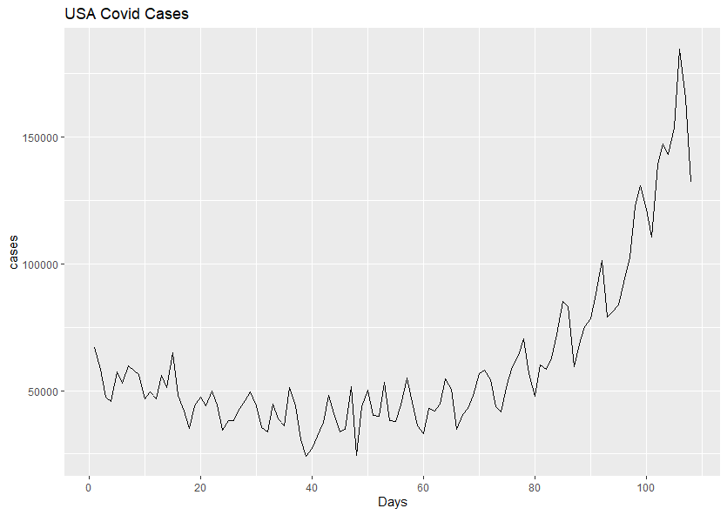
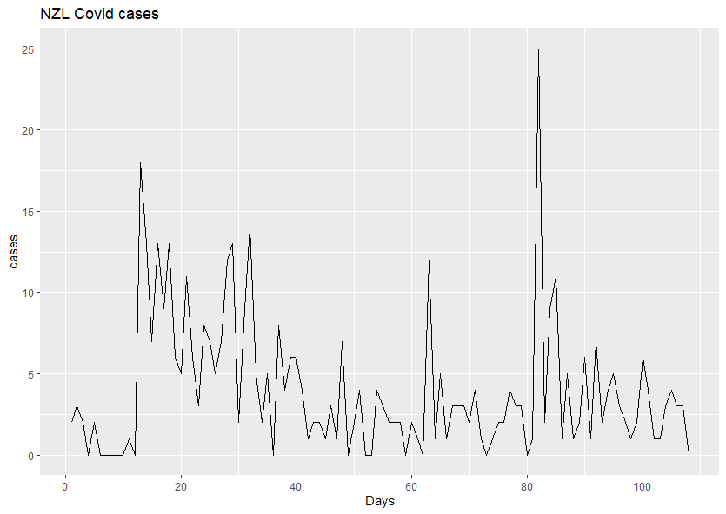
Data Description
autoplot(window(ts(CVUSA$cases)))+
xlab("Days")+ylab("cases")+
ggtitle("USA Covid Prediction") The chart shows no seasonality (not enough observations given 108 values) but appears to be an upward sloping trend.
autoplot(window(ts(CVNZL$cases)))+
xlab("Days")+ylab("cases")+
ggtitle(“NZL Covid Prediction") The chart appears to show random fluctuations which has no trend, seasonality or cyclic behavior. This will be difficult to forecast.

Slide 6
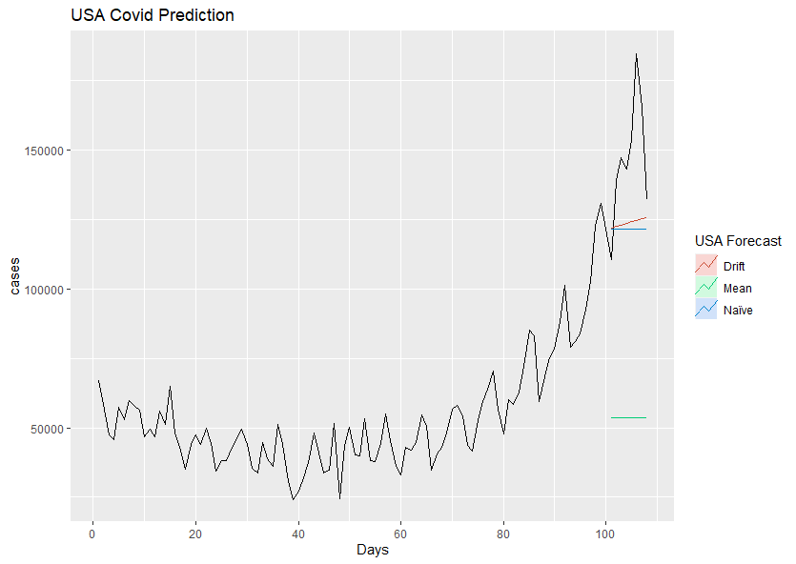
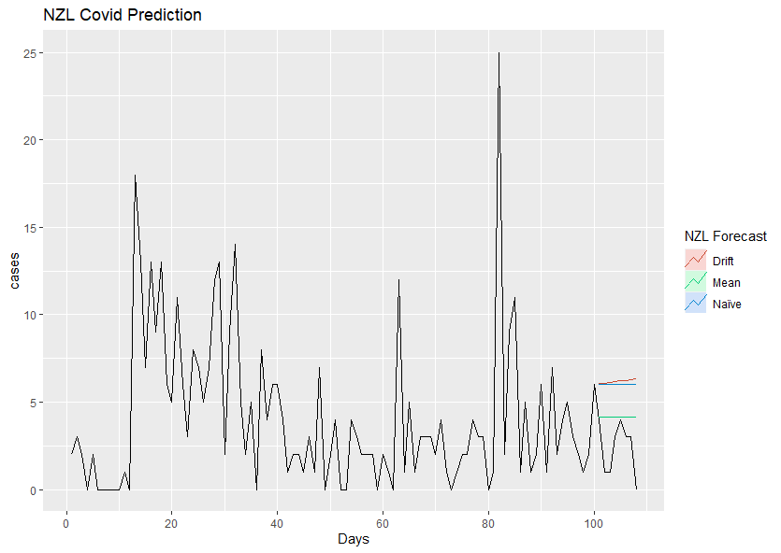
Methods –Classical Forecasting Methods
Mean, Naïve, Drift for USA
Mean, Naïve, Drift for NZL

Slide 7
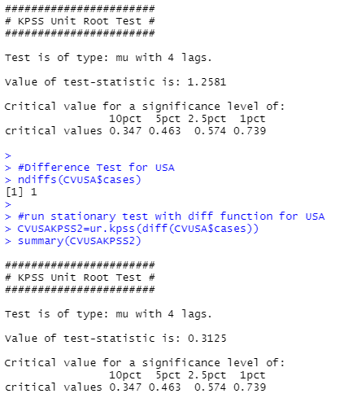
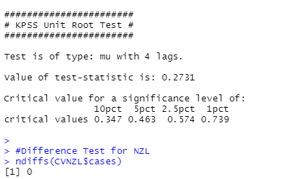
Methods – Test for Stationarity
KPSS Test for USA
KPSS Test for NZL
Null Hypothesis: The data is stationary
Alternative Hypothesis: The data is not stationary
Null Hypothesis: The data is stationary
Alternative Hypothesis: The data is not stationary
USAKPSS=ur.kpss(CVUSA)
summary(USAKPSS)
NZLKPSS=ur.kpss(CVNZL)
summary(NZLKPSS)
The p-value is not significant at 5% so we can accept the null hypothesis and derive that the series IS stationary.
By running a diff test and using ndiff, we can see that one difference is required for the data.
The p-value is significant at 5% so we can reject the null hypothesis and derive that the series is NOT stationary.
By running a diff test and using ndiff, we can see that no difference is required for the data.

Slide 8
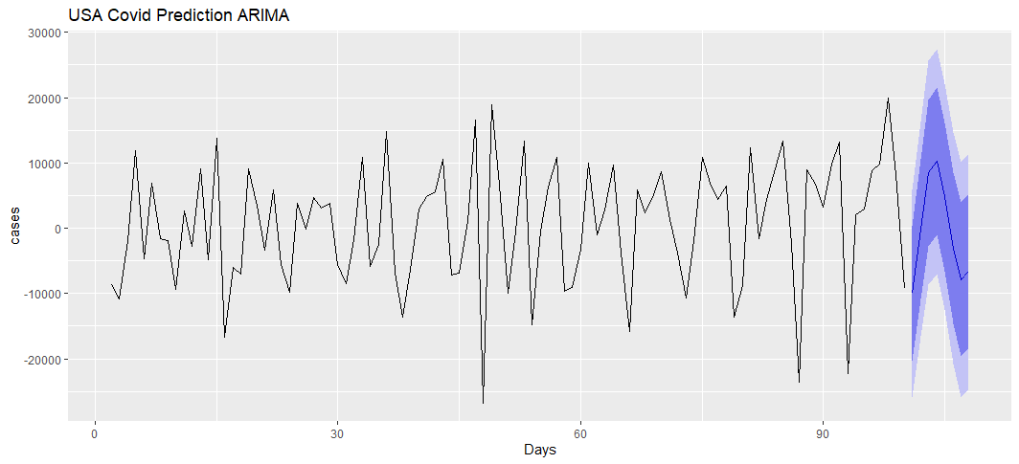
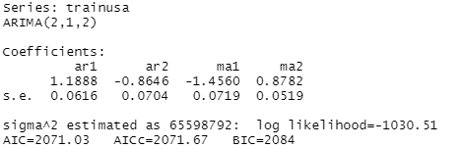
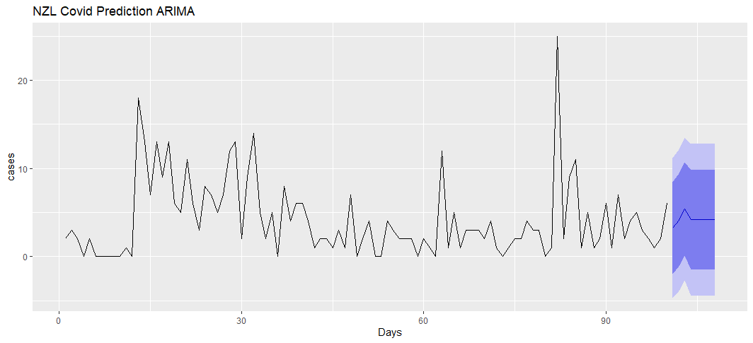
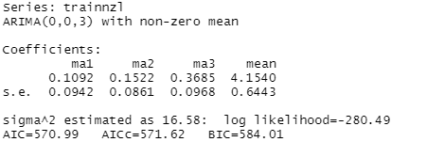
Methods – ARIMA Forecasting
ARIMA USA
ARIMA NZL

Slide 9
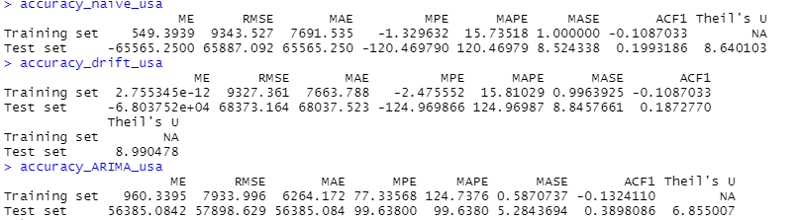
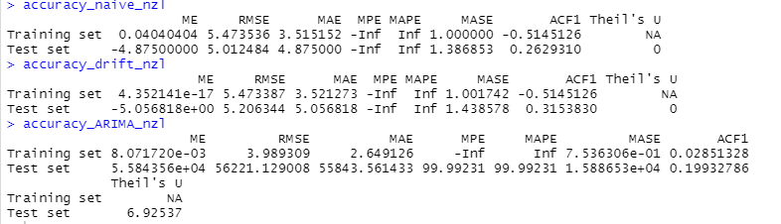
Performance Comparison
Test | Naïve | Drift | ARIMA
MAE | 65565.25 | 68037.52 | 56385.08
Test | Naïve | Drift | ARIMA
MAE | 4.87 | 5.05 | 2.64
The ARIMA method has the lowest MAE for USA among all other forecasts
The ARIMA method has the lowest MAE for NZL among all other forecasts

Slide 10
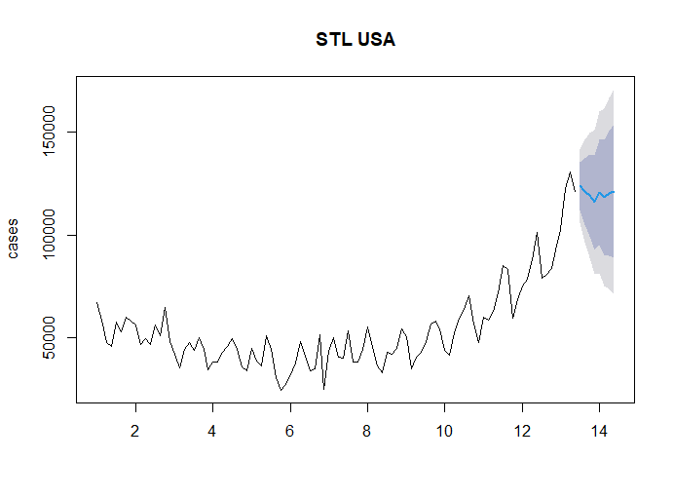
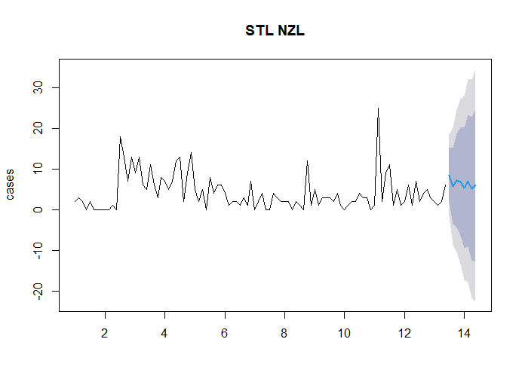
Additional Methods – STL Forecasting
STL USA
STL NZL
STL is another method we can use for forecasting since it breaks down each component and explains the behavior of time series.

Slide 11
Conclusion
ARIMA forecasting had the lowest MAE and therefore is the best method for forecasting both USA and NZL COVID-19 data for future cases.

